Slide 1
Unit – 1 Review of Mathematical Theory
Source: Textbook, referencebook, internet

Slide 2
Topics to be covered
Set
Logic
Function
Relation
Proof
Languages

Looping

Slide 3

Set
A set is a collection of objects.
The objects in a set are called elements of the set.
Examples:
A = {11, 12, 21, 22}
B = {11, 12, 21, 11, 12, 22}
C = {x | x is odd integer greater than 1}
D = {x | x Є B and x ≤ 11}
Roster Notation
Set-builder Notation

Slide 4

Operations on Sets
Operations on the sets are:
Complement
Union
Intersection
Set Difference
Symmetric Difference
Cartesian product
The complement of a set A is the set A’ of everything that is not an element of A from Universal Set U.
Example:
U = {1,2,3,4,5}
A = {1,2}
A’ = {3,4,5}
$$A’ = \{x ∈ U | x ∉ A\}$$
U
A

Slide 5




Operations on Sets
Operations on the sets are:
Complement
Union
Intersection
Set Difference
Symmetric Difference
Cartesian product
The Union $(A U B)$is a collection of all distinct elements from both the set A and B.
Example:
A = {1, 3, 5, 7, 9}
B = {1, 2, 3, 4, 5}
A U B = {1, 2, 3, 4, 5, 7, 9}
$$A U B = \{x | x ∈ A or x ∈ B\}$$
U
$$A$$
$$B$$

Slide 6



Operations on Sets
Operations on the sets are:
Complement
Union
Intersection
Set Difference
Symmetric Difference
Cartesian product
The intersection A ∩ B of two sets A and B is the set that contains all elements of A that also belong to B, but no other elements.
Example:
A = {1, 3, 5, 7, 9}
B = {1, 2, 3, 4, 5}
A ∩ B = {1, 3, 5}
$$A∩B = \{x | x ∈ A and x ∈ B\}$$
U
$$A$$
$$B$$

Slide 7

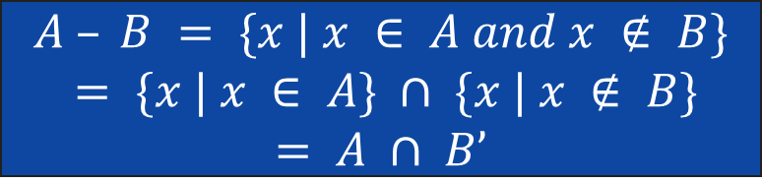

Operations on Sets
Operations on the sets are:
Complement
Union
Intersection
Set Difference
Symmetric Difference
Cartesian product
The set difference A - B of two sets A and B is the set of everything in A but not in B.
Example:
A = {1, 3, 5, 7, 9}
B = {1, 2, 3, 4, 5}
A - B = {7, 9}
$$A – B = \{x | x ∈ A and x ∉ B\}$$
$$= \{x | x ∈ A\} ∩ \{x | x ∉ B\}$$
$$= A ∩ B’$$
U
$$A$$
$$B$$

Slide 8

Operations on Sets
Operations on the sets are:
Complement
Union
Intersection
Set Difference
Symmetric Difference
Cartesian product
The symmetric difference A ⊖ B of two sets A and B is the set of everything in A but not in B or the set of everything in B but not in A.
Example:
A = {1, 3, 5, 7, 9}
B = {1, 2, 3, 4, 5}
A ⊖ B = {7, 9, 2, 4}
$$A ⊖ B = (A – B) U (B – A)$$
U

Slide 9

Operations on Sets
Operations on the sets are:
Complement
Union
Intersection
Set Difference
Symmetric Difference
Cartesian product
The Cartesian product A x B of two sets A and B is the set of all ordered pairs (a, b) where a ∈ A and b ∈ B.
Example:
A = {1, 3, 5}
B = {2, 4}
A x B = {(1,2), (1,4), (3,2), (3,4), (5,2), (5,4)}
$$A x B = \left\{\left(a,b\right) \right| a ∈ A and b ∈ B\}$$

Slide 10



Set of identities
Commutative laws
Associative laws
Distributive laws
$$A∩B = B∩A$$
$$A U B = B U A$$
$$A∩(B∩C) =(A∩B)∩C$$
$$A U (B U C) =(A U B) U C$$
$$A U (B∩C) = (A U B)∩(A U C)$$
$$A∩(B U C) = (A∩B) U (A∩C)$$

Slide 11



Set of identities
Idempotent laws
Absorptive laws
De Morgan laws
$$A U A = A$$
$$A∩A = A$$
$$A U (A∩B) = A$$
$$A∩(A U B) = A$$
$$(A U B)’ = A’∩B’$$
$$(A∩B)’ = A’ U B’$$

Slide 12



Set of identities
Other complements laws
Other empty set laws
Other universal set laws
$$(A’)’ = A$$
$$A∩A’ = Φ$$
$$A U A’ = U$$
$$A U Φ = A$$
$$A∩Φ = Φ$$
$$A U U = U$$
$$A∩U = A$$

Slide 13
LOGIC

Slide 14
Propositions
Declarative statement that is sufficiently objective, meaningful and precise to have a truth value (true or false) is known as proposition.
Examples:
p : Fourteen is an even integer.
r : 0 = 0
q : Mumbai is the capital city of India.
s : a²+b²=4

Slide 15
Logical Connectives
Logical Connectives
Conjunction
Disjunction
Negation
Conditional Connective
The logical connective Conjunction (And) is true only when both of the propositions are true.
Example: Truth table
p : It is raining
q : It is warm
r : It is raining AND it is warm
p | q | r = p ^ q
True | True | True
True | False | False
False | True | False
False | False | False

Slide 16
Logical Connectives
Logical Connectives
Conjunction
Disjunction
Negation
Conditional Connective
The logical disjunction, or logical OR, is true if one or both of the propositions are true.
Example: Truth table
p : 2 + 2 = 5
q : 1 < 2
r : 2 + 2 = 5 OR 1 < 2
p | q | r = p v q
True | True | True
True | False | True
False | True | True
False | False | False

Slide 17
Logical Connectives
Logical Connectives
Conjunction
Disjunction
Negation
Conditional Connective
¬p, the negation of a proposition p, is also a proposition.
Example: Truth table
p : John studies.
¬p : John does NOT study.
P | ¬P
True | False
False | True

Slide 18
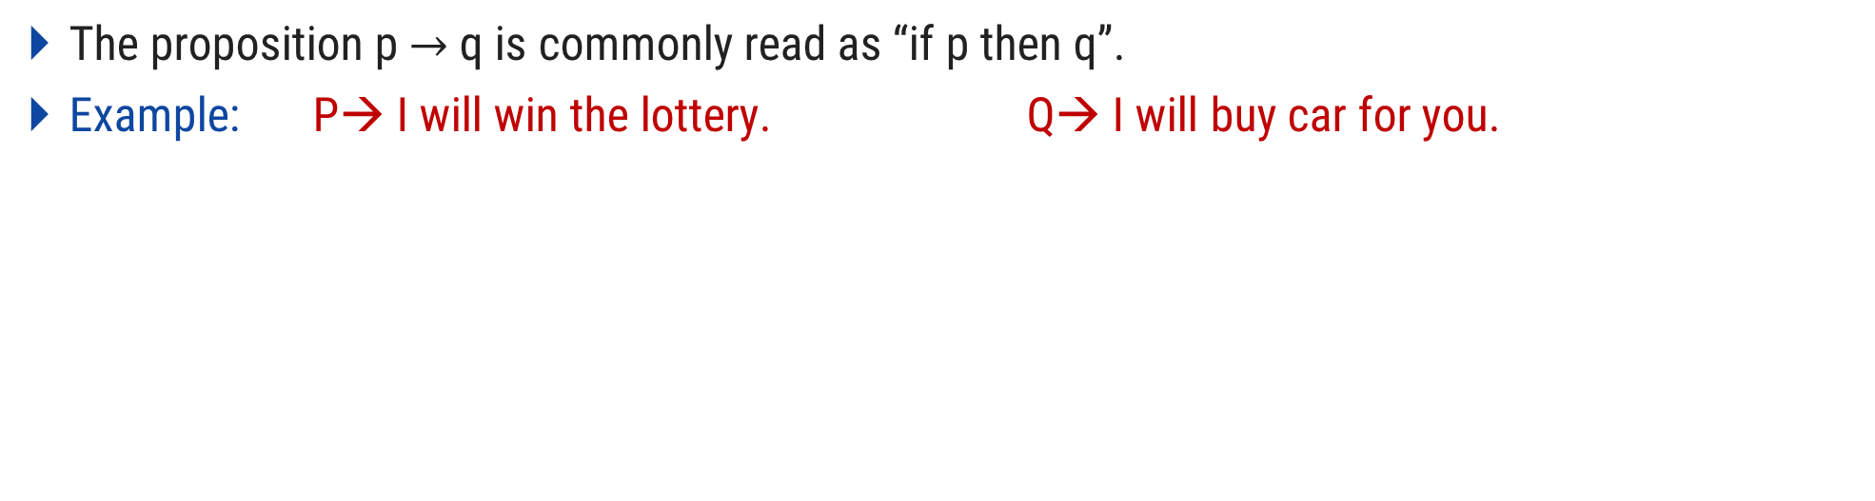
Logical Connectives
Logical Connectives
Conjunction
Disjunction
Negation
Conditional Connective
The proposition p $→$ q is commonly read as “if p then q”.
Example: P→ I will win the lottery. Q→ I will buy car for you.
I win the lottery | I will buy car for you | Promise kept/ broken
Yes | Yes | Kept
Yes | No | Broken
No | Yes | Not broken
No | No | Not broken
p | q | p→q
True | True | True
True | False | False
False | True | True
False | False | True

Slide 19
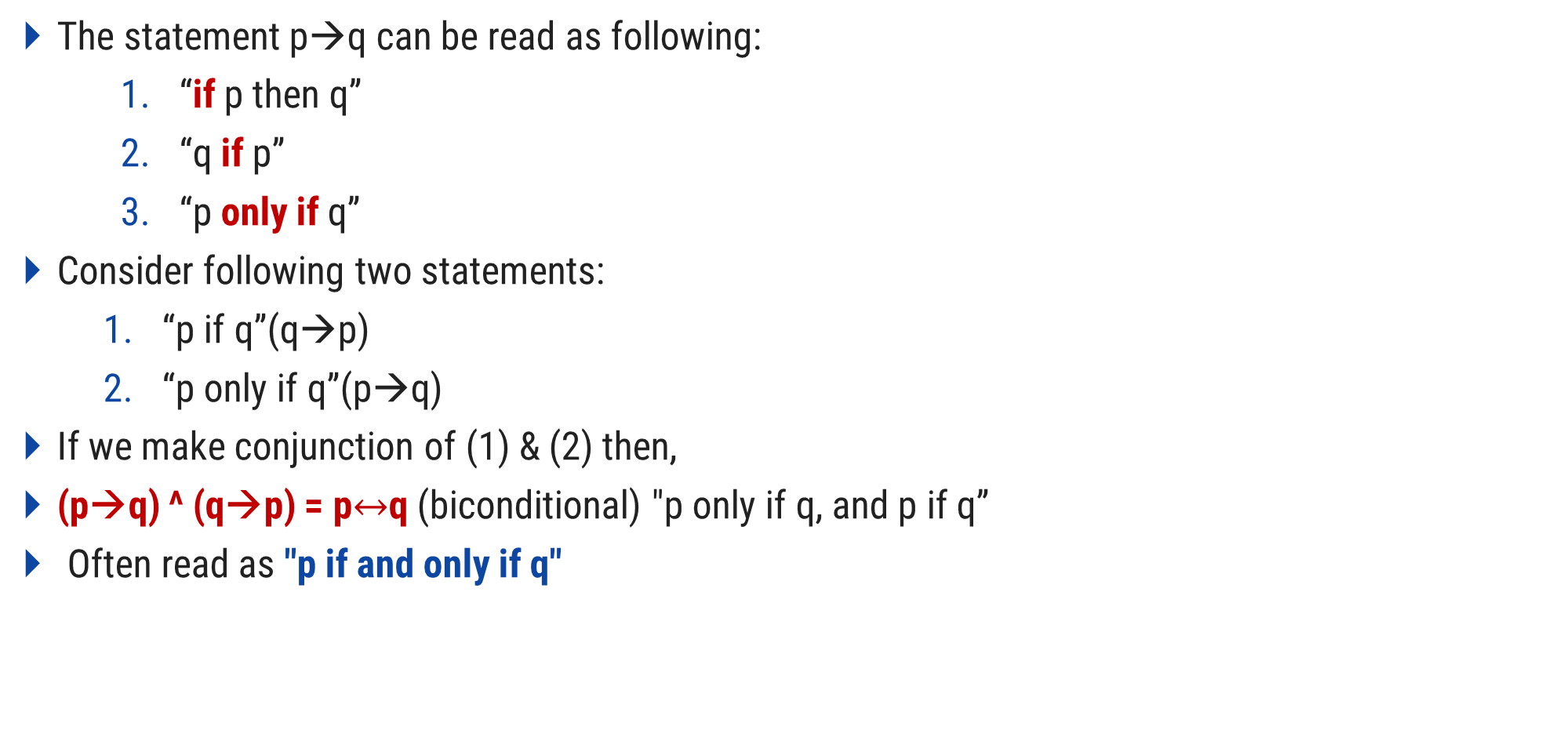
Logical Connectives
The statement p→q can be read as following:
“if p then q”
“q if p”
“p only if q”
Consider following two statements:
“p if q”(q→p)
“p only if q”(p→q)
If we make conjunction of (1) & (2) then,
(p→q) ^ (q→p) = p$↔$q (biconditional) "p only if q, and p if q”
Often read as "p if and only if q"
p | q | p ↔ q
T | T | T
T | F | F
F | T | F
F | F | T
Example:
(i) Two lines are parallel if and only if they have the same slope. (ii) You will pass the exam if and only if you will work hard.

Slide 20
Tautology and Contradiction
A proposition P is a tautology if it is true under all circumstances. It means it contains the only T in the final column of its truth table.
Example:
Eg:
a number is even or not even
He is healthy or not healthy
A contradiction is opposite.
If p is tautology, ¬P is contradiction.
I love you and I do not love you
A is married to B but B is not married to A
P | ¬P | P v ¬P
T | F | T
T | F | T
F | T | T
F | T | T
Tautology

Slide 21
Logical Quantifiers
Logical Quantifier
Universal Quantifier
Existential Quantifier
Represented by an upside-down A: ∀ (“for all”).
Example:
Let P(x) = x+1 > x, ∀x P(x)
English translation: “for all values of x, P(x) is true”
English translation: “for all values of x, x+1>x is true”

Slide 22
Logical Quantifiers
Logical Quantifier
Universal Quantifier
Existential Quantifier
Represented by ∃ : ∃ (“there exists”).
Example:
Let P(x) = x+1 > x
There is a numerical value for which x+1>x
Thus, ∃x P(x) is true

Slide 23
Functions

Slide 24
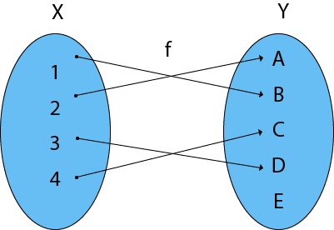
Definition
It is a mapping in which every element of set A is uniquely associated at the element with set B. The set of A is called Domain of a function and set of B is called Co domain.
Domain of function: {1, 2, 3, 4}
Range of function: {a, b, c, d}
Co-Domain of function: {a, b, c, d, e}

Slide 25
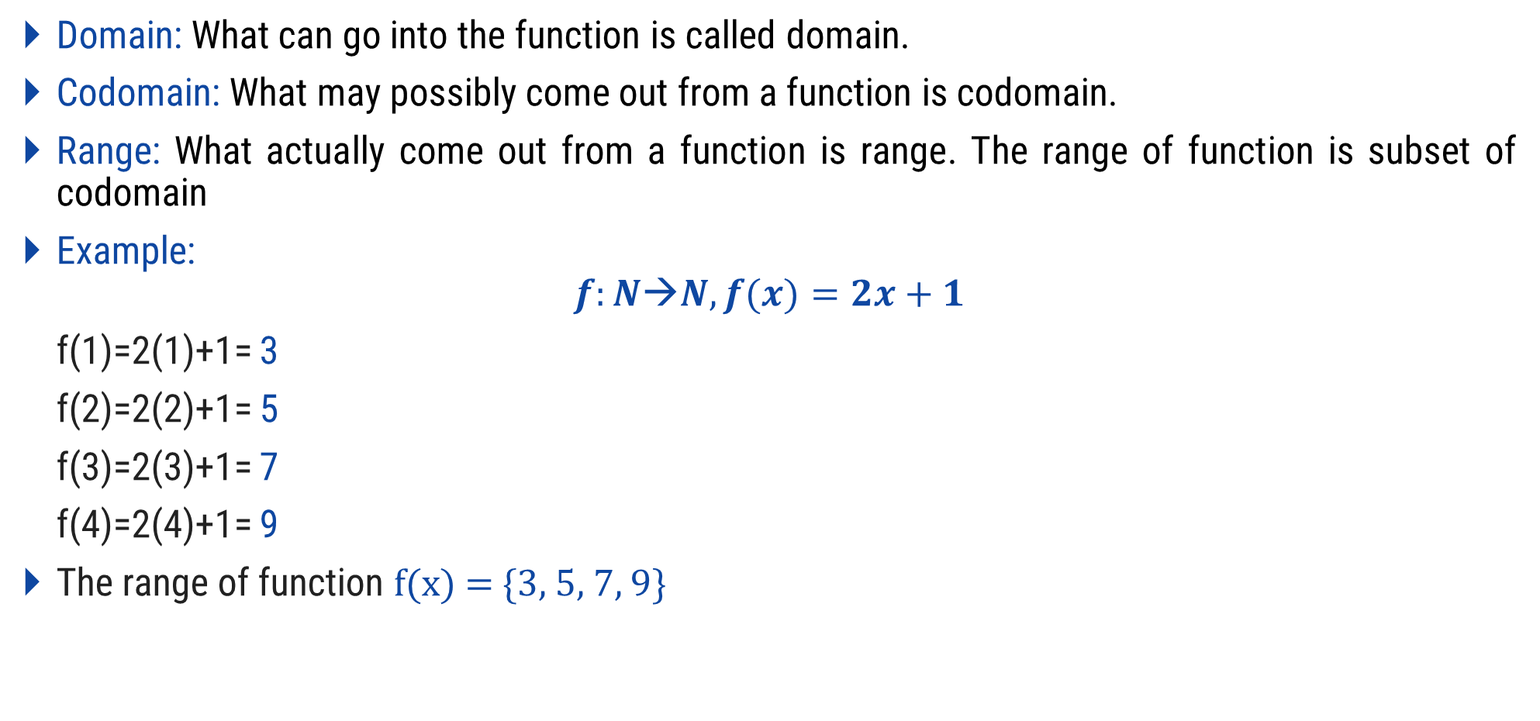
Functions
Domain: What can go into the function is called domain.
Codomain: What may possibly come out from a function is codomain.
Range: What actually come out from a function is range. The range of function is subset of codomain
Example:
$$f:N→N, f(x)=2x+1$$
f(1)=2(1)+1= 3
f(2)=2(2)+1= 5
f(3)=2(3)+1= 7
f(4)=2(4)+1= 9
The range of function f(x) = {3, 5, 7, 9}
A
B
1
1
2
3
2
4
5
Range
3
6
7
4
8
9
10
Domain
Codomain

Slide 26
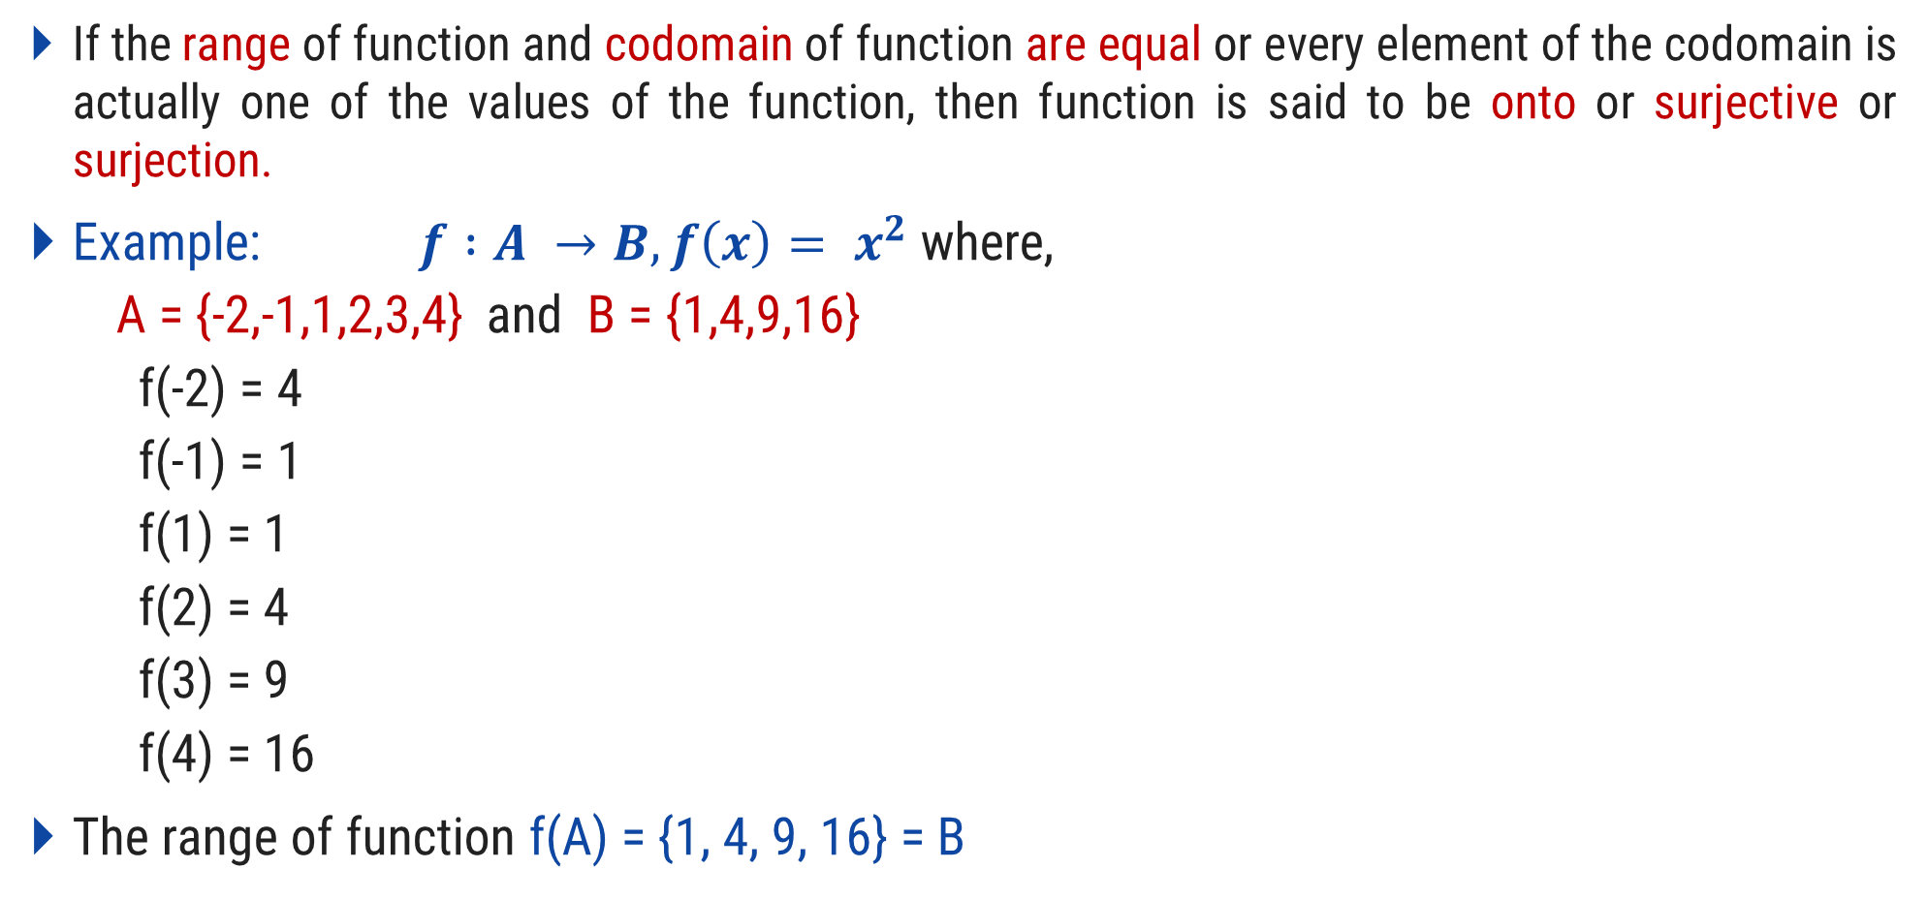
Onto Function
If the range of function and codomain of function are equal or every element of the codomain is actually one of the values of the function, then function is said to be onto or surjective or surjection.
Example: $f :A →B, f\left(x\right)= x^{2}$ where,
A = {-2,-1,1,2,3,4} and B = {1,4,9,16}
f(-2) = 4
f(-1) = 1
f(1) = 1
f(2) = 4
f(3) = 9
f(4) = 16
The range of function f(A) = {1, 4, 9, 16} = B
A
B
-2
-1
1
1
4
2
9
3
4
16

Slide 27
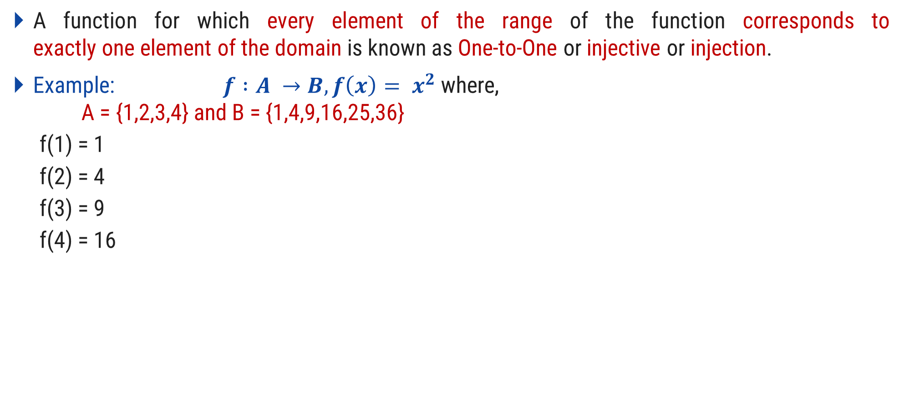
One-to-One Function
A function for which every element of the range of the function corresponds to exactly one element of the domain is known as One-to-One or injective or injection.
Example: $f :A →B, f\left(x\right)= x^{2}$ where, A = {1,2,3,4} and B = {1,4,9,16,25,36}
f(1) = 1
f(2) = 4
f(3) = 9
f(4) = 16
A
B
1
1
2
4
3
9
16
4
25
36

Slide 28

Bijection Function
If function is both one-to-one and onto then function is called Bijection function.
Example: $f :A →B, f\left(x\right)= x^{2}$ where,
A = {1,2,3,4} and B = {1,4,9,16}
f(1) = 1
f(2) = 4
f(3) = 9
f(4) = 16
A
B
1
1
2
4
3
9
16
4

Slide 29
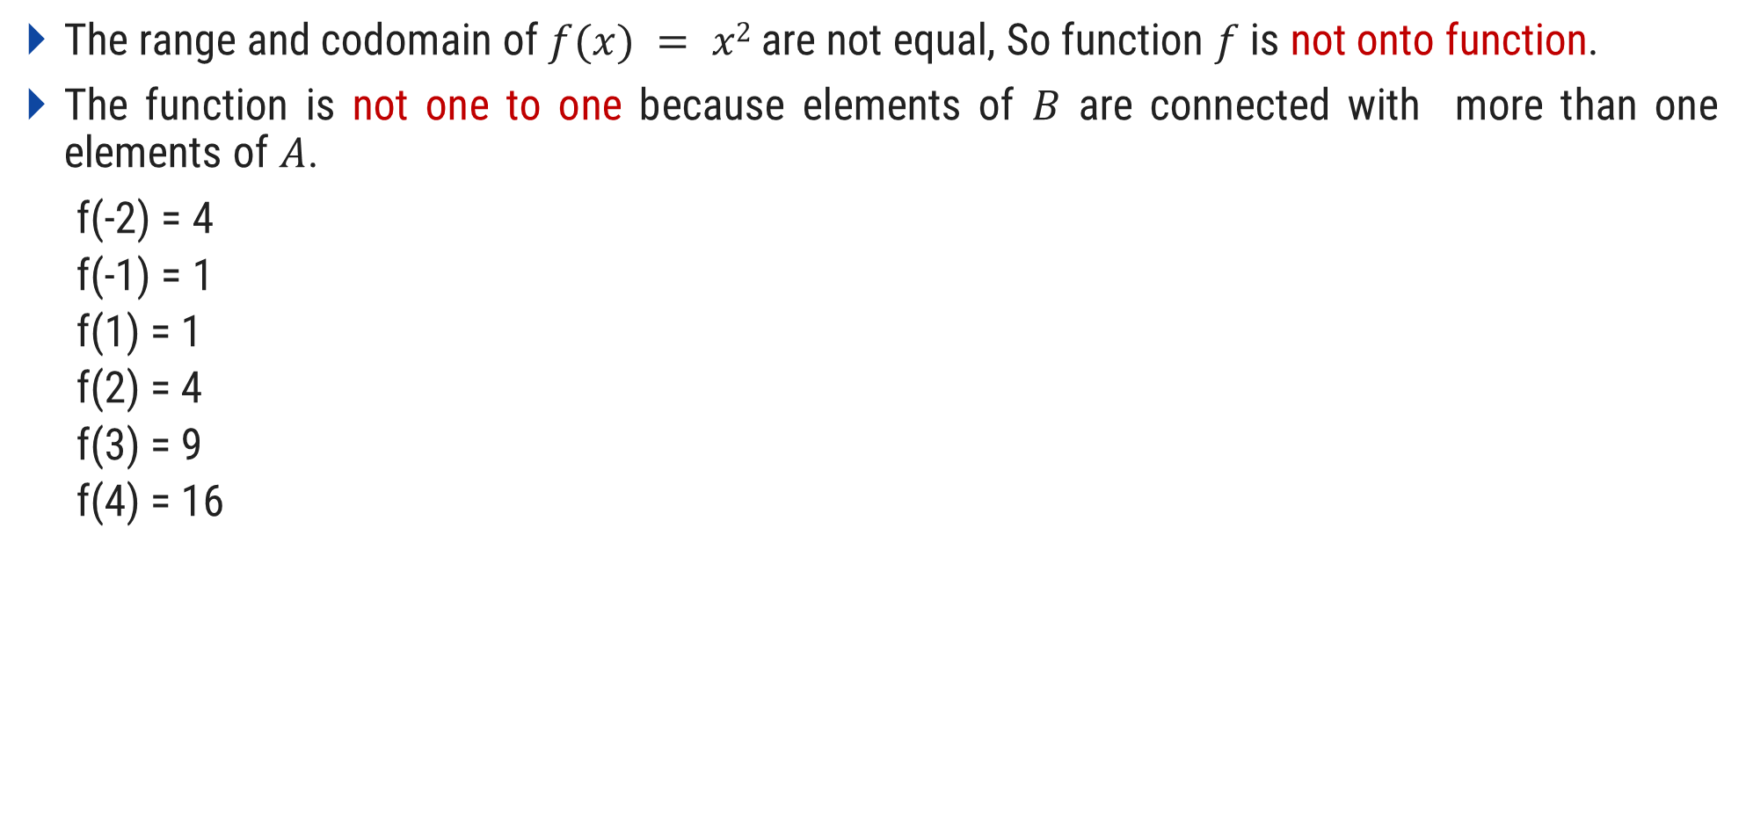
Prove that f: R → R, f(x) = x² is not one-to-one and not onto function
The range and codomain of $f(x) = x2$are not equal, So function $f$ is not onto function.
The function is not one to one because elements of $B$ are connected with more than one elements of $A$.
f(-2) = 4
f(-1) = 1
f(1) = 1
f(2) = 4
f(3) = 9
f(4) = 16
A
B
-2.0
-2.0
-1.0
-1.0
1.0
1.0
2.0
4.0
3.0
9.0
4.0
16.0

Slide 30

Prove that f: R → R⁺, f(x) = x² is not one-to-one and onto function
The range and codomain of $f(x) = x2$are equal So, function $f$is onto function.
The function is not one to one because elements of $B$ are connected with more than one elements of $A$.
f(-2) = 4
f(-1) = 1
f(1) = 1
f(2) = 4
f(3) = 9
f(4) = 16
A
B
-2.0
-1.0
1.0
1.0
2.0
4.0
3.0
9.0
4.0
16.0

Slide 31

Prove that f: R ⁺ → R, f (x) = x² is one-to-one and not onto function
The range and codomain of $f(x) = x2$are not equal So, function $f$ is not onto function.
The function is one to one because elements of $B$ are connected with single element of $A$.
f(1) = 1
f(2) = 4
f(3) = 9
f(4) = 16
A
B
-2.0
-1.0
1.0
1.0
2.0
4.0
3.0
9.0
4.0
16.0

Slide 32
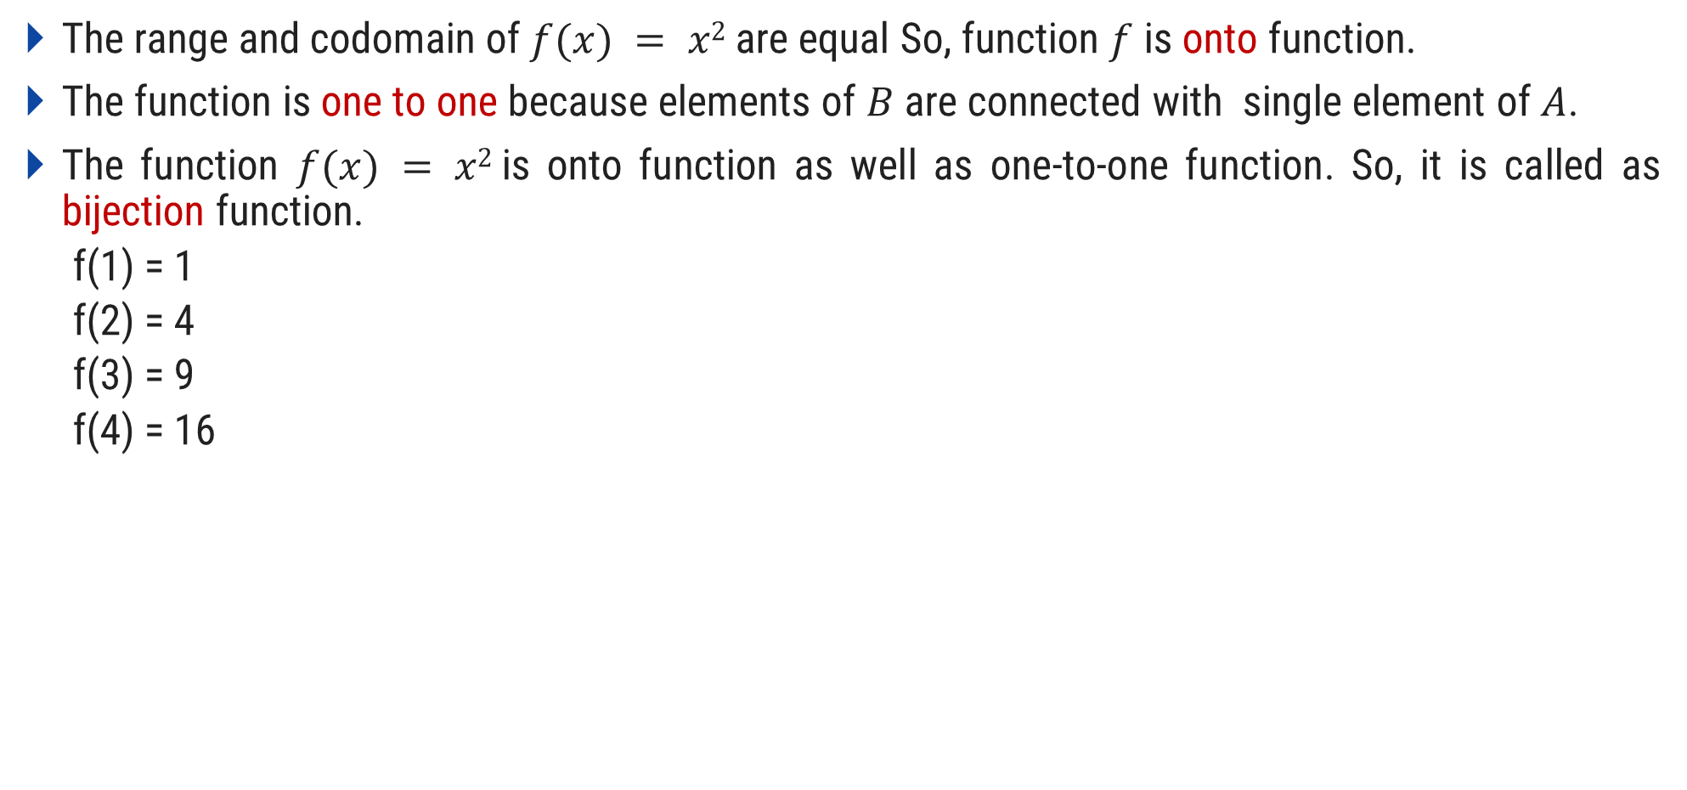
Prove that f: R ⁺ → R⁺, f (x) = x² is one-to-one and onto function (bijection)
The range and codomain of $f(x) = x2$are equal So, function $f$ is onto function.
The function is one to one because elements of $B$ are connected with single element of $A$.
The function $f(x) = x2$is onto function as well as one-to-one function. So, it is called as bijection function.
f(1) = 1
f(2) = 4
f(3) = 9
f(4) = 16
A
B
1.0
1.0
2.0
4.0
3.0
9.0
4.0
16.0

Slide 33

Compositions of Function
Let $f :A →B$ and $g :B1 →C$, the range of f is a subset of B₁, then $g\left(f\left(x\right)\right)$ makes sense for each $x∈A$ and the function $h : A →C$ defined by $h\left(x\right)=g\left(f\left(x\right)\right)$ is called the composition of $g$ and $f$.
It is written as $h=g∘f$
Example:
$h\left(c\right)=g\left(f\left(x\right)\right)=\#$
f
g
A
B
B₁
C
a
1
@
b
2
#
c
3
!
d
4

Slide 34

Inverse of Function
Let $f$ be a function whose domain is the set $X$, and whose range is the set $Y$. Then $f$ is invertible if there exists a function $g$ with domain $Y$ and range $X$, with the property:
$$f\left(x\right)=y ⇔g\left(y\right)=x$$
To be invertible a function must be both an injection and a surjection.
Example:
A
B
A
B
a
1
1
a
b
2
f
2
b
f⁻¹
c
3
3
c
d
4
4
d

Slide 35
Composition of a function and its inverse:
The composition of a function and its inverse is the identity function i(x) = x.
f⁻¹(f(x)) = x
Graph:
The graph of a function f:AB is the set of ordered pairs
{(a, b) | a∈ A and f(a) = b}.
The graph is a subset of AB that can be used to visualize f in a two-dimensional coordinate system.

Slide 36
Floor and Ceiling Functions
The floor and ceiling functions map the real numbers onto the integers (R→Z).
The floor function assigns to r∈R the largest z∈Z with z ≤ r, denoted by ⎣r⎦.
Examples: ⎣2.3⎦ = 2, ⎣2⎦ = 2, ⎣0.5⎦ = 0, ⎣-3.5⎦ = -4
The ceiling function assigns to r∈R the smallest z∈Z with z ≥ r, denoted by ⎡r⎤.
Examples: ⎡2.3⎤ = 3, ⎡2⎤ = 2, ⎡0.5⎤ = 1, ⎡-3.5⎤ = -3

Slide 37
Relations

Slide 38
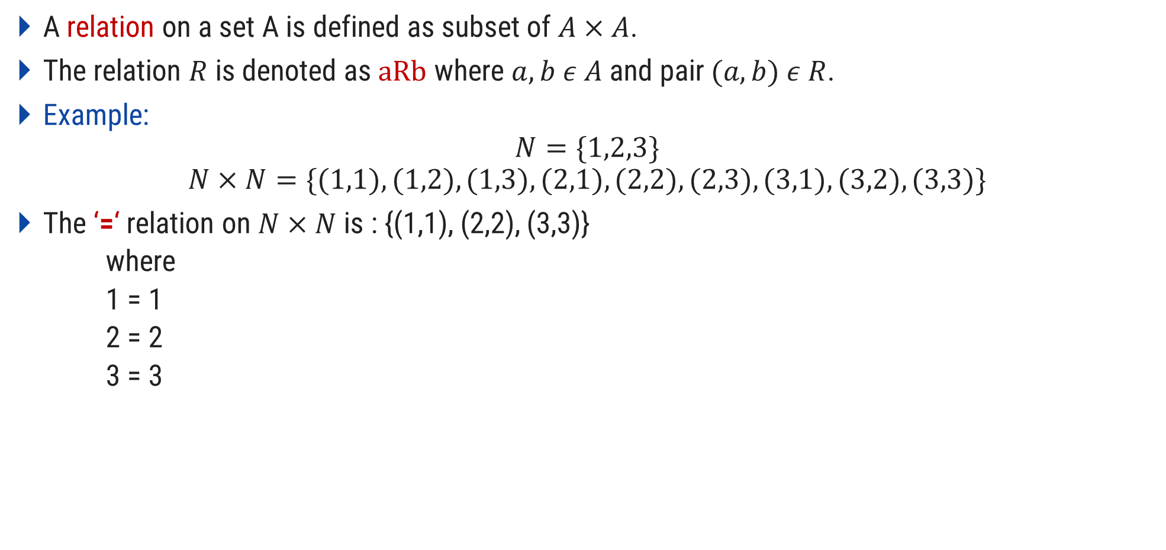
Relations
A relation on a set A is defined as subset of $A×A$.
The relation $R$ is denoted as $aRb$ where $a,b ε A$ and pair $(a,b) ε R$.
Example:
$$N=\{1,2,3\}$$
$$N×N=\{(1,1),(1,2),(1,3),(2,1),(2,2),(2,3),(3,1),(3,2),(3,3)\}$$
The ‘=‘ relation on $N×N$ is : {(1,1), (2,2), (3,3)}
where
1 = 1
2 = 2
3 = 3

Slide 39
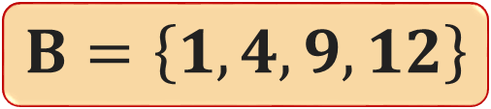


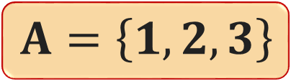




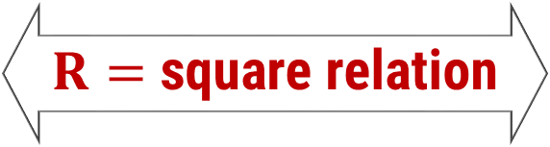
Let $A$ and $B$ be non-empty sets. A binary or simply relation from
$A$ to $B$ is a subset of $A×B$.
Relation
$$R=\left\{\left(1,1\right),\left(2,4\right),\left(3,9\right)\right\}$$
$$A=\left\{1,2,3\right\}$$
$R=$ square relation
$$B=\left\{1,4,9,12\right\}$$
Range
Domain
$$D_{R}=\left\{ x∈A :\left(x,y\right)∈R \right\}$$
$$D_{R}=\left\{1,2,3\right\}$$
$$R_{R}=\left\{ y∈B∶\left(x,y\right)∈R \right\}$$
$$R_{R}=\left\{1,4,9\right\}$$

Slide 40


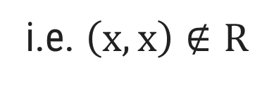
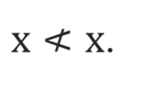

Properties of binary relation in a set
Reflexive
A binary relation $R$ in a set $A$ is said to be reflexive if, for every $x∈A$,
$$\left(x,x\right)∈R$$
For example: Consider a relation $R=\left\{\left(x,y\right) :x<y\right\}$ on a set $ℕ$.
Then, for every $x∈ℕ,$
$x≮x$.
i.e. $\left(x,x\right)∉R$
So, a relation $R$ is not reflexive.

Slide 41





Properties of binary relation in a set
Reflexive
A binary relation $R$ in a set $A$ is said to be reflexive if, for every $x∈A$,
$$\left(x,x\right)∈R$$
For example: Consider a relation $R=\left\{\left(x,y\right) :x<y\right\}$ on a set $ℕ$.
$A=\left\{\left(1,1\right),\left(2,3\right),\left(3,2\right),\left(3,3\right)\right\}$
$B=\left\{\left(x,y\right) :x,y∈ℕ,x=y\right\}$
$C=\left\{\left(1,1\right),\left(1,2\right),\left(2,2\right)\right\}$
$D=\left\{\left(1,2\right),\left(2,1\right)\right\}$
$E=\left\{\left(1,2\right),\left(2,3\right),\left(1,3\right)\right\}$
×
$$A=\left\{1,2,3,6\right\}$$
$$R=\left\{\left(x,y\right) :x<y\right\}$$



$$A=\left\{1,2,3,6\right\}$$
$$R=\left\{\left(x,y\right) :x divides y\right\}$$

Slide 42



Properties of binary relation in a set
Irreflexive
A binary relation $R$ in a set $A$ is said to be irreflexive if, for every $x∈A$,
$$\left(x,x\right)∉R$$
For example: Consider a relation $R=\left\{\left(x,y\right) :x<y\right\}$ on a set $ℕ$.
Then, for every $x∈ℕ,$
$x≮x$.
i.e. $\left(x,x\right)∉R$
So, a relation $R$ is irreflexive.

Slide 43


Properties of binary relation in a set
Irreflexive
A binary relation $R$ in a set $A$ is said to be irreflexive if, for every $x∈A$,
$$\left(x,x\right)∉R$$
$A=\left\{\left(1,1\right),\left(2,3\right),\left(3,2\right),\left(3,3\right)\right\}$
$B=\left\{\left(x,y\right) :x,y∈ℕ,x=y\right\}$
$C=\left\{\left(1,1\right),\left(1,2\right),\left(2,2\right)\right\}$
$D=\left\{\left(1,2\right),\left(2,1\right)\right\}$
$E=\left\{\left(1,2\right),\left(2,3\right),\left(1,3\right)\right\}$
For example: Consider a relation $R=\left\{\left(x,y\right) :x<y\right\}$ on a set $ℕ$.

$$A=\left\{1,2,3,6\right\}$$
$$R=\left\{\left(x,y\right) :x<y\right\}$$
×

$$A=\left\{1,2,3,6\right\}$$
$$R=\left\{\left(x,y\right) :x divides y\right\}$$


Slide 44


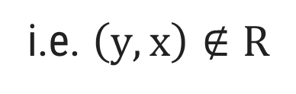


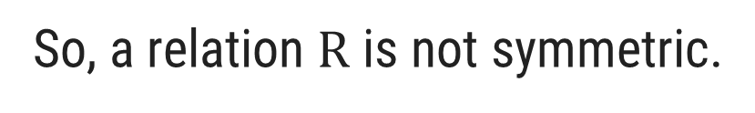
Properties of binary relation in a set
Symmetric
A binary relation $R$ in a set $A$ is said to be symmetric if, for every $x,y∈A$,
whenever $\left(x,y\right)∈R,$ then $\left(y,x\right)∈R$
For example: Consider a relation $R=\left\{\left(x,y\right) :x<y\right\}$ on a set $ℕ$.
Let $x,y∈ℕ,\left(x,y\right)∈R.$
$$⇒x<y$$
$$⇏y<x$$
i.e. $\left(y,x\right)∉R$
So, a relation $R$ is not symmetric.

Slide 45

Properties of binary relation in a set
Symmetric
A binary relation $R$ in a set $A$ is said to be symmetric if, for every $x,y∈A$,
whenever $\left(x,y\right)∈R,$ then $\left(y,x\right)∈R$
For example: Consider a relation $R=\left\{\left(x,y\right) :x<y\right\}$ on a set $ℕ$.

$A=\left\{\left(1,1\right),\left(2,3\right),\left(3,2\right),\left(3,3\right)\right\}$
$B=\left\{\left(x,y\right) :x,y∈ℕ,x=y\right\}$
$C=\left\{\left(1,1\right),\left(1,2\right),\left(2,2\right)\right\}$
$D=\left\{\left(1,2\right),\left(2,1\right)\right\}$
$E=\left\{\left(1,2\right),\left(2,3\right),\left(1,3\right)\right\}$
×
$$A=\left\{1,2,3,6\right\}$$
$$R=\left\{\left(x,y\right) :x<y\right\}$$

×

$$A=\left\{1,2,3,6\right\}$$
$$R=\left\{\left(x,y\right) :x divides y\right\}$$

Slide 46
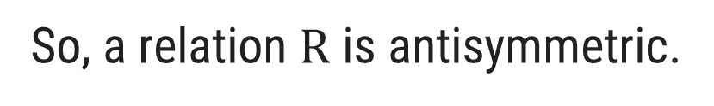



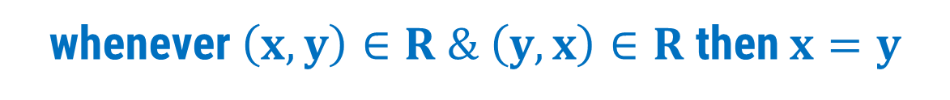
Properties of binary relation in a set
Antisymmetric
A binary relation $R$ in a set $A$ is said to be antisymmetric if, for every $x,y∈A$,
whenever $\left(x,y\right)∈R \& \left(y,x\right)∈R$ then $x=y$
For example: Consider a relation $R=\left\{\left(x,y\right) :x≤y\right\}$ on a set $ℕ$.
Let $x,y∈ℕ,\left(x,y\right)∈R \& \left(y,x\right)∈R.$
$$⇒x≤y \& y≤x$$
$$⇒x=y$$
So, a relation $R$ is antisymmetric.

Slide 47

Properties of binary relation in a set
Antisymmetric
A binary relation $R$ in a set $A$ is said to be antisymmetric if, for every $x,y∈A$,
whenever $\left(x,y\right)∈R \& \left(y,x\right)∈R$ then $x=y$
For example: Consider a relation $R=\left\{\left(x,y\right) :x<y\right\}$ on a set $ℕ$.
$A=\left\{\left(1,1\right),\left(2,3\right),\left(3,2\right),\left(3,3\right)\right\}$
$B=\left\{\left(x,y\right) :x,y∈ℕ,x=y\right\}$
$C=\left\{\left(1,1\right),\left(1,2\right),\left(2,2\right)\right\}$
$D=\left\{\left(1,2\right),\left(2,1\right)\right\}$
$E=\left\{\left(1,2\right),\left(2,3\right),\left(1,3\right)\right\}$

$$A=\left\{1,2,3,6\right\}$$
$$R=\left\{\left(x,y\right) :x<y\right\}$$



$$A=\left\{1,2,3,6\right\}$$
$$R=\left\{\left(x,y\right) :x divides y\right\}$$


Slide 48






Properties of binary relation in a set
Transitive
A binary relation $R$ in a set $A$ is said to be transitive if, for every $x,y,z∈A$,
whenever $\left(x,y\right)∈R \& \left(y,z\right)∈R$ then $\left(x,z\right)∈R$
For example: Consider a relation $R=\left\{\left(x,y\right) :x<y\right\}$ on a set $ℕ$.
Let $x,y,z∈ℕ,\left(x,y\right)∈R \& \left(y,z\right)∈R.$
$$⇒x<y \& y<z$$
$$⇒x<z$$
i.e. $\left(x,z\right)∈R$
So, a relation $R$ is transitive.

Slide 49

Properties of binary relation in a set
Transitive
A binary relation $R$ in a set $A$ is said to be transitive if, for every $x,y,z∈A$,
whenever $\left(x,y\right)∈R \& \left(y,z\right)∈R$ then $\left(x,z\right)∈R$
For example: Consider a relation $R=\left\{\left(x,y\right) :x<y\right\}$ on a set $ℕ$.
$A=\left\{\left(1,1\right),\left(2,3\right),\left(3,2\right),\left(3,3\right)\right\}$
$B=\left\{\left(x,y\right) :x,y∈ℕ,x=y\right\}$
$C=\left\{\left(1,1\right),\left(1,2\right),\left(2,2\right)\right\}$
$D=\left\{\left(1,2\right),\left(2,1\right)\right\}$
$E=\left\{\left(1,2\right),\left(2,3\right),\left(1,3\right)\right\}$

$$A=\left\{1,2,3,6\right\}$$
$$R=\left\{\left(x,y\right) :x<y\right\}$$



$$A=\left\{1,2,3,6\right\}$$
$$R=\left\{\left(x,y\right) :x divides y\right\}$$


Slide 50

Properties of Equivalence Relations
Assume that $R$ is a relation on a set $A$, in other words, $R⊆A ×A$, where $(x,y) ε R$ to indicate $x$ is related to $y$ via Relation $R$.
$R$ is reflexive if for every $x ϵ A, xRx$
$R$ is symmetric if for every $x$ and $y$ in $A$, if $xRy$, then $yRx$
$R$ is transitive if for every $x,y$ and $z$ in $A$, if $xRy$ and $yRz$, then $xRz.$
$R$ is an equivalence relation on $A$, if $R$ is reflexive, symmetric and transitive.

Slide 51

Example: Equivalence Relation
A={a, b}, R={(a, a), (b, b), (a, b), (b, a)}
Reflexive: {(a, a),(b, b)}
Symmetric: {(a, b), (b, a)}
Transitive: {(a, a), (a, b), (a, b)
(b, b), (b, a), (b, a)
(a, b), (b, b), (a, b)
(a, b), (b, a), (a, a)
(b, a), (a, b), (b, b)
(b, a), (a, a), (b, a)}
Above relation is Equivalence relation because it is Reflexive, symmetric and transitive.

Slide 52
Exercise
A={1, 2, 3}, R={(1, 2), (1, 1), (2, 1), (2, 2), (3, 2), (3, 3)} is equivalent relation?
A={1, 2, 3, 4}, R={(1, 1), (2, 2), (2, 3), (3, 2), (4, 2), (4, 4)} is equivalent relation?
A={0, 1, 2}, R={(0, 0), (1, 1), (2, 2), (1, 0), (2, 1)} is equivalent relation?

Slide 53
Combining Relation
Relations are sets, and therefore, we can apply the usual set operations to them.
If we have two relations R1 and R2, and both of them are from a set A to a set B, then we can combine them to R1  R2, R1  R2, or R1 – R2.
In each case, the result will be another relation from A to B.

Slide 54
N-Array relation
In order to study an interesting application of relations, namely databases, we first need to generalize the concept of binary relations to n-ary relations.
Definition: Let A1, A2, …, An be sets. An n-ary relation on these sets is a subset of A1A2…An.
The sets A1, A2, …, An are called the domains of the relation, and n is called its degree.

Slide 55
Example:
Let R = {(a, b, c) | a = 2b  b = 2c with a, b, cN}
What is the degree of R?
The degree of R is 3, so its elements are triples.
What are its domains?
Its domains are all equal to the set of integers.
Is (2, 4, 8) in R?
No.
Is (4, 2, 1) in R?
Yes.

Slide 56
Representation of relation
Example: How can we represent the relation
R = {(2, 1), (3, 1), (3, 2)} as a zero-one matrix?
Solution: The matrix MR is given by

Slide 57
What do we know about the matrices representing a relation on a set (a relation from A to A) ?
They are square matrices.
What do we know about matrices representing reflexive relations?
Reflexive relation.
symmetric relation.
non-symmetric relation.

Slide 58
The Boolean operations join and meet can be used to determine the matrices representing the union and the intersection of two relations, respectively.
Example: Let the relations R and S be represented by the matrices
What are the matrices representing RU S and R ∩S?
Solution: These matrices are given by

Slide 59
Representing relation using diagraphs
Definition: A directed graph, or digraph, consists of a set V of vertices (or nodes) together with a set E of ordered pairs of elements of V called edges (or arcs).
The vertex a is called the initial vertex of the edge (a, b), and the vertex b is called the terminal vertex of this edge.
We can use arrows to display graphs.
Example: Display the digraph with V = {a, b, c, d},
E = {(a, b), (a, d), (b, b), (b, d), (c, a), (c, b), (d, b)}.
An edge of the form (b, b) is called a loop.
a
b
d
c

Slide 60
Proof

Slide 61
Proof
A proof of a statement is essentially just a convincing argument that the statement is true.
A typical step in proof is to derive some statement from:
Assumptions or hypotheses
Statements that have already been derived
Other generally accepted facts
There are several methods for establishing a proof, some of them are:
Direct proof
By contradiction
By mathematical induction

Slide 62
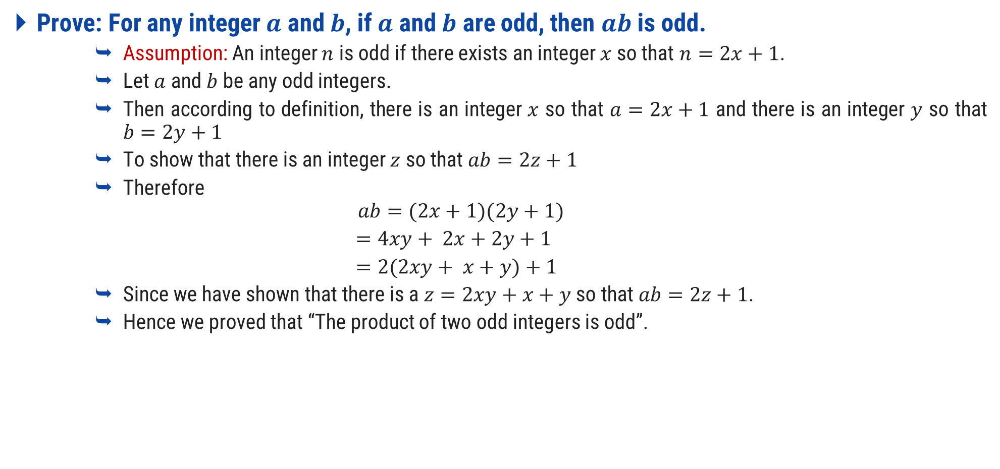
Prove: Product of Two Odd Integers is Odd
Prove: For any integer $a$ and $b$, if $a$ and $b$ are odd, then $ab$ is odd.
Assumption: An integer $n$ is odd if there exists an integer $x$ so that $n=2x+1$.
Let $a$ and $b$ be any odd integers.
Then according to definition, there is an integer $x$ so that $a=2x+1$ and there is an integer $y$ so that $b=2y+1$
To show that there is an integer $z$ so that $ab=2z+1$
Therefore
$$ab=(2x+1)(2y+1)$$
$=4xy+ 2x+2y+1$
$=2(2xy+ x+y)+1$
Since we have shown that there is a $z=2xy+x+y$ so that $ab=2z+1$.
Hence we proved that “The product of two odd integers is odd”.

Slide 63
Rational & Irrational numbers
A rational number is a number that can be in the form m/n where m and n are integers and n is not equal to zero.
Examples:
1.5 = 3/2
6 = 12/2
5 = 15/3
π=22/7= 3.14159265 3589793238462643383279502884197..…
Rational Numbers
Irrational Numbers

Slide 64
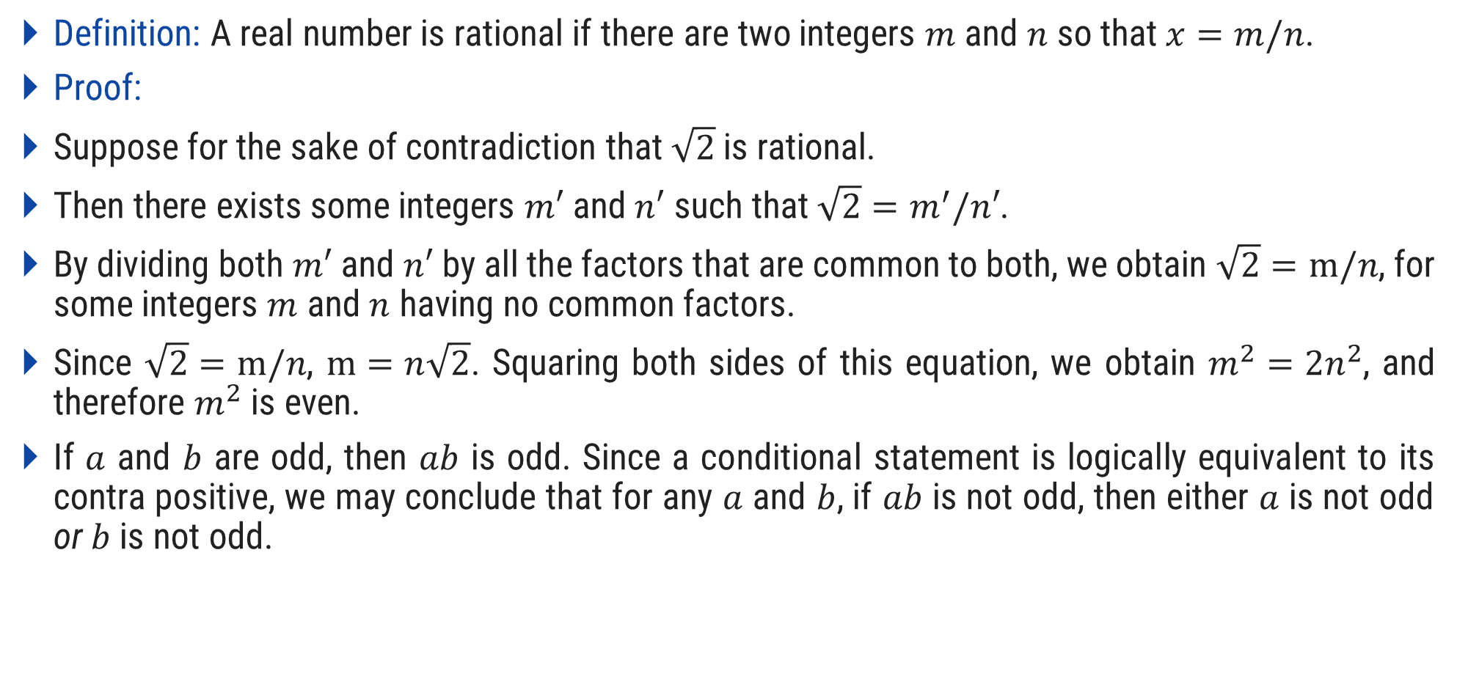
Prove: $\sqrt{2}$ is Irrational
Definition: A real number is rational if there are two integers $m$ and $n$ so that $x=m/n$.
Proof:
Suppose for the sake of contradiction that $\sqrt{2}$ is rational.
Then there exists some integers $m′$ and $n′$ such that ${\sqrt{2}=m}^{′}/n′$.
By dividing both $m′$ and $n′$ by all the factors that are common to both, we obtain $\sqrt{2}=m/n$, for some integers $m$ and $n$ having no common factors.
Since $\sqrt{2}=m/n$, $m=n\sqrt{2}$. Squaring both sides of this equation, we obtain $m^{2}=2n^{2}$, and therefore $m^{2}$ is even.
If $a$ and $b$ are odd, then $ab$ is odd. Since a conditional statement is logically equivalent to its contra positive, we may conclude that for any $a$ and $b$, if $ab$ is not odd, then either $a$ is not odd or $b$ is not odd.

Slide 65
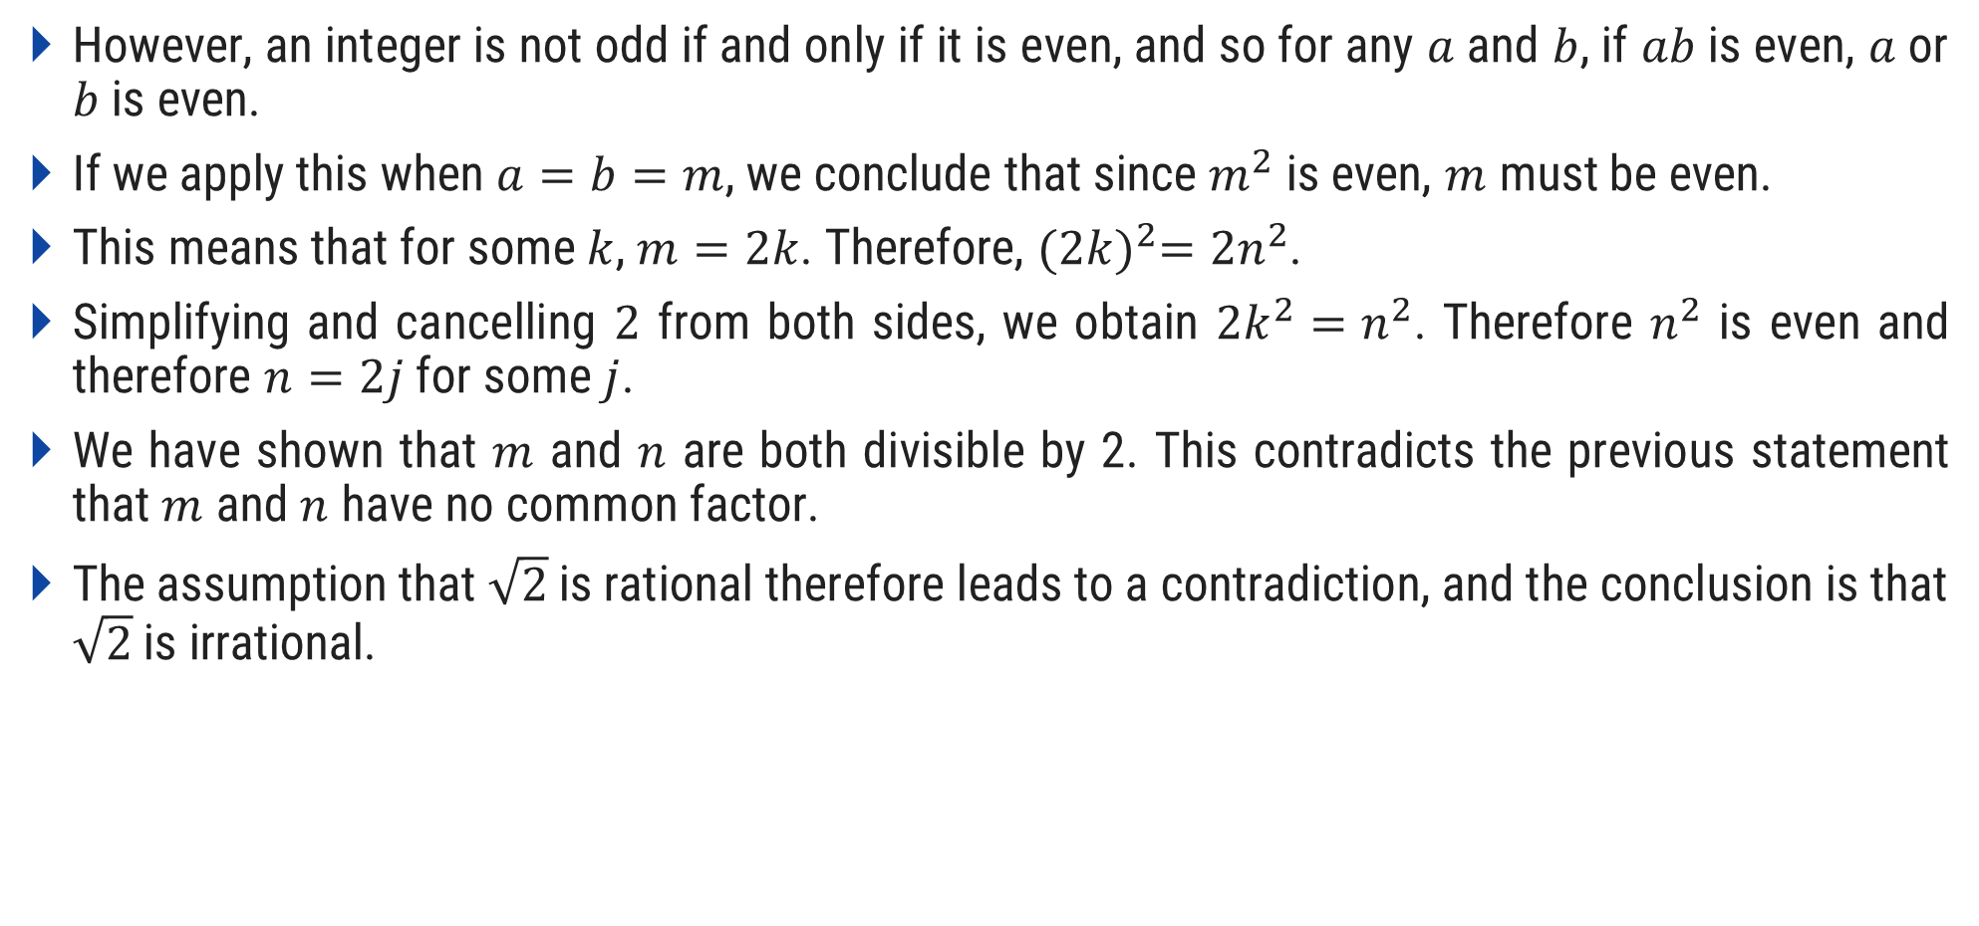
Prove: $\sqrt{2}$ is Irrational
However, an integer is not odd if and only if it is even, and so for any $a$ and $b$, if $ab$ is even, $a$ or $b$ is even.
If we apply this when $a=b=m$, we conclude that since $m^{2}$ is even, $m$ must be even.
This means that for some $k$, $m=2k$. Therefore, ${(2k)}^{2}=2n^{2}$.
Simplifying and cancelling $2$ from both sides, we obtain $2k^{2}=n^{2}$. Therefore $n^{2}$ is even and therefore $n=2j$ for some $j$.
We have shown that $m$ and $n$ are both divisible by 2. This contradicts the previous statement that $m$ and $n$ have no common factor.
The assumption that $\sqrt{2}$ is rational therefore leads to a contradiction, and the conclusion is that $\sqrt{2}$ is irrational.

Slide 66
Principle of Mathematical Induction

Slide 67





Principle of Mathematical Induction
Suppose $P(n)$ is a statement involving an integer $n$. Then to prove that $P(n)$ is true for every $n≥n_{0}$, it is sufficient to show these two things (consider n₀=1 for understanding)
$P(n_{0})$ is true.
For any $k≥n_{0}$, if $P(k)$ is true, then $P(k+1)$ is true.
Then P(n) is true for all integer n
$$k+1$$
$$k$$
Basic

Slide 68





Prove $\sum_{i=1}^{n}{i}=n(n+1)/2$ using PMI
Step-1: Basic step
We must show that P(1) is true.
$P(1)$ = $1$ (L.H.S)
P(1)$=1(1+1)/2$ =1, And this is obviously true.
Step-2: Induction Hypothesis
$k≥1$ and $1+2+3+…+k=k(k+1)/2$
Step-3: Proof of Induction
$$P(k+1)$$ | = $1+2+3+…k+\left(k+1\right)$
= $k(k+1)/2+\left(k+1\right)$
(by induction hypothesis)
= $\left(k+1\right)(\frac{k}{2}+1)$
= $\left(k+1\right)(k+2)/2$
= $\left(k+1\right)(\left(k+1\right)+1)/2$
(Hence Proved)

Slide 69
Prove 1 +3 +5 + … +2n-1 = n² using PMI, n>=1
Step-1: Basic step
We must show that P(1) is true.
P(1) = 2(1)-1= 1 (L.H.S)
P(1) = (1)² = 1 (R.H.S)
And, this is obviously true.
Step-2: Induction Hypothesis
k >= 1 and
p(k) = 1+3+5+…..+(2k-1)=k²
Step-3: Proof of Induction
P(k+1) = 1+3+5+….+(2k-1)+(2(k+1)-1)
= k² + (2(k+1)-1)
= k² + (2k+2-1)
= k² + 2k+1
=(k+1)² (Hence Proved)

Slide 70
Prove 7+ 13+19+…..+(6n+1)= n(3n+4) using PMI, n>=1
Step-1: Basic step
We must show that p(1) is true.
P(1)= 6n+1=(6(1)+1)=7
P(1)= n(3n+4) =1(3(1)+4)=7
And, this is obviously true.
Step-2: Induction Hypothesis
k >= 1 and
p(k) = 7+13+19+…..+(6k+1)=k(3k+4)
Step-3: Proof of Induction
P(k+1)= 7+13+…..+(6k+1)+(6(k+1)+1)
= k(3k+4)+(6(k+1)+1)
= k(3k+4)+(6k+6+1)
= 3k²+4k+6k+7
= 3k²+10k+7
= 3k²+3k+7k+7
= 3k(k+1)+7(k+1)
= (k+1)(3k+7)
= (k+1)(3k+3+4)
= (k+1)(3(k+1)+4) (Hence Proved)

Slide 71
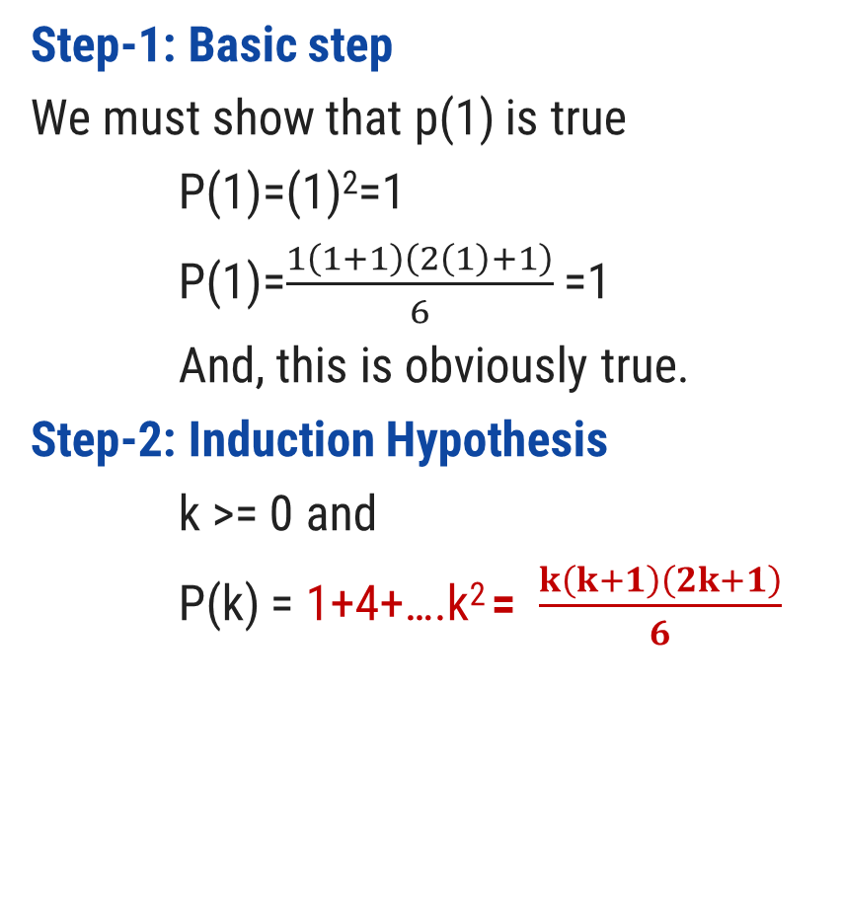
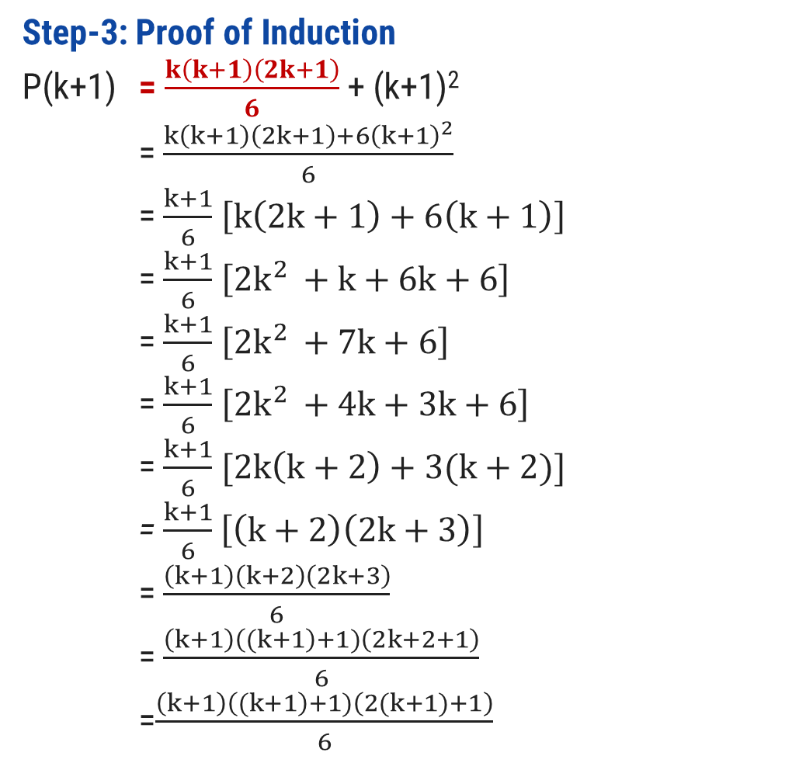
Prove $\sum_{i=1}^{n}{i^{2}=n(n+1)(2n+1)/6}$ using PMI
Step-1: Basic step
We must show that p(1) is true
P(1)=(1)²=1
P(1)=$\frac{1\left(1+1\right)\left(2\left(1\right)+1\right)}{6}$ =1
And, this is obviously true.
Step-2: Induction Hypothesis
k >= 0 and
P(k) = 1+4+….k² = $\frac{k\left(k+1\right)\left(2k+1\right)}{6}$
Step-3: Proof of Induction
P(k+1) = $\frac{k\left(k+1\right)\left(2k+1\right)}{6}$ + (k+1)²
= $\frac{k\left(k+1\right)\left(2k+1\right)+{6\left(k+1\right)}^{2}}{6}$
= $\frac{k+1}{6}$ $\left[k\left(2k+1\right)+6\left(k+1\right)\right]$
= $\frac{k+1}{6}$ $\left[{2k}^{2 }+k+6k+6\right]$
= $\frac{k+1}{6}$ $\left[{2k}^{2 }+7k+6\right]$
= $\frac{k+1}{6}$ $\left[{2k}^{2 }+4k+3k+6\right]$
= $\frac{k+1}{6}$ $[2k\left(k+2\right)+3(k+2)]$
= $\frac{k+1}{6}$ $\left[\left(k+2\right)\left(2k+3\right)\right]$
= $\frac{\left(k+1\right)\left(k+2\right)\left(2k+3\right)}{6}$
= $\frac{\left(k+1\right)\left((k+1\right)+1)\left(2k+2+1\right)}{6}$ =$\frac{\left(k+1\right)\left((k+1\right)+1)\left(2(k+1)+1\right)}{6}$

Slide 72
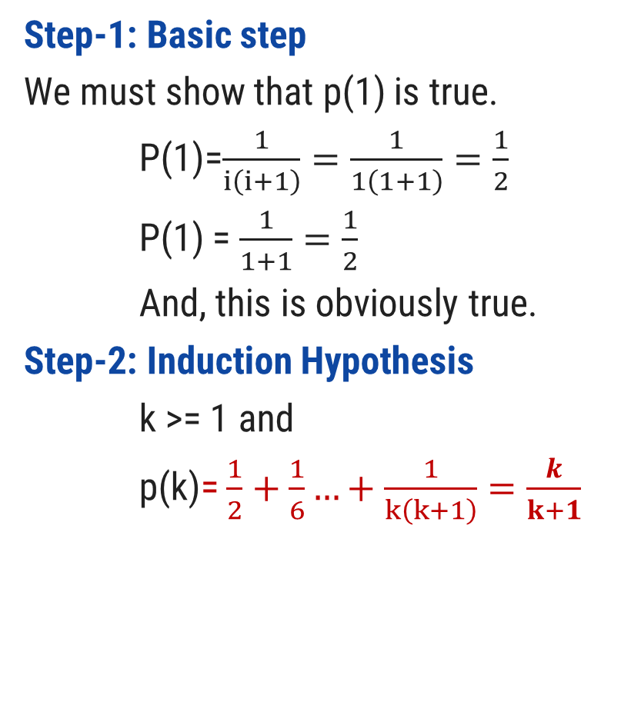
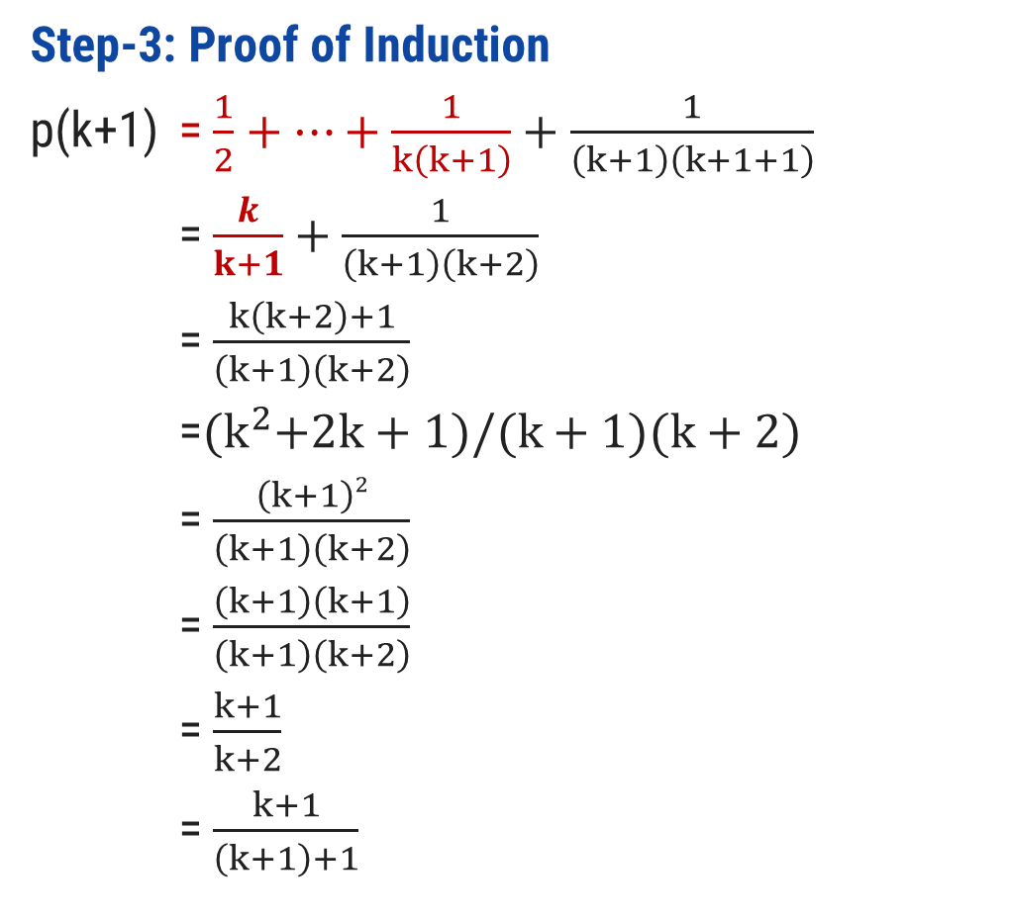
Prove $\sum_{i=1}^{n}{\frac{1}{i(i+1)}}= \frac{n}{n+1}$ using PMI
Step-1: Basic step
We must show that p(1) is true.
P(1)=$\frac{1}{i\left(i+1\right)}=\frac{1}{1\left(1+1\right)}=\frac{1}{2}$
P(1) = $\frac{1}{1+1}=\frac{1}{2}$
And, this is obviously true.
Step-2: Induction Hypothesis
k >= 1 and
p(k)= $\frac{1}{2}+\frac{1}{6}…+\frac{1}{k\left(k+1\right)}=\frac{k}{k+1}$
Step-3: Proof of Induction
p(k+1) = $\frac{1}{2}+…+\frac{1}{k\left(k+1\right)}+\frac{1}{\left(k+1\right)\left(k+1+1\right)}$
= $\frac{k}{k+1}+\frac{1}{\left(k+1\right)\left(k+2\right)}$
= $\frac{k\left(k+2\right)+1}{\left(k+1\right)\left(k+2\right)}$
=${(k}^{2}+2k+1)/(k+1)(k+2)$
= $\frac{\left(k+1\right)2}{\left(k+1\right)\left(k+2\right)}$
= $\frac{\left(k+1\right)\left(k+1\right)}{\left(k+1\right)\left(k+2\right)}$
= $\frac{k+1}{k+2}$
= $\frac{k+1}{\left(k+1\right)+1}$

Slide 73
Prove 1+ $\sum_{i=1}^{n}{i∗i!=\left(n+1\right)!}$ using PMI
Step-1: Basic step
We must show that p(1) is true.
P(1)= 1+(1*1!)=1+1=2
P(1)= (1+1)! =(2)! = 2
And, this is obviously true.
Step-2: Induction Hypothesis
k >= 1 and
p(k)= 1+(1+4..+(k*k!)) = (k+1)!
Step-3: Proof of Induction
P(k+1)= 1+(1+4..+(k*k!) + (k+1)*(k+1)!)
= (k+1)! + (k+1)(k+1)!)
= (k+1)! (1+(k+1))
= (k+1)! ((k+1)+1)
= ((k+1) + 1)!
(Hence Proved)
Note:
5!=5*4!
6!=6*5!
(K+1)!=(k+1)*k!

Slide 74
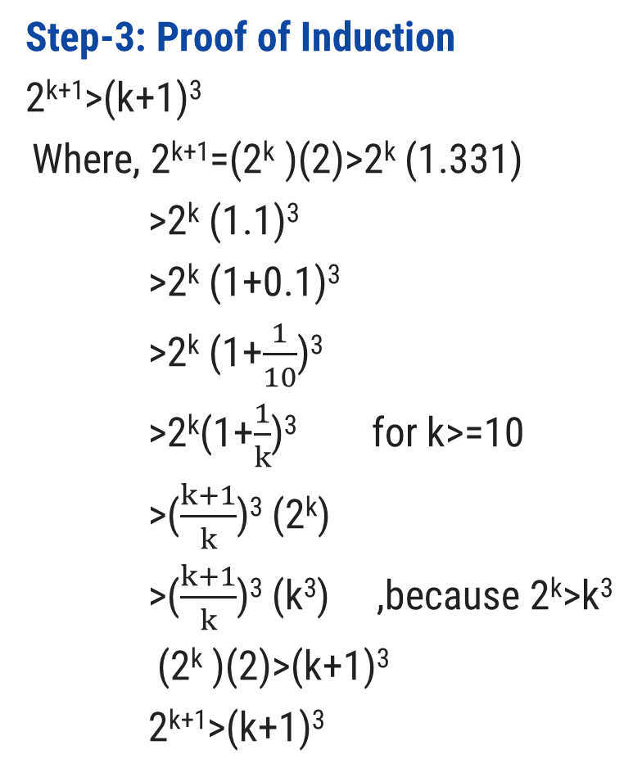
Prove that 2^{n}>n³ where n>=10, Using PMI
Step-1: Basic step
We must show that p(10) is true.
2¹⁰=1024 and 10³=1000
So,1024>1000
And, this is obviously true.
Step-2: Induction Hypothesis
For k>=10
P(k)= 2^{k}>k³
Step-3: Proof of Induction
2^{k+1}>(k+1)³
Where, 2^{k+1}=(2^{k} )(2)>2^{k} (1.331)
>2^{k} (1.1)³
>2^{k} (1+0.1)³
>2^{k} (1+$\frac{1}{10}$)³
>2^{k}(1+$\frac{1}{k}$)³ for k>=10
>($\frac{k+1}{k}$)³ (2^{k})
>($\frac{k+1}{k}$)³ (k³) ,because 2^{k}>k³
(2^{k} )(2)>(k+1)³
2^{k+1}>(k+1)³
(Hence Proved)

Slide 75
Prove n(n²+5) is divisible by 6 using PMI
Step-1: Basic step
We must show that p(1) is true.
P(1)=1(1²+5)=1+5/6=1
And, this is obviously true.
Step-2: Induction Hypothesis
For k>=1 and
P(k)=k(k²+5) is divisible by 6.
Step-3: Proof of Induction
(k+1)[(k+1)²+5]
= (k+1)(k²+2k+1+5)
= (k+1)(k²+2k+6)
=k³+2k²+6k+k²+2k+6
=k³+3k²+8k+6
=k³+3k²+5k+3k+6
=k(k²+5)+3k(k+1)+6
= k(k²+5)+3k(k+1)+6
Here, k(k²+5) is divisible by 6 ,given in induction hypothesis.
In Second term k and k+1 are consecutive. So, one number is even and one is odd. So, even number is always multiple of 2 and here 3 is also present .So, second term having (2*3) is also divisible by 6.
Last term 6 is obviously divisible by 6.Hence proved.

Slide 76

Strong Principle of Mathematical Induction
Suppose $P(n)$ is a statement involving an integer $n$. Then to prove that $P(n)$ is true for every $n≥n_{0}$, it is sufficient to show these two things:
$P(n_{0})$ is true.
For any $k≥n_{0}$, if $P(n)$ is true for every $n$ satisfying $n_{0}≤n≤k$, then $P(k+1)$ is true.

Slide 77
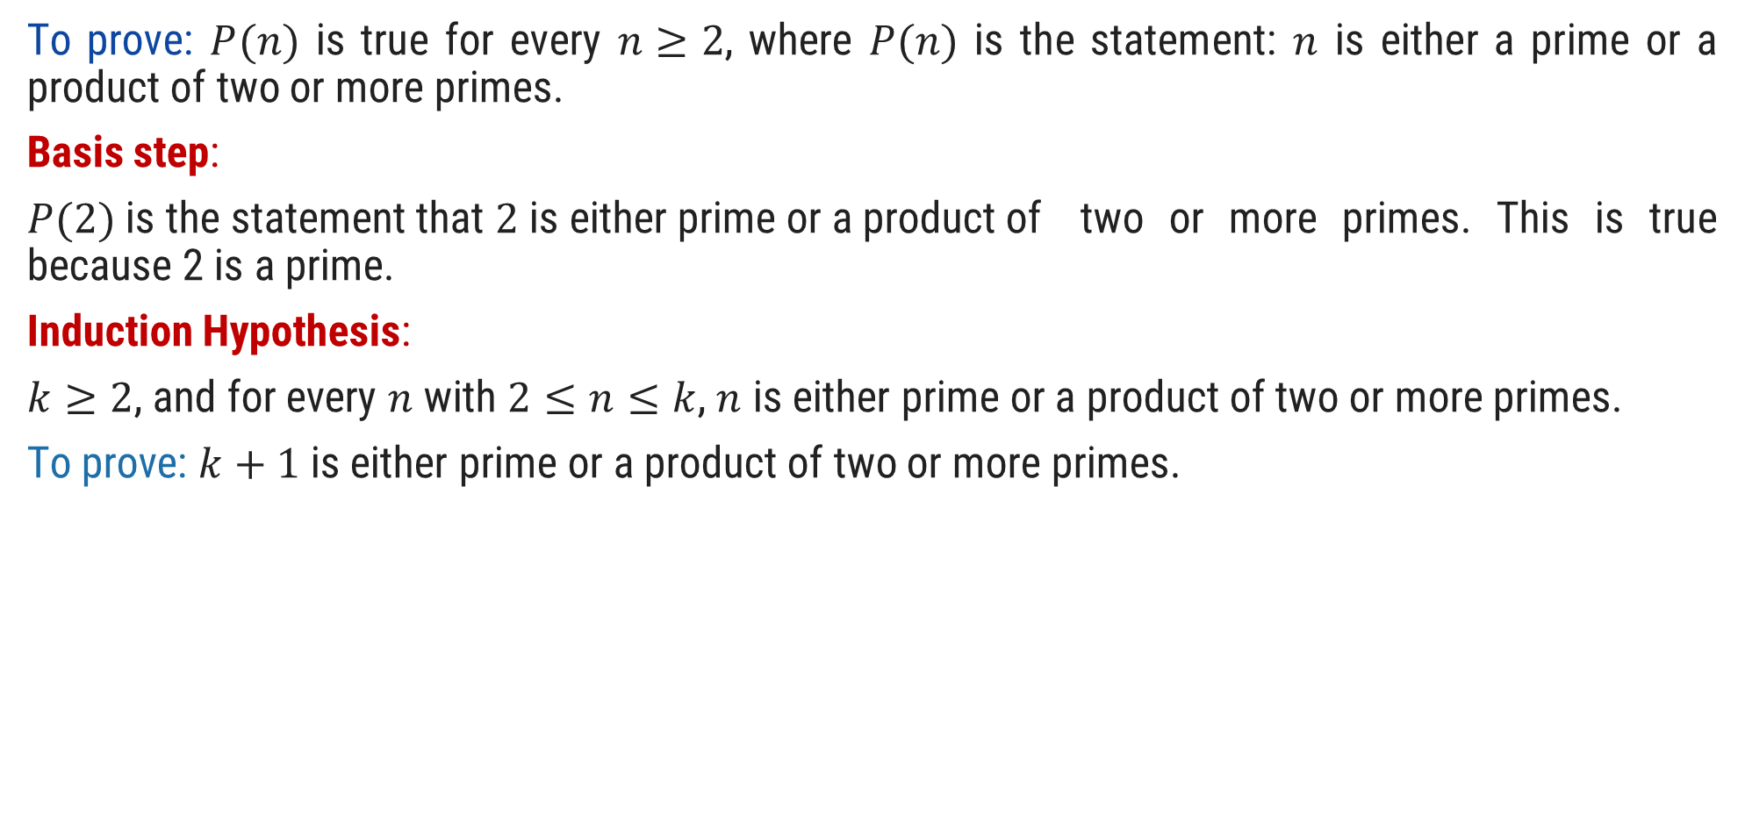
Prove that Integer Bigger than 2 have prime factorization using strong PMI
To prove: $P(n)$ is true for every $n≥2$, where $P(n)$ is the statement: $n$ is either a prime or a product of two or more primes.
Basis step:
$P(2)$ is the statement that $2$ is either prime or a product of two or more primes. This is true because 2 is a prime.
Induction Hypothesis:
$k≥2$, and for every $n$ with $2≤n≤k$, $n$ is either prime or a product of two or more primes.
To prove: $k+1$ is either prime or a product of two or more primes.

Slide 78
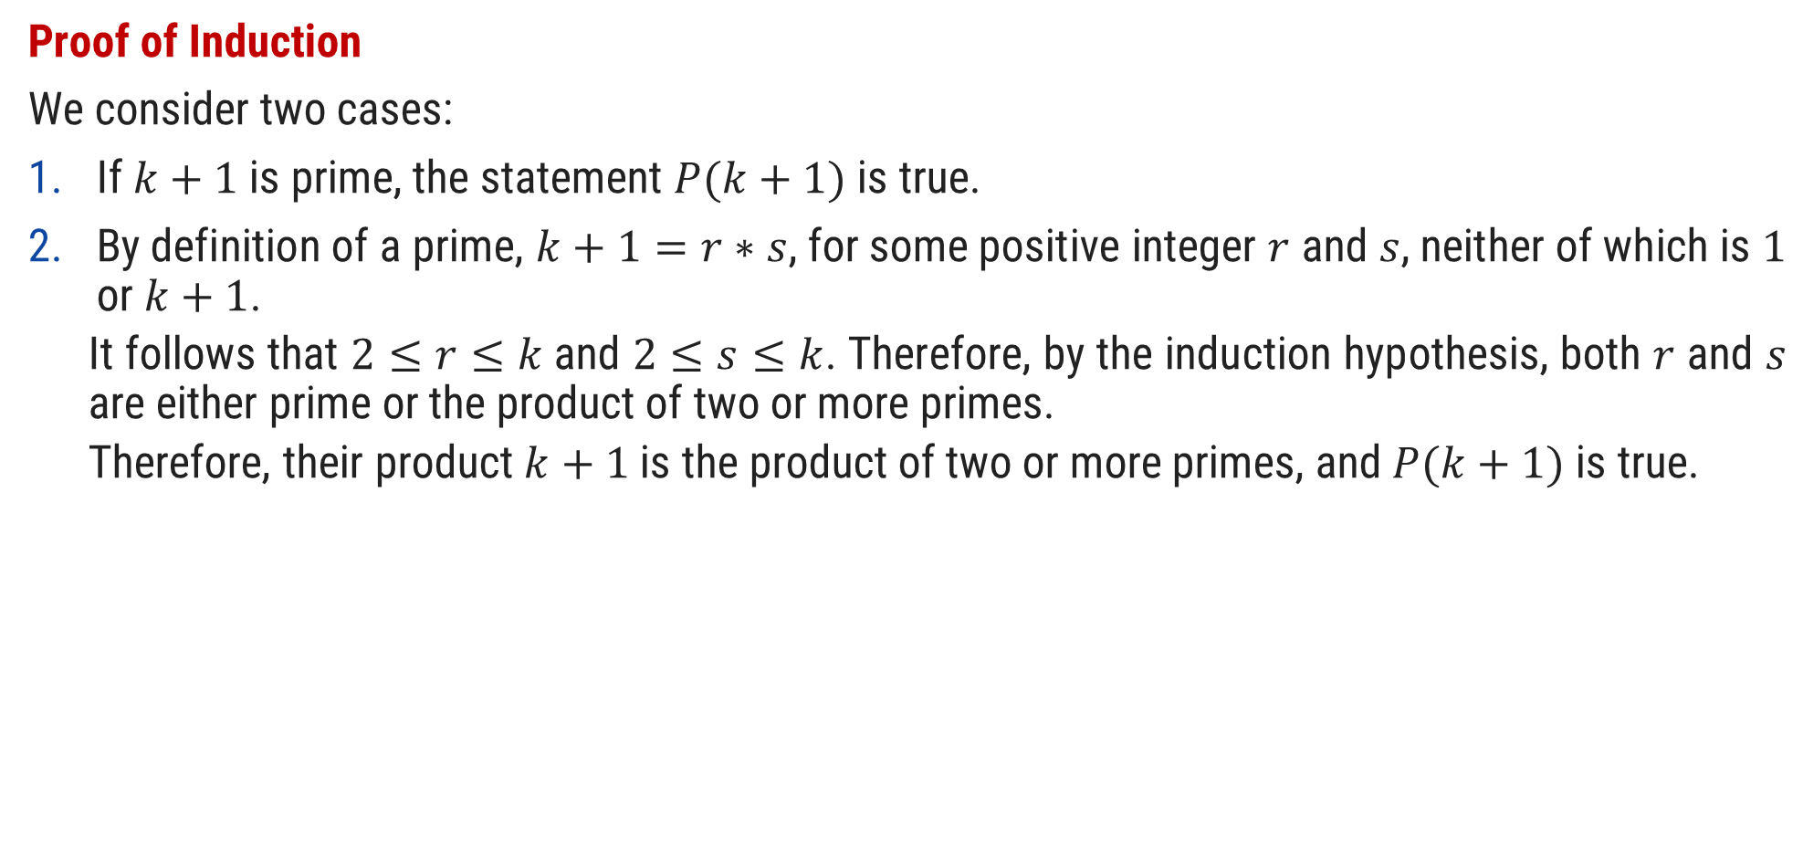
Prove that Integer Bigger than 2 have prime factorization using strong PMI
Proof of Induction
We consider two cases:
If $k+1$ is prime, the statement $P(k+1)$ is true.
By definition of a prime, $k+1=r∗s$, for some positive integer $r$ and $s$, neither of which is $1$ or $k+1$.
It follows that $2≤r≤k$and $2≤s≤k$. Therefore, by the induction hypothesis, both $r$ and $s$ are either prime or the product of two or more primes.
Therefore, their product $k+1$ is the product of two or more primes, and $P(k+1)$ is true.

Slide 79
Languages

Slide 80
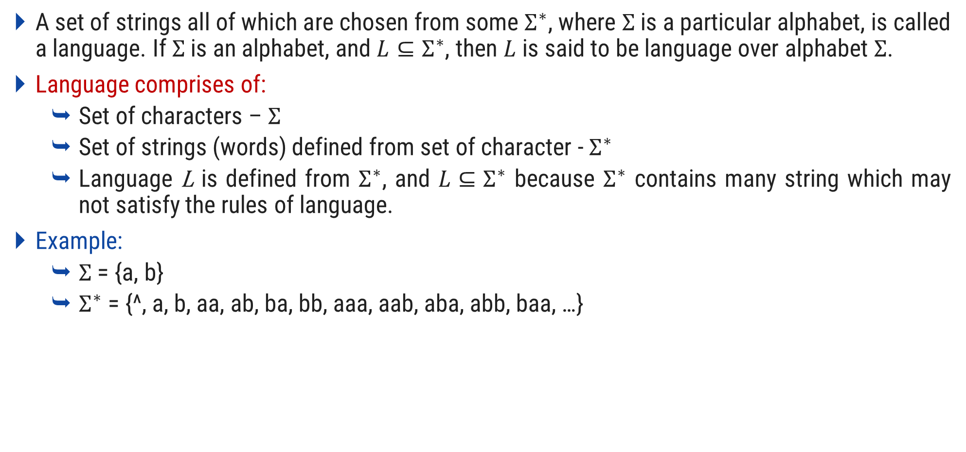
Language
A set of strings all of which are chosen from some $Σ^{∗}$, where $Σ$ is a particular alphabet, is called a language. If $Σ$ is an alphabet, and $L⊆Σ^{∗}$, then $L$ is said to be language over alphabet $Σ$.
Language comprises of:
Set of characters – $Σ$
Set of strings (words) defined from set of character - $Σ^{∗}$
Language L is defined from $Σ^{∗}$, and $L⊆Σ^{∗}$ because $Σ^{∗}$ contains many string which may not satisfy the rules of language.
Example:
$Σ$ = {a, b}
$Σ^{∗}$ = {^, a, b, aa, ab, ba, bb, aaa, aab, aba, abb, baa, …}

Slide 81
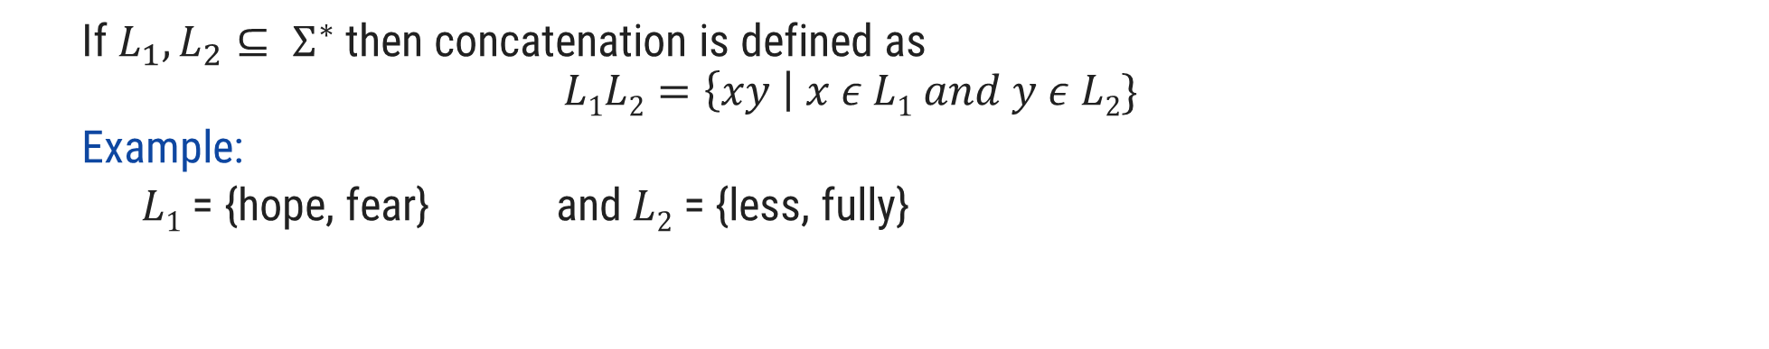
Operations over Language
Operations over the language are:
Concatenation
Union
* (Kleene closure)
+
If $L_{1}, L_{2}⊆ Σ^{∗}$ then concatenation is defined as
$$L1L2=\left\{xy \right| x ε L1 and y ε L2\}$$
Example:
$L1$ = {hope, fear} and $L2$ = {less, fully}
hopeless
$L1L2$ = {hopeless, hopefully, fearless, fearfully}

Slide 82

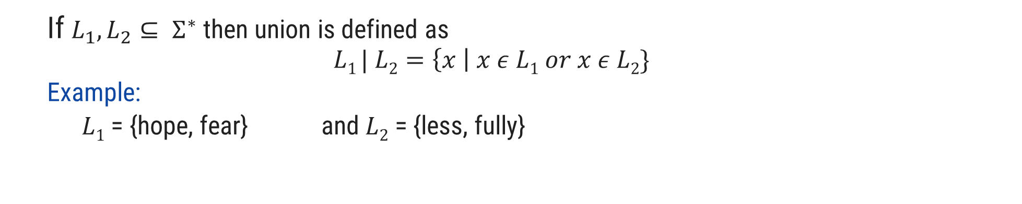
Operations over Language
Operations over the language are:
Concatenation
Union
* (Kleene closure)
+
If $L_{1}, L_{2}⊆ Σ^{∗}$ then union is defined as
$$L1 | L2=\left\{x \right| x ε L1 or x ε L2\}$$
Example:
$L1$ = {hope, fear} and $L2$ = {less, fully}
$L1 | L2$ = {hope, fear, less, fully}

Slide 83

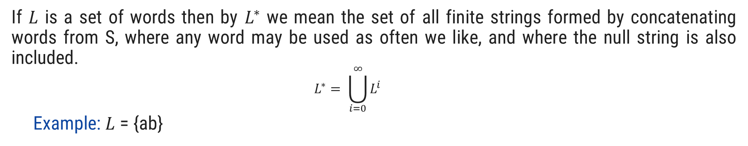
Operations over Language
Operations over the language are:
Concatenation
Union
* (Kleene closure)
+
If $L$ is a set of words then by $L^{∗}$ we mean the set of all finite strings formed by concatenating words from S, where any word may be used as often we like, and where the null string is also included.
$$L^{∗}= \bigcup_{i=0}^{∞}{L^{i}}$$
Example: $L$ = {ab}
$L$* = {^, ab, abab, ababab, abababab, ….}

Slide 84


Operations over Language
Operations over the language are:
Concatenation
Union
* (Kleene closure)
+
If $L$ is a set of words then by $L^{+}$ we mean the set of all finite strings formed by concatenating words from L, where any word may be used as often we like, and where the null string is not included.
$$L^{+}= \bigcup_{i=1}^{∞}{L^{i}}$$
Example:$L$ = {ab}
$L^{+}$ = {ab, abab, ababab, abababab, ….}

Slide 85
Thank You

