Slide 1
Context Free Grammar

Slide 2
Topics to be covered
Chomsky hierarchy
Context free grammar
Recursive definition
FA to regular grammar
Derivation
Ambiguity & unambiguous grammar
Simplified forms & normal forms
CFG to CNF
Union, Concatenation & Kleene’s of CFG

Slide 3
Chomsky Hierarchy

Slide 4
Chomsky hierarchy (Classification of grammar)
Grammar
Unrestricted grammar (type 0)
Restricted grammar
Context sensitive grammar (type 1)
Context free grammar(type 2)
Regular grammar(type 3)

Slide 5
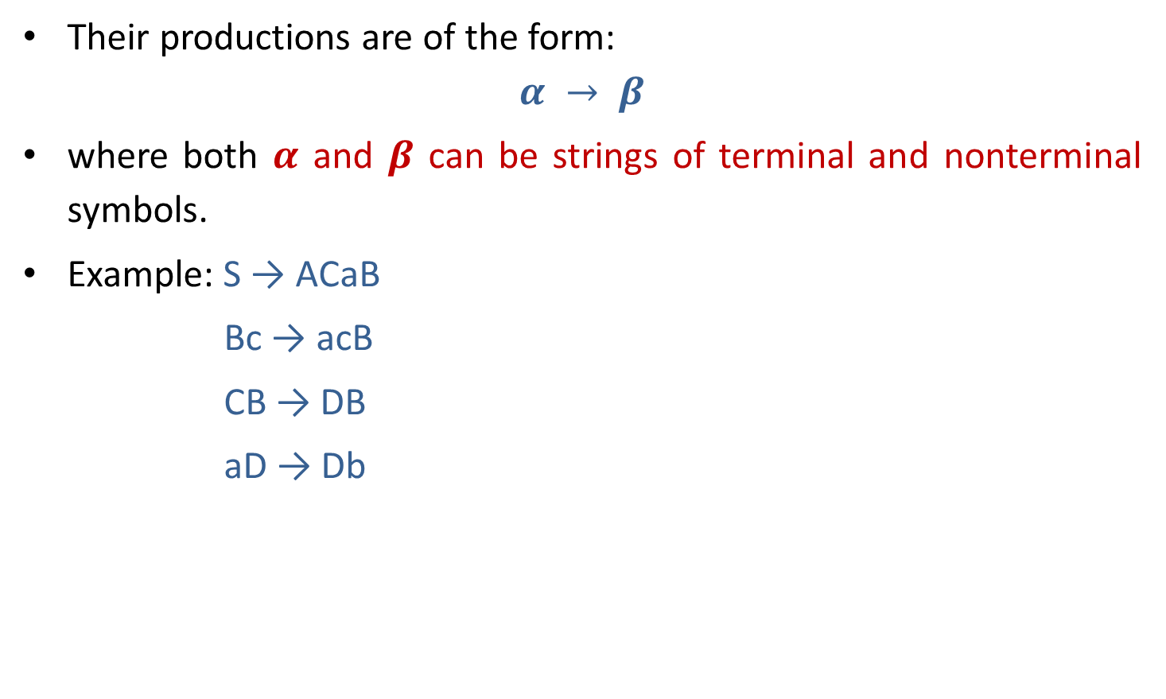
Type 0 grammar (Phrase Structure Grammar)
Their productions are of the form:
$$α → β$$
where both $α$ and $β$ can be strings of terminal and nonterminal symbols.
Example: S → ACaB
Bc → acB
CB → DB
aD → Db

Slide 6
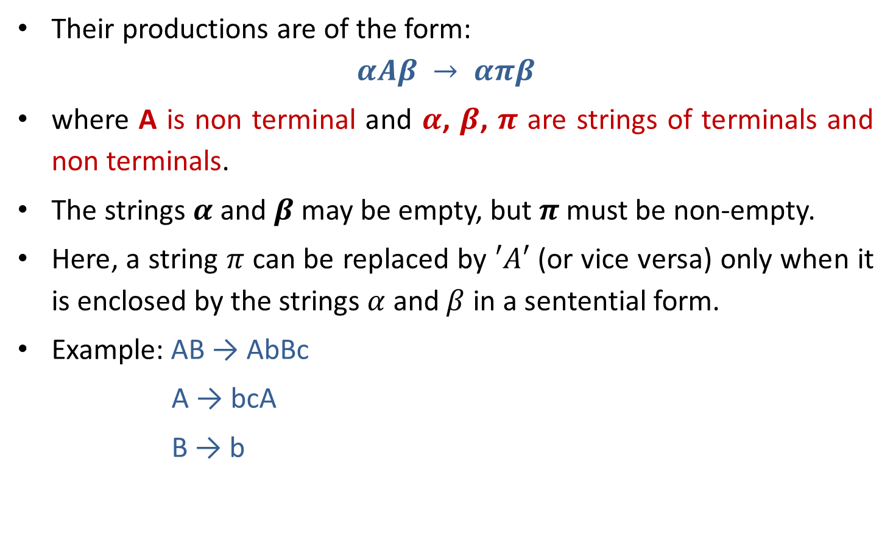
Type 1 grammar (Context Sensitive Grammar)
Their productions are of the form:
$$αAβ → απβ$$
where A is non terminal and $α$, $β$, $π$ are strings of terminals and non terminals.
The strings $α$ and $β$may be empty, but $π$ must be non-empty.
Here, a string $π$ can be replaced by $′A′$ (or vice versa) only when it is enclosed by the strings $α$ and $β$ in a sentential form.
Example: AB → AbBc
A → bcA
B → b

Slide 7

Type 2 grammar (Context Free Grammar)
Their productions are of the form:
$$A →α$$
Where $A$ is non terminal and $α$is string of terminals and non terminals.
Example: S → Xa
X → a
X → aX
X → abc

Slide 8
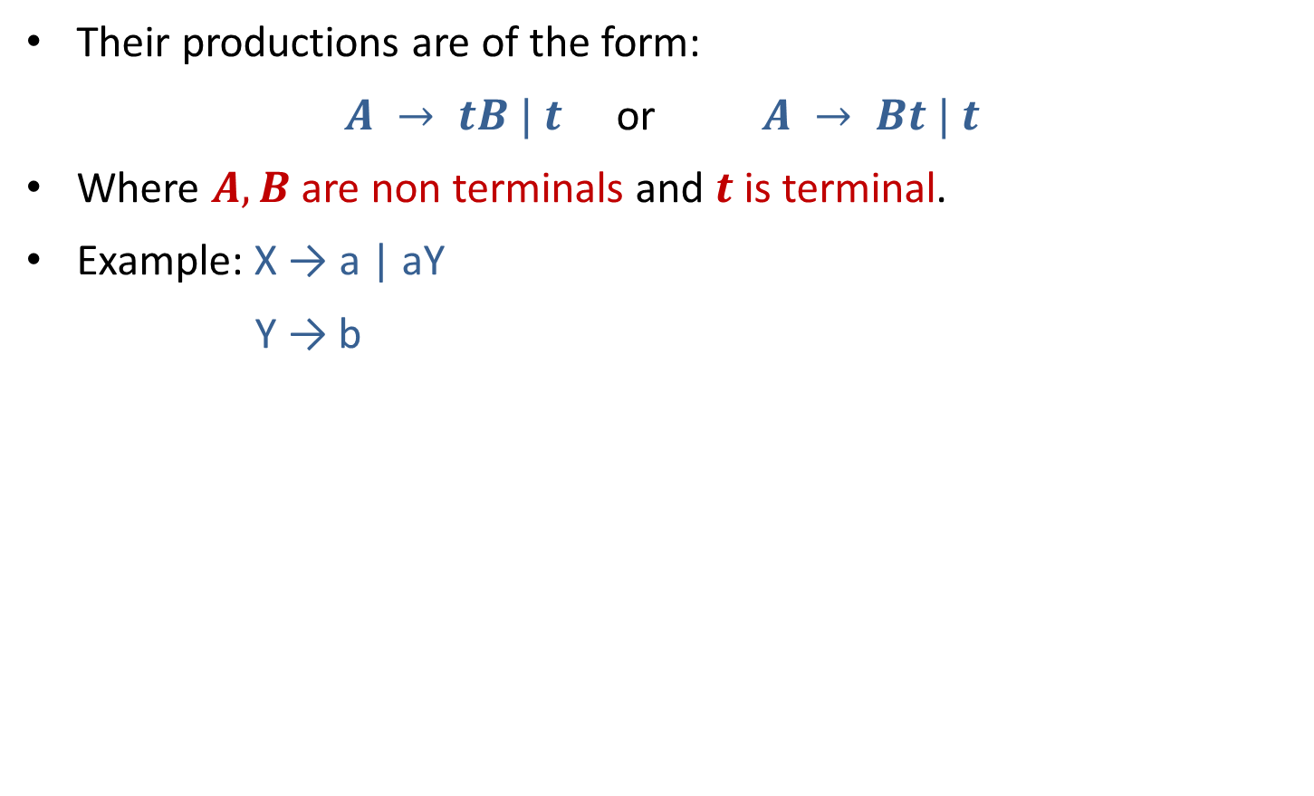
Type 3 grammar (Linear or Regular grammar)
Their productions are of the form:
$A → tB | t$ or $A → Bt | t$
Where $A, B$are non terminals and $t$ is terminal.
Example: X → a | aY
Y → b

Slide 9
Hierarchy of grammar
Type 0(Phrase structure)
Type 1(Context sensitive)
Type 2(Context free)
Type 3 (Regular)

Slide 10
Context free grammar

Slide 11
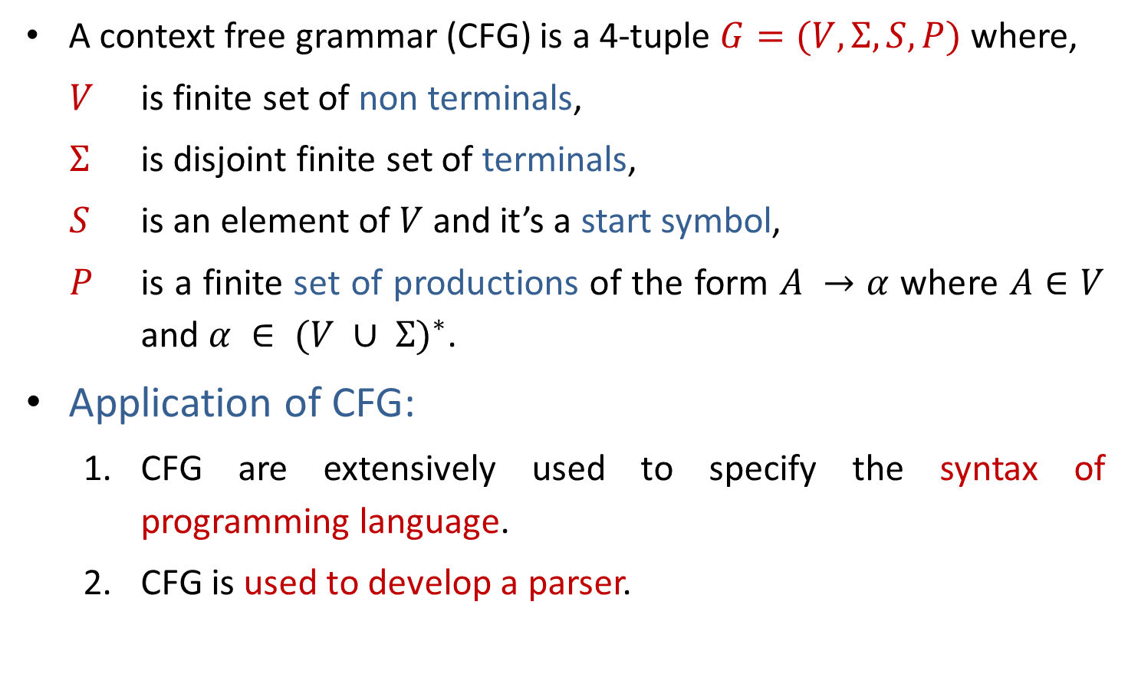
Context Free Grammar
A context free grammar (CFG) is a 4-tuple $G=(V,Σ,S,P)$where,
$V$ is finite set of non terminals,
$Σ$ is disjoint finite set of terminals,
$S$ is an element of $V$ and it’s a start symbol,
$P$ is a finite set of productions of the form $A →α$ where $A∈V$ and $α ∈ {(V ∪ Σ)}^{∗}$.
Application of CFG:
CFG are extensively used to specify the syntax of programming language.
CFG is used to develop a parser.

Slide 12
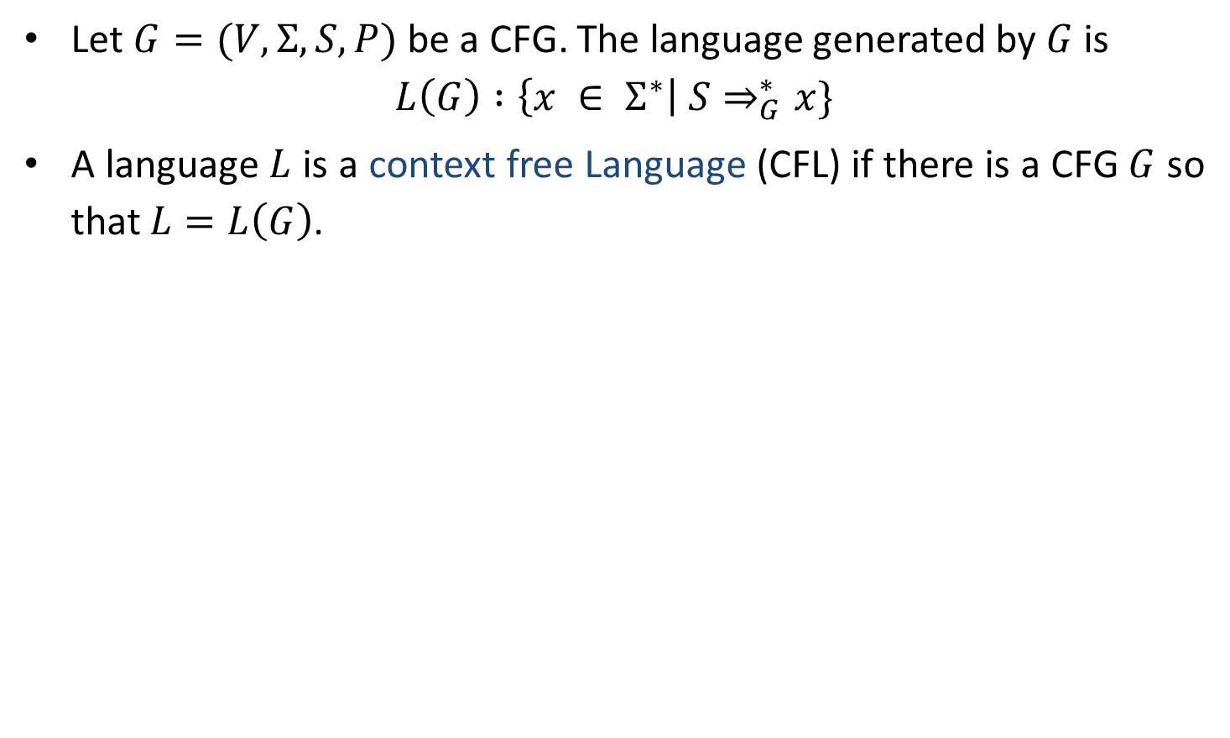
Context Free Language
Let $G=(V,Σ,S,P)$ be a CFG. The language generated by $G$ is
$$L\left(G\right) :\left\{x ∈ Σ^{∗}\right| S⇒_{G}^{∗}x\}$$
A language $L$ is a context free Language (CFL) if there is a CFG $G$ so that $L=L\left(G\right)$.

Slide 13
CFG Examples
Write CFG for either a or b
S→a | b
Write CFG for a⁺
S→ aS | a
Write CFG for a*
S→ aS | ^
Write CFG for (ab)*
S→abS | ^
Write CFG for any string of a and b
S→ aS | bS | a | b

Slide 14
CFG Examples
Write CFG for ab*
S→aX
X→˄| bX
Write CFG for a*b*
S→XY
X→aX|˄
Y→bY|˄
Write CFG for (a+b)*
S→aS | bS | ^
Write CFG for a(a+b)*
S→aX
X→aX | bX | ^

Slide 15
CFG Examples
Write CFG for a* | b*
S→A | B
A→˄| aA
B→^ |bB
Write CFG for (011+1)*(01)*
S→AB
A→011A | 1A | ^
B→01B | ^
Write CFG for balanced parenthesis
S→ [] | {} | [s] | {s} | ^

Slide 16
CFG Examples
Write CFG which contains at least three times 1.
S→A1A1A1A
A→0A | 1A | ^
Write CFG that must start and end with same symbol.
S→0A0 | 1A1
A→0A | 1A | ^
The language of even & odd length palindrome string over {a,b}
S→aSa|bSb|a|b|˄
No. of a and no. of b are same
S→aSb|bSa|aSa|bSb|˄
The language of {a, b} ends in a
S→aS | bS |a

Slide 17
CFG Examples
Write CFG for regular expression (a+b)*a(a+b)*a(a+b)*
S→XaXaX
X→aX|bX|˄
Write CFG for number of 0’s and 1’s are same (n₀(x)=n₁(x))
S→0S1 | 1S0 | ^
Write CFG for L={a^{i}b^{j}c^{k} | i=j or j=k}
For i=j for j=k
S→AB S→CD
A→aAb | ab C→aC | a
B→cB | c D→bDc | bc

Slide 18
CFG Examples
Write CFG for L={ a^{i}b^{j}c^{k} | j>i+k}
S→ABC
A→aAb |˄
B→bB | b
C→bCc |˄
Write CFG for L={ 0^{i}1^{j}0^{k} | j>i+k}
S→ABC
A→0A1 |˄
B→1B | 1
C→1C0 |˄
Write CFG for the language of Algebraic expressions
S→S+S | S*S | S-S | S/S | (S) | a

Slide 19

CFG Examples
CFG for syntax of programming language
<statement> $→$ … | <if-statement> | <for-statement> | …
<if-statement> $→$ if ( <expression> ) <statement>
<for-statement> $→$ for ( <expression>; <expression>; <expression> ) <statement>

Slide 20
Recursive Definitions

Slide 21
Recursive Definitions
Recursive Definition of {a,b}*
˄∈L.
For any S∈L, aS∈L.
For any S∈L, bS∈L.
No other strings are in L.
Recursive Definition of Palindrome
˄, a, b ∈ L
For any S ∈ L , aSa ∈ L and bSb ∈ L
No other string are in L
Recursive Definition of the language {a^{n}b^{n} | n≥0}
˄∈ L
For every S ∈ L, aSb ∈L
No other strings are in L
CFG: S→ aS | bS | ^
CFG: S→ aSa | bSb | a | b | ˄
CFG: S→ aSb | ˄

Slide 22
Derivation

Slide 23
Derivation
Derivation is used to find whether the string belongs to a given grammar or not.
There are two types of derivation:
Leftmost derivation
Rightmost derivation

Slide 24
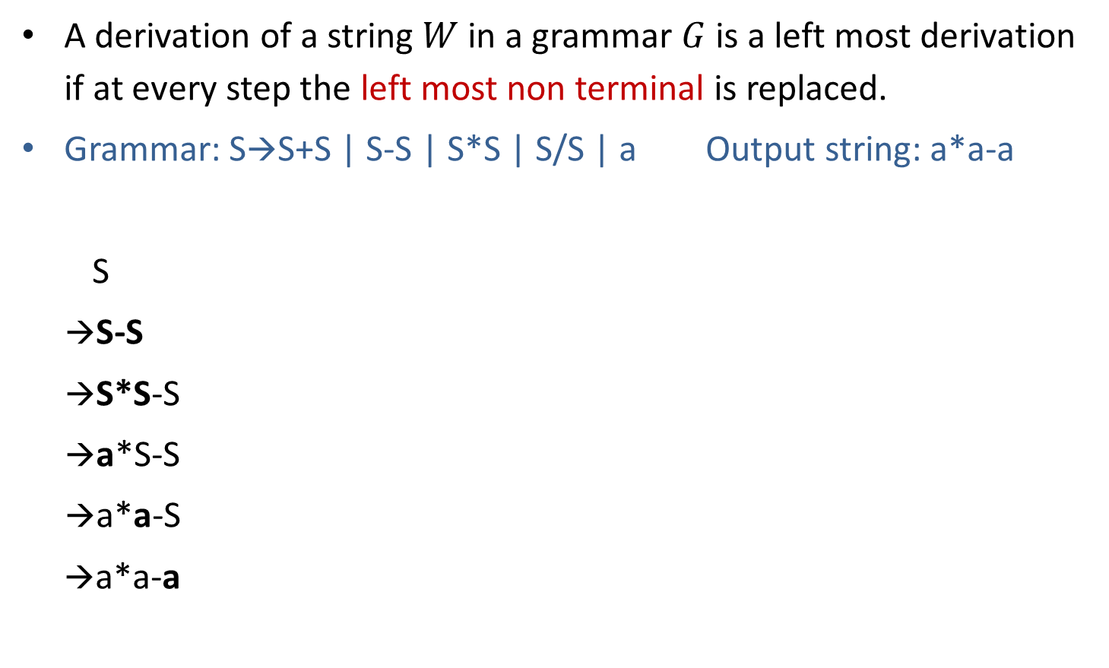
Leftmost derivation
A derivation of a string $W$ in a grammar $G$ is a left most derivation if at every step the left most non terminal is replaced.
Grammar: S→S+S | S-S | S*S | S/S | a Output string: a*a-a
S
→S-S
→S*S-S
→a*S-S
→a*a-S
→a*a-a
S
S
-
S
Parse tree represents the structure of derivation
S
*
S
a
a
a
Parse tree
Leftmost Derivation

Slide 25
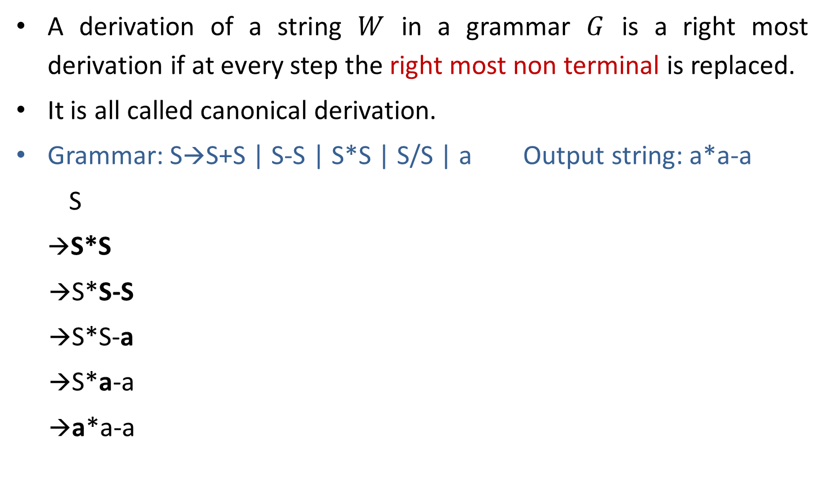
Rightmost derivation
A derivation of a string $W$ in a grammar $G$ is a right most derivation if at every step the right most non terminal is replaced.
It is all called canonical derivation.
Grammar: S→S+S | S-S | S*S | S/S | a Output string: a*a-a
S
→S*S
→S*S-S
→S*S-a
→S*a-a
→a*a-a
S
S
*
S
a
S
-
S
a
a
Parse Tree
Rightmost Derivation

Slide 26
Example: Derivation
S→A1B
A→0A | 𝜖
B→0B | 1B | 𝜖 Perform leftmost & Rightmost derivation.
(String: 00101)
Leftmost Derivation
S
A1B
0A1B
00A1B
001B
0010B
00101B
00101
Rightmost Derivation
S
A1B
A10B
A101B
A101
0A101
00A101
00101

Slide 27
Exercise: Derivation
Perform leftmost derivation and draw parse tree.
S→A1B
A→0A | 𝜖
B→0B | 1B | 𝜖
Output string: 1001.
Perform rightmost derivation and draw parse tree.
E→E+E | E*E | id | (E) | -E
Output string : id + id * id.

Slide 28
Ambiguous grammar

Slide 29
Ambiguous grammar
Ambiguous grammar is one that produces more than one leftmost or more then one rightmost derivation for the same sentence.
Grammar: S→S+S | S*S | (S) | a Output string: a+a*a
S S
→S*S →S+S
→S+S*S →a+S
→a+S*S →a+S*S
→a+a*S →a+a*S
→a+a*a →a+a*a
Here, Two leftmost derivation for string a+a*a is possible hence, above grammar is ambiguous.
S
S
S
*
S
S
+
S
S
+
S
a
a
S
*
S
a
a
a
a

Slide 30
Exercise: Ambiguous grammar
Check whether following grammars are ambiguous or not:
S→ aS | Sa | 𝜖 (string: aaaa)
S→ aSbS | bSaS | 𝜖 (string: abab)
S→SS+ | SS* | a (string: aa+a*)

Slide 31
Unambiguous grammar
Grammar: S→ S+S | S*S | (S) | a
Equivalent unambiguous grammar is
S→ S + T | T
T→ T * F | F
F→ (S) | a
Equivalent
unambiguous
grammar
Output string: a+a*a
S
→ S+T
→ T+T
→ F+T
→ a+T
→ a+T*F
→ a+F*F
→ a+a*F
→ a+a*a
Try for second leftmost derivation
Not possible????
Here, two left most derivation is not possible for string a+a*a hence, grammar is unambiguous.

Slide 32
Simplified forms & Normal forms

Slide 33
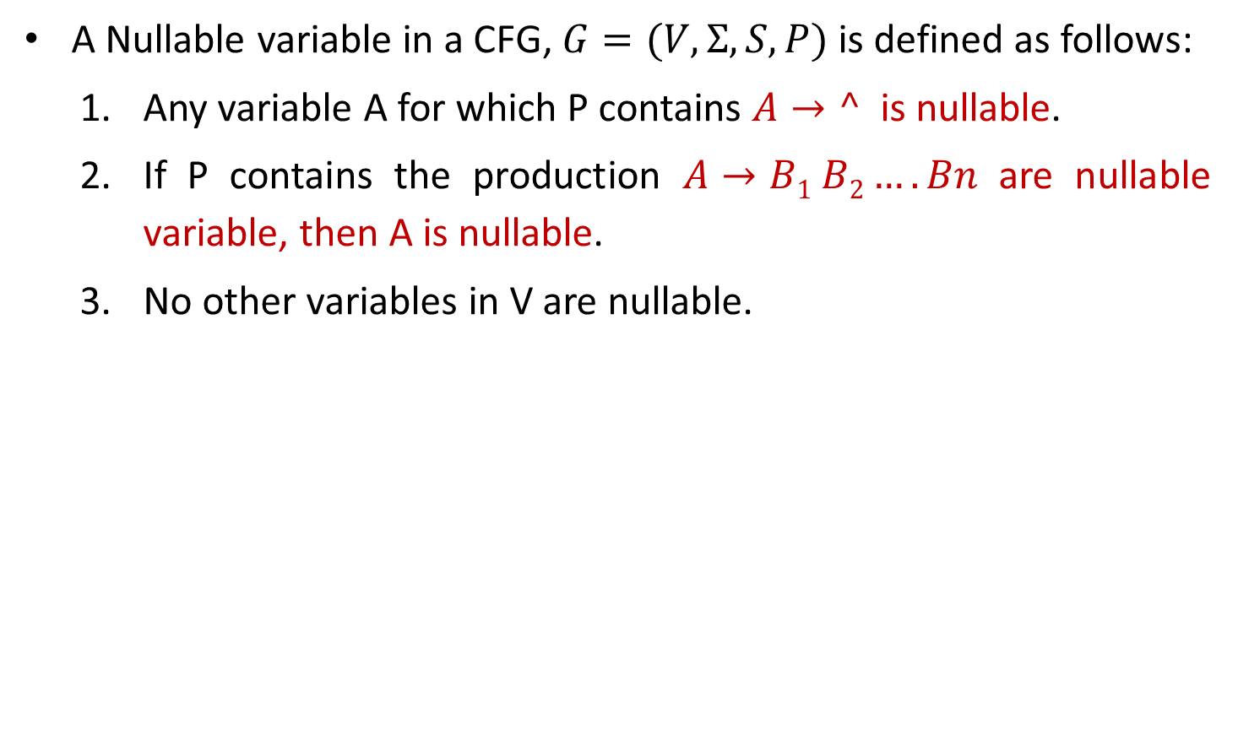
Nullable Variable
A Nullable variable in a CFG, $G=(V,Σ,S,P)$ is defined as follows:
Any variable A for which P contains $A→^$ is nullable.
If P contains the production $A→B1 B2….Bn$ are nullable variable, then A is nullable.
No other variables in V are nullable.

Slide 34
Eliminate ˄ production
S→a X |Yb
X→ ˄ | S
Y→bY|b
S→aX | Yb | a^
X→^ | S
Y→bY|b
S→aX|Yb|a
X→S
Y→bY|b
Nullable variable={X}
Replacing X by ^ in all productions containing X on RHS and rewriting the production again
Removing ^ productions

Slide 35
Exercise: Eliminate ^ production
S→AC
A→aAb|˄
C→aC|a
After elimination of ^ production:
S→AC | C
A→aAb| ab
C→aC|a
S→XaX|bX|Y
X→XaX|XbX|˄
Y→ab
After elimination of ^ production:
S→ XaX | bX | Y | aX | Xa | a | b
X→ XaX |XbX | aX | Xa | a | Xb | bX | b
Y→ab

Slide 36
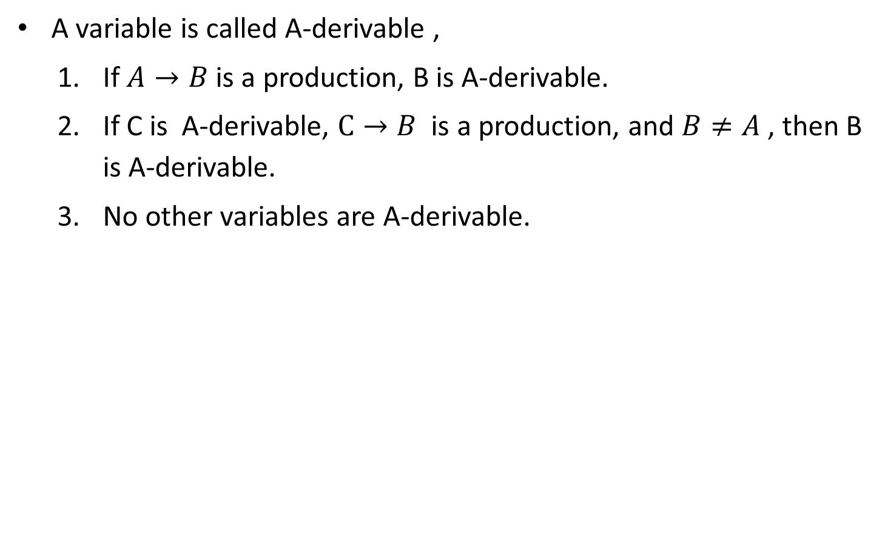
A-derivable
A variable is called A-derivable ,
If $A→B$ is a production, B is A-derivable.
If C is A-derivable, $C→B$ is a production, and $B≠A$ , then B is A-derivable.
No other variables are A-derivable.
S→A
S→B
S-derivable={A,B}
S→A
A→B
S-derivable={A,B}

Slide 37
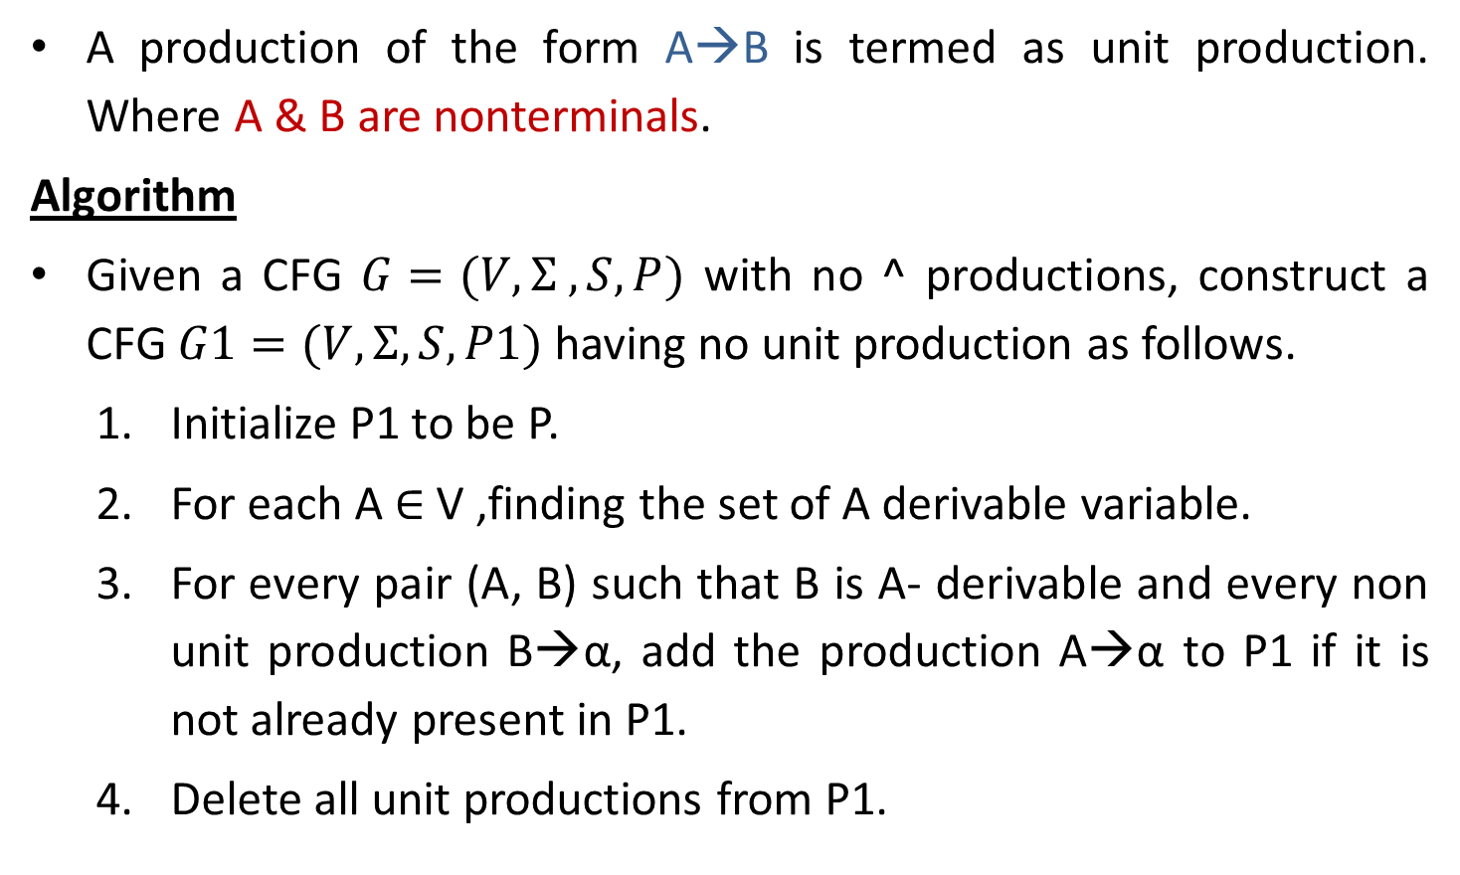
Unit Production & Elimination of Unit productions
A production of the form A→B is termed as unit production. Where A & B are nonterminals.
Algorithm
Given a CFG $G=(V,Σ ,S,P)$ with no ^ productions, construct a CFG $G1=(V,Σ,S,P1)$ having no unit production as follows.
Initialize P1 to be P.
For each A ∈ V ,finding the set of A derivable variable.
For every pair (A, B) such that B is A- derivable and every non unit production B→α, add the production A→α to P1 if it is not already present in P1.
Delete all unit productions from P1.

Slide 38
Elimination of unit production
S→ABA|BA|AA|AB|A|B
A→ aA|a
B→ bB|b
Unit Productions are S→A and S→B
A→aA|a
B→bB|b
S→ABA|BA|AA|AB
|aA|a
|bB|b
Removing unit productions

Slide 39
CFG to CNF

Slide 40
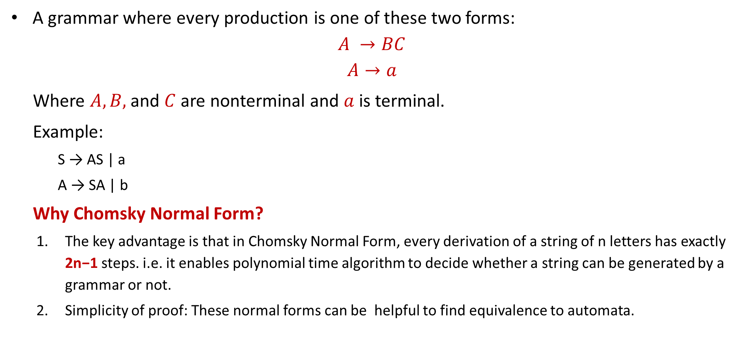
Chomsky Normal Form (CNF)
A grammar where every production is one of these two forms:
$$A →BC$$
$$A→a$$
Where $A, B,$and $C$ are nonterminal and $a$ is terminal.
Example:
S → AS | a
A → SA | b
Why Chomsky Normal Form?
The key advantage is that in Chomsky Normal Form, every derivation of a string of n letters has exactly 2n−1 steps. i.e. it enables polynomial time algorithm to decide whether a string can be generated by a grammar or not.
Simplicity of proof: These normal forms can be helpful to find equivalence to automata.

Slide 41
Converting CFG to CNF
Steps to convert CFG to CNF
0. Eliminate use less production
Eliminate ˄-Productions.
Eliminate Unit Productions.
Restricting the right side of productions to single terminal or string of two or more nonterminals.
Final step of CNF. (shorten the string of NT to length 2)
S→AB
A→a
B→b
C→c {this production is useless}

Slide 42
Example: CFG to CNF
S→AAC
A→aAb|˄
C→aC|a
Step 1: Elimination of ^ production
Step-2: Eliminate Unit Production
Step 3: Replace all mixed string with solid NT
Step-4: Shorten the string of NT to length 2
S→AX₁ X₁→AC
S→AC|PC|a
A→PY₁ Y₁→AQ
A→PQ
C→PC|a
P→a
Q→b
|a
aC
PC
S→AAC|AC|
aAb|ab
PAQ|PQ
A→
PC|a
C→
aC|a
P→a
Q→b
Eliminate A→^
S→AAC|
AC |
C
A→aAb|
ab
C→aC|a
Unit Production is S→C
S→AAC|AC|
C
aC|a
A→aAb|ab
C→aC|a
Chomsky Normal Form

Slide 43
Example: CFG to CNF
S→aAbB
A→Ab|b
B→Ba|a
Step 1 and 2 are not required as there is no ^ and unit productions
Step-3: Replace all mixed string with solid NT
S→PAQB
A→AQ|b
B→BP|a
P→a
Q→b
Step-4 : final step of CNF
S→PT1
T1→AT2
T2→QB
A→AQ|b
B→BP|a
P→a
Q→b

Slide 44
Example: CFG to CNF
S→AA
A→B|BB
B→abB|b|bb
Step 1 is not required as there is no ^ productions
Step-2: Eliminate Unit Production:
S→AA
A→ abB|b|bb|BB
B→abB|b|bb
Step-3:Replace all mixed string with solid NT:
S→AA
A→ PQB|b|QQ|BB
B→ PQB|b|QQ
P→a
Q→b
Step-4 : Shorten the string of NT to length 2
S→AA
A→ PT1|b|QQ|BB T1→QB
B→ PV1|b|QQ V1→QB
P→a
Q→b

Slide 45
Example: CFG to CNF
S→ASB|^
A→aAS|a
B→SbS|A|bb
Step-1: Eliminate ˄-Production:
S→ASB|AB
A→aAS|a|aA
B→SbS|A|bb|bS|Sb|b
Step-2: Eliminate Unit Production:
S→ASB|AB
A→aAS|a|aA
B→SbS|aAS|a|aA|bb|bS|Sb|b
Step-3:Replace all mixed string with solid NT:
S→ASB|AB
A→PAS|a|PA
B→SQS|PAS|a|PA|QQ|QS|SQ|b
P→a
Q→b
Step-4 : Shorten the string of NT to length 2
S→AB|AT1 T1→SB
A→a|PA|PU1 U1→AS
B→ SV1|PV2|a|PA|QQ|QS|SQ|b
V1→QS V2→AS
P→a
Q→b

Slide 46
CFG to GNF

Slide 47
Greibach Normal Form (GNF)
A CFG(context free grammar) is in GNF(Greibach normal form) if all the production rules satisfy one of the following conditions:
A start symbol generating ε. For example, S → ε.
A non-terminal generating a terminal. For example, A → a.
A non-terminal generating a terminal which is followed by any number of non-terminals. For example, S → aASB.
Or
A→ ε
A→aα where α Є V*

Slide 48
Example:
G1 = {S → aAB | aB, A → aA| a, B → bB | b}
G2 = {S → aAB | aB, A → aA | ε, B → bB | ε}
The production rules of Grammar G1 satisfy the rules specified for GNF, so the grammar G1 is in GNF.
However, the production rule of Grammar G2 does not satisfy the rules specified for GNF as A → ε and B → ε contains ε(only start symbol can generate ε). So the grammar G2 is not in GNF.

Slide 49
Steps to convert a CFG into GNF
Convert the Grammar into CNF: If the given Grammar is not in CNF, convert it.
If left recursion exists, remove it from the Grammar.
Convert the given production rules of the Grammar into GNF.
Note: you can directly arrange the grammar in to GNF if possible by some re arrangement or use algorithm
Example:
S→ABC
A→aB
B->cC
C→c
Solution:
S→aBBC
A→aB
B->cC
C→c
No need to convert grammar to CNF first

Slide 50
Removal of left recursion
A→ Aα | β {α and β may be a combination of Terminal and non terminal }
Then
A → βA’
A’→ αA’ | ε

Slide 51
Example
Consider the following Grammar G. Convert it into GNF.
S → abSb | aa
Solution: first we need to check and observe abSb and aa
A→ a
B→ b
Now we change it
S→ aBSB | aA
So finally :
S→ aBSB | aA
A→ a
B→ b

Slide 52
S→ AB
A→ aA | bB | b
B→ b
Sol: only 1st rule production is not in GNF, so replace A in with their production
S→ aAB | bBB | bB
A→ aA | bB | b
B→ b

Slide 53
B→b|bAB|BBB
A β₁ β₂ Aα
B→bB’|bABB’
B’→BBB’|ε
S→CA|BB
B→b|SB
C→b
A→a
Sol:
S→bA|BB
B→bB’|bABB’
B’→BBB’|ε
C→b
A→a
S→bA|BB
B→b|SB
C→b
A→a
Now we need to remove null production
S→bA|BB
B→b|bB’|bAB|bABB’
B’→BBB’|BB
C→b
A→a
Now we have choices, we change BB by B’s production or SB by S’s production, so we will change SB
S→bA|BB
B→b|bAB|BBB
C→b
A→a
S→bA|bB|bABB|bB’B|baBB’B
B→b|bB’|bAB|bABB’
B’→bBB’|bABBB’|bB’BB’|bABB’BB’|bB|bABB|bB’B|bABB’B
C→b
A→a
Now we need to remove left recursion which is B→BBB

Slide 54
Decision properties of CFG
1. Emptiness
2. Finiteness
3. Membership

Slide 55
1. Emptiness
If we can not derive any string of terminals from the given grammar, then its language is called as an Empty Language. L(G) = ϕ
For a given CFG, there exists an algorithm to decide whether its language is empty L(G) = ϕ or not.
Algorithm-
Remove all the useless symbols from the grammar.
A useless symbol is one that does not derive any string of terminals.
If the start symbol is found to be useless, then language is empty otherwise not.
→Consider the following grammar-
S → XY
X → AX
X → AA
A → a
Y → BY
Y → BB
B → b
Now, let us check whether language generated by this grammar is empty or not
The given grammar can be written as-
S → aabb
X → aX
X → aa
A → a
Y → bY
Y → bb
B→b
Clearly,
The start symbol generates at least one string (many more are possible).
Therefore, start symbol is useful.
Thus, language generated by the given grammar is non-empty.
L(G) ≠ ϕ

Slide 56
2. Finiteness
Algorithm To Decide Whether CFL Is Finite Or Not-
For a given CFG, there exists an algorithm to decide whether its language is finite or not.
Step-01:
Reduce the given grammar completely by-
Eliminating ∈ productions
Eliminating unit productions
Eliminating useless productions
Step-02:
Draw a directed graph whose nodes are variables of the given grammar.
There exists an edge from node A to node B if there exists a production of the form A → αBβ.
Now, following 2 cases are possible-
Case-01: Directed graph contains a cycle: Infinite
Case-02: Directed graph does not contain any cycle: finite

Slide 57
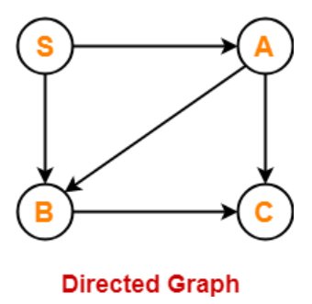
Example
S → AB / a
A → BC / b
B → CC / c
Step 1: The given grammar is already completely reduced.
Step 2: We will draw a directed graph whose nodes will be S , A , B , C.
Now,
Due to the production S → AB, directed graph will have edges S → A and S → B.
Due to the production A → BC, directed graph will have edges A → B and A → C.
Due to the production B → CC, directed graph will have edge B → C.
grammar is finite.

Slide 58
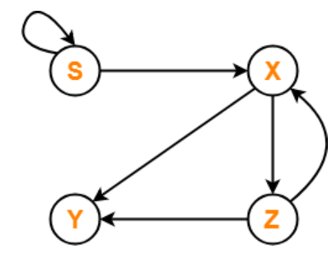
S → XS / b
X → YZ
Y → ab
Z → XY
Step-01: The given grammar is already completely reduced.
Step-02: We will draw a directed graph whose nodes will be S , X , Y , Z.
Now,
Due to the production S → XS / b, directed graph will have edges S → X and S → S.
Due to the production X → YZ, directed graph will have edges X → Y and X → Z.
Due to the production Z → XY, directed graph will have edges Z → X and Z → Y.
grammar is infinite.

Slide 59
3. Membership
Checking whether given string s is generated from the given grammar or not.
CYK Algorithm-
It is used to decide whether a given string belongs to the language of grammar or not.
It is also known as CKY Algorithm or Cocke-Younger-Kasami Algorithm after its inventors
Note:
CYK Algorithm operates only on Context Free Grammars given in Chomsky Normal Form.
The worst case running time of CYK Algorithm is Θ (n³.|G|).
Here, n = Length of parsed string and |G| = Size of the CNF Grammar G.

Slide 60
Basic
In a CYK algorithm, the structure of grammar should be in Chomsky normal form.
In addition, the CYK algorithm uses the dynamic programming or table filling algorithm.
The grammar will be in CNF if each rule has one of the following forms:
A→BC (at most two variables on the right-hand side)
A→ a (a single terminal on the right-hand side)
S→Ø (null string)
If the given Grammar is not in the CNF form, convert it to the CNF form before applying the CYK Algorithm.

Slide 61
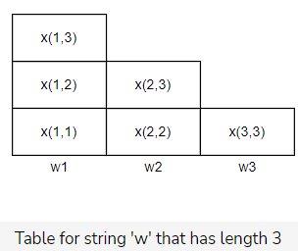
Algorithm
Construct a triangular table of the length of your given string.
Each row corresponds to the length of the substrings of the given word ‘w’:
The bottom row will have strings of length 1.
The second row from the bottom will have strings of length 2 and so on.
X(i,i) is a set of variables A such that A→w_{i}​ is a production of grammar G, where w_{i}​ is part of the given string ‘w’ or the whole string.
Compare at most n pairs of previously computed sets. For strings with a length of 2, compare two pairs, and for strings with a length of 3 compare three sets. In this way, the next sets (A) can be computed, which are derived from the given grammar as per the following formula:
(X(i,i),X((i+1),j),(X(i,i+1),X(i+2,j))…(X(i,j−1),Xj)
In the equation, X(i,i) refers to the set of variables derived from the production rules.
Rule: If the top row consists of the starting variable of the grammar, then the given string can be derived from it.

Slide 62
Example
Let’s look at an example to get a better understanding of the algorithm.
Consider the following CNF grammar G:
S→AB ∣ BC
A→BA ∣ a
B→CC ∣ b
C→AB ∣ a
The given word w=baaba.

Slide 63
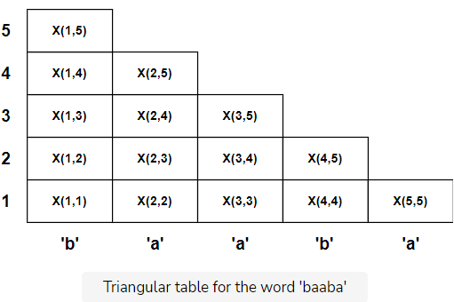
Step 1: Constructing the triangular table
Step 2: Populating the table
The first row is computed simply by looking at the grammar to see which production is producing the string of length 1 for the given word ‘w’.
The second row is computed by comparing the two strings that were computed previously. So we can have ′w′: ′ba′, ′aa′, ′ab′, and ′ba′.
For the third row, there are three possible substrings of length three in the given word, namely ′w′: ′baa′, ′aab′, and ′aba′. For the substring ′baa′, there are two possibilities: [′b′,′aa′] and [′ba′,′a′].
Finding the sets to compute these: [‘b′,′aa′]={B}{B} [′ba′,′a′]={S,A} {A,C}
We take the union of these as follows:
{B}{B}U{S,A}{A,C}{BB}U{SA,SC,AA,AC} →{BB,SA,SC,AA,AC},
Then, we look in the grammar rules for populating the table.
We’ll repeat this for all substrings with lengths greater than 3.

Slide 64
