Slide 1
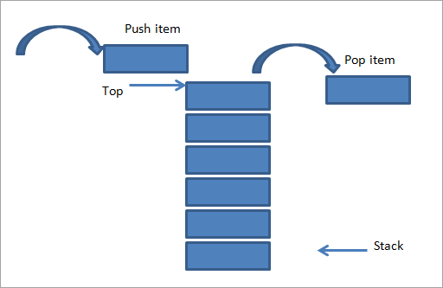
Pushdown Automata, CFL & NCFL

Slide 2
Topics to be covered
Why pushdown Automata?
Definition: PDA
Acceptance by PDA
Design PDA
CFG to PDA
PDA to CFG
Intersection and complement of CFL
Pumping lemma for CFG

Slide 3
Why Pushdown Automata?

Slide 4
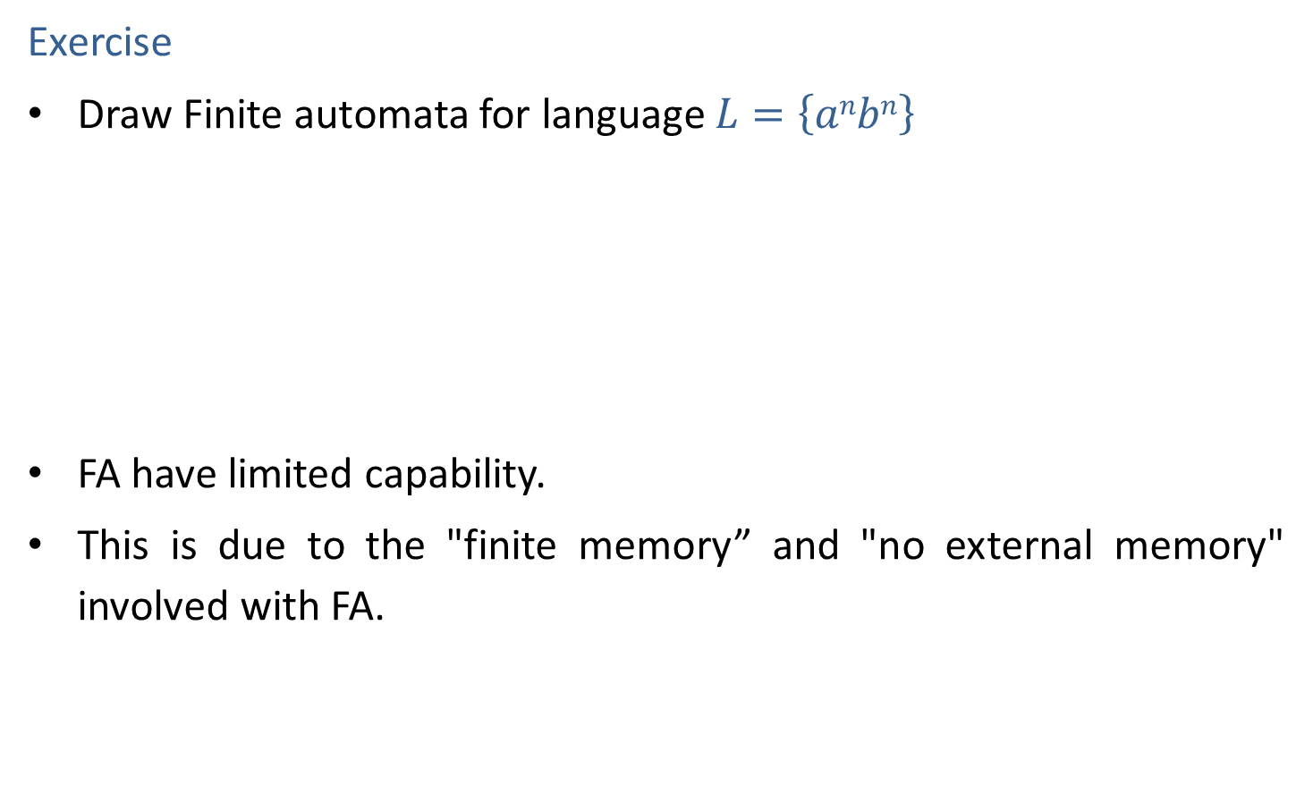
Why Pushdown Automata?
Exercise
Draw Finite automata for language $L=\left\{anbn\right\}$
FA have limited capability.
This is due to the "finite memory” and "no external memory" involved with FA.
Not Possible??
b
a

Slide 5
Pushdown Automata
A pushdown Automata is essentially a finite Automata with a stack data structure.
A PDA can write/remove an unbounded no. of symbols on the stack.
Writing a symbol on to the stack is called “PUSH” operation.
Removing a symbol off the stack is called “POP” operation.
Input
-- | a | b | ε
Read header
Finite
Control
Unit
Accept | Reject
Stack

Slide 6
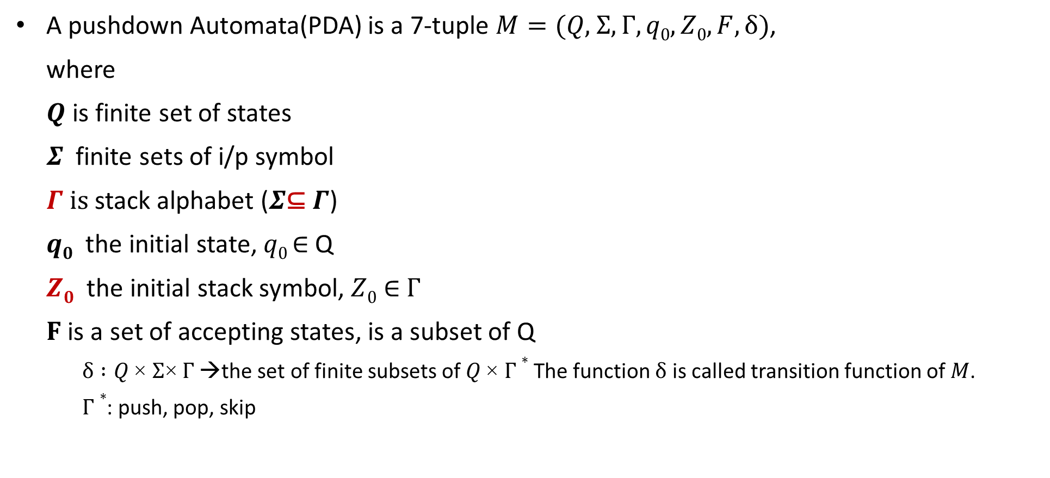
Definition of PDA
A pushdown Automata(PDA) is a 7-tuple $M=(Q\text{, }Σ,Γ, q0,Z0,F,δ)$,
where
$Q$ is finite set of states
$Σ$ finite sets of i/p symbol
$Γ$ is stack alphabet ($Σ$⊆ $Γ$)
$q0$ the initial state, $q0$∈ Q
$Z0$ the initial stack symbol, $Z0$ ∈$Γ$
$F$ is a set of accepting states, is a subset of Q
$δ :Q \text{×} Σ\text{×} Γ$ →the set of finite subsets of $Q \text{×} Γ∗$ The function $δ$ is called transition function of $M$.
$Γ∗$: push, pop, skip

Slide 7
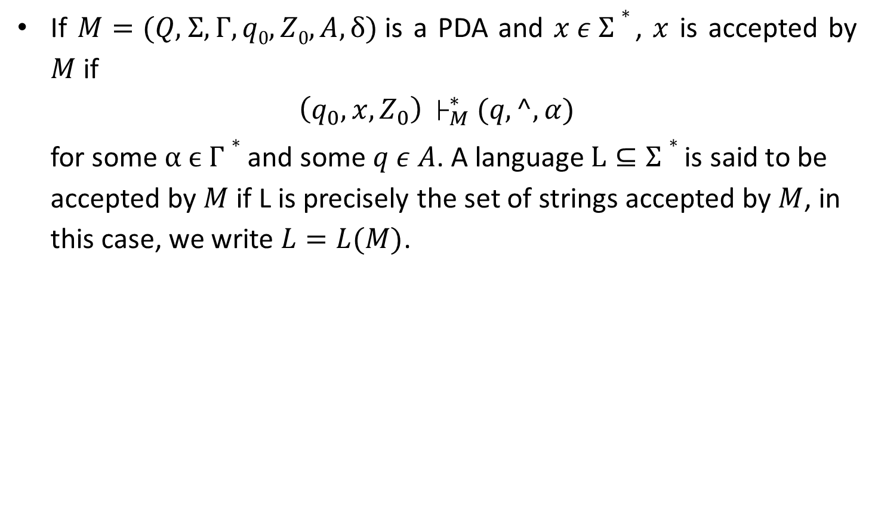
Acceptance by PDA
If $M=(Q\text{, }Σ,Γ, q0,Z0,A,δ)$is a PDA and $x ε Σ∗$, $x$ is accepted by $M$ if
$$\left(q_{0},x,Z_{0}\right) ├_{M}^{∗} (q, ^, α)$$
for some $α ϵ Γ∗$ and some $q ε A$. A language $L⊆Σ∗$is said to be accepted by $M$ if L is precisely the set of strings accepted by $M$, in this case, we write $L=L(M)$.

Slide 8
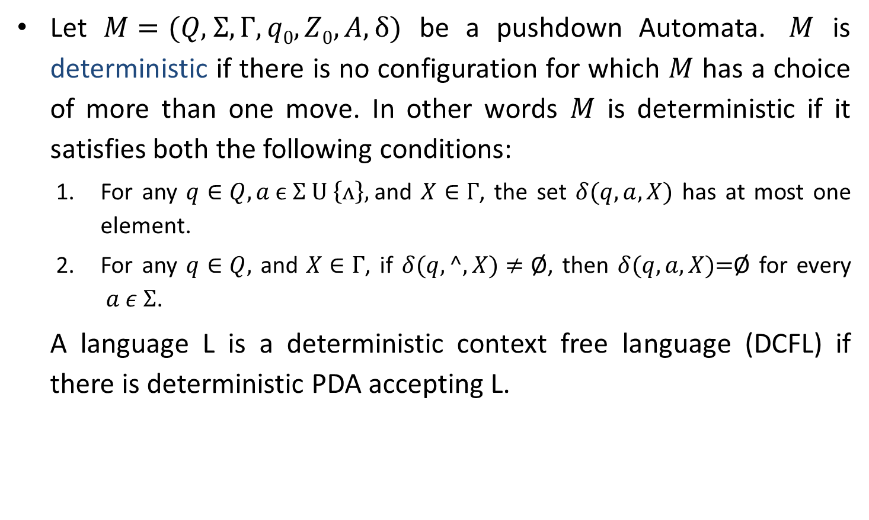
Deterministic PDA
Let $M=(Q\text{, }Σ,Γ, q0,Z0,A,δ)$ be a pushdown Automata. $M$ is deterministic if there is no configuration for which $M$ has a choice of more than one move. In other words $M$ is deterministic if it satisfies both the following conditions:
For any $q∈Q, a ϵ Σ U \left\{ʌ\right\},$and $X∈Γ$, the set $δ(q, a, X)$ has at most one element.
For any $q∈Q,$ and $X∈Γ$, if $δ(q, ^, X)≠\text{Ø}$, then $δ(q, a, X)\text{=}\text{Ø}$ for every $a ε Σ$.
A language L is a deterministic context free language (DCFL) if there is deterministic PDA accepting L.

Slide 9
Applications of PDA
A pushdown automata is a way to implement a context free grammar.
PDA is used in parser design for syntactic analysis.

Slide 10
Power
CFG
CFL
For Some
For all
PDA
Note: we can not convert all NPDA to PDA
Power <
DPDA
NPDA

Slide 11
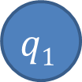
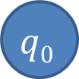


Basic operation on stack
1. PUSH 2. POP 3. SKIP
-- | a | b | ε
-- | a | b | ε
-- | a | b | ε
$$q0$$
a,z₀/az₀
$$q1$$
$$q0$$
a,bz₀/^₀
$$q1$$
$$q0$$
a,z₀/z₀
$$q1$$
a
Z₀
b
Z₀
Z₀
Z₀
Z₀
z0
z0
Z₀
z0
z0
z0
z0
𝜹(q_{0,}a,z₀)→(q₁,az₀)
𝜹(q_{0,}a,bz₀)→(q₁,^)
𝜹(q_{0,}a,z₀)→(q₁,z₀)

Slide 12







Design DPDA for L={a^{n}b^{n}|a,b ∈ Ʃ, n≥0}
$$a$$
$$a$$
$$a$$
a^{n}b^{n}
If n=3 then
a³b³
= a a a b b b
$$b$$
$$b$$
$$b$$
$$z0$$

Slide 13
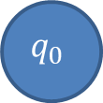
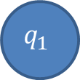
How to Represent PDA?
Move No | State | Input | Stack Symbol | Move(s)
$$1_{}$$ | $$q_{0}$$ | $$a_{}$$ | $$z_{0}$$ | $$(q0,az0)$$
$$2_{}$$ | $$q_{0}$$ | $$a_{}$$ | $$a$$ | $$(q0,aa)$$
$$3_{}$$ | $$q_{0}$$ | $$b_{}$$ | $$a$$ | $$(q1,^)$$
Input symbol, stack symbol | PUSH/POP
a, z₀|az₀
$$q_{0}$$
b, a | ^
$$q_{1}$$
FIRST 2 SYMBOLS OF THE STACK
^
a, a | aa

Slide 14

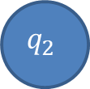
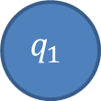
Design DPDA for L={a^{n}b^{n}|a,b ∈ Ʃ, n≥0}
Move No | State | Input | Stack Symbol | Move(s)
$$1_{}$$ | $$q_{0}$$ | $${^}_{}$$ | $$z_{0}$$ | $$(q2,z0)$$
$$2_{}$$ | $$q_{0}$$ | $$a_{}$$ | $$z_{0}$$ | $$(q0,az0)$$
$$3_{}$$ | $$q_{0}$$ | $$a_{}$$ | $$a$$ | $$(q0,aa)$$
$$4_{}$$ | $$q_{0}$$ | $$b_{}$$ | $$a$$ | $$(q1,^)$$
$$5_{}$$ | $$q_{1}$$ | $$b_{}$$ | $${ a}_{}$$ | $$(q1,^)$$
$$6_{}$$ | $$q_{1}$$ | $${^}_{}$$ | $${ z}_{0}$$ | $$(q2,z0)$$
$$(all other combinations)$$ | $$none$$
a, z₀|az₀
b, a | ^
$$q_{0}$$
b, a | ^
$$q_{1}$$
^,z₀ | z₀
$$q_{2}$$
a, a | aa
^,Z₀|^ is one of the way acceptance by empty stack on q₁ will have the same power.
^,z₀ | z₀

Slide 15


Design DPDA for same no. of a’s & b’s.
Move No | State | Input | Stack Symbol | Move(s)
$$1_{}$$ | $$q_{0}$$ | $$a_{}$$ | $$z_{0}$$ | $$(q0,az0)$$
$$2_{}$$ | $$q_{0}$$ | $$b_{}$$ | $$z_{0}$$ | $$(q0,bz0)$$
$$3_{}$$ | $$q_{0}$$ | $$a_{}$$ | $$a$$ | $$(q0,aa)$$
$$4_{}$$ | $$q_{0}$$ | $$b_{}$$ | $$b$$ | $$(q0,bb)$$
$$5_{}$$ | $$q_{0}$$ | $$a_{}$$ | $$b$$ | $$(q0,^)$$
$$6_{}$$ | $$q_{0}$$ | $$b_{}$$ | $$a$$ | $$(q0,^)$$
$$7_{}$$ | $$q_{0}$$ | $${^}_{}$$ | $$z0$$ | $$(q1,z0)$$
$$(all other combinations)$$ | $$none$$
a, z₀|az₀
a, b|^
b, z₀|bz₀
b, a|^
^,z₀ | z₀
$$q_{0}$$
$$q_{1}$$
a, a | aa
b, b | bb

Slide 16
Design PDA for {a^{n}b^{n+m} c^{m} | n,m>=1}
a^{n} b^{n+m} c^{m}
= a^{n} b^{n} b^{m} c^{m}
If n=2 and m=3 then
= a² b² b³ c³
= aa bb bbb ccc

Slide 17
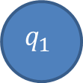

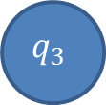
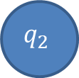
Design PDA for {a^{n}b^{n+m} c^{m} | n,m>=1}
Move No | State | Input | Stack Symbol | Move(s)
$$1_{}$$ | $$q_{0}$$ | $$a_{}$$ | $$z_{0}$$ | $$(q1,az0)$$
$$2_{}$$ | $$q_{1}$$ | $$a_{}$$ | $$a$$ | $$(q1,aa)$$
$$3_{}$$ | $$q_{1}$$ | $$b_{}$$ | $$a$$ | $$(q2,^)$$
$$4_{}$$ | $$q_{2}$$ | $$b_{}$$ | $$a$$ | $$(q2,^)$$
$$5_{}$$ | $$q_{2}$$ | $$b_{}$$ | $$z_{0}$$ | $$(q3,bz0)$$
$$6_{}$$ | $$q_{3}$$ | $$b_{}$$ | $$b_{}$$ | $$(q3,bb)$$
a, a| aa
b, a| ^
b, b| bb
a, z₀| az₀
b, a| ^
$$q_{2}$$
b, z₀| bz₀
$$q_{3}$$
$$q_{0}$$
$$q_{1}$$

Slide 18
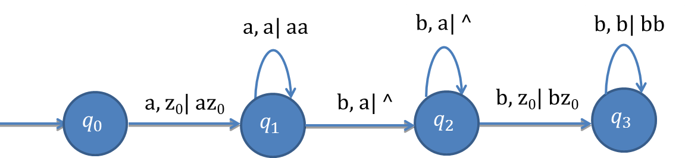
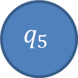
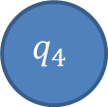
Design PDA for {a^{n}b^{n+m} c^{m} | n,m>=1}
Move No | State | Input | Stack Symbol | Move(s)
$$7_{}$$ | $$q_{3}$$ | $$c_{}$$ | $$b_{}$$ | $$(q4,^)$$
$$8_{}$$ | $$q_{4}$$ | $$c_{}$$ | $$b_{}$$ | $$(q4,^)$$
$$9_{}$$ | $$q_{4}$$ | $${^}_{}$$ | $$z_{0}$$ | $$(q5,z0)$$
$${(All other combination)}_{}$$ | $$none$$
c, b| ^
c, b| ^
$$q_{4}$$
^, z₀| z₀
$$q_{5}$$

Slide 19
Exercise: Design PDA
Design PDA for a^{n}b^{n}c^{m}d^{m} , n,m>=1
Design PDA for a^{n}b^{m}c^{m}d^{n} , n,m>=1
Design PDA for a^{n+m}b^{n}c^{m} , n,m>=1

Slide 20
Design PDA for palindrome with middle symbol c.
Design a PDA for following CFG.
S→aSa/bSb/c
Design PDA for L={xcx^{r}/x∈{a,b}*}. The string in L are odd length palindromes over {a,b}
Strings accepted in the language are:
aba c aba
aaa c aaa
bab c bab
ab c ba

Slide 21
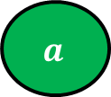
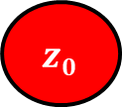

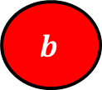
Design PDA for palindrome with middle symbol c.
$$a$$
$$b$$
$$a$$
a b a c a b a
$$a$$
$$b$$
$$a$$
$$z0$$

Slide 22
Design PDA for palindrome with middle symbol c.
Move No | State | Input | Stack Symbol | Move(s)
$$1_{}$$ | $$q_{0}$$ | $$a_{}$$ | $$z_{0}$$ | $$(q0,az0)$$
$$2_{}$$ | $$q_{0}$$ | $$b_{}$$ | $$z_{0}$$ | $$(q0,bz0)$$
$$3_{}$$ | $$q_{0}$$ | $$a_{}$$ | $$a$$ | $$(q0,aa)$$
$$4_{}$$ | $$q_{0}$$ | $$b_{}$$ | $$a$$ | $$(q0,ba)$$
$$5_{}$$ | $$q_{0}$$ | $$a_{}$$ | $${ b}_{}$$ | $$(q0,ab)$$
$$6_{}$$ | $$q_{0}$$ | $$b_{}$$ | $${ b}_{}$$ | $$(q0,bb)$$
b, z₀|bz₀
a, z₀|az₀
a, a | aa
$$q_{0}$$
b, b | bb
b, a | ba
a, b | ab

Slide 23


Design PDA for palindrome with middle symbol c.
Move No | State | Input | Stack Symbol | Move(s)
$$7_{}$$ | $$q_{0}$$ | $$c_{}$$ | $$z_{0}$$ | $$(q1,z0)$$
$$8_{}$$ | $$q_{0}$$ | $$c_{}$$ | $$a_{}$$ | $$(q1,a)$$
$$9_{}$$ | $$q_{0}$$ | $$c_{}$$ | $$b_{}$$ | $$(q1,b)$$
b, z₀|bz₀
a, z₀|az₀
a, a | aa
c,a | a
$$q_{0}$$
c,b | b
$$q_{1}$$
c,z₀ | z₀
b, b | bb
b, a | ba
a, b | ab

Slide 24
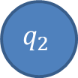
Design PDA for palindrome with middle symbol c.
Move No | State | Input | Stack Symbol | Move(s)
$${10}_{}$$ | $$q_{1}$$ | $$a$$ | $${ a}_{}$$ | $$(q1,^)$$
$${11}_{}$$ | $$q_{1}$$ | $$b_{}$$ | $${ b}_{}$$ | $$(q1,^)$$
$${12}_{}$$ | $$q_{1}$$ | $${^}_{}$$ | $${ z}_{0}$$ | $$(q2,{ z}_{0})$$
$$(all other combinations)$$ | $$none$$
b, z₀|bz₀
b, b | ^
a, z₀|az₀
a, a | aa
c,a | a
$$q_{0}$$
c,b | b
$$q_{1}$$
^,z₀ | z₀
$$q_{2}$$
c,z₀ | z₀
b, b | bb
b, a | ba
a, b | ab
a, a | ^

Slide 25

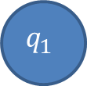



String Tracing
b, z₀|bz₀
b, b | ^
a, z₀|az₀
a, a | aa
c,a | a
$$q_{0}$$
c,b | b
$$q_{1}$$
^,z₀ | z₀
$$q_{2}$$
c,z₀ | z₀
b, b | bb
b, a | ba
a, b | ab
a, a | ^
Move No | Resulting State | Unread Input | Stack
$$Initially$$ | $$q_{0}$$ | $${abcba}_{}$$ | $$z_{0}$$
$$1$$ | $$q_{0}$$ | $${bcba}_{}$$ | $${az}_{0}$$
$$4$$ | $$q_{0}$$ | $$cba$$ | $${baz}_{0}$$
$$9$$ | $$q_{1}$$ | $${ba}_{}$$ | $${baz}_{0}$$
$$11$$ | $$q_{1}$$ | $$a_{}$$ | $${az}_{0}$$
$$10$$ | $$q_{1}$$ | $$−$$ | $$z_{0}$$
$$12$$ |  | $$−$$ | $$z_{0}$$
$$q_{2}$$
$$q_{2}$$

Slide 26
Exercise
Trace the following string:
bcb
ab
acaa

Slide 27

Design PDA for {a^{i}b^{j}c^{k} | i,j,k>=1 & j=i or j=k}
Move No | State | Input | Stack Symbol | Move(s)
$$1_{}$$ | $$q_{0}$$ | $$a_{}$$ | $$z_{0}$$ | $$(q1,az0)$$
$$2_{}$$ | $$q_{1}$$ | $$a_{}$$ | $$a$$ | $$(q1,aa)$$
$$3_{}$$ | $$q_{1}$$ | $$b_{}$$ | $$a$$ | $$(q2,^)$$
$$4_{}$$ | $$q_{2}$$ | $$b_{}$$ | $$a$$ | $$(q2,^)$$
$$5_{}$$ | $$q_{2}$$ | $$c_{}$$ | $$z_{0}$$ | $$(q3,z0)$$
$$6_{}$$ | $$q_{3}$$ | $$c_{}$$ | $$z_{0}$$ | $$(q3,z0)$$
a, a| aa
b, a| ^
c, z₀| z₀
$$q_{0}$$
a, z₀| az₀
b, a| ^
$$q_{2}$$
c, z₀| z₀
$$q_{3}$$
$$q_{1}$$

Slide 28
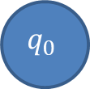

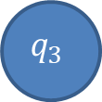

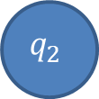

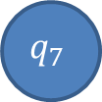
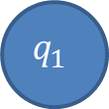
Design PDA for {a^{i}b^{j}c^{k} | i,j,k>=1 & j=i or j=k}
Move No | State | Input | Stack Symbol | Move(s)
$$7_{}$$ | $$q_{3}$$ | $${^}_{}$$ | $$z_{0}$$ | $$(q7,z0)$$
$$8_{}$$ | $$q_{0}$$ | $$a_{}$$ | $$z0$$ | $$(q4,z0)$$
$$9_{}$$ | $$q_{4}$$ | $$a_{}$$ | $$z0$$ | $$(q4,z0)$$
$${10}_{}$$ | $$q_{4}$$ | $$b_{}$$ | $$z_{0}$$ | $$(q5,bz0)$$
$${11}_{}$$ | $$q_{5}$$ | $$b_{}$$ | $b_{}$ | $$(q5,bb)$$
$${12}_{}$$ | $$q_{5}$$ | $$c_{}$$ | $$b_{}$$ | $$(q6,^)$$
$${13}_{}$$ | $$q_{6}$$ | $$c_{}$$ | $$b_{}$$ | $$(q6,^)$$
a, a| aa
b, a| ^
c, z₀| z₀
$$q_{0}$$
a, z₀| az₀
b, a| ^
$$q_{2}$$
c, z₀| z₀
$$q_{3}$$
^, z₀| z₀
$$q_{7}$$
$$q_{1}$$
a, z₀| z₀
a, z₀| z₀
b, b| bb
c, b| ^
$$q_{4}$$
$$q_{5}$$
$$q_{6}$$
b,z₀| bz₀
c, b| ^

Slide 29
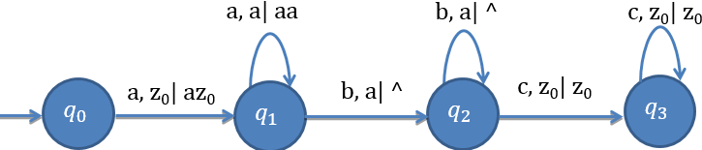




Design PDA for {a^{i}b^{j}c^{k} | i,j,k>=1 & j=i or j=k}
Move No | State | Input | Stack Symbol | Move(s)
$${14}_{}$$ | $$q_{6}$$ | $${^}_{}$$ | $$z_{0}$$ | $$(q7,z0)$$
$${(All other combination)}_{}$$ | $$none$$
J=
i=j
j=i
^, z₀| z₀
$$q_{7}$$
J=
j=k
a, z₀| z₀
a, z₀| z₀
b, b| bb
c, b| ^
^, z₀| z₀
$$q_{4}$$
b,z₀| bz₀
$$q_{5}$$
c, b| ^
$$q_{6}$$

Slide 30

Design DPDA for L={a^{n}b^{2n}|a,b ∈ Ʃ, n≥0}
$$a$$
$$a$$
a^{n}b^{2n}
If n=1 then
a¹b²
= a b b
$$b$$
$$b$$
$$b$$
$$z0$$

Slide 31

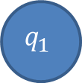
Design DPDA for L={a^{n}b^{2n}|a,b ∈ Ʃ, n≥0}
Move No | State | Input | Stack Symbol | Move(s)
$$1_{}$$ | $$q_{0}$$ | $${^}_{}$$ | $$z_{0}$$ | $$(q2,z0)$$
$$2_{}$$ | $$q_{0}$$ | $$a_{}$$ | $$z_{0}$$ | $$(q0,aa)$$
$$3_{}$$ | $$q_{0}$$ | $$a_{}$$ | $$a$$ | $$(q0,aa)$$
$$4_{}$$ | $$q_{0}$$ | $$b_{}$$ | $$a$$ | $$(q1,^)$$
$$5_{}$$ | $$q_{1}$$ | $$b_{}$$ | $${ a}_{}$$ | $$(q1,^)$$
$$6_{}$$ | $$q_{1}$$ | $${^}_{}$$ | $${ z}_{0}$$ | $$(q2,z0)$$
$$(all other combinations)$$ | $$none$$
a, z₀|aa
b, a | ^
$$q_{0}$$
b, a | ^
$$q_{1}$$
^,z₀ | z₀
$$q_{2}$$
a, a | aa
^,z₀ | z₀

Slide 32
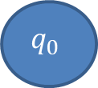
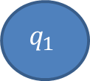
Design PDA for even odd length palindrome (Nondeterministic)
Move No | State | Input | Stack Symbol | Move(s)
$$1_{}$$ | $$q_{0}$$ | $$a_{}$$ | $$z_{0}$$ | $$(q0,az0)(q1,z0)$$
$$2_{}$$ | $$q_{0}$$ | $$b_{}$$ | $$z_{0}$$ | $$(q0,bz0)(q1,z0)$$
$$3_{}$$ | $$q_{0}$$ | $$a_{}$$ | $$a$$ | $$(q0,aa)(q1,a)$$
$$4_{}$$ | $$q_{0}$$ | $$b_{}$$ | $$a$$ | $$(q0,ba)(q1,a)$$
$$5_{}$$ | $$q_{0}$$ | $$a_{}$$ | $${ b}_{}$$ | $$(q0,ab)(q1,a)$$
$$6_{}$$ | $$q_{0}$$ | $$b_{}$$ | $${ b}_{}$$ | $$(q0,bb)(q1,b)$$
b, z₀|bz₀
a, z₀|az₀
a, a | aa
b, z₀| z₀ z₀
$$q_{0}$$
a, z₀| z₀
$$q_{1}$$
a,a | a
b,a | a
b, b | bb
b, a | ba
a, b | ab
a,b | b
b,b | b

Slide 33


Design PDA for even odd length palindrome
Move No | State | Input | Stack Symbol | Move(s)
$$7_{}$$ | $$q_{0}$$ | $$^$$ | $$z_{0}$$ | $$(q1,z0)$$
$$8_{}$$ | $$q_{0}$$ | $$^$$ | $$a$$ | $$(q1,a)$$
$$9_{}$$ | $$q_{0}$$ | $${^}_{}$$ | $$b_{}$$ | $$(q1,b)$$
^,b | b
b, z₀|bz₀
^,a | a
^,z₀ | z₀
a, z₀|az₀
a, a | aa
a,z₀ | z₀
$$q_{0}$$
b,z₀|z₀
$$q_{1}$$
a,a | a
b, a | ba
b,a | a
b, b | bb
a, b | ab
a,b | b
b,b | b

Slide 34

Design PDA for even odd length palindrome
Move No | State | Input | Stack Symbol | Move(s)
$${10}_{}$$ | $$q_{1}$$ | $$a$$ | $${ a}_{}$$ | $$(q1,^)$$
$${11}_{}$$ | $$q_{1}$$ | $$b$$ | $$b$$ | $$(q1,^)$$
$${12}_{}$$ | $$q_{1}$$ | $${^}_{}$$ | $${ z}_{0}$$ | $$(q2,{ z}_{0})$$
$$(all other combinations)$$ | $$none$$
^,b | b
b, z₀|bz₀
^,a | a
^,z₀ | z₀
b, b | ^
a, z₀|az₀
a, a | aa
a,z₀|z₀
$$q_{0}$$
b,z₀|z₀
$$q_{1}$$
^,z₀ | z₀
$$q_{2}$$
a,a | a
b, a | ba
b,b | b
b, b | bb
a, b | ab
a,b | b
a, a | ^
b,a | a

Slide 35


Design DPDA for grammar S→SS|[S]|{S}|˄
Move No | State | Input | Stack Symbol | Move(s)
$$1_{}$$ | $$q_{0}$$ | $$[_{}$$ | $$z_{0}$$ | $$(q1,[z0)$$
$$2_{}$$ | $$q_{0}$$ | $$\{_{}$$ | $$z_{0}$$ | $$(q1,\{z0)$$
$$3_{}$$ | $$q_{1}$$ | $$[_{}$$ | $$[_{}$$ | $$(q1,[[)$$
$$4_{}$$ | $$q_{1}$$ | $$\{_{}$$ | $$[_{}$$ | $$(q1,\{[)$$
$$5_{}$$ | $$q_{1}$$ | $$[_{}$$ | $$\{_{}$$ | $$(q1,[\{)$$
$$6_{}$$ | $$q_{1}$$ | $$\{_{}$$ | $$\{_{}$$ | $$(q1,\{\{)$$
{, [ | {[
{, z₀|{z₀
[, [|[[
[, { | [{
$$q_{0}$$
[, z₀|[z₀
$$q_{1}$$
{, { | {{

Slide 36
Design DPDA for grammar S→SS|[S]|{S}|˄
Move No | State | Input | Stack Symbol | Move(s)
$$7_{}$$ | $$q_{1}$$ | $$]_{}$$ | $$[_{}$$ | $$(q1,^)$$
$$8_{}$$ | $$q_{1}$$ | $$\}_{}$$ | $$\{_{}$$ | $$(q1,^)$$
$$9_{}$$ | $$q_{1}$$ | $${^}_{}$$ | $$z0$$ | $$(q0,z0)$$
$$(all other combinations)$$ | $$none$$
{, [ | {[
{, z₀|{z₀
[, [|[[
[, { | [{
$$q_{0}$$
[, z₀|[z₀
$$q_{1}$$
}, { | ^
{, { | {{
^,z₀ | z₀
{, { | {{
], [ | ^

Slide 37


Design DPDA for grammar S→SS|[S]|{S}|˄
{, [ | {[
[, [|[[
[, { | [{
{, z₀|{z₀
$$q_{0}$$
^,z₀ | z₀
$$q_{1}$$
[, z₀|[z₀
}, { | ^
{, { | {{
], [ | ^

Slide 38

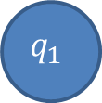
Design PDA to accept string with more a’s than b’s.
Move No | State | Input | Stack Symbol | Move(s)
$$1_{}$$ | $$q_{0}$$ | $$a_{}$$ | $$z_{0}$$ | $$(q1,az0)$$
$$2_{}$$ | $$q_{0}$$ | $$b_{}$$ | $$z_{0}$$ | $$(q0,bz0)$$
$$3_{}$$ | $$q_{0}$$ | $$a_{}$$ | $$b$$ | $$(q0,^)$$
$$4_{}$$ | $$q_{0}$$ | $$b_{}$$ | $$b$$ | $$(q0,bb)$$
$$5_{}$$ | $$q_{1}$$ | $$a_{}$$ | $${ a}_{}$$ | $$(q1,aa)$$
$$6_{}$$ | $$q_{1}$$ | $$b_{}$$ | $$a$$ | $$(q0,^)$$
$$7_{}$$ | $$q_{0}$$ | $${^}_{}$$ | $${ a}_{}$$ | $$(q1,a)$$
$$(all other combinations)$$ | $$none$$
a, b | ^
^, a | a
a, a | aa
b, z₀| bz₀
$$q_{0}$$
a, z₀|az₀
$$q_{1}$$
b, b | bb
b, a | ^

Slide 39
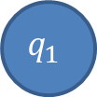

Design PDA for twice many a’s as b’s
Move No | State | Input | Stack Symbol | Move(s)
$$1_{}$$ | $$q_{0}$$ | $$a_{}$$ | $$z_{0}$$ | $$(q1,z0)$$
$$2_{}$$ | $$q_{1}$$ | $$a_{}$$ | $$z0$$ | $$(q0,xz0)$$
$$3_{}$$ | $$q_{0}$$ | $$b_{}$$ | $$z0$$ | $$(q0,yz0)$$
$$4_{}$$ | $$q_{0}$$ | $$b_{}$$ | $${ y}_{}$$ | $$(q0,yy)$$
b, y|yy
b, z₀|yz₀
$$q_{0}$$
a, z₀| z₀
$$q_{1}$$
a, z₀| xz₀

Slide 40
Design PDA for twice many a’s as b’s
Move No | State | Input | Stack Symbol | Move(s)
$$5_{}$$ | $$q_{0}$$ | $$a_{}$$ | $x_{}$ | $$(q1,x)$$
$$6_{}$$ | $$q_{1}$$ | $$a_{}$$ | $$x$$ | $$(q0,xx)$$
$$7_{}$$ | $$q_{1}$$ | $$b_{}$$ | $$z0$$ | $$(q1,yz0)$$
$$8_{}$$ | $$q_{1}$$ | $$b_{}$$ | $${ y}_{}$$ | $$(q1,yy)$$
$$9_{}$$ | $$q_{1}$$ | $$b_{}$$ | $${ x}_{}$$ | $$(q1,^)$$
b, x|^
b, y|yy
b, z₀|yz₀
b, z₀|yz₀
a, x| x
b, y|yy
$$q_{0}$$
a, z₀| z₀
$$q_{1}$$
a, x| xx
a, z₀| xz₀

Slide 41
Design PDA for twice many a’s as b’s
Move No | State | Input | Stack Symbol | Move(s)
$${10}_{}$$ | $$q_{0}$$ | $$a_{}$$ | $$y$$ | $$(q1,y)$$
$${11}_{}$$ | $$q_{0}$$ | $$b_{}$$ | $$a$$ | $$(q1,y)$$
$${12}_{}$$ | $$q_{1}$$ | $$a_{}$$ | $$y$$ | $$(q0,^)$$
$${13}_{}$$ | $$q_{0}$$ | $$b_{}$$ | $${ x}_{}$$ | $$(q0,^)$$
b, a| y
b, z₀|yz₀
b, y|yy
a, y| y
b, x|^
b, z₀|yz₀
a, x| x
b, y|yy
$$q_{0}$$
a, z₀| z₀
$$q_{1}$$
a, x| xx
b, x| ^
a, z₀| xz₀
a, y| ^

Slide 42
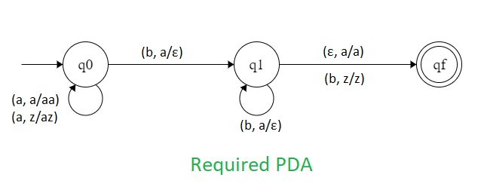
Design PDA for L={a^{n}b^{m} | n,m ≥ 1 and n ≠ m}
L = {aab, abb, aaab, abbb, aaaab, aaabb, aabbb, abbbb ......}

Slide 43
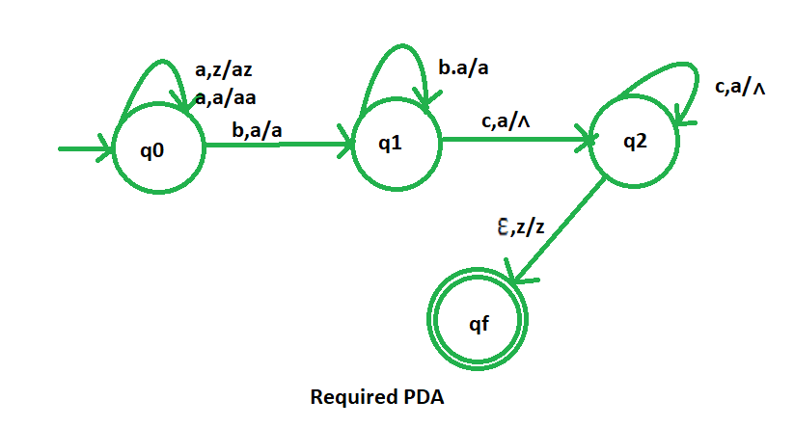
Design PDA for L={a^{n}b^{m} c^{n}| n,m ≥ 1}
L = { abc, abbc, abbbc, aabbcc, aaabccc, aaaabbbcccc, ...... }

Slide 44
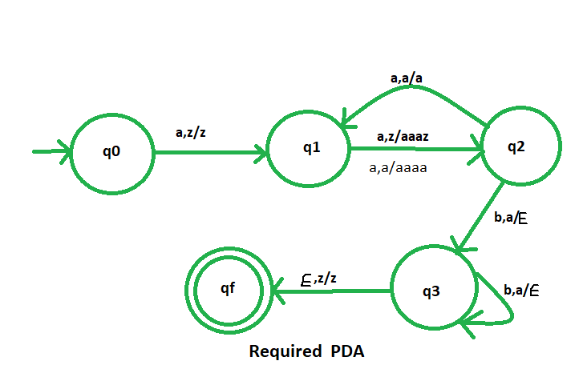
Design PDA for L={a^{2n}b^{3n} | n≥ 1}
L = {aabbb, aaaabbbbbb, aaaaaabbbbbbbbb, aaaaaaaabbbbbbbbbbbb, ......}

Slide 45
Design DPDA for L={a^{n}b^{3n} | n≥ 1}
L = {aabbb, aaaabbbbbb, aaaaaabbbbbbbbb, aaaaaaaabbbbbbbbbbbb, ......}
One solution: skip 2 b’s and on 3rd b pop one a
One solution: for every a on input we push three a (This approach is wrong as PDA allow only one operation either PUSH or POP on single input symbol.)

Slide 46
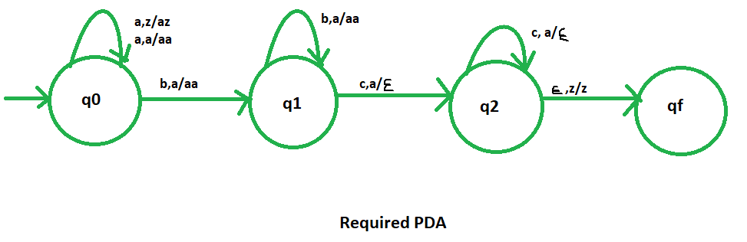
Design PDA for L={a^{m}b^{n}c^{(m+n)} | m,n ≥ 1}
L = {abcc, aabccc, abbbcccc, aaabbccccc, ......}

Slide 47
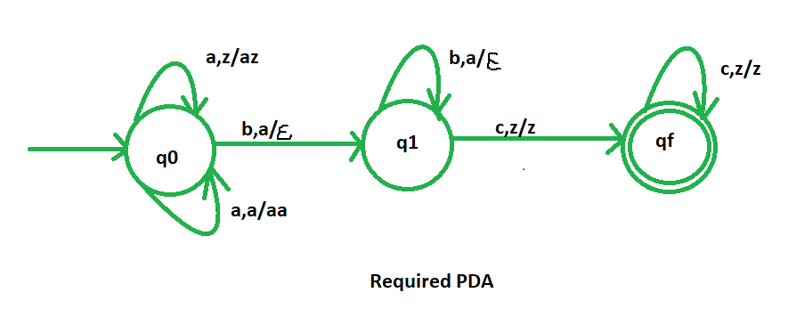
Design PDA for L={a^{n}b^{n}c^{m)} | m,n ≥ 1}
L = { abc, abcc, abccc, aabbc, aaabbbcc, aaaabbbbccccc, ...... }

Slide 48
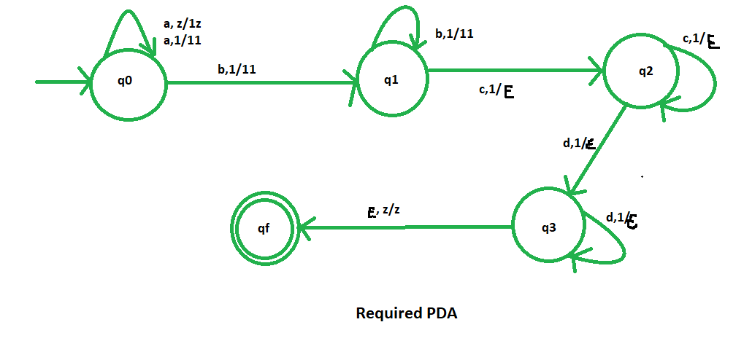
Design PDA for L={a^{m} b^{n} c^{p} d^{q} | m+n=p+q ; m, n, p, q>=1}
L = {abcd, abbcdd, abbccd, abbbccdd, ......}

Slide 49
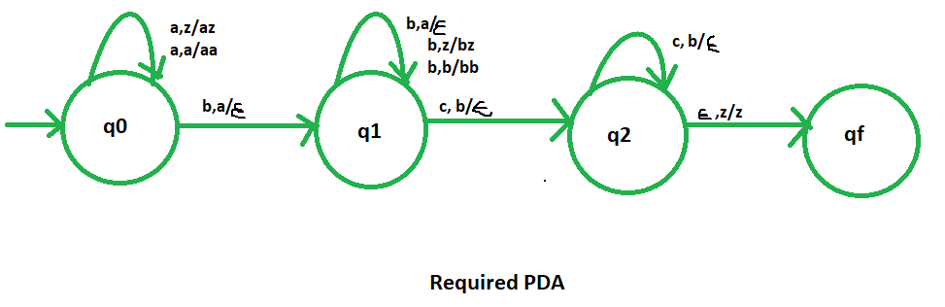
Design PDA for L={a^{m}b^{(m+n)}c^{n} | m, n ≥ 1}
L = {abbc, abbbcc, abbbcc, aabbbbcc, ......}

Slide 50
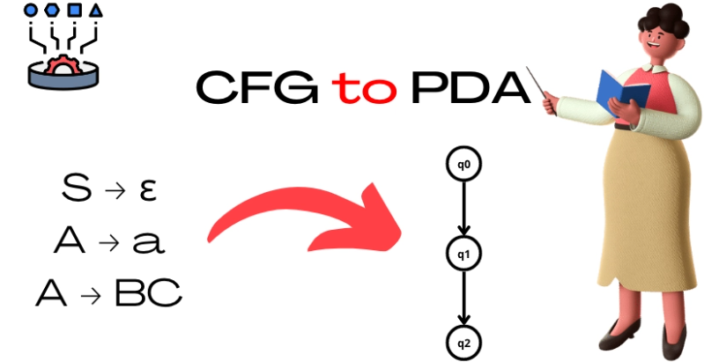
CFG to PDA

Slide 51
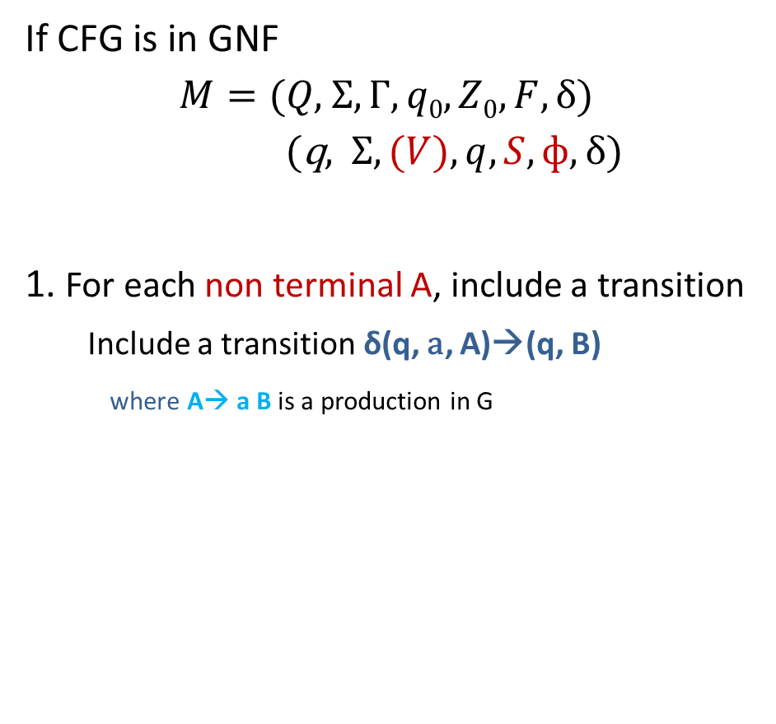

Steps
If CFG is not in GNF
$$M=(Q\text{, }Σ,Γ, q0,Z0,F,δ)$$
$$(\text{q}\text{, } Σ,(VUT), q,S,ф,δ)$$
1. For each non terminal A, include a transition
Include a transition δ(q, 𝜖, A)→(q, α)
where A→ α is a production in G
2. For each terminal a, include a transition
Include a transition δ(q, a, a)→(q, 𝜖)
If CFG is in GNF
$$M=(Q\text{, }Σ,Γ, q0,Z0,F,δ)$$
$$(\text{q}\text{, } Σ,(V), q,S,ф,δ)$$
1. For each non terminal A, include a transition
Include a transition δ(q, a, A)→(q, B)
where A→ a B is a production in G

Slide 52
Example
S→ aSb
S→ ab
R1: δ(q, ε, S) = {(q, aSb)}
R2: δ(q, ε, S) = {(q, ab)
R3: δ(q, a, a) = {(q, ε)}
R4: δ(q, b, b) = {(q, ε)}
W = aaabbb
δ(q, , S) ⊢ δ(q, aaabbb, S)
⊢ δ(q, aaabbb, aSb) R1
⊢ δ(q, aabbb, Sb) R3
⊢ δ(q, aabbb, aSbb) R1
⊢ δ(q, abbb, Sbb) R3
⊢ δ(q, abbb, abbb) R3
⊢ δ(q, bbb, bbb) R2
⊢ δ(q, bb, bb) R3
⊢ δ(q, b,b) R2
⊢ δ(q, ε, ε) stack empty=>Accept

Slide 53
S → 0BB
B → 0S | 1S |0
R1. δ(q, 0, S) = {(q, BB)}
R2. δ(q, 0, B) = {(q, S)}
R3. δ(q, 1, B) = {(q, S)}
R4. δ(q, 0, B) = {(q, Є)}
W = 010000
δ(q, , S) ⊢ δ(q, 010000, S)
⊢ δ(q, 10000, BB) R1
⊢ δ(q, 0000, SB) R2
⊢ δ(q, 000, BBB) R1
⊢ δ(q, 00, BB) R4
⊢ δ(q, 0, B) R4
⊢ δ(q, ε, ε) stack empty=>Accept

Slide 54
Example
S → 0S1 | A
A → 1A0 | S | ε
A PDA could be:
R1: δ(q, ε, S) = {(q, 0S1) | (q, A)}
R2: δ(q, ε, A) = {(q, 1A0)|(q, S)|(a, ε)}
R4: δ(q, 0, 0) = {(q, ε)}
R5: δ(q, 1, 1) = {(q, ε)}

Slide 55
Example
Create a PDA for the provided CFG, and check if 010⁴ is supported by it.
S → 0BB
B → 0S | 1S | 0
Analyzing 010⁴, i.e., 010000, against a PDA
δ(q, 010000, S) ⊢ δ(q, 010000, 0BB)
⊢ δ(q, 10000, BB) R2
⊢ δ(q, 10000,1SB) R3
⊢ δ(q, 0000, SB) R2
⊢ δ(q, 0000, 0BBB) R1
⊢ δ(q, 000, BBB) R3
⊢ δ(q, 000, 0BB) R2
⊢ δ(q, 00, BB) R3
⊢ δ(q, 00, 0B) R2
⊢ δ(q, 0, B) R3
⊢ δ(q, 0, 0) R2
⊢ δ(q, ε) R3
ACCEPT
R1: δ(q, ε, S) = {(q, 0BB)}
R2: δ(q, ε, B) = {(q, 0S) | (q, 1S) | (q, 0)}
R3: δ(q, 1, 1) = {(q, ε)}
R4: δ(q, 0, 0) = {(q, ε)}

Slide 56
Example: CFG to PDA
Find PDA for following grammar:
S→0S1 | 00 | 11
The equivalent PDA, M is given by:
δ(q, 𝜖, S)= {(q, 0S1), (q, 00), (q,11)}
δ(q, 0, 0)={(q, 𝜖)}
δ(q, 1, 1)={(q, 𝜖)}
δ(q, 𝜖, A)→{(q, α)|A→ α is a production in G
Non Terminal
δ(q, a, a)→{(q, 𝜖)}
Terminal

Slide 57
Exercise: CFG to PDA
Given a CFG , G =( {S,A,B},{0,1},P,S) with P as follows:
S → 0B| 1A
A → 0S|1AA|0
B → 1S| 0BB | 1
Design a PDA M corresponding to CFG:
I → a | b | Ia | Ib | I0 | I1
E → I | E * E | E + E | (E)

Slide 58
Closure Properties of Context-Free Language
Union : If L1 and L2 are two context free languages, their union L1 ∪ L2 will also be context free. For example,
L1 = { a^{n}b^{n}c^{m} | m >= 0 and n >= 0 } and L2 = { a^{n}b^{m}c^{m} | n >= 0 and m >= 0 } L3 = L1 ∪ L2 = { a^{n}b^{n}c^{m} ∪ a^{n}b^{m}c^{m} | n >= 0, m >= 0 } is also context free.
L1 says number of a’s should be equal to number of b’s and L2 says number of b’s should be equal to number of c’s.
Their union says either of two conditions to be true. So it is also context free language.
Note: So CFL are closed under Union.

Slide 59
Concatenation : If L1 and If L2 are two context free languages, their concatenation L1.L2 will also be context free. For example,
L1 = { a^{n}b^{n} | n >= 0 } and L2 = { c^{m}d^{m} | m >= 0 } L3 = L1.L2 = { a^{n}b^{n}c^{m}d^{m} | m >= 0 and n >= 0} is also context free.
L1 says number of a’s should be equal to number of b’s and L2 says number of c’s should be equal to number of d’s.
Their concatenation says first number of a’s should be equal to number of b’s, then number of c’s should be equal to number of d’s.
So, we can create a PDA which will first push for a’s, pop for b’s, push for c’s then pop for d’s. So it can be accepted by pushdown automata, hence context free.
Note: So CFL are closed under Concatenation.

Slide 60
Kleene Closure : If L1 is context free, its Kleene closure L1* will also be context free. For example, L1 = { a^{n}b^{n} | n >= 0 } L1* = { a^{n}b^{n} | n >= 0 }* is also context free.
Note :So CFL are closed under Kleen Closure.

Slide 61
Intersection and complementation : If L1 and If L2 are two context free languages, their intersection L1 ∩ L2 need not be context free.
For example, L1 = { a^{n}b^{n}c^{m} | n >= 0 and m >= 0 } and L2 = (a^{m}b^{n}c^{n} | n >= 0 and m >= 0 } L3 = L1 ∩ L2 = { a^{n}b^{n}c^{n} | n >= 0 } need not be context free.
L1 says number of a’s should be equal to number of b’s and L2 says number of b’s should be equal to number of c’s.
Their intersection says both conditions need to be true, but push down automata can compare only two. So it cannot be accepted by pushdown automata, hence not context free.
Similarly, complementation of context free language L1 which is ∑* – L1, need not be context free.
Note : So CFL are not closed under Intersection and Complementation.

Slide 62
Problem
Consider the language L1,L2,L3 as given below. L1 = { a^{m}b^{n} | m, n >= 0 } L2 = { a^{n}b^{n} | n >= 0 } L3 = { a^{n}b^{n}c^{n} | n >= 0 } Which of the following statements is NOT TRUE? A. Push Down Automata (PDA) can be used to recognize L1 and L2 B. L1 is a regular language C. All the three languages are context free D. Turing machine can be used to recognize all the three languages

Slide 63

Deterministic vs Non-deterministic PDA
In DPDA, only one transition exists for an input alphabet when applying over on any state.
L = { w x w^{R} | w Є ( a , b )* and w^{R} is the reverse of w }

Slide 64

Deterministic vs Non-deterministic PDA
In NPDA, more than one transition exists for an input alphabet when applying over on any state.
L = { w w^{R} | w Є ( a , b )* and w^{R} is the reverse of w }

Slide 65
Intersection and complement of CFL
Theorem:-There are CFLs L1 and L2 so that L1∩ L2 is not a CFL, and there is a CFL L so that L’ is not a CFL.
We observed that
L= { a^{i}b^{j}c^{k}| i < j and i < k }
is not context-free. However, although no PDA can test both conditions i < j and i< k simultaneously, it is easy enough to build two PDAs that test the conditions separately. In other words, although the intersection L of the two languages
L₁ = {a ^{i} b^{j}c^{k} | i < j}
and
L₂ = {a^{i}b^{j}c^{k} | i < k}
is not a CFL, both languages themselves are.

