Slide 1
Introducing Information Retrieval
and Web Search

Slide 2
Why IR?
Web sites increasing sharply
Internet users increasing continuously
Current web(more than 1 billion users so more than 1000 billion pages)
Google
more than 3 million documents indexed
10-20TB of text on web
Approx. more than 1000TB of information produced every year

Slide 3
How big Facebook data?
2.5 billion content items shared per day
2.7 billion likes per day, 300 million photos uploaded per day.
100+ petabytes of disk space in one of the FB’s largest HADOOP(HDFS) clusters.
105 terabytes of data scanned via HIVE every 30 minutes.
70,000 queries executed on these databases per day
500+ terabytes of new data ingested into the databases every day.

Slide 4
Keywords in IR
A large repository of documents are stored on computers(Corpus). (or distributed across the web).
There is a topic about which I desire to get information(information need)
Some of the documents may contain information that satisfies my need(Relevance).
How do I retrieve these documents?
I communicate my information need in the form of query.

Slide 5
Structures data
How the query is expressed will depend on whether the data in the document corpus is structured/unstructured.
Structures data tends to refer to information in “tables” and has a clear, overt semantic structure.
Employee | Manager | Salary
Ramesh | Vishal | 5000000
Mahesh | Ramesh | 600000
Suersh | Hardik | 40000

Slide 6
Structured Data
Structured data allows for expressive queries like:
Give me the aadhar card number of all employees who have stayed with company with more than 5 years, and whose yearly salaries are three standard deviations above average salary

Slide 7
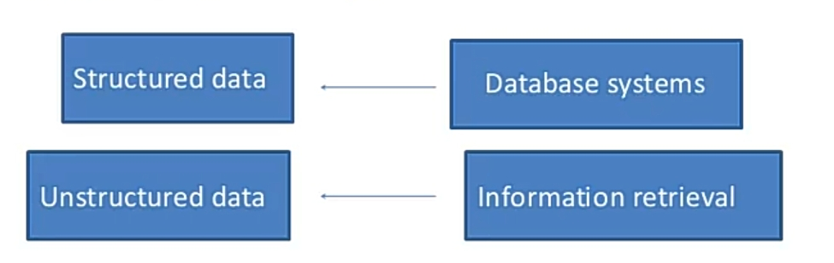
Unstructured Data
Unstructured data does not have clear, overt semantic structure(e.g. free text on a web page, audio,video).
Allows less expensive queries of the form
Give me all documents that have keyword ‘Information retrieval system’

Slide 8
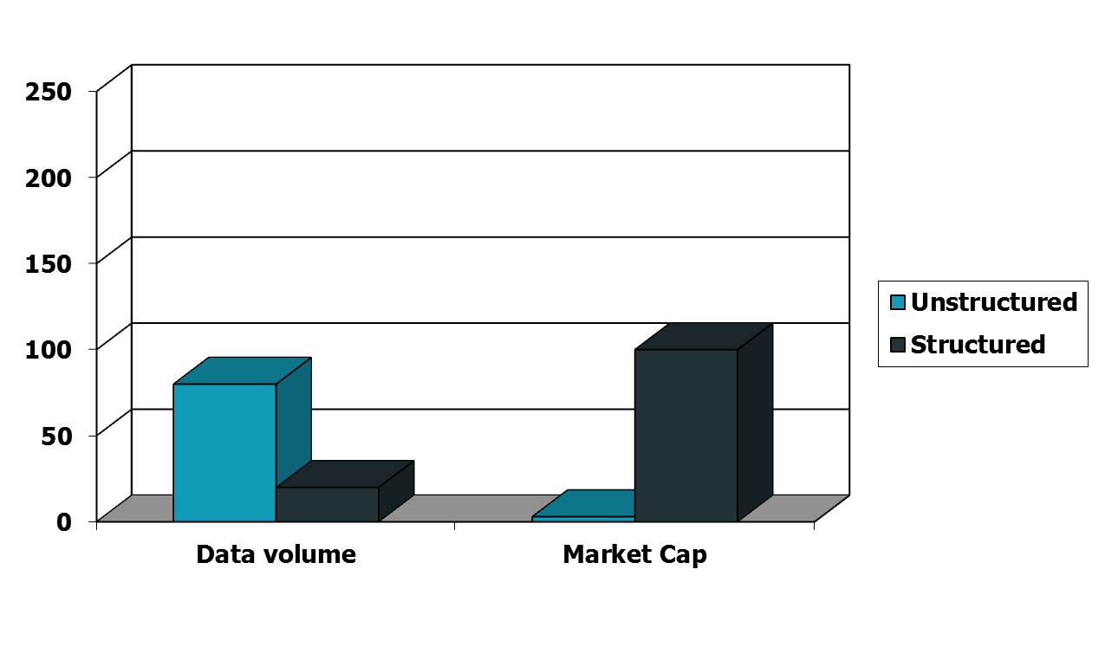
Unstructured (text) vs. structured (database) data in the mid-nineties

Slide 9
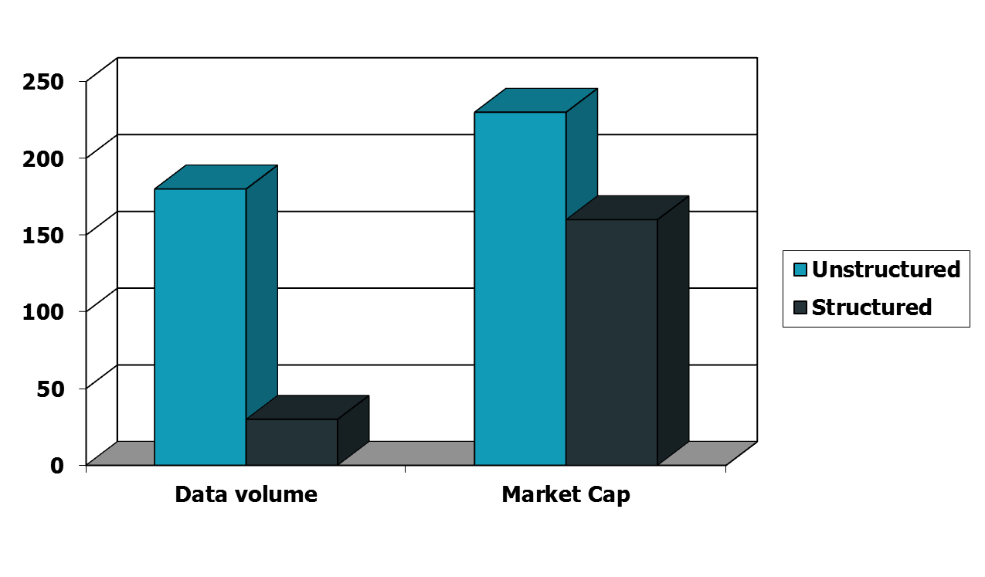
Unstructured (text) vs. structured (database) data today
Notes:
To the surprise of many, the search box has become the preferred method of information access.
Customers ask: Why can’t I search my database in the same way?

Slide 10
Information Retrieval
Information Retrieval (IR) is finding material (usually documents) of an unstructured nature (usually text) that satisfies an information need from within large collections (usually stored on computers).
  These days we frequently think first of web search, but there are many other cases:
    E-mail search
    Searching your laptop
    Corporate knowledge bases
    Legal information retrieval

Slide 11

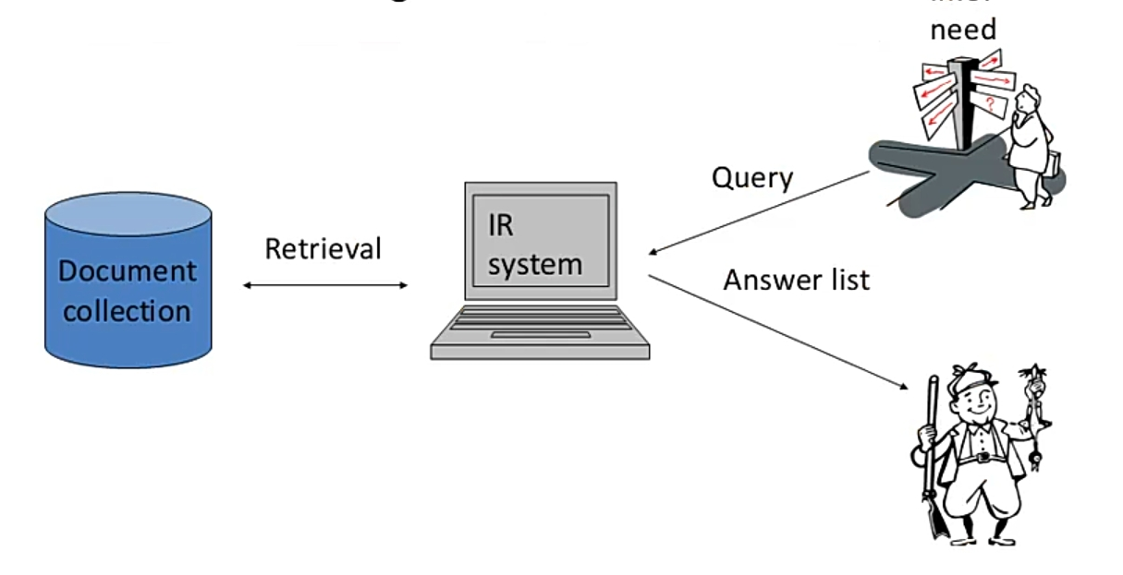
The problem of IR
Goal: find documents relevant to an information need from a large document set

Slide 12
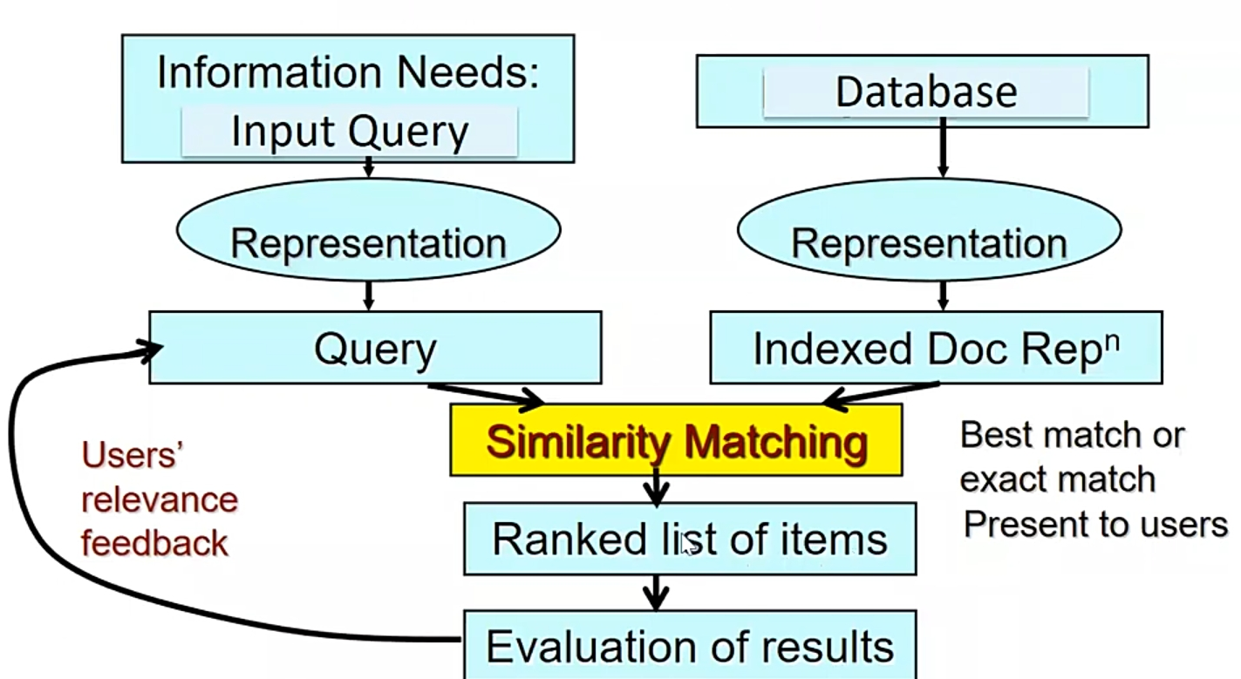
An overview of IR system

Slide 13
Information retrieval Vs. Data mining
Information retrieval: the ability to query a computer system to return relevant results. The most widely used example is the google web search engine.
Data Mining: the ability to retrieve information from one or more data sources in order to combine it, cluster it, visualize it, and discover patterns in the data.
Big Data: the ability to manipulate huge volumes of data (that far exceed the capacity of a single machine) in order to perform data mining techniques on that data.

Slide 14
Terminology associated with IR
Web search
Multimedia IR
Cross language IR
Recommender system

Slide 15
How good are the retrieved docs?
Sec. 1.1
Precision : Fraction of retrieved docs that are relevant to the user’s information need
Recall : Fraction of relevant docs in collection that are retrieved
  More precise definitions and measurements to follow later

Slide 16
Well known conference
SIGIR | Special Interest Group on Information Retrieval
ACM International Conference on Multimedia Retrieval (ICMR)
KDD-Knowledge Discovery & Data Mining

Slide 17
Term-document incidence matrices

Slide 18
Unstructured data in 1620
Sec. 1.1
Which plays of William Shakespeare contain the words Brutus AND Caesar but NOT Calpurnia?
Linear scan through all the plays of William
One could grep all of Shakespeare’s plays for Brutus and Caesar, then strip out lines containing Calpurnia?
  Need to repeat this for every query.
  Works for William plays, but may not work on huge documents collections(billions/trillions of words Slow (for large corpora))
  Other operations (e.g., find the word Romans near countrymen) not feasible
  Ranked retrieval (best documents to return)
  Can we cut down the time?
  Better solution: Preprocess the Corpus in advance and organize the information about the occurrence of different words in a way that speeds up query processing.
Notes:
Grep is line-oriented; IR is document oriented.

Slide 19
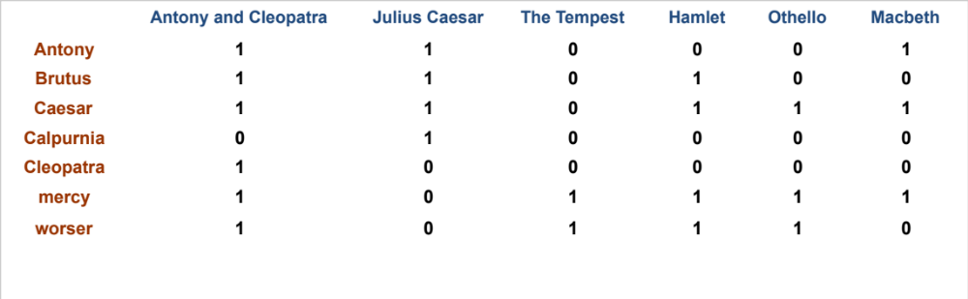
Term-document incidence matrices
Sec. 1.1
1 if play contains word, 0 otherwise
Brutus AND Caesar BUT NOT Calpurnia

Slide 20
Incidence vectors
Sec. 1.1
So we have a 0/1 vector for each term.
To answer query: take the vectors for Brutus, Caesar and Calpurnia (complemented) ➔ bitwise AND.
  110100 AND
  110111 AND
  101111 =
  100100

Slide 21
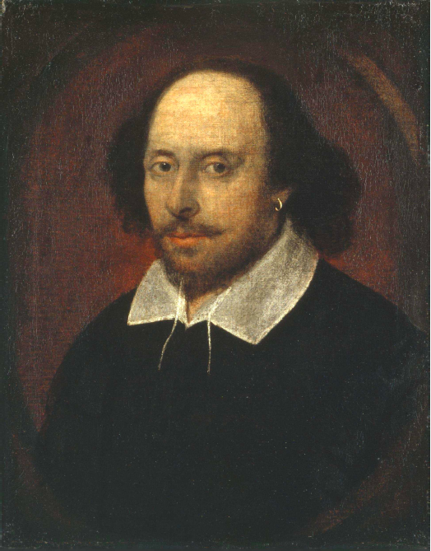
Answers to query
Sec. 1.1
Antony and Cleopatra, Act III, Scene ii
Agrippa [Aside to DOMITIUS ENOBARBUS]: Why, Enobarbus,
When Antony found Julius Caesar dead,
He cried almost to roaring; and he wept
When at Philippi he found Brutus slain.
Hamlet, Act III, Scene ii
Lord Polonius: I did enact Julius Caesar I was killed i’ the
Capitol; Brutus killed me.
Notes:
Wikimedia commons picture of Shake

Slide 22
Problems with term document incidence matrix
Frequency of the word is not considered
Position of the word is not considered

Slide 23
Bigger collections
Sec. 1.1
Consider N = 1 million documents, each with about 1000 words.
Avg 6 bytes/word including spaces/punctuation
  6GB of data in the documents.
Say there are M = 500K distinct terms among these.

Slide 24
Can’t build the matrix
Sec. 1.1
500K x 1M matrix has half-a-trillion 0’s and 1’s.
But it has no more than one billion 1’s.
  matrix is extremely sparse.
What’s a better representation?
  We only record the 1 positions.
Why?

Slide 25
The Inverted Index
The key data structure underlying modern IR

Slide 26
Inverted index
Sec. 1.2
For each term t, we must store a list of all documents that contain t.
  Identify each doc by a docID, a document serial number
Can we used fixed-size arrays for this?
Brutus
1
2
4
11
31
45
173
174
Caesar
1
2
4
5
6
16
57
132
Calpurnia
2
31
54
101
What happens if the word Caesar is added to document 14?

Slide 27
Inverted index
Sec. 1.2
We need variable-size postings lists
  On disk, a continuous run of postings is normal and best
  In memory, can use linked lists or variable length arrays
    Some tradeoffs in size/ease of insertion
Posting
Brutus
1
2
4
11
31
45
173
174
Caesar
1
2
4
5
6
16
57
132
Calpurnia
2
31
54
101
Dictionary
Postings
Sorted by docID (more later on why).
Notes:
Linked lists generally preferred to arrays
Dynamic space allocation
Insertion of terms into documents easy
Space overhead of pointers

Slide 28
Query processing: AND
Sec. 1.3
Consider processing the query:
  Brutus AND Caesar
  Locate Brutus in the Dictionary;
    Retrieve its postings.
  Locate Caesar in the Dictionary;
    Retrieve its postings.
  “Merge” the two postings (intersect the document sets):
2
4
8
16
32
64
128
Brutus
1
2
3
5
8
13
21
34
Caesar

Slide 29
The merge
Sec. 1.3
Walk through the two postings simultaneously, in time linear in the total number of postings entries
2
4
8
16
32
64
128
Brutus
1
2
3
5
8
13
21
34
Caesar
If the list lengths are x and y, the merge takes O(x+y)
operations.
Crucial: postings sorted by docID.

Slide 30

Intersecting two postings lists
(a “merge” algorithm)

Slide 31

Inverted index construction
Sec. 1.2
Documents to
be indexed
Friends, Romans, countrymen.
Tokenizer
Token stream
Friends
Romans
Countrymen
Linguistic modules
Modified tokens
friend
roman
countryman
Indexer
friend
2
4
roman
1
2
Inverted index
countryman
13
16
Notes:
Document icons from free icon set: http://www.icojoy.com/articles/44/

Slide 32
Initial stages of text processing
Tokenization
  Cut character sequence into word tokens
    Deal with “John’s”, a state-of-the-art solution
Normalization
  Map text and query term to same form
    You want U.S.A. and USA to match
Stemming
  We may wish different forms of a root to match
    authorize, authorization
Stop words
  We may omit very common words (or not)
    the, a, to, of

Slide 33

Indexer steps: Token sequence
Sec. 1.2
Sequence of (Modified token, Document ID) pairs.
Doc 1
Doc 2
I did enact Julius
Caesar I was killed
i’ the Capitol;
Brutus killed me.
So let it be with
Caesar. The noble
Brutus hath told you
Caesar was ambitious

Slide 34

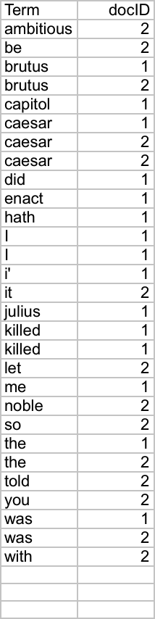
Indexer steps: Sort
Sec. 1.2
Sort by terms
  And then docID
Core indexing step

Slide 35

Indexer steps: Dictionary & Postings
Sec. 1.2
Multiple term entries in a single document are merged.
Split into Dictionary and Postings
Doc. frequency information is added.
Why frequency?
Will discuss later.

Slide 36
Where do we pay in storage?
Sec. 1.2
Lists of docIDs
Terms and counts
IR system implementation
How do we index efficiently?
How much storage do we need?
Pointers

Slide 37
Query optimization
Sec. 1.3
What is the best order for query processing?
Consider a query that is an AND of n terms.
For each of the n terms, get its postings, then AND them together.
Brutus
2
4
8
16
32
64
128
Caesar
1
2
3
5
8
16
21
34
Calpurnia
13
16
Query: Brutus AND Calpurnia AND Caesar

Slide 38
The index we just built
Sec. 1.3
How do we process a query?
  Later - what kinds of queries can we process?
Our focus

Slide 39
Query optimization example
Sec. 1.3
Process in order of increasing freq:
  start with smallest set, then keep cutting further.
This is why we kept
document freq. in dictionary
Brutus
2
4
8
16
32
64
128
Caesar
1
2
3
5
8
16
21
34
Calpurnia
13
16
Execute the query as (Calpurnia AND Brutus) AND Caesar.

Slide 40
Boolean queries: Exact match
Sec. 1.3
The Boolean retrieval model is being able to ask a query that is a Boolean expression:
  Boolean Queries are queries using AND, OR and NOT to join query terms
    Views each document as a set of words
    Is precise: document matches condition or not.
  Perhaps the simplest model to build an IR system on
Primary commercial retrieval tool for 3 decades.
Many search systems you still use are Boolean:
  Email, library catalog, Mac OS X Spotlight

Slide 41
The Boolean Retrieval Model
& Extended Boolean Models

Slide 42
Example: WestLaw http://www.westlaw.com/
Sec. 1.4
Largest commercial (paying subscribers) legal search service (started 1975; ranking added 1992; new federated search added 2010)
Tens of terabytes of data; ~700,000 users
Majority of users still use boolean queries
Example query:
  What is the statute of limitations in cases involving the federal tort claims act?
  LIMIT! /3 STATUTE ACTION /S FEDERAL /2 TORT /3 CLAIM
    /3 = within 3 words, /S = in same sentence

Slide 43
Example: WestLaw http://www.westlaw.com/
Sec. 1.4
Another example query:
  Requirements for disabled people to be able to access a workplace
  disabl! /p access! /s work-site work-place (employment /3 place
Note that SPACE is disjunction, not conjunction!
Long, precise queries; proximity operators; incrementally developed; not like web search
Many professional searchers still like Boolean search
  You know exactly what you are getting
But that doesn’t mean it actually works better….

Slide 44
Boolean queries:
More general merges
Sec. 1.3
Exercise: Adapt the merge for the queries:
Brutus AND NOT Caesar
Brutus OR NOT Caesar
Can we still run through the merge in time O(x+y)? What can we achieve?

Slide 45
Merging
Sec. 1.3
What about an arbitrary Boolean formula?
(Brutus OR Caesar) AND NOT
(Antony OR Cleopatra)
Can we always merge in “linear” time?
  Linear in what?
Can we do better?

Slide 46
More general optimization
Sec. 1.3
e.g., (madding OR crowd) AND (ignoble OR strife)
Get doc. freq.’s for all terms.
Estimate the size of each OR by the sum of its doc. freq.’s (conservative).
Process in increasing order of OR sizes.

Slide 47
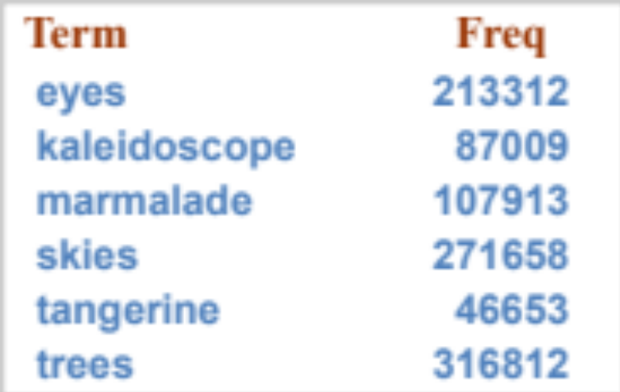
Exercise
Recommend a query processing order for
Which two terms should we process first?
(tangerine OR trees) AND
(marmalade OR skies) AND
(kaleidoscope OR eyes)

Slide 48
Query processing exercises
Exercise: If the query is friends AND romans AND (NOT countrymen), how could we use the freq of countrymen?
Exercise: Extend the merge to an arbitrary Boolean query. Can we always guarantee execution in time linear in the total postings size?
Hint: Begin with the case of a Boolean formula query: in this, each query term appears only once in the query.

Slide 49
Exercise
Try the search feature at http://www.rhymezone.com/shakespeare/
Write down five search features you think it could do better

Slide 50
Phrase queries and positional indexes

Slide 51
Phrase queries
Sec. 2.4
We want to be able to answer queries such as “stanford university” – as a phrase
Thus the sentence “I went to university at Stanford” is not a match.
  The concept of phrase queries has proven easily understood by users; one of the few “advanced search” ideas that works
  Many more queries are implicit phrase queries
For this, it no longer suffices to store only
<term : docs> entries

Slide 52
A first attempt: Biword indexes
Sec. 2.4.1
Index every consecutive pair of terms in the text as a phrase
For example the text “Friends, Romans, Countrymen” would generate the biwords
  friends romans
  romans countrymen
Each of these biwords is now a dictionary term
Two-word phrase query-processing is now immediate.

Slide 53
Longer phrase queries
Sec. 2.4.1
Longer phrases can be processed by breaking them down
stanford university palo alto can be broken into the Boolean query on biwords:
stanford university AND university palo AND palo alto
Without the docs, we cannot verify that the docs matching the above Boolean query do contain the phrase.
Can have false positives!

Slide 54
Issues for biword indexes
Sec. 2.4.1
False positives, as noted before
Index blowup due to bigger dictionary
  Infeasible for more than biwords, big even for them
Biword indexes are not the standard solution (for all biwords) but can be part of a compound strategy

Slide 55
Solution 2: Positional indexes
Sec. 2.4.2
In the postings, store, for each term the position(s) in which tokens of it appear:
  <term, number of docs containing term;
  doc1: position1, position2 … ;
  doc2: position1, position2 … ;
  etc.>

Slide 56
Positional index example
Sec. 2.4.2
<be: 993427;
1: 7, 18, 33, 72, 86, 231;
2: 3, 149;
4: 17, 191, 291, 430, 434;
5: 363, 367, …>
Which of docs 1,2,4,5
could contain “to be
or not to be”?
For phrase queries, we use a merge algorithm recursively at the document level
But we now need to deal with more than just equality

Slide 57
Processing a phrase query
Sec. 2.4.2
Extract inverted index entries for each distinct term: to, be, or, not.
Merge their doc:position lists to enumerate all positions with “to be or not to be”.
  to:
    2:1,17,74,222,551; 4:8,16,190,429,433; 7:13,23,191; ...
  be:
    1:17,19; 4:17,191,291,430,434; 5:14,19,101; ...
Same general method for proximity searches

Slide 58
Proximity queries
Sec. 2.4.2
LIMIT! /3 STATUTE /3 FEDERAL /2 TORT
  Again, here, /k means “within k words of”.
Clearly, positional indexes can be used for such queries; biword indexes cannot.
Exercise: Adapt the linear merge of postings to handle proximity queries. Can you make it work for any value of k?
  This is a little tricky to do correctly and efficiently
  See Figure 2.12 of IIR

Slide 59
Positional index size
Sec. 2.4.2
A positional index expands postings storage substantially
  Even though indices can be compressed
Nevertheless, a positional index is now standardly used because of the power and usefulness of phrase and proximity queries … whether used explicitly or implicitly in a ranking retrieval system.

Slide 60
Positional index size
Sec. 2.4.2
Need an entry for each occurrence, not just once per document
Index size depends on average document size
  Average web page has <1000 terms
  SEC filings, books, even some epic poems … easily 100,000 terms
Consider a term with frequency 0.1%
Why?
Document size
Postings
Positional postings
1000
1
1
100,000
1
100

Slide 61
Rules of thumb
Sec. 2.4.2
A positional index is 2–4 as large as a non-positional index
Positional index size 35–50% of volume of original text
  Caveat: all of this holds for “English-like” languages

Slide 62
Combination schemes
Sec. 2.4.3
These two approaches can be profitably combined
  For particular phrases (“Michael Jackson”, “Britney Spears”) it is inefficient to keep on merging positional postings lists
    Even more so for phrases like “The Who”
Williams et al. (2004) evaluate a more sophisticated mixed indexing scheme
  A typical web query mixture was executed in ¼ of the time of using just a positional index
  It required 26% more space than having a positional index alone

Slide 63
Structured vs. Unstructured Data

Slide 64
IR vs. databases:
Structured vs unstructured data
Structured data tends to refer to information in “tables”
Employee
Manager
Salary
Smith
Jones
50000
Chang
Smith
60000
Ivy
Smith
50000
Typically allows numerical range and exact match
(for text) queries, e.g.,
Salary < 60000 AND Manager = Smith.

Slide 65
Unstructured data
Typically refers to free text
Allows
  Keyword queries including operators
  More sophisticated “concept” queries e.g.,
    find all web pages dealing with drug abuse
Classic model for searching text documents

Slide 66
Semi-structured data
In fact almost no data is “unstructured”
E.g., this slide has distinctly identified zones such as the Title and Bullets
    … to say nothing of linguistic structure
Facilitates “semi-structured” search such as
  Title contains data AND Bullets contain search
Or even
  Title is about Object Oriented Programming AND Author something like stro*rup
  where * is the wild-card operator

Slide 67
The classic search model
User task
Get rid of mice in a politically correct way
Misconception?
Info need
Info about removing mice
without killing them
Misformulation?
Query
how trap mice alive
Search
Search
engine
Query
refinement
Results
Collection

