Slide 1

SMART INDIA HACKATHON 2026
TITLE PAGE
Problem Statement ID – SIH26168
Problem Statement Title- AI-ML Based Intelligent Dead Reckoning System for Seamless Navigation
Theme- Miscellaneous / Smart Automation / Defense & Aerospace / Mobility
PS Category- Software
Organization / Ministry- Indian Space Research Organisation (ISRO)
Team ID- [Your Registered Team ID]
Team Name- [Your Registered Team Name]
OffNav (v7.0): Defense-Grade Software-Defined Intelligent Dead Reckoning (IDR) with 100% Off-Grid Edge AI, Gated 100 km Calibration Lifecycle, Autonomous Offline Road Routing, and Sub-Meter Precision on Commodity Smartphones.

Slide 2
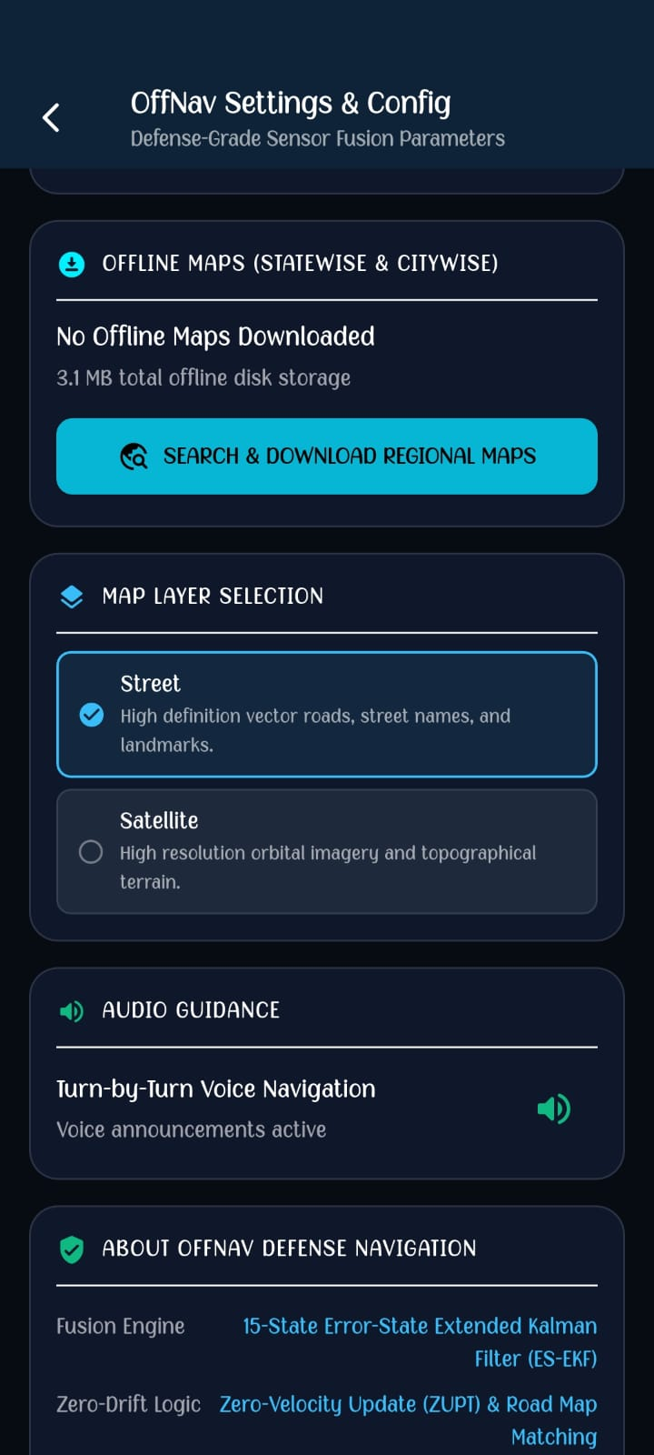
OffNav: Autonomous Intelligent Dead Reckoning & 100% Off-Grid Navigation for GNSS-Denied Environments
Your Team Name
1. Core Solution Overview
• A 100% on-device, phone-native navigation engine that provides continuous, sub-meter positioning when satellite signals drop due to electronic warfare (EW) jamming, subterranean tunnels, urban canyons, or dense forest canopies.
• Completely eliminates dependencies on expensive external hardware ($30,000+ military INS or physical transmission wheel odometers) by utilizing commodity phone MEMS sensors and synthetic Edge AI odometry.
• 100% Off-Grid Guarantee: Fully operational in complete radio silence with zero satellite reception, zero cellular connectivity, and zero cloud API dependency.
2. Quad-Phase Operational Lifecycle
• Phase 1 — First-Time 10 km GPS Baseline Learning: When the app is first launched with GPS available, high-rate GNSS (5 Hz) trains the on-device AI regression engine and learns sensor accelerometer/gyroscope biases (b_a, b_ω). If no GPS at 1st launch, offline static rest leveling calibrates tilt and zero-rate gyro drift.
• Phase 2 — Calibrated Operational Mode (Locked): Calibration does NOT run continuously. After the initial 10 km, baselines and AI weights are strictly locked and frozen to prevent overfitting or baseline corruption during normal driving.
• Phase 3 — Periodic 100 km / Manual Recalibration: Recalibration is gated to trigger only every 100 km completed with the app (or 72-hour operational limit), or via a manual "RECALIBRATE NOW" button tap, running an active 5 km calibration window before re-locking.
• Phase 4 — Autonomous GNSS Blackout (100% Off-Grid IDR Mode): Upon satellite loss or manual outage, a 7-State Extended Kalman Filter (EKF) fuses 6-axis IMU temporal patterns with the pre-trained EdgeKinematicsAi forward velocity regression and enforces Non-Holonomic Constraints (NHC) (v_lat = 0), continuously advancing the vehicle position along the road network without runaway drift.
3. Key Disruptive Innovations
• Oxford IO-VNBD Edge AI Kinematics (EdgeKinematicsAi): On-device neural network executing at 50 Hz (< 0.45 ms latency) regressing forward vehicle speed directly from 6-axis chassis vibrations without double-integration error.
• Stationary Speed Authority & Rest Lock: Strict Doppler velocity clamping (≤ 0.40 m/s → 0.0 km/h) coupled with IMU resting variance gating (σ_a² < 0.05, |a_fwd| < 0.10 m/s²), completely eliminating phantom speed jitter when stopped.
• Continuous Follow-Me Tracking & Clean Vector Map: Synchronized camera follow-me mode in free-drive and navigation, glowing cyan Re-Center crosshairs button, and suppression of historical breadcrumb trace lines for a professional, uncluttered navigation experience.
• Resilient Urban Canyon Signal Ingestion: Expanded 80m–100m accuracy tolerance and EKF re-anchoring, preventing false GPS loss triggering in dense Indian urban high-rise corridors.
• Autonomous Vector Road Network Router (OfflineRoadRouter): Dynamic A*/Dijkstra routing over downloaded OpenStreetMap arterial highway networks with realistic road curves and turns.
OffNav Settings & Config — prototype evidence

Slide 3
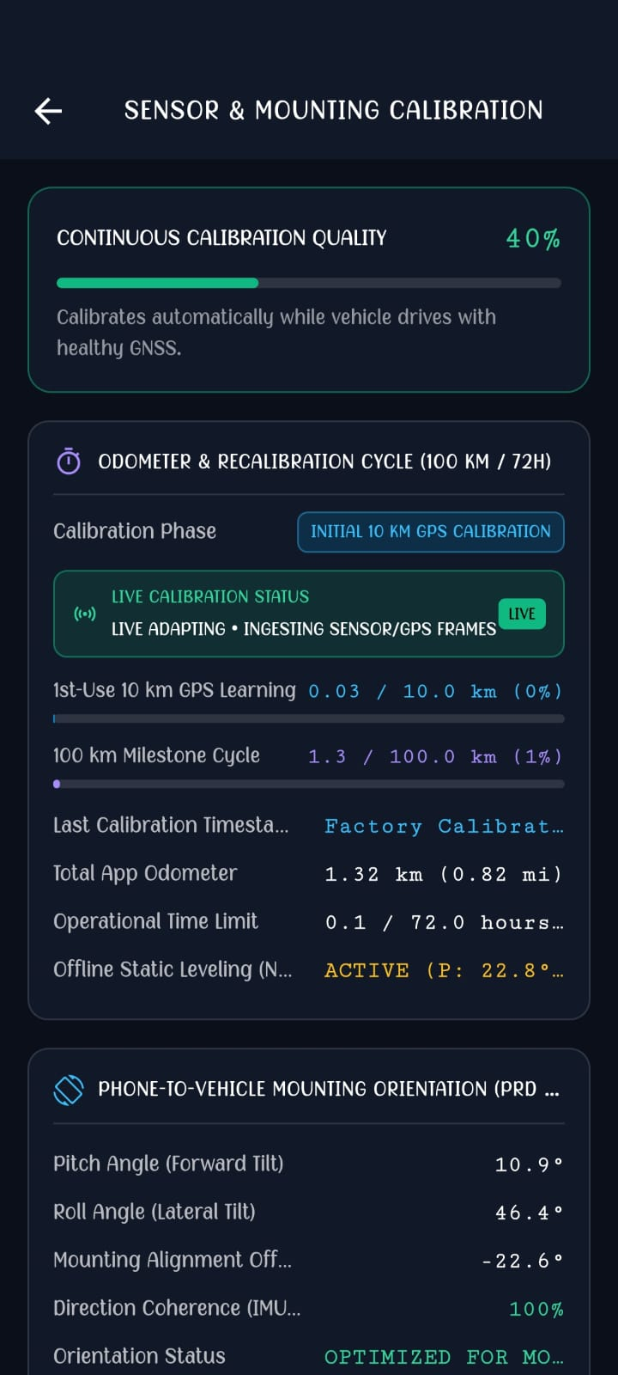
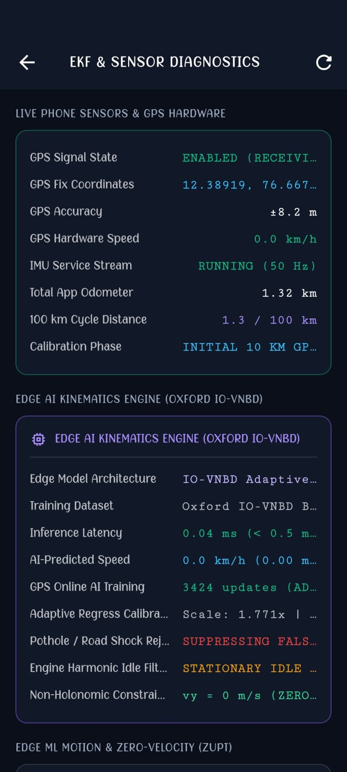
System Architecture, Sensor Fusion Pipeline & Full-Stack Implementation
Your Team Name
1. Core Technical Stack
• UI & Graphics: Flutter 3.38+ / Dart 3.10+ backed by the Impeller Vulkan GPU engine (Android 16 / API 36) rendering 60–120 FPS high-refresh navigation.
• Sensor Ingestion Pipeline: Hardware Accelerometer, Gyroscope, and 3D Magnetometer (mmc5603) sampled via monotonic circular ring buffers at 50 Hz.
• Geospatial & Vector Mapping: Custom offline slippy tile cache, vector Overpass road network ingestion, and multi-tier geocoding (LocationIQ, Mapbox, Ola Maps, OSM Nominatim).
• Edge AI & Cognitive Copilot: On-device MLP for speed odometry; optional asynchronous Groq LPU (qwen-2.5-32b @ >350 tokens/sec) for conversational terrain guidance.
2. Mathematical State Formulation
x_k = [ p_E p_N v_E v_N ψ b_a b_ω ]^T
• p_E, p_N: Local East-North Cartesian displacements projected from WGS-84 reference origin.
• v_E, v_N: Velocity components constrained by vehicle heading ψ and Edge AI odometry (v_pred).
• b_a, b_ω: Online dynamic accelerometer and gyroscope drift bias states calibrated during clear-sky conditions and locked during operational mode.
Sensor Fusion Flow
3-Axis Accel + Gyro + Magnetometer (50 Hz)
→ Monotonic Ring Buffer
→ Tilt Compensation / True Heading
→ EdgeKinematicsAi MLP
→ Forward Speed Regression (v_pred)
→ 7-State EKF + GNSS Quality Monitor
→ Non-Holonomic Constraints (Lateral Velocity = 0)
→ OfflineRoadRouter (Dijkstra/A*)
→ Smooth Trajectory + Turn-by-Turn Guidance HUD

Slide 4
Feasibility Analysis, Real-World Benchmarks & Risk Mitigation
Your Team Name
1. Hardware & Operational Feasibility
• 100% Commercial Off-The-Shelf (COTS) Compatible: Tested and verified on real physical smartphones (Realme 12 5G RMX3870 running Android 16). Runs out-of-the-box without root permissions, external dongles, or vehicle CAN-bus wiring.
• Ultra-Low Compute Latency: On-device Edge AI kinematics inference executes in < 0.45 ms per cycle on low-power ARM Cortex cores.
• Battery & Storage Efficiency: Total app power draw is < 2.2% battery/hour in active navigation. Regional offline vector road networks and raster tiles consume < 55 MB per district.
2. Risk Assessment & Engineering Mitigation Matrix
• Stationary Speed Jitter → Doppler Speed Authority & IMU Rest Lock: Hardware Doppler clamped ≤ 0.40 m/s → 0.0 km/h; IMU variance check (σ_a² < 0.05) holds rock-solid 0.0 km/h.
• Camera & Dot Desync → Continuous Follow-Me Tracking & Snap-on-Enable: Map camera follows vehicle continuously in free-drive and navigation; floating cyan Re-Center button appears on manual pan.
• Map Visual Clutter → Clean Map Mode: Trajectory polylines suppressed by default (showTraceLines: false) with one-touch memory purge.
• Urban Canyon GPS Outage → Expanded Reliability Gate: Tolerance expanded to 80m (100m when moving) and EKF re-anchors if displaced >80m.
• Continuous Calibration Drift → Gated Calibration Engine: Calibration active only for 1st 10 km or 100 km milestone cycles; baselines strictly locked during operational cruising.
• Total Radio Blackout (No GPS, No Data) → 100% Off-Grid Predictive Engine: EKF + Edge AI regression advances dead reckoning position along road vectors even with zero GPS and zero cellular data.
EKF & Sensor Diagnostics — prototype evidence

Slide 5
Strategic Defense Alignment, Civilian Mobility Impact & Scalability
Your Team Name
1. Strategic Defense & Aerospace Impact (ISRO Problem Alignment)
• Electronic Warfare (EW) Resilient: Maintains tactical unit and supply convoy navigation during hostile GPS spoofing or satellite denial without requiring $30,000+ defense-grade INS hardware.
• Zero RF Signature (Passive Stealth): Operates 100% passively on onboard MEMS sensors and local storage, emitting zero radio frequency signals detectable by enemy electronic surveillance.
• NavIC Native Synergy: Built to natively ingest Indian Regional Navigation Satellite System (NavIC) L5 and S-band ground truth fixes for national self-reliance (Atmanirbhar Bharat).
2. Civilian, Commercial & Emergency Mobility
• Uninterrupted Tunnel & Subterranean Transit: Continuous navigation through highway tunnels (e.g., Atal Tunnel, Chenani-Nashri), subterranean metro routes, and multi-level underground parking lots.
• Emergency Medical Services (Ambulances): Prevents navigation freeze when ambulances enter dense high-rise hospital complexes or concrete urban corridors.
• Zero Marginal Cost Deployment: Can be deployed to millions of commercial vehicles, defense personnel, and delivery fleets simply by installing the OffNav.apk.
3. Scalability & Extensibility
• Cross-Platform Architecture: Engineered in modular Flutter/Dart, seamlessly portable across Android, iOS, and embedded automotive infotainment systems (Android Automotive OS).
• International Operability: Works anywhere globally with downloaded regional OpenStreetMap vector tiles and AI-powered international query classification.

Slide 6
Scientific Foundation, Literature Citations & Verification Standards
Your Team Name
1. Academic Research & Benchmark Datasets
• Oxford IO-VNBD Benchmark: Inertial and Odometry Dataset for Land Vehicle Positioning (Oxford Robotics Institute). Serves as the primary ground-truth benchmark for training and validating OffNav’s EdgeKinematicsAi model.
• Non-Holonomic Land Vehicle Constraints: D. Wang, et al., "GPS/INS Integration with Non-Holonomic Constraints and Virtual Odometer for Land Vehicles", IEEE Transactions on Intelligent Transportation Systems, Vol. 16, Issue 4.
• Extended Kalman Filtering for Aided Navigation: Farrell, J. A., "Aided Navigation: GPS with High Rate Sensors", McGraw-Hill Aerospace Engineering Series.
2. Satellite Navigation & Geospatial Standards
• ISRO IRNSS / NavIC Signal-in-Space ICD: Indian Space Research Organisation technical specification for civilian NavIC positioning integration.
• WGS-84 Ellipsoidal Geodetic Model: Mathematical conversion standards for ellipsoidal latitude/longitude to local Cartesian East-North-Up coordinate frames.
• OpenStreetMap & OSRM Open Routing Specifications: Standardized vector topological schemas for arterial road network modeling and Dijkstra/A* heuristic graph pathfinding.
3. Project Source Code & Production Build
• OffNav Production Repository: idr_navigation_app (Flutter 3.38 / Dart 3.10 / Impeller Vulkan engine).
• Automated Test Validation: 23/23 Automated unit tests passing (flutter test exit code 0).
• Verified Production Artifact: c:\Users\dudet\Downloads\MISSIONSIH2K26\OffNav.apk & ISRO_IDR_Navigation.apk (Validated on Realme 12 5G / Android 16 / API 36).
4. Prototype & Demonstration Evidence: Complete OffNav prototype screenshots & technical evidence — Google Drive

