Slide 1

WeCare
Empowering Women Together
By:
IO Stream

Slide 2
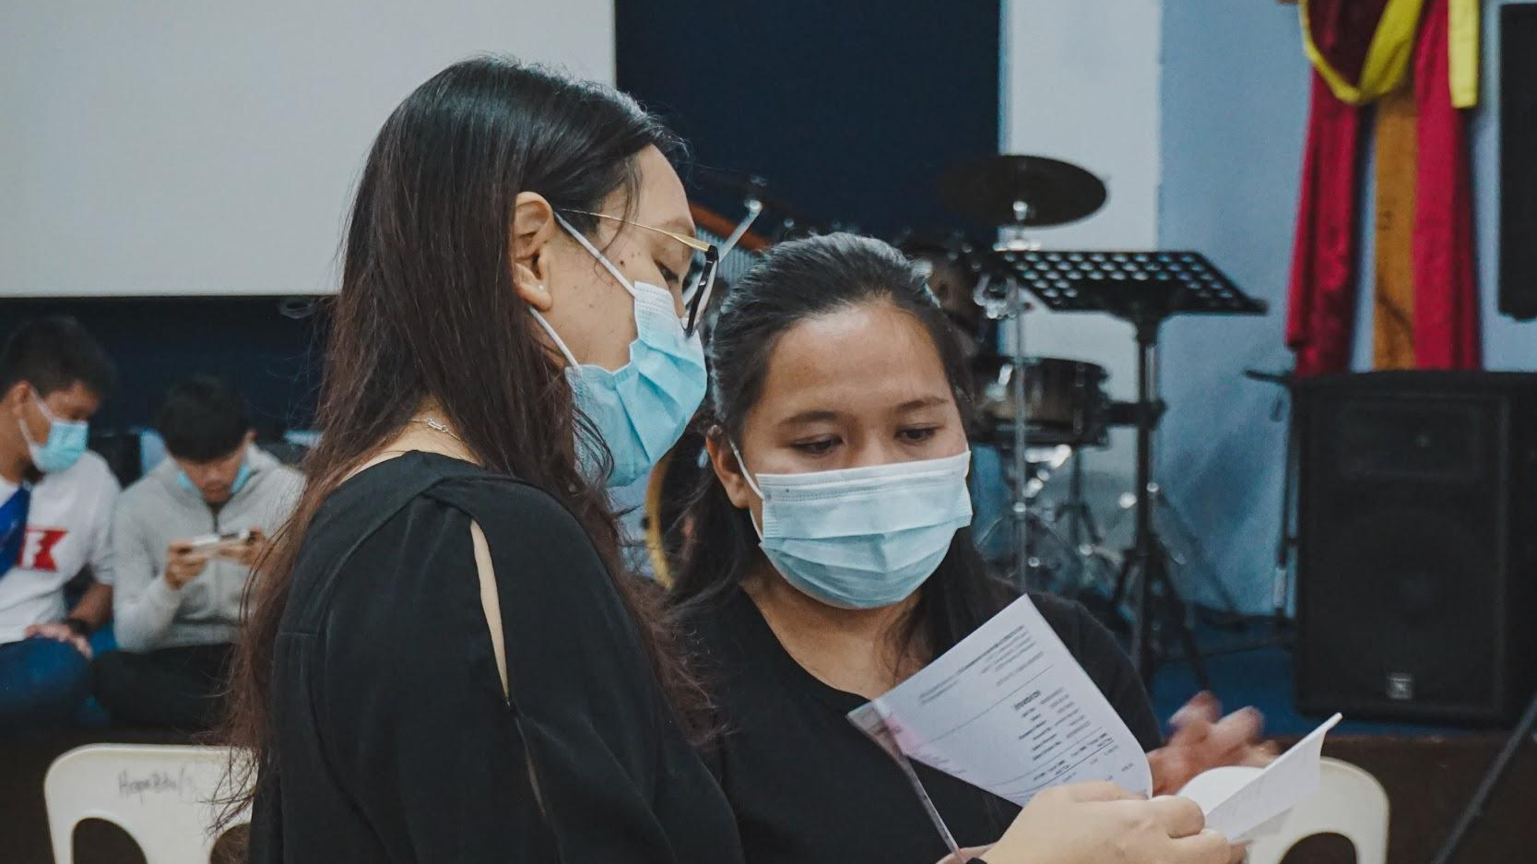
Problem Statement Track:
Social Awareness.

Slide 3
The Problem
For many years, women in Indian culture have been viewed as inferior to men. They have to face different challenges and problems in their lives because of this form of inferiority.
To prove themselves equal, they have to go additional miles than men. Earlier, they were never allowed to go outside and engage as men in social events.

Slide 4
The Problem
Even in the modern world, women in their daily lives have to face far more challenges and fail a lot to develop their careers.
There are so many parents who only prefer to have a boy child and only encourage boys to be taught. For them, women are just a way of preserving family happiness and health.

Slide 5
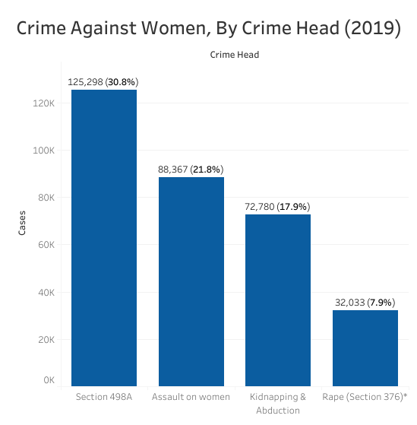
The Problem

Slide 6
The Problem
The government has taken measures to improve this condition. But, most women are unaware of these various norms or schemes undertaken by the government for their benefit. It is also seen that women are deprived of the basic rights and resources available to them from a very young age in both rural and urban areas. This often leads to manipulation or exploitation, even at workplaces.

Slide 7

The Solution
This is where WeCare comes into play. Our website provides all the relevant information regarding these schemes or norms. We make women aware of their rights and empower them.

Slide 8
The Solution
Here, they learn about the various laws and the resources available in areas such as healthcare, education, employment, and protection.
We equip young girls with techniques on how to protect themselves when being harassed or exploited (self-defense).
We also provide women with various women helpline numbers, accessible in their localities; so that, they are aware of whom to reach out in case of any kind of discrimination or ill-treatment.

Slide 9

Thank You!

