Slide 1

Indian Institute of Information Technology Kalyani
Biasness Detection in text
Submitted to:
Dr. Tirthankar Dasgupta
Scientist
Innovation Lab
Tata Consultancy Services
Submitted by:
Dilpreet Singh Chawla
Reg. No. 171
B.Tech CSE (4th year)
IIIT Kalyani

Slide 2
Introduction
In collaborative environments or environments where impartial language is desired (eg. Wikipedia, news media), statements and language therein should represent equally the involved parties and be neutrally phrased.
Biased language is introduced through the presence of inflammatory words or phrases, or statements that may be incorrect, or one-sided, thus violating such consensus.

Slide 3
Objective
This work focuses on the specific case of phrasing bias, which may be introduced through specific inflammatory words or phrases in a statement.
It uses an approach that relies on Recurrent Neural Networks in order to capture the inter-dependencies between words in a phrase that introduced bias.

Slide 4
Dataset Used
This work focuses on detecting biased language in Wikipedia statements and whether a statement is written in a neutral tone, thus, following the principles of the NPOV (Neutral Point Of View) policy.
This dataset was used by this work and is provided here. It contains the following categories of samples.
Biased (1843 samples)
Neutral CW-Hard (3109 samples)
Neutral Featured (5000 samples)
Neutral Type-Balanced (1994 samples)

Slide 5
Sentence Representation
Elmo Embeddings: We represent a sentence as a sequence of words through their corresponding word representations. This work uses Elmo, a state-of-the-art NLP framework developed by AllenNLP to develop deep contextualized word embeddings.
POS tags: They are one of the most basic features used to represent text, and are able to capture stylistic linguistic features.

Slide 6
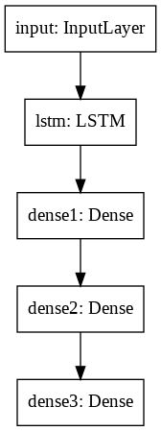
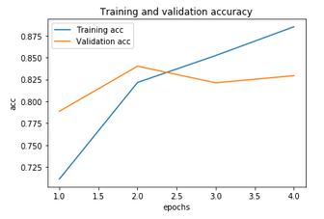
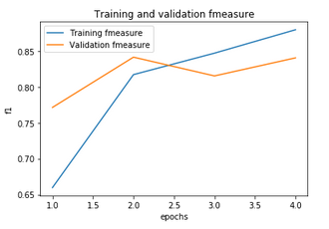
Models Trained
Elmo-LSTM model

Slide 7
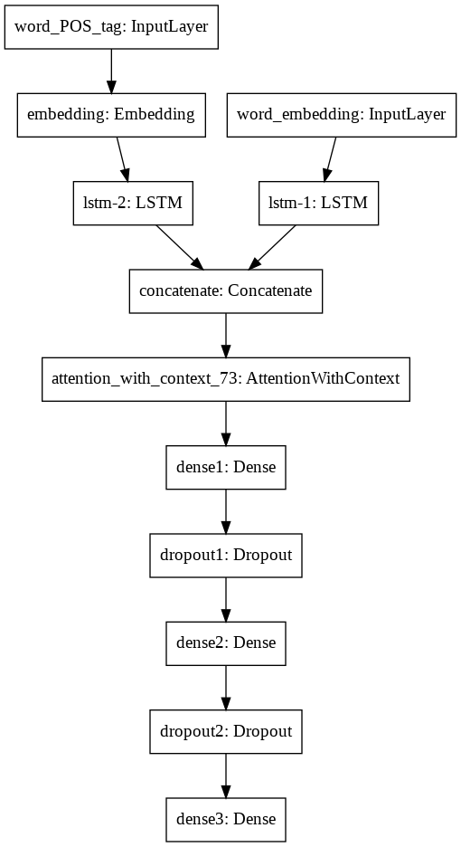
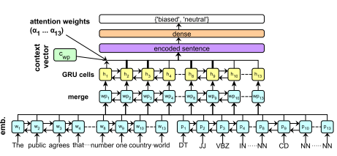
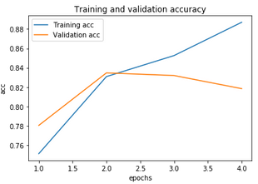
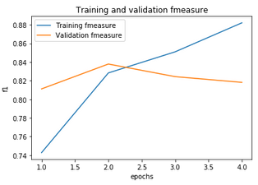
2) Elmo-LSTM-POS-Attention model
Using Global Attention

Slide 8
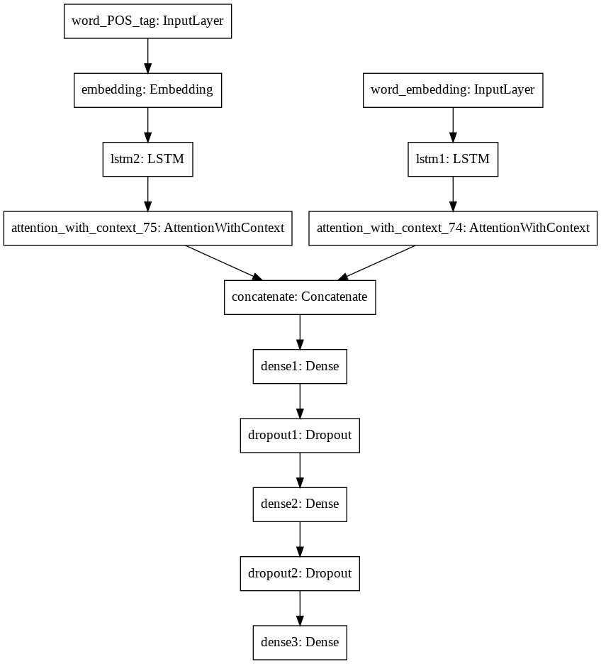
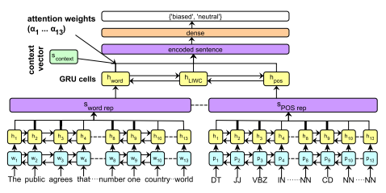
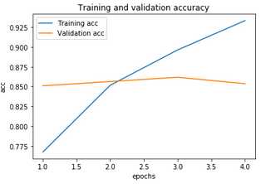
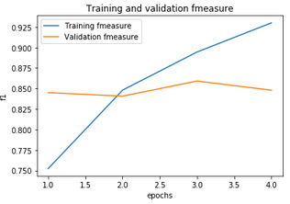
3) Elmo-LSTM-Attn-POS-Attn model
Using Hierarchical Attention

Slide 9
Results Achieved
Model Rankings: Validation Accuracy
Elmo-LSTM-Attn-POS-Attn model 86%
Elmo-LSTM model 84%
Elmo-LSTM-POS-Attention model 83%

Slide 10
Future Work
Improvement in Hierarchical Attention Model by incorporating LIWC codes.
Using Tree-LSTM as recurrent neural network architecture.
Using larger dataset for training the models to increase performance.

