Slide 1
Hibernate+JPA

Slide 2
Persistence in Java
EJB
JDO
JPA

Slide 3
Hibernate != JPA
JPA
TopLink
Hibernate
Kopo
OpenJPA

Slide 4
Jerarquía de JPA
EntityManagerFactory
EntityManager
EntityTransaction
Query

Slide 5
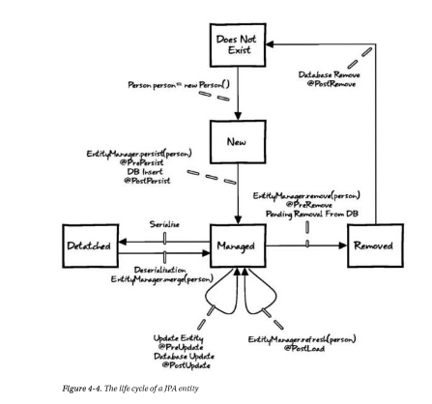
Entidades
@Entity

