Slide 1
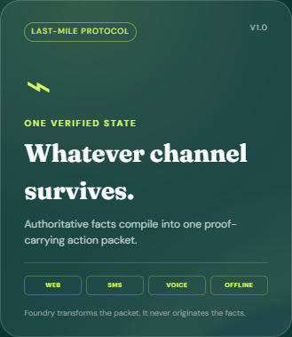
LAST-MILE
A verified path
through disaster help.
One proof-carrying action packet. Four resilient channels. Minimum data.
Built with Microsoft Foundry and Azure-ready services for the Virginia challenge.
DISASTER ASSISTANCE NAVIGATOR
Notes:
Open with the citizen outcome: trustworthy next steps without waiting on hold.
The product is a working prototype, not a simulated wireframe.

Slide 2
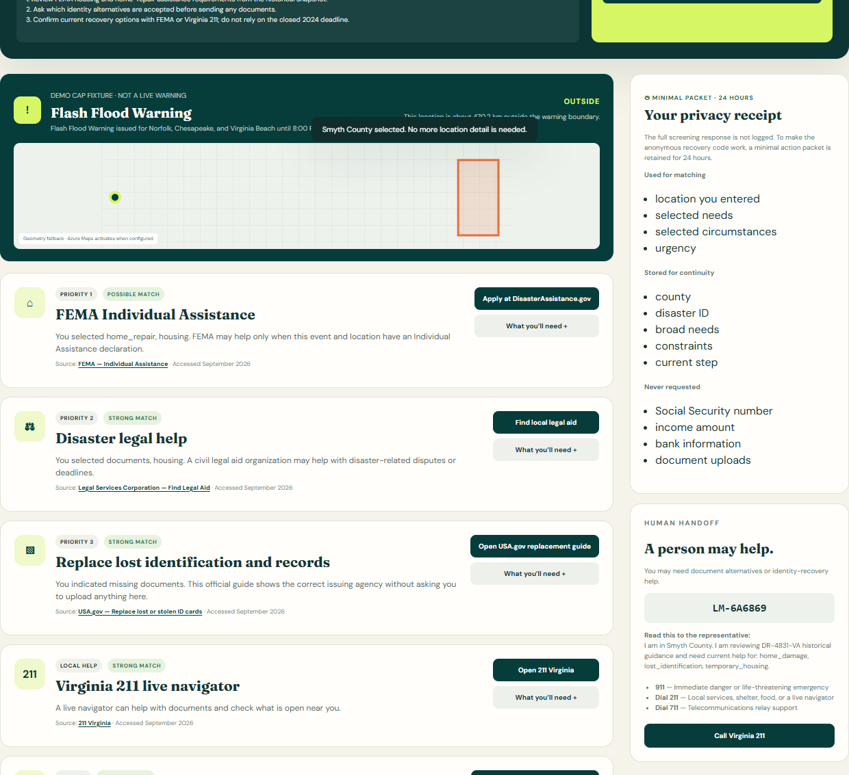
THE SERVICE GAP
The source can be right while the experience still fails.
After a disaster, citizens must translate a maze of deadlines, documents, eligibility rules, and portals into one safe next step.
•
Contact centers overload at the exact moment ambiguity spikes.
•
Language, disability, device loss, and weak connectivity turn navigation into exclusion.
•
A confident wrong answer can be more harmful than a clear refusal and human handoff.
MICROSOFT × CCI INNOVATION CHALLENGE
02
Notes:
Describe the need for a citizen experience that is better than a phone tree or FAQ.
The visible result list is grounded in checked-in official program URLs. Final eligibility remains with the agency.

Slide 3
CENTRAL INNOVATION
The Last-Mile Protocol turns trusted facts into portable action.
Foundry transforms the packet. It never originates the facts.
CANONICAL DISASTER
ACTION PACKET
CHANNEL COMPILERS
AUTHORITATIVE
INPUTS
WEB · SMS
VOICE · OFFLINE
NWS alerts
FEMA declarations
Virginia 211
Agency program pages
Locked facts
Source hash + provenance
Policy boundaries
Current citizen state
Escalation trigger
Same state. Same proof.
Different delivery budget.
Human escalation wraps every stage when risk or ambiguity exceeds policy.
MICROSOFT × CCI INNOVATION CHALLENGE
03
Notes:
This packet is the system boundary. It lets channels change without regenerating the truth.
Microsoft Foundry is used for controlled explanation. Deterministic checks protect critical facts and instructions.

Slide 4
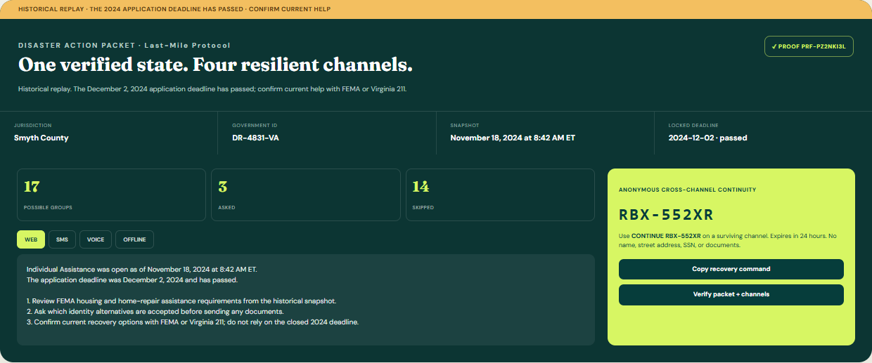
INFORMATION-GAIN INTAKE
Ask only the question that changes the next action.
ZIP 24370 maps to more than one Virginia county, so the navigator asks one jurisdiction question before recommending aid.
17
3
14
possible
asked
skipped
MICROSOFT × CCI INNOVATION CHALLENGE
04
Notes:
Demo case: a citizen enters ZIP 24370, chooses Smyth County, and identifies housing, repair, and lost-document needs.
Official historical basis: FEMA DR-4831-VA. The prototype clearly labels the replay and the passed December 2, 2024 deadline.
Sources: https://www.fema.gov/sites/default/files/documents/fema_r3_4831-public-notice.pdf ; https://www.fema.gov/disaster/4831

Slide 5
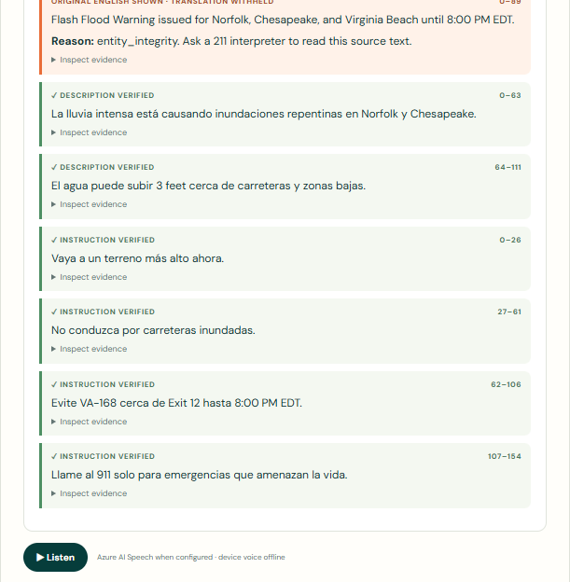
PROOF-CARRYING GUIDANCE
If one critical fact breaks, only that segment is withheld.
Four checks run before release: entity integrity, semantic fidelity, instruction coverage, and source grounding.
•
Numbers, dates, roads, places, URLs, and phone numbers are locked.
•
Negations and safety instructions must survive the transform.
•
A failed segment returns original English plus a human escalation path.
ABSTENTION IS A SAFETY FEATURE
MICROSOFT × CCI INNOVATION CHALLENGE
05
Notes:
The screenshot is a live failure injection. The altered headline is withheld while verified segments remain available.
Content Safety is an optional output guard when configured. Its failure also causes abstention.
NWS source interface: https://api.weather.gov/alerts/active?area=VA

Slide 6
RESILIENT DELIVERY
One verified state survives the channel change.
WEB
SMS
VOICE
OFFLINE
Full explanation
and source links
Compressed steps
and recovery code
Readable script
and Azure Speech
602-byte packet
and cached shell
RBX-KRBTD
Anonymous continuity code keeps a minimal packet for 24 hours. No name, street address, Social Security number, income amount, bank information, or document upload.
MICROSOFT × CCI INNOVATION CHALLENGE
06
Notes:
The same canonical packet compiles into web, SMS, voice, and offline representations.
The continuity code stores only the minimum state needed to resume. The full screening response is not logged.
Azure Speech documentation: https://learn.microsoft.com/en-us/azure/ai-services/speech-service/rest-text-to-speech

Slide 7
MICROSOFT ARCHITECTURE
Azure services reinforce the protocol boundary.
The local deterministic path remains operable when cloud services are unavailable.
INGEST
REASON + VERIFY
STORE
DELIVER
Azure Functions
NWS + FEMA + 211
Snapshot timestamps
Microsoft Foundry
Azure Translator
Content Safety
Deterministic verifier
Cosmos DB adapter
Local SQLite fallback
24-hour continuity
Static web app
Azure AI Speech
SMS-ready packet
Human handoff
POLICY: Foundry explains. Authoritative sources decide. Verification gates release.
MICROSOFT × CCI INNOVATION CHALLENGE
07
Notes:
The repository includes Azure Functions packaging, Bicep infrastructure, Foundry model configuration, Translator round-trip checks, Content Safety, Speech, and a Cosmos adapter.
Services use local fallbacks when credentials are not configured, which keeps the demo reproducible.
Sources: https://learn.microsoft.com/en-us/azure/foundry/openai/latest ; https://learn.microsoft.com/en-us/rest/api/translator/translator/translate?view=rest-translator-v3.0 ; https://learn.microsoft.com/en-us/azure/ai-services/content-safety/quickstart-text

Slide 8
EVALUATION
The evidence is strong because the claims stay scoped.
September 23, 2026 local harness results against the checked-in NWS-schema fixture.
CHECK | RESULT | WHAT IT MEANS
Automated tests | 19 passing | API, protocol, transforms, and privacy behavior
Injected corruption | 17 / 17 caught | 100% recall in the deterministic fixture
Clean segments | 0 / 140 refused | 0% false abstention in this harness
Transform latency | 1.82 ms p95 | Local deterministic path, not an Azure benchmark
Cached shell | 91,990 bytes | Uncompressed repository bytes
Offline packet | 602 bytes | Compact cross-channel recovery payload
Not claimed: production translation quality, statewide impact, or live Azure latency.
MICROSOFT × CCI INNOVATION CHALLENGE
08
Notes:
The harness results are reproducible with python -m eval.report.
Do not extrapolate these fixture results to production model quality or statewide societal impact.

Slide 9
TEN IMPLEMENTED INNOVATIONS
Innovation is a system behavior, not a chatbot label.
01
Canonical Disaster Action Packet
06
Four-channel compiler
02
Proof-carrying guidance
07
24-hour anonymous continuity
03
Information-gain question planner
08
NWS-to-FEMA lifecycle bridge
04
Jurisdiction disambiguation
09
Connectivity-aware offline mode
05
Per-segment abstention
10
Context-rich human handoff
MICROSOFT × CCI INNOVATION CHALLENGE
09
Notes:
Each item on this slide exists in the repository and appears in the runnable demo.
The innovations reinforce each other around one boundary: a verified packet that carries only the state needed for action.

Slide 10
WHY THIS CAN WIN
A safer citizen journey,
ready for a real pilot.
25%
25%
25%
25%
PERFORMANCE
INNOVATION
SOCIETAL VALUE
FEASIBILITY
Fast local fallback
and explicit evaluation
Protocol plus proof,
not generic conversation
Less waiting, less data,
more accessible channels
Working app, tests, docs,
Azure deployment assets
KEY LEARNING
In disaster assistance, restraint is a product capability: preserve authoritative facts, collect less, and hand off early when confidence is not enough.
LAST-MILE · MICROSOFT × CCI
10
Notes:
Close by mapping directly to the four judging categories, each weighted 25 percent.
Ask for a Virginia pilot with current agency feeds, accessibility testing, and operator feedback.

