Slide 1
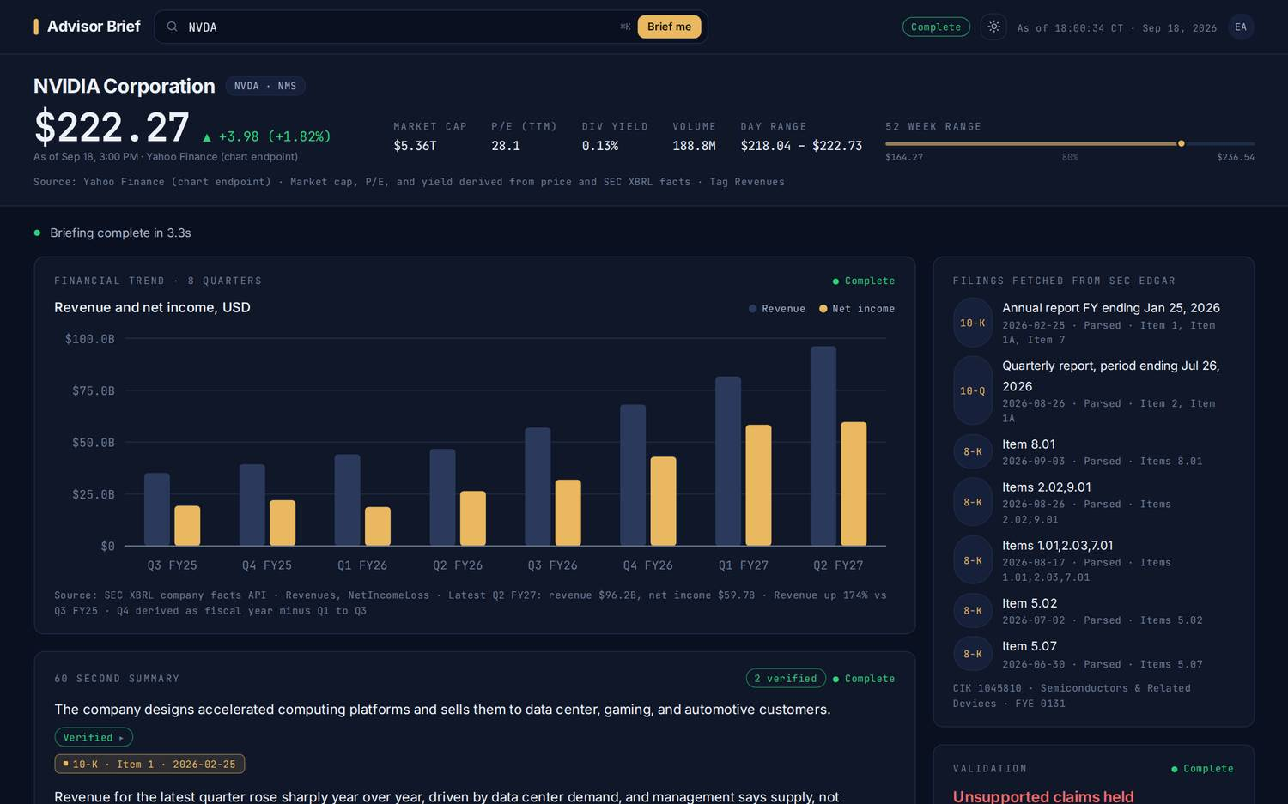
Advisor Brief
Get up to speed on any
stock in about a minute.
Built for the moment a client asks about a company you have not looked at this quarter. One page, every sentence backed by the company's own filings.
A working prototype, not a mockup. Live data, live filings.
Advisor Brief · Prototype for wealth management advisors · September 2026
01 / 08

Slide 2
THE PROBLEM
The ten minutes before the call.
A client mentions a stock. The advisor has a few minutes to sound informed, be accurate, and stay on the right side of compliance. Today that means one of two things.
01
02
03
Read for an hour
Or trust a summary
Either way, no record
The annual and quarterly reports run to hundreds of pages. The recent announcements sit in a separate feed. Nobody has an hour.
Third party summaries and search results are fast, but they do not show where a number came from, and they are sometimes simply wrong.
Whatever the advisor says on the call, there is no trail showing which document supported it. That is a problem the first time a client disputes a fact.
What advisors told us they want: the facts, the source, and the time back for the conversation.
Advisor Brief · Prototype for wealth management advisors · September 2026
02 / 08

Slide 3
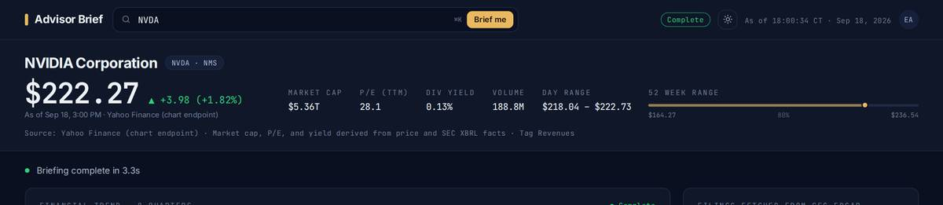
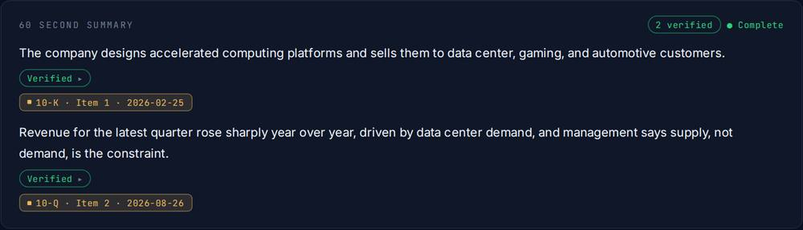
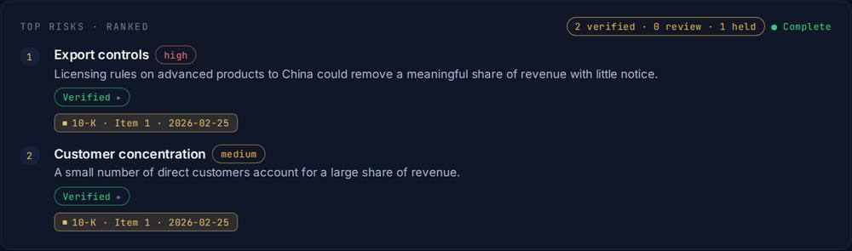
WHAT IT DOES
Type a ticker. Read for one minute.
The price and the key numbers
Live quote, market value, valuation, and the 52 week range.
Two years of results in one chart
Revenue and profit, quarter by quarter, straight from the filed statements.
The story in 60 seconds
What the company does, how it makes money, how the last quarter went.
What changed, the top risks, recent announcements
Ranked and dated, so the advisor knows what is new.
Talking points and likely client questions
Ready to say out loud, with the answer the filing supports.
Advisor Brief · Prototype for wealth management advisors · September 2026
03 / 08

Slide 4
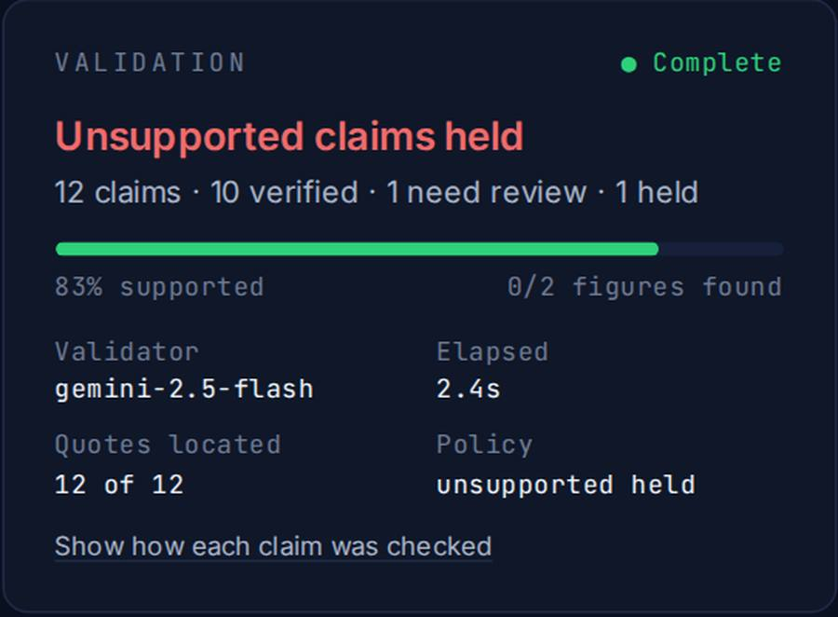
WHY IT CAN BE TRUSTED
Every sentence shows its source.
Linked to the filing
Every line carries a tag naming the exact report and section it came from. One click opens the original on the SEC's website.
Checked by a second reviewer
Before the advisor sees a sentence, an independent reviewer reads the cited pages and confirms the claim is really there, numbers included.
Held aside when unsure
Anything the reviewer cannot confirm is taken out of the brief and listed separately with the closest evidence. It is never shown as fact.
■ 10-K · Item 1A · 2026-02-25
the tag on every sentence; click to open the filing
Never a false confidence score
If the review could not run, the brief says so plainly and shows no score at all.
Advisor Brief · Prototype for wealth management advisors · September 2026
04 / 08

Slide 5
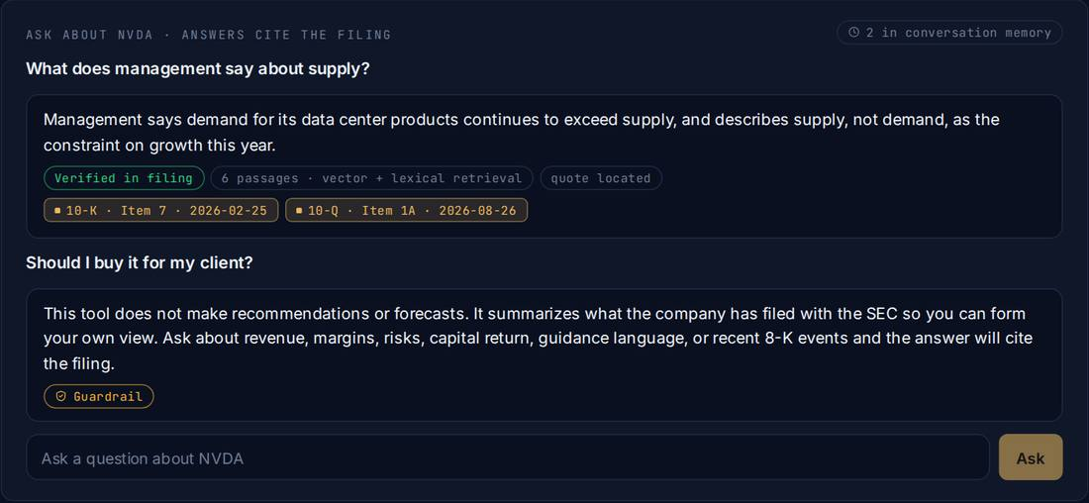
FOLLOW UP
Ask a follow up. It remembers.
Questions in plain English
"What does management say about supply?" The answer comes from the filings read for this brief, with the source on it, checked the same way.
It keeps the thread
"And what about margins?" is understood in context, because the conversation is remembered for the session.
Earlier briefings open instantly
A name briefed earlier today opens in under a second, refreshed with the live price. New filings refresh the brief automatically.
Advisor Brief · Prototype for wealth management advisors · September 2026
05 / 08

Slide 6
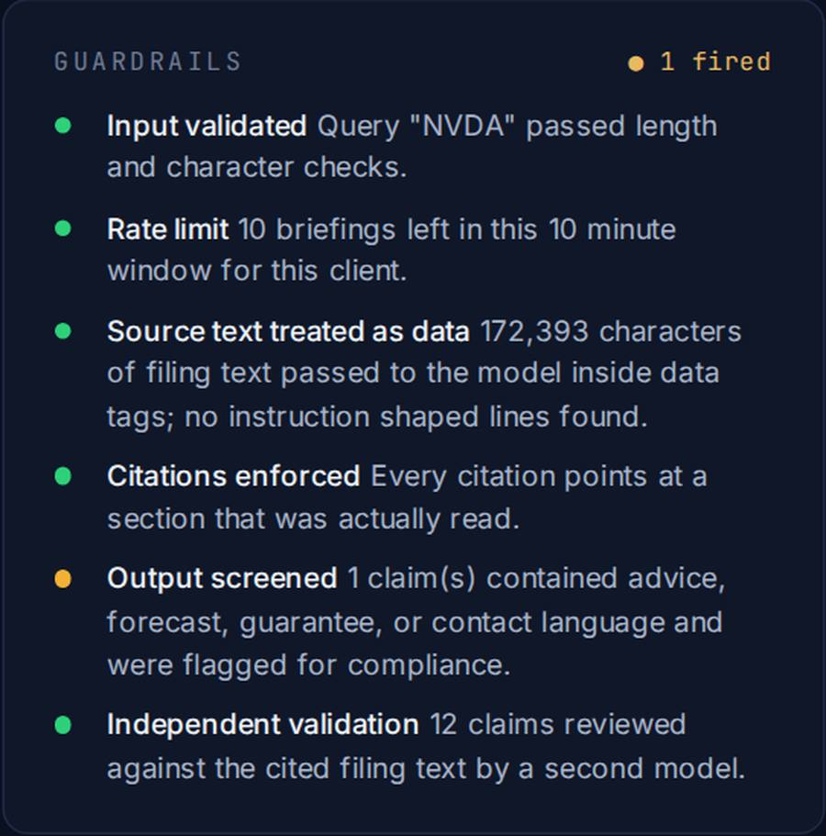
GUARDRAILS
Built to say no when it should.
It never recommends a trade
Ask whether to buy or sell and it declines, every time, and points back to the facts.
It never accepts client details
Account, card, or identity numbers in a question are refused before anything is processed.
It never invents a number
Every figure is matched against the filing. A number that is not there is held for review.
It cannot be talked out of its rules
Text inside a filing is treated as information, never as instructions.
It degrades gracefully
If the writing service is unavailable, the advisor still gets the filed figures, the announcements, and the links, straight from the SEC.
Advisor Brief · Prototype for wealth management advisors · September 2026
06 / 08

Slide 7
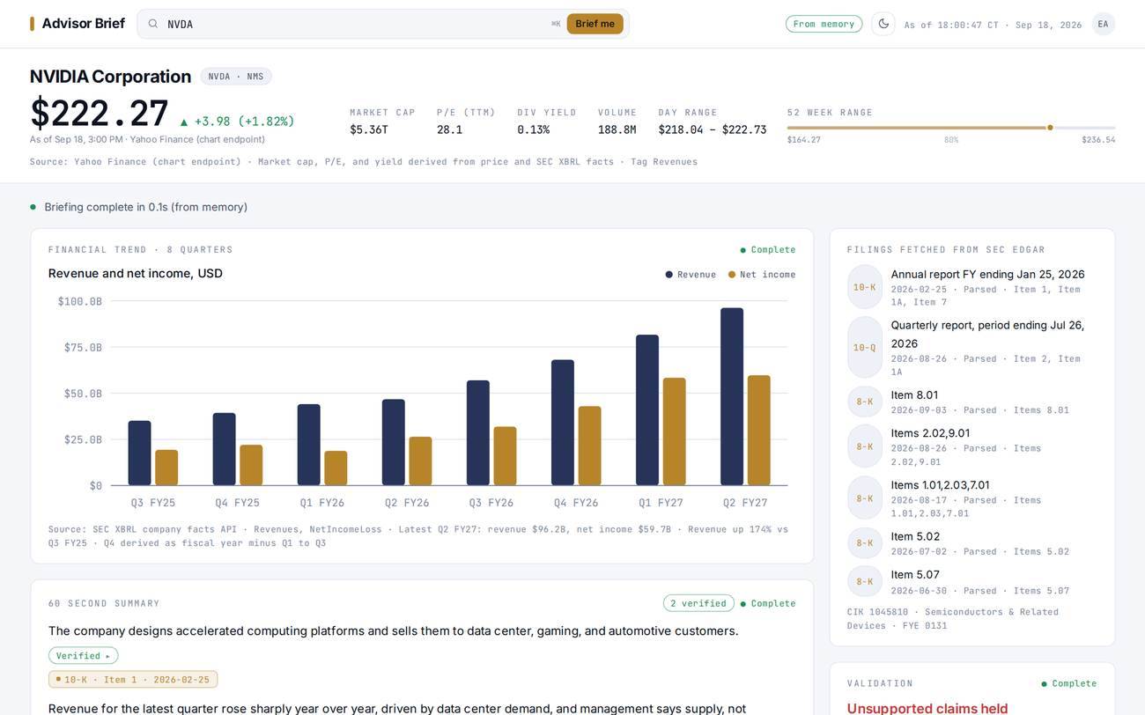
WHAT CHANGES
An hour of reading becomes a minute of preparation.
BEFORE
AFTER
LIGHT OR DARK, DESK OR LAPTOP
45 minutes across three tabs
Notes pasted into an email to self
Numbers remembered, not sourced
Different answers from different advisors
No record of what was said or why
One minute, one page
The source on every sentence
Every number matched to the filing
The same brief for every advisor on the desk
A record of what was shown, with time stamps
The time comes back to the conversation. The consistency comes back to the firm.
Advisor Brief · Prototype for wealth management advisors · September 2026
07 / 08

Slide 8
WHAT HAPPENS NEXT
A four week pilot with your advisors.
WEEKS 1 AND 2
WEEK 3
WEEK 4
Five advisors, ten names each
Review with compliance
Decide
Real client names, real calls. We watch what they ask and what the brief holds aside.
Every brief keeps a record. We sit down with one reviewer and go through what was shown and why.
Usage, accuracy, and time saved on one page, and a plan for rolling it out to the desk.
What we need from you
A short list of names your advisors get asked about most. Ten minutes of feedback per advisor per week. One compliance reviewer for a single session.
The prototype is live today. The pilot can start Monday.
Advisor Brief · Prototype for wealth management advisors · September 2026
08 / 08

