Slide 1
Team Uno
Anthony - AWS, Lobbies, UX
Stephen - Routing, Database, UX
Faisal - Gamepage, Messaging, UX
Chris - Documentation, UX

Slide 2
Structure
"scripts": {
"start": "node ./bin/www",
}
./bin/www → App.JS Starts server and begins listening
Heroku
Amazon AWS (photos)
Express.JS
Handlebars
Postgres

Slide 3
Directory Structure
Bin - Server config
Config - DB (postgres) config from .env
DB - Access DB Functions (pull, update)
Helpers/error - Status messages and redirects
Lib - Server-side handling of actions, games, cookies, authentication ,etc
Migrations - Initialization of DB tables, DB fixes; used by “npx sequelize”
Models - models the db tables
Public - JS and CSS stuff for the client
Routes - Routes client requests
Seeders - Init info the the database (UNO cards)
Socket - Socket endpoints
Views - Uses handlebars to template pages
Env - Configuration Info
App.js - initializes view engine and handlebars

Slide 4
Server Endpoint Examples
/api/users/login (POST)
…/:username/avatar (POST DELETE) ← upload or delete upload profile picture
/api/lobbies (GET) ← get all lobbies
…/:lobby_id (PATCH) ← change name, password, or capacity
…/:lobby_id/guests/:username (PATCH) ← toggle user readiness in lobby
/api/games (POST) ← create a game
…/:game_id/messages (GET) ← fetch all messages in the game chat
…/:game_id/messages (POST) ← send a message in the game chat
…/:game_id/playCard (PATCH) ← handle play card
…/:game_id/drawCard (PATCH) ← handle draw card

Slide 5
Socket.io
Players join a game on the client side and are redirected to /games/:game_id
Clients connect to socket and join a room called “/game/:game_id” via socket.join()
When players in the game make HTTP requests, the requests are broadcasted to the appropriate clients via their room “/game/:game_id” with io.to(“/game/:game_id”)

Slide 6
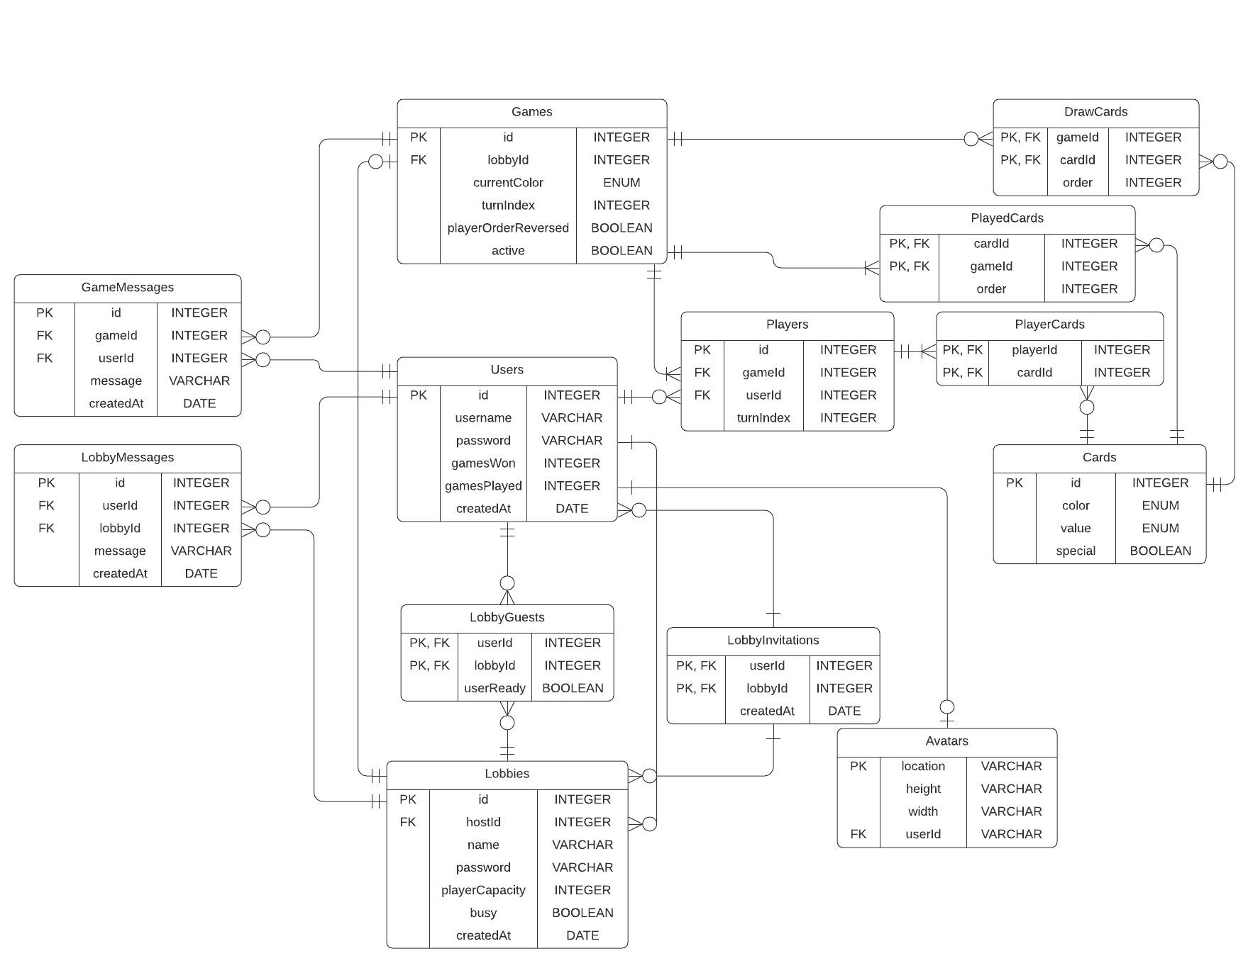

Slide 7
What We Knew And Learned
Anthony
Came in pretty confident
Prior knowledge from previous classes.
Learned about AWS, migrations, and got some great practice
Stephen
Prior knowledge from “Intro. to Web Dev” and “Intro. to Database Systems”
Learned about migrations, better JS async practices, and improved CSS
Faisal
Prior knowledge from other classes + internship
Learned how to use Postgres
Chris
Knew the basics
Learned about handlebars, better structure, and version control

Slide 8
Struggles
Anthony
Using AWS buckets and connecting and implementing the functionality from creating a lobby to initializing a game state.
Stephen
Finding a way to detect whether an image was a portrait or landscape to center it appropriately inside a div element
Ended up creating a new table called “Avatars” which contains height and width columns for users’ profile pictures
Faisal
Brainstorming the game layout, actions, and logic so the game flows well.
Server handling was easy, but the complex (but nice) UI made websocket updates difficult to handle.
Chris
The size and scope of the project
The fact I had little prior experience
Understanding database stuff / also some of the architecture standards

Slide 9
Features List
Creating a lobby
Inviting users to lobby (notification system)
Searching lobbies and available lobbies board
Lobby messaging
Lobby readiness toggle
New lobby owner assigned
Deleting lobby
Private lobbies and lobby password
Leaderboard of top user scores
Secure passwords / account creation
Updating and changing of passwords
Profile pictures and updating profile pictures
Search users and display profile picture
Full implementation of Uno game
In-game chat
Changing background color while in-game
Basic animations

Slide 10
What We Would Do If We Had More Time
Better refreshing / some bug handling w.r.t. the gameplay
Known bug #1: very rarely gameplay doesn’t update and the user must refresh their screen (and it only happens to Chris’ browser).
Mobile browser compatibility
A detailed game history for each user
Ability to add other users as friends
Add 30 second time limit for each player’s turn in a game
Allow stacking of +2 & +4 cards

Slide 17
Thanks For Teaching Us!

