Slide 1
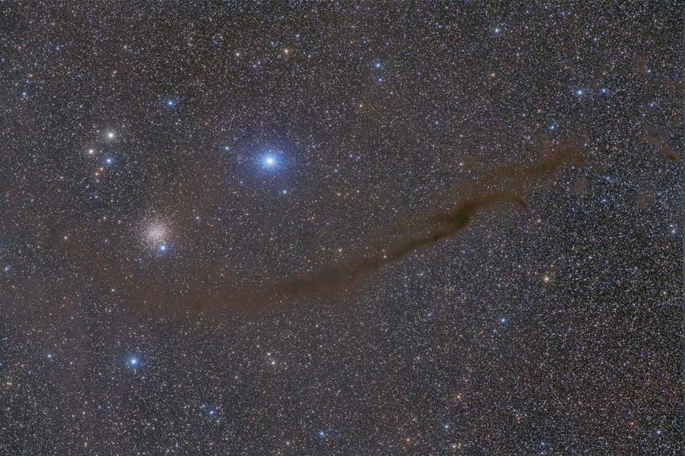
5.5 Parallel and Perpendicular Lines
SWBAT verbally tell me how the slope of parallel lines and perpendicular lines are related. They can find the equation of a line parallel/perpendicular to a given line that passes through a given point.
http://apod.nasa.gov/apod/
The Dark Doodad Nebula

Slide 2

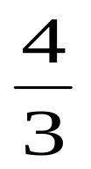
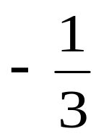
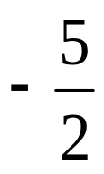
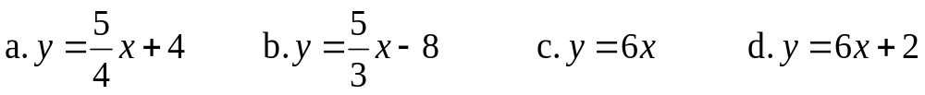
Mini Quiz 45
1.Find the reciprocal of each fraction
a. b. c. d.
2.Find the slope and y-intercept of each equation

Slide 3
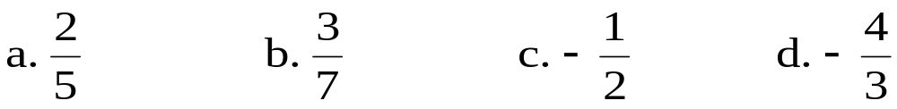
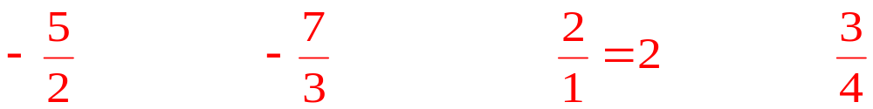
Quick Review/Preview
1. What is the Slope-Intercept Form?
y = mx + b
2. What is the Standard Form?
Ax + By = C
3. What is the Point-Slope Form?
y – y₁ = m(x – x₁)
4. Find the “negative reciprocal” of each fraction

Slide 4
Overview
Parallel Lines and Perpendicular Lines
Property of their slopes
Write equations for each type of lines

Slide 5
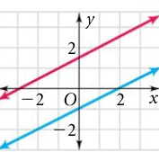
Parallel Lines
Parallel Lines - lines that never intersect
What is the slope of the
red line?
1/2
What is the slope of the
blue line?
1/2
Parallel Lines have the slope!
same

Slide 6
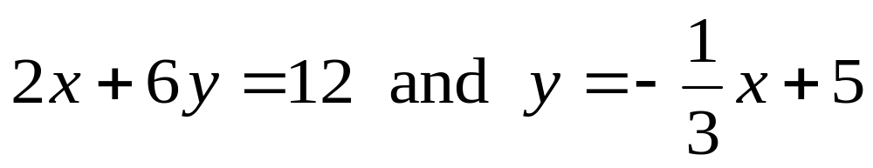
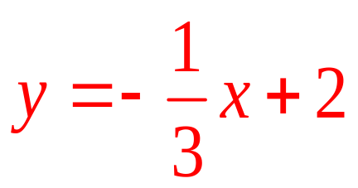
Parallel Lines
Determine if the lines are parallel
1.
2x + 6y = 12
6y = -2x + 12
yes

Slide 7
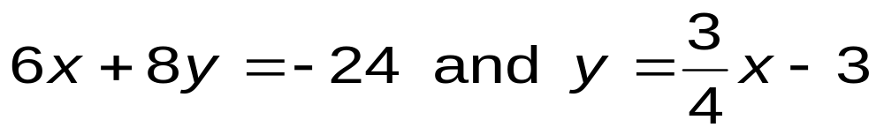
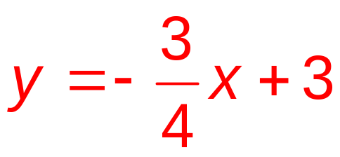
Parallel Lines
Determine if the lines are parallel
2.
6x + 8y = -24
8y = -6x – 24
No

Slide 8
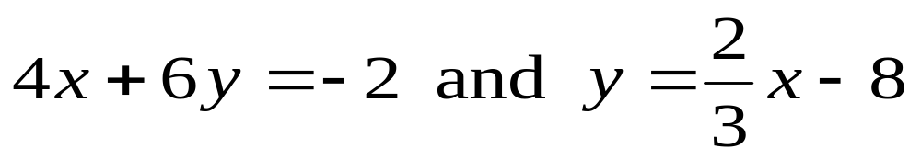
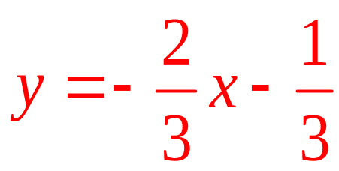
Parallel Lines
Determine if the lines are parallel
3.
4x + 6y = -2
6y = -4x – 2
No

Slide 9
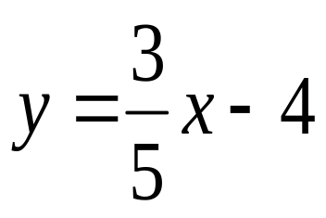

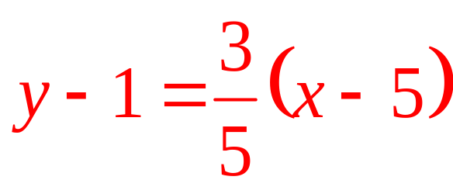
Equations of Parallel Lines
4. Write an equation for the line that contains (5, 1) and is parallel to
m =

Slide 10
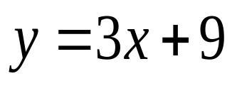
Equations of Parallel Lines
5. Write an equation for the line that contains (2, -6) and is parallel to
m = 3
y + 6 = 3(x – 2)

Slide 11
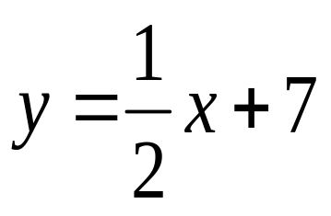

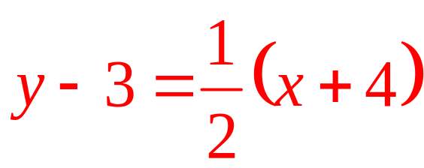
Equations of Parallel Lines
6. Write an equation for the line that contains (-4, 3) and is parallel to
m =

Slide 12
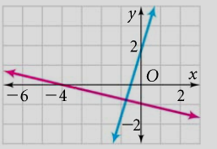
Perpendicular Lines
Perpendicular Lines – lines that intersect to form right angles
What is the slope of the
red line?
-1/4
What is the slope of the
blue line?
4/1
Perpendicular Lines have slope!
negative reciprocal

Slide 13
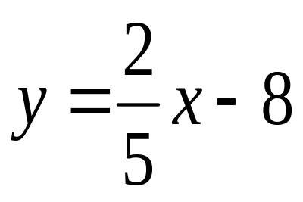
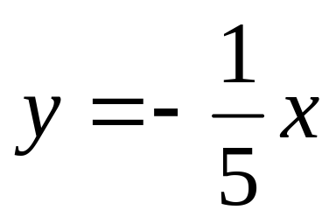
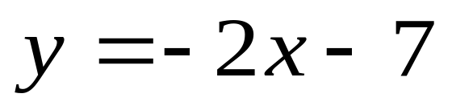
Perpendicular Lines
What is the slope of the perpendicular line?
7.
-5/2
8.
5/1 = 5
9.
1/2

Slide 14
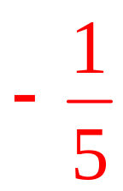
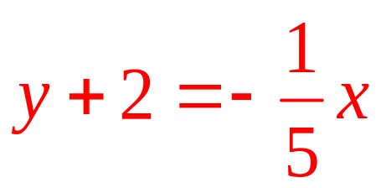
Equations of Perpendicular Lines
10. Find the equation of the line that contains (0, -2) and is perpendicular to y = 5x + 3
m =

Slide 15
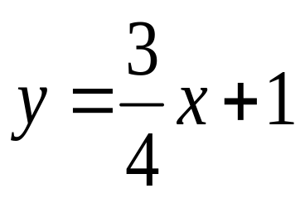
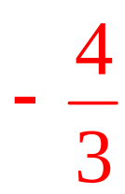
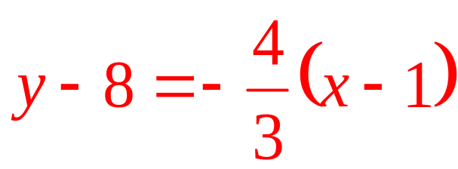
Equations of Perpendicular Lines
11. Find the equation of the line that contains (1, 8) and is perpendicular to
m =

Slide 16
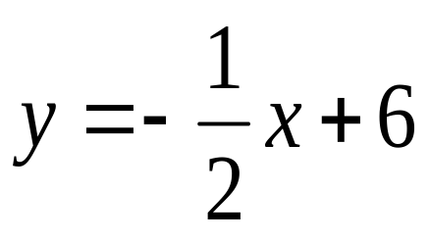
Equations of Perpendicular Lines
12. Find the equation of the line that contains (2, -3) and is perpendicular to
m = 2
y + 3 = 2(x – 2)

Slide 17
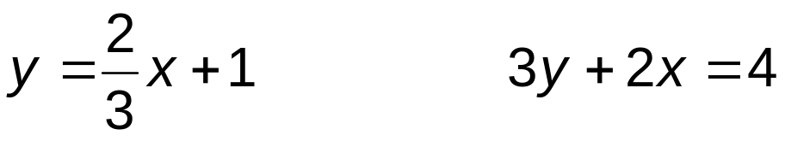


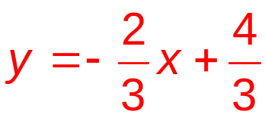
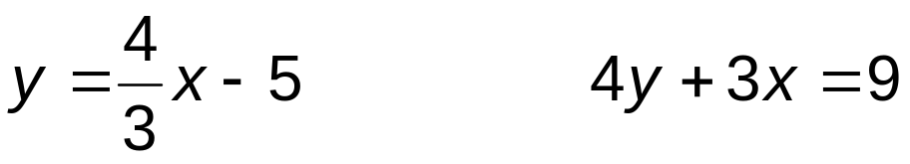


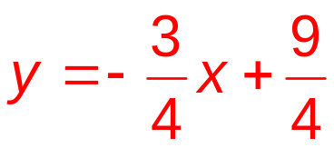
Perpendicular Lines
13. Determine if the lines are perpendicular:
and
No
14. Determine if the lines are perpendicular:
and
Yes

Slide 18
Challenge
What is the slope of the line that is parallel to x = 4?
undefined
What is the slope of the line that is perpendicular to x = 4?
zero

Slide 19
Wrap Up
Parallel lines
  Slopes
  Determine if two lines are parallel
  Write equations of parallel lines
Perpendicular lines
  Slopes
  Determine slope of perpendicular lines
  Write equations of perpendicular lines
  HW: P. 262 #1-45 EOO; P. 265 #1-5 all
  DLUQ: What kind of slope do parallel and perpendicular lines have?

