Slide 1
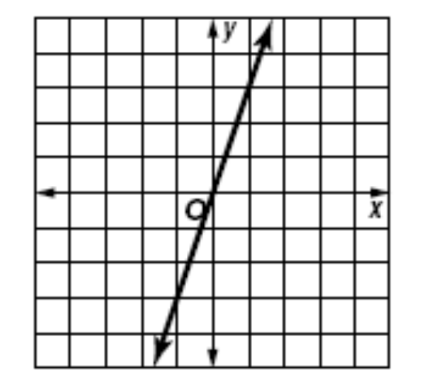
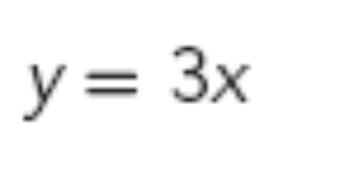
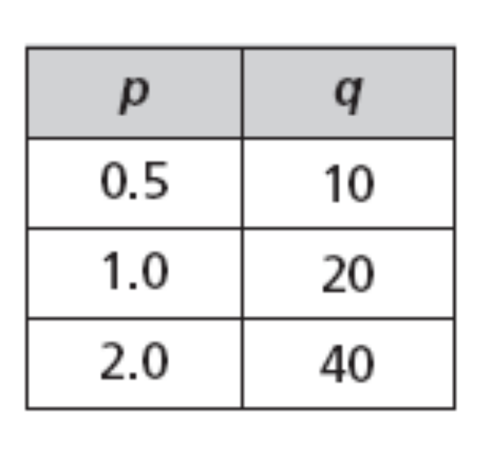
What do all three of these have in common?

Slide 2
11.3 Direct and Inverse Variation
Direct Variation
The following statements are equivalent:
y varies directly as x.
y is directly proportional to x.
y = kx for some nonzero constant k.
k is the constant of variation or the constant of proportionality

Slide 3
11.3 Direct and Inverse Variation
If y varies directly as x, then y = kx.
This looks similar to function form y = mx + b without the b
So if x = 2 and y = 10
Therefore, by substitution 10 = k(2).
What is the value of k? 10 = 2k
10 = 2k
5 = k

Slide 4
11.3 Direct and Inverse Variation
y = kx
can be rearranged to get k by itself
y = kx
÷x ÷x
y ÷x = k
or
k= y/x
So our two formulas for Direct Variation are
y=kx and k=y/x

Slide 5
Direct Variation in Function Tables
Direct Variation Formulas:
y= kx or k= y/x
y= kx
Since we multiply x by five in each set, the constant (k) is 5.
k= y/x
Or you can think of it as y divided by x is K.
This is a Direct Variation.
x y
2 10
4 20
6 30

Slide 6
Direct Variation in Function Tables
x y
2 1
4 2
6 3
y= kx or k=y/x
Is this a direct variation?
What is K?
K= ½ which is similar to divide by 2.

Slide 7
Direct Variation in Function Tables
x y
-2 -4.2
-1 -2.1
0 0
2 4.2
y= kx or k=y/x
Is this a direct variation?
What is K?
K= 2.1

Slide 8
Direct Variation in Function Tables
x y
2 6.6
4 13.2
6 19.8
y= kx or k=y/x
Is this a direct variation?
What is K?
K= 3.3

Slide 9
Direct Variation in Function Tables
x y
2 -6.2
4 -12.4
7 -21.5
y= kx or k=y/x
Is this a direct variation?
No, K was different for the last set.

Slide 10
11.3 Direct and Inverse Variation
Direct variations should
graph a straight line
Through the origin.
15
y = kx
10
y = 2x
5
2 = y/x
0
0
5
10
15
20

Slide 11
Direct Variation
How do you recognize direct variation from a table?
How do you recognize direct variation from a graph
How do you recognize direct variation from an equation?

Slide 12
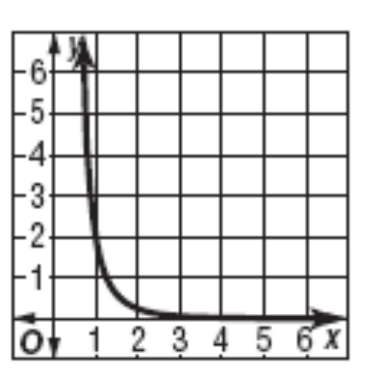
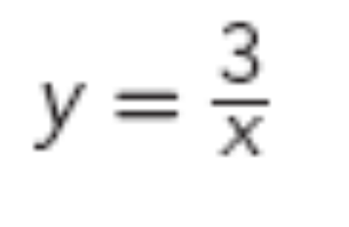
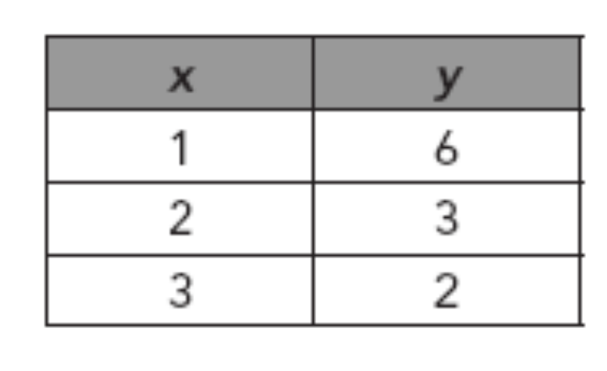
What do all three of these have in common?

Slide 13
11.3 Direct and Inverse Variation
Inverse Variation
The following statements are equivalent:
y varies inversely as x.
y is inversely proportional to x.
y = k/x for some nonzero constant k.
xy = k

Slide 14
Since Direct Variation is Y=kx
(k times x)
then
Inverse Variation is the opposite Y=k/x
(k divided by x)

Slide 15
Inverse Variation in Function Tables
Inverse Variation Formulas
y= k/x or xy= k
Is this an inversely proportional?
Yes, xy=10
x y
2 5
4 2.5
8 1.25

Slide 16
InverseVariation in Function Tables
Inverse Variation Formulas
y= k/x or xy= k
Is this an inversely proportional?
Yes, xy=-2
x y
-2 1
-4 1/2
6 -1/3

Slide 17
Inverse Variation in Function Tables
Inverse Variation Formulas
y= k/x or xy= k
Is this an inversely proportional?
No
x y
-2 -4.2
-1 -2.1
0 0
2 4.2

Slide 18
Inverse Variation in Function Tables
Inverse Variation Formulas
y= k/x or xy= k
Is this inversely proportional?
No, the last set is incorrect.
x y
2 6.6
2.5 5.28
-3 -4

Slide 19
Inverse Variation in Function Tables
Inverse Variation Formulas
y= k/x or xy= k
Is this inversely proportional?
No, the middle set is incorrect.
x y
2 -6.2
4 -12.4
8 -1.55

Slide 20
11.3 Direct and Inverse Variation
will be a curve that never crosses the x or y axis
•
15
y= 16/x
10
k= xy
•
16= xy
5
•
•
•
0
0
5
10
15
20

Slide 21
Inverse Variation
How do you recognize inverse variation from a table?
How do you recognize inverse variation from a graph
How do you recognize inverse variation from an equation?

