Slide 1
Exponent Rules

Slide 2
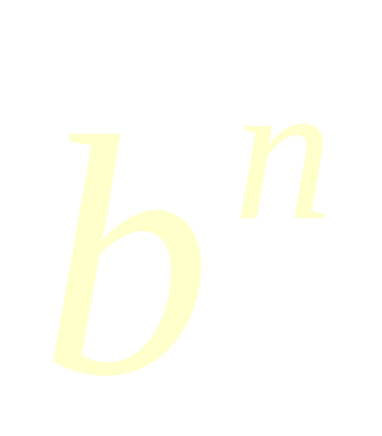
Parts
When a number, variable, or expression is raised to a power, the number, variable, or expression is called the base and the power is called the exponent.

Slide 3
What is an Exponent?
An exponent means that you multiply the base by itself that many times.
For example
x⁴ =
x
● x
● x
● x
2⁶ =
2
● 2
● 2
● 2
● 2
● 2
= 64

Slide 4
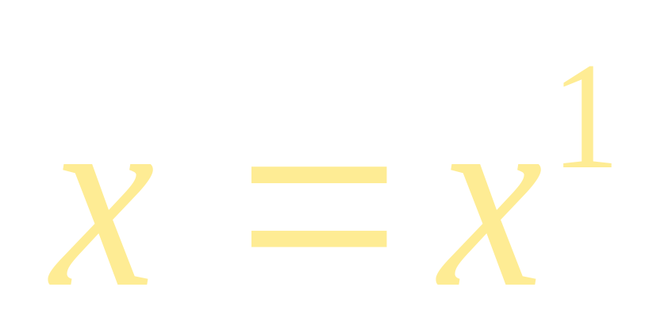
The Invisible Exponent
When an expression does not have a visible exponent its exponent is understood to be 1.

Slide 5
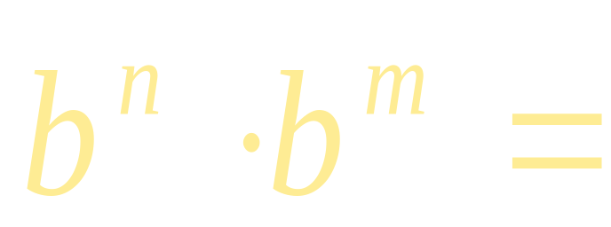
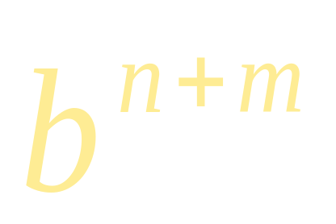
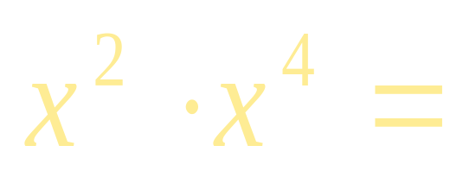
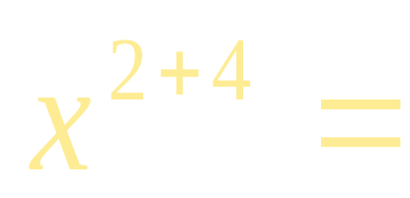
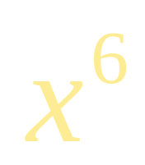
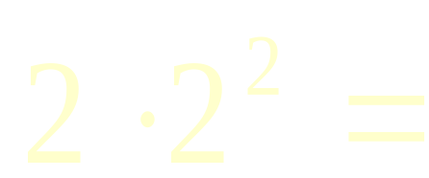
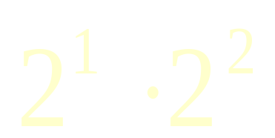
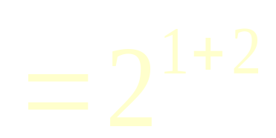
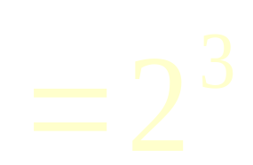
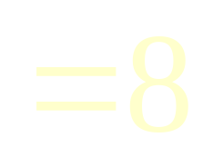
Exponent Rule #1
When multiplying two expressions with the same base you add their exponents.
For example

Slide 6
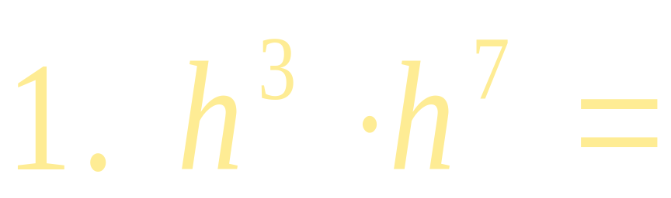
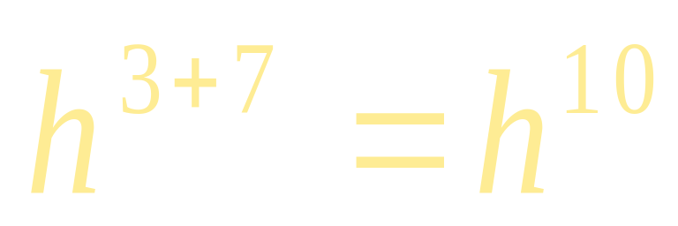
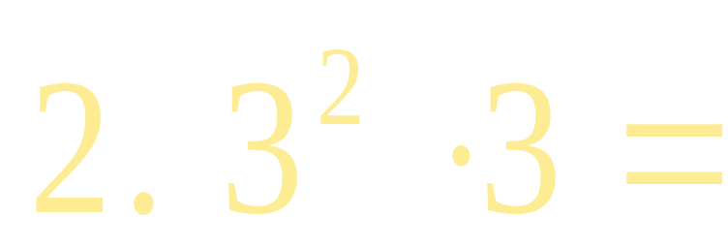
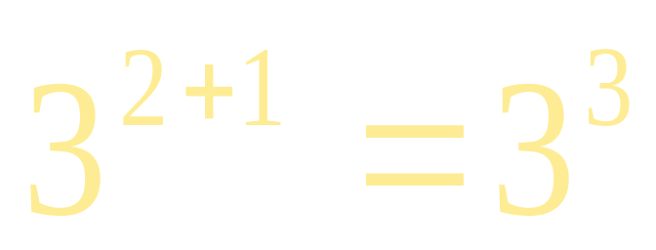
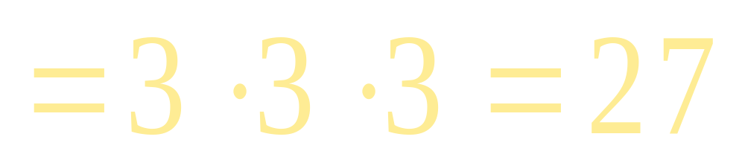
Exponent Rule #1
Try it on your own:

Slide 7
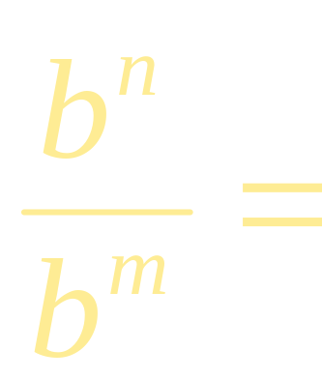
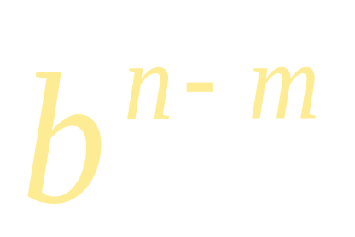
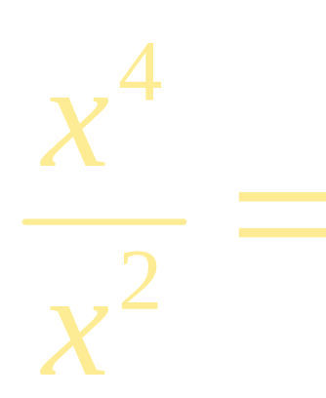
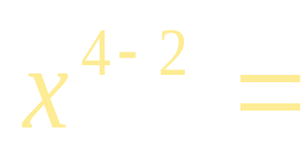
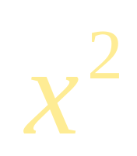
Exponent Rule #2
When dividing two expressions with the same base you subtract their exponents.
For example

Slide 8
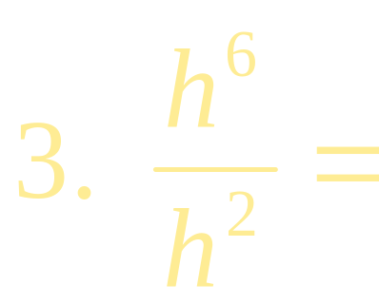
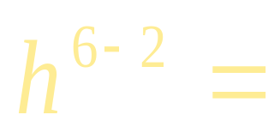
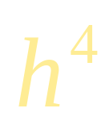
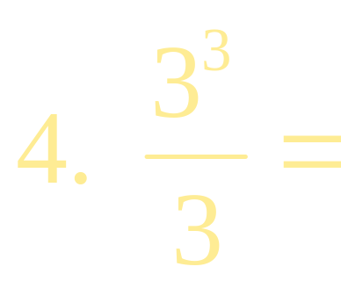
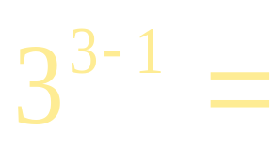
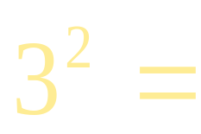

Exponent Rule #2
Try it on your own:

Slide 9
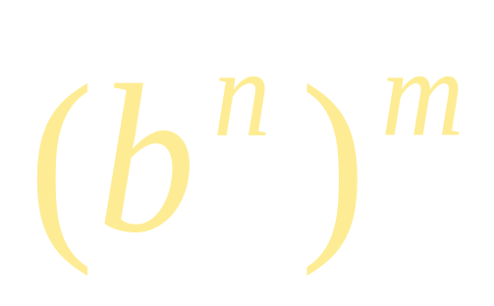
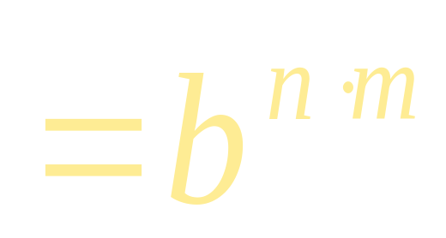
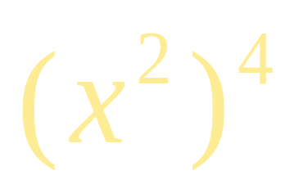
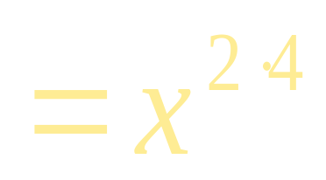
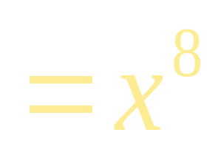
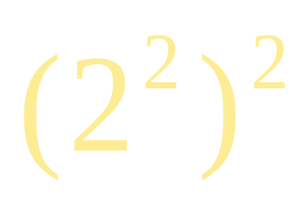
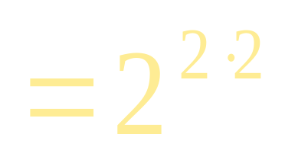
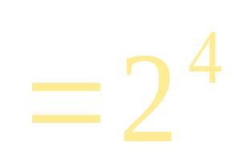
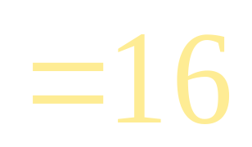
Exponent Rule #3
When raising a power to a power you multiply the exponents
For example

Slide 10
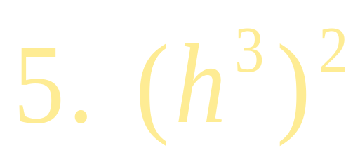
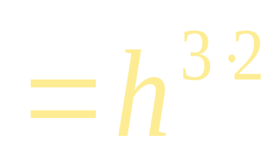
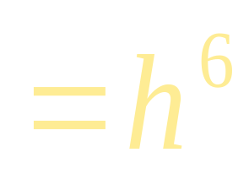
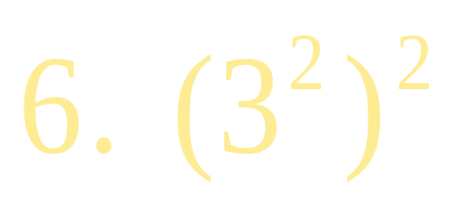
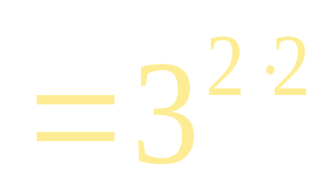
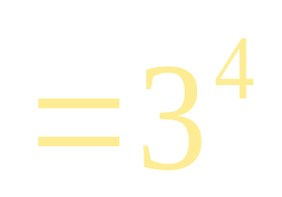
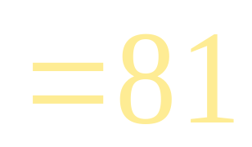
Exponent Rule #3
Try it on your own

Slide 11
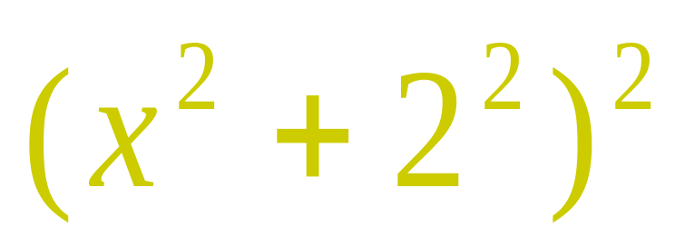
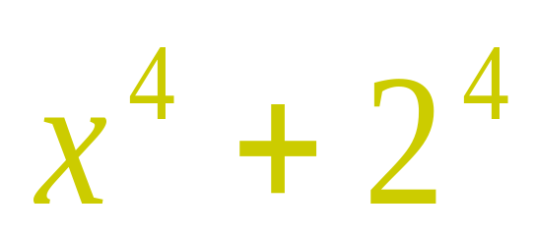

Note
When using this rule the exponent can not be brought in the parenthesis if there is addition or subtraction
You would have to use FOIL in these cases

Slide 12
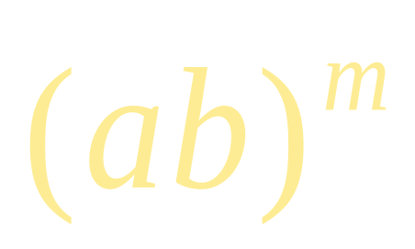
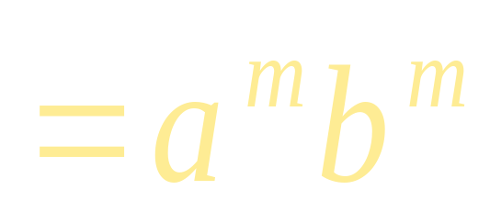
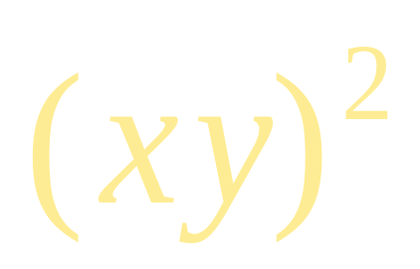
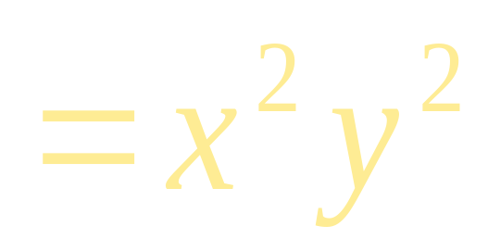




Exponent Rule #4
When a product is raised to a power, each piece is raised to the power
For example

Slide 13






Exponent Rule #4
Try it on your own

Slide 14


Note
This rule is for products only. When using this rule the exponent can not be brought in the parenthesis if there is addition or subtraction
You would have to use FOIL in these cases

Slide 15




Exponent Rule #5
When a quotient is raised to a power, both the numerator and denominator are raised to the power
For example

Slide 16






Exponent Rule #5
Try it on your own

Slide 17




Zero Exponent
When anything, except 0, is raised to the zero power it is 1.
For example
( if a ≠ 0)
( if x ≠ 0)

Slide 18




Zero Exponent
Try it on your own
( if a ≠ 0)
( if h ≠ 0)

Slide 19







Negative Exponents
If b ≠ 0, then
For example

Slide 20





Negative Exponents
If b ≠ 0, then
Try it on your own:

Slide 21






Negative Exponents
The negative exponent basically flips the part with the negative exponent to the other half of the fraction.

Slide 22
Math Manners
For a problem to be completely simplified there should not be any negative exponents

Slide 23







Mixed Practice

Slide 24






Mixed Practice

Slide 25









Mixed Practice

Slide 26




Mixed Practice

Slide 27








Mixed Practice
F
O
I
L

Slide 28




Mixed Practice

