Slide 1
Function
IGCSE Math

Slide 2
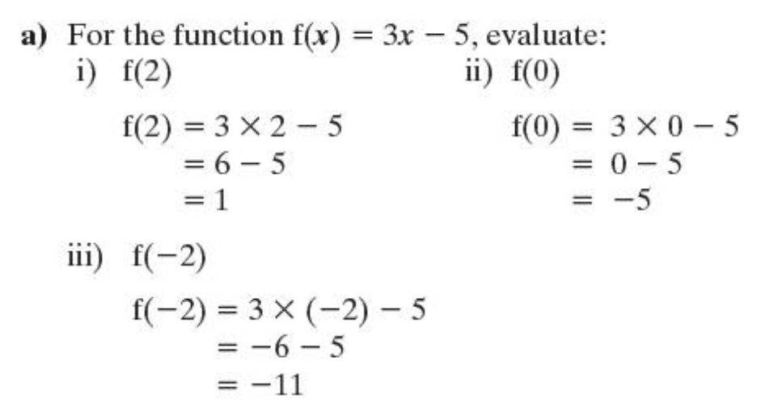
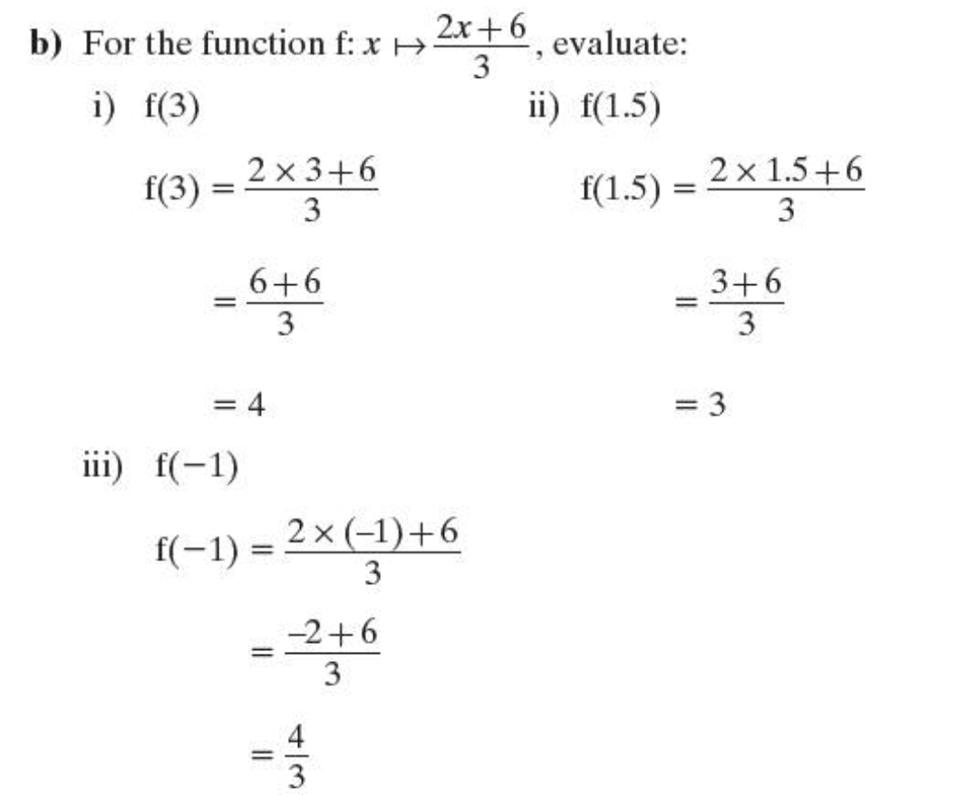
An expression such as 4x – 9, in which the variable is x, is called “a function of x”. Its numerical value depends on the value of x. We sometimes write f(x) = 4x – 9, or f: x ↦ 4x – 9.

Slide 3
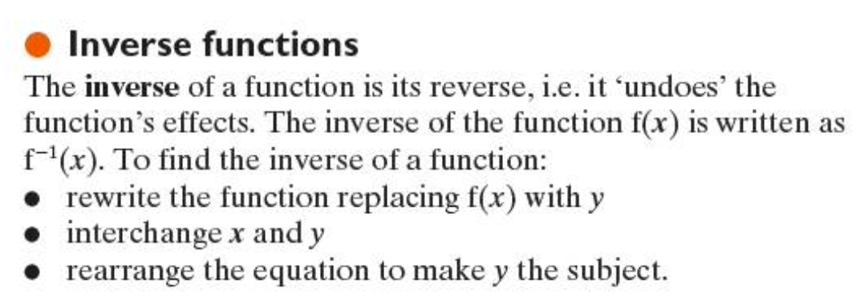
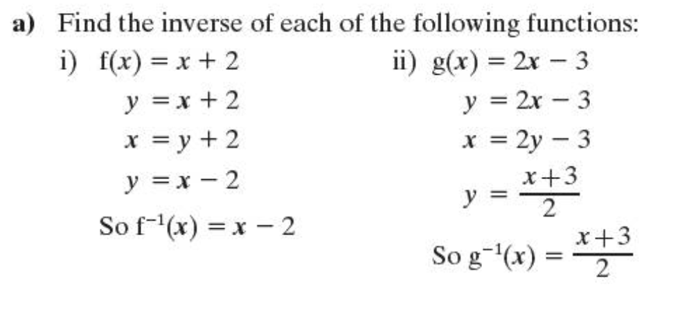
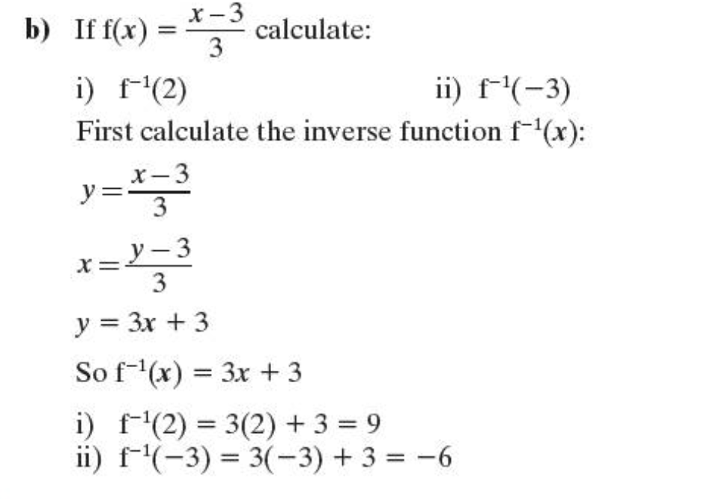

Slide 4
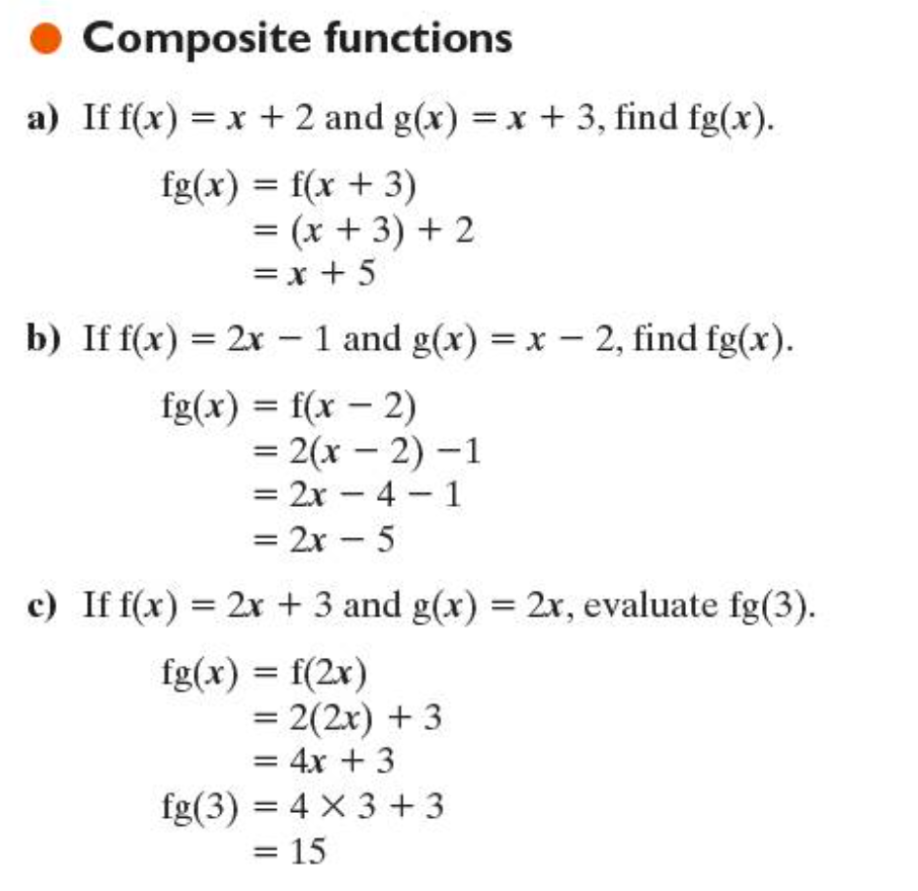

Slide 5
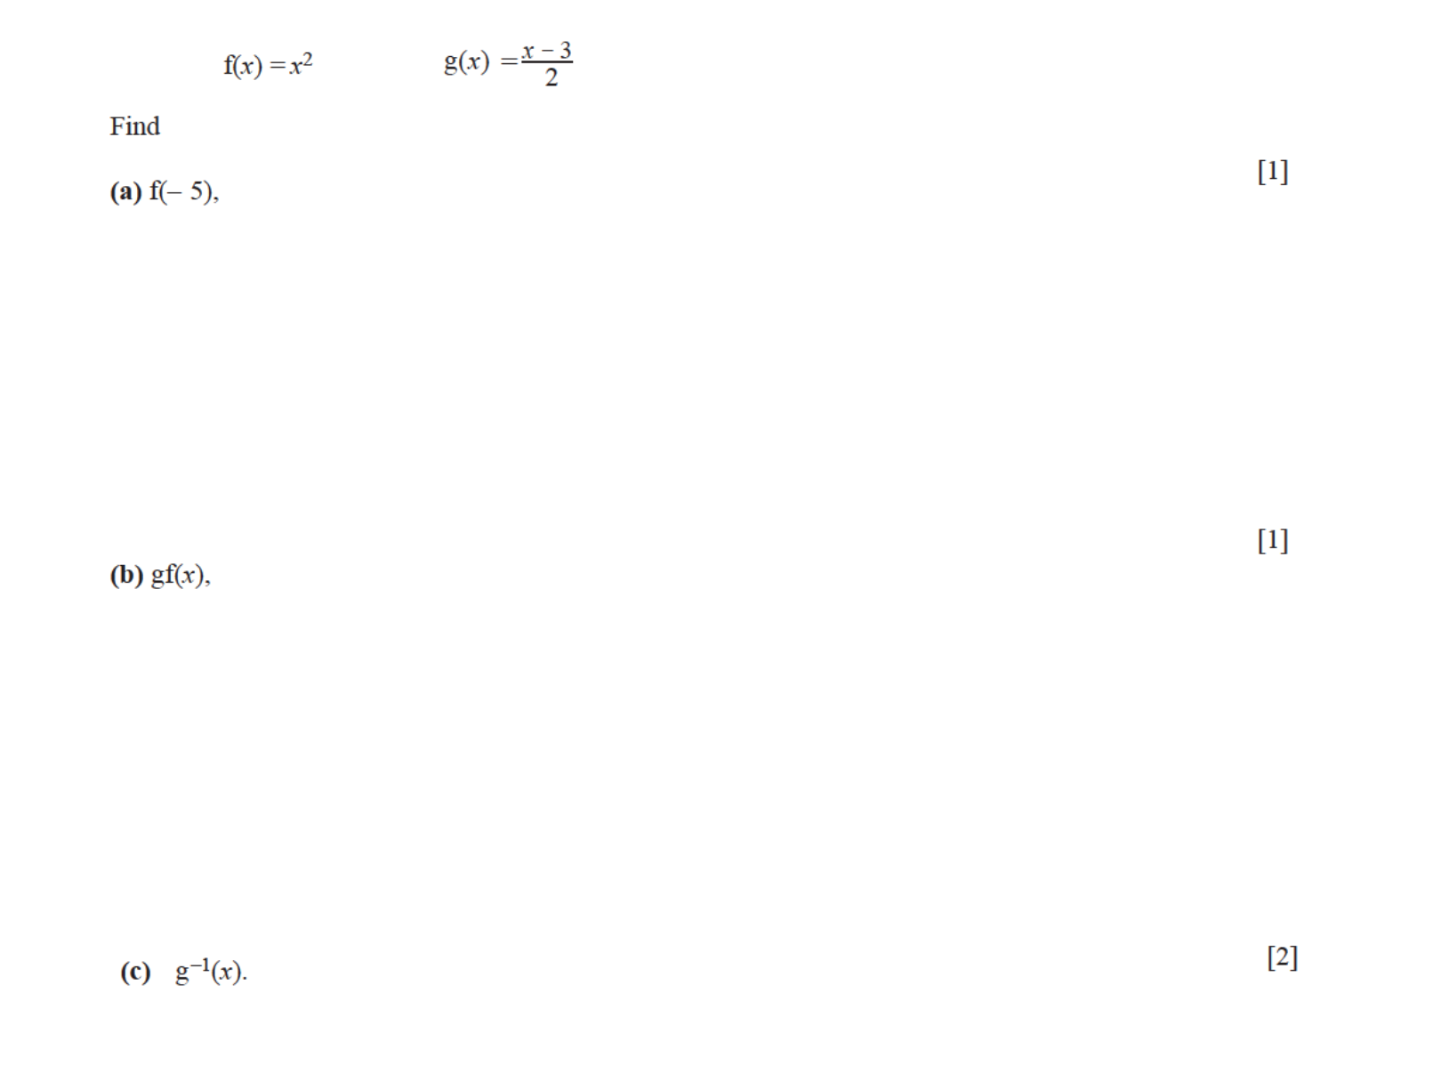

Slide 6
