Slide 1
Concept: What is Slope?
Steepness
Change in Y
Change in X
+SLOPE +
Rise
Run
- SLOPE -
Y=mx + b
Amount of Slant

Slide 2

What does the line look like when…
You have positive slope?
You have negative slope?
You have zero slope?
0
0
You have NO slope?
(Undefined)

Slide 3
Concept: Definitions of Slope
The tilt or inclination of a line
The ratio of vertical change to horizontal change.
The change in y over the change in x
Notes:
Allow students time to copy
May need to review that a ratio is a comparison of numbers

Slide 4
Concept: The Graph of y = mx +b
DO NOT WRITE THIS DOWN!! JUST WATCH.
Consider the graph of y = x - 2
5
4
3
2
1
y
Compare to the graph of y = ½x - 2
Notice with the smaller slope, the line becomes flatter.
x
-7 -6 -5 -4 -3 -2 -1 1 2 3 4 5 6 7
Now compare to the graph of y=2x-2
-2
-3
-4
-5
Notice with the larger slope, the line becomes steaper.

Slide 5
Concept: The Graph of y = mx +b cont.
DO NOT WRITE THIS DOWN!!! JUST WATCH.
Consider the graph of y = x - 2
When x is positive the graph goes up-hill from left to right.
5
4
3
2
1
y
Compare to the graph of y = -x – 2.
What do you think will
happen?
x
-7 -6 -5 -4 -3 -2 -1 1 2 3 4 5 6 7
-2
-3
-4
-5
When x is negative the graph goes down-hill from left to right.

Slide 6
Concept: Determining Slope
Slope = 0
Positive Slope
Negative slope is a downer
Undefined Slope
Negative Slope

Slide 7
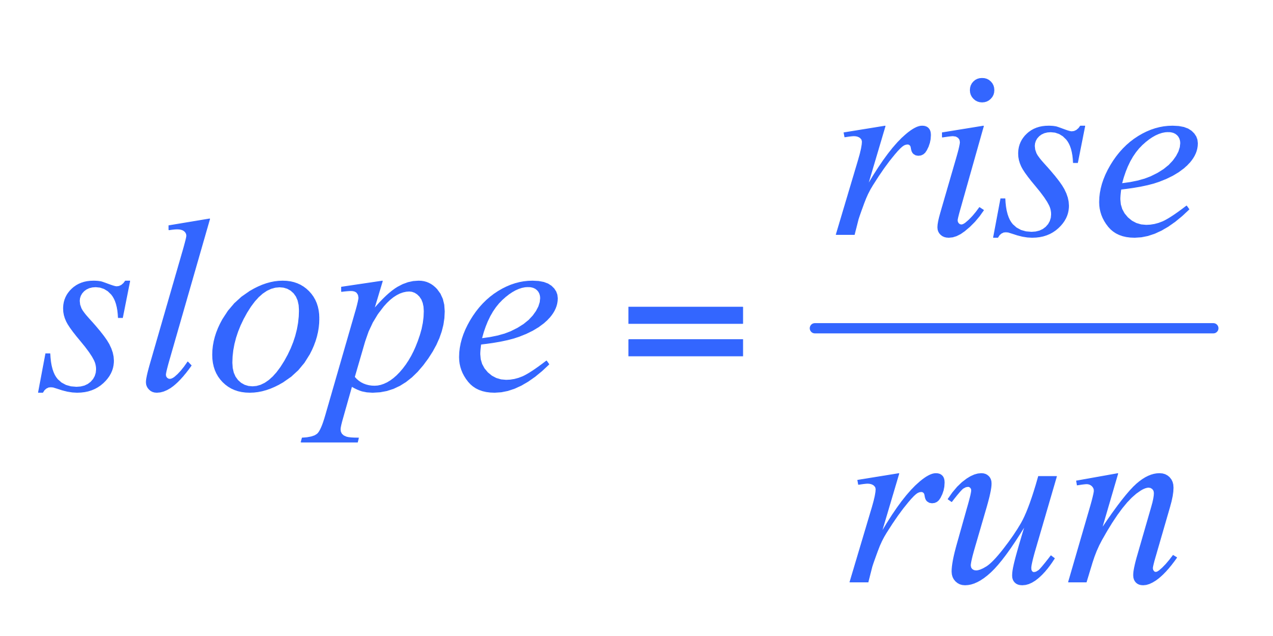
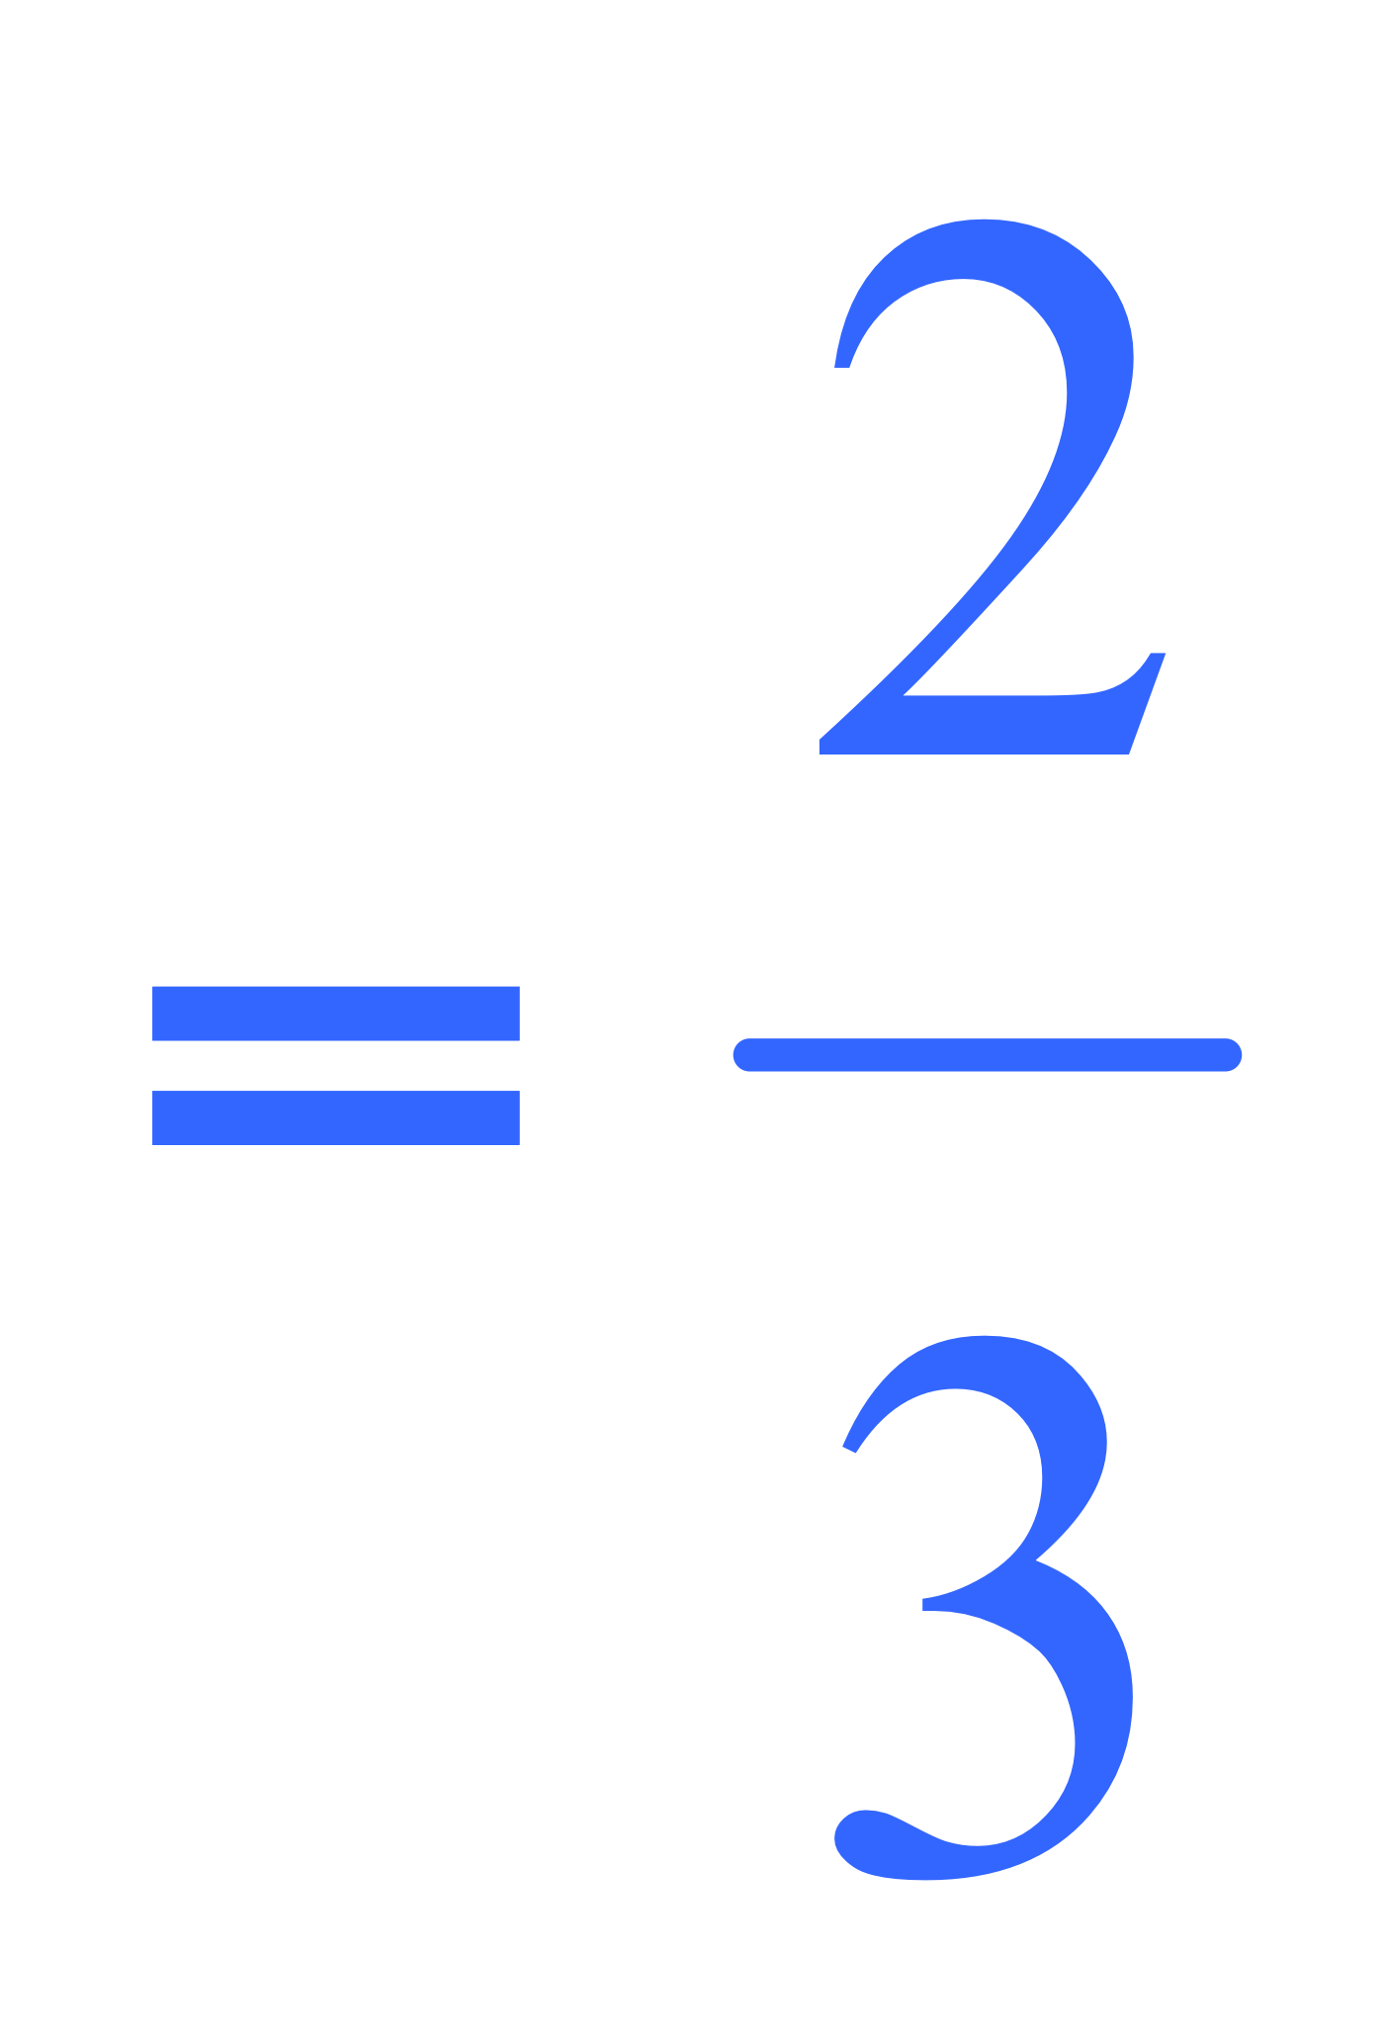
Concept: Determining Slope cont. . .
First pick two points on the line
The points need to be where the lines cross so they are integers
2. Then find the rise and run
3. Determine if the slope of the line is positive or negative
Rise = –2
Run = 3

Slide 8
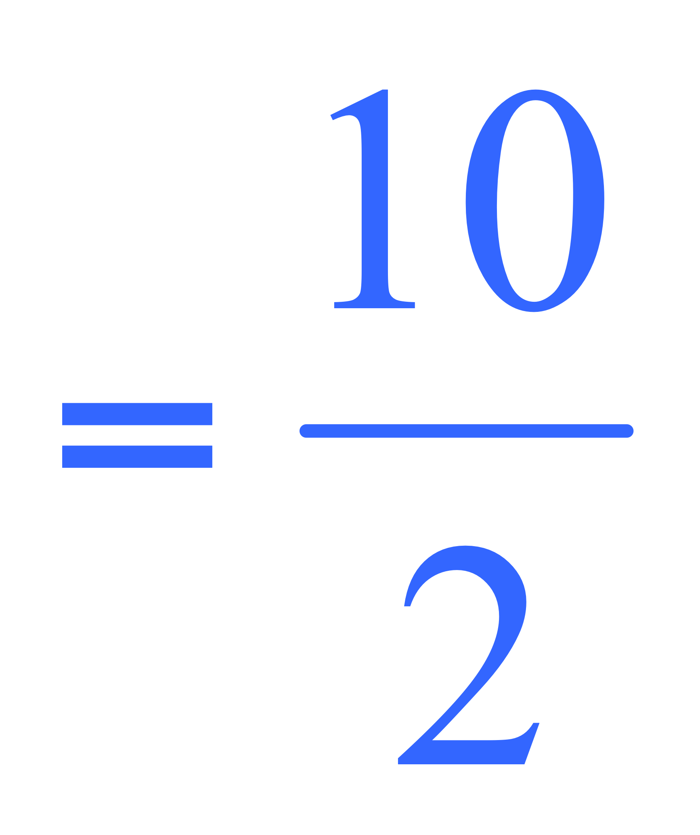
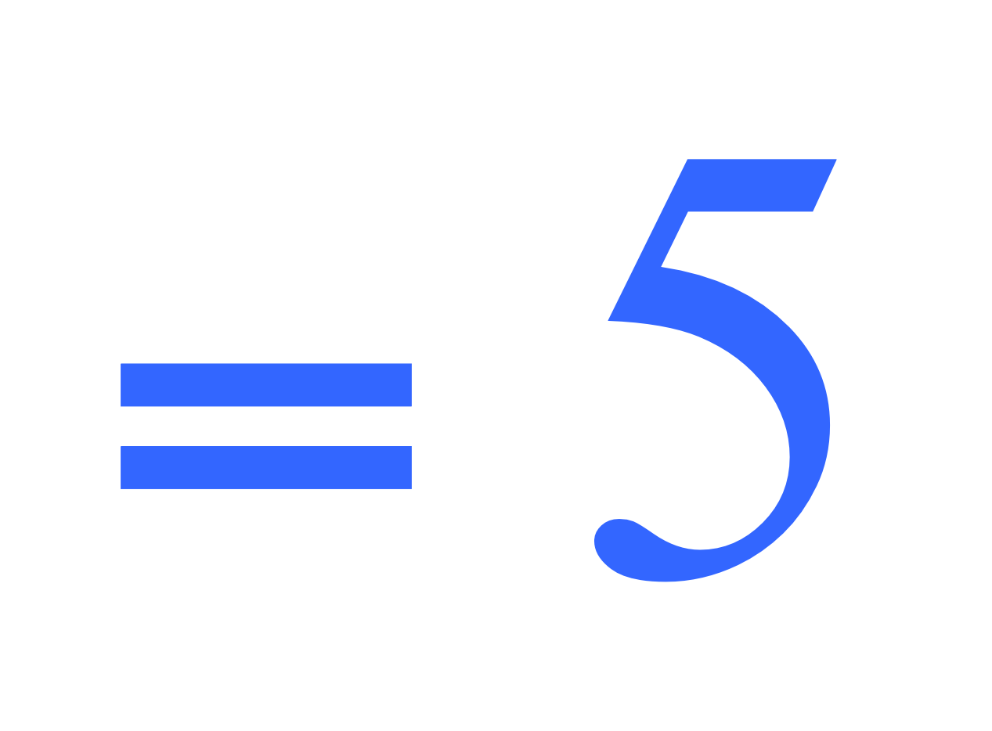
Concept: Determining Slope cont. . .
First pick two points on the line
The points need to be where the lines cross so they are integers
2. Then find the rise and run
3. Determine if the slope of the line is positive or negative
Rise = 10
Run = 2

Slide 9
Concept: Determining Slope cont. . .
Special Lines: Horizontal Lines
Rise= 0
Run = n
Slope= 0

Slide 10
Concept: Determining Slope cont. . .
Rise= n
Run = 0
The Slope is UNDEFINED

Slide 11
Concept: Review slope-intercept form
Slope-Intercept Form of the Linear Equation
y = mx + b
m
b
= slope
= y-intercept
Any linear equation which is solved for y is in slope-intercept form.

Slide 12
Find the slope and y-intercept of the following linear equations:
Concept: Review cont…
y = 3x + 4
y = -2x - 1
m = 3
b = 4
m = -2
b = -1
-2
1
y = x –
y = 5x
9
4
m =
-2
-1
b =
m = 5
b = 0
9
4

Slide 13
Concept: Graphing Using Slope and y-Intercept
1: Make sure the equation is in slope-intercept
form (y = mx + b)
2: Find the slope and y-intercept
3: Plot the y-intercept
4: Apply the slope (rise/run) to the y-intercept

Slide 14
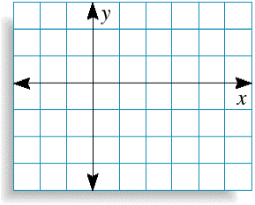
Concept: Graphing slope-intercept cont…
3
Graph y = x – 2
4
SOLUTION
(4, 1)
The equation is already in slope-intercept form.
3
(0, – 2)
The y-intercept is – 2, so plot the point (0, – 2) where the line crosses the y -axis.
4
(0, – 2)
3
The slope is , so plot a second point on the line by moving
4 units to the right and 3 units up. This point is (4, 1).
4
(4, 1).
Draw a line through the two points.

Slide 15
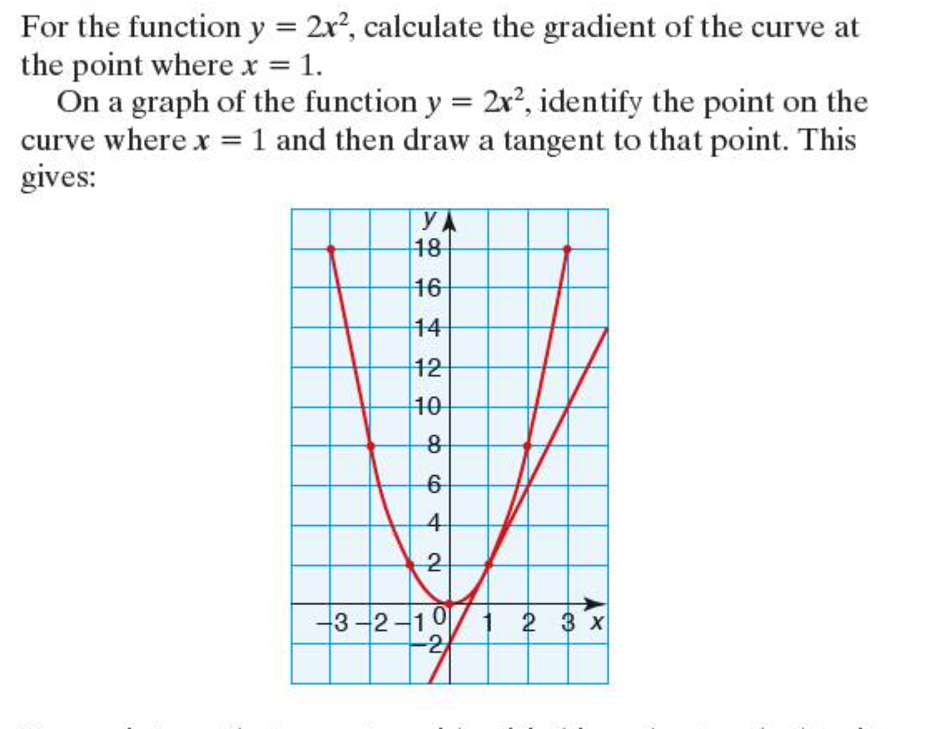

Slide 16
