Slide 1
Upper & Lower Bounds
WALT:
WILF:
Find the upper and lower bounds of quantities and calculations
Grade 6
Is the answer to:
Is the answer to:
Is the answer to:
Work out the upper and lower bounds of the height of Laura.
Laura’s height is 1.4m to 2sf.
All these numbers have been rounded to 2sf.
Work out the upper and lower bounds for this calculation.
12 ÷ 5.6
Here are the dimensions of a room to 3sf.
5.25m x 10.1m x 2.00m
Work out the upper and lower bounds for the volume of the room.
Grade 5
Grade 6
Grade 7
Accurate Upper and lower bounds Rounding
Significant figures
Keywords

Slide 2
Upper & Lower Bounds
Starter:
Round these numbers to 2sf and 3f.
2sf
3sf
1
5,316
5,300
5,320
2
0.002399
0.0024
0.00240
3
20,081,623
20,000,000
20,100,000
4
0.99999
1.0
1.00
5
0.50505
0.51
0.505
6
5.28431
5.3
5.28

Slide 3
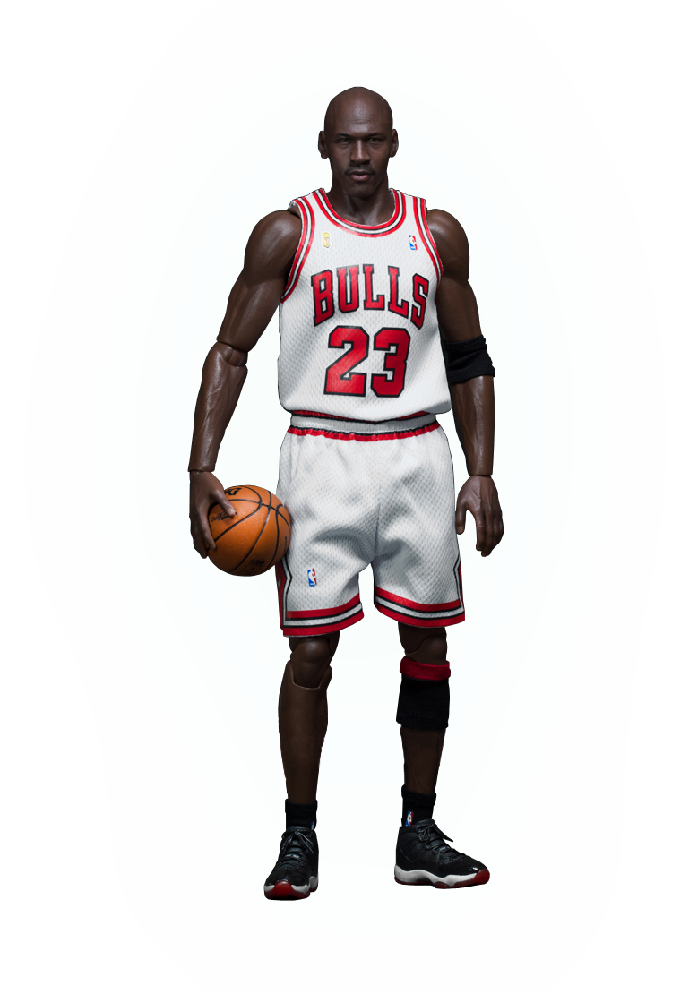
Upper & Lower Bounds
B-Ball:
When you measure something, it is rarely totally accurate.
The accuracy depends on the units to which you are measuring
What is the upper and lower bounds of Michael Jordan's height?
Lower Bound:
Lower bound is the lowest number that can be rounded to 198cm
198cm
197.5cm
Upper Bound:
Upper bound is the maximum number that can be rounded to 198cm
198.5cm

Slide 4
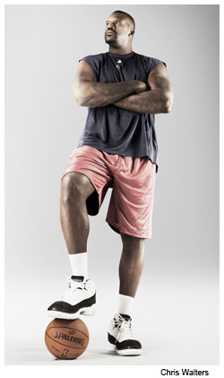
Upper & Lower Bounds
B-Ball:
When you measure something, it is rarely totally accurate.
The accuracy depends on the units to which you are measuring
What is the upper and lower bounds of Shaquille O’Neal’s height?
Lower Bound:
Lower bound is the lowest number that can be rounded to 2.16m
2.16m
2.155m
Upper Bound:
Upper bound is the maximum number that can be rounded to 2.16m
2.165m

Slide 5
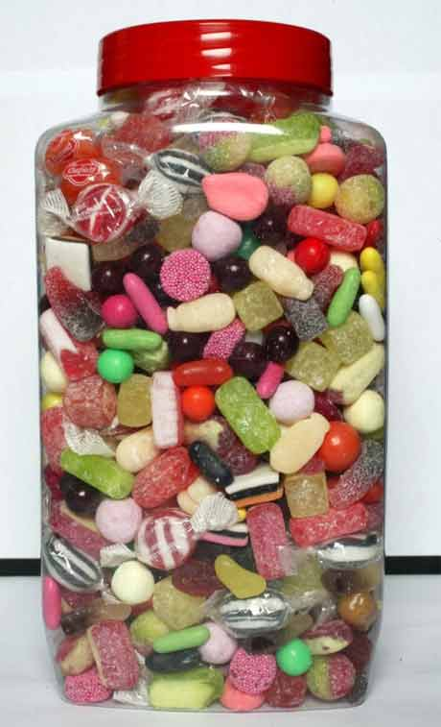
Upper & Lower Bounds
B-Ball:
When you measure something, it is rarely totally accurate.
The accuracy depends on the units to which you are measuring
There are 500 sweets in this jar.
Lower Bound:
Lower bound is the lowest number that can be rounded to 500
450 sweets
Upper Bound:
Upper bound is the maximum number that can be rounded to 500
549 sweets

Slide 6
Upper & Lower Bounds
Examples:
Find the upper and lower bounds for each quantity
Eg1
The population of Liverpool is 466,000 (to the nearest 1000)
Lower Bound:
465,500
Upper Bound:
466,499
Eg2
The distance from L’pool to M’chester is 34 miles (nearest mile)
Lower Bound:
33.5 miles
Upper Bound:
34.5 miles
Eg2
0.035m (to 2sf)
Lower Bound:
0.0345m
Upper Bound:
0.0355m

Slide 7
Upper & Lower Bounds
Exercise 1:
Find the upper and lower bounds for each quantity
1
4500 people (nearest 100)
LB: 4450 UB: 4549
2
163cm (nearest cm)
LB: 162.5 UB: 163.5
3
£9 (1sf)
LB: £8.50 UB: £9.49
4
1.1kg (2sf)
LB: 162.5 UB: 163.5
5
A box of 8300 sweets (3sf)
LB: 8295 UB: 8304
6
2000cm (nearest 100)
LB: 1950 UB: 2050
7
James is putting a table into a space which is 1450mm wide (nearest mm). The cupboard is 145cm wide. Why might the cupboard not fit?

Slide 8
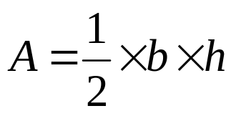
Upper & Lower Bounds
Calculations:
Find the upper and lower bounds for the area of this triangle.
4cm
6cm:
LB = 5.5cm
UB = 6.5cm
6cm
4cm:
LB = 3.5cm
UB = 4.5cm
Upper bound Area:
½ x 6.5 x 4.5 =
14.625cm²
Lower bound Area:
½ x 5.5 x 3.5 =
9.625cm²

Slide 9
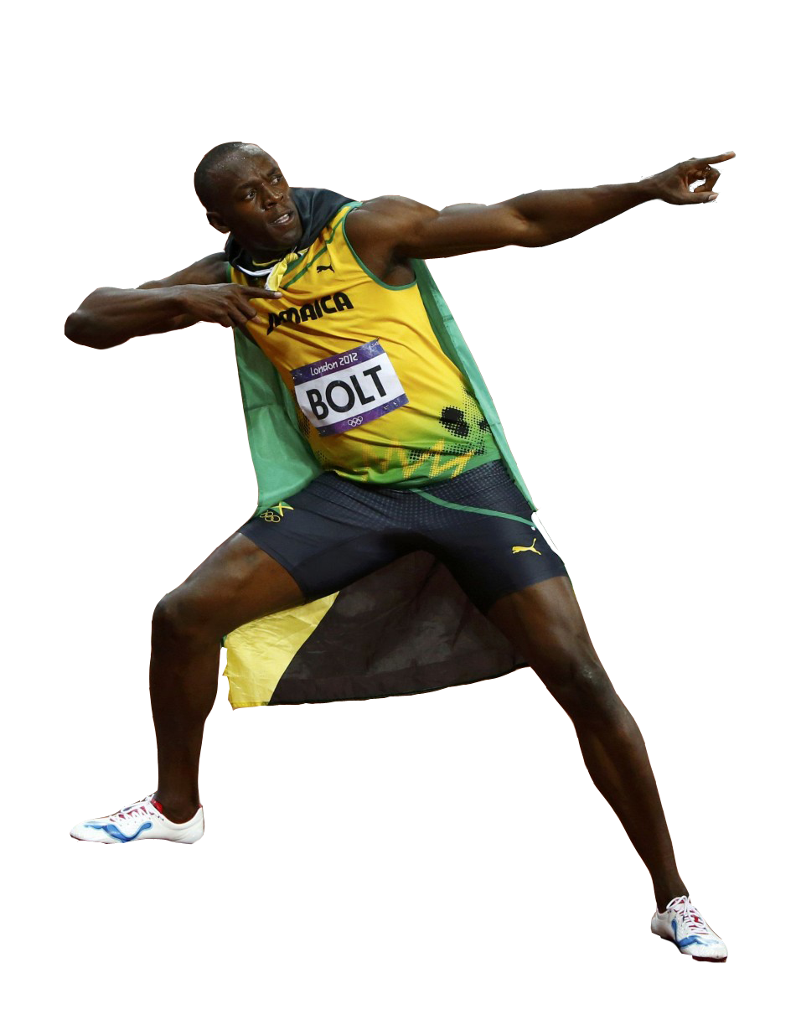
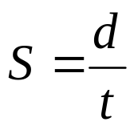
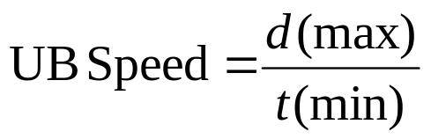
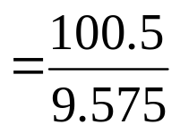

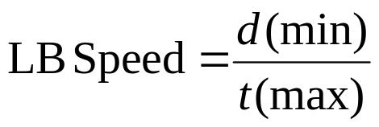
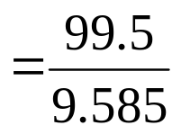

Upper & Lower Bounds
Calculations:
Find the upper and lower bounds for the speed of Usain Bolt’s fastest 100m (to nearest m) race of 9.58 seconds (to nearest 2 dp)
100m:
LB = 99.5m
UB = 100.5m
9.58 secs:
LB = 9.575 secs
UB = 9.585 secs

Slide 10
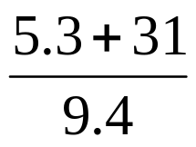
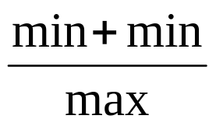
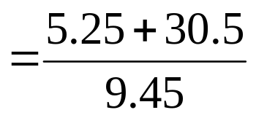
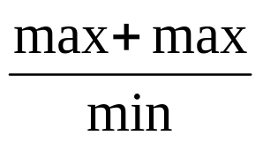
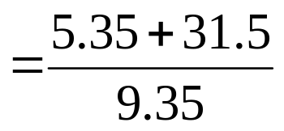


Upper & Lower Bounds
Examples:
Find the upper and lower bounds for each quantity
Eg4
8.8 (1dp) x 6 (whole number)
Lower Bound:
8.75 x 5.5
Upper Bound:
8.85 x 6.5
= 48.125
= 57.525
Eg5
All to 2sf
LB:
UB:

Slide 11

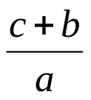
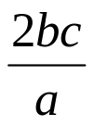




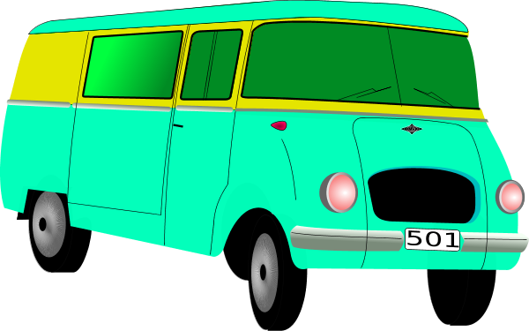
1
Find the upper and lower bounds of the following calculations given that:
a = 8.2 b = 0.63 c = 17 all rounded to 2sf
a
b
c
d
e
f
LB = 8.775
LB = 82.5
LB = 134.475
LB = 2
LB = 2.08
LB = 2.5
UB = 8.885
UB = 87.5
UB=144.375
UB = 2.15
UB = 2.23
UB = 2.73
2
The dimensions of a room are 2.5m and 3.8m and 5.3m all rounded to 2sf. Calculate the upper and lower bound volumes of the room.
LB = 48.2m²
UB = 52.5m²
3
A car is travelling 60 miles (to the nearest 10). It takes 1 and a half hours to complete distance (to 2sf).
Calculate the upper and lower bound average speed of the car.
LB = 35.5mph
UB = 44.8mph
4
The population of Liverpool is 466,000 (to the nearest 1000). The area of Liverpool is 110 km² (to 2sf). Calculate the upper and lower bound population density of Liverpool.
LB = 4048/km²
UB = 4443/km²
A van weighs 0.8 tonnes (to the nearest 100kg). The van is loaded with 4 boxes weighted 50kg each (to the nearest 10kg).
In the vans manual, it states that the maximum safe weight of the van is 1.05 tonnes. Is the van at a safe weight? Explain your answer.
John understands that the maximum safe weight of the van is 1.05 tonnes and the van already weighs 0.8 tonnes (to the nearest 100kg).
He wants to load the van with boxes each weighing 20kg (to the nearest 10kg). What is the maximum number of boxes John can put into the van?
20 boxes

Slide 12
Upper & Lower Bounds
WALT:
WILF:
Find the upper and lower bounds of quantities and calculations
Grade 5
Is the answer to:
Is the answer to:
Is the answer to:
Work out the upper and lower bounds of the height of Laura.
Laura’s height is 1.4m to 2sf.
All these numbers have been rounded to 2sf.
Work out the upper and lower bounds for this calculation.
12 ÷ 5.6
Here are the dimensions of a room to 3sf.
5.25m x 10.1m x 2.00m
Work out the upper and lower bounds for the volume of the room.
Grade 5
Grade 6
Grade 6
Accurate Upper and lower bounds Rounding
Significant figures
Keywords

