Slide 1

The Quadratic Formula
Intro: We already know the standard form of a quadratic equation is:
y = ax² + bx + c
The coefficients are: a , b, c
The variables are: y, x

Slide 2
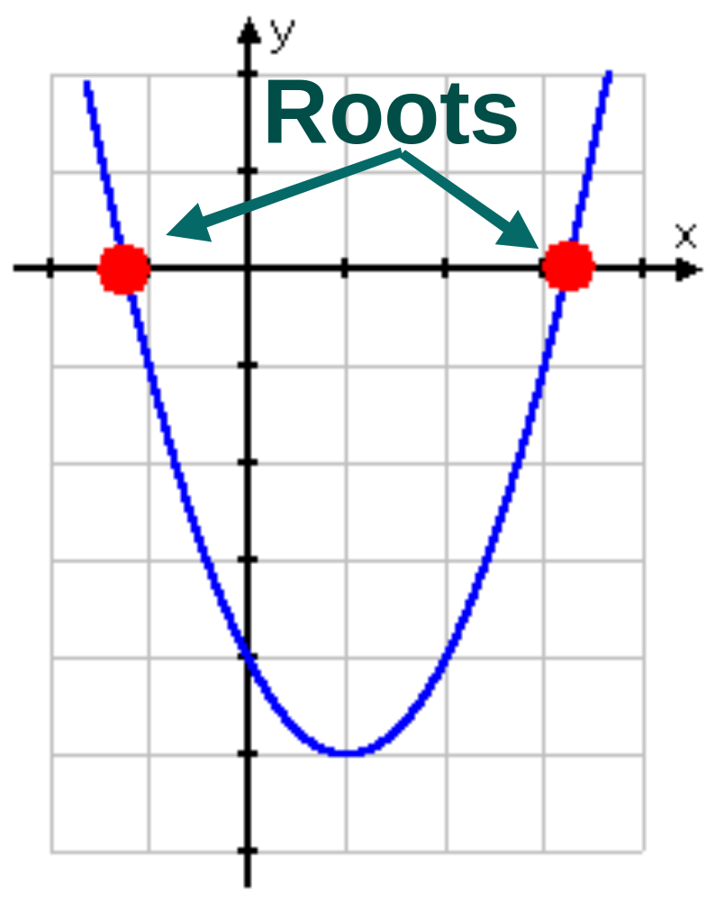
What it means
The ROOTS (or solutions) of a polynomial are its x-intercepts
The x-intercepts occur where y = 0.

Slide 3
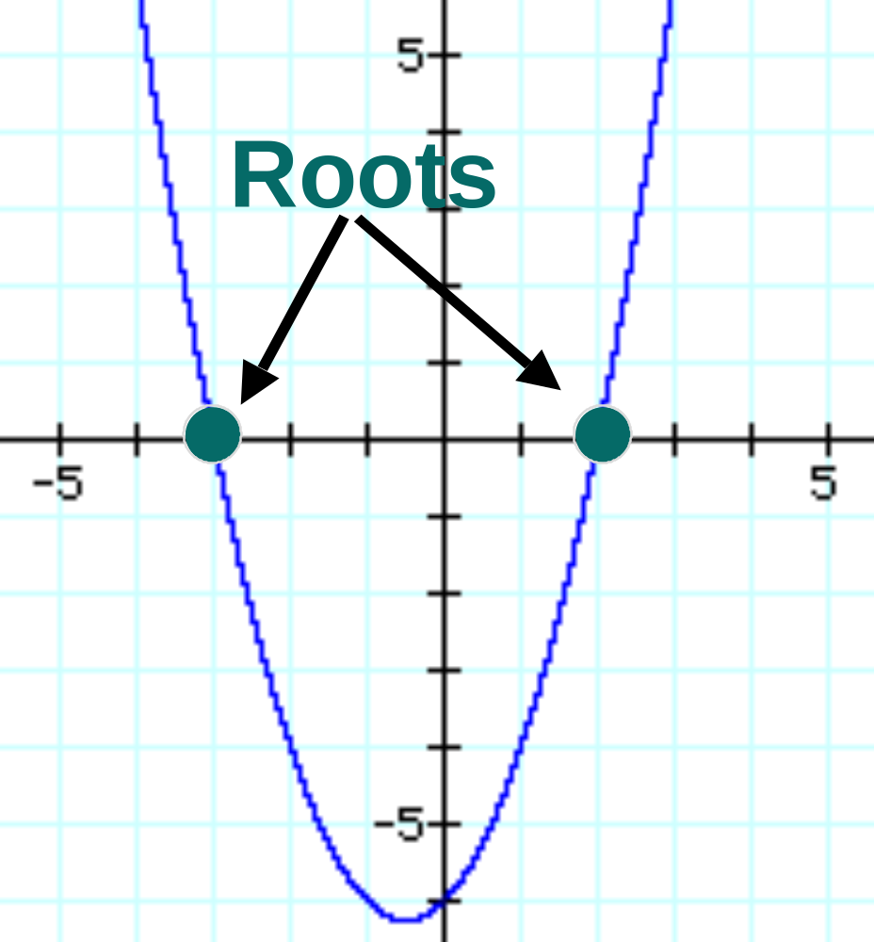
The Easy Way?
Example: Find the roots: y = x² + x - 6
Solution: Factoring: y = (x + 3)(x - 2)
0 = (x + 3)(x - 2)
The roots are:
x = -3; x = 2

Slide 4

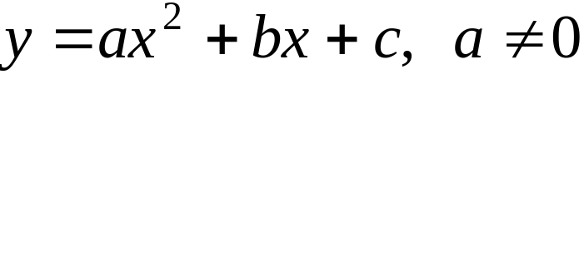
The Formula
After centuries of work, mathematicians realized that as long as you know the coefficients, you can find the roots of the quadratic. Even if it doesn’t factor!

Slide 5
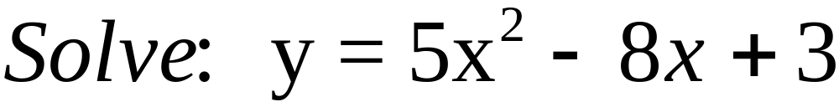
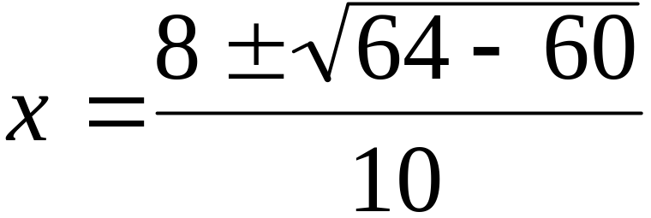
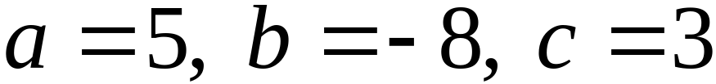
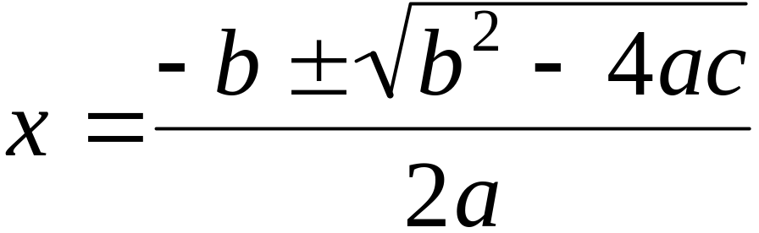
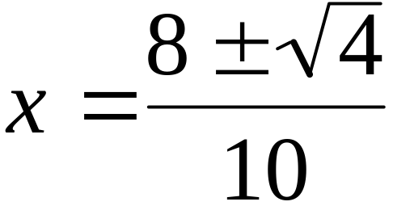
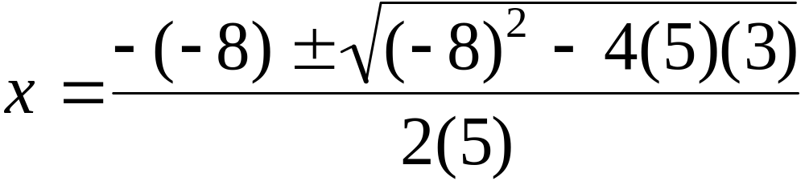
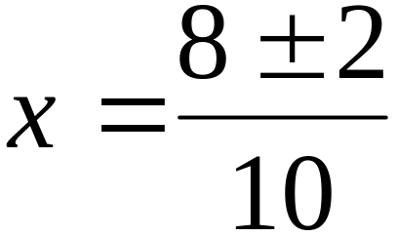
Example

Slide 6
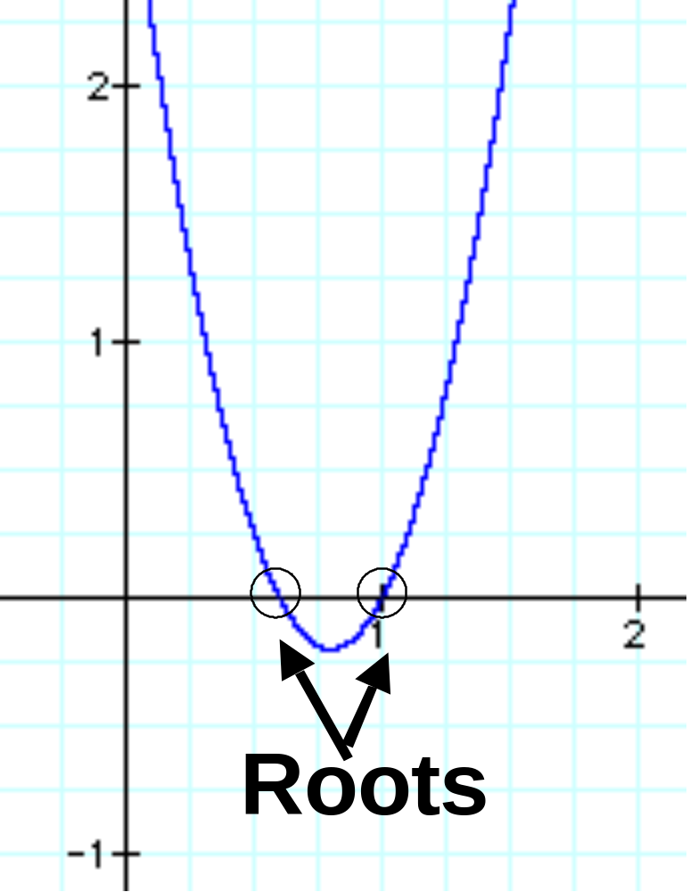
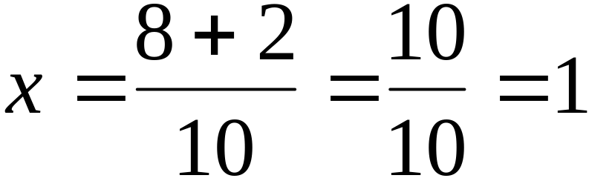
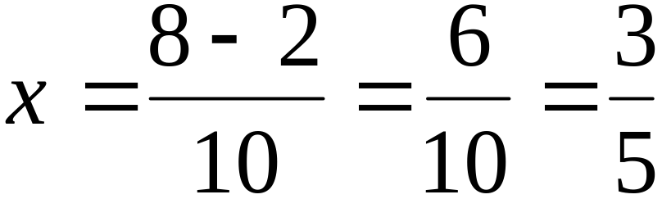
Solution!

Slide 7
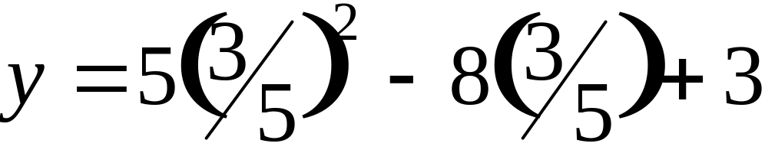
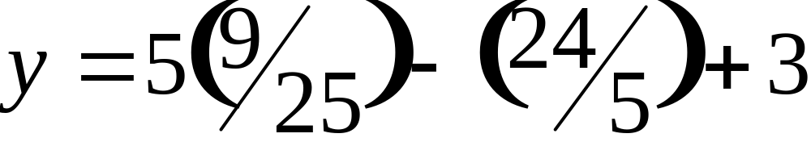
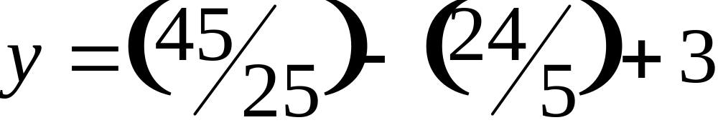
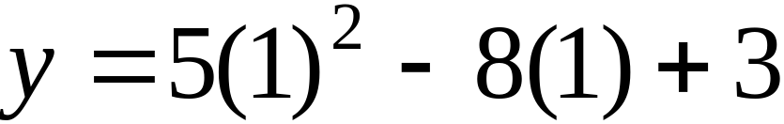
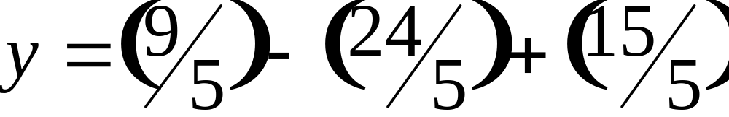
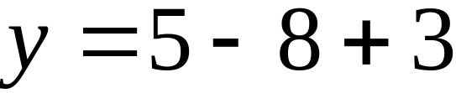
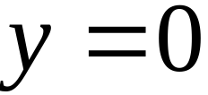
Check your answer!
Plug in your answers for x.
If you’re right, you’ll get y = 0.

Slide 8
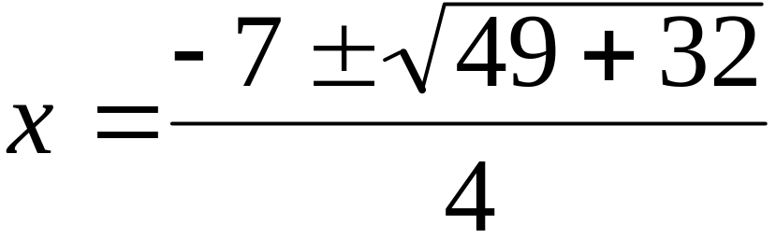
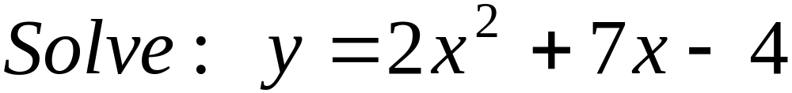
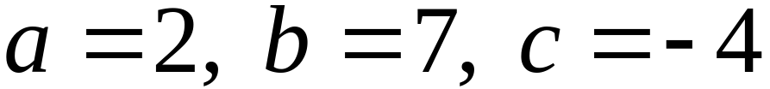
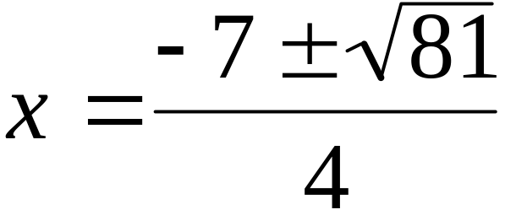
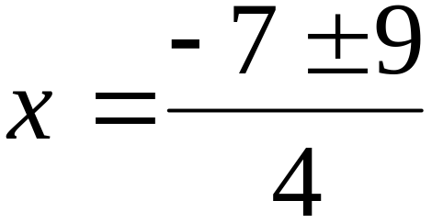
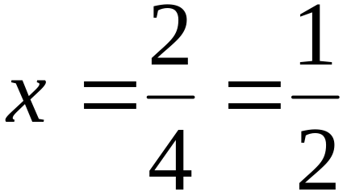
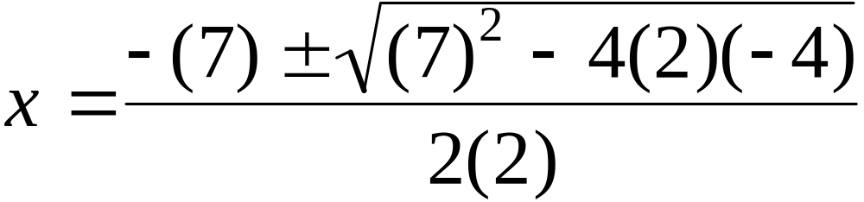
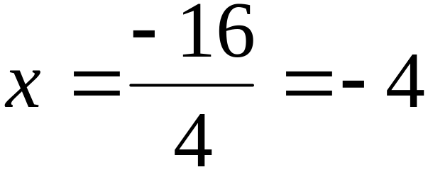
Your turn

Slide 9
Tricks of the Trade
Remember: All the terms must be on one side BEFORE you use the quadratic formula.
Example: Solve 3m² - 8 = 10m
Solution: 3m² - 10m - 8 = 0
a = 3, b = -10, c = -8

Slide 10
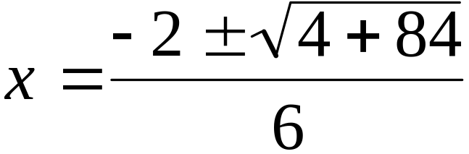
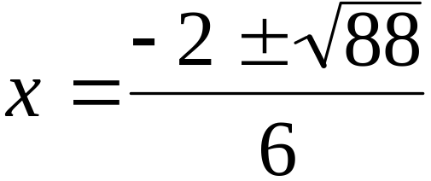

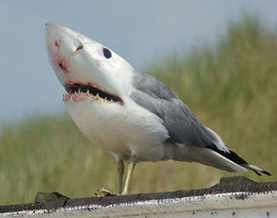
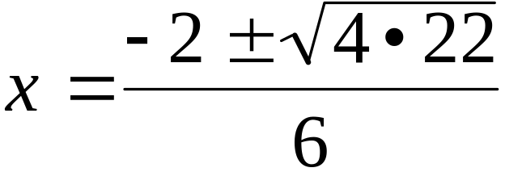
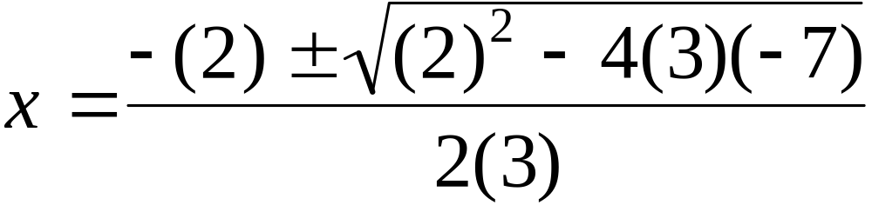
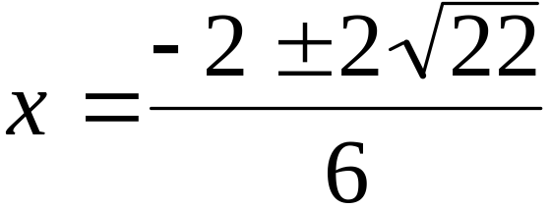
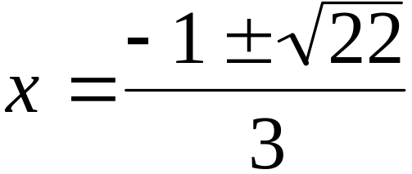
Your turn!
Solve: 3x² = 7 - 2x
Solution: 3x² + 2x - 7 = 0
a = 3, b = 2, c = -7

Slide 11

Watch this:
http://www.youtube.com/watch?v=jGJrH49Z2ZA

