Slide 1

Year 7: Charts & Averages
Dr J Frost (jfrost@tiffin.kingston.sch.uk)
Last modified: 22nd July 2018

Slide 2




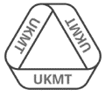
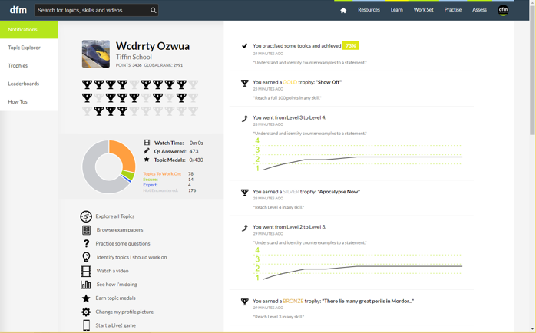
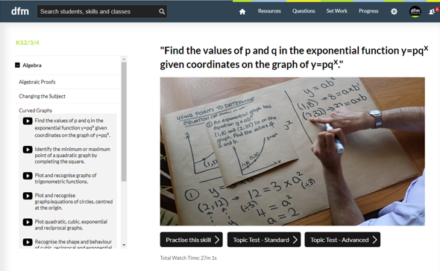
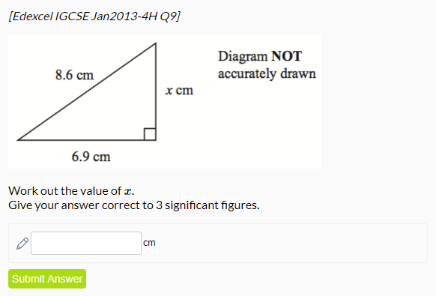
www.drfrostmaths.com
Everything is completely free.
Why not register?
Register now to interactively practise questions on this topic, including past paper questions and extension questions (including UKMT).
Teachers: you can create student accounts (or students can register themselves), to set work, monitor progress and even create worksheets.
With questions by:
Dashboard with points, trophies, notifications and student progress.
Questions organised by topic, difficulty and past paper.
Teaching videos with topic tests to check understanding.

Slide 3
For Teacher Use:
Recommended lesson structure:
Lesson 1: Introduction. Pie charts.
Lesson 2: Frequency Diagrams (Bar Charts vs Histograms, Frequency Polygons)
Lesson 3: Averages (from listed data) and range.
Lesson 4: Stem and Leaf
Lesson 5: Mean of frequency table/Estimated mean of grouped data.
Combined means.
Go >
Go >
Go >
Go >
Go >

Slide 4
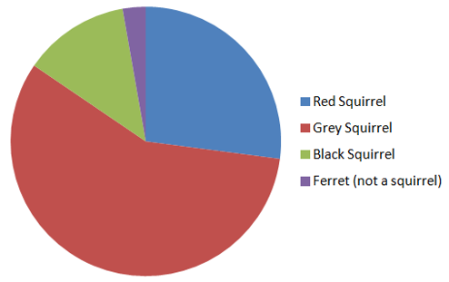
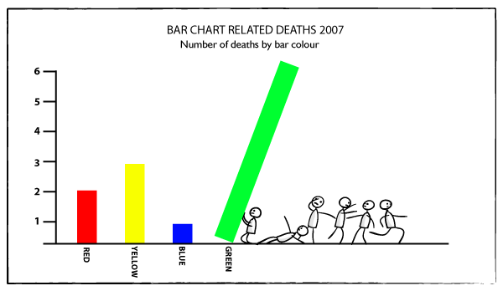
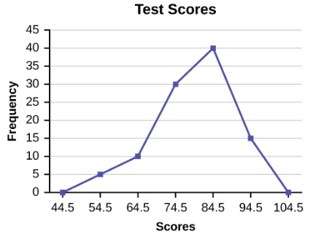
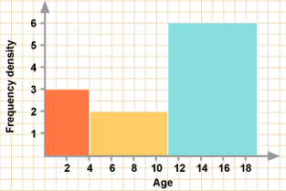
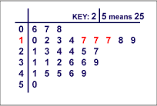
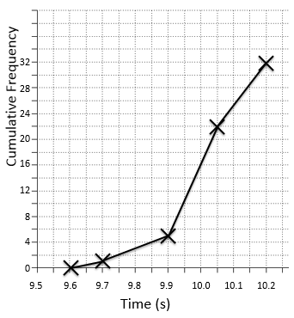
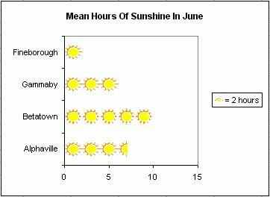
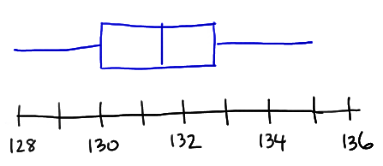
Ways of Displaying Data
In pairs, try and think of all the different types of ‘charts’ and diagrams you could use to display data.
Pie charts
(Covered in KS2, Year 7)
Frequency Diagrams
Bar charts
(Covered in KS2)
Frequency Polygons
(Covered in Year 7, 8)
Histogram
(Covered at GCSE)
Stem & Leaf Diagrams
(Covered in Year 7, 8)
Pictogram
(Covered in KS2)
Box Plot
(Covered in Year 8)
Cumulative Frequency Graphs
(Covered in Year 8)

Slide 5
Year 7 Pie Charts
Dr J Frost (jfrost@tiffin.kingston.sch.uk)

Slide 6
Pie Charts
For which sets of data is a pie chart suitable, and which are not (and why?)
If not, suggest a better way to display this data.
Pie charts should be used when we interested in proportions/percentage/fractions of some total and are less concerned with the frequencies.
The fraction of the total goals of the four teams is not particularly significant here, it’s the number of goals (i.e. the frequencies) we’re more interested in.
A more suitable representation would be a bar chart:
?

Slide 7
Pie Charts
For which sets of data is a pie chart suitable, and which are not (and why?)
If not, suggest a better way to display this data.
Yes this is suitable. We’re interested in what proportion of a day Dr Frost is doing different things.
Yes this is suitable. We’re interested in what proportion of Year 7 who like each of the colours.
The percentages here are more important than the frequencies.
?
?
Bro Tip: Don’t use a pie if either:
There’s not a clear total for which we can have fractions of.
The pie chart wouldn’t work if we were to omit the frequencies.

Slide 8
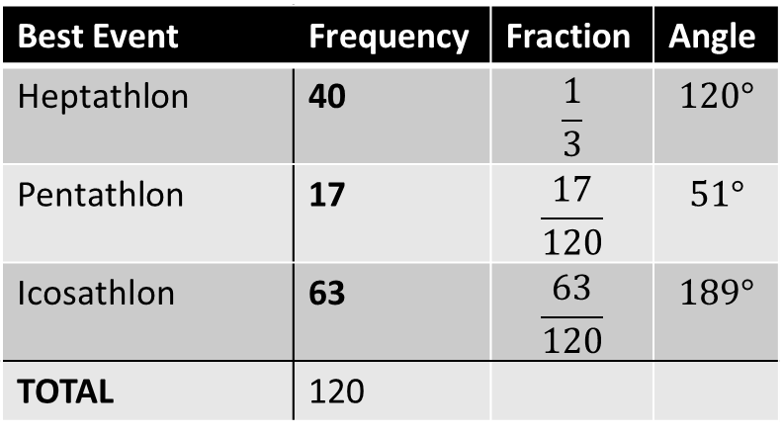
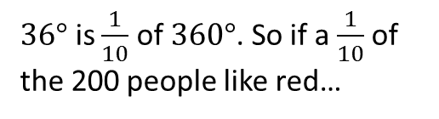
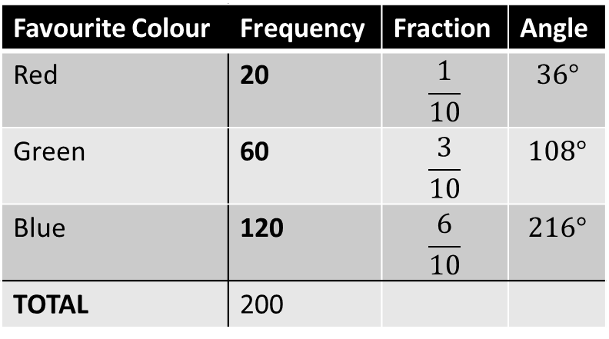
Frequencies $↔$ Angles
To work out frequencies from the angles, simply see what fraction of a full circle the slice occupies.
Favourite Colour | Frequency | Fraction | Angle
Red | 20 | $$\frac{1}{10}$$ | $$36°$$
Green | 60 | $$\frac{3}{10}$$ | $$108°$$
Blue | 120 | $$\frac{6}{10}$$ | $$216°$$
TOTAL | 200
?
?
?
?
?
?
$36°$ is $\frac{1}{10}$ of $360°$. So if a $\frac{1}{10}$ of the 200 people like red…
Best Event | Frequency | Fraction | Angle
Heptathlon | 40 | $$\frac{1}{3}$$ | $$120°$$
Pentathlon | 17 | $$\frac{17}{120}$$ | $$51°$$
Icosathlon | 63 | $$\frac{63}{120}$$ | $$189°$$
TOTAL | 120
?
?
?
?
?
?
It’s exactly the same principle the other way round.

Slide 9
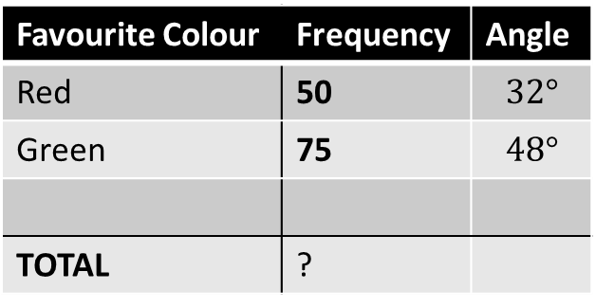
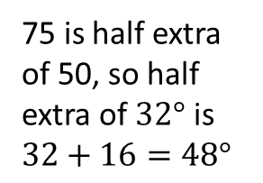
Frequencies $↔$ Angles
Favourite Colour | Frequency | Angle
Red | 50 | $$32°$$
Green | 75 | $$48°$$
TOTAL | ?
75 is half extra of 50, so half extra of $32°$ is $32+16=48°$
?
Even if the total isn’t available, we can find missing angles/frequencies by:
Finding out what one person/degree is worth or
Scaling. e.g. If the angle doubles, the frequency doubles, and so on.

Slide 10
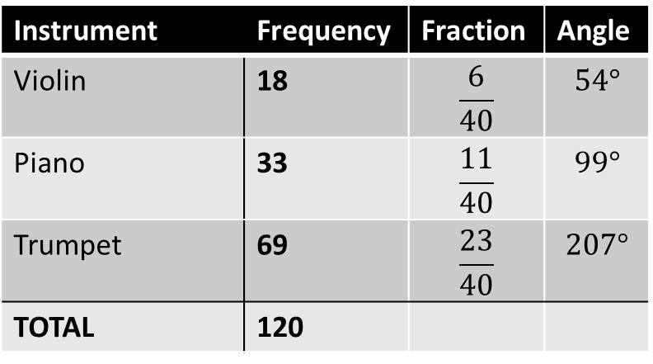
Test Your Understanding
Instrument | Frequency | Fraction | Angle
Violin | 18 | $$\frac{6}{40}$$ | $$54°$$
Piano | 33 | $$\frac{11}{40}$$ | $$99°$$
Trumpet | 69 | $$\frac{23}{40}$$ | $$207°$$
TOTAL | 120
?
?
?
?
?
?

Slide 11
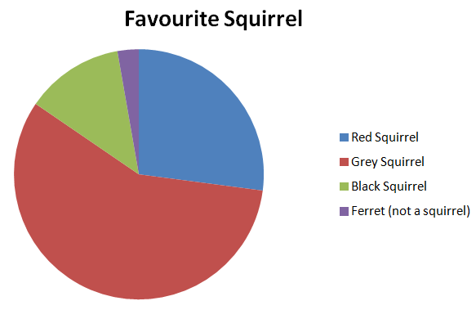
How to draw a super awesome pie chart
Title
?
Key
?
Circle drawn with compass and lines drawn with ruler.

Slide 12
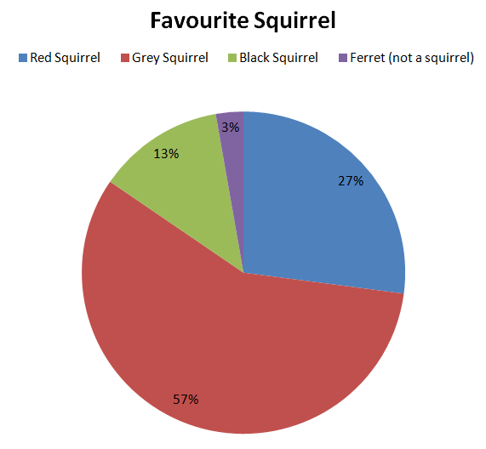
Variants of pie charts
Sectors labelled with percentages.

Slide 13
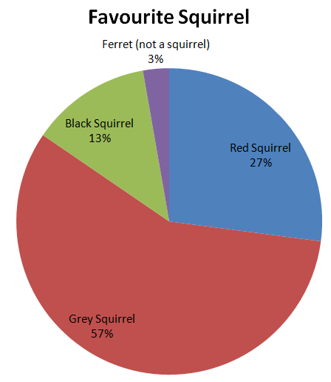
Variants of pie charts
Sectors labelled with percentages and values. No key.

Slide 14
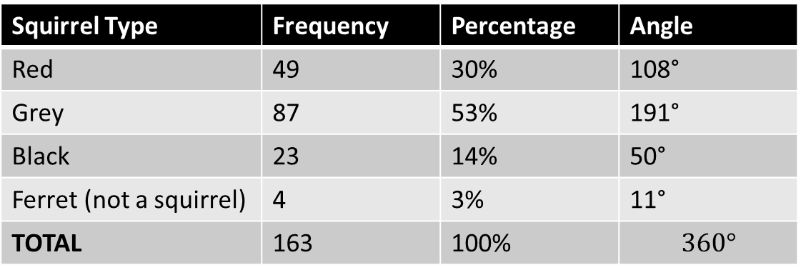
Calculating percentages and angles
Squirrel Type | Frequency | Percentage | Angle
Red | 49 | 30% | 108°
Grey | 87 | 53% | 191°
Black | 23 | 14% | 50°
Ferret (not a squirrel) | 4 | 3% | 11°
TOTAL | 163 | 100% | $$360°$$
?
?
?
?
?
?
?
?
?
?
?

Slide 15
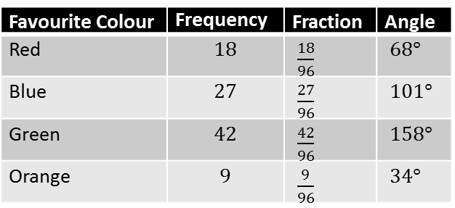
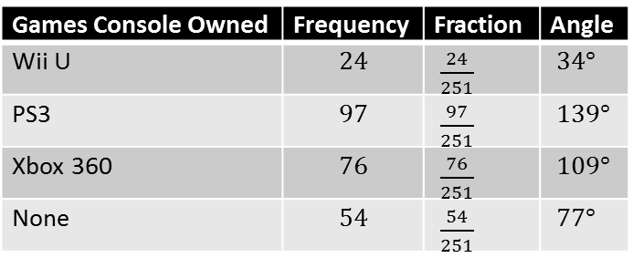
Exercise 1
(on provided sheet)
1
We’ll do the first one together...
2
Favourite Colour | Frequency | Fraction | Angle
Red | $$18$$ | $\frac{18}{96}$ | $68°$
Blue | $$27$$ | $\frac{27}{96}$ | $101°$
Green | $$42$$ | $\frac{42}{96}$ | $158°$
Orange | $$9$$ | $\frac{9}{96}$ | $34°$
Games Console Owned | Frequency | Fraction | Angle
Wii U | $$24$$ | $\frac{24}{251}$ | $34°$
PS3 | $$97$$ | $\frac{97}{251}$ | $139°$
Xbox 360 | $$76$$ | $\frac{76}{251}$ | $109°$
None | $$54$$ | $\frac{54}{251}$ | $77°$
?
?
?
?
?
?
?
?
?
?
?
?
?
?
?
?
?
(Pie chart using protractor and ruler)
?
(Pie chart using protractor and ruler)

Slide 16
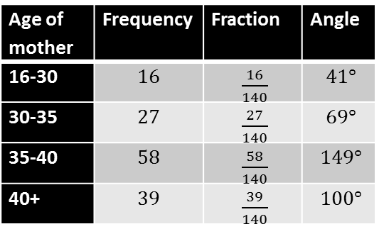
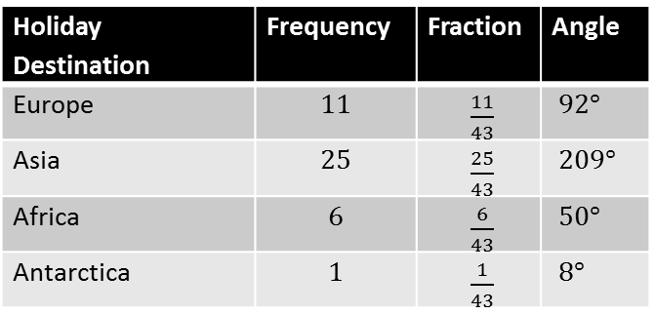
Exercise 1
(on provided sheet)
3
4
Age of mother | Frequency | Fraction | Angle
16-30 | $$16$$ | $\frac{16}{140}$ | $41°$
30-35 | $$27$$ | $\frac{27}{140}$ | $69°$
35-40 | $$58$$ | $\frac{58}{140}$ | $149°$
40+ | $$39$$ | $\frac{39}{140}$ | $100°$
Holiday Destination | Frequency | Fraction | Angle
Europe | $$11$$ | $\frac{11}{43}$ | $92°$
Asia | $$25$$ | $\frac{25}{43}$ | $209°$
Africa | $$6$$ | $\frac{6}{43}$ | $50°$
Antarctica | $$1$$ | $\frac{1}{43}$ | $8°$
?
?
?
?
?
?
?
?
?
?
?
?
?
?
?
?
?
(Pie chart using protractor and ruler)
?
(Pie chart using protractor and ruler)

Slide 17
Year 7 Frequency Diagrams
Dr J Frost (jfrost@tiffin.kingston.sch.uk)

Slide 18
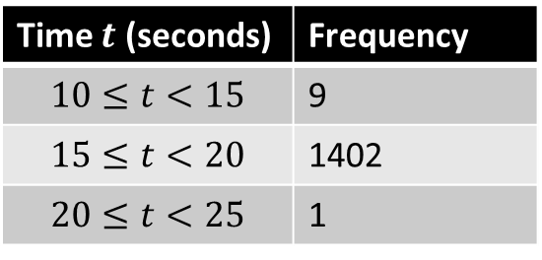
Frequency Diagrams
When we record data, we may record the number of times we saw a value (we’d use a ‘tally’ when collecting the data) – this is known as the frequency.
A frequency table might show ungrouped or grouped data:
Ungrouped Data
Grouped Data
Shoe Size | Frequency
12 ½ | 4
13 | 10
13 ½ | 6
Time $t$ (seconds) | Frequency
$$10≤t<15$$ | 9
$$15≤t<20$$ | 1402
$$20≤t<25$$ | 1
A Frequency Diagram are charts where the vertical axis shows the frequency.
frequency

Slide 19
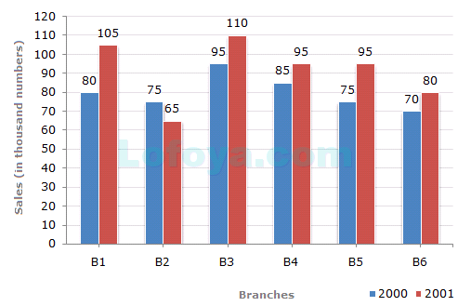
Types of Frequency Diagrams
BAR CHART
HISTOGRAM
Frequency (Density)
! Features:
For discrete data. Values written on horizontal axis.
Gaps between bars (why? to emphasise values are discrete)
Can have multiple sets of data.
?
0 10 20 30 40 50
Height (m)
! Features:
For grouped continuous data.
No gaps between bars (because data is continuous)
Allows bars to be different widths.
?
Bro Note: Not all bar charts are frequency diagrams, e.g. if the vertical axis was “sales (£)”

Slide 20
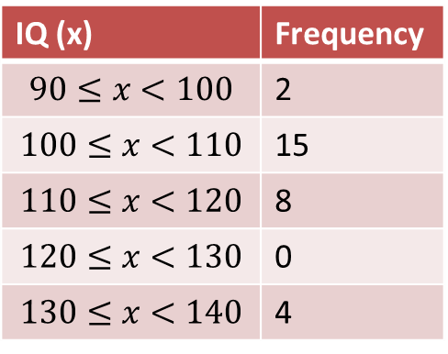
Frequency Polygons
But suppose that we had data grouped into ranges.
What would be a sensible value to represent each range?
Sometimes we see frequency polygons combined with a histogram (why is not called a bar chart?). The points of the frequency polygon will be in the middle of the bars.
!
IQ (x) | Frequency
$$90≤x<100$$ | 2
$$100≤x<110$$ | 15
$$110≤x<120$$ | 8
$$120≤x<130$$ | 0
$$130≤x<140$$ | 4
16
14
12
10
8
6
4
2
Join the points up with straight lines.
Frequency
We use the midpoint of each range.
This is known as a frequency polygon.
90 100 110 120 130 140
IQ

Slide 21
Exercise 2
(on provided sheet)
Q1
Q2
?
?

Slide 22
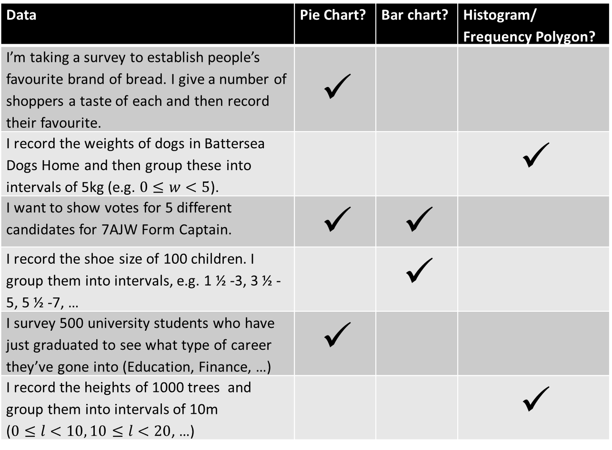
Exercise 2
(on provided sheet)
Q3
Pick the most suitable chart to display the data described. (Put ✓ as appropriate)
Data | Pie Chart? | Bar chart? | Histogram/ Frequency Polygon?
I’m taking a survey to establish people’s favourite brand of bread. I give a number of shoppers a taste of each and then record their favourite. | ✓
I record the weights of dogs in Battersea Dogs Home and then group these into intervals of 5kg (e.g. $0≤w<5$). |  |  | ✓
I want to show votes for 5 different candidates for 7AJW Form Captain. | ✓ | ✓
I record the shoe size of 100 children. I group them into intervals, e.g. 1 ½ -3, 3 ½ -5, 5 ½ -7, … |  | ✓
I survey 500 university students who have just graduated to see what type of career they’ve gone into (Education, Finance, …) | ✓
I record the heights of 1000 trees and group them into intervals of 10m ($0≤l<10, 10≤l<20$, …) |  |  | ✓
?
The frequencies depend on how many people are surveyed so are not important. We care more what proportion of people like each brand.
?
Weight is continuous.
We care about the number of votes for each. But a pie chart would also be suitable.
?
?
Shoe size is discrete. Bar charts are better for grouped numerical data.
?
?
Length is continuous.

Slide 23
Exercise 2
(on provided sheet)
Q4
a) Draw a bar chart for this frequency table using the axis provided. Ensure you label your axes.
?
Age | Freq
11-15 | 3
16-20 | 6
21-25 | 2
26-30 | 7
8
6
4
2
b) Why technically are we using a bar chart and not a histogram?
While time is continuous, the age ranges are written here in a way that suggests that age is discrete (i.e. it’s rounded to a whole). If we did allow decimal ages, what group would 15.6 go in? There would be gaps!
?
11-15
16-20
21-25
26-30

Slide 24
Year 7 Averages and Range
Dr J Frost (jfrost@tiffin.kingston.sch.uk)

Slide 25
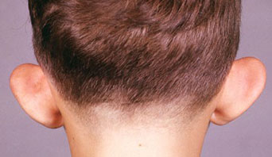
Averages
There are different averages: some are more meaningful than others depending on the context.
What is the average number of ears in the world human population?
The mode
(the “modal average”)
?
The mode represents the most common value.
Modal number of ears: 2
?
The median
The median represents the middle value.
?
Median number of ears: 2
?
The mean
The mean takes into account all values. We add up the values and divide by the number of values.
Mean number of ears: 1.99999
?

Slide 26
Averages
The mode
(the “modal average”)
The mode tends to be a good average when the values are discrete and have a limited range of values.
e.g. “red red red green blue” (the mode is ‘red’)
The median
Median is often good because it makes it easier to tell whether a value is in the top 50% or the bottom 50%.
It’s also less sensitive to extreme values.
The mean
The mean is the best average to use if we want to take all the values into account.
Salaries of people in the room: £13,000 £18,000 £24,000 £25,500 £26,000 £32,000 £45,000 £1,200,000
What would the best average be here?
?
Median, because the £1,200,000 salary drags up the mean. Otherwise all but one person would earn less than the average!

Slide 27
Averages
Copy these numbers down, and work out the mean, mode and median.
10, 13, 15, 16, 17, 17, 20
The mode
(the “modal average”)
?
17
The median
?
16
The mean
?
10 + 13 + 15 + 16 + 17 + 17 + 20
7
= 15.43

Slide 28
Averages – Round 2!
Copy these numbers down, and work out the mean, mode and median.
13, 13, 17, 20
The mode
(the “modal average”)
13
?
The median
?
15
When there’s two items in the middle, we use the value in between: i.e. add them and divide by 2.
The mean
?
15.75
The range
?
The range is the difference between the smallest and largest number.
The range is NOT an average.
7

Slide 29
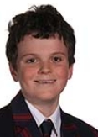
Puzzles involving mean
In pairs, see how many of these puzzles you can work out…
1
The mean average of Dr Frost and Sebastian’s age is 19.5. If Sebastian is 13, how old is Dr Frost?
3
If the range of two numbers is 6 and the their mean is 15, what are the two numbers?
?
?
Answer: 26
Answer: 12 and 18
2
The mean of the four numbers is 8. What is the missing number?
4
The mode of four numbers is 5. The median is 6.5 and the mean is 7. What is the range?
3
4
5
?
Answer: 5
(The numbers are 5, 5, 8, 10)
?
Answer: 20
?

Slide 30
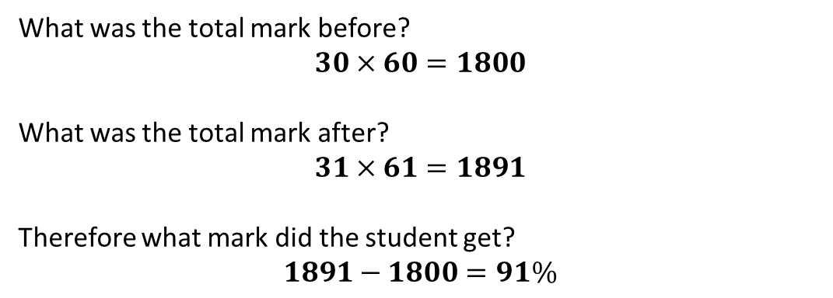
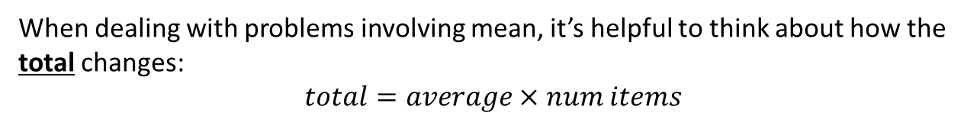
Using totals
When dealing with problems involving mean, it’s helpful to think about how the total changes:
$$total=average×num items$$
A class with 30 students gets an average mark of 60%. An extra student joins and the average mark rose to 61%. What mark did he get?
What was the total mark before?
$$30×60=1800$$
What was the total mark after?
$$31×61=1891$$
Therefore what mark did the student get?
$$1891−1800=91\%$$
?
?
?

Slide 31
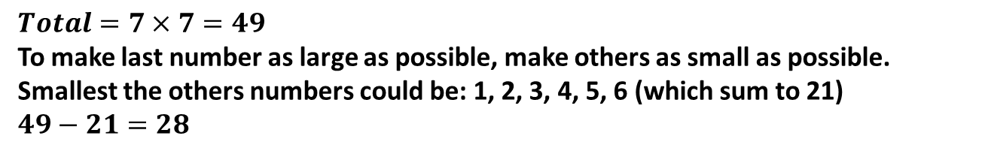
Test Your Understanding
[JMC 2003 Q9] The mean age of the four members of ‘All Sinners’ boy band is 19. What is the mean age when an extra member who is 24 years old joins them? A 19 B 20 C 21 D 22 E 24
A
B
C
D
E
[JMC 2010 Q20] Nicky has to choose 7 different positive whole numbers whose mean is 7. What is the largest possible such number she could choose? A 7 B 28 C 34 D 43 E 49
A
B
C
D
E
$$Total=7×7=49$$
To make last number as large as possible, make others as small as possible. Smallest the others numbers could be: 1, 2, 3, 4, 5, 6 (which sum to 21)
$$49−21=28$$

Slide 32

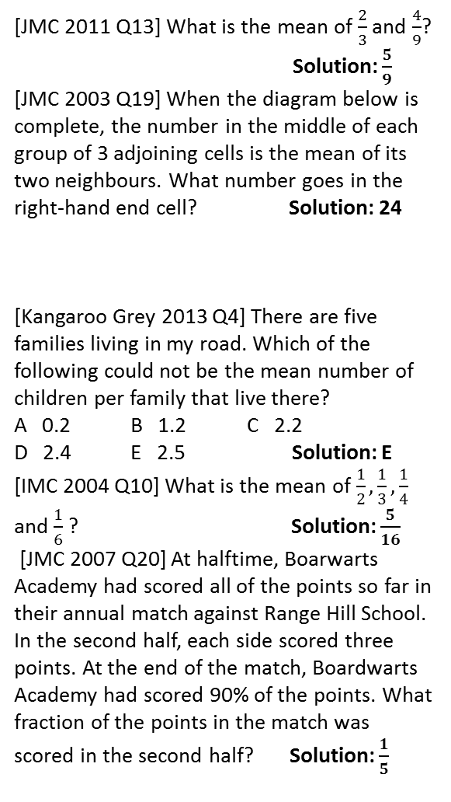
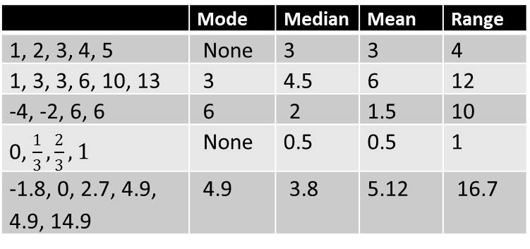
Exercise 3
(on provided sheet)
For the following lists of numbers, determine the following:
5
[JMC 2011 Q13] What is the mean of $\frac{2}{3}$ and $\frac{4}{9}$? Solution: $\frac{5}{9}$
[JMC 2003 Q19] When the diagram below is complete, the number in the middle of each group of 3 adjoining cells is the mean of its two neighbours. What number goes in the right-hand end cell? Solution: 24
[Kangaroo Grey 2013 Q4] There are five families living in my road. Which of the following could not be the mean number of children per family that live there? A 0.2 B 1.2 C 2.2 D 2.4 E 2.5 Solution: E
[IMC 2004 Q10] What is the mean of $\frac{1}{2},\frac{1}{3},\frac{1}{4}$ and $\frac{1}{6}$ ? Solution: $\frac{5}{16}$
[JMC 2007 Q20] At halftime, Boarwarts Academy had scored all of the points so far in their annual match against Range Hill School. In the second half, each side scored three points. At the end of the match, Boardwarts Academy had scored 90% of the points. What fraction of the points in the match was scored in the second half? Solution: $\frac{1}{5}$
1
?
 | Mode | Median | Mean | Range
1, 2, 3, 4, 5 | None | 3 | 3 | 4
1, 3, 3, 6, 10, 13 | 3 | 4.5 | 6 | 12
-4, -2, 6, 6 | 6 | 2 | 1.5 | 10
0, $\frac{1}{3},\frac{2}{3}, 1$ | None | 0.5 | 0.5 | 1
-1.8, 0, 2.7, 4.9, 4.9, 14.9 | 4.9 | 3.8 | 5.12 | 16.7
6
?
?
?
?
?
?
7
2
Determine the numbers given the clues.
Two numbers have a mean of 9 and a range of 6. Solution: 6, 12
The mode of four numbers is 6, the median is 8, and the mean is 9. Solution: 6, 6, 10, 14
The median of four numbers is 6, the range is 5 and the mode is 4. Solution: 4, 4, 8, 9
[JMC 2013 Q2] Heidi is 2.1m tall, while Lola is only 1.4m tall. What is their average height? Solution: 1.75m
[JMC 2007 Q12] The six-member squad for the Ladybirds five-a-side team consists of a 2-spot ladybird, a 10-spot, a 14-spot, an 18-spot, a 24-spot and a pine ladybird (on the bench). The average number of spots for members of the squad is 12. How many spots has the pine ladybird? S: 4
?
?
?
8
?
?
9
3
?
4
?
?

Slide 33
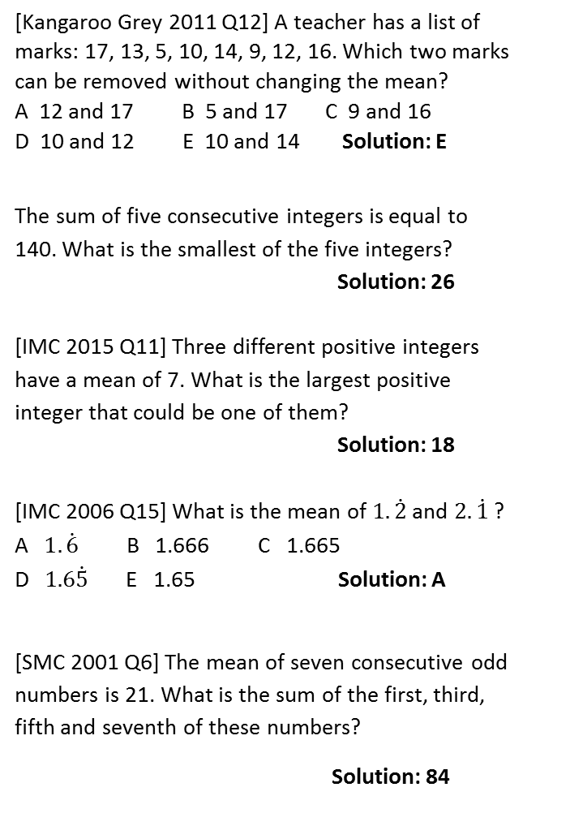
Exercise 3
(on provided sheet)
10
[Kangaroo Grey 2011 Q12] A teacher has a list of marks: 17, 13, 5, 10, 14, 9, 12, 16. Which two marks can be removed without changing the mean? A 12 and 17 B 5 and 17 C 9 and 16 D 10 and 12 E 10 and 14 Solution: E
The sum of five consecutive integers is equal to 140. What is the smallest of the five integers? Solution: 26
[IMC 2015 Q11] Three different positive integers have a mean of 7. What is the largest positive integer that could be one of them? Solution: 18
[IMC 2006 Q15] What is the mean of $1.\dot{2}$ and $2.\dot{1}$ ? A $1.\dot{6}$ B 1.666 C 1.665 D $1.6\dot{5}$ E 1.65 Solution: A
[SMC 2001 Q6] The mean of seven consecutive odd numbers is 21. What is the sum of the first, third, fifth and seventh of these numbers?
Solution: 84
N₁
[JMO Mentoring Feb2012 Q5] On the second to last test of the school year, Barbara scored 98 and her average score so far then increased by 1. On the last test she scored 70 at which her average score then decreased by 2. How many tests has she taken through the school year?
Solution: 10
[Cayley 2007 Q6] You are told that one of the integers in a list of distinct positive integers is 97 and that their average value is 47. (a) If the sum of all the integers in the list is 329, what is the largest possible value for a number in the list? (b) Suppose the sum of all the numbers in the list can take any value. What would the largest possible number in the list be then?
Solution: (a) 217 (b) 1078
?
11
?
?
12
N₂
?
13
?
14
?
?

Slide 34
Year 7 Stem and Leaf Diagrams
Dr J Frost (jfrost@tiffin.kingston.sch.uk)

Slide 35
Stem and Leaf Diagram
Suppose this “stem and leaf diagram” represents the lengths of beetles.
The key tells us how two digits combine.
1
2
3
4
5
4
1 2 4 5
2 5 6 6 6 7 7 8 8
0 1 2 2 4 5 6 7 7 7 7 8
0 1 1 2
Key:
2 | 1 means 2.1cm
The ‘leaves’ must be in order.
Value represented = 4.5cm
?
These numbers (known as the ‘stems’) represent the first digit of the number.
These numbers (the ‘leaves’) represent the second.

Slide 36
Example
Here are the weights of a group of cats. Draw a stem-and-leaf diagram to represent this data.
36kg 15kg 35kg 50kg 11kg 36kg 38kg 47kg 12kg 30kg 18kg 57kg
1
2
3
4
5
?
1 2 5 8
0 5 6 6 8
7
0 7
?
Key:
3 | 8 means 38kg
?
?
?
What do you think are the advantages of displaying data in a stem-and-leaf diagram?
Shows how the data is spread out.
Identifies gaps in the values.
All the original data is preserved (i.e. we don’t ‘summarise’ in any way).
?
?
?

Slide 37
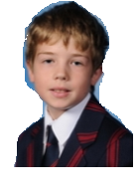
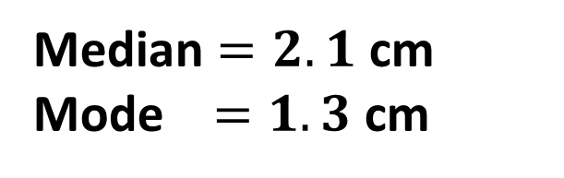
Your turn
Here is the brain diameter of a number of members of 8IW. Draw a stem and leaf diagram representing this data.
1.3cm 2.1cm 5.3cm 2.0cm 1.7cm 4.2cm 3.3cm 3.2cm 1.3cm 4.6cm 1.9cm
1
2
3
4
5
?
3 3 7 9
0 1
2 3
2 6
3
?
Key:
3 | 8 means 3.8cm
?
?
?
?
?
?
Median $=2.1$ cm
Mode $=1.3$ cm
?

Slide 38
Exercise 3
(on provided sheet)
1
Here are the times, in minutes, taken to solve a puzzle.
5 10 15 12 8 7 20 35 24 15
20 33 15 24 10 8 10 20 16 10
(a) In the space below, draw a stem and leaf diagram to show these times.
?
0
5 7 8 8
?
1
0 0 0 0 2 5 5 5 6
Key: 3|4 means 34 minutes
?
?
2
0 0 0 4 4
3
3 5
?
Find the median time to solve this puzzle.
15 minutes
?

Slide 39
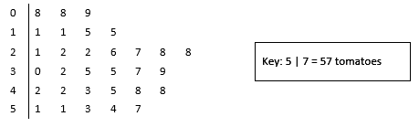
Exercise 3
(on provided sheet)
The stem and leaf diagram gives information about the numbers of tomatoes on 31 tomato plants.
Work out the median.
32 tomatoes
2
?

Slide 40
Exercise 3
(on provided sheet)
3
Here are the ages, in years, of 15 students.
19 18 20 25 37
33 21 17 29 20
42 18 23 37 22
Show this information in an ordered stem and leaf diagram.
?
1
7 8 8 9
?
2
0 0 1 2 3 5 9
1|3 means 13 years
?
?
3
3 7 7
4
2
?

Slide 41
Exercise 3
(on provided sheet)
4
Here is the weight of 16 cats:
4.5kg 4.9kg 5.2kg 3.9kg 4.1kg 5.0kg 3.6kg 4.9kg 5.3kg 4.3kg 7.4kg 3.6kg 5.3kg 3.8kg 5.3kg
(a) Produce an ordered stem and leaf diagram to show this information.
(b) What is the median weight? 4.9kg (c) What is the mode weight? 5.3kg
?
3
6 6 8 9
1 3 5 9 9
?
4
Key: 3|6 means 3.6kg
?
5
?
0 2 3 3 3
?
6
7
4
?
?
?

Slide 42
Year 7 Mean of Frequency Tables
Dr J Frost (jfrost@tiffin.kingston.sch.uk)

Slide 43
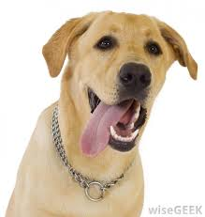
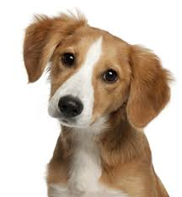
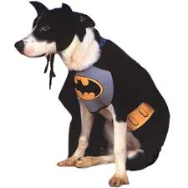
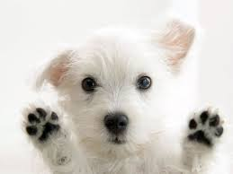
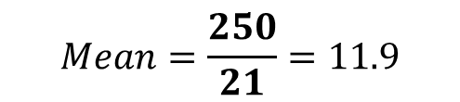
Mean of Frequency Tables
We know how to find the mean of listed data. What if we have a frequency table?
Starting point: Suppose we listed this data out with duplicated values. What would be the total age of the dogs aged 10?
Age of Dog | Frequency
10 | 3 | 30
11 | 4 | 44
12 | 7 | 84
13 | 6 | 78
14 | 1 | 14
TOTAL |  | 250
?
?
?
?
Once we’d found the total, we’d usually divide by the number of values. What is that?
21. A common mistake is to divide by 5 because there’s 5 rows. But that’s the number of unique values, and doesn’t take into account duplicates. There’s 21 dogs, not 5!
?
21
?
?
?
$$Mean=\frac{250}{21}=11.9$$

Slide 44

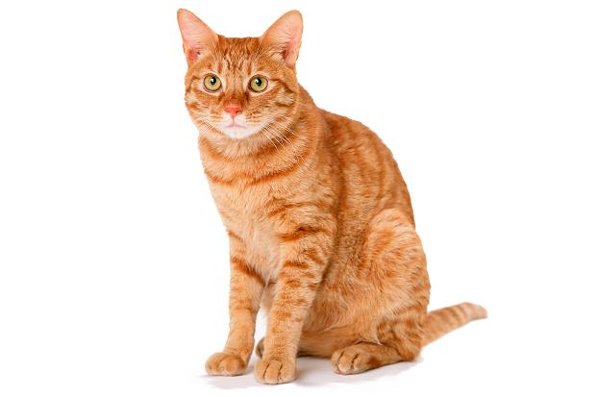

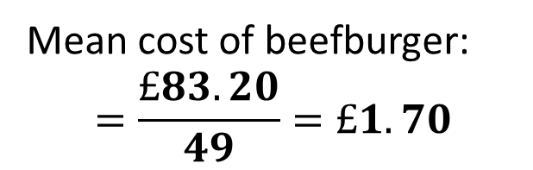
Test Your Understanding
Cost | Frequency
£1.50 | 1
£1.65 | 20
£1.70 | 21
£1.80 | 5
£2.00 | 2
Mean cost of beefburger:
$$=\frac{£83.20}{49}=£1.70$$
?
Weight | Frequency
2kg | 4
3kg | 0
4kg | 8
5kg | 7
6kg | 3
Mean weight of cats:
$$=\frac{93}{22}=4.23 kg$$
?

Slide 45
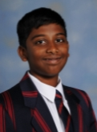


Mean of Grouped Data
A number of members of 8EWS are running in a race.
Their times were as follows
Time (secs) | Freq
$$35≤t<40$$ | $$6$$ | 225
$$40≤t<50$$ | $$12$$ | 540
$$50≤t<70$$ | $$9$$ | 540
TOTAL | 27 | 1305
37.5
?
We don’t know the individual times within each group. What time could we use for each person in the 35-40 group? 37.5
45
?
?
60
?
?
?
?
Estimate of mean: $\frac{1305}{27}=48.3s to 1dp$
Why is it an estimate?
?
Because we don’t know the exact times within each group.

Slide 46




Test Your Understanding
There are 25 people in a room who do 10 GCSEs and 5 people who do 12. What is the average number of GCSEs taken?
$$Total GCSEs \\ =\left(25×10\right)+\left(5×12\right)=310$$
$$Total people=30$$
$Mean=\frac{310}{30}=10.33$ GCSEs
Age of rock (years) | Frequency
$$0≤a<100$$ | $$40$$
$$100≤a<400$$ | $$24$$
$$400≤a<1000$$ | $$5$$
?
?
$$Estimate of mean=\frac{11500}{69}=166.7 years$$

Slide 47

Combining Means
We can use a similar approach when combining means.
Class 7SM, with 30 students, got an average of 60 marks in a maths test.
Class 7XQ, with 25 students, got an average of 75 marks in the same maths test.
What was the average mark across all students?
?
$$Total mark=\left(30×60\right)+\left(25×75\right) \\ =3675$$
$$Total students=55$$
$$Mean=\frac{3675}{55}=66.8$$

Slide 48


Exercise 5
(on provided sheet)
1
At a party, thirty people have an age of 30, forty have an age of 40 and fifty an age of fifty. What is their average age?
$$41.7$$
In a hardware shop, there are 30 spanners costing £6, 55 hacksaws costing £9 and 10 soldering irons costings £20. What is the average cost per item?
$$£9.21$$
Using this frequency table, find the average height of a turnip.
$$7.71cm$$
4
Sam collects the weights of 15 squirrels and puts them into weight ranges. His data is presented below. Estimate the mean weight of a squirrel.
$$18.4kg$$
Miss Clarke values a number of pieces of artwork in the Tiffin School Vault. The price ranges are summarised below. Estimate the average value of a piece of art in school.
£5119.05
I record the times of 50 runners in a 10km race. Their times are summarised below. Determine their mean time in minutes.
44.85 minutes
?
Weight | 10-16kg | 16-20kg | 20-30kg | 30kg-32kg
Frequency | 7 | 3 | 4 | 1
2
?
5
?
3
Value | £0-£1000 | £1 000-5 000 | £5 000-£20 000 | £20 000-£100 000
Frequency | 10 | 25 | 6 | 1
Height (nearest cm) | 6cm | 7cm | 8cm | 9cm | 10cm
Frequency | 3 | 8 | 12 | 4 | 1
?
?
6
Time (minutes) | 35-40 | 40-42 | 42-48 | 48-60
Frequency | 5 | 15 | 20 | 10
?

Slide 49



Exercise 5
(on provided sheet)
7
The 180 students of Year 7 have an average IQ of 124 and the 150 students of Year 8 have an average IQ of 95. What’s the average IQ of all the students?
$$\frac{\left(180×124\right)+\left(150×95\right)}{150+180}=110.8$$
9
If I mix 2kg of substance A which contains 8% poison with 8kg of substance B which contains 2% poison, what percentage poison is the mixture?
$$\frac{\left(2×0.08\right)+\left(8×0.02\right)}{2+8}=0.032$$
i.e. $3.2\%$
?
?
8
10 friends have an average of 5 dogs each. When 5 friends joined them the average number of dogs dropped to 4.6. What was the average number of dogs these extra five men had?
$$\frac{\left(15×4.6\right)−\left(10×5\right)}{5}=3.8$$
?

