Slide 1
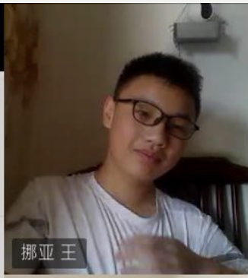
“I want to make the most of my education, but I need tools that keep up with my pace and curiosity.”
Goals
To efficiently manage his school assignments and deadlines.
To have easy access to learning resources and supplementary materials.
Frustrations
Struggling to keep track of multiple platforms for different classes.
Difficulty in finding quick, reliable help when stuck on a problem.
Noa Wang
Noa is homeschooled. He often finds himself switching between different apps for each subject, leading to confusion and missed deadlines. Noa wishes for a unified platform that not only helps him organize his schoolwork but also connects him with classmates for group studies. The app should provide interactive and engaging learning materials that make studying less monotonous and more effective.
Age:
Education:
Hometown:
Family:
Occupation:
14
Middle School Student
Ningbo
Full-time parents
Student

