Slide 1
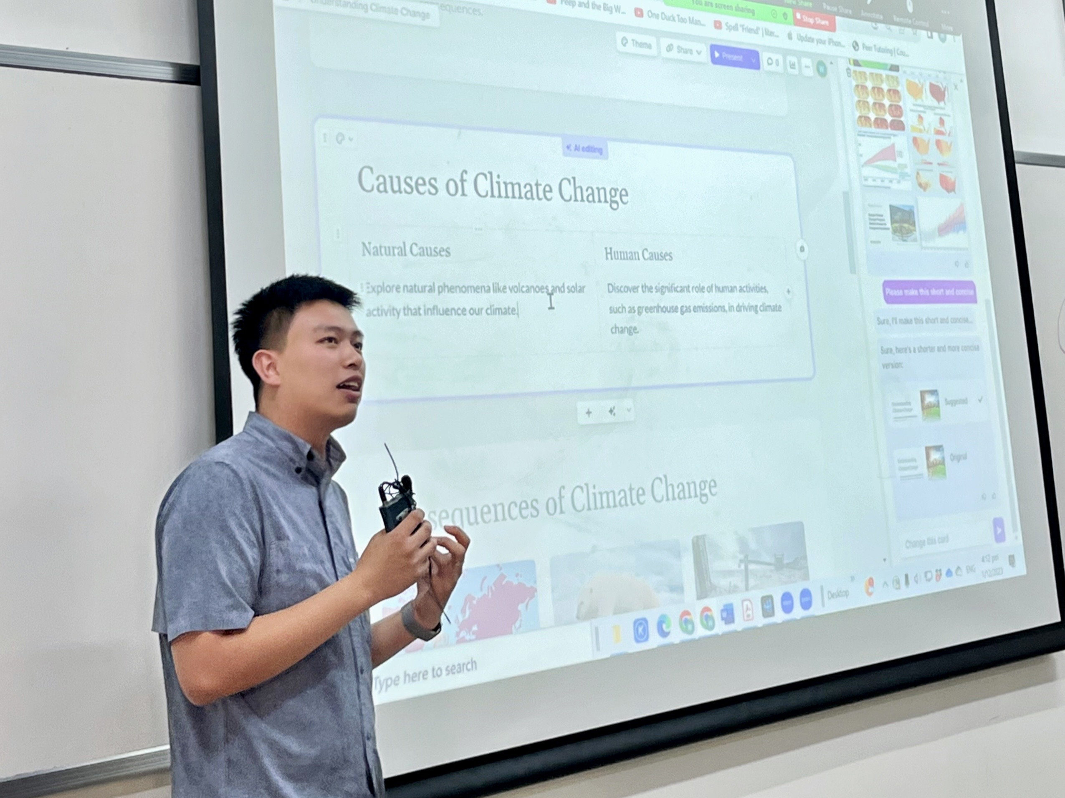
“Teaching is evolving, and I want to evolve with it. I need tools that simplify digital education, not complicate it.”
Add image that represents this persona
Goals
To efficiently manage online classes and distribute educational materials.
To track student progress and provide individualized feedback.
Frustrations
Challenges in adapting traditional teaching methods to a digital format.
Difficulty in keeping students engaged in a virtual environment.
George Wang
Age:
Education:
Hometown:
Family:
Occupation:
23
BS CUHK(SZ)
Shenzhen
Single
Math Teacher
Mr. George has been teaching math for about 5 years. He finds it challenging to keep his students engaged and track their progress effectively online. He is looking for an app that simplifies the administrative aspects of teaching and allows him to focus more on interactive and personalized education. The app should enable him to provide a more immersive and engaging learning experience, bridging the gap between traditional and digital education.

