Slide 1





CHORUS: Designing Human–AI Multi-Agent
Collaboration for Professional Translators
George Xi Wang1,2*, Jiaqian Hu³*, Guande Wu¹, Jing Qian⁴
¹New York University ²Stony Brook University ³Middlebury Institute of International Studies at Monterey ⁴Tongji University
*Equal contribution
Napoli, Italy · October 2026
ICMI 2026
Notes:
Hi everyone, I'm George Wang, a PhD student at Stony Brook University. Today I'll present CHORUS, our work on human–AI multi-agent collaboration for professional translators, with Jiaqian Hu, Guande Wu, and Jing Qian.
The question behind it is simple: what if an AI assistant helped the way professional translators actually revise, one quality dimension at a time, instead of rewriting everything at once? I'll show where that idea came from, what we built, and what happened when thirty professional translators used it.

Slide 2



Current Challenges in Professional Translation
High Stakes
Client Context
Human Accountability
Small errors can have serious consequences.
Client context is absent from LLM training data.
Translators resolve ambiguity with clients.
Medical · Legal · Business
Context Absence
Human responsibility
2
ICMI 2026
Wang et al. 2026
Notes:
Let me start with why professional translation is different. First, the stakes are high. In medical, legal, or business documents, a small error can change the meaning, and errors are far less tolerated.
Second, the work is client-specific. Each client has its own terminology, tone, and house style, which are rarely in the public data an LLM learns from.
Third, the translator is accountable. They resolve ambiguity with the client and stand behind the final result. So fluent output alone is not enough. AI assistance has to support the translator's context and judgment, not replace it.

Slide 3
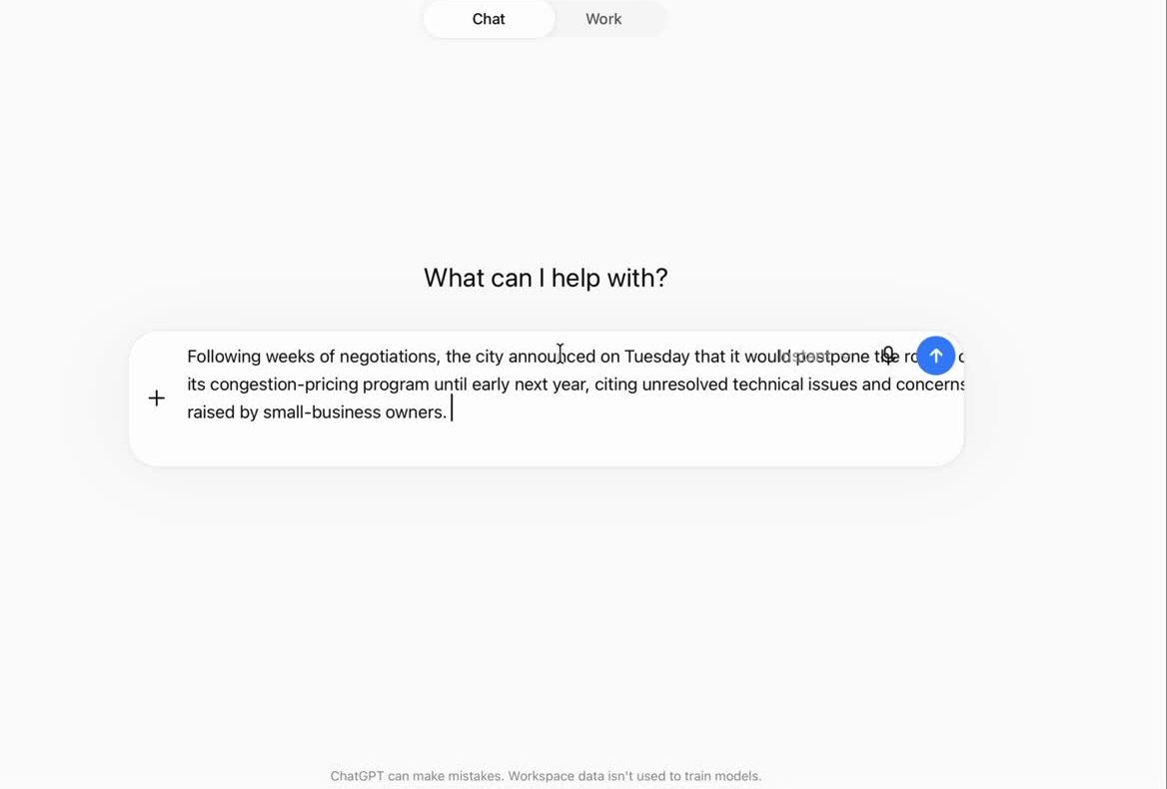
Current Challenges in LLM Chatbot
  One-shot rewriting mixes multiple dimensions
    Accuracy
    Terminology
    Style
    ...
  A small revision can force a full re-check
CAT tools rely on translation memories & termbases; traditional interactive MT (CASMACAT, TranSmart) was not built for multi-dimensional revision with LLMs
3
ICMI 2026
Wang et al. 2026
Notes:
Now imagine the tool most translators use day to day: a general chat LLM. You paste a sentence and ask it to make the translation more formal. What comes back is one rewrite of the whole sentence. The tone changes, but so do terminology and sometimes meaning. You cannot revise one dimension on its own, and after every prompt you have to re-check the entire sentence.
Existing alternatives don't close this gap. CAT tools rely on translation memories and termbases a new project may not have, and earlier interactive translation systems were not designed for multi-dimensional editing with an LLM.

Slide 4
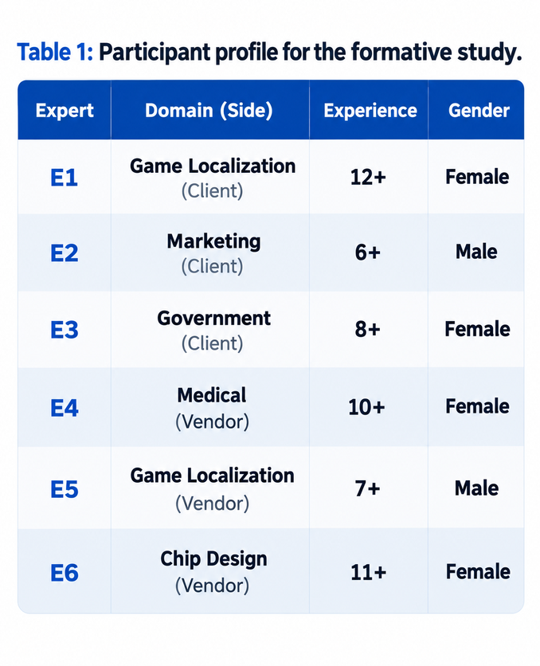
Formative Study
One rewrite changes multiple quality dimensions
Translators must re-check accuracy, terminology, fluency, and style.
C1
C2
AI loses prior revision context
Translators must repeatedly restate what to keep and prioritize.
AI does not expose checks or rationale
Translators must independently justify decisions to clients and supervisors.
C3
4
ICMI 2026
Wang et al. 2026
Notes:
To understand this gap, we interviewed six professional translators, each with at least six years of experience, across client and vendor roles and domains from game localization to medical and chip design. Three challenges emerged.
[CLICK] First, a single rewrite mixes quality dimensions. As one expert put it, “It rewrites everything at once. I cannot tell if it is fixing terminology or just changing the style, so I end up going back and rechecking.”
[CLICK] Second, the AI forgets earlier adjustments, so translators keep repeating what to keep and what to prioritize. One expert had to say, “This part has been revised three times. Don’t change it.”
[CLICK] Third, it keeps no record of what it checked or why, yet translators must justify their decisions to clients and supervisors.

Slide 5
Design Rationales
C1 · Rewrites mix all quality dimensions
D1 · Operationalize MQM as separable agent roles
7 MQM agents
C2 · Adjustments are forgotten
D2 · Capture editing history to reduce repeated adjustments
Effort-aware memory
C3 · No record of what was checked
D3 · Support structured review of history & coverage
Live Style Guide
5
ICMI 2026
Wang et al. 2026
Notes:
These challenges led directly to our design rationales.
[CLICK] For the first, we separate translation quality into seven agent roles based on MQM, so each suggestion addresses one dimension and can be inspected on its own. All of our experts recognized MQM as an authoritative framework.
[CLICK] For the second, effort-aware memory captures the translator's editing history and carries earlier adjustments into future suggestions, so they do not have to restate them.
[CLICK] For the third, a Live Style Guide turns that history into a record of preferences, recurring corrections, and quality coverage that translators can review and explain.

Slide 6







(D1) From MQM to seven agents
Style
Fluency
Audience Appropriateness
MQM
(Multidimensional Quality Metrics)
a scaffold for revision, not just scoring
Terminology
Locale Convention
Accuracy
Design and Markup
Seven MQM-aligned dimensions, adapted from MQM error typologies (Lommel et al., 2014; Lommel, 2018)
6
ICMI 2026
Wang et al. 2026
Notes:
So where do the seven agents come from? MQM stands for Multidimensional Quality Metrics, a framework widely used to describe translation quality. Instead of using it only to score translations afterwards, we use it to structure revision.
Accuracy checks that the meaning is preserved. Terminology checks domain terms. Fluency checks that the text is grammatical and natural. Style checks tone and register. Audience Appropriateness checks fit for the intended reader. Locale Convention checks regional formats, and Design and Markup checks formatting and placeholders. Each agent looks at the draft through one lens.

Slide 7
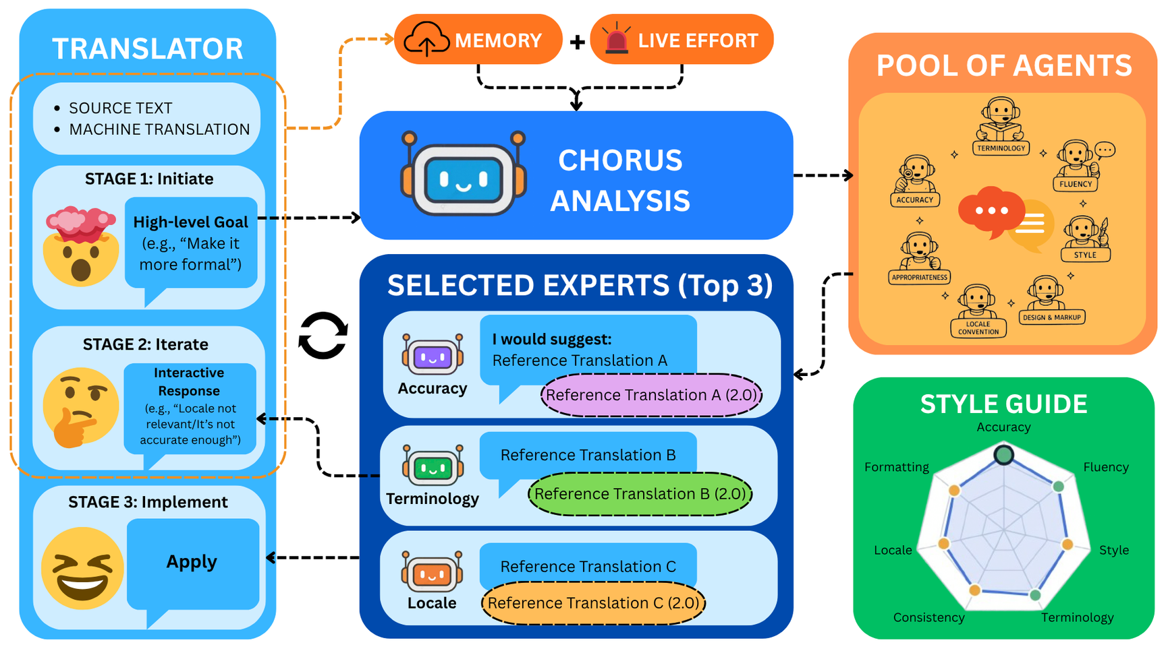
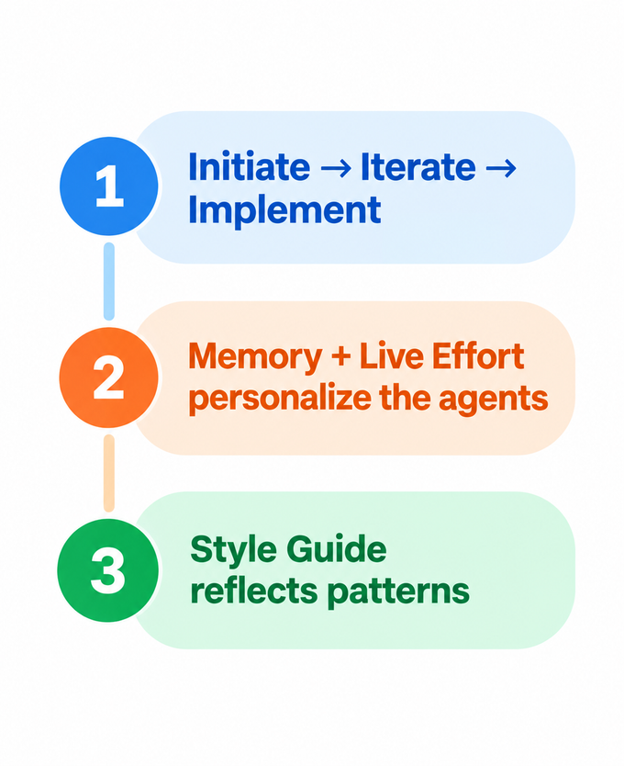
The CHORUS System
7
ICMI 2026
Wang et al. 2026
Notes:
Here is how CHORUS works, in three stages. The translator starts with the source text and a machine-translated draft. First, they state a high-level goal, such as “make it more formal.” CHORUS analyzes the goal and the context and selects the three most relevant agents out of seven.
Second, the translator compares their suggestions and gives feedback, for example, “locale is not relevant here.” Third, they apply a change.
Throughout, editing effort and memory tell CHORUS which edits mattered most, and the Live Style Guide reflects the translator's own patterns back to them.

Slide 8
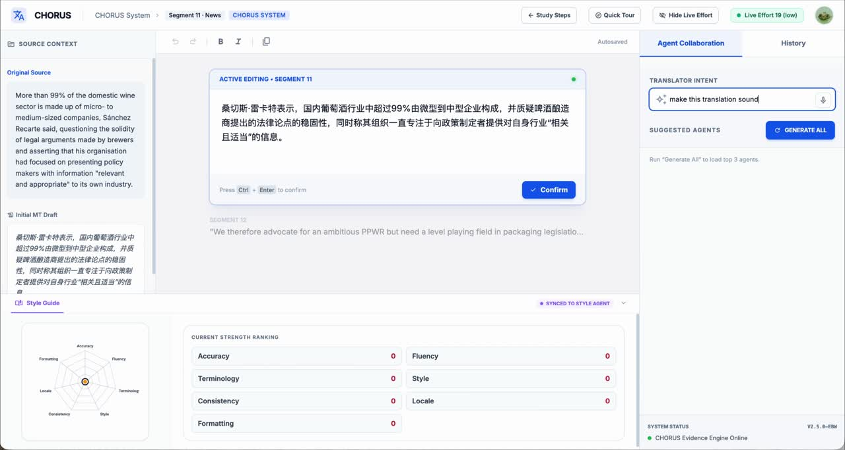
The CHORUS interface
D
A
C
E
8
ICMI 2026
Wang et al. 2026
Notes:
Let's look at the actual interface, on a sentence from a news article. On the left, the Source Context panel shows the original and the initial machine translation draft. In the middle, the Active Editing panel is the main workspace, where the translator edits and confirms each segment. On the right is the Agent Collaboration panel. Here, the translator has typed the intent: “Make it more formal, this is from a newspaper.”

Slide 9
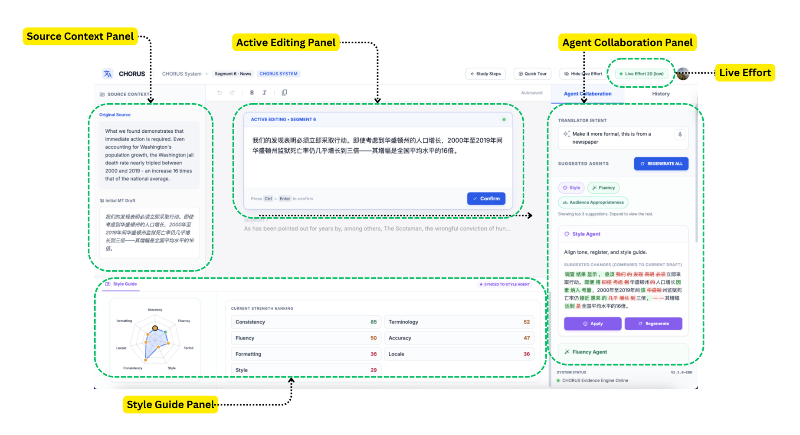
The CHORUS interface
D
A
C
E
8
ICMI 2026
Wang et al. 2026
Notes:
CHORUS then suggests the top three agents for that goal, in this case Style, Fluency, and Audience Appropriateness, and the rest are one click away. Each agent's suggestion is shown as a diff against the current draft, so I can see exactly what each one would change, apply the one I want, and confirm the segment.
At the top right, Live Effort estimates my effort in real time. Along the bottom, the Style Guide shows learned preferences and a strength ranking that fills in as editing continues.

Slide 10
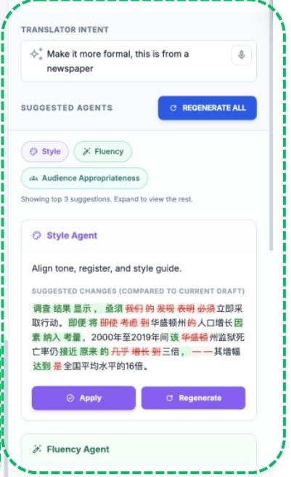



(D1) Coordinating multiple agents
Sync
Rank
Recover
  Bad examples list
  Few-shot learning
  Single agent regeneration
  After every edit
  Token-level diff vs. latest draft
  minimal patch & re-render
  Score from goal & context
  Top 3 shown first
  All 7 available
Agent Collaboration panel
9
ICMI 2026
Wang et al. 2026
Notes:
Splitting quality across seven agents creates a coordination problem, so CHORUS does three things.
First, sync. After every edit, each agent's output is diffed at the token level against the latest draft, and only the minimal patch is applied, so an agent never overwrites what you just changed.
Second, rank. Each agent gets a relevance score from the translator's goal and context, updated as they interact. The top three are shown, and all seven stay available.
Third, recovery. When a translator flags an error, it joins a list of bad examples the model is told to avoid when it regenerates. Any single agent can also be regenerated.

Slide 11
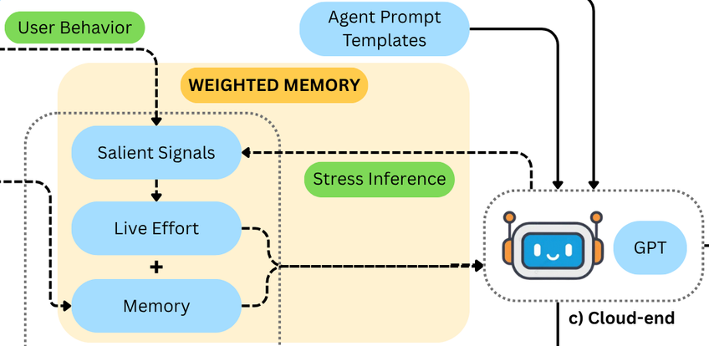



(D2) Effort-aware memory
Live Effort
Micro-Edits
Memory
Agent prompts
How costly was this edit?
What changed
and where
7 agent buckets
+ 1 general bucket
Top-5 edits by effort
as few-shot examples
Live Effort = temporal + technical + cognitive
Temporal
Technical
Cognitive
Initial pause + edit duration
Keystrokes, deletions, cursor moves
Redos + stress (appraisal theory)
Krings, 2001; Stasimioti & Sosoni, 2020; Scherer, 2014
10
ICMI 2026
Wang et al. 2026
Notes:
The second key idea is effort-aware memory. Not all edits matter equally, so CHORUS should remember the ones that cost the translator the most.
It starts with Live Effort. Following prior post-editing research, we model effort at three levels: temporal effort, the reading pause plus edit duration; technical effort, keystrokes and cursor movement; and cognitive effort, redos plus a stress estimate. A linear model combines these into one score.
Micro-edits then record what changed and where, stored in seven buckets, one per agent, plus a general bucket for direct edits. The top five edits by effort go into the agent prompts as examples, so later suggestions build on the edits that mattered most.

Slide 12
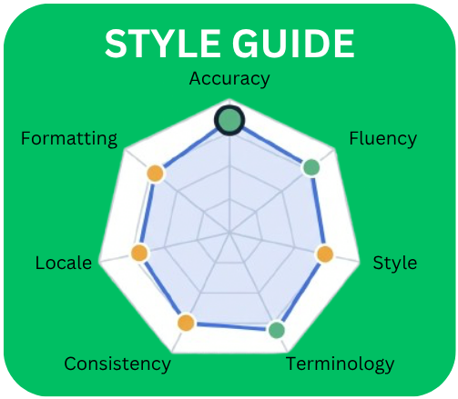
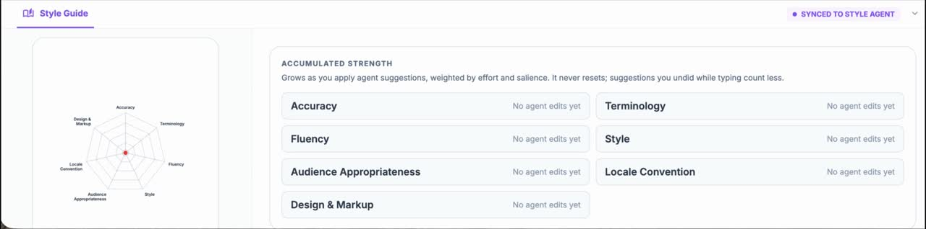
(D3) Live Style Guide
  Radar chart of attention across MQM dimensions
  Learned preferences & recurring corrections
  Dimension-level strength ranking
  Built from the weighted memory
11
ICMI 2026
Live Style Guide radar chart
Wang et al. 2026
Notes:
The third idea is the Live Style Guide, which turns editing history into feedback for reflection. Its radar chart is built from the weighted memory and shows how the translator's attention is spread across the MQM dimensions. Below it, the guide summarizes recurring corrections, learned preferences, and dimension-level strengths.
The goal is reflection without a separate task. Translators can notice dimensions that get less attention, recognize their strengths, and explain their choices in shared quality terms, all during ordinary editing.

Slide 13



Within-subject study
Participants
Tasks & conditions
Research questions
  30 licensed En–Zh translators
  Age: 21–50 (M = 28.9)
  ~100 min/session
  Condition order counterbalanced
  4 translation domains
  2 domains/person
  40 sentences total
  GPT-5.3 baseline
  Counterbalanced
  RQ1 Does CHORUS reduce translators’ editing effort and perceived workload?
  RQ2 Does CHORUS improve final translation quality?
  RQ3 How does CHORUS support professional translators in revision, reflection, and preference formation?
WMT24 (Deutsch et al., 2025) · NASA-TLX (Hart & Staveland, 1988) · BLEU (Papineni et al., 2002) · COMET (Rei et al., 2020)
12
ICMI 2026
Wang et al. 2026
Notes:
To evaluate CHORUS, we ran a within-subject study with thirty licensed English–Chinese translators, with three to twenty-one years of experience. The sentences came from four WMT24 domains: literary, news, social, and speech. Each participant worked in two of them, with both conditions in each, forty sentences in total.
The baseline was GPT-5.3 on the web, with chat history cleared between trials, and both conditions started from GPT-5.3 drafts. Condition order was counterbalanced, and sessions took about a hundred minutes.
We asked three questions: does CHORUS reduce effort and workload, does it improve quality, and how does it support revision, reflection, and preference formation?

Slide 14
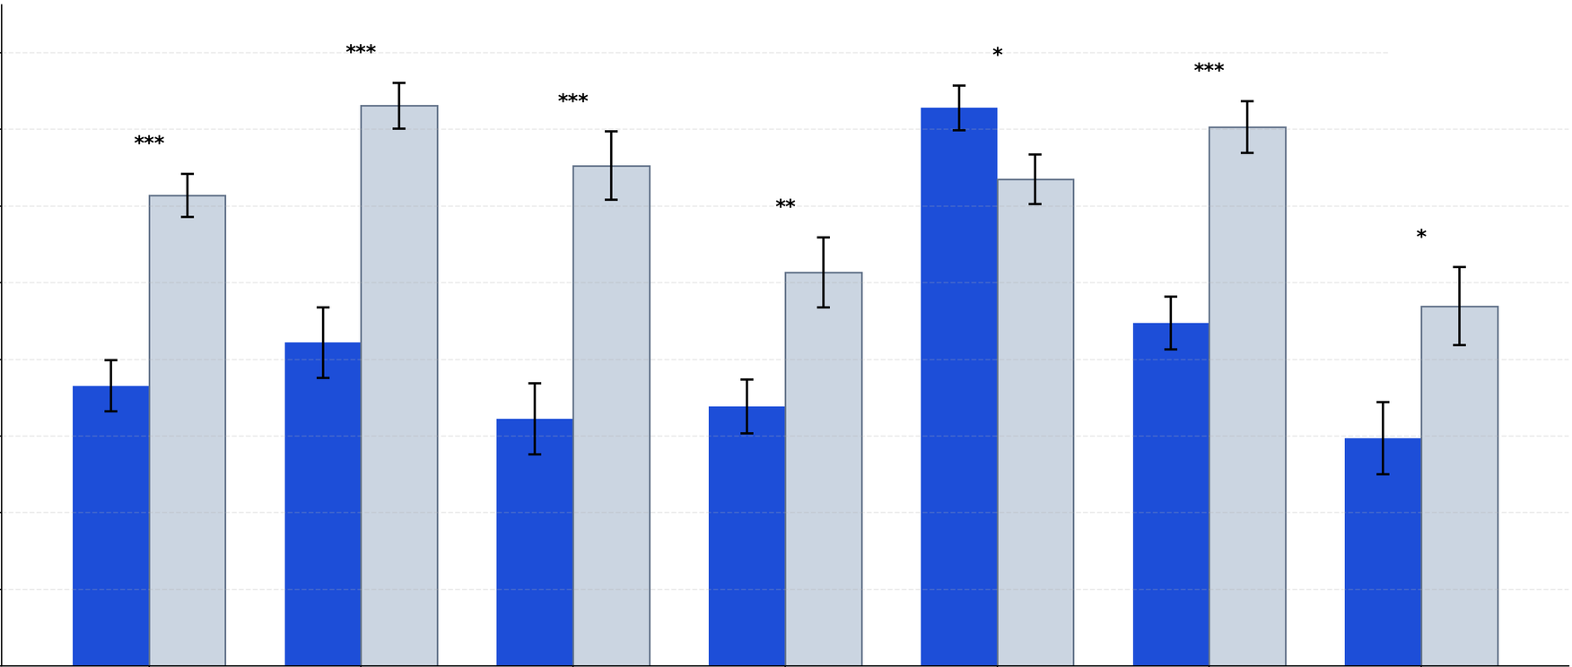
(RQ1) Faster, with less effort
NASA-TLX score (0–100)
CHORUS
Baseline
80
60
40
20
0
Overall
workload
Mental
demand
Physical
demand
Temporal
demand
Success
Effort
Frustration
13
ICMI 2026
Error bars: ±SEM · every difference significant (paired t-tests, p < .05)
Wang et al. 2026
Notes:
Let's start with effort and workload. First, CHORUS made translators faster. Completion time dropped by about thirty-four percent, and the difference was significant.
Second, it lowered effort. Live Effort combines time, keystrokes, and cognitive signals. The average score was about fifty-five with CHORUS versus sixty-six with the baseline, and we found no significant domain effect, so the advantage was not driven by a single domain.
Third, perceived workload tells the same story. On NASA-TLX, CHORUS was lower on every subscale, from mental demand to frustration, and participants rated their own performance higher. So translators finished faster, with less effort and less strain.

Slide 15
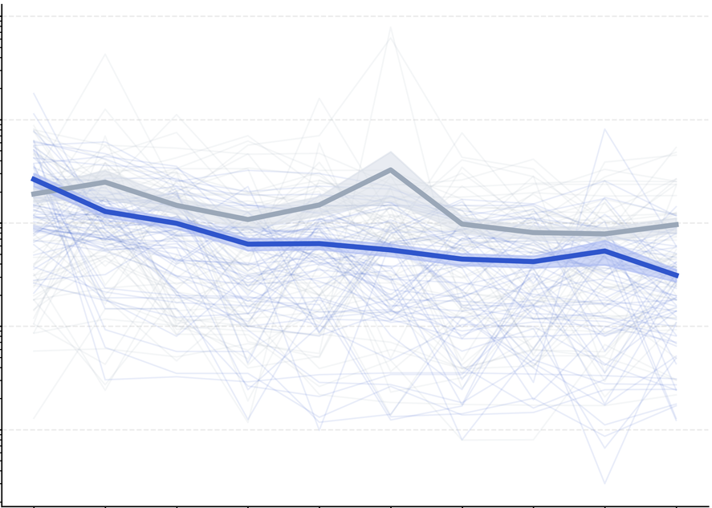
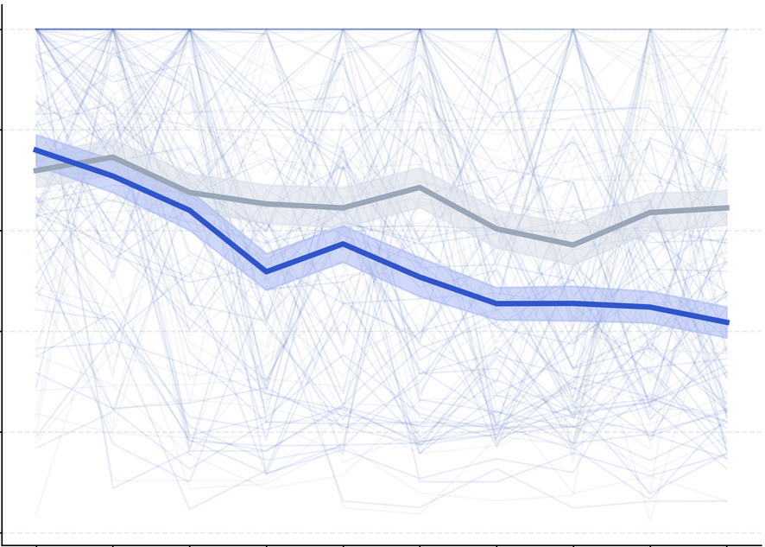
(RQ1) Less time and effort with use
Completion time (seconds, log scale)
Live Effort score (0–100)
BASELINE
10k
100
CHORUS
1k
80
100
60
10
40
20
1
0
1
2
3
4
5
6
7
8
9
10
1
2
3
4
5
6
7
8
9
10
Task order
Task order
14
ICMI 2026
Wang et al. 2026
Notes:
And CHORUS gets faster with use. These plots show completion time and Live Effort across the ten tasks in a session. Gray is the baseline and blue is CHORUS. The two conditions start close together, but CHORUS declines more steeply and stays below the baseline from the second task onward.
The interaction between condition and task order was significant for both time and effort. This suggests participants settled into more efficient working patterns with CHORUS as the session went on.

Slide 16
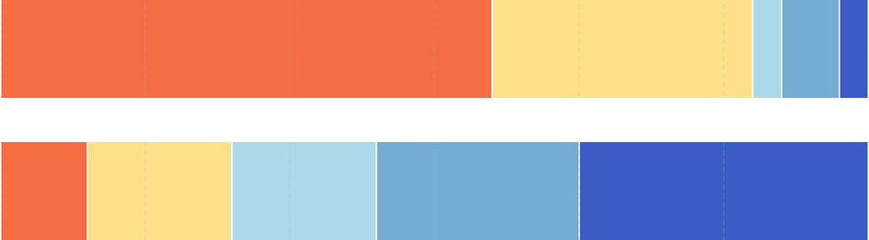
(RQ2) Better translations
BLEU
COMET
Participants
+3.08
+0.015
73.3%
34.90 → 37.98 (p = .0036)
0.837 → 0.852 (p = .0015)
higher with CHORUS on each metric (BLEU and COMET)
Expert raters: “The translation quality gets better over time.”
3 Expert Raters
Baseline
M = 1.70
3.53 vs 1.70
CHORUS
M = 3.53
mean rating that quality improves over time (CHORUS vs Baseline)
strongly disagree
strongly agree
15
ICMI 2026
Wang et al. 2026
Notes:
CHORUS also improved translation quality. Against the human WMT references, BLEU rose from about thirty-five to thirty-eight, and COMET rose from 0.837 to 0.852. Both gains were statistically significant, and on each metric roughly seventy-three percent of participants scored higher with CHORUS.
We also asked three expert translators, each with more than six years of experience, to rate whether quality improved over the session. For CHORUS they averaged about 3.5 on a five-point scale, while for the baseline the ratings leaned toward disagreement, at about 1.7.

Slide 17
(RQ3) Inspectable, focused, reflective
Inspectable
Focused
More reflection
  Dimension-specific suggestions make trade-offs explicit
  Catch issues otherwise missed; verify before confirming
  One dimension at a time: less mental tracking
  Less re-prompting: increasingly reflects ongoing edits & priorities
  Radar chart used to rebalance focus
  Style Guide helps justify decisions
Paraphrased from participants' open-ended responses and interviews
16
ICMI 2026
Wang et al. 2026
Notes:
Our third question was how CHORUS supported translators, and three themes stood out.
First, it is inspectable. Dimension-specific suggestions made trade-offs explicit, helped them catch issues they might have missed, and let them verify before confirming.
Second, it is focused. Working on one dimension at a time reduced the burden of tracking accuracy, terminology, fluency, and style together, and because CHORUS remembered their preferences, there was less re-prompting.
Third, it supports reflection. Many participants used the radar chart to rebalance their attention, and the Style Guide helped them see their editing patterns and explain their decisions with more confidence.

Slide 18

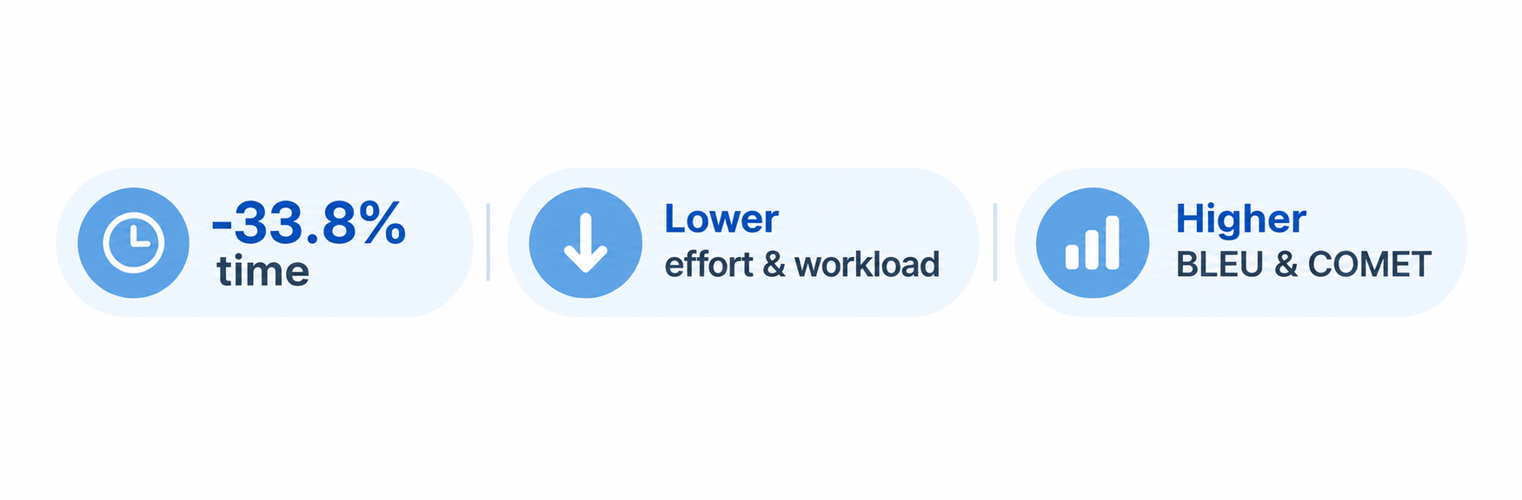
Takeaways
Reorganize LLM help around how professionals revise
One inspectable quality dimension at a time
Limitations & next steps
  Integrated workflow evaluated: components not yet isolated
  Sentence-level En–Zh (WMT24) only
  Next: multilingual & document-level studies
  Next: component-level evaluation
A division of labor
Agents: surface · organize · remember
Professionals: interpret · weigh · decide
17
ICMI 2026
Wang et al. 2026
Notes:
So what should you take away? CHORUS helps not by replacing the translator's judgment, but by reorganizing AI assistance around how professionals actually revise. More broadly, it suggests a division of labor for human-centered multi-agent systems: agents surface issues, organize alternatives, and remember history; professionals interpret context, weigh trade-offs, and make the final call.
[CLICK] There are limitations. We evaluated the whole workflow, which differs from the baseline in both its agents and its interface, so we cannot yet isolate what each component contributes. And we tested only sentence-level English–Chinese translation. Next, we want to run multilingual and document-level studies.

Slide 19


Thank you.
Paper
Code
doi.org/10.1145/3776574.3831126
github.com/iamgeorge/CHORUS-OSS
18
ICMI 2026
Wang et al. 2026
Notes:
To close, CHORUS supports professional translation through focused agent suggestions, effort-aware memory, and a Live Style Guide, with the goal of giving translators more control over revision while keeping their judgment central. The QR codes link to the paper and to our open-source implementation, including all the agent prompts. Thank you, and I'm happy to take questions.
[NOT SPOKEN: Stay here for questions. Backup slides: 21 baseline choice; 22 Live Effort; 23 participants and counterbalancing; 24 quality trends; 25 perception ratings; 26 Style Guide ratings; 27 confounds and statistics; 28 responsible deployment.]

Slide 20
References
  Alabau et al. 2013. CASMACAT: An open source workbench for advanced computer aided translation. De Gruyter Open.
  Banerjee and Lavie. 2005. METEOR: An automatic metric for MT evaluation with improved correlation with human judgments. In Proc. ACL Workshop on Intrinsic and Extrinsic Evaluation Measures for MT and/or Summarization.
  Braun and Clarke. 2006. Using thematic analysis in psychology. Qualitative Research in Psychology 3, 2.
  Deutsch et al. 2025. WMT24++: Expanding the language coverage of WMT24 to 55 languages & dialects. arXiv:2502.12404.
  Hart and Staveland. 1988. Development of NASA-TLX (Task Load Index): Results of empirical and theoretical research. In Advances in Psychology 52. Elsevier.
  Huang et al. 2021. TranSmart: A practical interactive machine translation system. arXiv:2105.13072.
  Jiao et al. 2023. Is ChatGPT a good translator? A preliminary study. arXiv:2301.08745.
  Krings. 2001. Repairing texts: Empirical investigations of machine translation post-editing processes. Kent State University Press.
  Lommel. 2018. Metrics for translation quality assessment: A case for standardising error typologies. In Translation Quality Assessment: From Principles to Practice. Springer.
  Lommel et al. 2014. Multidimensional quality metrics (MQM): A framework for declaring and describing translation quality metrics. Tradumàtica 12.
  Lu et al. 2025. MQM-APE: Toward high-quality error annotation predictors with automatic post-editing in LLM translation evaluators. In Proc. COLING.
  OpenAI. 2026. GPT-5.3 Instant: Smoother, more useful everyday conversations. openai.com/index/gpt-5-3-instant
  Papineni et al. 2002. BLEU: A method for automatic evaluation of machine translation. In Proc. ACL.
  Rei et al. 2020. COMET: A neural framework for MT evaluation. In Proc. EMNLP.
  Scherer. 2014. On the nature and function of emotion: A component process approach. In Approaches to Emotion. Psychology Press.
  Sellam et al. 2020. BLEURT: Learning robust metrics for text generation. In Proc. ACL.
  Stasimioti and Sosoni. 2020. Translation vs post-editing of NMT output: Insights from the English-Greek language pair. In Proc. 1st Workshop on Post-Editing in Modern-Day Translation.
  Zhang et al. 2025. HiMATE: A hierarchical multi-agent framework for machine translation evaluation. arXiv:2505.16281.
Full bibliography in the paper: doi.org/10.1145/3776574.3831126
19
ICMI 2026
Wang et al. 2026
Notes:
[NOT SPOKEN: References are available for questions. Keep the Thank-you slide visible unless a specific reference is needed.]

Slide 21
(B1) Why GPT-5.3 web as baseline?
Alternative | Why not a baseline
CAT tools | Rely on translation memories & termbases, unavailable for our tasks
CASMACAT | Predates LLM-based assistance; not evaluated on En–Zh
TranSmart | Closed commercial service
MQM-APE, HiMATE | Evaluation methods, not interactive systems
What professionals use
  All 6 formative experts: GPT web is their primary day-to-day AI aid
  CAT tools only for projects with established translation memories
Keeping it comparable
Alabau et al. 2013; Huang et al. 2021; Lu et al. 2025; Zhang et al. 2025; OpenAI 2026
  GPT-5.3 produced the initial drafts in both conditions
  Chat history cleared between trials
20
ICMI 2026
Wang et al. 2026
Notes:
All 6 formative-study experts described GPT web as their main everyday AI aid. CAT tools depended on translation memories and terminology resources that our tasks lacked. Other systems either predated LLM assistance, were closed services, or focused on evaluation. We therefore chose a familiar chatbot baseline. Both conditions used GPT-5.3 drafts, and we cleared baseline chat history between trials.

Slide 22



(B2) How Live Effort is computed
Temporal
Technical
Cognitive
  Initial pause (reading and understanding the source)
  Total edit duration
  Keystroke counts
  Deletions and cursor movement
  Number of redos
  Stress, inferred by ChatGPT-5.3 via appraisal theory: difficulty, ambiguity, risk, controllability
Linear effort model → one Live Effort score → ranks Micro-Edits → top-5 injected as few-shot examples
Krings 2001; Stasimioti & Sosoni 2020; Scherer 2014
21
ICMI 2026
Wang et al. 2026
Notes:
Live Effort combines time, interaction activity, and cognitive proxies. Temporal signals include the initial reading pause and editing duration. Technical signals include keystrokes, deletions, and cursor movement. Cognitive proxies include redos and model-inferred stress. A linear model combines these signals to rank edits for memory. We also report completion time and NASA-TLX, which support the same overall direction of results.
[NOT SPOKEN: Exact weights are not listed in the paper. Refer to the open-source implementation.]

Slide 23
(B3) Participants & counterbalancing
Participants (N = 30)
Within-subject design
  Licensed En–Zh translators, proof of certification
  Age 21–50 (M = 28.9, SD = 6.1)
  Experience 3–21 yrs (M = 5.4, SD = 4.9)
  AI translation tool use: median 4/5
  CAT tool familiarity: median 3.5/5
  2 of 4 WMT24 domains per participant (literary, news, social, speech)
  Both conditions in each domain: 20 sentences per domain, 40 total
  Condition order counterbalanced (pre-generated table)
  No sentence repeated across conditions or trials
  5-min practice · ≈100-min session
 | Domain A | Domain B | Domain C | Domain D
Participant n | Baseline + CHORUS | Baseline + CHORUS | – | –
Participant n+1 | – | – | Baseline + CHORUS | Baseline + CHORUS
22
ICMI 2026
Wang et al. 2026
Notes:
We recruited 30 certified English–Chinese translators with 3 to 21 years of experience. Each worked in 2 domains and used both conditions within each domain, completing 40 sentences overall. We counterbalanced condition order and never repeated a sentence across conditions or trials. Participants received 5 minutes of practice, and sessions lasted about 100 minutes. They were already frequent users of AI translation tools.
[NOT SPOKEN: Verify the analysis code before explaining differing test degrees of freedom. Confirm exact sentence sampling from study materials if asked.]

Slide 24
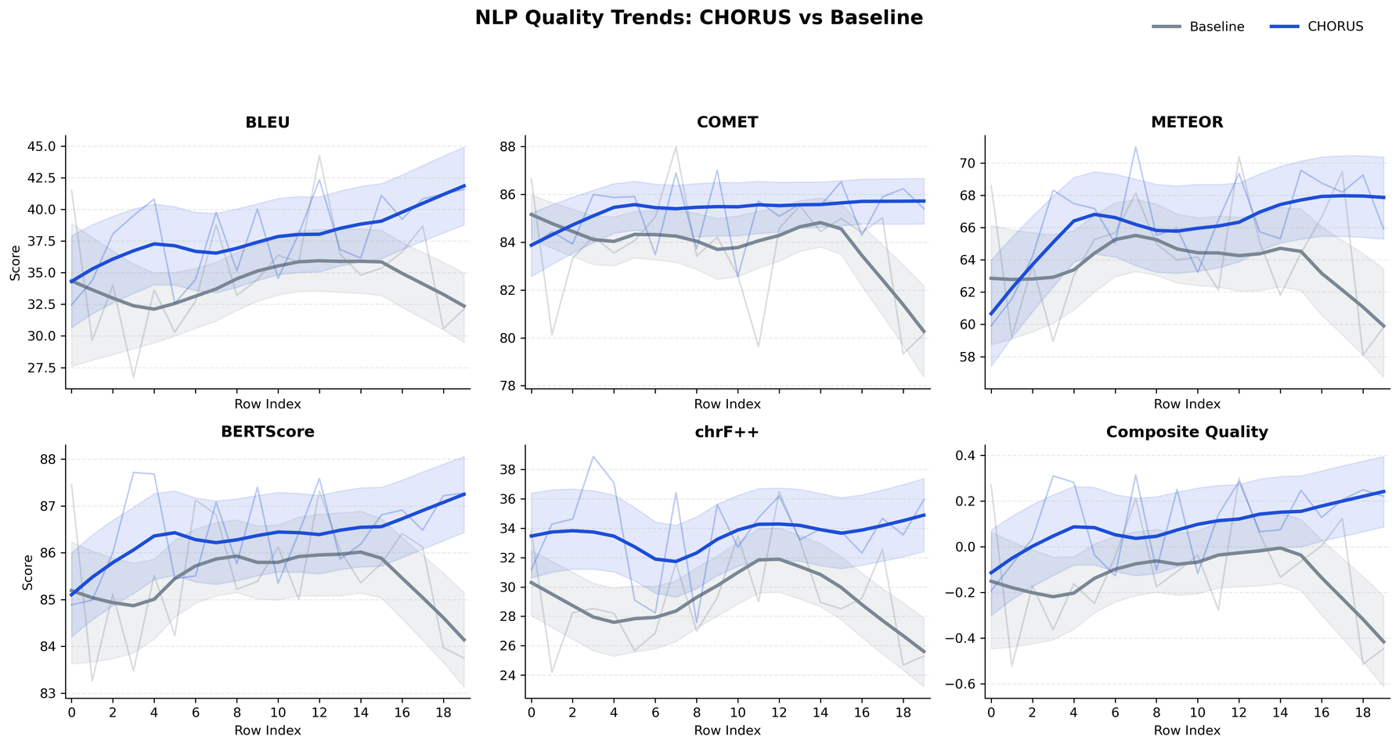
(B4) Quality trends over task order
Metric | Baseline | CHORUS
BLEU | largely flat | 0.297 (p = .014)
METEOR | largely flat | 0.00236 (p = .024)
Composite | 0.00062 (p = .923) | 0.0119 (p = .059)
BLEURT* | −0.00830 (p < .001) | −0.00295 (p = .101)
Slopes over task order; bold blue = significant CHORUS slope. *BLEURT is not plotted in the figure. METEOR (Banerjee & Lavie, 2005) · BLEURT (Sellam et al., 2020)
23
ICMI 2026
Wang et al. 2026
Notes:
Under CHORUS, BLEU and METEOR increased significantly across task order, while the baseline stayed largely flat. The composite quality index also trended upward, but did not reach conventional significance. BLEURT declined significantly for the baseline and showed a smaller, non-significant decline for CHORUS. These results suggest improvement on some measures during the session, with expert ratings supporting the same general direction.
[NOT SPOKEN: Do not quote unreported slopes for COMET, BERTScore, or chrF++.]

Slide 25
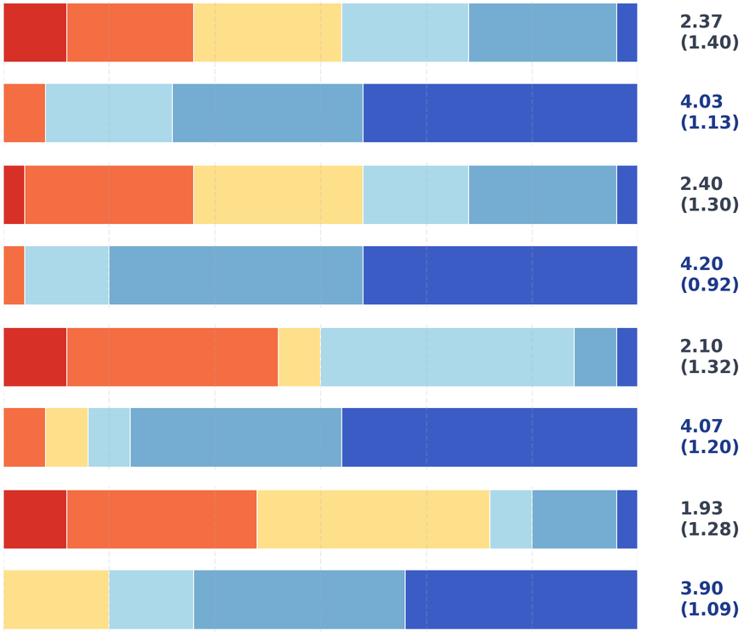
(B5a) Perception ratings
Mean (SD)
The System helped me find issues I would otherwise miss.
Baseline
CHORUS
I am satisfied with the translation quality of this system.
Baseline
CHORUS
The system increasingly understands my translation preferences OVERTIME.
Baseline
CHORUS
The system yields more translation insights OVERTIME.
Baseline
CHORUS
CHORUS: higher agreement on every statement
Rating
0
1
2
3
4
5
24
ICMI 2026
Wang et al. 2026
Notes:
Participants rated 4 statements for each condition. These covered finding otherwise missed issues, satisfaction with translation quality, growing understanding of their preferences, and gaining translation insights over time. CHORUS received higher agreement on every statement. These ratings complement the performance measures by showing how participants experienced the workflow, especially whether its suggestions became more useful and better aligned with their preferences.
[NOT SPOKEN: Point to the bars. The paper text does not provide exact rating values.]

Slide 26
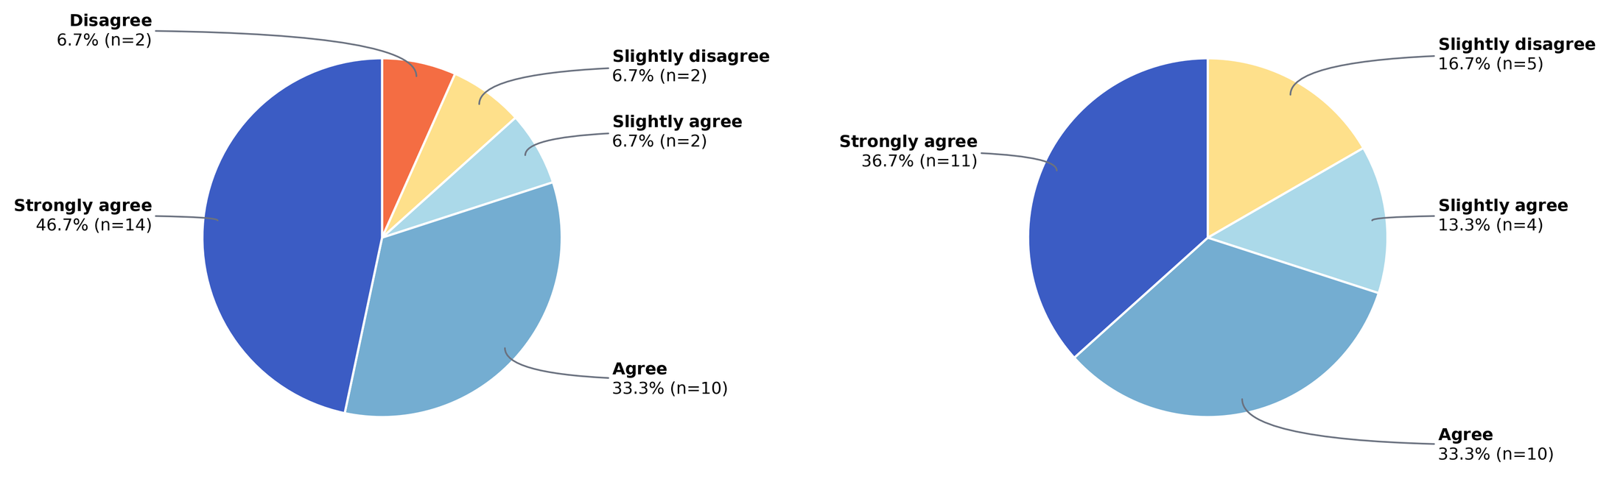
(B5b) Style Guide ratings over time
The Style Guide (Bottom Panel) yields useful translation hints over time
The Style Guide (Bottom Panel) yields more translation reflections over time
Disagree
Slightly disagree
Slightly agree
Agree
Strongly agree
Most participants agreed or strongly agreed with both statements
25
ICMI 2026
Wang et al. 2026
Notes:
Most participants agreed or strongly agreed that the Style Guide provided useful translation hints and encouraged reflection over time. In interviews, they described using the radar chart to notice overlooked dimensions and rebalance their attention. They also used the guide to spot possible misclassifications in their edits and explain decisions with more confidence. These findings reflect participants' perceptions of its usefulness.
[NOT SPOKEN: Point to the charts. The paper text does not provide exact percentages.]

Slide 27

(B6) Confound & full statistics
CHORUS differs in backend AND interface
  We interpret gains as the effect of the integrated workflow, not the agent architecture alone
  Efficacy of individual components remains future work
Measure | Test | Result
Completion time (log) | Paired t-test | t(59) = −5.35, p < .001; ratio 0.662, 95% CI [0.567, 0.772]
Live Effort | t-test | t(59) = −5.81, p < .001; 54.85 vs 65.84
Domain effect, time | Mixed-effects | χ²(3) = 5.45, p = .142
Domain effect, effort | Mixed-effects | χ²(3) = 6.00, p = .112
BLEU | Paired t-test | t(29) = 3.16, p = .0036; Wilcoxon p = .0081; g = 0.56
COMET | Paired t-test | t(29) = 3.51, p = .0015; Wilcoxon p = .0019; g = 0.62
26
ICMI 2026
Wang et al. 2026
Notes:
CHORUS changes both the backend and the interface, so we attribute the gains to the integrated workflow. This study cannot isolate the contribution of the agents, memory, or Style Guide. Across the full system, completion time and effort fell significantly, and BLEU and COMET improved. Evaluating individual components is a next step for understanding which parts contribute to these benefits.
[NOT SPOKEN: The paper explicitly names a paired t-test for log completion time, but does not name the Live Effort test.]

Slide 28




(B7) Safe & responsible innovation
Human-accountable
AI support stays explainable, inspectable, and subject to human judgment
Confidentiality
Protect confidential materials in deployment
Audit uneven performance
Across users and domains
Prevent over-reliance
On agent suggestions in high-stakes settings
27
ICMI 2026
Wang et al. 2026
Notes:
Professional translators remain accountable for the final text, so agent suggestions need to stay inspectable and subject to human judgment. Deployment also needs protection for confidential client materials and stored editing history. We should audit performance across users and domains, and address over-reliance in high-stakes work. The aim is to support careful review while keeping translators responsible for accepting each change.

