Slide 1
Stats1 Chapter 5 :: Probability
jamie@drfrostmaths.com
www.drfrostmaths.com @DrFrostMaths
Last modified: 15th November 2019

Slide 2




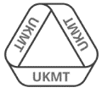
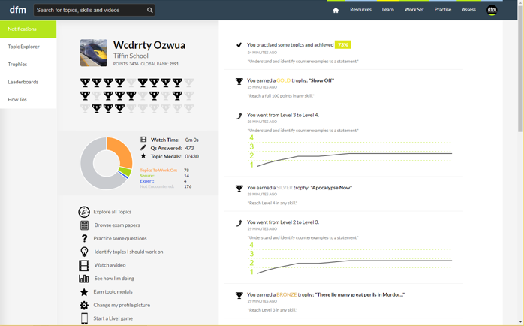
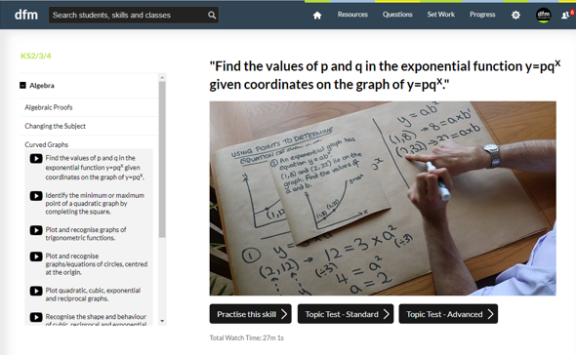
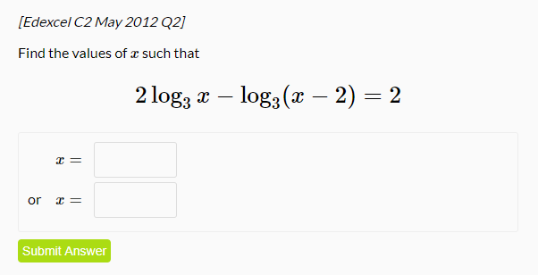
www.drfrostmaths.com
Everything is completely free.
Why not register?
Register now to interactively practise questions on this topic, including past paper questions and extension questions (including MAT + UKMT).
Teachers: you can create student accounts (or students can register themselves), to set work, monitor progress and even create worksheets.
With questions by:
Dashboard with points, trophies, notifications and student progress.
Questions organised by topic, difficulty and past paper.
Teaching videos with topic tests to check understanding.

Slide 3

Experimental
i.e. Dealing with collected data.
Chp2: Measures of Location/Spread
Chp3: Representation of Data
Chp1: Data Collection
Statistics used to summarise data, including mean, standard deviation, quartiles, percentiles. Use of linear interpolation for estimating medians/quartiles.
Producing and interpreting visual representations of data, including box plots and histograms.
Methods of sampling, types of data, and populations vs samples.
Chp4: Correlation
Measuring how related two variables are, and using linear regression to predict values.
Theoretical
Deal with probabilities and modelling to make inferences about what we ‘expect’ to see or make predictions, often using this to reason about/contrast with experimentally collected data.
Chp5: Probability
Chp6: Statistical Distributions
Chp7: Hypothesis Testing
Venn Diagrams, mutually exclusive + independent events, tree diagrams.
Common distributions used to easily find probabilities under certain modelling conditions, e.g. binomial distribution.
Determining how likely observed data would have happened ‘by chance’, and making subsequent deductions.

Slide 4




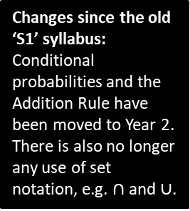






This Chapter Overview
This chapter is a recap of the concepts you learnt at GCSE.
2 :: Venn Diagrams
1 :: Basic Probability
“Out of 50 students, 12 play both piano and drums, 30 play piano and 25 play drums. Find the probability a randomly chosen student plays neither instrument.”
“I throw two fair die. Calculate the probability the sum of the two dice is more than 6.”
3 :: Mutually Exclusive/Independent Events
4 :: Tree Diagrams
“The probability I hit a target is 0.3. If I hit it, the probability I hit again on the next shot is 0.4. If I miss, the probability I hit on the next shot is 0.1. If I shoot 3 times, what’s the probability I hit on the first and third shot?”
Determine whether $A$ and $B$ are independent.
Changes since the old ‘S1’ syllabus:
Conditional probabilities and the Addition Rule have been moved to Year 2. There is also no longer any use of set notation, e.g. $∩$ and $∪$.
$$A$$
$$B$$
$$C$$
$$3$$
$$1$$
$$4$$
$$6$$
$$2$$
$$5$$

Slide 5


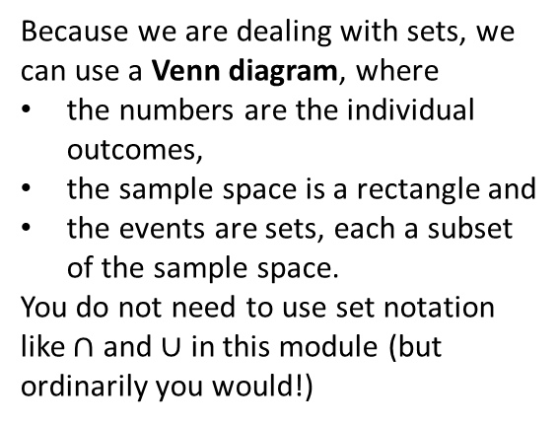


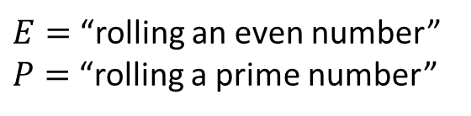
Probability concepts
! An experiment is a repeatable process that gives rise a number a number of outcomes.
! An event is a set of one or more of these outcomes. (We often use capital letters to represent them)
$$S$$
$$P$$
$E=$“rolling an even number”
$P=$“rolling a prime number”
1
3
5
! A sample space is the set of all possible outcomes.
$$E$$
Because we are dealing with sets, we can use a Venn diagram, where
the numbers are the individual outcomes,
the sample space is a rectangle and
the events are sets, each a subset of the sample space.
You do not need to use set notation like $∩$ and $∪$ in this module (but ordinarily you would!)
2
6
4

Slide 6
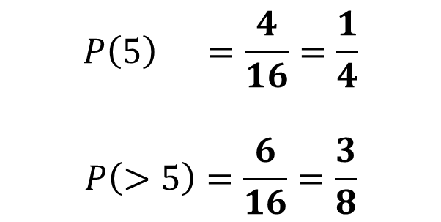
Example
Two fair spinners each have four sectors numbered 1 to 4. The two spinners are spun together and the sum of the numbers indicated on each spinner is recorded.
Find the probability of the spinners indicating a sum of
(a) exactly 5 (b) more than 5
Spinner 1
?
$$P\left(5\right) =\frac{4}{16}=\frac{1}{4}$$
$$P\left(>5\right)=\frac{6}{16}=\frac{3}{8}$$
+
1 2 3 4
1
2
3
4
2 3 4 5
3 4 5 6
?
Spinner 2
4 5 6 7
5 6 7 8
If the sample space is the amalgamation of two underlying experiments, a table is a helpful way to list the outcomes.

Slide 7
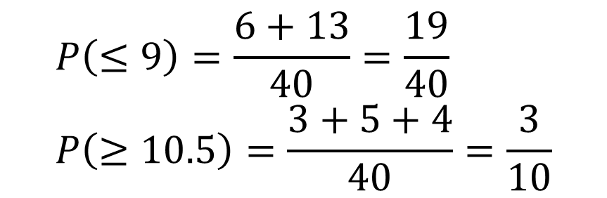
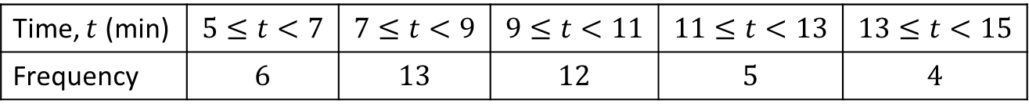
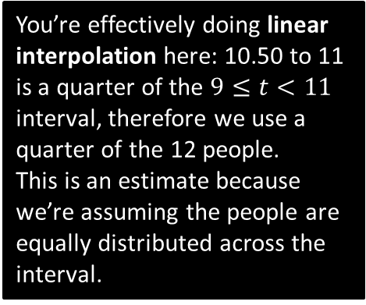
Another Example
The table shows the times taken, in minutes, for a group of students to complete a number puzzle.
A student is chosen at random. Find the probability for a group of students to complete a number puzzle
(a) In under 9 minutes (b) in over 10.5 minutes.
Time, $t$ (min) | $$5≤t<7$$ | $$7≤t<9$$ | $$9≤t<11$$ | $$11≤t<13$$ | $$13≤t<15$$
Frequency | $$6$$ | $$13$$ | $$12$$ | $$5$$ | $$4$$
?
$$P\left(≤9\right)=\frac{6+13}{40}=\frac{19}{40} \\ P\left(≥10.5\right)=\frac{3+5+4}{40}=\frac{3}{10}$$
You’re effectively doing linear interpolation here: 10.50 to 11 is a quarter of the $9≤t<11$ interval, therefore we use a quarter of the 12 people.
This is an estimate because we’re assuming the people are equally distributed across the interval.
?

Slide 8
Exercise 5A
Pearson Applied Year 1/AS
Pages 71-72

Slide 9









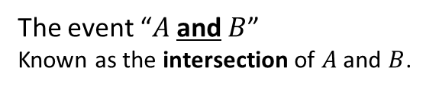






Venn Diagrams
Venn Diagrams allow us to combine events, e.g. “$A$ happened and $B$ happened”.
$$S$$
$$S$$
$$A$$
$$B$$
$$A$$
$$B$$
The event “$A$ and $B$”
Known as the intersection of $A$ and $B$.
The event “$A$ or $B$”
Known as the union of $A$ and $B$.
$$S$$
$$S$$
$$A$$
$$B$$
$$A$$
$$B$$
The event “not $A$”
Known as the union of $A$ and $B$.
These can be combined,
e.g. “$A$ and not $B$”.

Slide 10

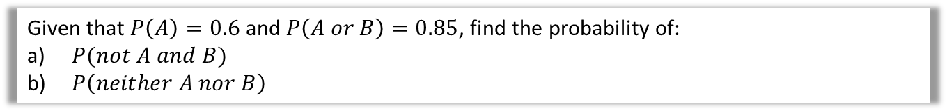
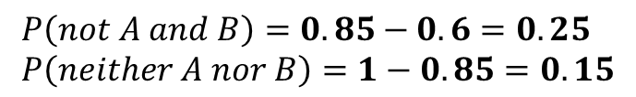


Example involving probabilities
We can either put frequencies or probabilities into the Venn Diagram.
Given that $P\left(A\right)=0.6$ and $P\left(A or B\right)=0.85$, find the probability of:
$P(not A and B)$
$P\left(neither A nor B\right)$
?
$$S$$
0.15
$$A$$
$$B$$
$$P\left(not A and B\right)=0.85−0.6=0.25 \\ P\left(neither A nor B\right)=1−0.85=0.15$$
0.6
0.25
0.85

Slide 11
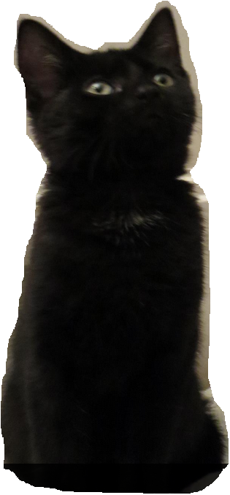





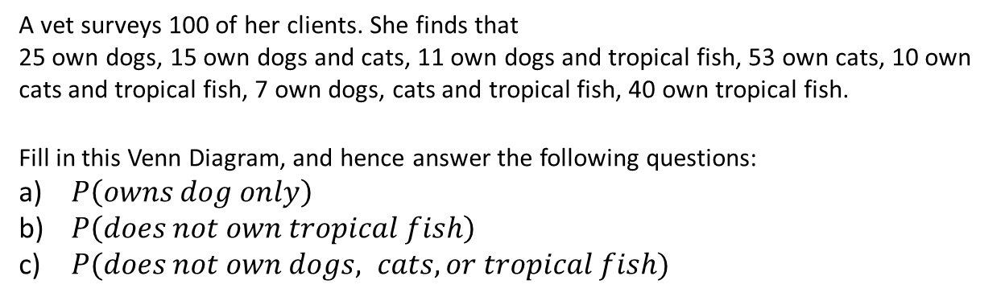








Example involving frequencies
A vet surveys 100 of her clients. She finds that
25 own dogs, 15 own dogs and cats, 11 own dogs and tropical fish, 53 own cats, 10 own cats and tropical fish, 7 own dogs, cats and tropical fish, 40 own tropical fish.
Fill in this Venn Diagram, and hence answer the following questions:
$P\left(owns dog only\right)$
$P\left(does not own tropical fish\right)$
$P(does not own dogs, cats, or tropical fish)$
$$S$$
Fro Tip: Start from the centre frequency and work your way outwards using subtraction.
$$C$$
?
?
$$35$$
$$11$$
?
?
$$8$$
$$3$$
?
$$D$$
$$7$$
$\frac{6}{100}=\frac{3}{50}$
$\frac{60}{100}=\frac{3}{5}$
$\frac{11}{100}$
$$F$$
?
?
?
?
$$26$$
$$6$$
$$4$$
?
Dr Frost’s cat “Pippin”

Slide 12
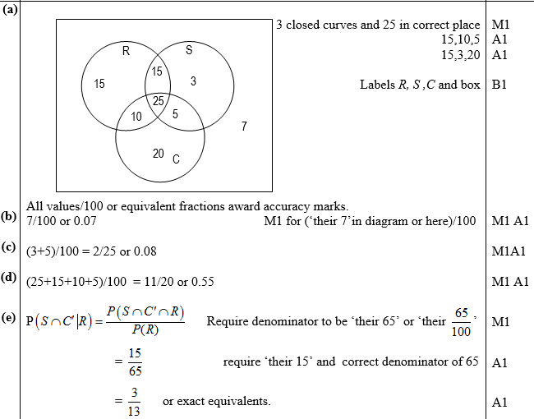
Test Your Understanding
Jan 2012 Q6
Fro Tip: You’ll lose a mark if you don’t have a box!
The following shows the results of a survey on the types of exercise taken by a group of 100 people.
65 run 48 swim
60 cycle 40 run and swim
30 swim and cycle 35 run and cycle 25 do all three
(a) Draw a Venn Diagram to represent these data. (4)
Find the probability that a randomly selected person from the survey
(b) takes none of these types of exercise, (2)
(c) swims but does not run, (2)
takes at least two of these types of exercise. (2)
Jason is one of the above group. Given that Jason runs,
(e) find the probability that he swims but does not cycle. (3)
?
?
?
?

Slide 13
Exercise 5B
Pearson Applied Year 1/AS
Pages 74-75

Slide 14

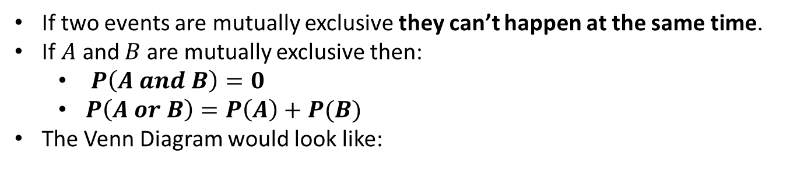
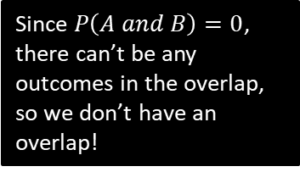


Mutually Exclusive Events
?
If two events are mutually exclusive they can’t happen at the same time.
If $A$ and $B$ are mutually exclusive then:
$P\left(A and B\right)=0$
$P\left(A or B\right)=P\left(A\right)+P(B)$
The Venn Diagram would look like:
?
?
$$S$$
?
$$A$$
$$B$$
Since $P\left(A and B\right)=0$, there can’t be any outcomes in the overlap, so we don’t have an overlap!

Slide 15
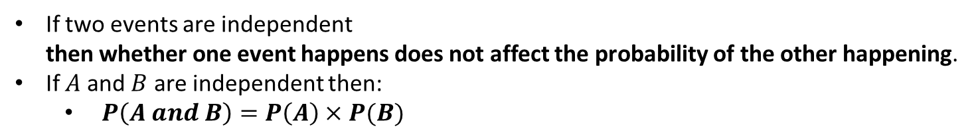

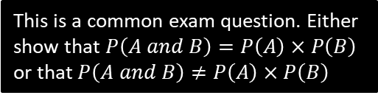
Independent Events
If two events are independent then whether one event happens does not affect the probability of the other happening.
If $A$ and $B$ are independent then:
$P\left(A and B\right)=P\left(A\right)×P(B)$
?
?
Fro Note: Independence does not affect how the circles interact in a Venn Diagram.
1 2 3 4
Example
1
I pick one of the four numbers 1, 2, 3, 4 at random. What’s the probability that:
I pick a multiple of 2: $\frac{1}{2}$
I pick a multiple of 4: $\frac{1}{4}$
Explain (conceptually) why these two events are not independent.
If it is a multiple of 4, then it must also be a multiple of 2. But if it wasn’t a multiple of 4 then it may or may not be a multiple of 2. So the events are linked and whether one happened influences the probability of the other happening.
Show that the events are not independent.
$$P\left(multiple of 2\right)×P\left(multiple of 4\right)=\frac{1}{2}×\frac{1}{4}=\frac{1}{8} \\ P\left(multiple of 2 and multiple of 4\right)=\frac{1}{4}$$
But $\frac{1}{8}≠\frac{1}{4}$ therefore not independent.
?
?
2
?
3
?
This is a common exam question. Either show that $P\left(A and B\right)=P\left(A\right)×P\left(B\right)$ or that $P\left(A and B\right)≠P\left(A\right)×P\left(B\right)$

Slide 16


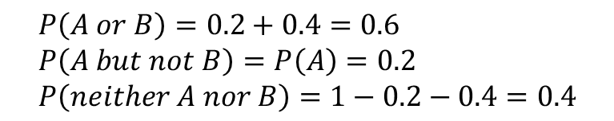



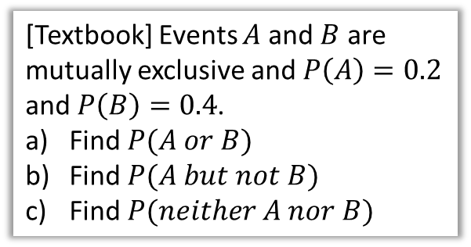

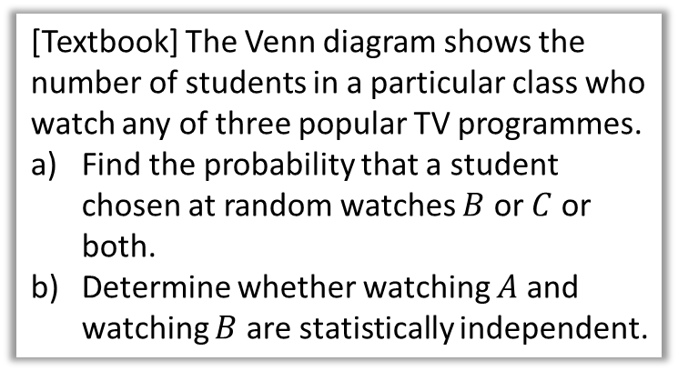

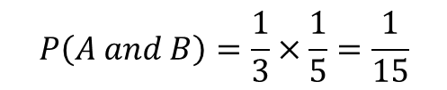


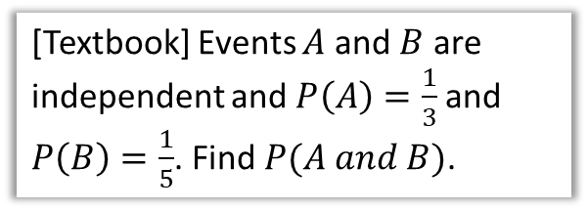


Further Examples
[Textbook] Events $A$ and $B$ are mutually exclusive and $P\left(A\right)=0.2$ and $P\left(B\right)=0.4$.
Find $P(A or B)$
Find $P(A but not B)$
Find $P(neither A nor B)$
[Textbook] The Venn diagram shows the number of students in a particular class who watch any of three popular TV programmes.
Find the probability that a student chosen at random watches $B$ or $C$ or both.
Determine whether watching $A$ and watching $B$ are statistically independent.
?
$$P\left(A or B\right)=0.2+0.4=0.6 \\ P\left(A but not B\right)=P\left(A\right)=0.2 \\ P\left(neither A nor B\right)=1−0.2−0.4=0.4$$
$$S$$
$$B$$
$$A$$
$$C$$
[Textbook] Events $A$ and $B$ are independent and $P\left(A\right)=\frac{1}{3}$ and $P\left(B\right)=\frac{1}{5}$. Find $P(A and B)$.
$$3$$
$$4$$
$$5$$
$$10$$
$$7$$
$$1$$
$$P\left(watches B or C\right)=\frac{26}{30}$$
$$P\left(A\right)=\frac{7}{30} P\left(B\right)=\frac{19}{30} \\ P\left(A and B\right)=\frac{4}{30} \\ P\left(A\right)×P\left(B\right)=\frac{7}{30}×\frac{19}{30}=\frac{133}{900}≠\frac{4}{30}$$ $∴$ not independent.
?
$$P\left(A and B\right)=\frac{1}{3}×\frac{1}{5}=\frac{1}{15}$$
?

Slide 17









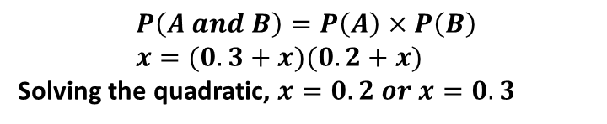

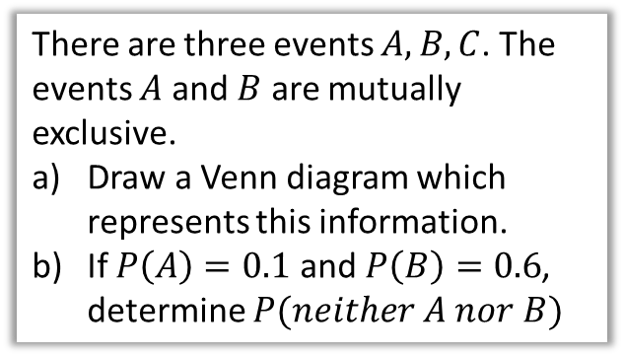

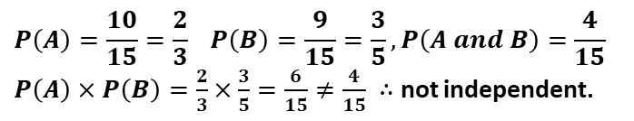






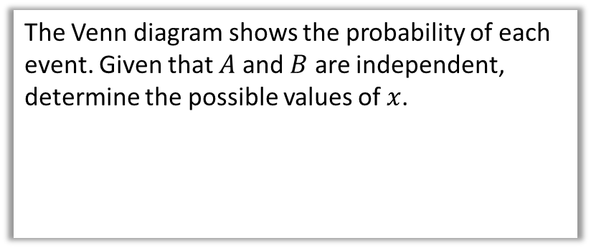


Test Your Understanding
There are three events $A,B,C$. The events $A$ and $B$ are mutually exclusive.
Draw a Venn diagram which represents this information.
If $P\left(A\right)=0.1$ and $P\left(B\right)=0.6$, determine $P(neither A nor B)$
The Venn diagram shows the number of people who like each of two different colours. Determine if $A$ and $B$ are independent.
$$A$$
$$B$$
$$6$$
$$4$$
$$5$$
$$0$$
$$P\left(A\right)=\frac{10}{15}=\frac{2}{3} P\left(B\right)=\frac{9}{15}=\frac{3}{5}, P\left(A and B\right)=\frac{4}{15}$$ $P\left(A\right)×P\left(B\right)=\frac{2}{3}×\frac{3}{5}=\frac{6}{15}≠\frac{4}{15} ∴$ not independent.
?
?
$$S$$
$$C$$
$$A$$
$$B$$
The Venn diagram shows the probability of each event. Given that $A$ and $B$ are independent, determine the possible values of $x$.
Note that $C$ may occur with $A$ or with $B$, as we’re not told otherwise.
$$A$$
$$B$$
$$0.3$$
$$x$$
$$0.2$$
$$y$$
$$P\left(neither A nor B\right) \\ =1−0.1−0.6=0.3$$
$$P\left(A and B\right)=P\left(A\right)×P\left(B\right) \\ x=(0.3+x)(0.2+x)$$
Solving the quadratic, $x=0.2 or x=0.3$
?

Slide 18
Exercise 5C
Pearson Applied Year 1/AS
Pages 77-78

Slide 19
















Tree Diagrams
At GCSE we saw that tree diagrams were an effective way of showing the outcome of two events which happen in succession.
(Personal opinion however is that their use is easily avoidable)
$$0.6$$
$$A$$
$$0.3$$
$$A$$
$$not A$$
$$0.4$$
$$not A$$
$$0.8$$
$$A$$
$$0.7$$
There are 3 yellow and 2 green counters in a bag. I take two counters at random. Determine the probability that:
They are of the same colour.
They are of different colours.
$$0.2$$
$$not A$$
$$GY:\frac{2}{5}×\frac{3}{4}=\frac{6}{20} \\ YG:\frac{3}{5}×\frac{2}{4}=\frac{6}{20} \\ P\left(different\right)=\frac{6}{20}+\frac{6}{20}=\frac{3}{5}$$
(Or we could have used our answer to (a): $1−\frac{2}{5}=\frac{3}{5}$)
$$YY: \frac{3}{5}×\frac{2}{4}=\frac{6}{20} \\ GG:\frac{2}{5}×\frac{1}{4}=\frac{2}{20} \\ P\left(same\right)=\frac{6}{20}+\frac{2}{20}=\frac{8}{20}=\frac{2}{5}$$
b
?
a
?
Note that if the outcomes are the same but reordered, the probability will be the same. So we could have quickly done $\frac{2}{5}×\frac{3}{4}×2$
I like to list out the matching sequences of outcomes first, then find the probability for each.
The probability I hit a target on each shot is 0.3. I keep firing until I hit the target. Determine the probability I hit the target on the 5th shot.
?
$${0.7}^{4}×0.3=0.07203$$

Slide 20
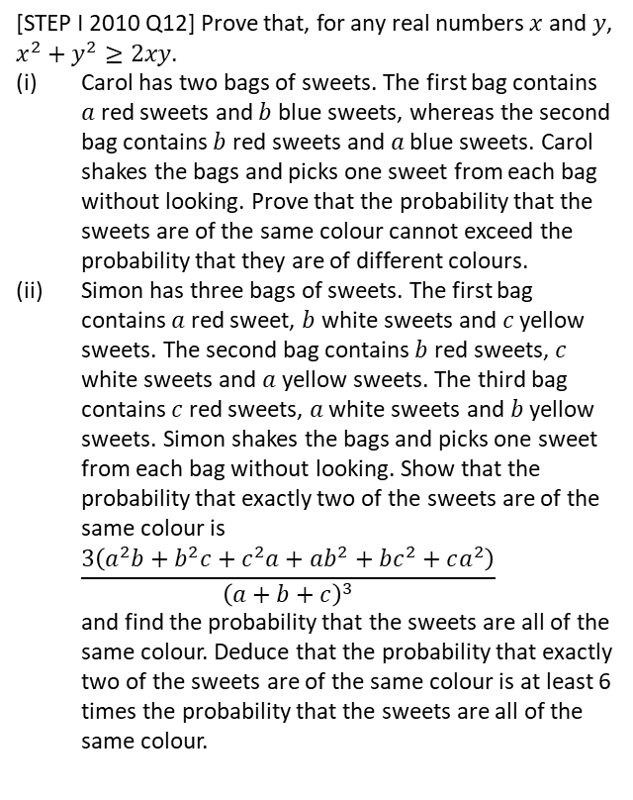

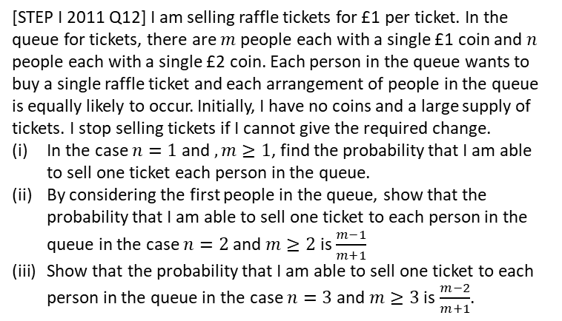
Exercise 5D
Pearson Pure Mathematics Year 1/AS
Pages 79-80
Extension Questions
2
[STEP I 2011 Q12] I am selling raffle tickets for £1 per ticket. In the queue for tickets, there are $m$ people each with a single £1 coin and $n$ people each with a single £2 coin. Each person in the queue wants to buy a single raffle ticket and each arrangement of people in the queue is equally likely to occur. Initially, I have no coins and a large supply of tickets. I stop selling tickets if I cannot give the required change.
In the case $n=1$ and $,m≥1$, find the probability that I am able to sell one ticket each person in the queue.
By considering the first people in the queue, show that the probability that I am able to sell one ticket to each person in the queue in the case $n=2$ and $m≥2$ is $\frac{m−1}{m+1}$
Show that the probability that I am able to sell one ticket to each person in the queue in the case $n=3$ and $m≥3$ is $\frac{m−2}{m+1}$.
1
[STEP I 2010 Q12] Prove that, for any real numbers $x$ and $y$, $x^{2}+y^{2}≥2xy$.
Carol has two bags of sweets. The first bag contains $a$ red sweets and $b$ blue sweets, whereas the second bag contains $b$ red sweets and $a$ blue sweets. Carol shakes the bags and picks one sweet from each bag without looking. Prove that the probability that the sweets are of the same colour cannot exceed the probability that they are of different colours.
Simon has three bags of sweets. The first bag contains $a$ red sweet, $b$ white sweets and $c$ yellow sweets. The second bag contains $b$ red sweets, $c$ white sweets and $a$ yellow sweets. The third bag contains $c$ red sweets, $a$ white sweets and $b$ yellow sweets. Simon shakes the bags and picks one sweet from each bag without looking. Show that the probability that exactly two of the sweets are of the same colour is $\frac{3\left(a^{2}b+b^{2}c+c^{2}a+ab^{2}+bc^{2}+ca^{2}\right)}{{\left(a+b+c\right)}^{3}}$ and find the probability that the sweets are all of the same colour. Deduce that the probability that exactly two of the sweets are of the same colour is at least 6 times the probability that the sweets are all of the same colour.
3
I have an unfair coin with a fixed probability $p$ of heads. Determine how the unfair coin could be used to simulate a fair coin, i.e. you declare “Heads” or “Tails” each with probability 0.5.
Throw the coin twice. Then the probability of each sequence:
$$P\left(HH\right)=p^{2} P\left(TT\right)={\left(1−p\right)}^{2} \\ P\left(HT\right)=p\left(1−p\right) P\left(TH\right)=p(1−p)$$
Note that two of these have the same probability. So if the first throw is Heads and the second Tails, declare “Heads”, or if Tails then Heads, declare “Tails”. If the two throws are the same, repeat the process until the two throws are different.
?

