Slide 1
Histograms

Slide 2
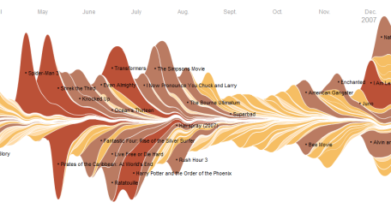
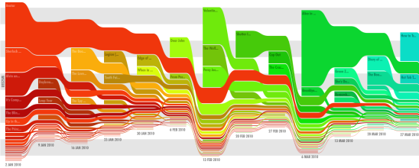
Starter
In the back of your book, draw a Bar Chart to show the following information;
Height (cm) | Frequency
100 < x ≤ 120 | 20
120 < x ≤ 140 | 25
140 < x ≤ 150 | 30
150 < x ≤ 160 | 25
160 < x ≤ 200 | 20

Slide 3
Starter
Frequency
Height (cm) | Frequency
100 < x ≤ 120 | 20
120 < x ≤ 140 | 25
140 < x ≤ 150 | 30
150 < x ≤ 160 | 25
160 < x ≤ 200 | 20
25
20
15
10
5
0
100
120
140
160
180
200
Height (cm)

Slide 4
Starter
Problems
1) The data is continuous so there should be no gaps
2) 150 – 160 has the same height as 120 – 140, even though it represents a smaller range
A Histogram will correct both of these problems!
Frequency
25
20
15
10
5
0
100
120
140
160
180
200
Height (cm)

Slide 5
Histograms
Height (cm)
Frequency
Frequency Density
To take into account the size of the group, we calculate ‘Frequency Density’
100 < x ≤ 120
20
1
Frequency Density
Frequency
120 < x ≤ 140
25
1.25
=
Classwidth
Frequency Density
20
30
25
20
25
140 < x ≤ 150
30
3
=
20
10
20
40
10
=
=
=
=
=
1
3
1.25
0.5
150 < x ≤ 160
25
2.5
2.5
160 < x ≤ 200
20
0.5

Slide 6
Histograms
Height (cm) | Frequency | Frequency Density
100 < x ≤ 120 | 20 | 1
120 < x ≤ 140 | 25 | 1.25
140 < x ≤ 150 | 30 | 3
150 < x ≤ 160 | 25 | 2.5
160 < x ≤ 200 | 20 | 0.5
3
Frequency Density
2
1
0
100
110
120
130
140
150
160
170
180
190
200
Height (cm)

Slide 7

Histograms
3
Frequency Density
2
1
0
100
110
120
130
140
150
160
170
180
190
200
Height (cm)
With a Histogram, area represents Frequency, not the height
eg) The first group is a rectangle measuring 20 by 1
20 x 1 = 20 so there were 20 people in the group
eg) The fifth group is a rectangle measuring 40 by 0.5
40 x 0.5 = 20 so there were 20 people in the group

Slide 8
Histograms
Speed (mph)
Frequency
Frequency Density
To take into account the size of the group, we calculate ‘Frequency Density’
0 < x ≤ 40
10
0.25
40 < x ≤ 50
15
1.5
Frequency Density
Frequency
=
Classwidth
50 < x ≤ 60
18
1.8
Frequency Density
10
18
35
20
15
20
=
40
10
5
5
10
10
60 < x ≤ 65
20
4
=
=
=
=
=
=
0.25
1.8
7
4
1.5
2
65 < x ≤ 70
35
7
70 < x ≤ 80
20
2

Slide 9
Histograms
Speed (mph) | Frequency | Frequency Density
0 < x ≤ 40 | 10 | 0.25
40 < x ≤ 50 | 15 | 1.5
50 < x ≤ 60 | 18 | 1.8
60 < x ≤ 65 | 20 | 4
65 < x ≤ 70 | 35 | 7
70 < x ≤ 80 | 20 | 2
10
8
Frequency Density
6
4
2
0
0
10
20
30
40
50
60
70
80
Speed (mph)

Slide 10
Histograms
10
8
Frequency Density
6
4
2
0
0
10
20
30
40
50
60
70
80
Speed (mph)
Remember that Area represents Frequency!
Group 1 is a 40 by 0.25 rectangle
40 x 0.25 = 10
So 10 people in the group
Group 5 is a 5 by 7 rectangle
5 x 7 = 35
So 35 people in the group

Slide 11
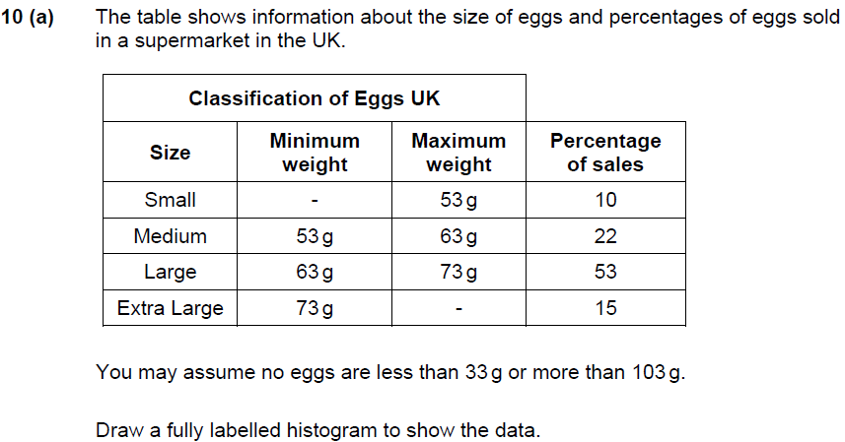
Plenary
Frequency Density
33g
0.5
2.2
5.3
103g
0.5
(4)

Slide 12
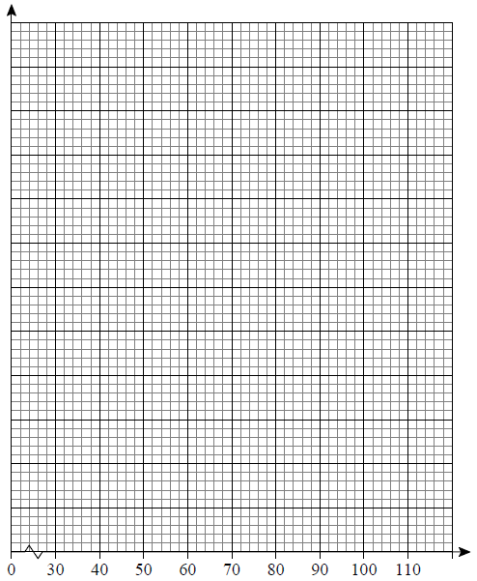
Plenary
6
Frequency Density
5
4
3
2
1
Egg Weight (g)

Slide 13
Summary
We have learnt how to plot Histograms of sets of data
We have seen how they are different to Bar Charts
We have learnt what is meant by ‘Frequency Density’
We have shown that on a Histogram, area represents Frequency, not height!

