Slide 1
Interpreting Histograms

Slide 2
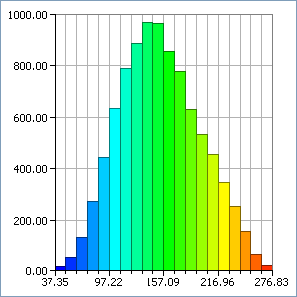
Starter
Seconds
Frequency
Frequency Density
Draw a Histogram to show the following information on time taken to do a crossword.
Remember;
- You need to work out ‘Frequency Density’ (Frequency ÷ Classwidth)
- You must plot consistent intervals (eg → 10,20,30 not 10,20,40,60 etc…)
0-
30
0.5
60-
90
1.5
120-
140
7
140-
180
9
160-240
160
2

Slide 3
Starter
Seconds | Frequency | Frequency Density
0- | 30 | 0.5
60- | 90 | 1.5
120- | 140 | 7
140- | 180 | 9
160-240 | 160 | 2
8
Frequency Density
6
4
2
0
0
40
80
120
160
200
Seconds

Slide 4
Starter
Remember that AREA represents Frequency on a Histogram!
The 4th group is a Rectangle measuring 20 wide and 9 high
20 x 9 = 180 people
8
Frequency Density
6
4
2
0
0
40
80
120
160
200
Seconds

Slide 5
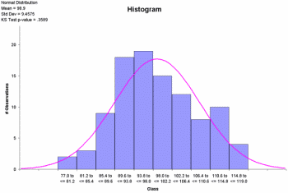
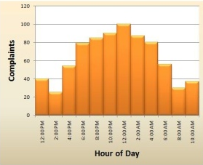
Interpreting Histograms
What if you were asked;
Estimate the number of people who took between 30 and 90 seconds to complete the test?
Rectangle 1 → 0.5 by 30
= 15 people
Rectangle 2 → 1.5 by 30
= 45 people
Total = 60 people!
8
Frequency Density
6
30 to 90 seconds
4
2
2
0
1
0
40
80
120
160
200
Seconds

Slide 6
Interpreting Histograms
8
Frequency Density
6
4
10 x 8 = 80
30 x 6 = 180
10 x 5 = 50
2
20 x 2 = 40
20 x 1 = 20
0
0
10
20
30
40
50
60
70
80
90
Speed
Frequency
Speed (mph)
Use the Histogram to complete the table
0 – under 20
40
20 – under 50
180
50 – under 60
80
60 – under 70
50
70 – up to 90
20

Slide 7
Interpreting Histograms
10 to 40 mph
8
Frequency Density
6
4
2
2
1
0
0
10
20
30
40
50
60
70
80
90
Speed (mph)
Estimate the number of people whose average speed was 10 to 40 mph
Rectangle 1:
10 x 2 = 20 people
Rectangle 2:
20 x 6 = 120 people
So 140 people in total!

Slide 8
Interpreting Histograms
45 to 65 mph
8
Frequency Density
6
4
2
1
3
2
0
0
10
20
30
40
50
60
70
80
90
Rectangle 1:
Speed (mph)
Estimate the number of people whose average speed was 45 to 65 mph
5 x 6 = 30 people
Rectangle 2:
10 x 8 = 80 people
Rectangle 3:
So 135 people in total!
5 x 5 = 25 people

Slide 9
Interpreting Histograms
16
Frequency Density
12
8
?
4
100
0
0
50
100
150
200
250
300
350
400
450
Gallons of Milk produced by Farm
100 Farms produced 400-450 gallons of milk. How many produced 150-250 gallons?
50 x ? = 100
100 x 10
1000 Farms
The height must be 2 units, making the height of the gridlines 4 units!

Slide 10
Interpreting Histograms
200 to 300
Frequency Density
24
18
12
1
2
6
900
0
0
50
100
150
200
250
300
350
400
450
Gallons of Milk produced by Farm
900 Farms produced up to 150 Gallons. Estimate the number that produced 200-300 Gallons
Rectangle 1:
50 x 15 = 750 Farms
Rectangle 2:
50 x 18 = 900 Farms
150 x ? = 900
The height must be 6 units!
Total
= 1650 Farms

Slide 11
Interpreting Histograms
Frequency Density
24
18
12
1800
1500
6
450
900
900
2400
150
0
0
50
100
150
200
250
300
350
400
450
Which interval will the median be in?
Median = (n+1) ÷ 2
= (4501) ÷ 2
= 2250.5
Gallons of Milk produced by Farm
After the first group, we have had 900 farms from the total. After the 150-250 group, we have had 2400 farms. The middle farm must therefore be in the 150-250 group.

Slide 12
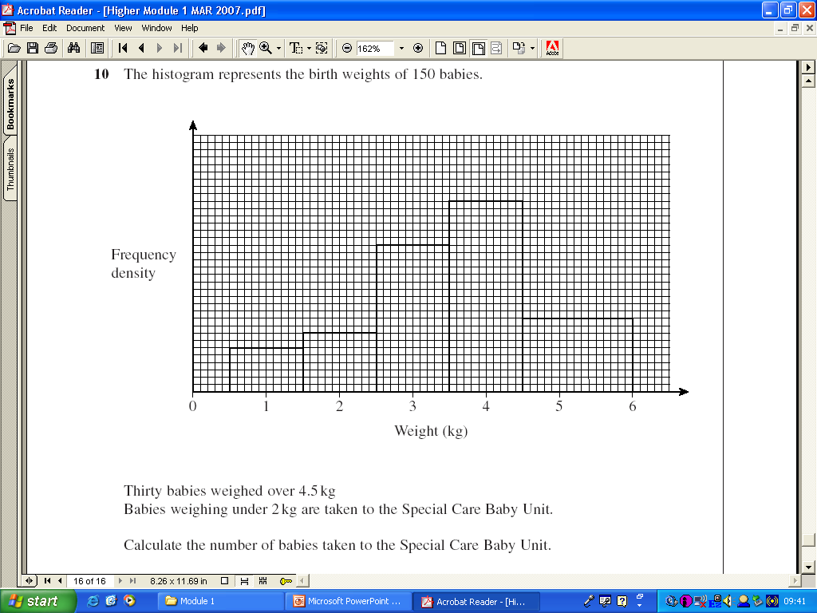
Plenary
10. The Histogram represents the birth weights of 150 babies.
Rectangle 1
1 x 12
= 12 babies
Rectangle 2
0.5 x 16
= 8 babies
Total
= 20 babies
60
50
Frequency Density
40
30
20
10
2
30
30 ÷ 1.5
= 20
1
Weight (kg)
1.5
Thirty babies weighed over 4.5kg. Babies weighing under 2kg are taken to a Special Care unit.
Calculate the number of babies taken to the Special Care unit.

Slide 13
Summary
We have recapped how to draw a Histogram
We have learnt how to interpret a Histogram to make estimations

Slide 14
Thirty babies weighed over 4.5kg. Babies weighing under 2kg are taken to a Special Care unit.
Calculate the number of babies taken to the Special Care unit.

