Slide 1
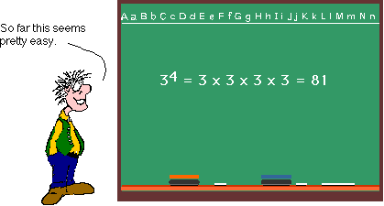
The Laws of Exponents

Slide 2
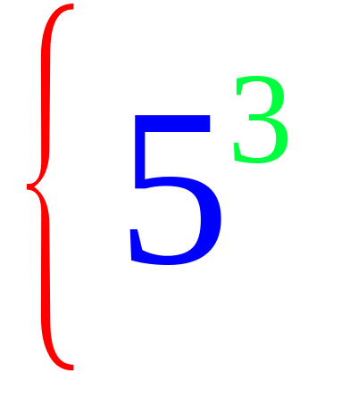
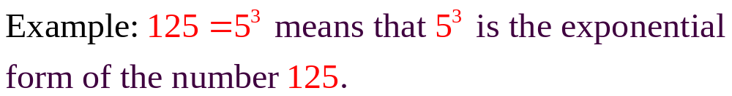
Exponents
exponent
Power
base
5³ means 3 factors of 5 or 5 x 5 x 5

Slide 3
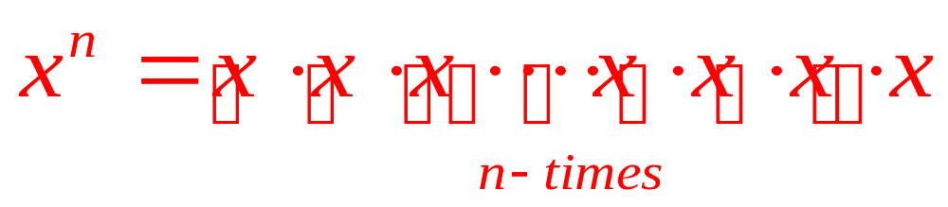
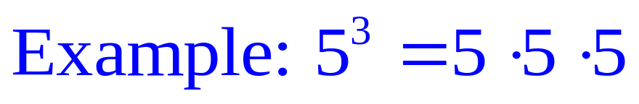
The Laws of Exponents:
#1: Exponential form: The exponent of a power indicates
how many times the base multiplies itself.
n factors of x

Slide 4
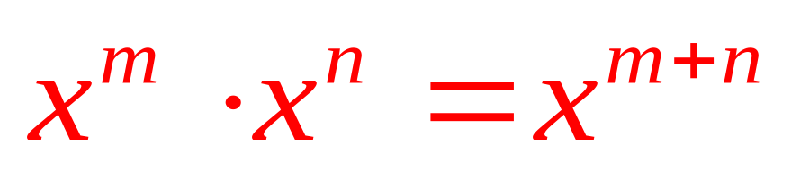
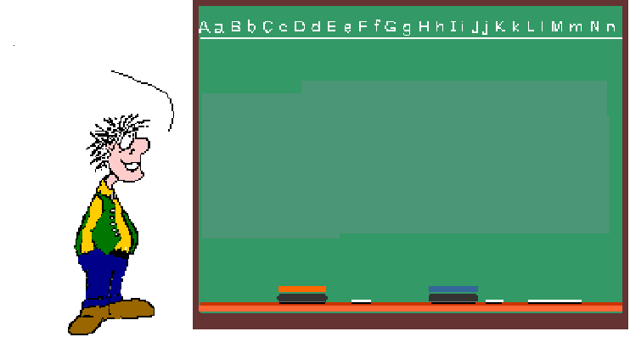
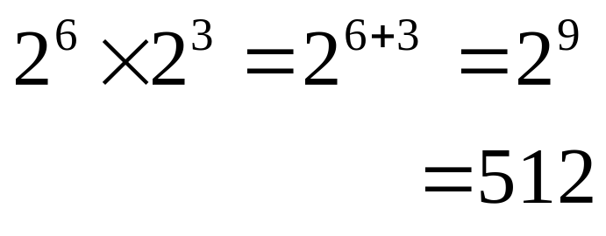
#2: Multiplying Powers: If you are multiplying Powers with the same base, KEEP the BASE & ADD the EXPONENTS!
So, I get it! When you multiply Powers, you add the exponents!

Slide 5
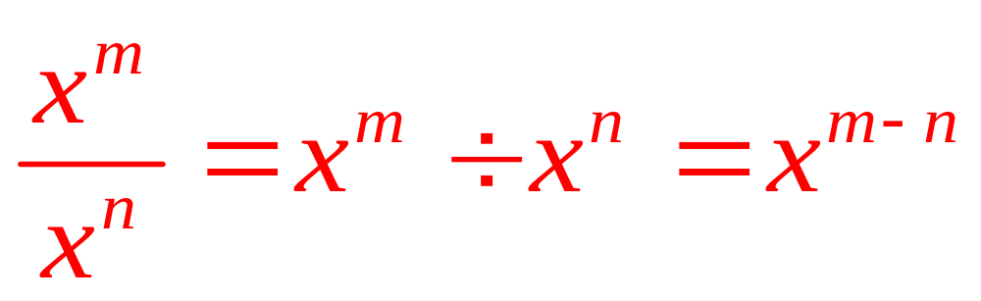
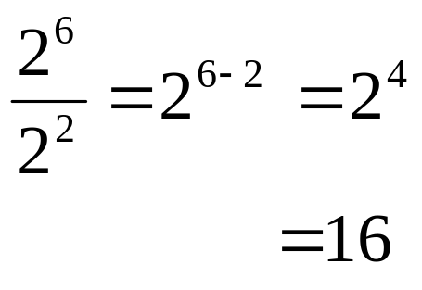
#3: Dividing Powers: When dividing Powers with the same base, KEEP the BASE & SUBTRACT the EXPONENTS!
So, I get it!
When you divide Powers, you subtract the exponents!

Slide 6
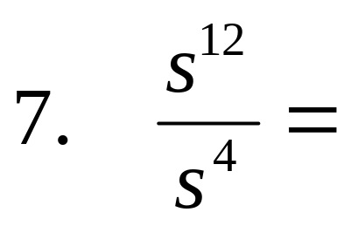
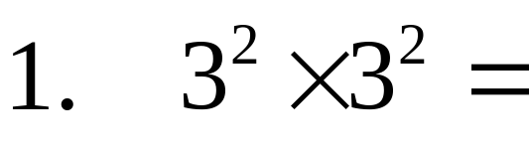
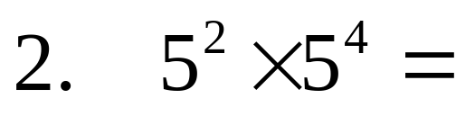
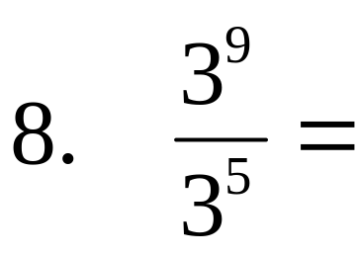
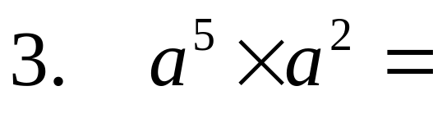
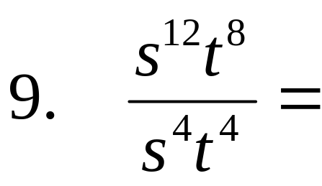
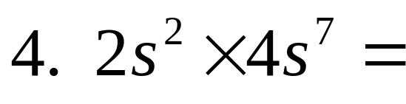
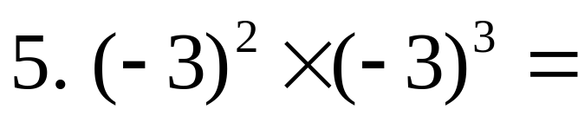
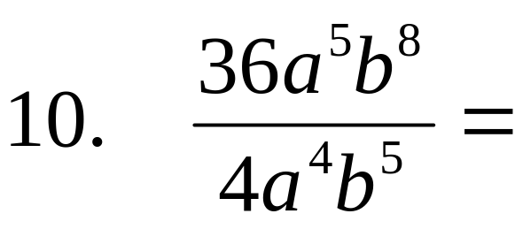
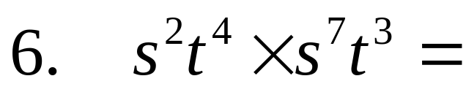
Try these:

Slide 7

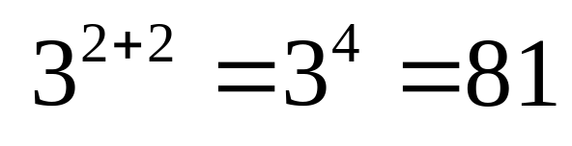
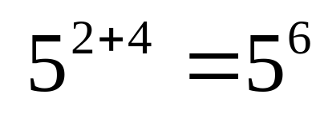
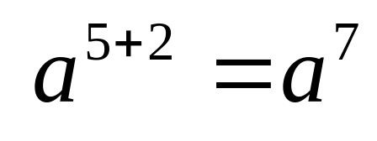
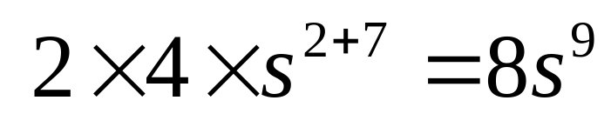
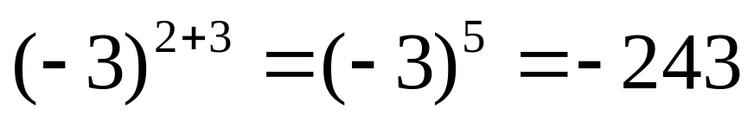
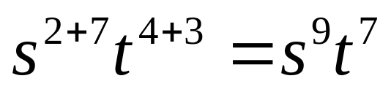
SOLUTIONS

Slide 8
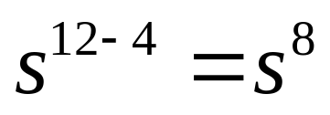
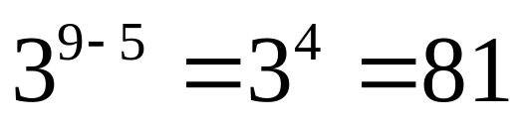
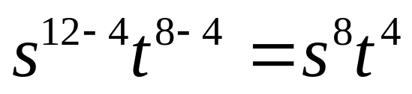
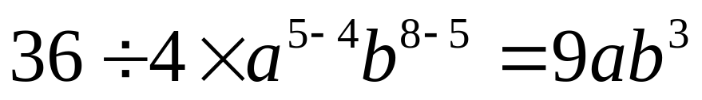
SOLUTIONS

Slide 9
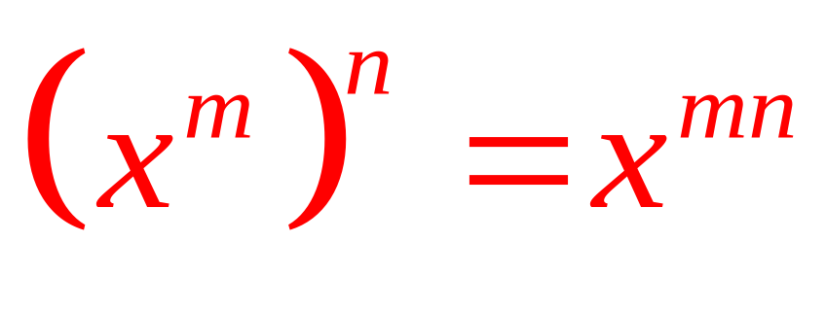
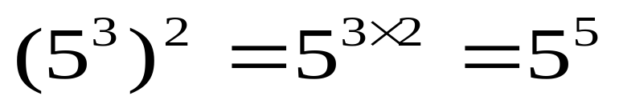
#4: Power of a Power: If you are raising a Power to an exponent, you multiply the exponents!
So, when I take a Power to a power, I multiply the exponents

Slide 10
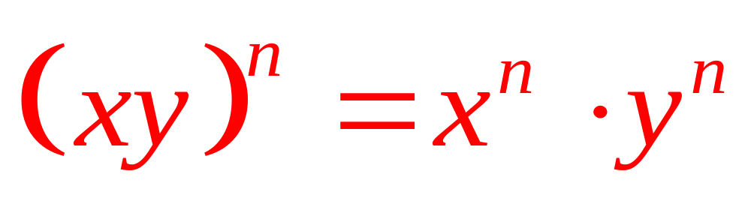
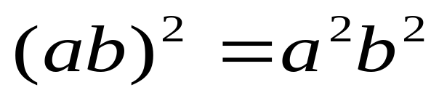
#5: Product Law of Exponents: If the product of the bases is powered by the same exponent, then the result is a multiplication of individual factors of the product, each powered by the given exponent.
So, when I take a Power of a Product, I apply the exponent to all factors of the product.

Slide 11
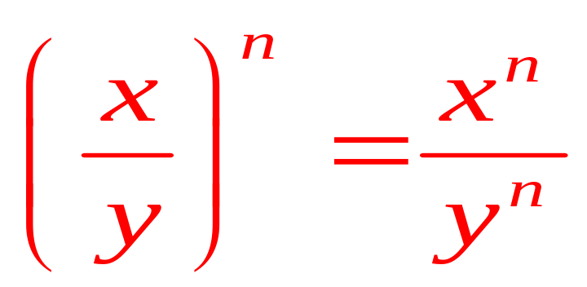
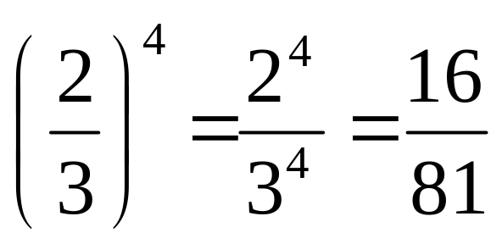
#6: Quotient Law of Exponents: If the quotient of the
bases is powered by the same exponent, then the result is both
numerator and denominator , each powered by the given exponent.
So, when I take a Power of a Quotient, I apply the exponent to all parts of the quotient.

Slide 12
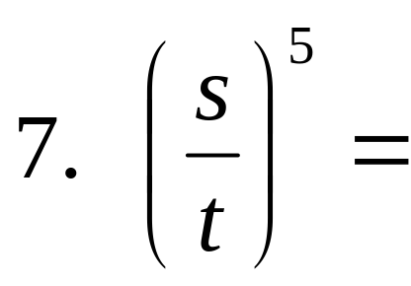
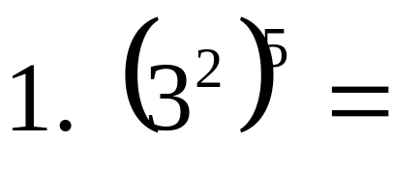
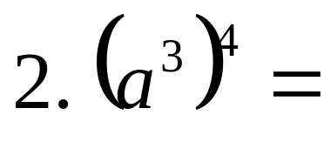
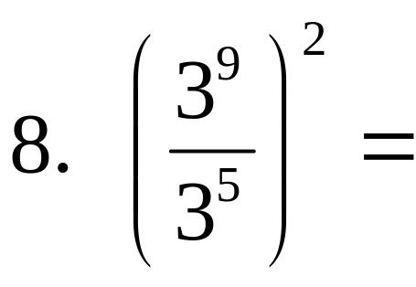
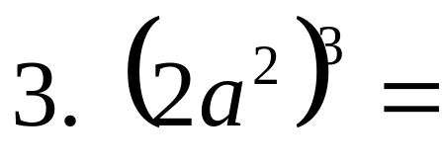
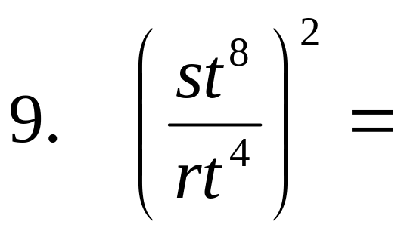
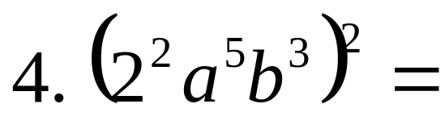
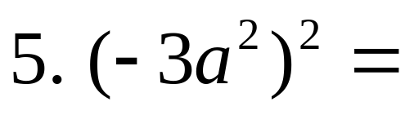
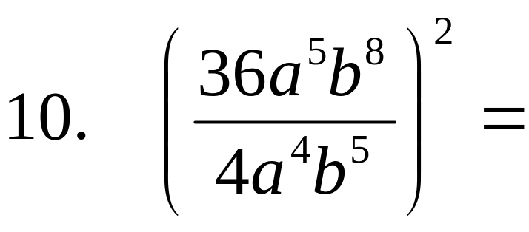
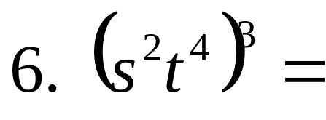
Try these:

Slide 13
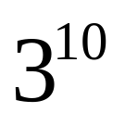

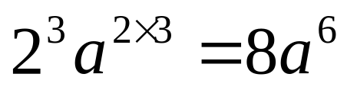
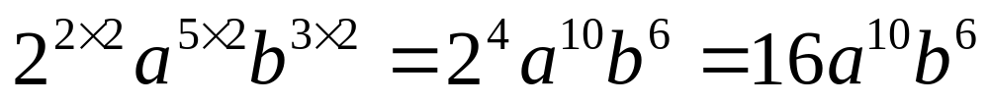
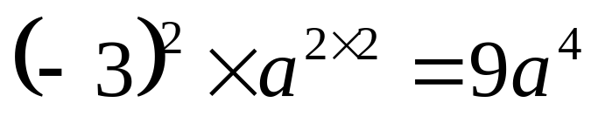

SOLUTIONS

Slide 14





SOLUTIONS

Slide 15


#7: Negative Law of Exponents: If the base is powered
by the negative exponent, then the base becomes reciprocal with the
positive exponent.
So, when I have a Negative Exponent, I switch the base to its reciprocal with a Positive Exponent.
Ha Ha!
If the base with the negative exponent is in the denominator, it moves to the numerator to lose its negative sign!

Slide 16


#8: Zero Law of Exponents: Any base powered by zero exponent equals one.
So zero factors of a base equals 1. That makes sense! Every power has a coefficient of 1.

Slide 17










Try these:

Slide 18










SOLUTIONS

Slide 19




SOLUTIONS

Slide 20
5.7 Rational Exponents
Fraction Exponents

Slide 21

Radical expression and Exponents
By definition of Radical Expression.
The index of the Radical is 3.

Slide 22


How would we simplify this expression?
What does the fraction exponent do to the number?
The number can be written as a Radical expression, with an index of the denominator.

Slide 23

The Rule for Rational Exponents

Slide 24

Write in Radical form

Slide 25

Write in Radical form

Slide 26

Write each Radical using Rational Exponents

Slide 27

Write each Radical using Rational Exponents

Slide 28

What about Negative exponents
Negative exponents make inverses.

Slide 29

What if the numerator is not 1
Evaluate

Slide 30

What if the numerator is not 1
Evaluate

Slide 31

What if the numerator is not 1
Evaluate

Slide 32

For any nonzero real number b, and integer m and n
Make sure the Radical express is real, no b<0 when n is even.

Slide 33

Simplify each expression
No fraction in the denominators.

Slide 34

Simplify

Slide 35

Simplify

Slide 36

Simplify

Slide 37

Simplify

Slide 38

Simplify

Slide 39

Simplify

Slide 40

Simplify

Slide 41

Simplify

Slide 42

Simplify

