Slide 1
Lesson 3.11
Concept: Arithmetic Sequences
EQ: How do we recognize and represent arithmetic sequences? F.BF.1-2 & F.LE.2
Vocabulary: Arithmetic Sequences, recursive formula, explicit formula, common difference

Slide 2
Nature by Numbers
http://www.youtube.com/watch?v=kkGeOWYOFoA

Slide 3
Introduction
An arithmetic sequence is a list of terms separated by a common difference, d, which is the number added to each consecutive term in an arithmetic sequence.
An arithmetic sequence is a linear function with a domain of whole numbers.

Slide 4
Introduction (continued)
Arithmetic sequences can be represented by formulas, either explicit or recursive.
A recursive formula is a formula used to find the next term of a sequence when the previous term is known.
An explicit formula is a formula used to find the nth term of a sequence.

Slide 5
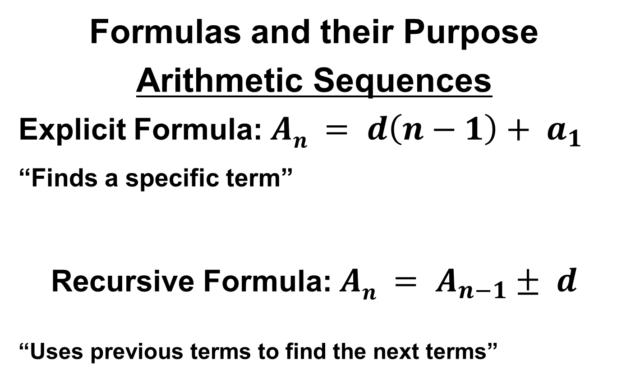
Formulas and their Purpose
Arithmetic Sequences
Explicit Formula: $An = d\left(n−1\right)+ a_{1}$
_{“Finds a specific term”}
Recursive Formula: $An = A_{n−1}± d$
“Uses previous terms to find the next terms”
First Term
Common Difference
Current Term
Previous Term

Slide 6
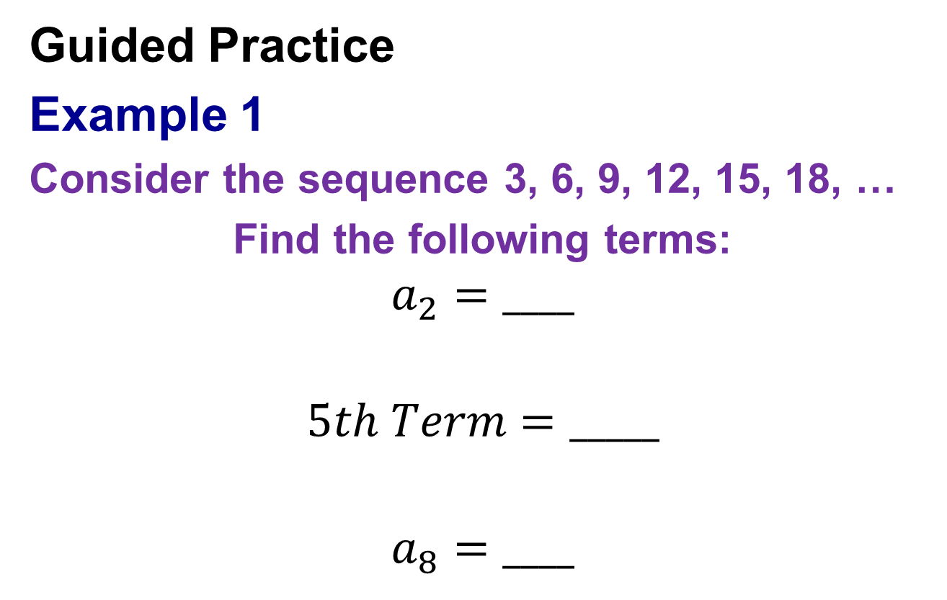
Guided Practice
Example 1
Consider the sequence 3, 6, 9, 12, 15, 18, …
Find the following terms:
$$a_{2}=____$$
$$5th Term=_____$$
$$a_{8}=____$$

Slide 7
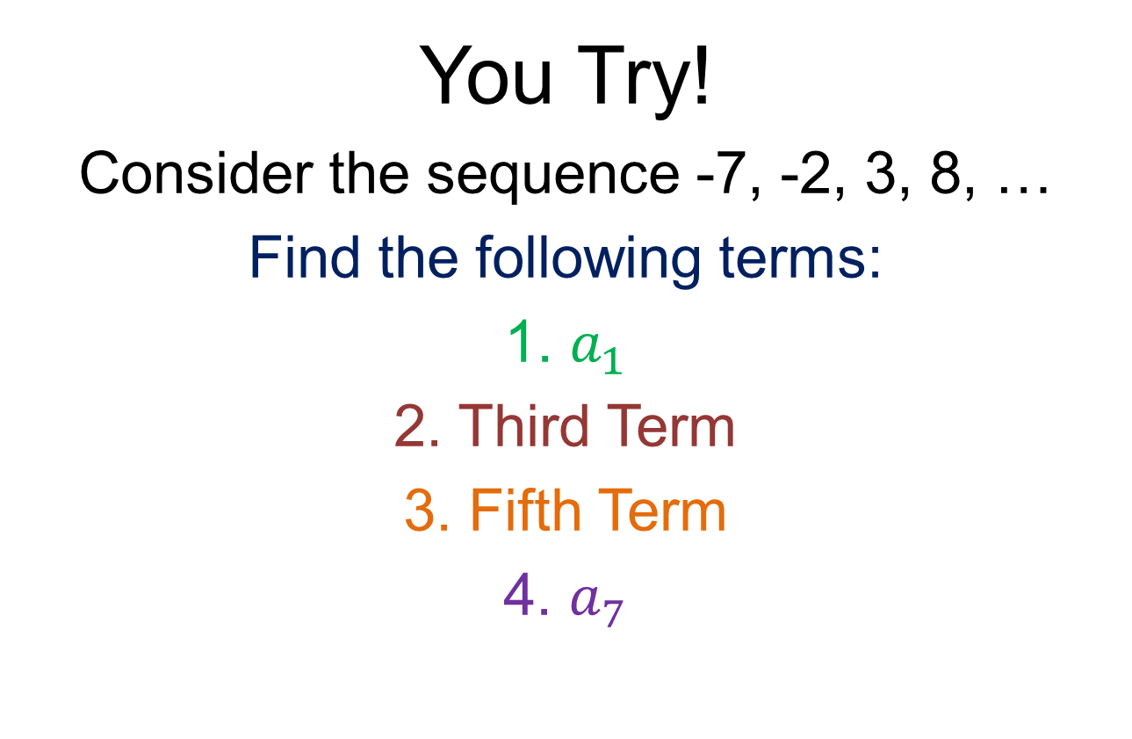
You Try!
Consider the sequence -7, -2, 3, 8, …
Find the following terms:
1. $a_{1}$
2. Third Term
3. Fifth Term
4. $a_{7}$

Slide 8
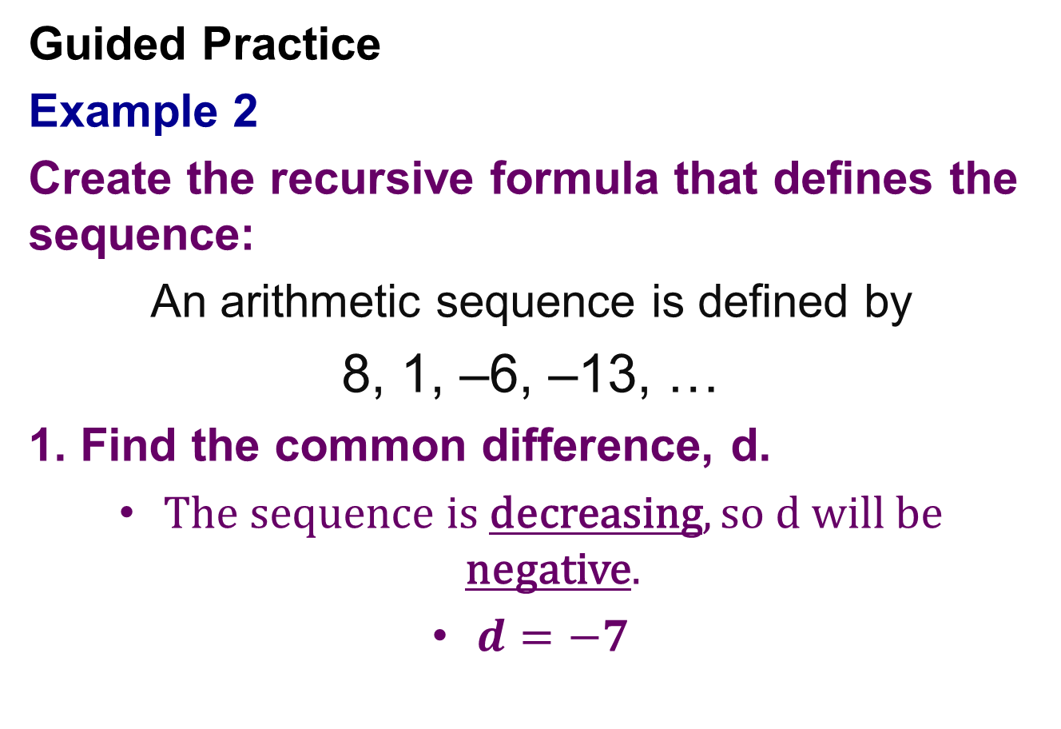
Guided Practice
Example 2
Create the recursive formula that defines the sequence:
An arithmetic sequence is defined by
8, 1, –6, –13, …
1. Find the common difference, d.
The sequence is decreasing, so d will be negative.
$d=−7$

Slide 9
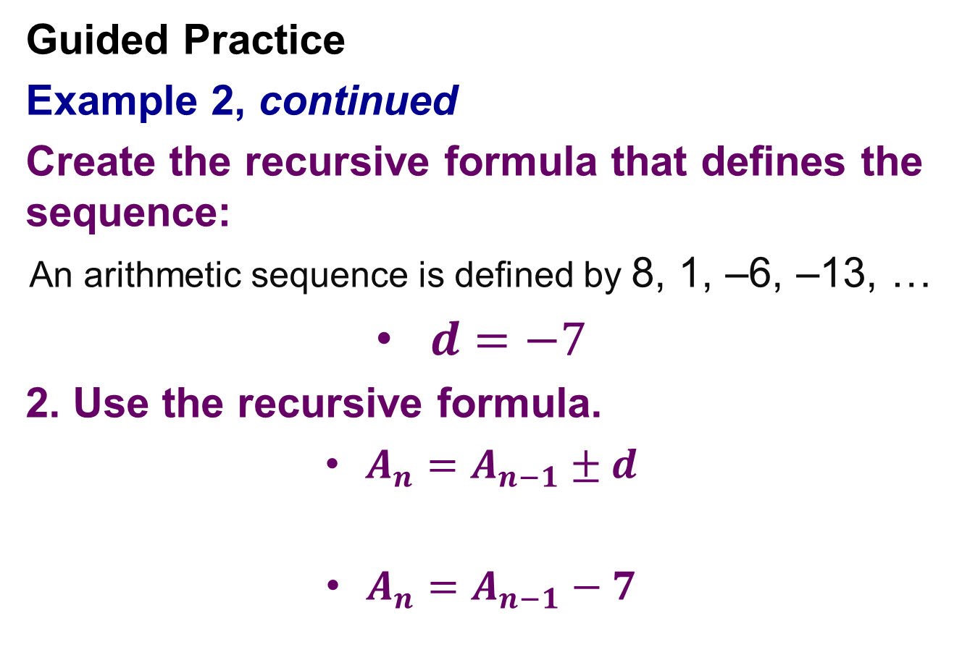
Guided Practice
Example 2, continued
Create the recursive formula that defines the sequence:
An arithmetic sequence is defined by 8, 1, –6, –13, …
$d=−7$
2. Use the recursive formula.
$A_{n}=A_{n−1}±d$
$A_{n}=A_{n−1}−7$

Slide 10
Guided Practice
Example 3
Create the recursive formula that defines the sequence:
An arithmetic sequence is defined by
10, 6, 2, –2, …
1. Find the common difference, d.

Slide 11
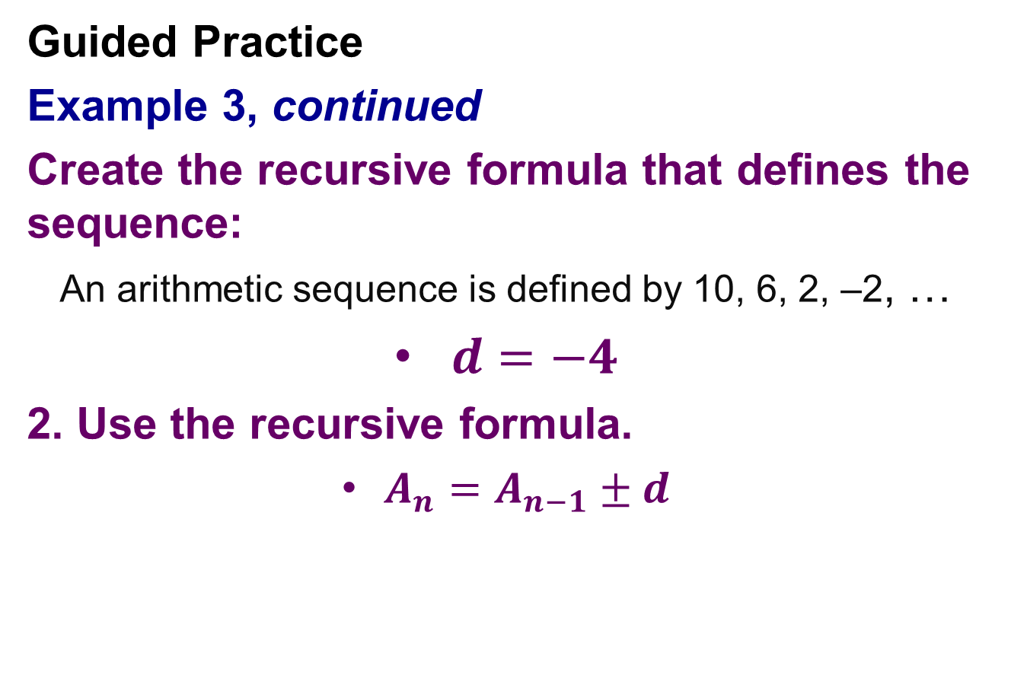
Guided Practice
Example 3, continued
Create the recursive formula that defines the sequence:
An arithmetic sequence is defined by 10, 6, 2, –2, …
$d=−4$
2. Use the recursive formula.
$A_{n}=A_{n−1}±d$

Slide 12

You Try 5
Use the following sequence to create a recursive formula. $A_{n}=A_{n−1}±d$
18, 10, 2, -6, …

Slide 13
Guided Practice
Example 4
An arithmetic sequence is defined recursively by a_{n} = a_{n – 1} + 5, with a₁ = 29. Find the first 5 terms of the sequence.
Using the recursive formula:
a₁ = 29
a₂ = a₁ + 5
a₂ = 29 + 5 = 34
a₃ = 34 + 5 = 39
a₄ = 39 + 5 = 44
a₅ = 44 + 5 = 49
The first five terms of the sequence are 29, 34, 39, 44, and 49.

Slide 14
Guided Practice
Example 5
An arithmetic sequence is defined recursively by a_{n} = a_{n – 1} – 8, with a₁ = 68. Find the first 5 terms of the sequence.
The first five terms of the sequence are:
____, ____, ____, ____, and ____

Slide 15

You Try 6
An arithmetic sequence is defined recursively by $an = a_{n−1} −4$, with a₁ = 12.
Find the first 5 terms of the sequence.

Slide 16
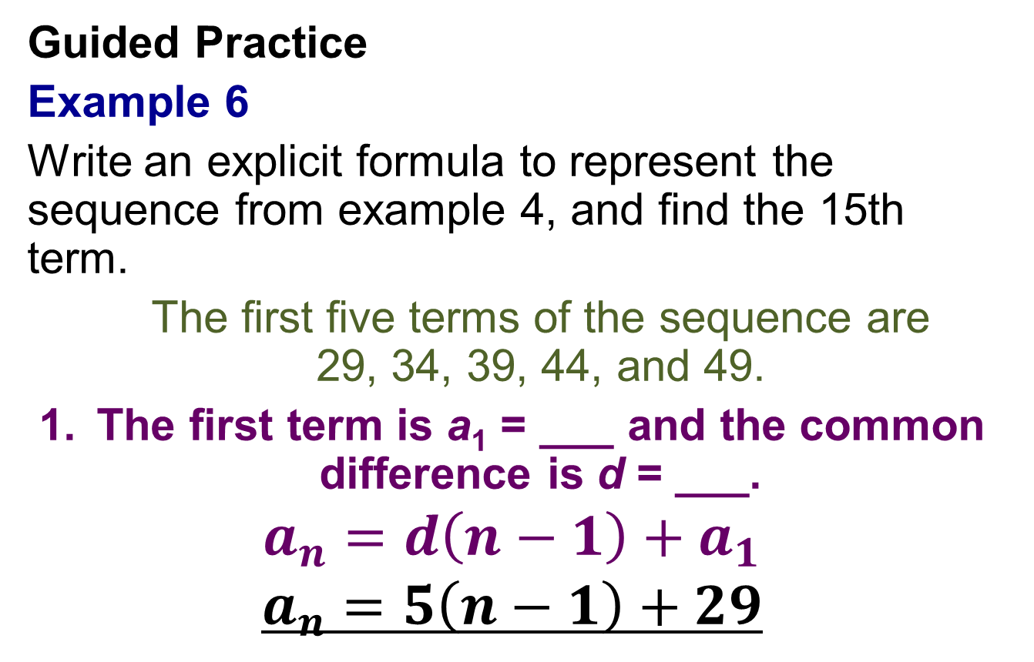
Guided Practice
Example 6
Write an explicit formula to represent the sequence from example 4, and find the 15th term.
The first five terms of the sequence are 29, 34, 39, 44, and 49.
The first term is a₁ = ___ and the common difference is d = ___.
$$a_{n}=d\left(n−1\right)+a_{1}$$
$$a_{n}=5\left(n−1\right)+29$$

Slide 17
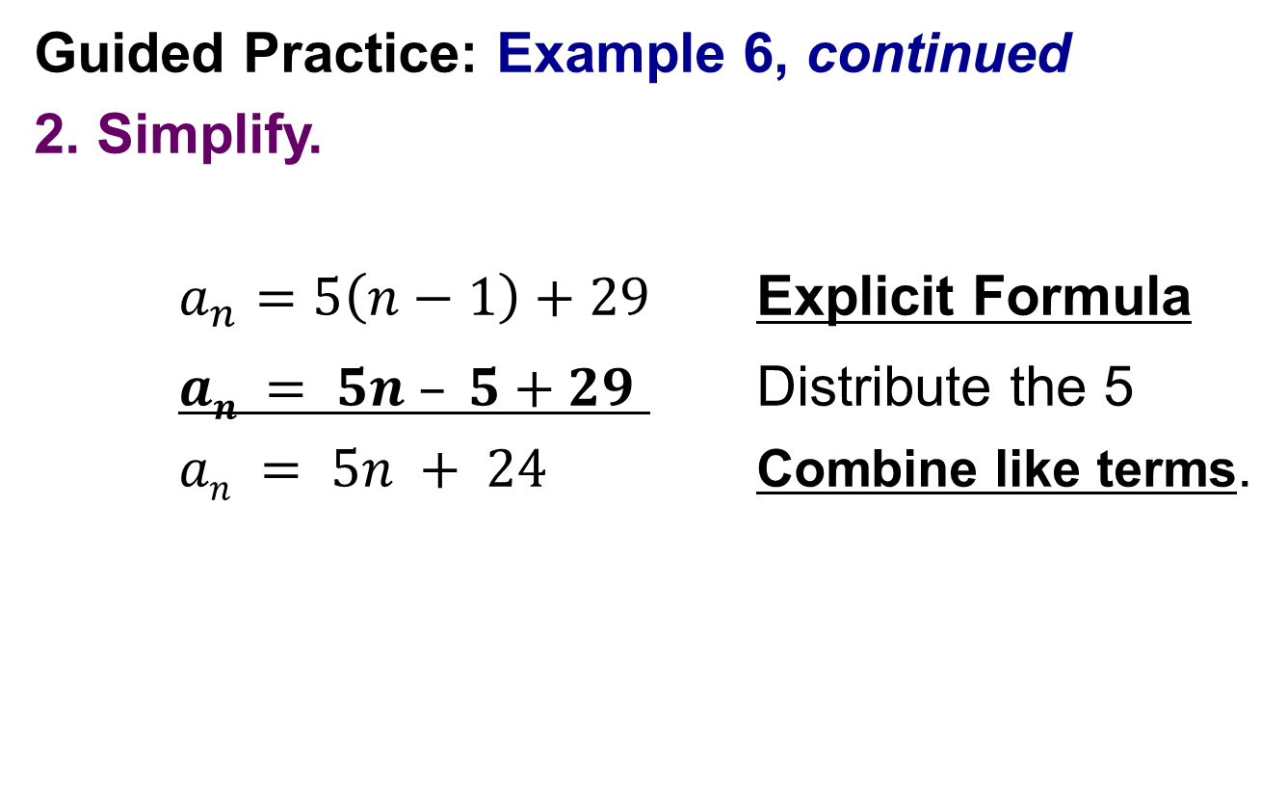
Guided Practice: Example 6, continued
2. Simplify.
$a_{n}=5\left(n−1\right)+29$ Explicit Formula
$an = 5n – 5+29$ Distribute the 5
$an = 5n + 24$ Combine like terms.

Slide 18
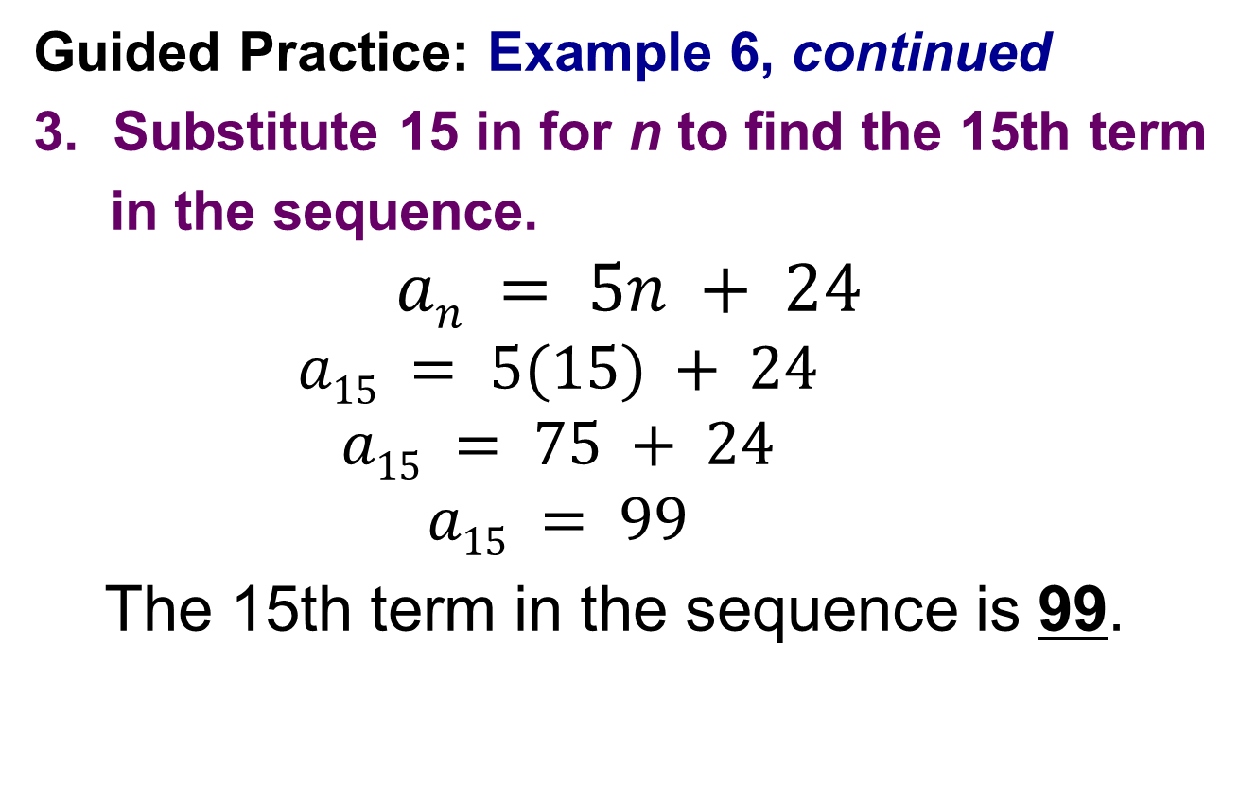
Guided Practice: Example 6, continued
Substitute 15 in for n to find the 15th term
in the sequence.
$$an = 5n + 24$$
$$a15 = 5(15) + 24$$
$$a15 = 75 + 24$$
$$a15 = 99$$
The 15th term in the sequence is 99.
✔

Slide 19
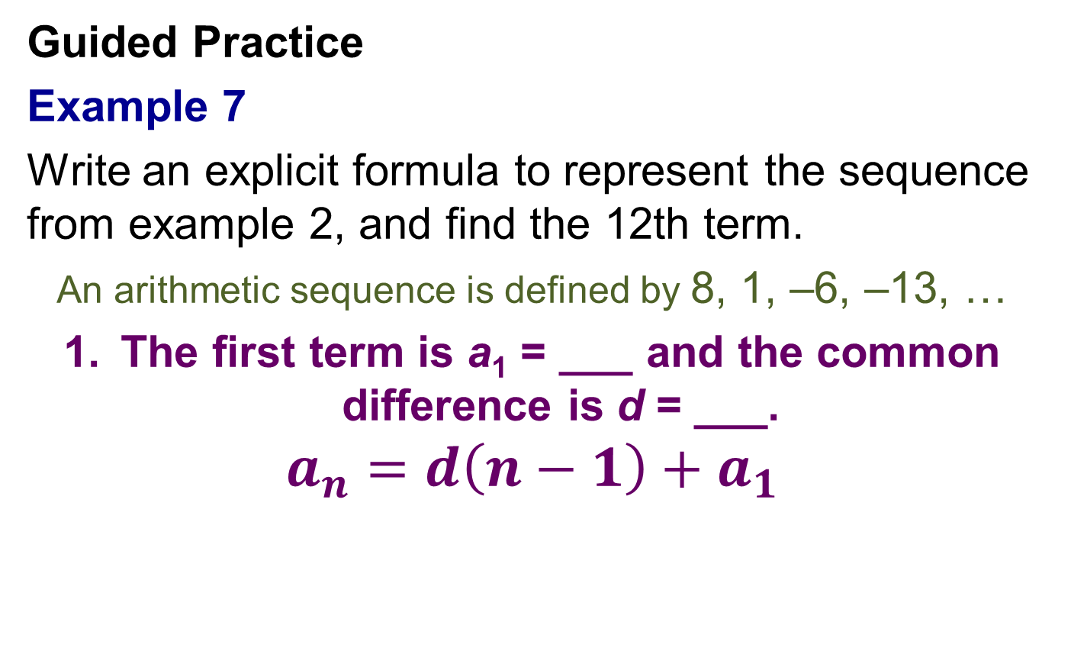
Guided Practice
Example 7
Write an explicit formula to represent the sequence from example 2, and find the 12th term.
An arithmetic sequence is defined by 8, 1, –6, –13, …
The first term is a₁ = ___ and the common difference is d = ___.
$$a_{n}=d\left(n−1\right)+a_{1}$$

Slide 20
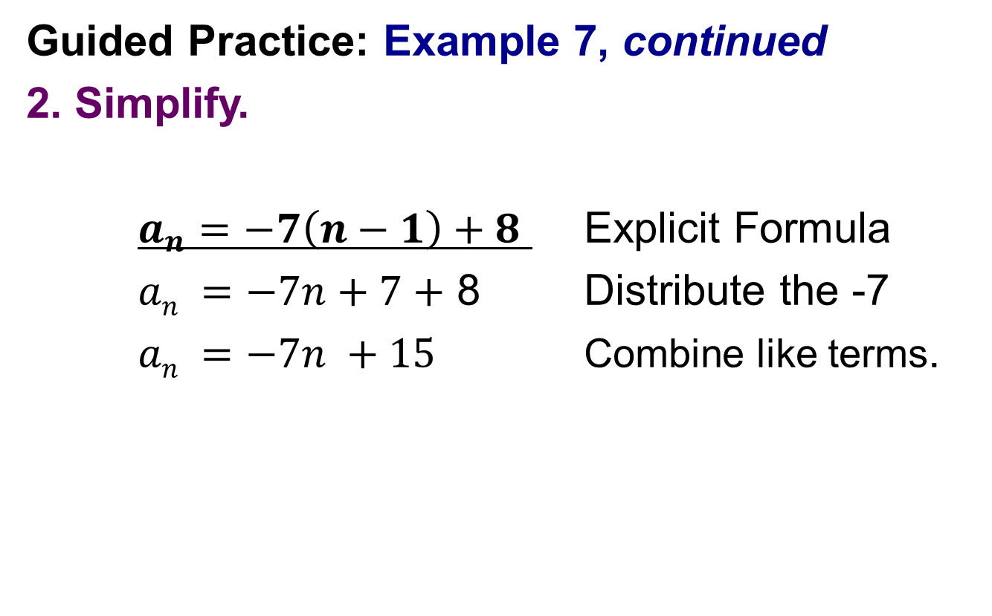
Guided Practice: Example 7, continued
2. Simplify.
$a_{n}=−7\left(n−1\right)+8$ Explicit Formula
$an =−7n+7+$ 8 Distribute the -7
$an =−7n +15$ Combine like terms.

Slide 21

Guided Practice: Example 7, continued
Substitute 12 in for n to find the 12th term
in the sequence.
$$an =−7n +15$$
$$a12 =−7(12) +15$$
$$a12 =−84 +15$$
$$a12 =−69$$
The 12th term in the sequence is ____.
✔

Slide 22

You Try 7
Use the following sequence to create an explicit formula. $a_{n}=d\left(n−1\right)+a_{1}$Then find $a_{20}$.
18, 10, 2, -6, …

