Slide 1
Exponential Functions

Slide 2

Objectives
To use the properties of exponents to:
  Simplify exponential expressions.
  Solve exponential equations.
To sketch graphs of exponential functions.

Slide 3
Exponential Functions
A polynomial function has the basic form: f (x) = x³
An exponential function has the basic form: f (x) = 3^{x}
An exponential function has the variable in the exponent, not in the base.
General Form of an Exponential Function: f (x) = N^{x}, N > 0

Slide 4
Properties of Exponents

Slide 5
Properties of Exponents
Simplify:

Slide 6
Properties of Exponents
Simplify:

Slide 7
Exponential Equations
Solve:
Solve:

Slide 8
Exponential Equations
Solve:
Solve:

Slide 9
Exponential Equations
Solve:
Solve:
Not considered an
exponential equation,
because the variable
is now in the base.

Slide 10
Exponential Equations
Solve:
Not considered an
exponential equation,
because the variable
is in the base.

Slide 11

Exponential Functions
General Form of an Exponential Function: f (x) = N^{x}, N > 0
g(x) = 2^{x}
g(3) =
8
g(2) =
4
x
g(1) =
2
g(0) =
1
g(–1) =
2^{x}
g(–2) =

Slide 12
Exponential Functions
g(x) = 2^{x}
x
2
4
1
2
0
1
–1
–2

Slide 13
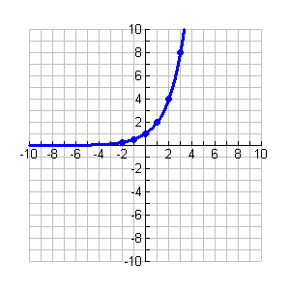
Exponential Functions
g(x) = 2^{x}

Slide 14
Exponential Functions
h(x) = 3^{x}
x
2
9
1
3
0
1
–1
–2

Slide 15
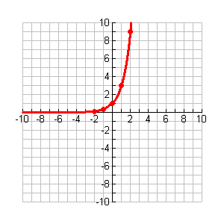
Exponential Functions
h(x) = 3^{x}

Slide 16
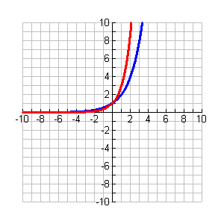
Exponential Functions
g(x) = 2^{x} (blue)
Exponential functions with positive bases greater than 1 have graphs that are increasing.
The function never crosses the x-axis because there is nothing we can plug in for x that will yield a zero answer.
The x-axis is a left horizontal asymptote.
h(x) = 3^{x} (red)

Slide 17
Exponential Functions
g(x) = 2^{x} (blue)
A smaller base means the graph rises more gradually.
A larger base means the graph rises more quickly.
Exponential functions will not have negative bases.
h(x) = 3^{x} (red)

Slide 18
The Number e
e ≈ 2.71828169
A base often associated with exponential functions is:

Slide 19

The Number e
Compute:
x
x
–.1
2.868
.1
2.5937
–.01
2.732
.01
2.7048
–.001
2.7196
.001
2.7169

Slide 20
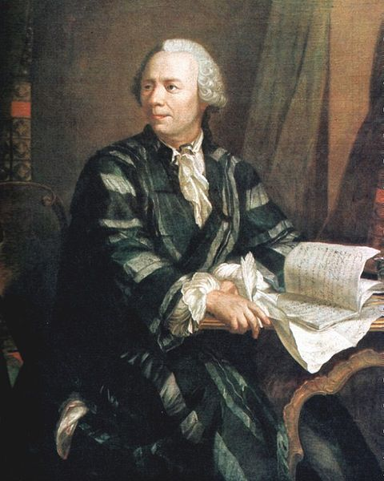
The Number e
Euler’s number
Leonhard Euler (pronounced “oiler”)
Swiss mathematician and physicist

Slide 21
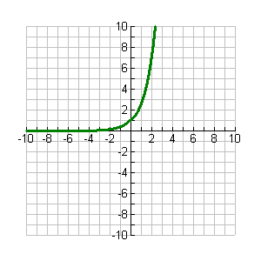
The Exponential Function
f (x) = e^{x}

Slide 22
Exponential Functions
x
2
1
0
1
–1
2
–2
4

Slide 23
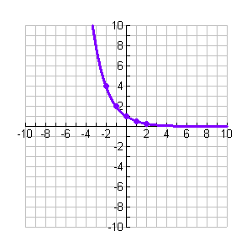
Exponential Functions
Exponential functions with positive bases less than 1 have graphs that are decreasing.

Slide 24
Why study exponential functions?
Exponential functions are used in our real world to measure growth, interest, and decay.
Growth obeys exponential functions.
Ex: rumors, human population, bacteria, computer technology, nuclear chain reactions, compound interest
Decay obeys exponential functions.
Ex: Carbon-14 dating, half-life, Newton’s Law of Cooling

