Slide 1
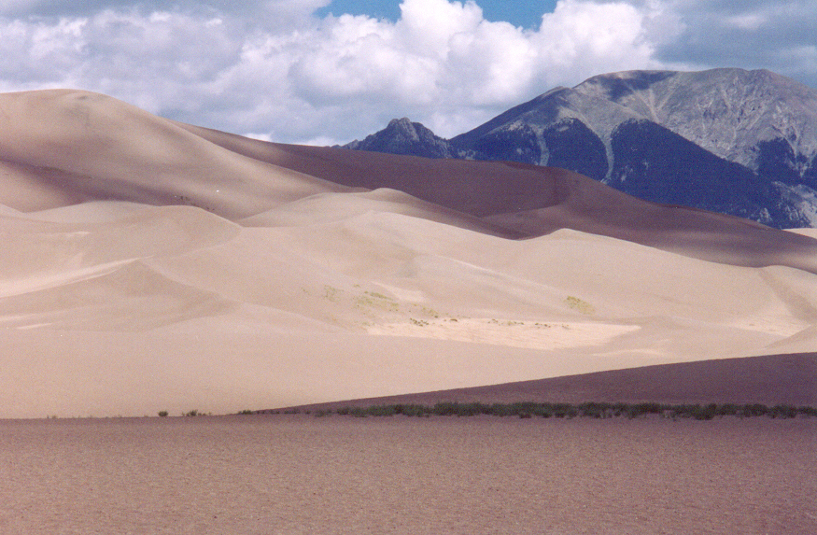
3.1 Derivatives
Great Sand Dunes National Monument, Colorado
Photo by Vickie Kelly, 2003
Greg Kelly, Hanford High School, Richland, Washington

Slide 2
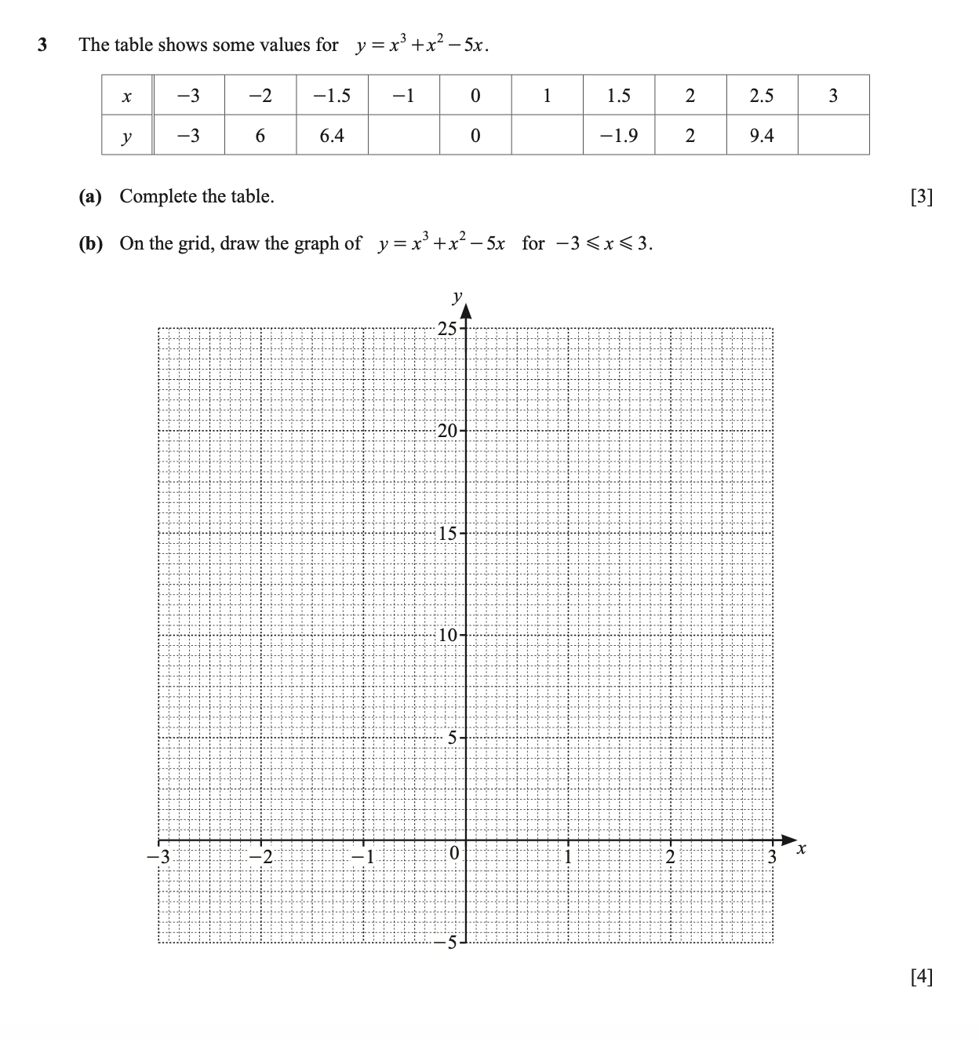

Slide 3
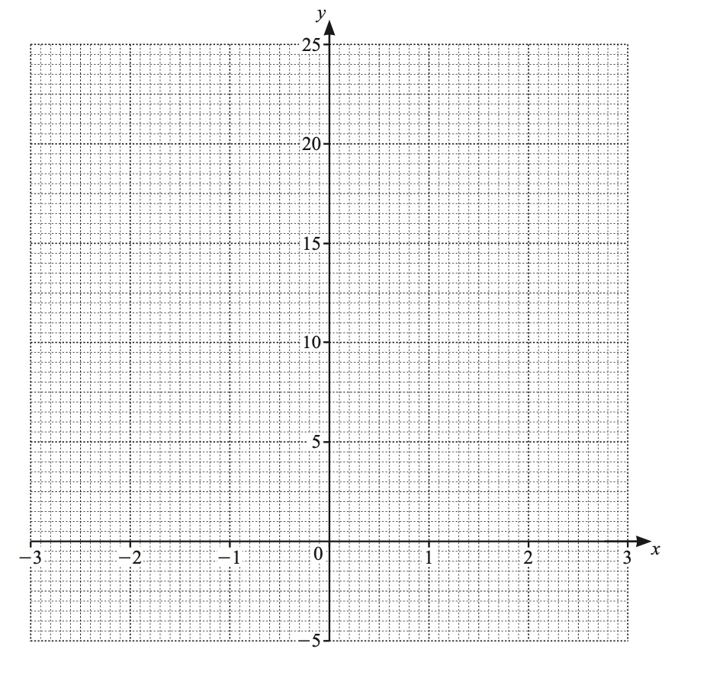

Slide 4
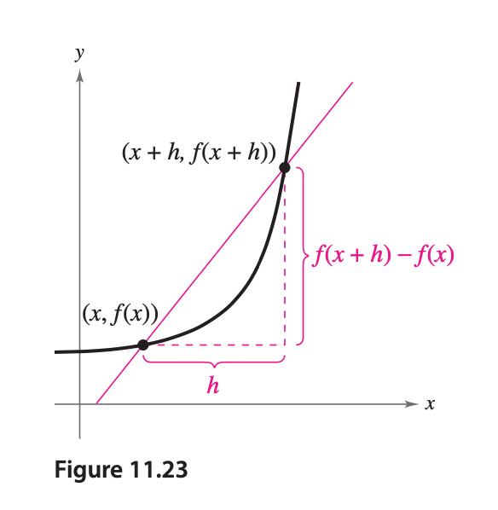
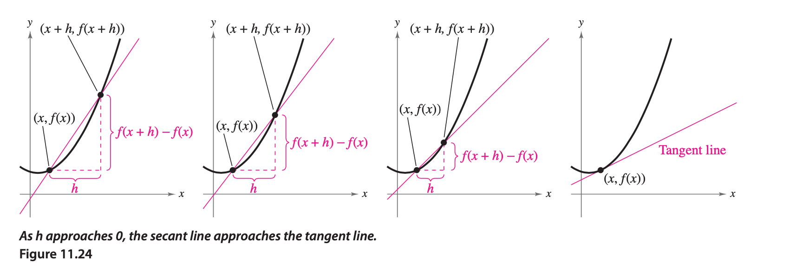
Slope

Slide 5
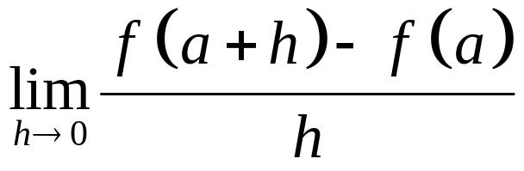
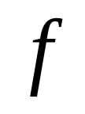

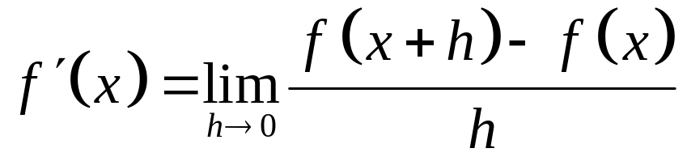
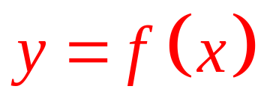

is called the derivative of at .
We write:
“The derivative of f with respect to x is …”
There are many ways to write the derivative of

Slide 6
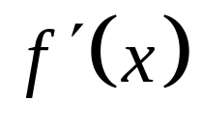

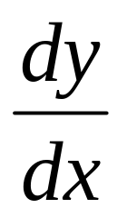
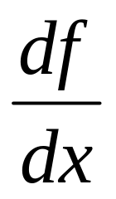
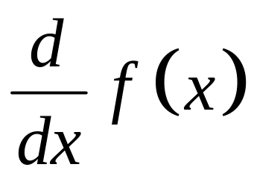
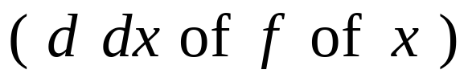
“f prime x”
or
“the derivative of f with respect to x”
“y prime”
or
“the derivative of y with respect to x”
“dee why dee ecks”
or
“the derivative of f with respect to x”
“dee eff dee ecks”
“dee dee ecks uv eff uv ecks”
or
“the derivative of f of x”

Slide 7
Note:
dx does not mean d times x !
dy does not mean d times y !

Slide 8
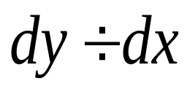
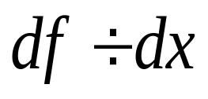
Note:
does not mean !
(except when it is convenient to think of it as division.)
does not mean !
(except when it is convenient to think of it as division.)

Slide 9
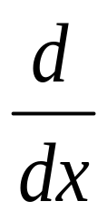
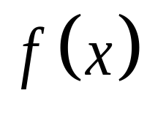
Note:
does not mean times !
(except when it is convenient to treat it that way.)

Slide 10
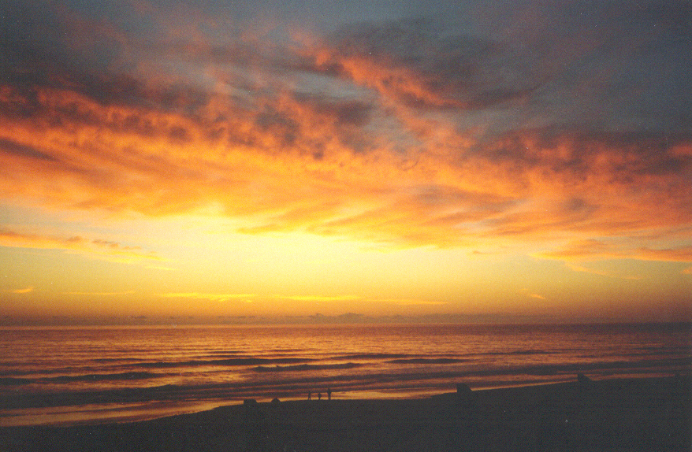
In the future, all will become clear.

Slide 11
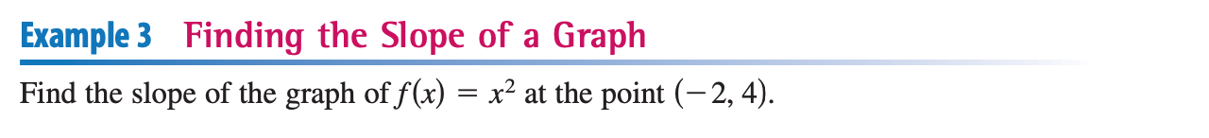
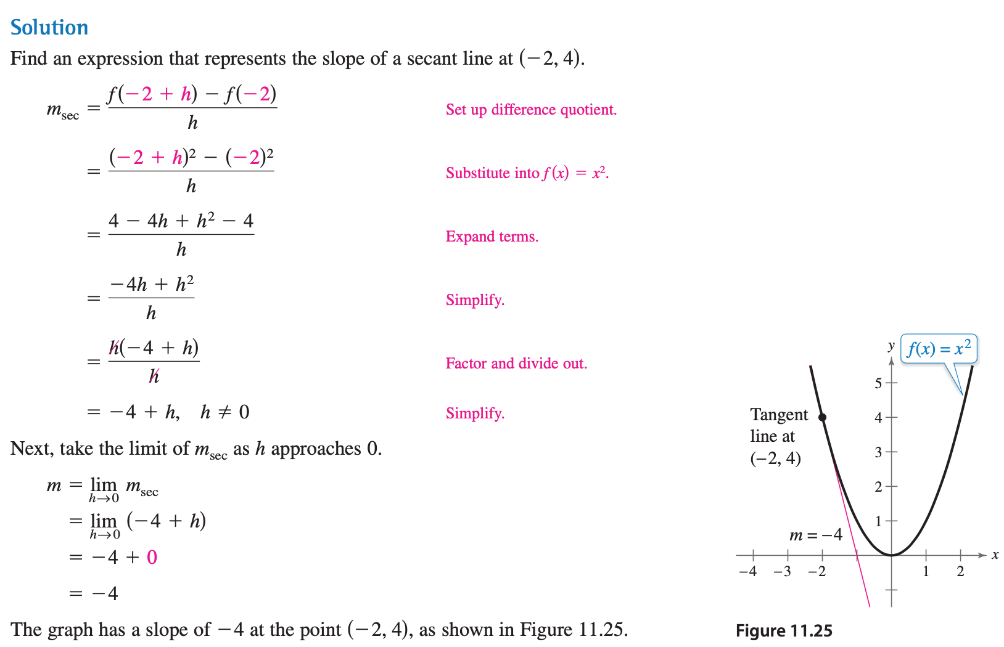

Slide 12

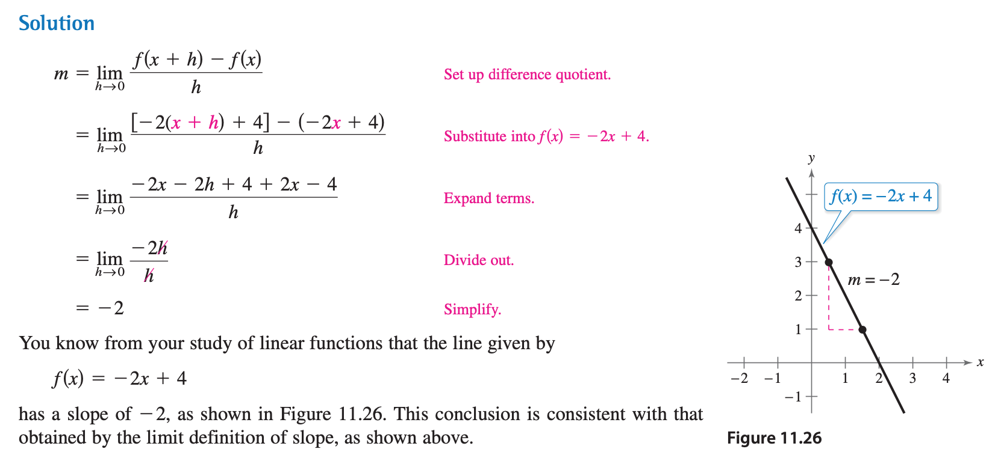

Slide 13
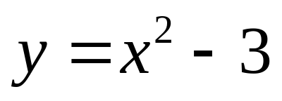
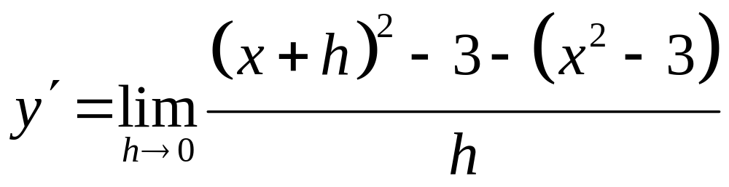
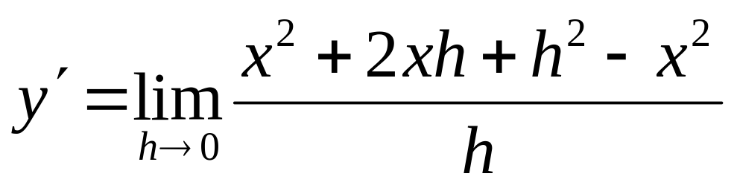

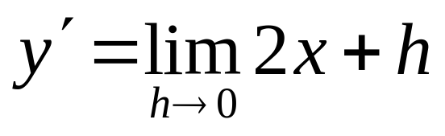
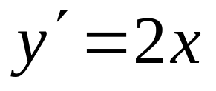

Slide 14
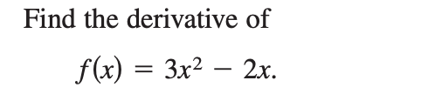
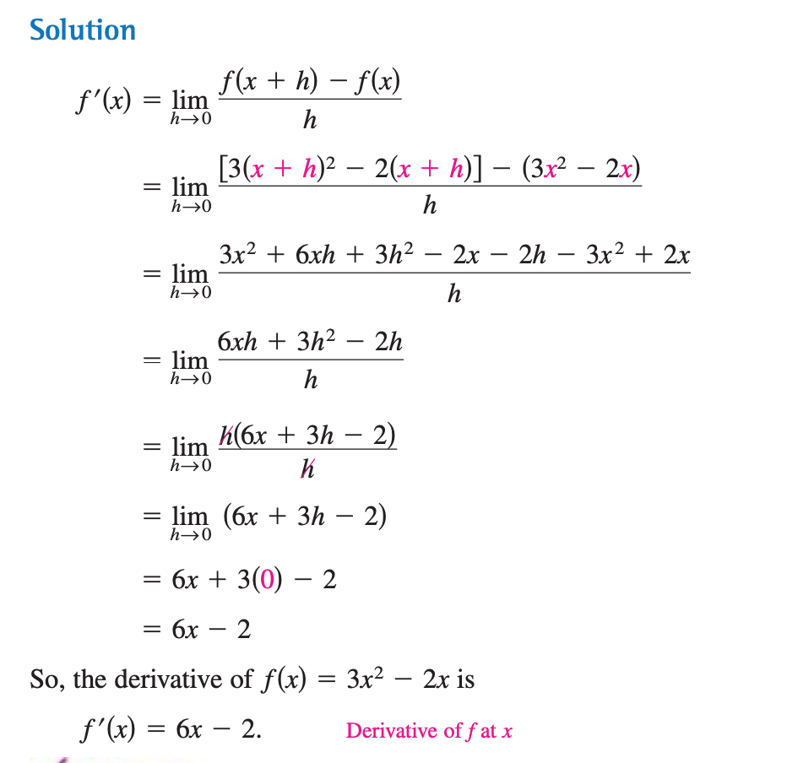

Slide 15
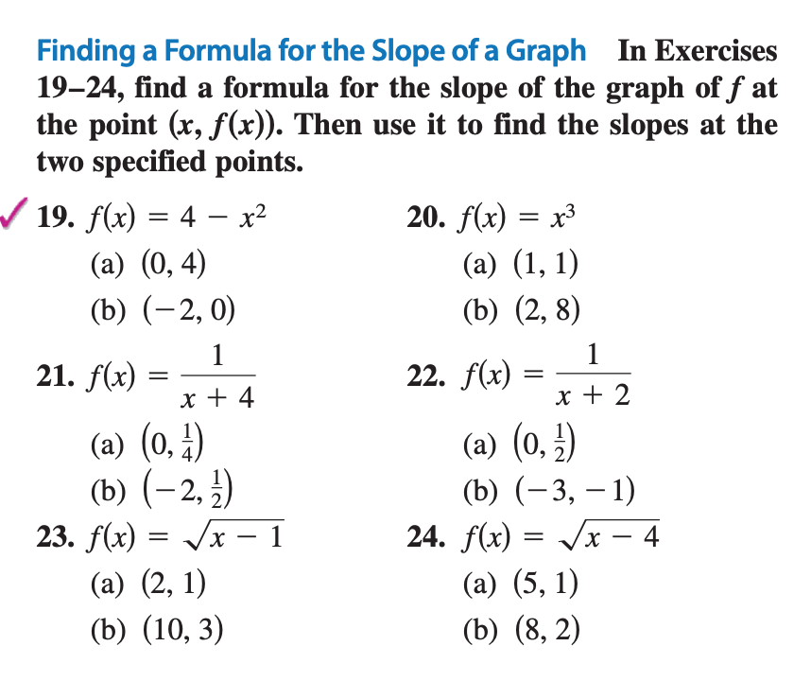

Slide 16
A function is differentiable if it has a derivative everywhere in its domain. It must be continuous and smooth. Functions on closed intervals must have one-sided derivatives defined at the end points.
π

