Slide 1
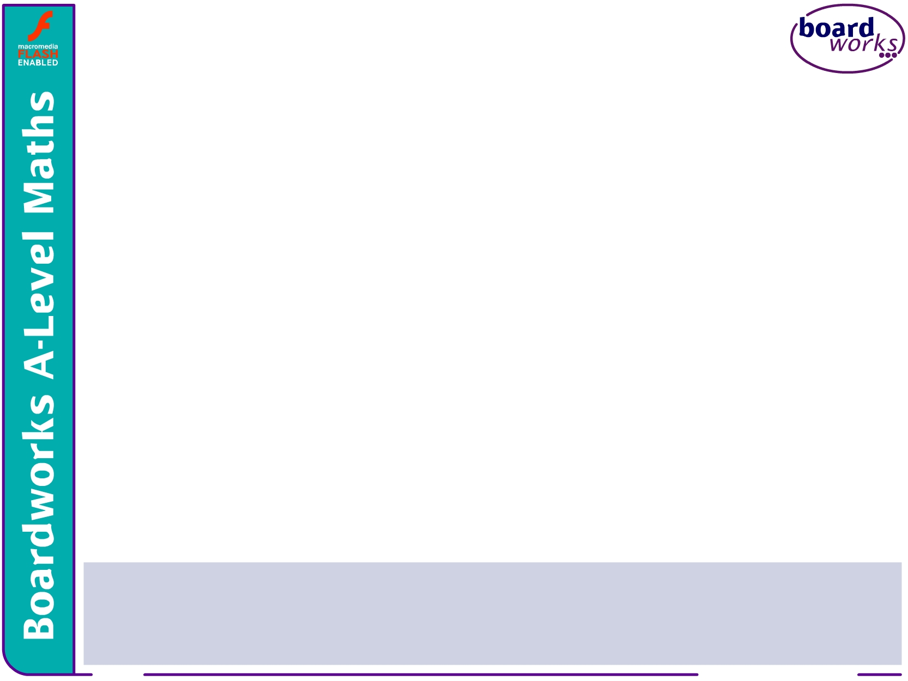




AS-Level Maths:
Core 2 for Edexcel
C2.7 Differentiation
These icons indicate that teacher’s notes or useful web addresses are available in the Notes Page.
This icon indicates the slide contains activities created in Flash. These activities are not editable.
For more detailed instructions, see the Getting Started presentation.
<number> of 28
© Boardworks Ltd 2005

Slide 2



Increasing and decreasing functions
Increasing and decreasing functions
Stationary points
Second order derivatives
Optimization problems
Examination-style questions
Contents
<number> of 28
© Boardworks Ltd 2005

Slide 3
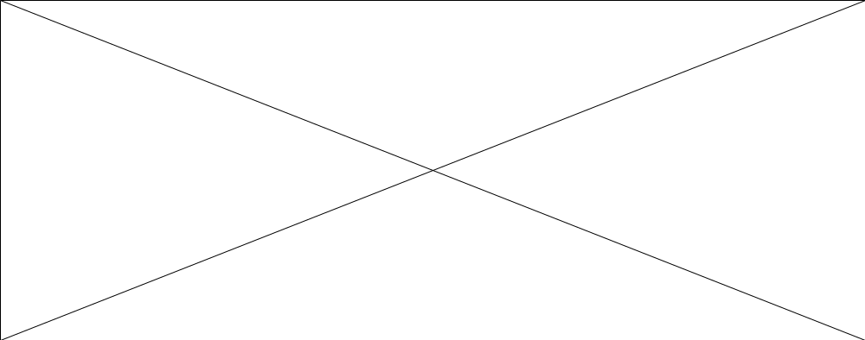
Increasing and decreasing functions
Look at how the value of the gradient changes as we move along this curve.
At any given point the function is either increasing, decreasing or stationary.
Notes:
Move the point P along the curve to show where it is increasing, decreasing and stationary. Define each stationary point as a local minimum, a local maximum or a stationary point of inflection.

Slide 4
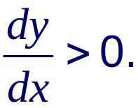
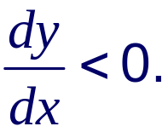
Increasing and decreasing functions
A function is said to be increasing when its gradient is positive.
So:
A function y = f(x) is increasing if
A function is said to be decreasing when its gradient is negative.
So:
A function y = f(x) is decreasing if
Is the function f(x) = x³ – 6x² + 2 increasing or decreasing at the point where x = 3?
f ′(x) = 3x² – 12x
f ′(3) = 27 – 36 = –9
The gradient is negative, so the function is decreasing.
Notes:
The example on this slide shows that it is relatively simple to find out whether a function is increasing or decreasing at a given point.
The more difficult task of finding the range of values for which a given function is increasing or decreasing is discussed on the next slide.

Slide 5
Increasing and decreasing functions
Suppose we want to know the range of values over which a function is increasing or decreasing. For example:
Find the range of values of x for which the function f(x) = x³ – 6x² + 2 is decreasing.
f ′(x) = 3x² – 12x
f(x) is decreasing when f ′(x) < 0.
That is, when
3x² – 12x < 0
x² – 4x < 0
x(x – 4) < 0
We can sketch the graph of y = x(x – 4) to find the range for which this inequality is true.
Notes:
Point out that when solving 3x² –12x < 0 we can divide through by 3 but we can’t divide through by x without losing a solution.

Slide 6
Increasing and decreasing functions
The coefficient of x² > 0 and so the graph will be ∪-shaped.
Also, the roots of y = x(x – 4) are x = 0 and x = 4.
This is enough information to sketch the graph.
The inequality
y
y
x(x – 4) < 0
(4, 0)
(0, 0)
(4, 0)
(0, 0)
is true for the parts of the curve that lie below the
x-axis.
0
0
x
x
So 0 < x < 4.
f(x) = x³ – 6x² + 2 therefore decreases for 0 < x < 4

Slide 7
Stationary points
Increasing and decreasing functions
Stationary points
Second order derivatives
Optimization problems
Examination-style questions
Contents
<number> of 28
© Boardworks Ltd 2005

Slide 8
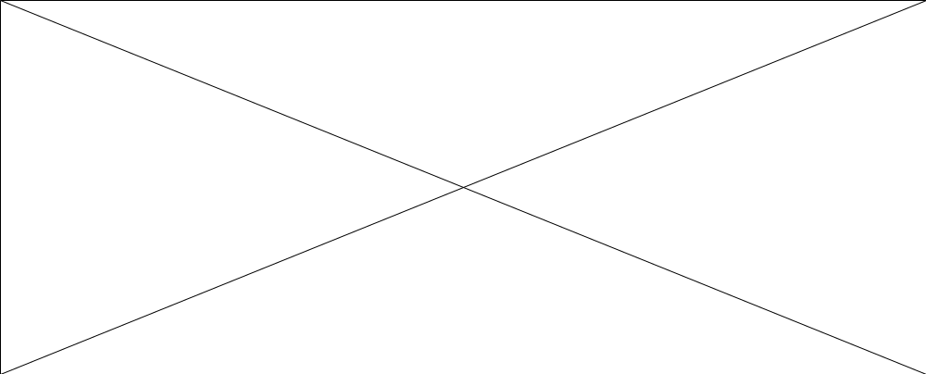
Stationary points
A stationary point occurs when the gradient of a curve is 0.
A stationary point can be:
a maximum point
a minimum point
Notes:
A maximum point is often called a ‘peak’ and a minimum point a ‘trough’.

Slide 9
Stationary points
Maximum and minimum stationary points are often called turning points because the curve turns as its gradient changes from positive to negative or from negative to positive.
A stationary point can also be a point of inflection.
Notes:
Point out that a stationary point can be a point of inflection but that a point of inflection is not always a stationary point.
When a point of inflection is stationary it is called a stationary (or horizontal) point of inflection or saddle point.
A point of inflection is not a turning point because the gradient doesn’t change sign as we move from one side of the point to the other.
Move the point along each curve and note that the gradient changes from positive to zero to positive again or from negative to zero to negative again.

Slide 10
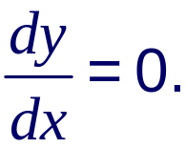
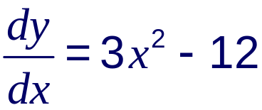
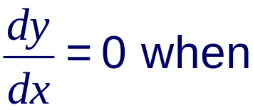
Finding stationary points
We can find the coordinates of the stationary point on a
given curve by solving For example:
Find the coordinates of the stationary points on the curve with equation y = x³ – 12x + 7.
3x² – 12 = 0
x² – 4 = 0
(x – 2)(x + 2) = 0
x = 2 or x = –2
Notes:
Point out that x² – 4 is the difference between two squares and so it can be factorized to give (x – 2)(x + 2).
Point out that since there are two values of x for which ^{dy}/_{dx} = 0 there must be two turning points.

Slide 11
Finding stationary points
Substituting x = 2 into y = x³ – 12x + 7 gives
y = 2³ – 12(2) + 7
= 8 – 24 + 7
= –9
So one of the stationary points has the coordinates (2, –9).
Substituting x = –2 into y = x³ – 12x + 7 gives
y = (–2)³ – 12(–2) + 7
= –8 + 24 + 7
= 23
So the other stationary point has the coordinates (–2, 23).
Notes:
Discuss how these points could be used to help us sketch the curve y = x³ – 12x + 7.

Slide 12
Deciding the nature of a stationary point
We can decide whether a stationary point is a maximum, a minimum or a point of inflection by working out whether the function is increasing or decreasing just before and just after the stationary point.
We have shown that the point (2, –9) is a stationary point on the curve y = x³ – 12x + 7.
Let’s see what happens when x is 1.9, 2 and 2.1.
Value of x
1.9
2
2.1
Value of
–1.17
0
1.23
Slope
–ive
0
+ive
So (2, –9) is a minimum turning point.
Notes:
The calculations would of course be easier if we took x to be 1, 2 and 3. Explain that the danger in taking larger step on either side is that the behavior of the curve may change dramatically (if there is an asymptote, for example). It is therefore better to choose points as close as possible to the turning point.

Slide 13
Deciding the nature of a stationary point
Using this method for the other stationary point (–2, 23) on the curve y = x³ – 12x + 7.
Value of x
–2.1
–2
–1.9
Value of
1.23
0
–1.17
Slope
+ive
–ive
0
So (–2, 23) is a maximum turning point.
The main disadvantage of this method is that the behaviour of more unusual functions can change quite dramatically on either side of the turning point.
It is also time consuming and involves several calculations.

Slide 14
Second order derivatives
Increasing and decreasing functions
Stationary points
Second order derivatives
Optimization problems
Examination-style questions
Contents
<number> of 28
© Boardworks Ltd 2005

Slide 15

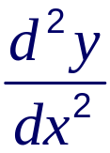
Using second order derivatives
Differentiating a function y = f(x) gives us the derivative
or
f ′(x)
Differentiating the function a second time give us the second order derivative. This can be written as
or
f ′′(x)
The second order derivative gives us the rate of change of the gradient of a function.
We can think of it as the gradient of the gradient.
The second order derivative can often be used to decide whether a stationary point is a maximum point or a minimum point.

Slide 16

Using second order derivatives
Notes:
Move the point through the maximum point and explain that moving through a positive gradient to 0 to a negative gradient means that the gradient is decreasing. The second derivative (the gradient of the gradient) will therefore be negative (below the x-axis) for a maximum turning point.
Similarly, by moving the point through the minimum point we can see that moving through a negative gradient to 0 to a positive gradient means that the gradient is increasing. The second derivative (the gradient of the gradient) will therefore be positive (above the x-axis) for a minimum turning point.

Slide 17
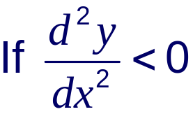
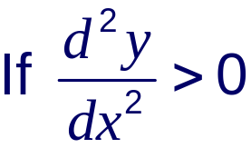
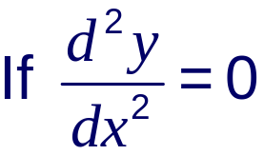
Using second order derivatives
at a stationary point, the point is a maximum.
at a stationary point, the point is a minimum.
at a stationary point then the point could be a
maximum, a minimum or a point of inflection.
In this case we would have to use the method of looking at the sign of the derivative at either side of the stationary point to decide its nature.

Slide 18
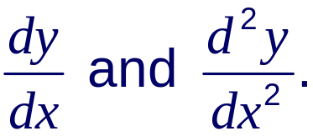
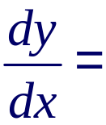



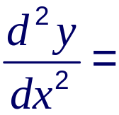


Using second order derivatives
Examination-style question: Given that y = x³ – 6x² – 15x
a) Find
b) Find the coordinates of any stationary points on the curve and determine their nature.
c) Sketch the curve.
a)

Slide 19




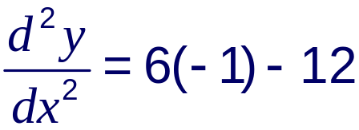

Using second order derivatives
b) The stationary points occur when
x = –1 or x = 5
When x = –1
y = (–1)³ – 6(–1)² – 15(–1)
= –1 – 6 + 15
= 8
∴ (–1, 8) is a maximum

Slide 20
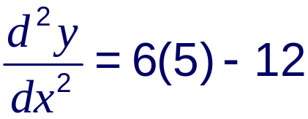

Using second order derivatives
When x = 5
y = (5)³ – 6(5)² – 15(5)
= 125 – 150 – 75
= –100
∴ (5, –100) is a minimum
y
c) Sketching the curve:
(–1, 8)
0
x
(5, –100)
Notes:
The sketch can be completed using the turning points and the fact that the curve passes through the origin (because when x = 0, y = 0). It is not necessary to find the other two roots unless they are asked for.

Slide 21
Optimization problems
Increasing and decreasing functions
Stationary points
Second order derivatives
Optimization problems
Examination-style questions
Contents
<number> of 28
© Boardworks Ltd 2005

Slide 22
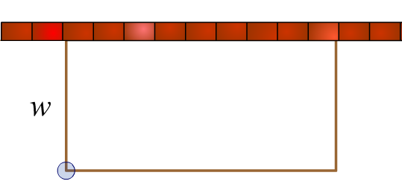
Optimization problems
A very useful application of differentiation is in finding the solution to optimization problems. For example:
A farmer has 60 m of fencing with which to construct a rectangular enclosure against an existing wall. Find the dimensions of the largest possible enclosure.
If l is the length of the enclosure and w is the width, we can write
2w + l = 60
w
l = 60 – 2w
The area A of the enclosure is:
l
A = wl
= w(60 – 2w)
= 60w – 2w²
Notes:
Explain that the area must be written in terms of one variable so that it can be differentiated in terms of that variable.

Slide 23
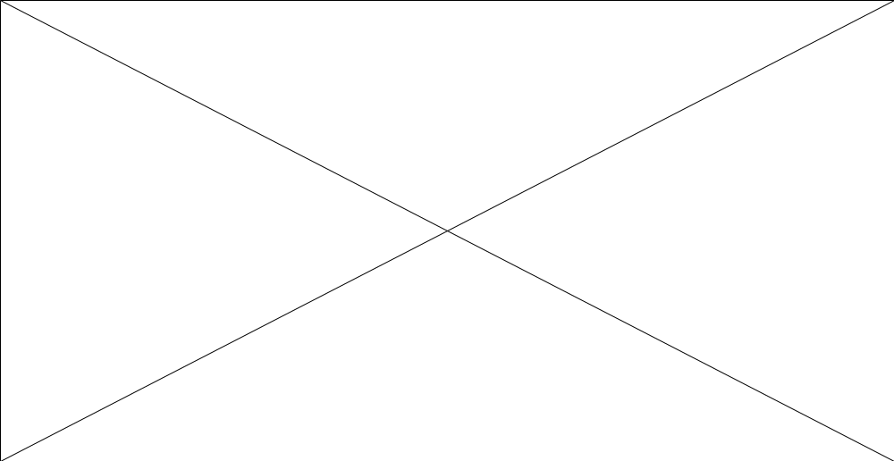
Optimization problems
Look at how the value of w affects the area of the enclosure.
Notes:
Move the point on the enclosure downwards to illustrate how the area changes as the width increases. It should be clear from the graph that there is a width for which the area reaches a maximum. The value of w for which this happens can be found by differentiating.

Slide 24
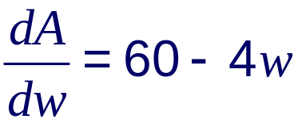
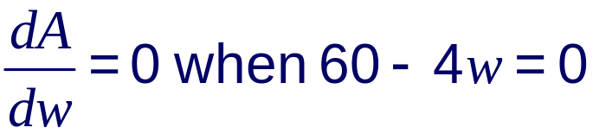
Optimization problems
To find the maximum area we differentiate A = 60w – 2w²
with respect to w.
4w = 60
w = 15
The maximum area is therefore achieved when the width of the enclosure is 15 m.
The dimensions of the enclosure in this case are 15 m by 30 m and the area is 450 m².

Slide 25
Examination-style questions
Increasing and decreasing functions
Stationary points
Second order derivatives
Optimization problems
Examination-style questions
Contents
<number> of 28
© Boardworks Ltd 2005

Slide 26
Examination-style question
Given that y = x³ – 6x² – 15x
a) Find
b) Find the coordinates of any stationary points on the curve and determine their nature.
c) Sketch the curve.
a)

Slide 27
Examination-style question
b) The stationary points occur when
x = –1 or x = 5
When x = –1
y = (–1)³ – 6(–1)² – 15(–1)
= –1 – 6 + 15
= 8
∴ (–1, 8) is a maximum

Slide 28
Examination-style question
When x = 5
y = (5)³ – 6(5)² – 15(5)
= 125 – 150 – 75
= –100
∴ (5, –100) is a minimum
y
c) Sketching the curve:
(–1, 8)
0
x
(5, –100)
Notes:
The sketch can be completed using the turning points and the fact that the curve passes through the origin (because when x = 0, y = 0). It is not necessary to find the other two roots unless they are asked for.

