Slide 1


12
Limits and an Introduction
to Calculus
Copyright © Cengage Learning. All rights reserved.

Slide 2
12.1
Introduction to Limits
Copyright © Cengage Learning. All rights reserved.

Slide 3
Objectives
Use the definition of limit to estimate limits.
Determine whether limits of functions exist.
Use properties of limits and direct substitution to
evaluate limits.

Slide 4
The Limit Concept

Slide 5
The Limit Concept
The notion of a limit is a fundamental concept of calculus.
In this chapter, you will learn how to evaluate limits and how to use them in the two basic problems of calculus: the tangent line problem and the area problem.

Slide 6
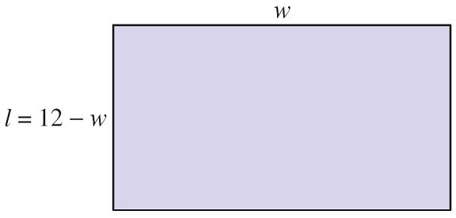
Example 1 – Finding a Rectangle of Maximum Area
Find the dimensions of a rectangle that has a perimeter of 24 inches and a maximum area.
Solution:
Let w represent the width of the rectangle and let l represent the length of the rectangle. Because
2w + 2l = 24
it follows that l = 12 – w,
as shown in the figure.
Perimeter is 24.

Slide 7
Example 1 – Solution
cont’d
So, the area of the rectangle is
A = lw
= (12 – w)w
= 12w – w².
Using this model for area, experiment with different values of w to see how to obtain the maximum area.
Formula for area
Substitute 12 – w for l.
Simplify.

Slide 8
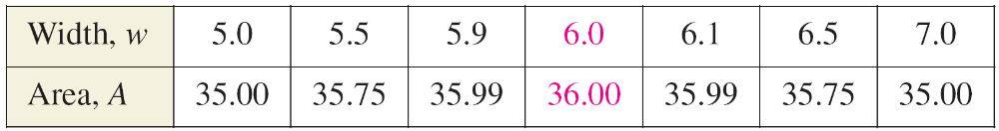
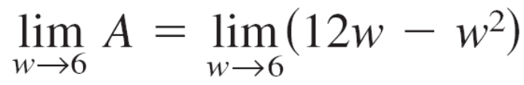

Example 1 – Solution
cont’d
After trying several values, it appears that the maximum area occurs when w = 6, as shown in the table.
In limit terminology, you can say that “the limit of A as w approaches 6 is 36.” This is written as

Slide 9
Definition of Limit

Slide 10
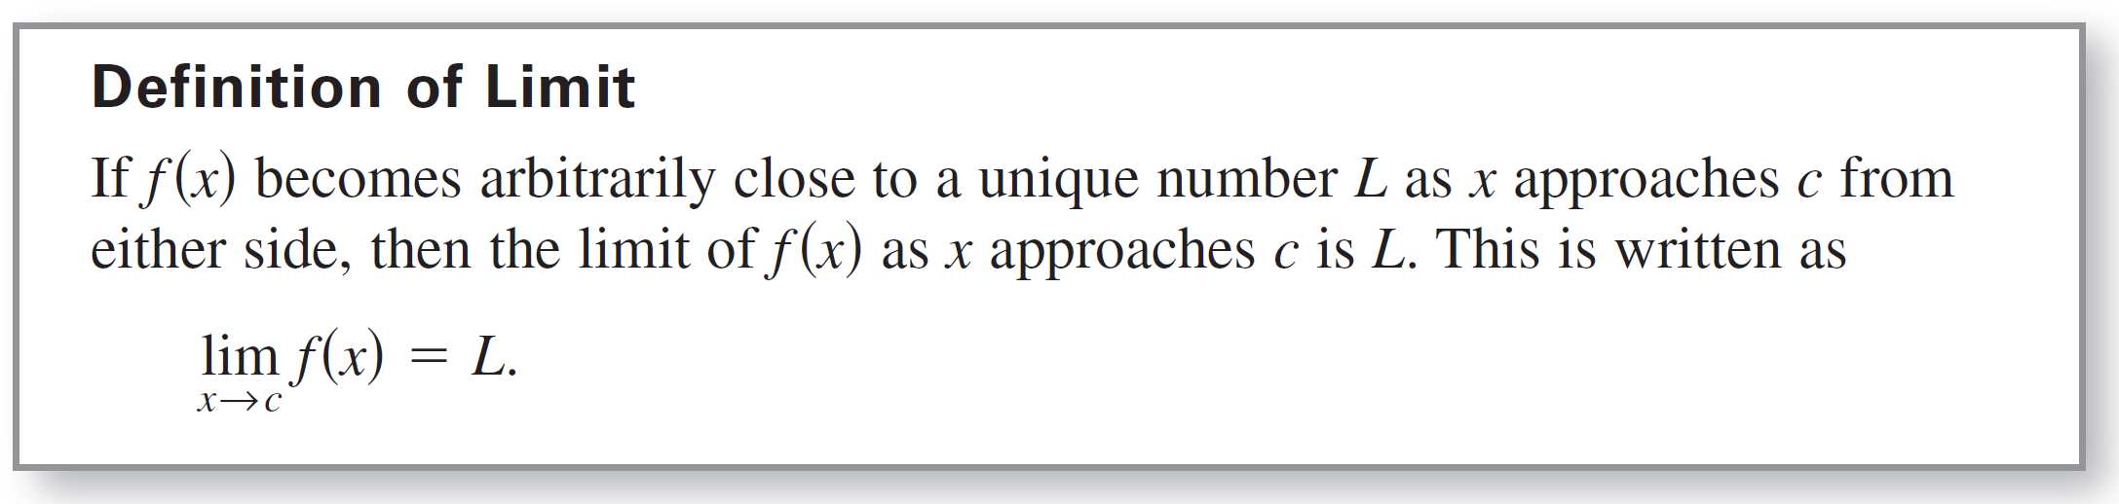
Definition of Limit

Slide 11
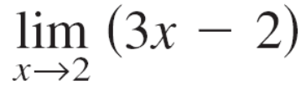
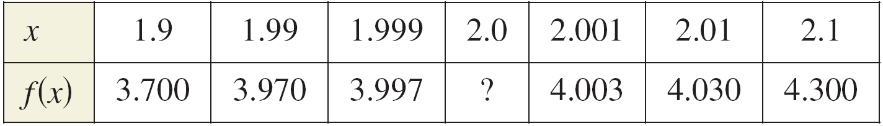
Example 2 – Estimating a Limit Numerically
Use a table to estimate numerically the limit: .
Solution:
Let f (x) = 3x – 2.
Then construct a table that shows values of f (x) for two sets
of x-values—one set that approaches 2 from the left and one that approaches 2 from the right.

Slide 12
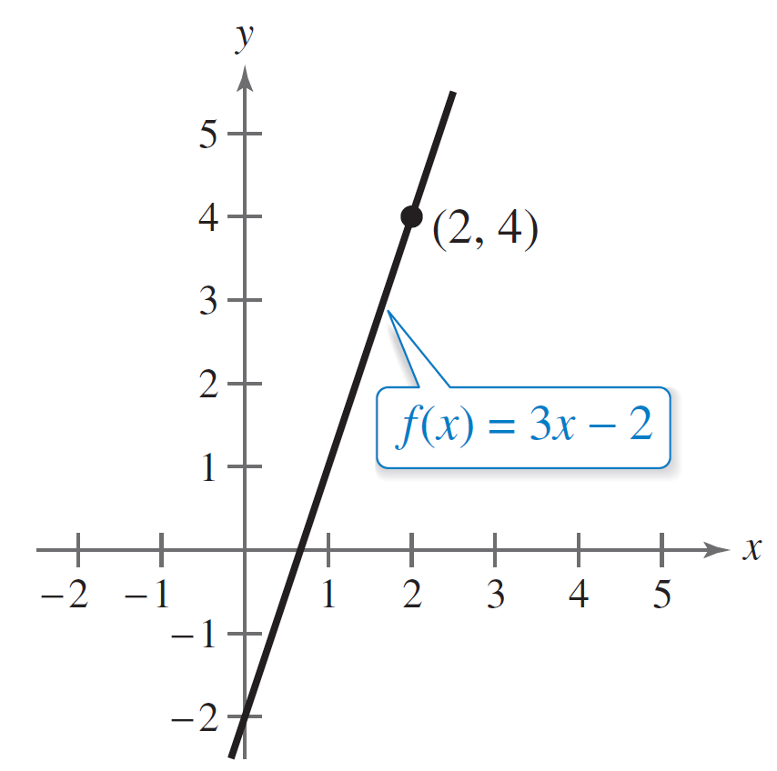
Example 2 – Solution
cont’d
From the table, it appears that the closer x gets to 2, the closer f (x) gets to 4. So, you can estimate the limit to be 4. Figure 12.1 illustrates this conclusion.
Figure 12.1

Slide 13
Limits That Fail to Exist

Slide 14
Limits That Fail to Exist
Next, you will examine some functions for which limits do not exist.

Slide 15
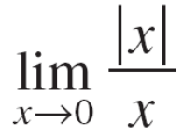
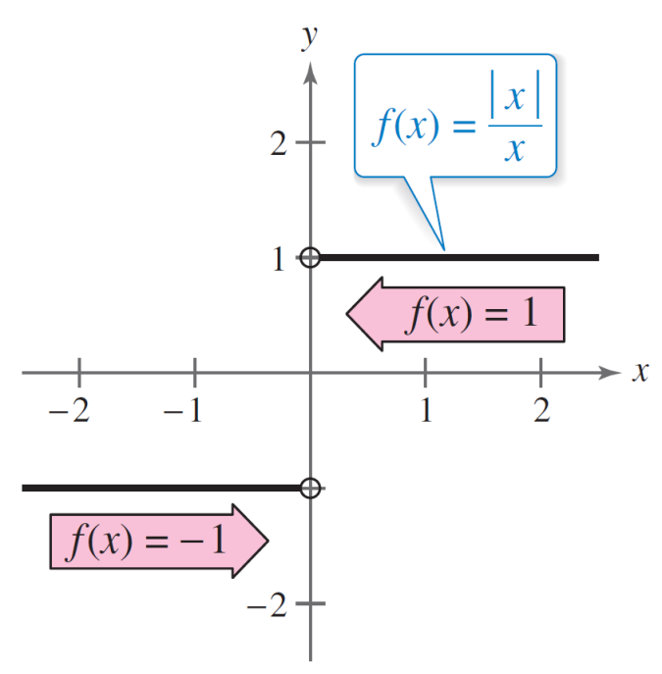
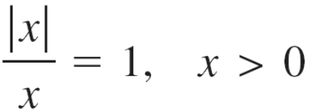
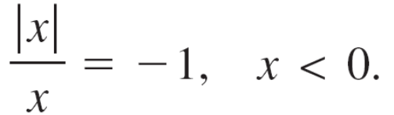
Example 6 – Comparing Left and Right Behavior
Show that the limit does not exist.
Solution:
Consider the graph of f (x) = | x |/x.
From Figure 12.4, you can see that
for positive x-values
and for negative x-values
Figure 12.4

Slide 16
Example 6 – Solution
cont’d
This means that no matter how close x gets to 0, there will be both positive and negative x-values that yield f (x) = 1 and f (x) = –1.
This implies that the limit does not exist.

Slide 17
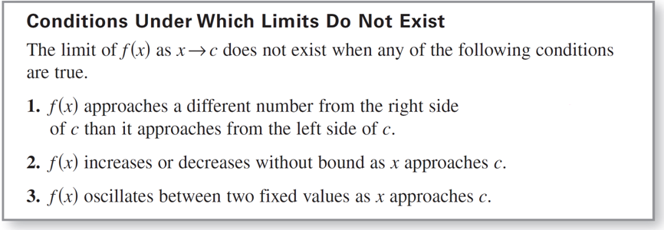
Limits That Fail to Exist
Following are the three most common types of behavior associated with the nonexistence of a limit.

Slide 18
Properties of Limits and
Direct Substitution

Slide 19
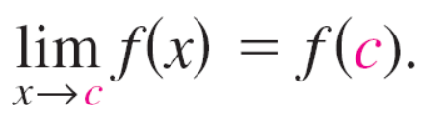
Properties of Limits and Direct Substitution
You have seen that sometimes the limit of f (x) as x → c is simply f (c), as shown in Example 2. In such cases, the limit can be evaluated by direct substitution.
That is,
There are many “well-behaved” functions, such as polynomial functions and rational functions with nonzero denominators, that have this property.
Substitute c for x.

Slide 20
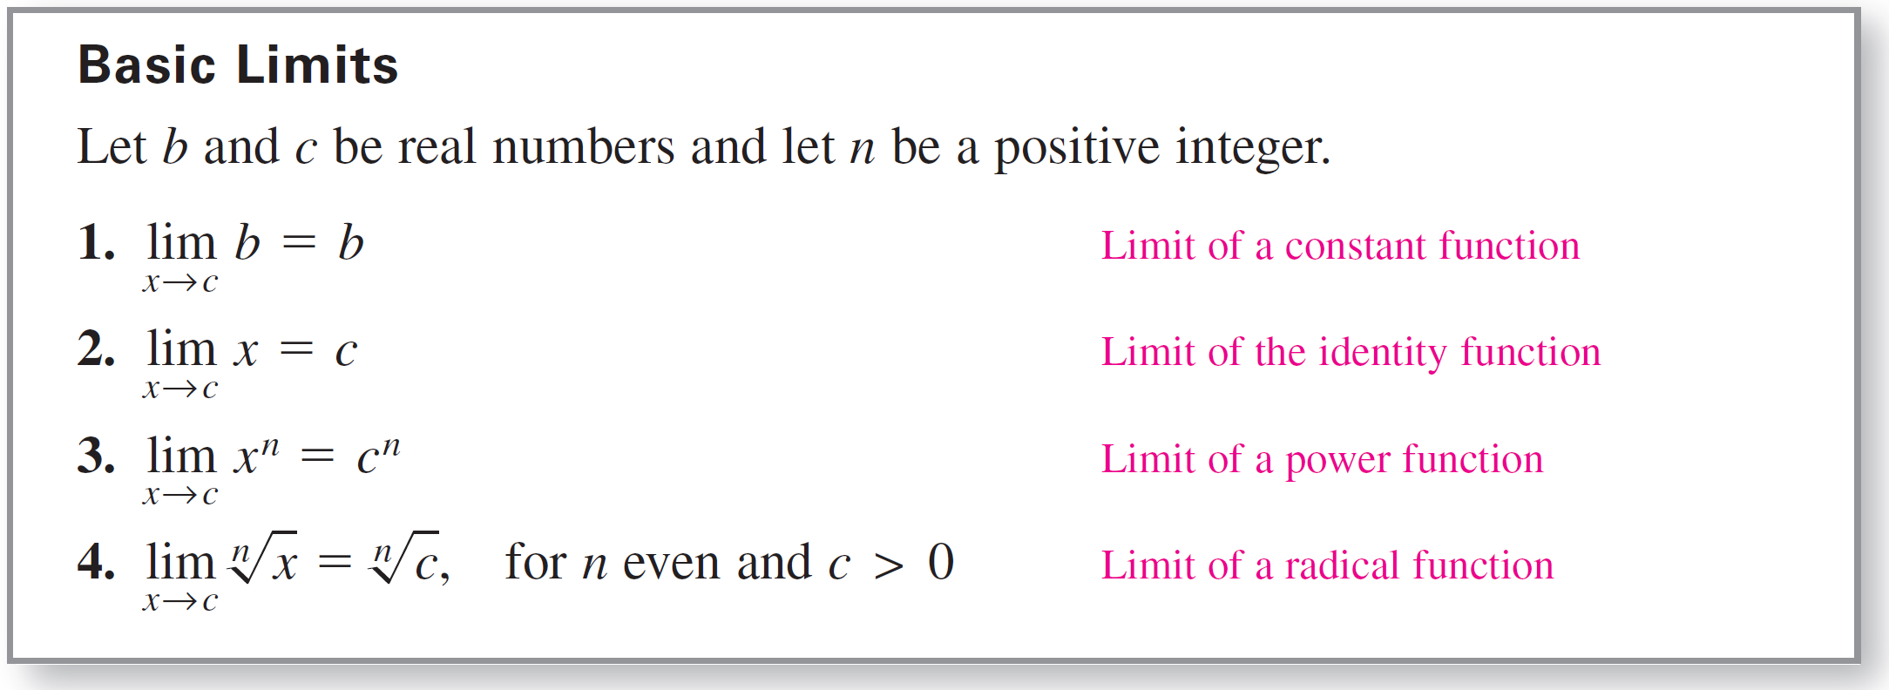
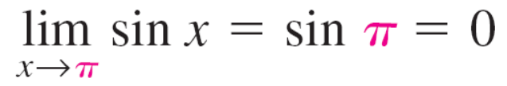
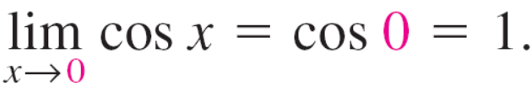
Properties of Limits and Direct Substitution
The following list includes some basic limits.
This list can also include trigonometric functions. For instance,
and

Slide 21
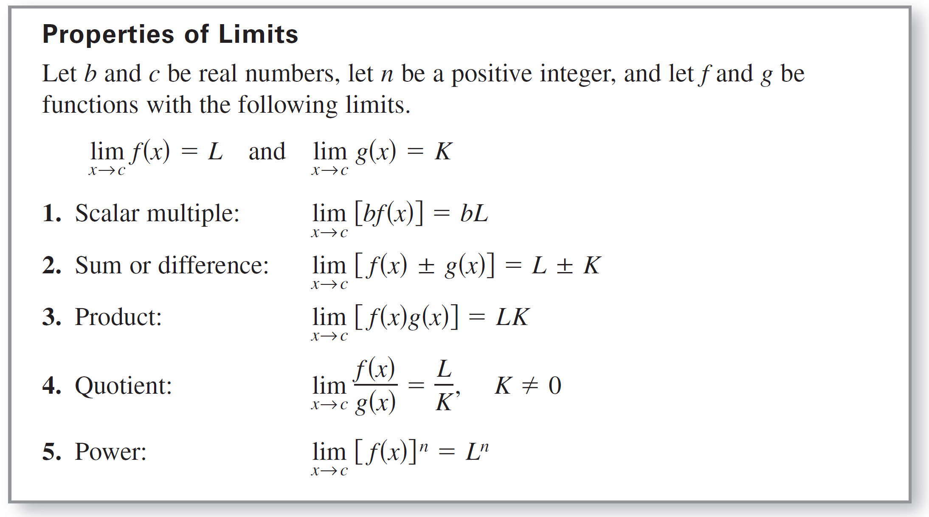
Properties of Limits and Direct Substitution
By combining the basic limits with the following operations, you can find limits for a wide variety of functions.

Slide 22

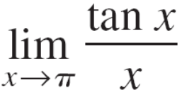
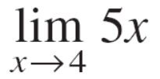
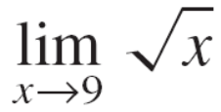
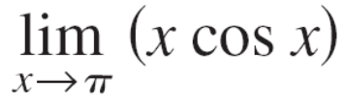
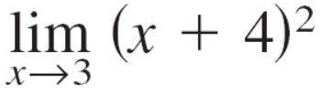
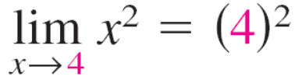

Example 9 – Direct Substitution and Properties of Limits
Find each limit.
a. b. c.
d. e. f.
Solution:
Use the properties of limits and direct substitution to evaluate each limit.
a.

Slide 23
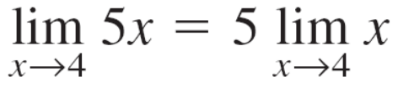


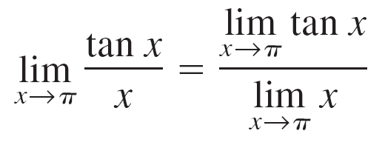
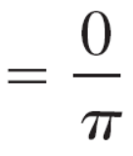

Example 9 – Solution
cont’d
b.
c.
Property 1
Property 4

Slide 24





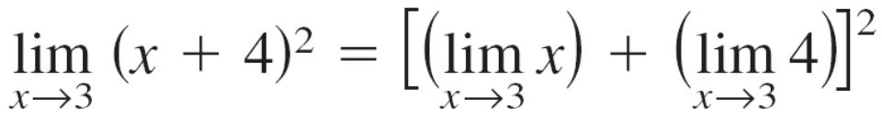


Example 9 – Solution
cont’d
d.
e.
f.
Property 3
Properties 2 and 5

Slide 25
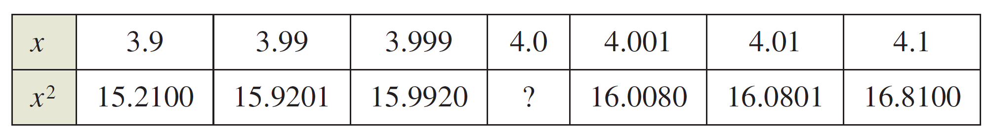
Properties of Limits and Direct Substitution
Example 9 shows algebraic solutions. To verify the limit in Example 9(a) numerically, for instance, create a table that shows values of x² for two sets of x-values—one set that approaches 4 from the left and one that approaches 4 from the right, as shown below.

Slide 26
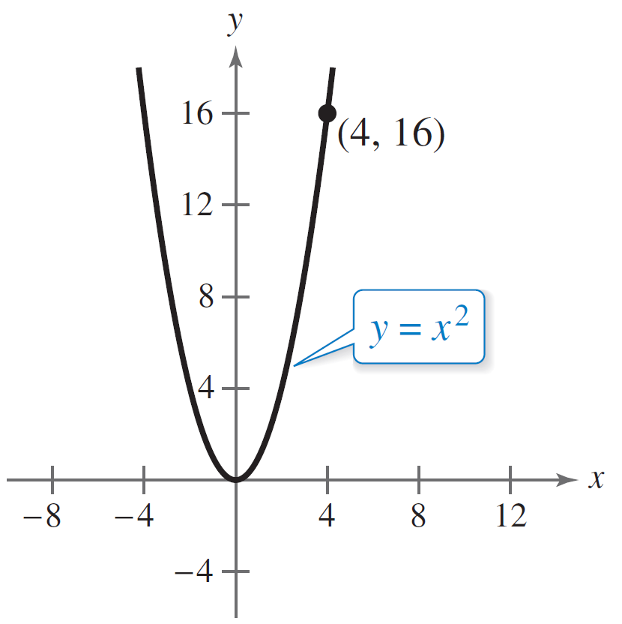
Properties of Limits and Direct Substitution
From the table, you can see that the limit as x approaches 4 is 16. To verify the limit graphically, sketch the graph
of y = x². From the graph shown in Figure 12.7, you can determine that the limit as x approaches 4 is 16.
Figure 12.7

Slide 27
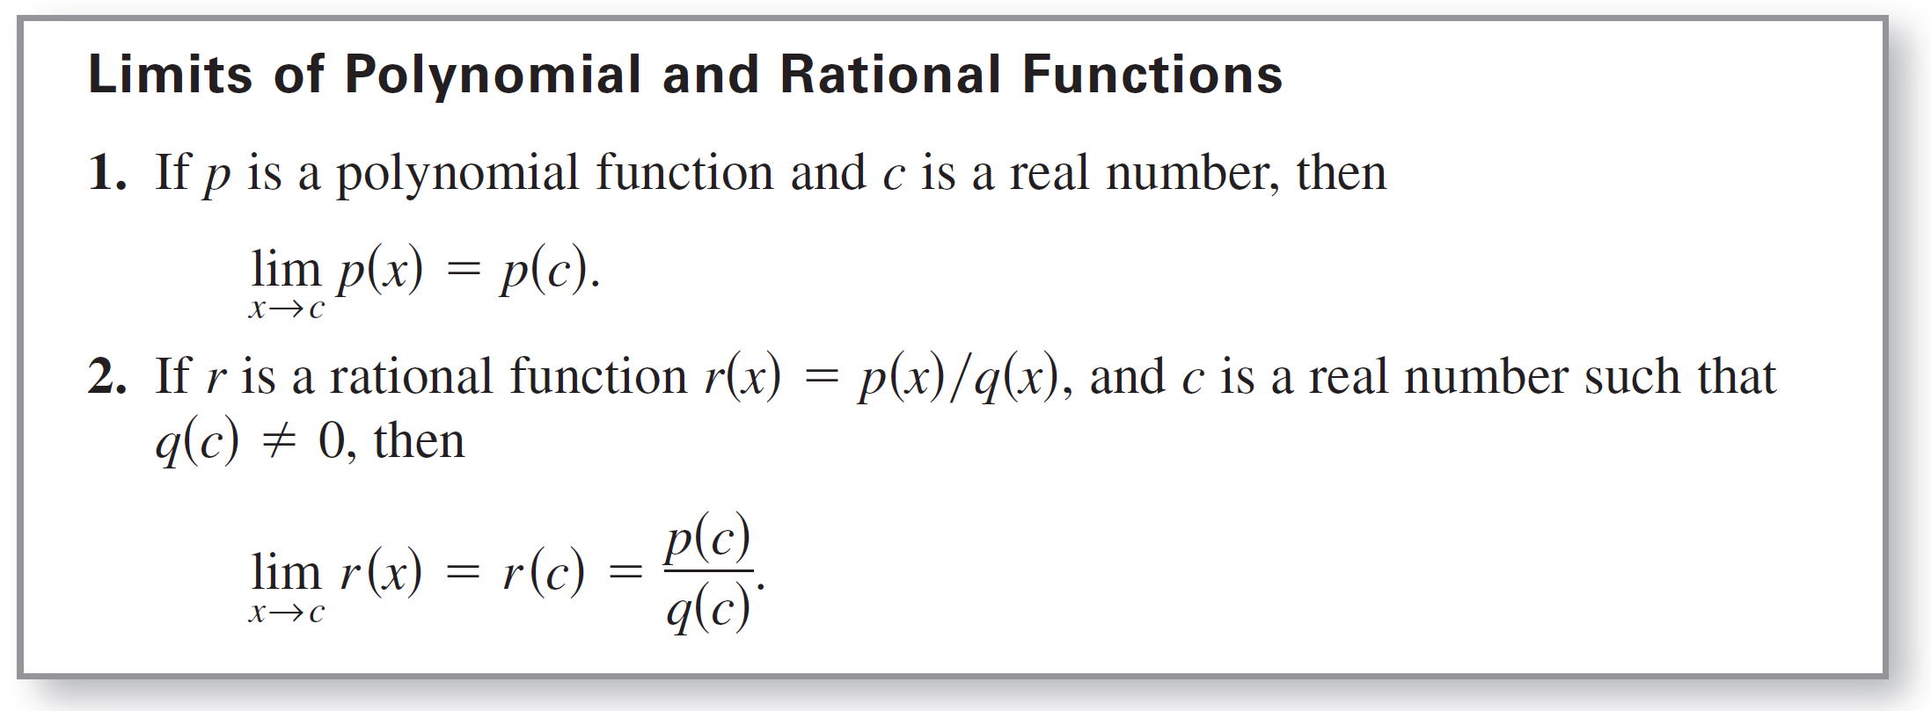
Properties of Limits and Direct Substitution
The following summarizes the results of using direct
substitution to evaluate limits of polynomial and rational functions.

