Slide 1
Sets
A set is a well defined group of objects or symbols.

Slide 2
The objects or symbols are called the elements of the set. If an element e belongs to a set S, this is represented as e ∈ S. If e does not belong to set S this is represented as e ∉ S.
a) {South Africa, Namibia, Egypt, Angolar, …}
i) Descirbe the set.
The elements of the set are countries of Africa
ii) Is the set finite or infinite?
Finite. This is a finite number of countries in Africa
b) Set A = {x : x is a natural number}
i) Descirbe the set.
The elements of the set are the natural numbers
ii) Is the set finite or infinite?
Infinite. There are infinite natural numbers
iii) Write down two elements of the set
5,6

Slide 3
C) Set B = {(x,y): y = 2x -4}
i) Descirbe the set.
The elements of the set are the coordinates of points found on the straight line with equation y = 2x -4
ii) Is the set finite or infinite?
Infinite. There are infinite natural of points on a line
iii) Write down two elements of the set
(0,-4) and (10,16)
C) Set C = {x : 2 ≤ x ≤ 8}
i) Descirbe the set.
The elements of the set include any number between 2 and 8 inclusive
ii) Is the set finite or infinite?
Infinite.
iii) Write down two elements of the set
5 and 6.3

Slide 4
Subsets
If all the elements of one set X are also elements of another set Y, then X is said to be a subset of Y.
This is Written as X ⊆ Y
If a set A is empty(it has no elements in it), then this is called the empty set and it is represented by the symbol ∅. Therefore A = ∅. The empty set is a subset of all sets.

Slide 5
E.g. Three girls, Winnie, Natalie and Emma form a set A
A = {Winnie, Natalie, Emma}
All the possible subsets are A are given below:
B = {Winnie, Natalie, Emma}
C = {Winnie, Natalie}
D = {Winnie, Emma}
….
I = {∅}
Note that the sets B and I above are considered as subsets of A.
i.e. B ⊆ A and I ⊆ A
Sets C,D are considered proper subsets of A.
i.e. C ⊂ A and D ⊂ A

Slide 6
Extension
G ⊈ A
H ⊄ A

Slide 7
Practice: State whether each of the following statements is true or false:
{Algeria, Mozambique} ⊆ {countries in Africa}
{mango, banana} ⊆ {fruit}
{1,2,3,4} ⊆ {1,2,3,4}
{1,2,3,4} ⊂ {1,2,3,4}
{Volleyball, basketball} ⊈ {team sport}
{4,6,8,10} ⊄ {4,6,8,10}
{potatos, carrots} ⊆ {vegetables}
{12,13,14,15} ⊄ {whole numbers}

Slide 8

The universal set
The universal set (U or ) for any particular problem is the set
which contains all the possible elements for that problem.
The complement of a set A is the set of elements which are in U but not in A. The complement of A is identified as A’.
Notice: U’ = ∅ and ∅’ = U
If U = {1,2,3,4,5,6,7,8,9,10}. And A = {1,2,3,4,5} what set is represented by A’?
A’ = {6,7,8,9,10}

Slide 9
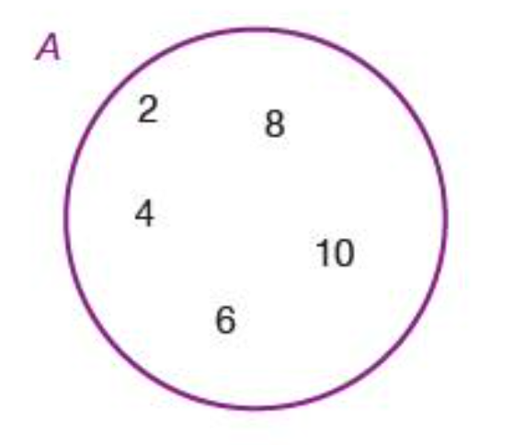
Set Notation and Venn diagrams
Venn diagrams are the principal way of showing sets diagrammatically. The method consists primarily of entering the elements of a set in a circle or circles.
A = {2,4,6,8,10}

Slide 10
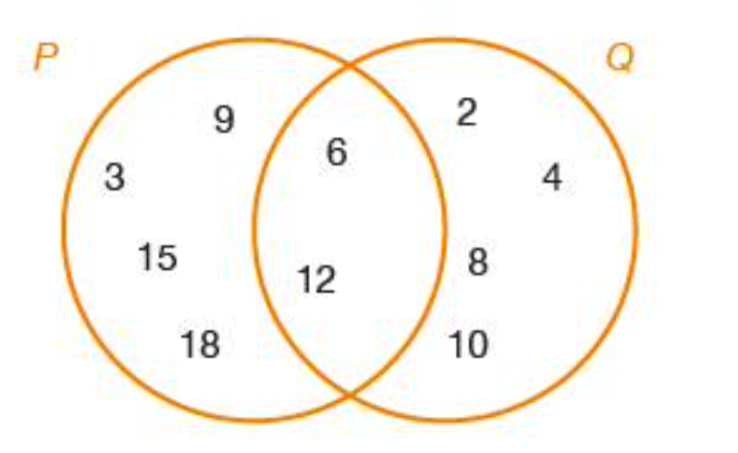
Elements which are in more than one set can also be represented using a Venn diagram.
P = {3,6,9,12,15,18} and Q = {2,4,6,8,10,12} can be represented as:

Slide 11
When two sets P and Q overlap as they do above.
Intersection: P ∩ Q = {6,12}
Note that 6 ∈ P ∩ Q ; Q ∉ P ∩ Q

Slide 12
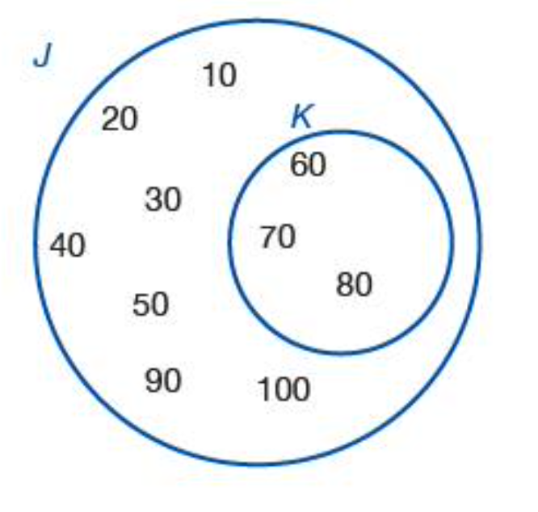
J = {10,20,30,40,50,60,70,80,90,100} and K = {60,70,80}

Slide 13
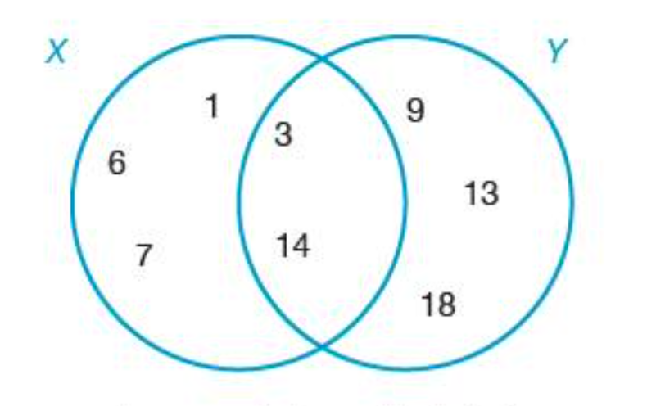
Union U
The union of two sets is everything which belongs to either or both sets and is represented by the symbol ∪
X = {1,3,6,7,14} and Y = {3,9,13,14,18}

Slide 14
Rational Number & Real Number?
Q ⊂ R
Natural Number & Integers?
N ⊂ Z
Irrational Number & Integers?
I ⊂ Z

Slide 15
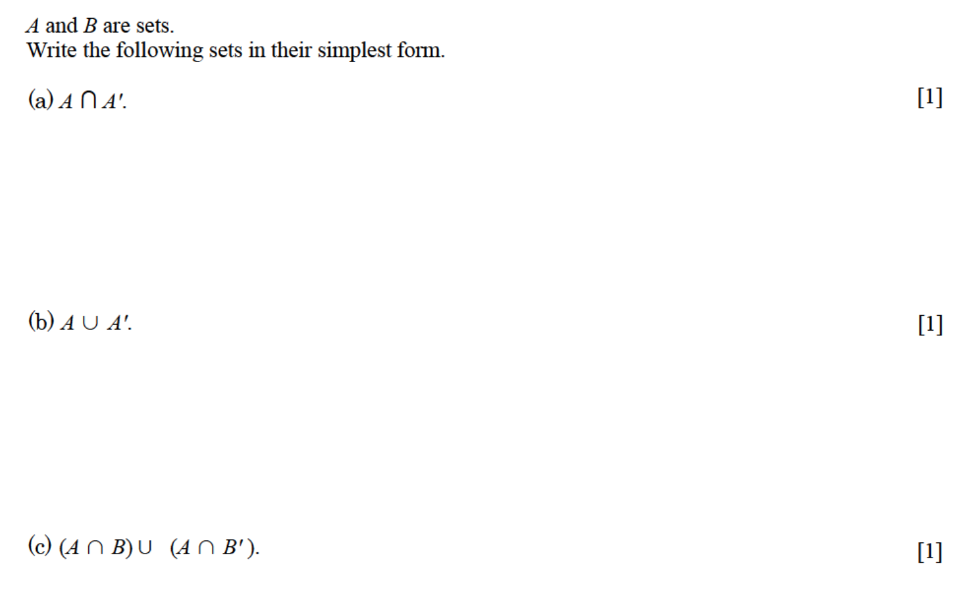

Slide 16
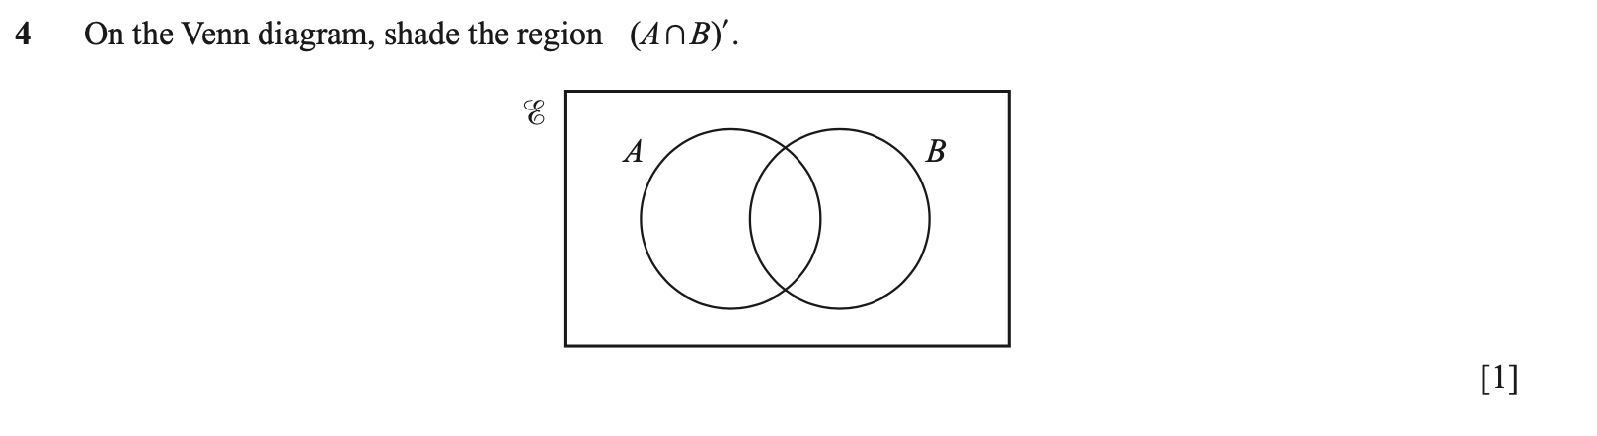

Slide 17
