Slide 1
Transformations for GCSE Maths
Translation
Rotation
Reflection
Invariant points
Enlargement
(Higher only)

Slide 2
Translation
Translations are usually given in vector form:
means 3 units to the right
and 1 unit down.
So what does mean?
What is the vector translating A to B?
What about B to A?
+3
A
+4
-4
A to B:
B to A:
-3
B
After translation, a shape will be
the same shape and size
the same way round (orientation)
in a different position
Back to main menu
Next

Slide 3
Translation
Start by taking one corner of the shape to be translated.
Draw in the translation vector and mark the position of the corresponding corner on the translated shape.
Repeat with the other corners until you are able to complete the shape.
New location
of top corner
C’
3 up
2 right
Start here
C
Now translate shape C
with vector
Try the question before you click to continue!
Back to main menu
Next

Slide 4
Translation
y
P’
New location
of bottom corner
Now try a couple more!
6
P
Translate shape P
with vector
2 up
4
-4 right
= 4 left
Start here
+3
2
Q
Try it before you click to continue!
-5
Now translate shape Q
with vector
x
-6
-4
-2
0
2
4
6
-2
Q’
Try it before you click to continue!
-4
Can you see how the coordinates of the vertices (corners) change?
Look at the coordinates of one vertex at a time.
-6
What vector would translate each shape back to its original position?
Back to main menu
On to Reflection

Slide 5
Reflection
When a shape is reflected, the reflection takes place in a “line of reflection” or “mirror line”.
To draw the reflection, first draw the mirror line.
Now draw a perpendicular line from one corner of the original shape to the mirror line, and extend it for the same distance on the other side (as on diagram above).
Repeat with the other corners until you can draw the whole shape.
Back to main menu
Next

Slide 6
Reflection
y
Now try reflecting shape S in the line y=0.
6
Have a go before you click to continue!
4
S
Where is the line y=0? Hint: the points (0,0), (1,0), (2,0) etc. are all on it…
5
4
2
3
x
-6
-4
-2
0
2
4
6
…yes, it’s the x-axis!
5
3
4
-2
Now draw in your perpendicular lines…
-4
S’
Finally, draw in your transformed shape…
-6
Back to main menu
Next

Slide 7
Reflection
y
Now reflect shape T in the line x=2…
3
3
6
5
5
Try it before clicking to continue!
T
3.5
T’
4
4
4
4
2
2
… and then reflect shape T in the line y=x
3.5
2
x
-6
-4
-2
0
2
4
4
6
Try it before clicking to continue!
-2
T’’
-4
-6
Back to main menu
On to Rotation

Slide 8
Rotation
You need to be able to rotate a shape about a given point
  clockwise or anticlockwise
  through 90, 180 or 270 degrees (quarter-, half- or ¾-turn)
A piece of tracing paper can make this easier!
  Mark the centre of rotation and draw a straight line connecting it to one corner on the shape
  Put tracing paper over both the shape AND the centre of rotation
  Trace the shape and line onto the paper,
  You can add a vertical (or horizontal) arrow from the centre of rotation, to make your angle of rotation easier to see
  Put your pencil point on the centre of rotation and turn the paper through the appropriate angle
  Draw the transformed shape in its new position
Let’s give it a try…
Back to main menu
Next

Slide 9
Rotation
Rotate shape A clockwise through 90° about the origin.
y
First, mark your centre of rotation at (0,0) and join it to the shape.
6
A
Place the tracing paper over the shape and the CoR, and trace. Also draw an arrow pointing straight up from the CoR.
4
2
With your pencil point on the CoR, rotate the tracing paper clockwise through 90°, then transfer the shape to its new position on the grid.
x
-6
-4
-2
0
2
4
6
-2
A’’
Now try rotating the same shape anticlockwise through 180° about the origin.
A’
-4
-6
Try it, then click to see the answer.
Back to main menu
Next

Slide 10
Rotation
Now rotate shape D anticlockwise through 90° about the point (2,-1).
y
Try it before clicking to continue!
6
D
Can you think of another way to describe this transformation?
Click again for the answer…
4
2
Rotation clockwise through 270° about the point (2, -1)
x
-6
-4
-2
0
2
4
6
What transformation would return the shape to its original position?
-2
D’
-4
Rotation clockwise through 90° (or anticlockwise through 270°) about the point (2, -1)
-6
Back to main menu
Next

Slide 11
Rotation
Sometimes the centre of rotation can be inside the shape.
Try rotating shape F clockwise through 90° about the point (-1,2).
y
6
F
4
Have a go before clicking to see the answer!
2
F’
x
-6
-4
-2
0
2
4
6
-2
-4
-6
Back to main menu
On to Enlargement

Slide 12
Enlargement
You need to be able to enlarge a shape about a given point (the centre of enlargement) with a given scale factor
If the scale factor is more than 1, the shape will get bigger
  e.g. a scale factor of 3 will result in a shape with sides 3 times as long (and 9 times the area!)
If the scale factor is less than 1, the shape will get smaller – but it’s still called an enlargement!
  e.g. a scale factor of ½ will result in a shape with sides only half as long (and ¼ of the area!)
For Higher you also have to be able to deal with negative scale factors – we’ll deal with these later on.
Back to main menu
Next

Slide 13
Enlargement
(scale factor >1)
y
Enlarge shape P about the origin with scale factor 2.
P’
6
First, mark the centre of enlargement.
2→ and 8↑
Now draw a line from the CoE to one vertex (corner) on the shape.
4
P
1→ and 4↑
Multiply the length of line by the S.F. and extend it to find the position of the corresponding vertex on the enlarged shape.
2
New
vertex
x
-6
-4
-2
0
2
4
6
Original line:
3→ and 1↑
Repeat with the other vertices until you have enough information to draw the new shape.
-2
Extended line:
6→ and 2↑
-4
-6
Back to main menu
Next

Slide 14
Enlargement
(scale factor <1)
y
Now enlarge shape Q about the point
(-4, -5) with scale factor ⅓.
Q
6
Try it before clicking to see the answer!
4
6→ and 12↑
x ⅓ gives
2→ and 4↑
2
x
-6
-4
-2
0
2
4
6
Q’
-2
-4
12→ and 3↑
x ⅓ gives
4→ and 1↑
-6
Back to main menu
Next

Slide 15
Enlargement
y
R’’
Now enlarge shape R about the point
(-2, 1) with scale factor 3.
R’
6
Try it before clicking to continue!
1← and 2↑
x 3 gives
3← and 6↑
One more question…
4
R’’ is also an enlargement of shape R. Can you work out the scale factor and find the centre of enlargement?
R
2
x
-6
-4
-2
0
2
4
6
Compare the side lengths:
Scale factor = new length
old length
3→ and 2↓
x 3 gives
9→ and 6↓
-2
So scale factor = 6/4 = 1.5
-4
Now draw lines through the corresponding vertices of the two shapes, and extend them back until they meet; this point is the CoE.
-6
Centre of enlargement = (-5,-7)
Back to main menu
Next

Slide 16
Enlargement
(negative scale factor)
(Higher only)
y
Enlarge shape S about the point (3, 1) with scale factor -2.
6
First, mark the centre of enlargement.
Now draw a line from the CoE to one vertex (corner) on the shape.
1→
and 4↑
S
4
Multiply the length of line by the S.F. and extend it in the opposite direction to find the position of the corresponding vertex on the enlarged shape.
2
Image line:
6← and 2↓
x
-6
-4
-2
0
2
4
6
New
vertex
Original line:
3→ and 1↑
-2
S’
Repeat with the other vertices until you have enough information to draw the new shape.
2 ← and 8↓
-4
-6
Back to main menu
On to Invariant Points

Slide 17
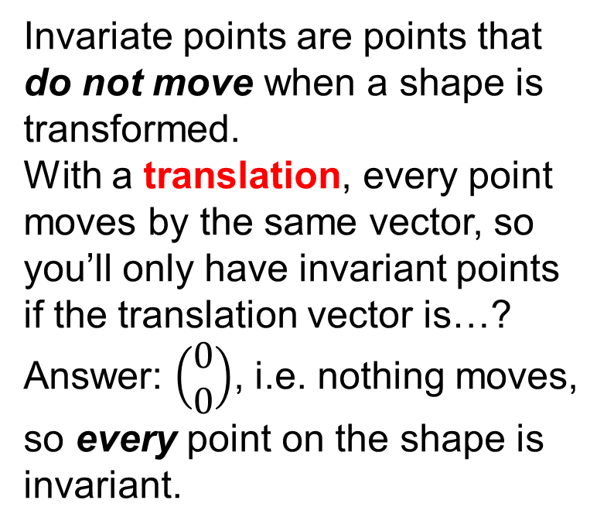
Invariant points
(Higher only)
y
Invariate points are points that do not move when a shape is transformed.
With a translation, every point moves by the same vector, so you’ll only have invariant points if the translation vector is…?
Answer: $\left(\begin{aligned}0 \\ 0\end{aligned}\right)$, i.e. nothing moves, so every point on the shape is invariant.
A’
6
4
A
A’’’
2
A’’
x
-6
-4
-2
0
2
4
6
A’’’’
-2
-4
-6
Back to main menu
Next

Slide 18
Invariant points
(Higher only)
Can you predict where there will be invariant points in the case of a reflection?
For example, try reflecting shape V in the line y = 3.
There is just one invariant point; where is it?
Answer: (2, 3), i.e. the point that lies on the line of reflection.
If one edge of a shape lies along the line of reflection then all points on that edge will be invariant.
For example, let’s reflect shape W in the line y = 3.
The set of invariant points is given by
{-6 ≤ x ≤ -3, y = 3}.
y
6
4
V
W
4
2
W’
2
4
2
V’
x
-6
-4
-2
0
2
4
6
-2
-4
-6
Back to main menu
Next

Slide 19
Invariant points
(Higher only)
With rotations, if the centre of rotation is on the shape then that point will be invariant.
Looking at shape F, the centre of rotation is (-2, 1) so this point remains invariant while all the points around it rotate.
What angle would you have to rotate through to have more than one invariant point? Would the location of the centre of rotation matter?
Answer: Rotation through 360° (or any multiple of it) would result in the shape ending up back where it started, regardless of the centre of rotation,
so all points on the shape would be invariant.
y
6
4
F
2
F’
x
-6
-4
-2
0
2
4
6
-2
-4
-6
Back to main menu
Next

Slide 20
Invariant points
(Higher only)
With enlargements, if the centre of enlargement is on the shape then that point will be invariant.
When shape R is enlarged with scale factor 3 about (-3, 2)…
… the centre of enlargement stays where it is and all the other points move outwards, so the only invariant point is (-3, 2).
This is true regardless of whether the scale factor is greater or less than 1, positive or negative.
What enlargement would give more than one invariant point?
Answer: An enlargement of S.F. 1 about any point (resulting in all points on the shape being invariant).
y
R’
6
4
R
2
x
-6
-4
-2
0
2
4
6
-2
-4
-6
Back to main menu
End

