Slide 1
LAB Ⅱ LECTURE 07
Library
Seoul National University
Graphics & Media Lab
Notes:
저도 조교하면서 실습을 먼저 강의하는 것은 처음. 슬퍼하지 마시고 너무..

Slide 2
Contents
Two Types of Library
Static Library
Dynamic Library
Create Static Library using Visual Studio
Create Dynamic Library using Visual Studio

Slide 3
Library
Package of code reused in many programs
2 pieces of C++ library
Header file
Declaration of function
Precompiled binary
Implementation of function precompiled into machine language
Why precompiled?
Libraries rarely change
Need not be recompiled often
Prevent people from accessing or changing the source code

Slide 4
Two Types of Library
By linking time
Static linking library
Dynamic linking library
Source
Program
Assembly
Code
Preprocessor
Compiler
Assembler
Dynamic
-linking
Object
Program
Static
-linking
Loader
Executables
Linker

Slide 5
Two Types of Library
By linking time
Static linking library
Dynamic linking library
*.exe
*.exe
Program Code
Program Code
Program Data
Program Data
Library Code
Library Code
Static Library
Dynamic Library

Slide 6
Static Linking Library
The code segments will be copy to each executables
On Windows platform, *.lib
On Linux, *.a
Pros:
Easy to use
No dependency problem after compilation
Cons:
The executable size will be larger
Require re-linking when library changed

Slide 7
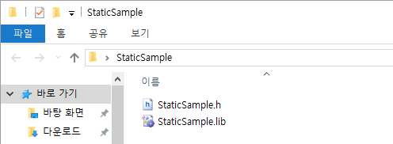
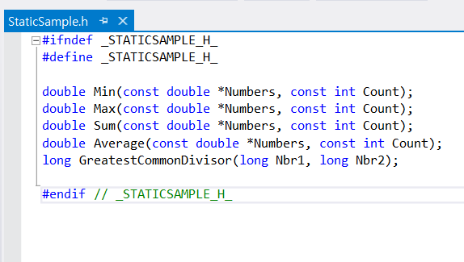
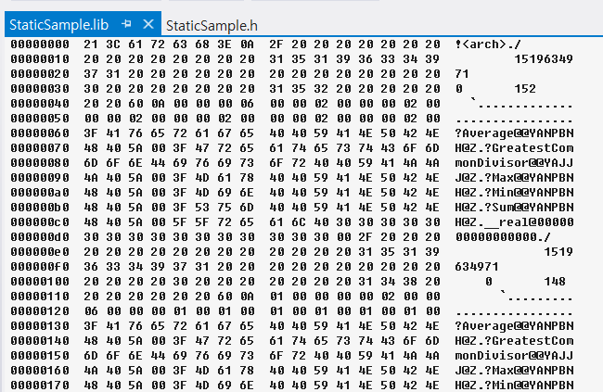
Use Static Linking Library
Open “StaticSample” folder

Slide 8
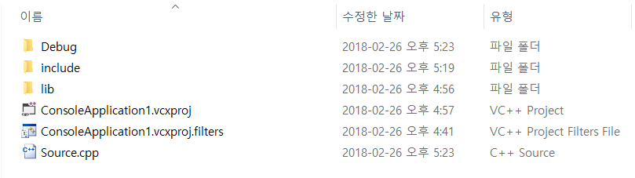
Use Static Linking Library
Create include and lib folder on your project folder (with .cpp file)

Slide 9
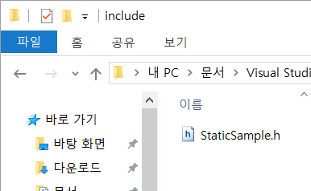
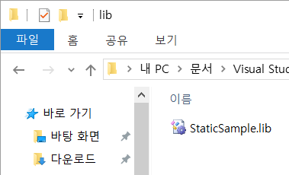
Use Static Linking Library
Copy header file(*.h) to include folder
Copy library file(*.lib) to lib folder

Slide 10
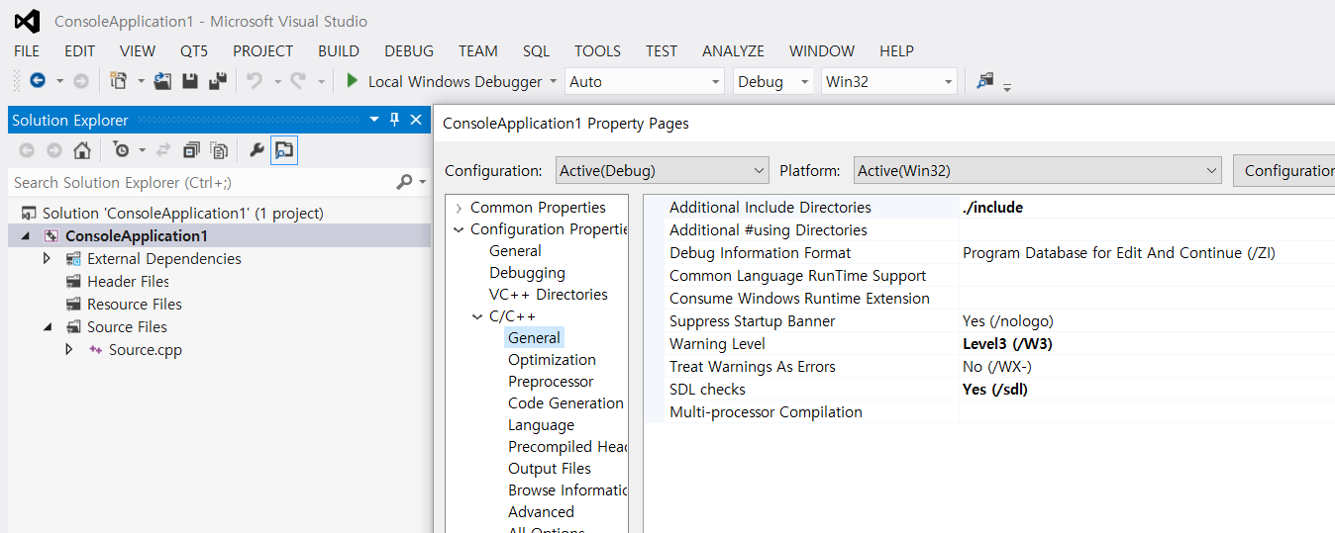
Use Static Linking Library
Add “./include” at the additional include directories section in property page.
Type “./include”
Open property pages

Slide 11
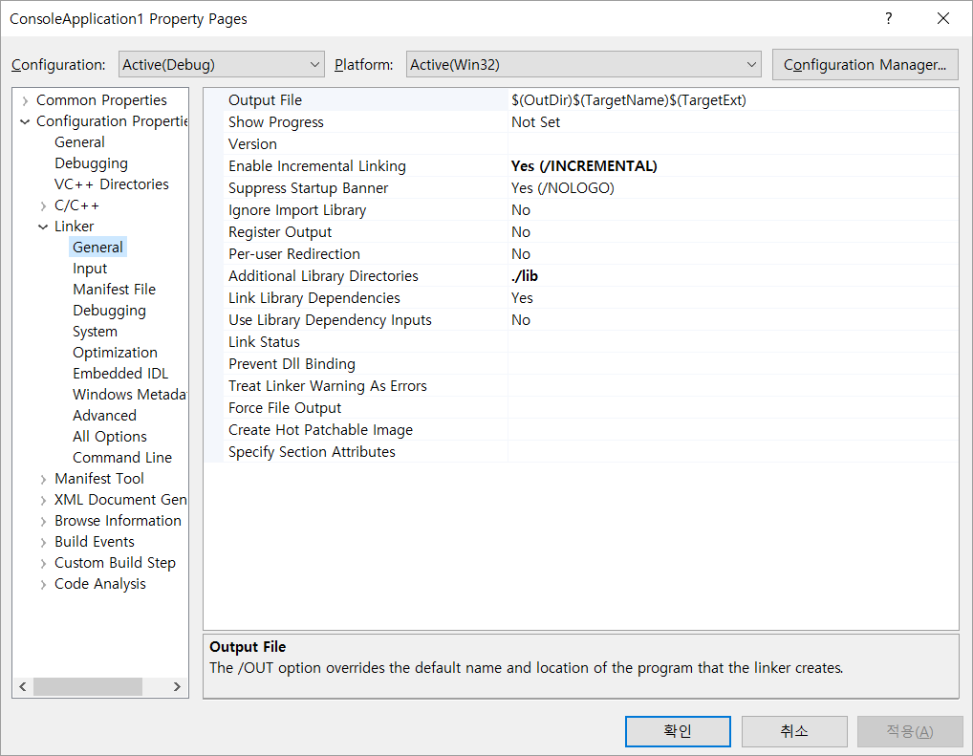
Use Static Linking Library
Add “./lib” at the additional library directories section in property page.
Type “./lib”

Slide 12
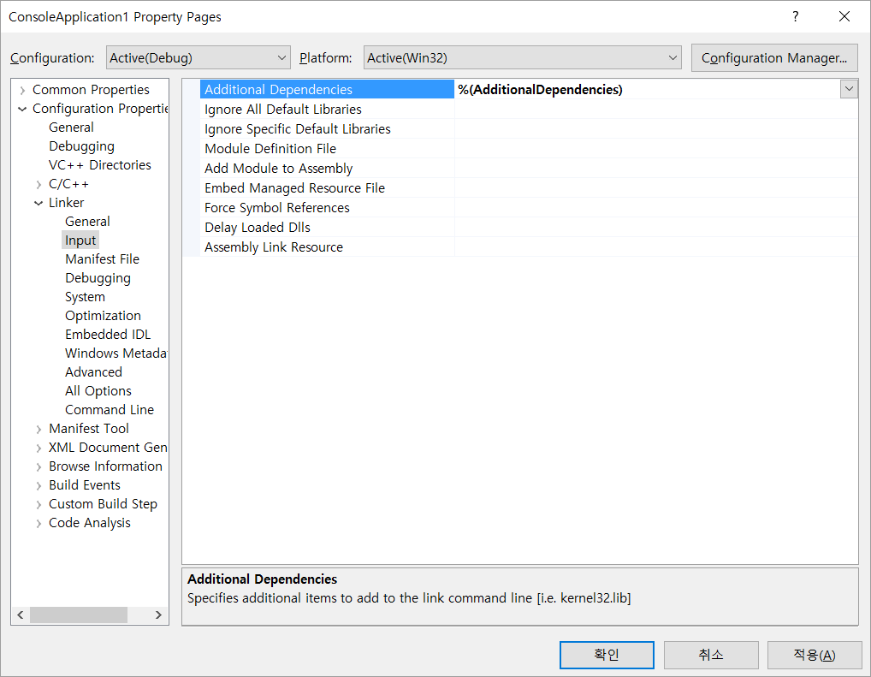
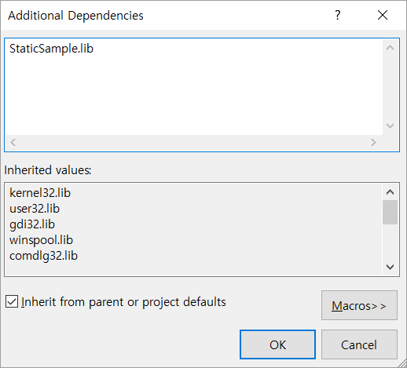
Use Static Linking Library
Add library file name at additional dependencies in property page.
Type “StaticSample.lib”

Slide 13
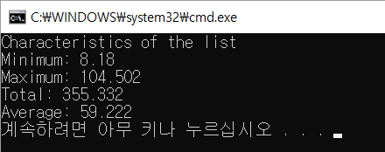
Use Static Linking Library
Include header file in your program
#include <iostream>
#include "StaticSample.h“
using namespace std;
int main()
{
double Numbers[] = { 12.55, 94.68, 8.18, 60.37, 104.502, 75.05 };
int Count = sizeof(Numbers) / sizeof(double);
double Total = Sum(Numbers, Count);
double Avg = Average(Numbers, Count);
double Low = Min(Numbers, Count);
double High = Max(Numbers, Count);
cout << "Characteristics of the list";
cout << "\nMinimum: " << Low;
cout << "\nMaximum: " << High;
cout << "\nTotal: " << Total;
cout << "\nAverage: " << Avg << endl;
return 0;
}

Slide 14
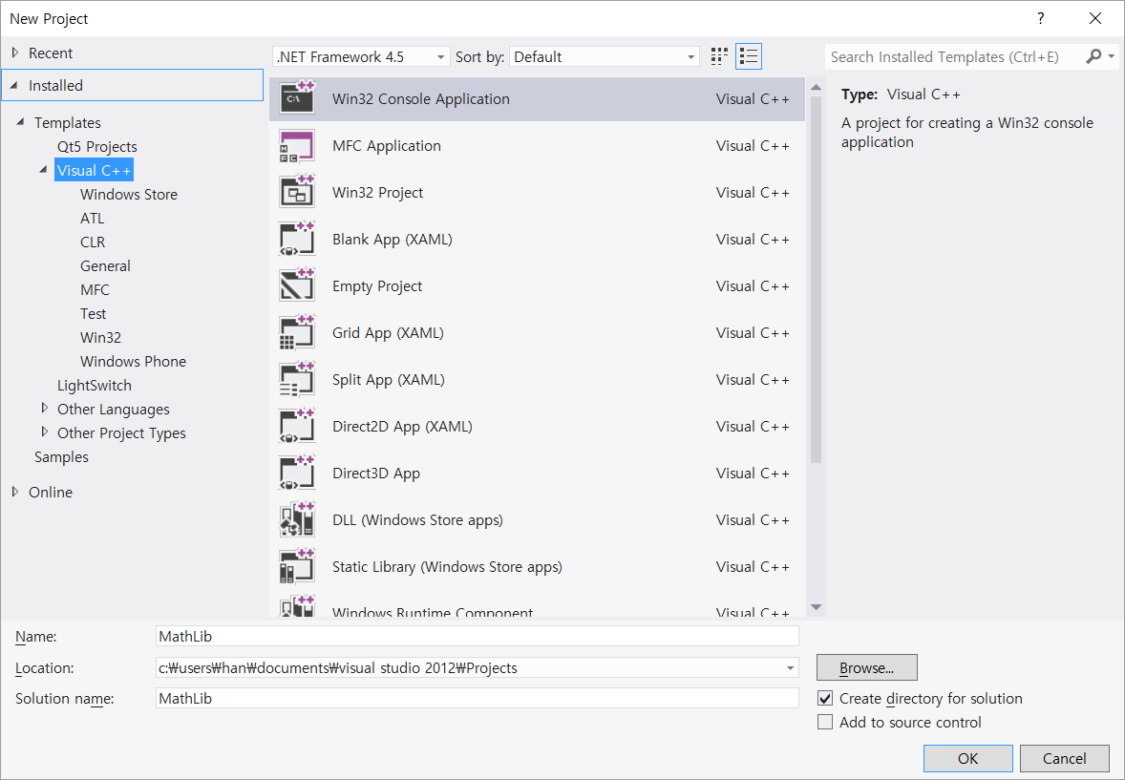
Create Static Library
Create New Project
Project Name: MathLib

Slide 15
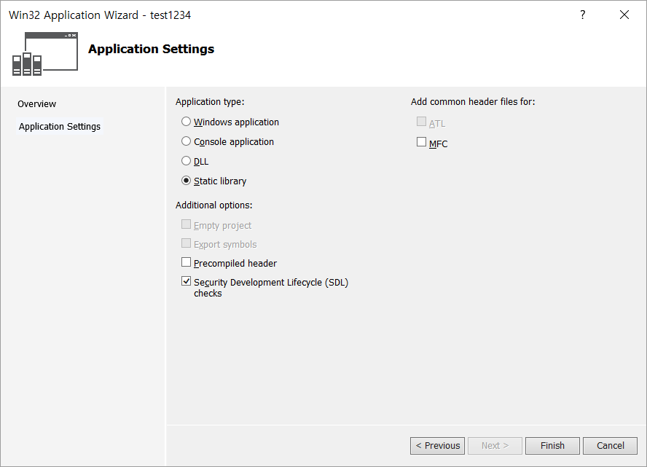
Create Static Library
On Application Settings page, under Application type, select Static library
Uncheck Precompiled header under Additional options

Slide 16
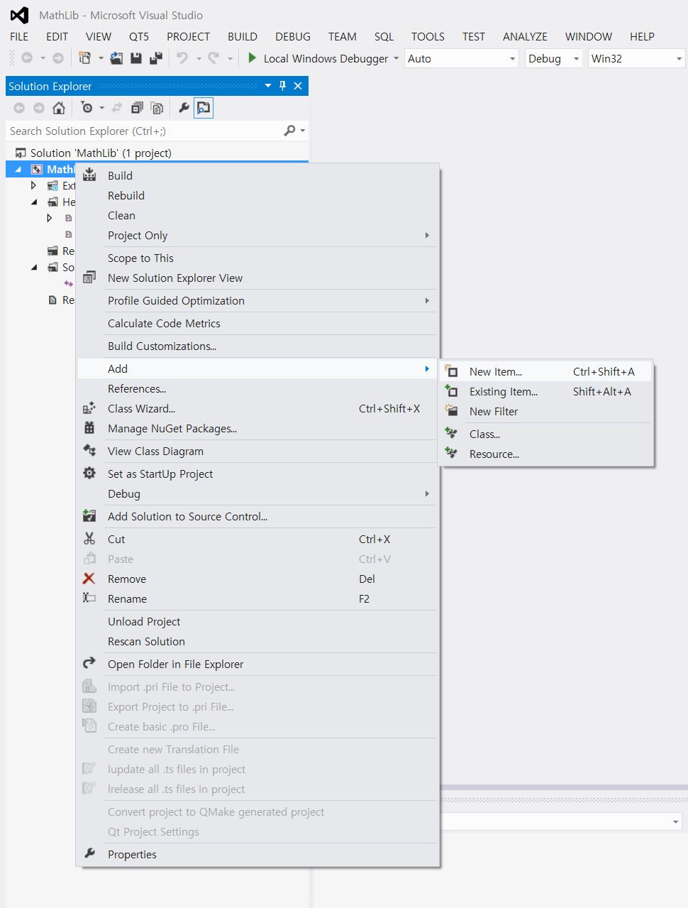
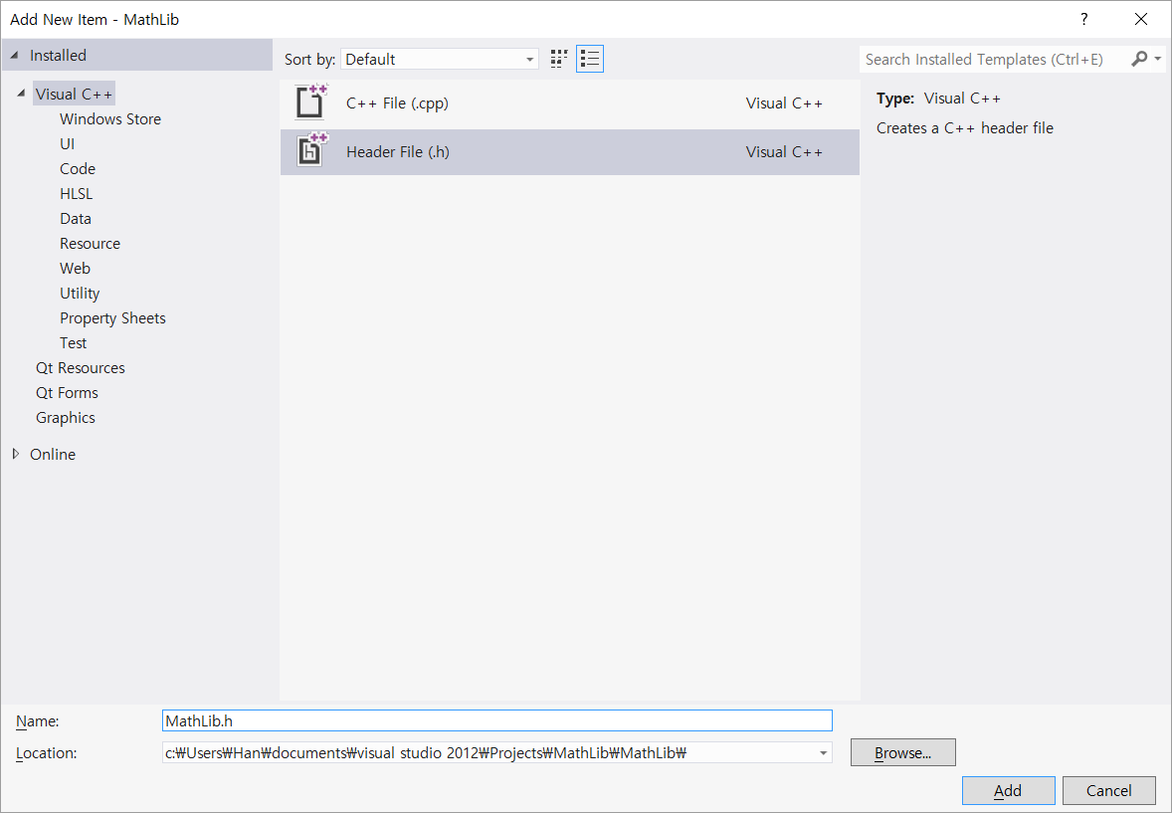
Create Static Library
Create a header file for a new class
Create MathLib.h

Slide 17
Create Static Library
class MyMathFuncs{
public:
// Returns a + b
static double Add(double a, double b);
// Returns a - b
static double Subtract(double a, double b);
// Returns a * b
static double Multiply(double a, double b);
// Returns a / b
static double Divide(double a, double b);
};
MathLib.h

Slide 18
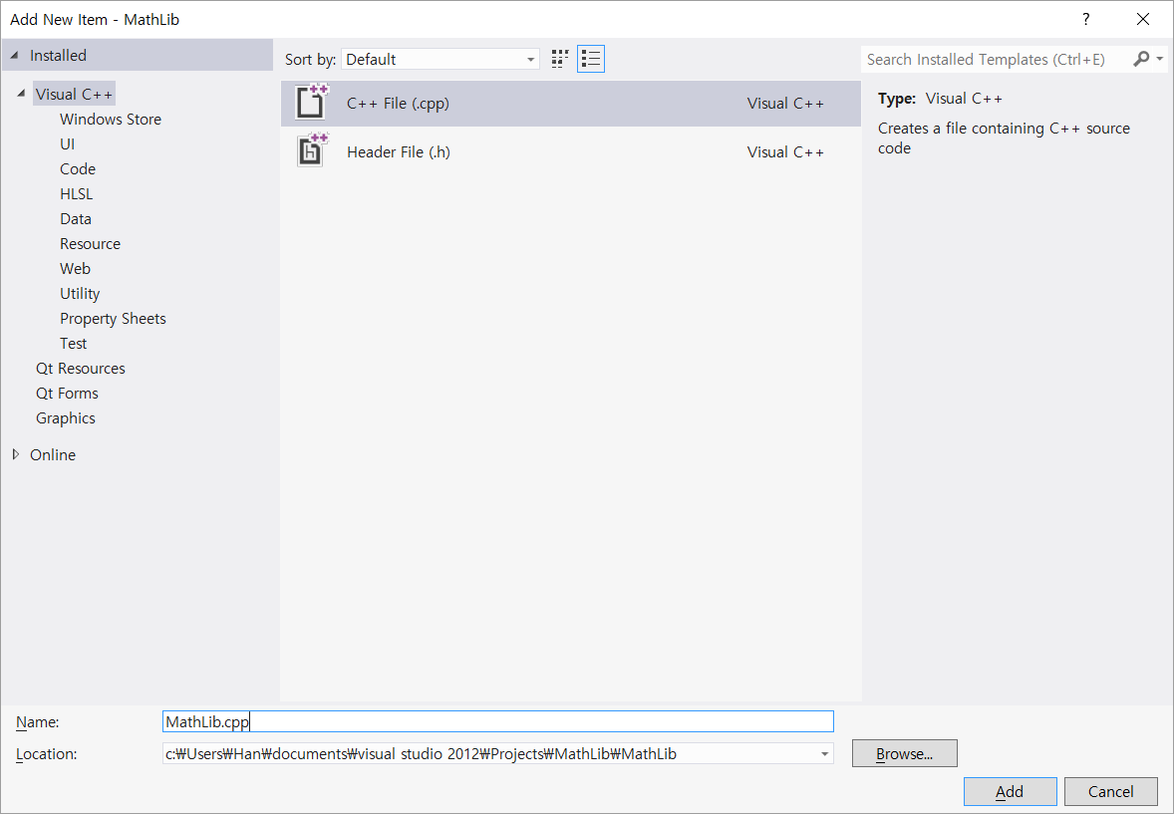
Create Static Library
Create a source file for the new class
Create MathLib.cpp

Slide 19
Create Static Library
#include "MathLib.h"
using namespace std;
double MyMathFuncs::Add(double a, double b){
return a + b;
}
double MyMathFuncs::Subtract(double a, double b){
return a + b;
}
double MyMathFuncs::Multiply(double a, double b){
return a * b;
}
double MyMathFuncs::Divide(double a, double b){
return a / b;
}

Slide 20
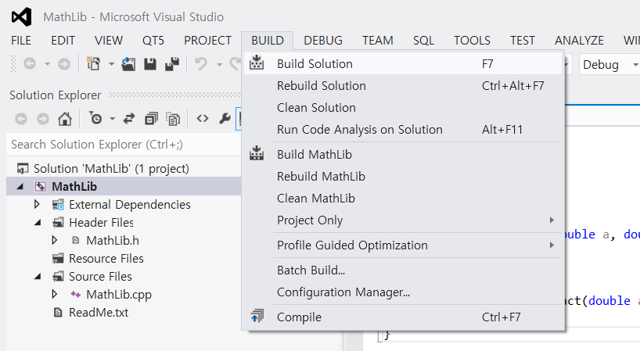
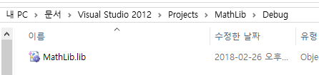
Create Static Library
Compile the static library by selecting Build, Build Solution
In debug folder, library file is created

Slide 21


Practice
Use your own static library
#include <iostream>
#include "MathLib.h"
using namespace std;
int main()
{
double a = 7.4;
int b = 99;
cout << "a + b = " <<
MyMathFuncs::Add(a, b) << endl;
cout << "a - b = " <<
MyMathFuncs::Subtract(a, b) << endl;
cout << "a * b = " <<
MyMathFuncs::Multiply(a, b) << endl;
cout << "a / b = " <<
MyMathFuncs::Divide(a, b) << endl;
return 0;
}
Desired result

Slide 22
Dynamic Linking Library
Loaded into program at run time
Not become part of executable, remain as separate unit
On Windows platform, *.dll
On Linux, *.so
Pros:
Flexibility
Possible support for plugins
Cons:
Slow application at start time
Dependent on the libraries when execution

Slide 23
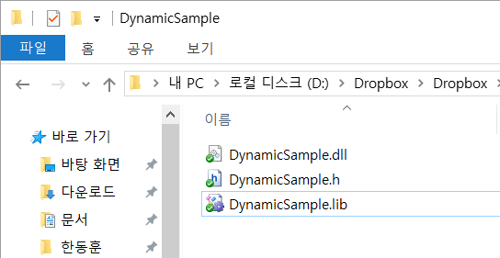
Use Dynamic Linking Library
Open “DynamicSample” folder

Slide 24

Use Dynamic Linking Library
Copy header file(*.h) to include folder

Slide 25
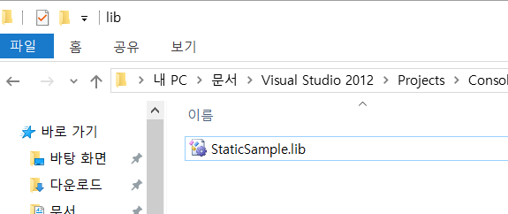
Use Dynamic Linking Library
Copy lib file(*.lib) to lib folder

Slide 26
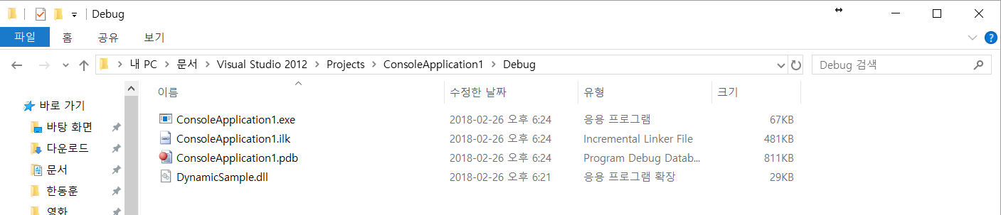
Use Dynamic Linking Library
Copy dll file to exe folder

Slide 27
Use Dynamic Linking Library
Include header file in your program
#include <iostream>
#include "DynamicSample.h"
using namespace std;
int main()
{
double Numbers[] = { 12.55, 94.68, 8.18, 60.37, 104.502, 75.05 };
int Count = sizeof(Numbers) / sizeof(double);
double Total = Sum(Numbers, Count);
double Avg = Average(Numbers, Count);
double Low = Min(Numbers, Count);
double High = Max(Numbers, Count);
cout << "Characteristics of the list";
cout << "\nMinimum: " << Low;
cout << "\nMaximum: " << High;
cout << "\nTotal: " << Total;
cout << "\nAverage: " << Avg << endl;
return 0;
}

Slide 28
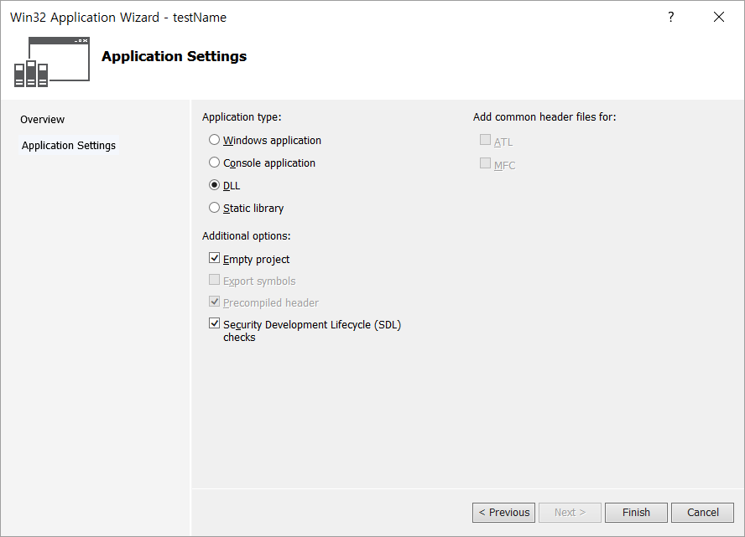
Create Dynamic Library
Create New project
Project name: DynamicLib
Application type: DLL

Slide 29
Create Dynamic Library
Create a header file for a new class
Create DynamicLib.h
#pragma once
__declspec(dllimport) double Add(double a, double b);
__declspec(dllimport) double Multiply(double a, double b);
__declspec(dllimport) double AddMultiply(double a, double b);

Slide 30
Create Dynamic Library
Create a source file for the new class
Create DynamicLib.cpp
#include "DynamicLib.h"
double Add(double a, double b){
return a + b;
}
double Multiply(double a, double b){
return a * b;
}
double AddMultiply(double a, double b){
return a + (a * b);
}

Slide 31
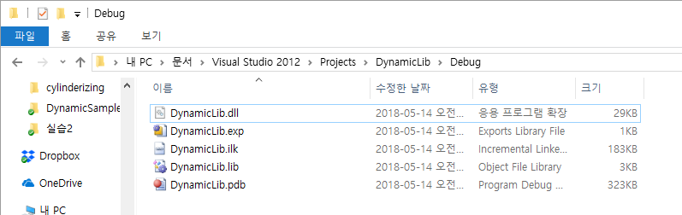
Create Dynamic Library
Compile the dynamic library by selecting Build, Build Solution
In debug folder, library file is created

Slide 32

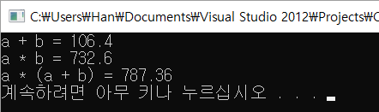
Practice
Use your own dynamic library
#include <iostream>
#include "DynamicLib.h"
using namespace std;
int main()
{
double a = 7.4;
int b = 99;
cout << "a + b = " <<
Add(a, b) << endl;
cout << "a * b = " <<
Multiply(a, b) << endl;
cout << "a * (a + b) = " <<
AddMultiply(a, b) << endl;
system("PAUSE");
return 0;
}
Desired result

