Slide 1
LAB Ⅱ Project 1
Infix Calculator
Seoul National University
Graphics & Media Lab
Notes:
저도 조교하면서 실습을 먼저 강의하는 것은 처음. 슬퍼하지 마시고 너무..

Slide 2
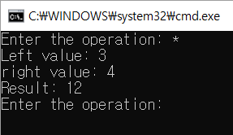

Calculator
Basic calculator
Enter operator
Enter operands
Infix calculator
Enter equation

Slide 3
Project 1
Implement infix-to-postfix convertor
Operator: +,-,*, / and ^ (only binary operator)
Parentheses
Implement a program to evaluate postfix expression
Due date
2018.05.04 23:59:59
Upload at ETL
Material (only source code)
Main.cpp

Slide 4
Today’s Mission
Implement postfix expression evaluation program
Assume
Postfix expression is given
https://www.mathblog.dk/tools/infix-postfix-converter/
Input postfix expression from input file
Given
Parsing postfix expression
vector<string>
Given

Slide 5
Infix Expressions
Example: 1 + 2 * ( 3 + 4 )
Operands appear both before and after operators
When there are multiple operators, precedence and associativity determine how operators are processed.
Precedence: tells which of two operators should be processed first.
Associativity: tells which of two operators should be processed first when both operators have same precedence.
Exponentiation: Right to Left
Multiplication/Division: Left to Right
Addition/Subtraction: Left to Right
Parentheses override precedence and associativity.
Easy for human, but difficult for a computer, e.g. 1 + 2 * (...)

Slide 6
Postfix Expression
A postfix expression is a series of operators and operands. The operands are always known when an operator is about to be processed. A postfix expression requires no knowledge of precedence or associativity.
Example of a postfix expression of 1+2*3
1 2 3 * +

Slide 7
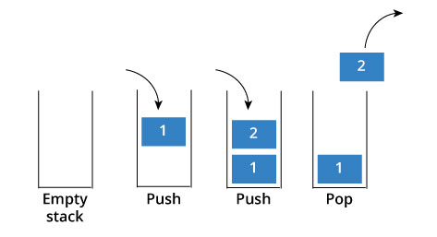
Stack
A stack is a data structure that stores data in such a way that the last piece of data stored, is the first one retrieved
also called last-in, first-out (LIFO)
Only access to the stack is the top element
Operation
Push
Place a new item at the top of the stack
Pop
Remove the next item from the top of the stack

Slide 8
Stack in C++ Standard Template Library
Function
empty() | Returns whether the stack is empty
size() | Returns the size of the stack
top() | Returns a reference to the top most element of the stack
push(g) | Adds the element ‘g’ at the top of the stack
pop() | Deletes the top most element of the stack

Slide 9

Stack Practice
#include <iostream>
#include <stack>
using namespace std;
void showstack(stack <int> gq)
{
stack <int> g = gq;
while (!g.empty())
{
cout << '\t' << g.top();
g.pop();
}
cout << '\n';
}
int main ()
{
stack <int> gquiz;
gquiz.push(10);
gquiz.push(30);
gquiz.push(20);
gquiz.push(5);
gquiz.push(1);
cout << "The stack gquiz is : ";
showstack(gquiz);
cout << "\ngquiz.size() : " << gquiz.size();
cout << "\ngquiz.top() : " << gquiz.top();
cout << "\ngquiz.pop() : ";
gquiz.pop();
showstack(gquiz);
return 0;
}

Slide 10
Algorithm for Evaluating Postfix Exps.
When an operand is seen, it is pushed onto a stack.
When an operator is seen, the operands are popped, the operators is evaluated, and the result is pushed onto the stack.
For binary operators, first popped item is second operand (matters for subtraction).
At the end of expression, stack should have one item, which is the answer.
1 2 3 * +
3
2
2
6
1
1
1
1
7
Push 1
Push 2
Push 3
Pop 3
Pop 6
Pop 2
Pop 1
Push 6
Push 7

Slide 11
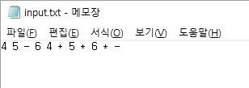
Input/Output
Text file input
Postfix expression is given
https://www.mathblog.dk/tools/infix-postfix-converter/
Operators and operands are separated by space (“ “)
Read a line by string and parsing the expression
Operator and operands will be saved in vector<vector<string>> postfixs
Evaluate postfix expression
Using stack STL
Output
Print on screen using console program

Slide 12

Parsing the expression
Operators and operands are separated by space (“ “)
Using range-based for loop from begin to end of string
When meet space(‘ ‘), save at vector<vector<string>>
string
Vector<string>
4
5
-
6
4
+
5
*
6
*
-
Vector<vector<string>>
Vector<string>
1.5
20
*

Slide 13
Evaluate postfix expression
Read operator or operand
Is it number or operator?
Using isdigit(string) function
If it is number
Save at stack
If it is operator
Pop two number in stack
Calculate the operation using two number and operator

