Slide 1
LAB Ⅱ LECTURE 01
Compiler
Seoul National University
Graphics & Media Lab
Donghoon Han

Slide 2
Introduction
TA
Han Donghoon
dhhan@graphics.snu.ac.kr
133-210
Jang Inseo

Slide 3
Introduction
Lab 02
Advanced course
Other feature of C++ not covered in class
Helpful knowledge about programming
Java

Slide 4
Introduction
실습 주차 | 실습 내용 (안)
1주차 | Compiler
2주차 | C++ 디버깅 : Visual Studio에서의 코드 디버깅
3~4주차 | Git으로 배우는 Version Control System 이용 개발
5주차 | OOP 기본개념
6주차 | C++ 심화 I : 최신 C++ 표준 (C++15 등) 주요 변경사항 및 추가기능
7주차 | C++ 심화 II : 최신 STL
8주차 | C++ 심화 III : library 빌드 및 링크, 고급 파일 입출력
9주차 (프로젝트 I) | C++ 콘솔 응용 프로그램 프로젝트 : 프로젝트를 통한 1~6주차 강의 내용 응용 및 점검
10주차 | Java 기초 교육 I : Eclipse 개발환경 설정
11~12주차 | Java 기초 교육 II : C++ 예제 Java로 재구현 및 기본 교육
13~15주차 (프로젝트 II) | OpenGL 기반 2D Graphics 프로그래밍 실습 및 프로젝트 구현 (프로젝트는 다양화 할 수 있음)

Slide 5
Introduction
Mission in each class
Confirm from TAs when you are finished
Attendance will be checked when confirm your mission complete
Any problem with your programming, freely raise your hand

Slide 6
Essential Tool
Computer
Ok
Compiler toolchain
Compile source code
Build program to run
Visual Studio
https://www.visualstudio.com/
gcc
https://gcc.gnu.org/

Slide 7
Today’s Contents
Compiler
Console program

Slide 8
What is Compiler?
Computers understand only one language and that language consists of sets of instructions made of ones and zeros.
Machine language
Single instruction of machine language
Total instruction of program
00000
10011110
00000
10011110
00001
01010110
00010
11011101
00011
10100010

Slide 9
What is Compiler?
Programming with machine language
Tedious
Easy to make an error
Hard to understand code
To make programming easier
High level language
00000
10011110
00001
01010110
00010
11011101
00011
10100010
int a,b,sum;
cin >> a;
cin >> b;
sum = a+b;
cout << sum << endl;

Slide 10
What is Compiler?
Need to translate high level language to machine language
Compiler
int a,b,sum;
cin >> a;
cin >> b;
sum = a+b;
cout << sum << endl;
00000
10011110
00001
01010110
00010
11011101
00011
10100010

Slide 11
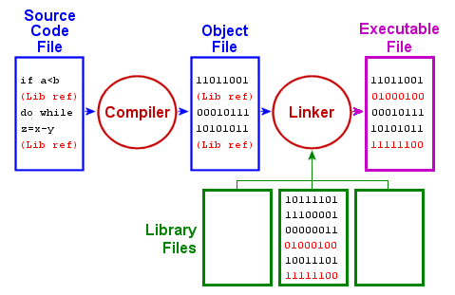
Compile Flowchart

Slide 12
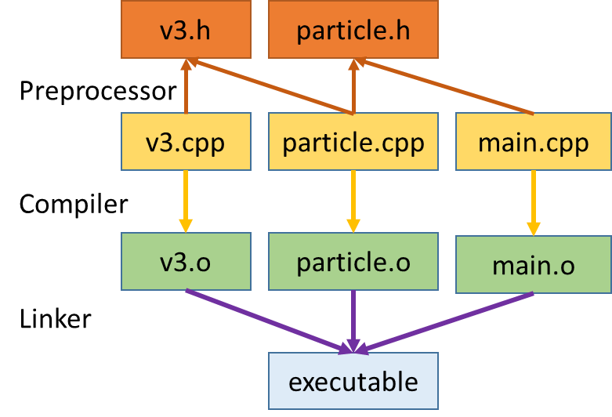
Compiler
Compiler and Linker

Slide 13
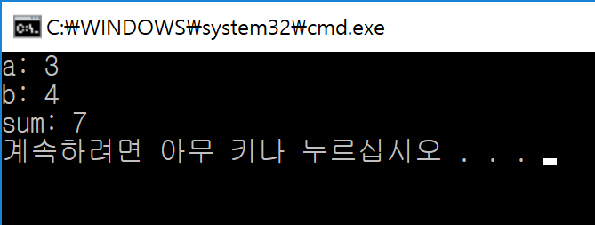
Console Program
programs that use text to communicate with the user and the environment, such as printing text to the screen or reading input from a keyboard

Slide 14
Console Program
Easy to interact with user
Predictable behavior that is identical across all platforms
Simple to implement
Very useful to learn the basics of a programming language

