Slide 1

Social Media Growth Analysis: Sustainable vs Bubble
Data Analyst Project | Comparative Study
echo team
Gheid Abdulkarim Abomaghara — analysis, metrics, problem solving
Rasha Abdulhameed Naji — data collection, cleaning
Elaf Hamed Alhajj — presentation, visualization
Notes:
• This deck compares TikTok and Threads growth
• We focus on real vs hype growth
• You will see simple, clear takeaways

Slide 2
Agenda
Executive Summary
Data Preparation
Dataset & Columns
Problem Statement
Threads Analysis
TikTok Analysis
Comparison
Bubble Warning System
Conclusion & Next Steps
Notes:
• Here is our story flow today
• We start with data cleaning and quality
• Then findings, comparison, and actions

Slide 3
Executive Summary
Analyzed two years of data to distinguish traction from hype. Sustainable platforms show organic retention. Bubbles rely on paid ads and lack steady usage.
TikTok Growth
Sustainable model. 0.92 engagement correlation. Mostly organic traffic (~85%) with stable retention.
Threads Bubble
Classic bubble driven by paid ads (~60%). High negative churn (-0.7) shows rapid decline.
Key Criterion
Sustainability needs 75–90% organic share and >0.85 engagement correlation.
Notes:
• TikTok shows stable, organic growth
• Threads peaks fast, then drops — a bubble
• Organic share and engagement are key signals

Slide 4
Data Cleaning
Preparation steps ensured reliability and integrity.
Missing Values
Imputed or removed for better accuracy.
Date Standardization
Unified formats for consistent analysis.
Duplicates
Removed from both datasets.
Numeric Normalization
Standardized ranges and units (0–100).
Outliers
Fixed errors like negative churn.
Result
Clean, accurate records ready for analysis.
Notes:
• We fixed missing and duplicate records
• We corrected impossible values like negative churn
• Clean data makes results trustworthy

Slide 5
Data Quality
Validity: logical values; scores 0–100; churn 0–1
Accuracy: corrected errors (e.g., negative churn)
Completeness: all key fields filled
Consistency: standardized dates and formats
Uniformity: aligned structure across platforms
Notes:
• Values are valid and realistic
• Dates and numbers use one format
• Datasets are complete and consistent

Slide 6
Dataset & Columns
Platforms: Threads & TikTok (Sustainable vs Bubble)
Columns: Date, DAU, Session Duration, Churn, Organic %
Factors: Twitter Volatility / Algorithm Score
Notes:
• Two platforms: Threads and TikTok
• Key fields: DAU, session time, churn, organic
• External scores guide context

Slide 7
Problem Statement
User counts mislead without engagement data
Need data to separate real growth from hype
Approach: Use correlations and organic share
Notes:
• Big user counts can hide weak engagement
• We need numbers to spot hype vs real growth
• Our method checks correlation and organic share

Slide 8
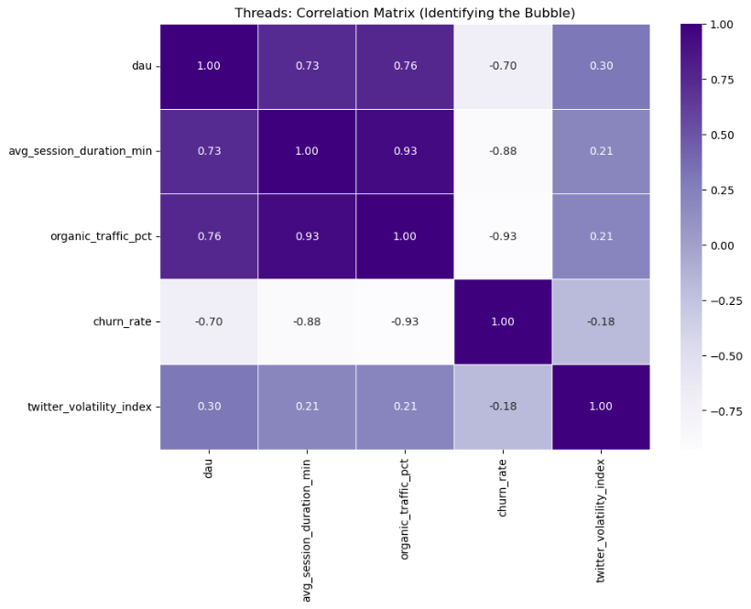
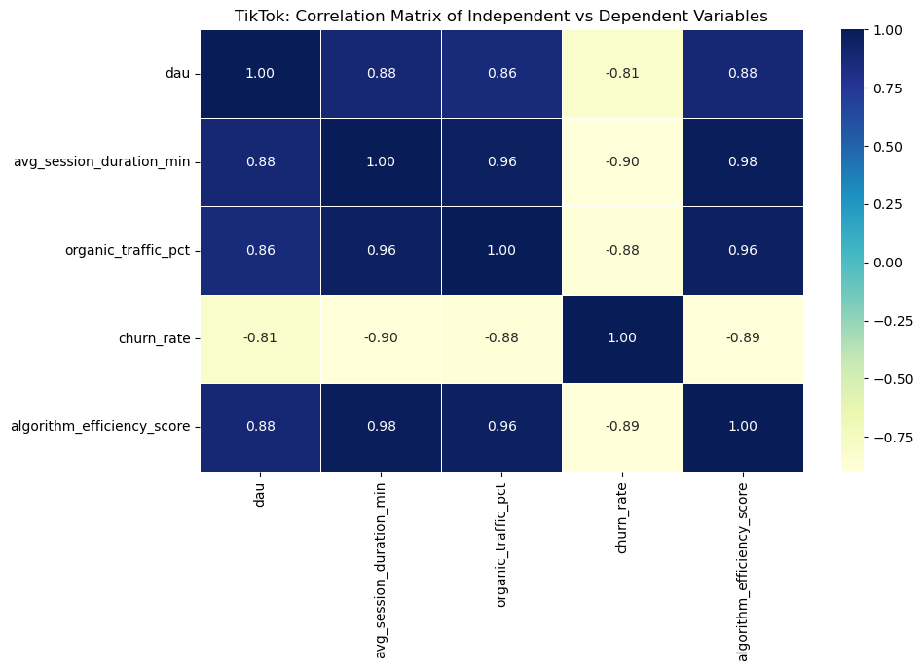
Heatmaps: Threads vs TikTok
Threads
TikTok
Threads: correlations show bubble risks (churn link is strong)
TikTok: correlations show healthy engagement and tech impact
Read both to compare patterns quickly
Notes:
Here we dive deeper into the heatmaps. On the left, Threads shows strong negative correlations with churn, indicating instability. On the right, TikTok displays strong positive correlations with engagement and tech factors, confirming a sustainable model.

Slide 9
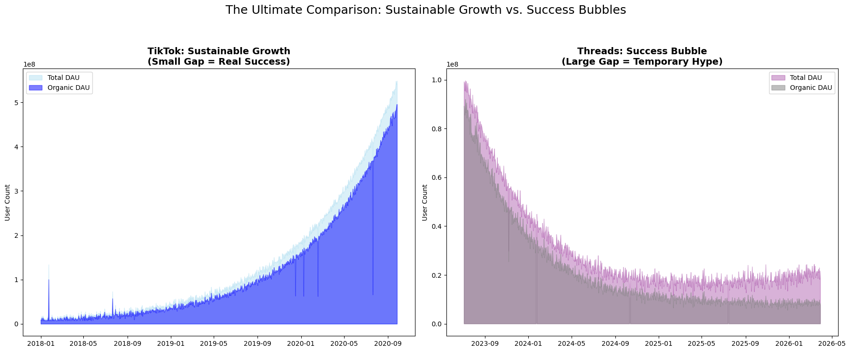
Area Chart Analysis
Area: compare TikTok vs Threads growth side by side
Read the gap: small (TikTok) vs large (Threads)
Takeaway: trends are clear without extra visuals
Notes:
Here we visualize the comparison between TikTok and Threads growth using the area chart. We can clearly see the gap between the two platforms, with trends visible side-by-side without needing extra visuals.

Slide 10
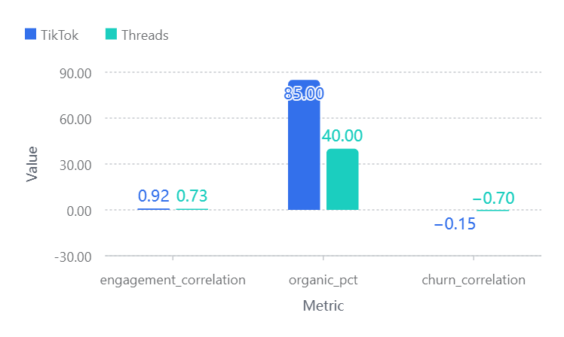
Dashboard KPIs
Organic Dominance
TikTok: 85% organic. Threads: 40% (marketing-heavy).
Engagement Lead
Correlation (0.92) proves habit formation.
Retention Health
TikTok churn is stable as it scales.
Notes:
• Compare engagement, organic %, and churn links
• TikTok scores show stability
• Threads scores show risk

Slide 11
Threads: EDA Key Findings
DAU vs Session: 0.73 (Strong). Activity spikes, then fades.
DAU vs Organic: 0.76 (Strong). Gap widens over time.
DAU vs Churn: -0.70 (Strong Negative). 'Leaky bucket' decline.
DAU vs Twitter Volatility: 0.30 (Weak). Minimal external impact.
Verdict: Classic bubble — spike then decline
Notes:
• 0.73: users active early, not sustained
• -0.70 churn link: users left quickly
• Twitter volatility mattered little

Slide 12
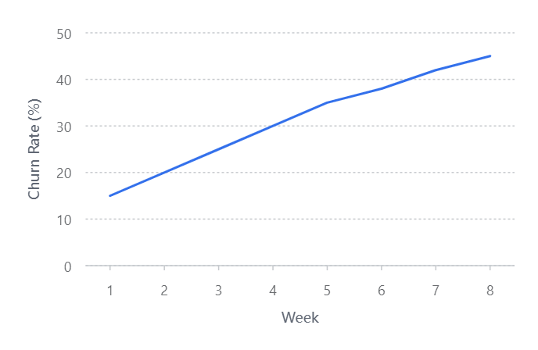
Churn Trend Analysis
The Leaky Bucket
Threads fails to retain users despite aggressive acquisition.
Rapid Erosion
Churn rose from ~15% to ~45% in 8 weeks. A "bubble burst" signal.
Notes:
• Churn rose from 15% to 45% in 8 weeks
• Leaving users drain DAU fast
• Retention beats new acquisition

Slide 13
TikTok: EDA Key Findings
DAU vs Session: 0.92 (Very Strong). Engagement scales with growth.
DAU vs Algorithm: 0.89 (Strong). Tech drives expansion.
DAU vs Organic: 0.85 (Very Strong). Mostly organic (75–90%).
DAU vs Churn: -0.15 (Very Weak). Stable retention.
Verdict: Healthy, sustainable growth
Notes:
• 0.92: engagement rises with user growth
• Tech and algorithm strongly drive sessions
• Organic discovery powers stable growth

Slide 14
Comparison: Sustainable vs Bubble
TikTok: 75–90% organic. Small gap to total DAU. Steady climb.
Threads: Large organic gap. Spike then drop. Unsustained.
Takeaway: Organic share and engagement predict sustainability.
Notes:
• TikTok: small gap between total and organic users
• Threads: large gap; spike then drop
• Watch organic share and engagement together

Slide 15
Sustainable vs Bubble Drivers
Three core mechanisms distinguish healthy growth from hype:
Engagement Sync
Correlation between DAU and session duration. TikTok (0.92) is strong. Threads (0.73) lags.
Organic Gap
Paid ads vs natural virality. Threads has a ~60% gap. TikTok is minimal (<15%).
Churn Effect
Impact of user loss. Threads is a "leaky bucket". TikTok retains users well.
Notes:
• Sustainable: high engagement and organic growth
• Bubble: marketing spike without retention
• Use these signals to judge health

Slide 16
Problem Solution:Bubble Warning System
Signal 1: Organic Gap
Metric: Difference between Total and Organic Growth.
Trigger: Gap >30% for 14+ days.
Signal 2: Growth Sync
Metric: DAU vs Session Duration correlation.
Trigger: Correlation <0.8 for 3+ weeks.
Signal 3: Churn Accel
Metric: WoW Churn Rate Change.
Trigger: Churn increases +5% WoW for 2+ weeks.
Alert Levels
1 Signal = Caution | 2 Signals = Warning | 3 Signals = CRITICAL BUBBLE
Notes:
• Three checks: gap, sync, churn speed
• One alert: caution; two: warning; three: critical
• Act early to avoid bubble collapse

Slide 17
Limitations
Simulated datasets based on industry trends
Focuses on numbers, not regulations
Matches public patterns; needs validation
Notes:
• Data is simulated from known patterns
• We focus on numbers, not regulation
• Validate across more cases

Slide 18
Future Research
Test Warning System on more platforms
Add sentiment analysis from reviews
Build ML for predictive alerts
Test outside social media
Notes:
• Test the model on more platforms
• Add user sentiment and reviews
• Build early-warning ML models

Slide 19
Conclusion & Next Steps
Verdict: TikTok is sustainable. Threads was a hype bubble with weak retention.
Application: Use 3-Signal System to detect bubbles early.
Next Steps: Validate framework, add sentiment, and explore ML.
Notes:
• TikTok fits the healthy growth pattern
• Threads was a hype spike
• Use the dashboard to monitor signals

