Slide 1
E-Collaborative – Sanity Testing Automation [RPA]
Chandrapriya– 4th Dec 2019

Slide 2
Agenda
What is RPA?
01
02
How RPA works?
How to get started with RPA
03
RPA tools
Comparison of RPA tools
Market trend of RPA tools
Applications of RPA
04
Use case Implementation
05
Group IT Testing Dashboard

Slide 3
What is RPA?
The process of automating business operations with the help of robots to reduce human intervention is said to be Robotic Process Automation(RPA).
Robotic are entities which mimic human actions.
A process is a sequence of steps which lead to meaningful activity. For example, the process of making tea or your favorite dish etc.
Automation is any process which is done by a robot without human intervention.
So, when we summarize all these terms together, then mimicking human actions to perform a sequence of steps, leading to a meaningful activity, without any human intervention is also known as Robotic Process Automation.
Group IT Testing Dashboard

Slide 4
How RPA Works?
This question has always popped on whether RPA uses physical robots, or are there actual robots present to automate tasks.
Well, RPA does not replace humans with actual robots. But, there are software's available in the market which let you configure automation workflows to automate your business operations.
According to our experts, the demand for RPA certification training is going to rise by 150% due to the lack of the skill set in the market.

Slide 5
How To Get Started With RPA?
You need to follow the below steps, to get started with RPA:
Step 1: Learn about UI-Path referring to the site :https://academy.uipath.com/learn
Step 2: Choose the process that you wish to automate, and retrospect about the process dependencies. This is a way to make sure that your business doesn’t suffer loss while you are busy automating the task.
Step 3: Gain extensive hands-on experience in RPA Tools, such as UiPath, Blue Prism, and Automation Anywhere.

Slide 6
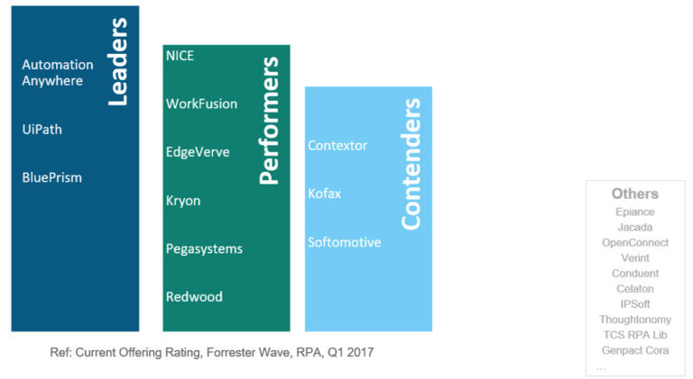
RPA Tools
RPA Tools/Vendors are the software through which you can configure tasks to get automated. In today’s market, there are RPA Vendors such as Blue Prism, Automation Anywhere, UiPath, WorkFusion, Pega Systems and many more. But, the leaders in the market are the trio (UiPath, Blue Prism & Automation Anywhere). Refer to the below Forester Research on RPA, to know the current ranking of various RPA Tools.

Slide 7
Comparison of top Tools
As I mentioned before the leaders in the RPA market are UiPath, Blue Prism, and Automation Anywhere. These tools are the most widely used tools in the industry for various purposes. These tools have their own advantages and drawbacks.
Features | UI- Path | Blue Prism | Automation Anywhere
Is trial version available? | Community edition/ Free edition is available | No trial version available | A trial version is available for 30 days
Is it user-friendly? | Provides the user-friendly visual design | Provides a user-friendly visual designer, easier than Automation Anywhere | Developers friendly but requires high programming skills
Popularity | Most Popular Tool | More popular than Automation Anywhere | The least popular tool in the trio

Slide 8
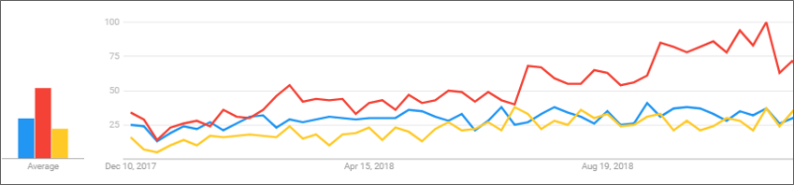
Market Trend of RPA Tools
Here, the red line here is UiPath, blue line Blue Prism and the yellow line is Automation Anywhere. As it is evident from the graph, UiPath emerges as a winner here.

Slide 9
Brief about UI- Path
What is Ui PATH?
UiPath Studio software solution allows automating repetitive office tasks. It is founded by Romanian entrepreneur Daniel Dines in the year 2005. It converts boring tasks into automation process can work with multiple tools.
Products of Ui Path
UiPath studio is available with three different product suite:-
a) UiPath Studio
b) UiPath Robot
c) UiPath Orchestrator

Slide 10
Features of UiPath
Hosting Options: It can be hosted in cloud environments or virtual terminals.
Application Compatibility: Offers a high range of applications to work with, which includes web and desktop applications.
Centralized repository: This feature helps for handling all the robots simultaneously by users.
Security: Offers auto login features to run the bots
Advanced screen scraping solution: Scraping solution that works with any application like,.Net, Java, Flash, PDF, Legacy, SAP, with absolute accuracy.
Reliable tool for modeling business processes: The UiPath studio offers automation excellence with the help of model business processes.
Level of scalability and Robustness:
Effective debugging and exception handling mechanisms
Artificial intelligence handling day to day applications like outlooks excel, PDF

Slide 11
How to install Ui PATH?
Step 1.Enter this URL in your browser: https://www.uipath.com/developers/community-edition. Click on get community edition button.
Step 2.Click on Community cloud
Step 3. Enter all the marked details
Step 4. Click Request Community Edition
Step 5. You will receive a mail below. Click on download community edition your download will begin.
Step 6. Once the download is completed click on the setup file
Step 7. Once the software is installed click on start free trial

Slide 12
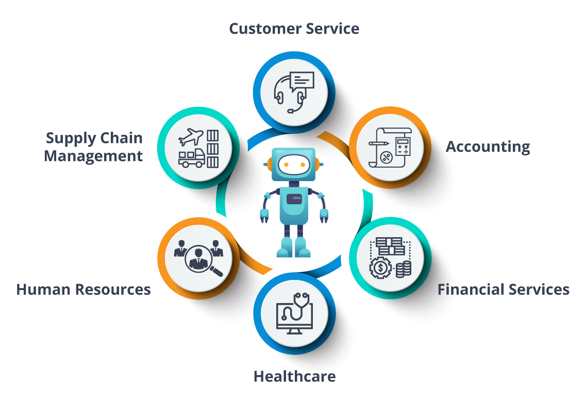
Applications of RPA
Multinational companies such as Deloitte, Accenture, Capgemini and many more, use Robotic Process Automation in their day to day tasks. These companies, benefit by using RPA as it provides, accurate, reliable, consistent outputs with high productivity rates. So, now let me tell you the top applications of RPA so that you know the various sectors in which RPA can be used.

Slide 13
Use Case Implementation
E-Collaborative Sanity Testing
Introduction
E – Collaborative is an application which helps in collaboration of Cap Gemini with its internal and external clients .This application allows user to share , upload , track the progress , save code to SVN repository using a common site which is accessible by both Cap Gemini and its clients.
2. Problem Statement
E-collaborative Testing team needs to perform sanity testing for different sites on weekends /weekdays based on the demand from the client, which requires a lot of human efforts and may take up to 60 minutes for a single site. For E.g. if 3 sites are needed to be test it will take 60*3 = 180 minutes. The number of sites and frequency for this testing may get increased in future.
The solution is to develop a robot which will reduce human efforts, saves time and increases the accuracy. The high level explanation of the task performed by robot is to filter out the mail based on the subject line and triggering the UFT to run the automated scripts on the sites mentioned in the requested mail and publish the results.

Slide 14
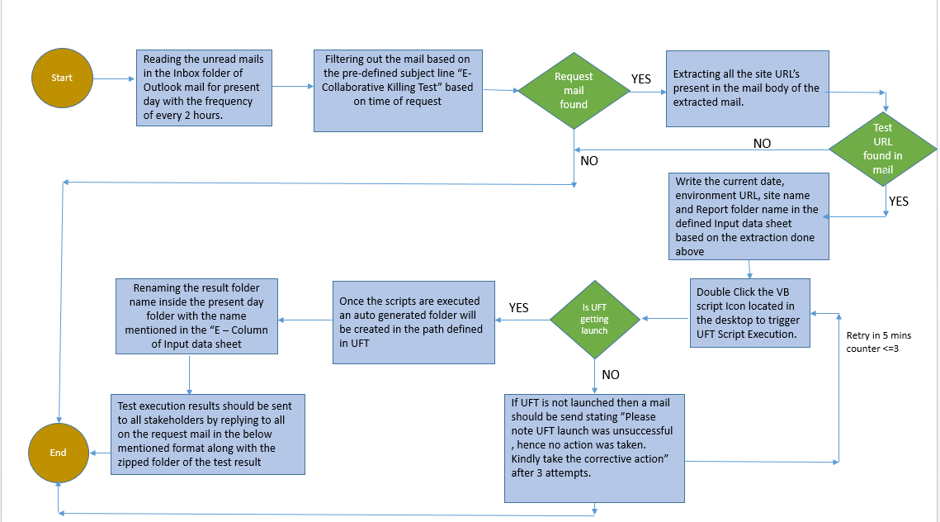
Flowchart

Slide 15
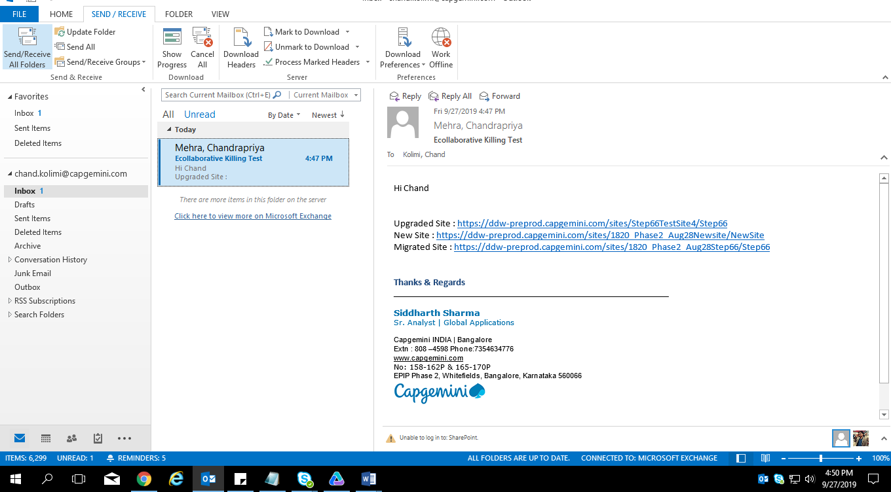
Process Flowchart AS-IS
1. Reading the unread mails in the Inbox folder of Outlook mail for present day with the frequency of every 2 hours.

Slide 16
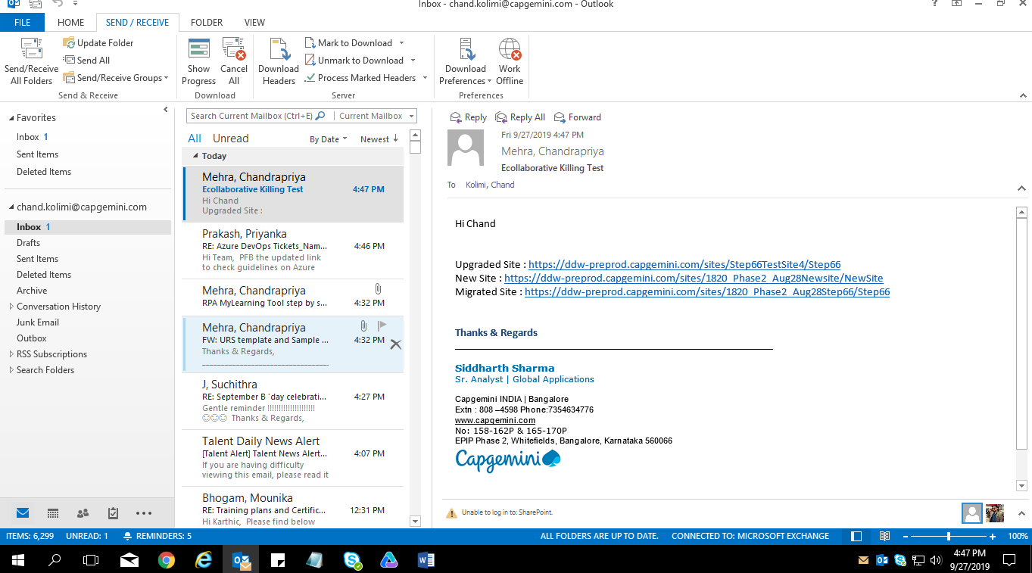
Process Flowchart AS-IS Continued…
2. Filtering out the mail based on the pre-defined subject line “E-Collaborative Killing Test” based on time of request

Slide 17
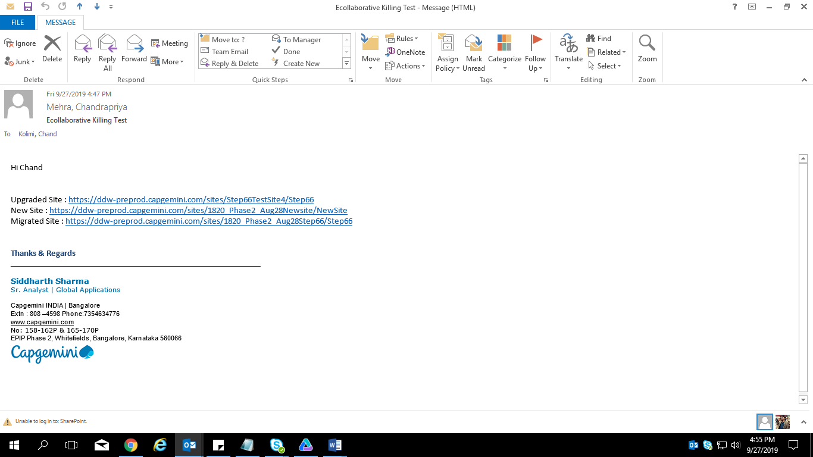
Process Flowchart AS-IS Continued…
3. Extracting all the site URL’s present in the mail body of the extracted mail.

Slide 18
Process Flowchart AS-IS Continued…
4. Write the current date, environment, URL, site name and Report folder name in the defined Input data sheet, based on the extraction done in Step 3.

Slide 19

Process Flowchart AS-IS Continued…
5. Double Click the VB script Icon located in the desktop to trigger UFT Script Execution.

Slide 20
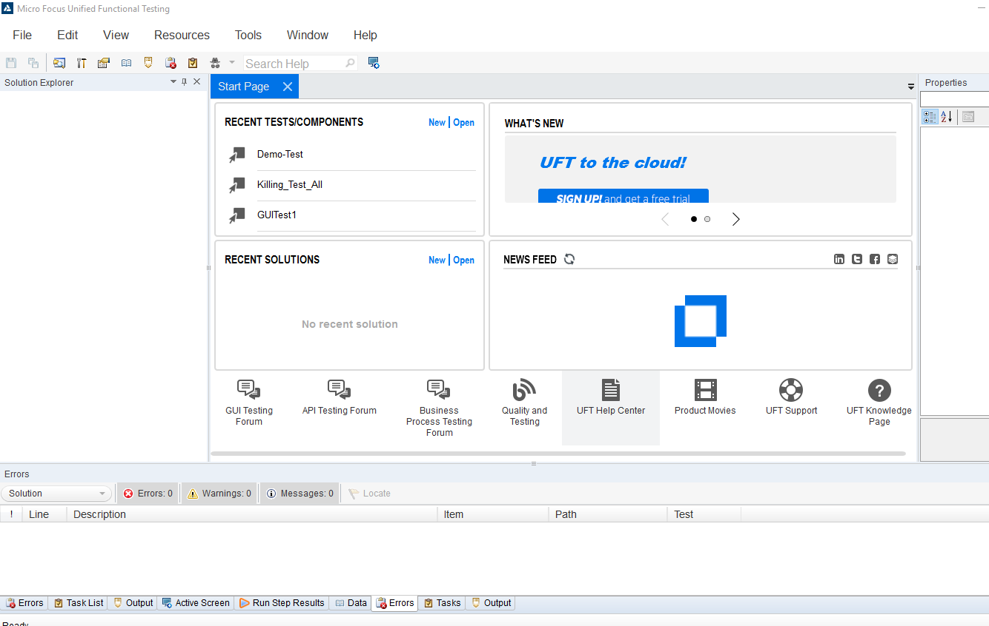
Process Flowchart AS-IS Continued…
6. UFT launch validation – If UFT is not launched then a mail should be send stating ”Please note UFT launch was unsuccessful , hence no action was taken. Kindly take the corrective action.”

Slide 21
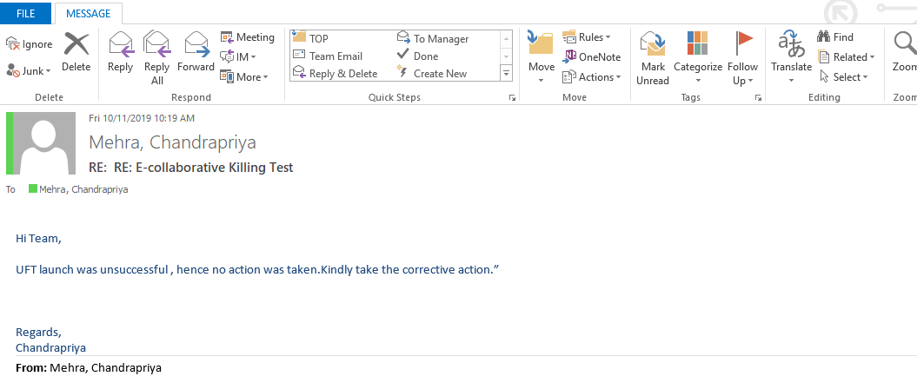
Process Flowchart AS-IS Continued…

Slide 22
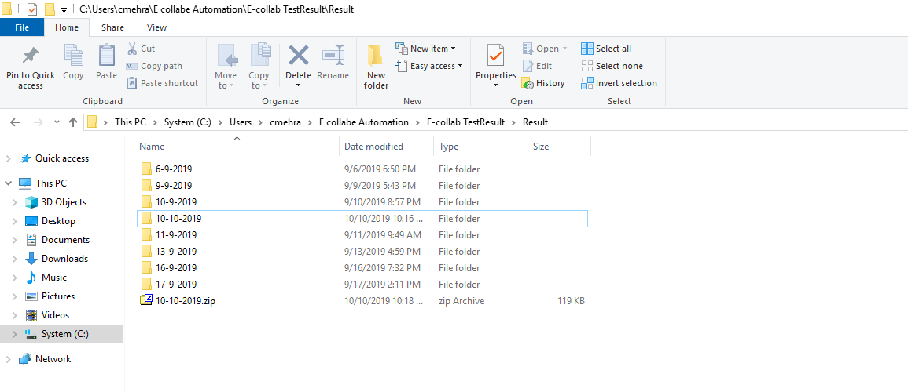
Process Flowchart AS-IS Continued…
7. Once the scripts are executed an auto generated folder with present date as folder name will be created in the path defined in UFT script

Slide 23
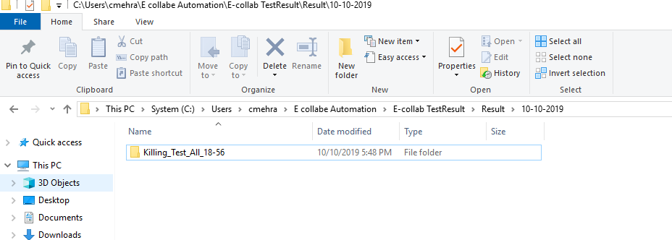
Process Flowchart AS-IS Continued…
8. Renaming the result folder name inside the present day folder with the name mentioned in the “E – Column of Input data sheet ” as mentioned below:
1. Copy the name from E column of Input data sheet.
2. Go to the present day folder

Slide 24
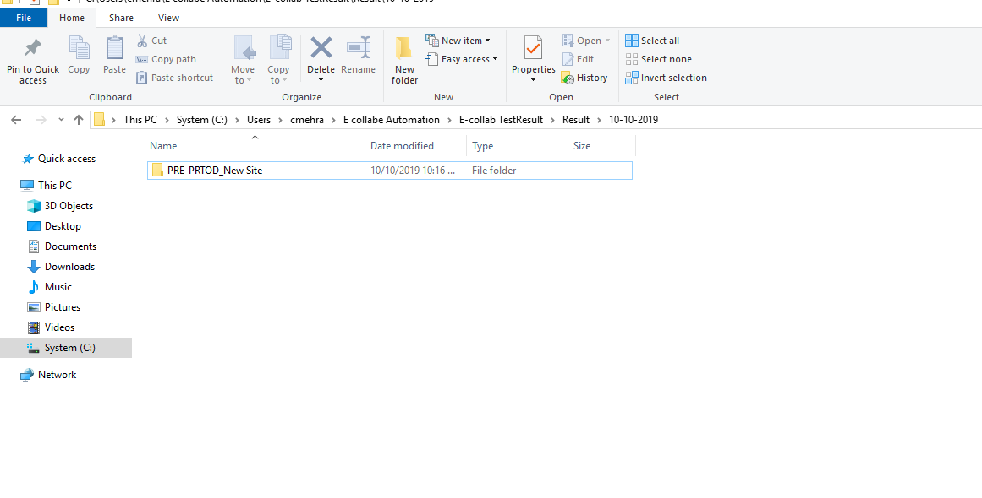
Process Flowchart AS-IS Continued…
3.Search for folder name with “Killing test” name
4. Rename the Killing test name folder with ”PRE-PROD _New Site” as copied from Input data sheet.

Slide 25
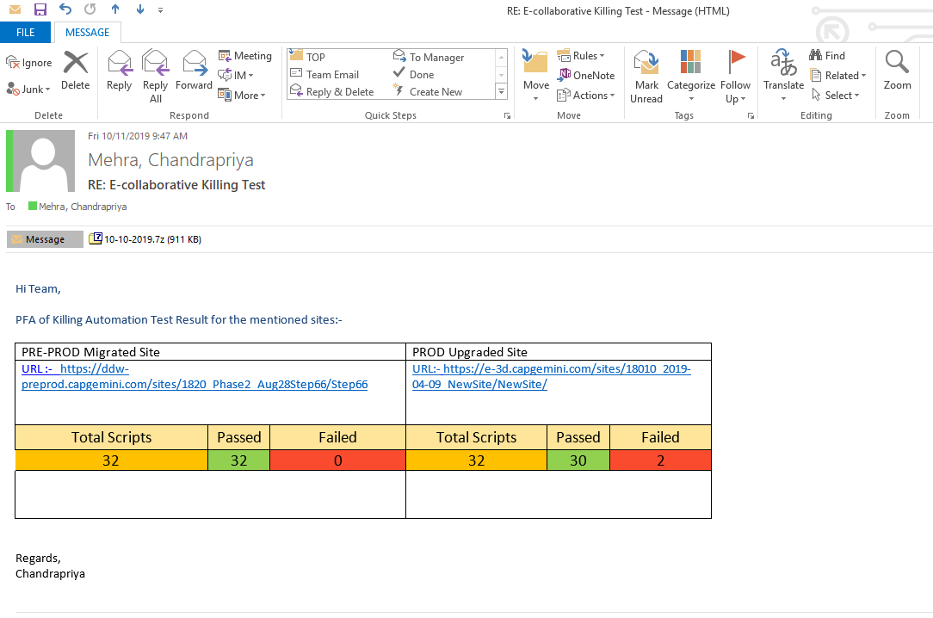
Process Flowchart AS-IS Continued…
9. Test execution results should be sent to all stakeholders by replying to all on the request mail in the below mentioned format along with the zipped folder of the test result created in present day folder.

Slide 26


Slide 27
Thank You

