Slide 1
Predictive Webserver Results and Demo
Team 3
Andy Chea, Sandhya Govindarajan, Justin Patterson, Joel Vaz

Slide 2
Outline
Objective - Users
Server Function
User Experience
Inputs/Outputs
Final Implementation
Nextflow and Streamlit
Pipeline Results
Server Demo

Slide 3
Objective
WHAT
Web-server → raw FastQ to functional annotation
WHO
For biologists, access to preliminary results
WHY
Ease of use; simple functionality

Slide 4
We came up with…
BacBuster Isolate Analyzer!

Slide 5
Features
Genome assembly
Input as raw FastQ (.fq, .fq.gz)
Quality control - fastp
Assembly - skesa
Gene prediction
Prodigal
Functional annotation
AMRFinderPlus

Slide 6
Implementation

Slide 7
Workflows
Analysing data involves a sequence of tasks, including gathering, cleaning, and processing data.
These sequence of tasks are called a workflow or a pipeline.
Different computing environments, such as a desktop or a compute cluster.
Python/bash implementation.

Slide 8
Workflow management systems
Software tools that are designed to help manage and automate complex sequences of tasks
Involves data processing and analysis.
Web servers, workflow management systems for running a web application, such as processing user requests, accessing databases, and generating output.

Slide 9
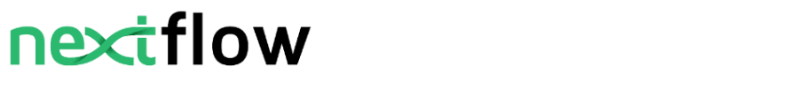
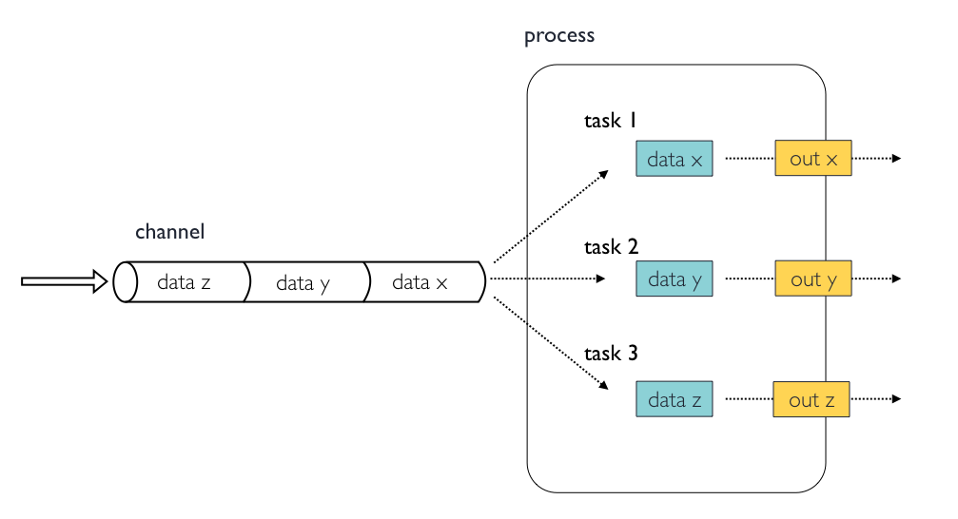
Enables the development of portable and reproducible workflows
Framework is based on the dataflow programming model, simplifies writing parallel and distributed pipelines
Extends the Unix pipes model with a fluent Domain Specific Language
Allows to handle complex stream interactions easily
Notes:
that combines a runtime environment, software that is designed to run other software, and a programming domain specific language (DSL) that eases the writing of computational pipelines.

Slide 10
Comparison
 | nextflow | Snakemake
Language | DSL - Groovy-based language | DSL- Python-based language
Data Handling | Allows for custom data types & advanced data manipulation | More built-in functionality
Portability | Built-in support for containerization through Docker and Singularity allows running pipelines on different systems | Built-in support for conda environments, help with managing software dependencies
Execution Model | Dataflow-based execution model | DAG-based (Directed Acyclic Graph)

Slide 11
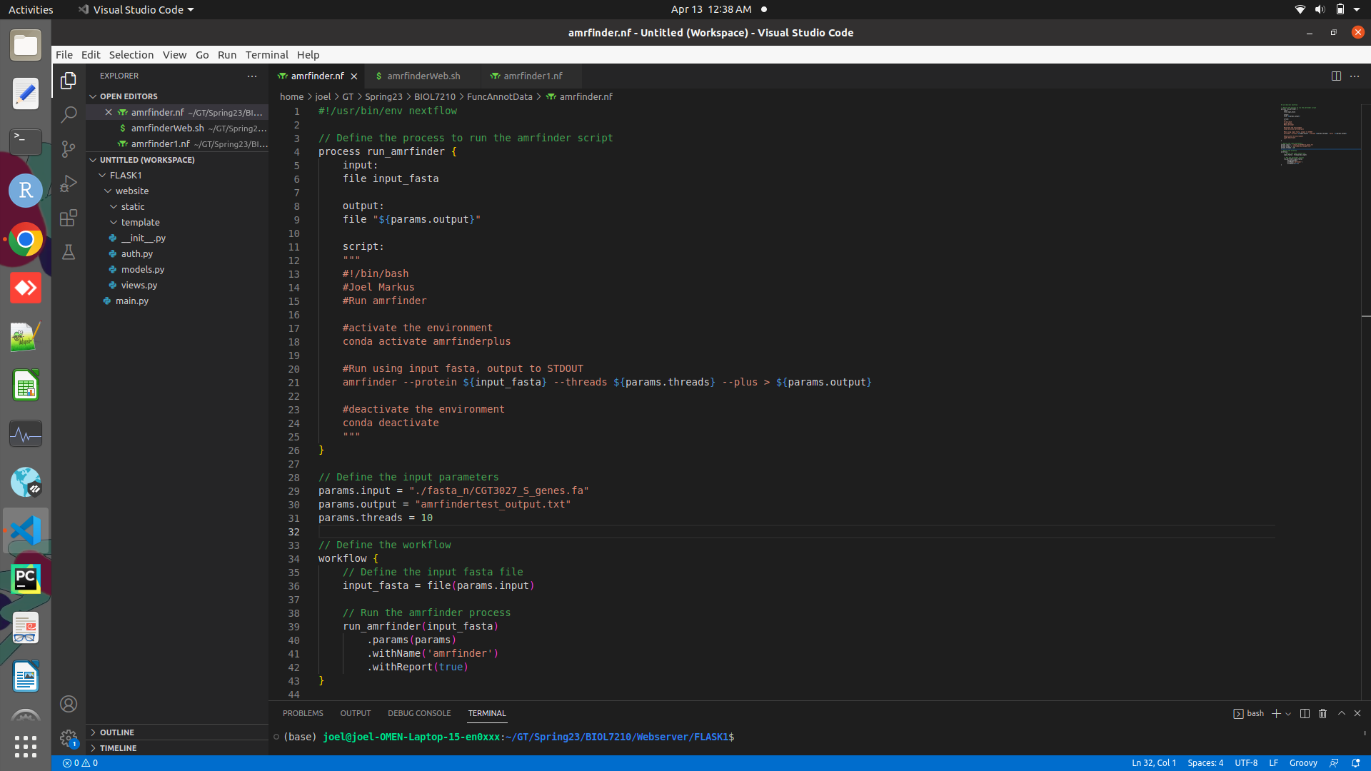
Shebang declaration
Process definition
input/output declaration blocks
Script
Pipeline parameters
Executing process

Slide 12
Framework Discussion
FLASK:
Extensible: Control over network architecture
Supports HTTPS and RESTful requests
Integrated unit testing and debugger included
Secure cookies available
Supports WSGI templates
When to use?
Smaller project
Have varied database support
Have flexibility to choose library and extension
Have API support
Create static websites, rapid prototypes, and RESTful web service
Used to create simple implementation of NextFlow scripts

Slide 13
Framework Discussion
DJANGO:
Written in Python- compatible with any platform
bundles robust user authentication systems
Supports formats such as JSON, HTML, XML
When to use?
Large projects
Use built-in features and gain access support to speed up development
Build secure projects that require authorization
Possible scale up
Create web applications with API backends
Used to create complex implementation of NextFlow scripts

Slide 14
Framework Discussion
Shiny:
Interactive widgets: sliders, dropdown menus, checkboxes, and text boxes.
Reactive expressions: : Dynamic visualizations
Layout options: control the overall appearance and organization of your application
Deployment options: hosting it on a Shiny server or deploying it as a standalone HTML file to share application with others
When to use?
Working with R
Applications that don’t need general purpose frameworks
Looking to create quick interactive frameworks for R code

Slide 15
Framework Discussion
Dash:
Built on top of Plotly.js, React, and Flask
modern UI elements like dropdowns, sliders and graphs
Written in python, so NO HTML or JavaScript is necessary.
Reactive components: components update automatically in response to user changes
Plotting and visualization libraries
Customizable layout
Integration with other Python frameworks

Slide 16
Comparison of Frameworks
Feature | Django | Flask | Dash | Shiny
Language | Python | Python | Python | R
Main Use Case | Full-featured web applications | Lightweight web applications | Data visualization applications | Data visualization applications
Ease of Use | Requires more setup and configuration | Easy to get started with | Easy to get started with | Easy to get started with
Learning Curve | Moderate to high | Low | Low | Moderate
Scalability | Highly scalable | Scalable | Scalable | Less scalable than others
Database Support | Built-in ORM (Object-Relational Mapping) | SQLAlchemy or other ORM can be used | No built-in database support | Can use R's database interfaces
Visualization | No built-in visualization | No built-in visualization | Built-in Plotly visualization | Built-in ggplot2 visualization
Reactive Programming | No built-in support | No built-in support | Built-in reactive programming using callback functions | Built-in reactive programming using reactive expressions
Deployment Options | Can be deployed to cloud platforms such as Heroku and AWS | Can be deployed to cloud platforms such as Heroku and AWS | Can be deployed to cloud platforms such as Heroku and AWS | Can be deployed to cloud platforms such as Heroku and AWS
From the comparison, we need a robust, scalable, lightweight implementation for our NextFlow scripts that is easy to get started with. Thus we will proceed with flask for web implementation

Slide 17
Streamlit
Problems faced with Flask:
More html and css knowledge required
Widgets require more more implementation
Flask spread over separate files for logic and front-end
Solution:
Streamlit
Easier for beginners
Simple and intuitive interface
Fast prototyping
Sharing and deployment

Slide 18
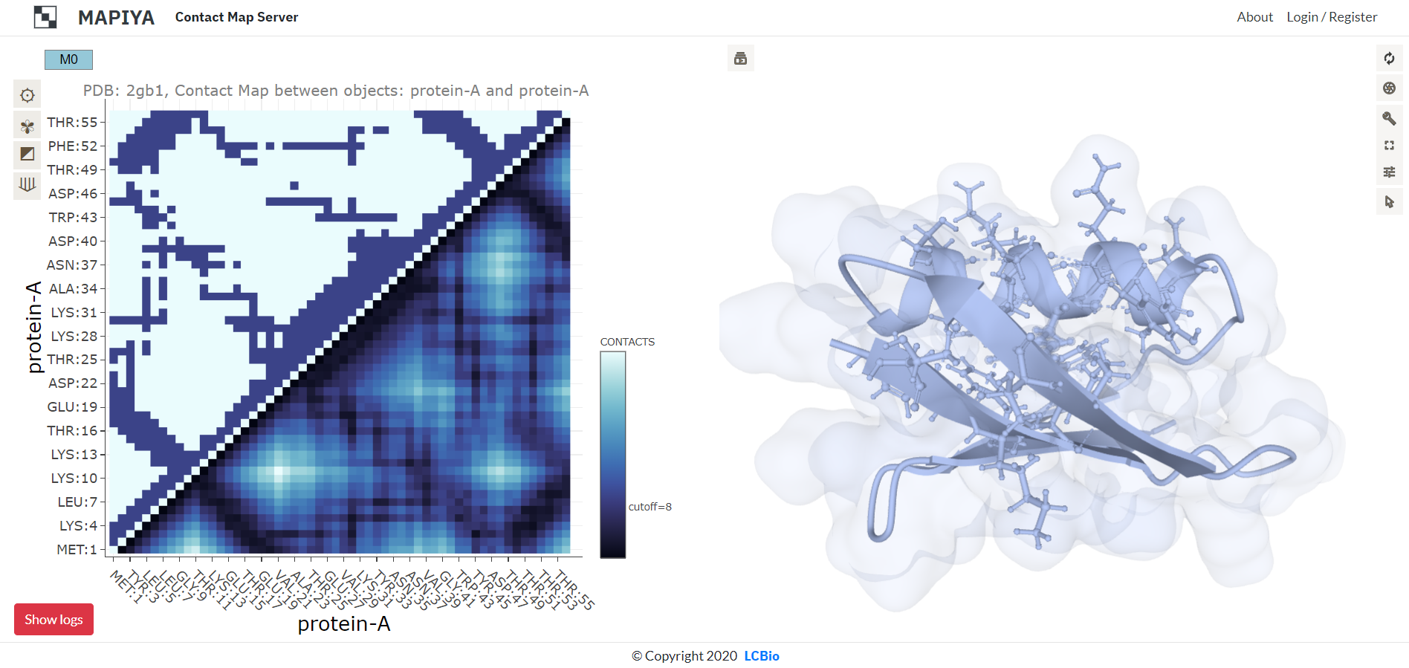
Example of a Bioinformatics Web Server Built Using Dash
https://mapiya.lcbio.pl/project/m1mIs4bxQWVV/

Slide 19
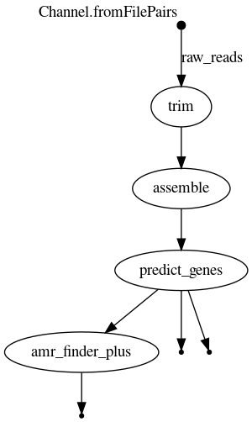


Slide 20
Data Flowchart
User input: Raw, paired Illumina reads
Genome Assembly: fastp, Skesa
Gene Prediction: Prodigal
Functional Annotation: AMRFinderPlus
Outputs:
Assembled genomes .fa
Outputs:
.gff
.faa
Outputs:
.tsv

Slide 21
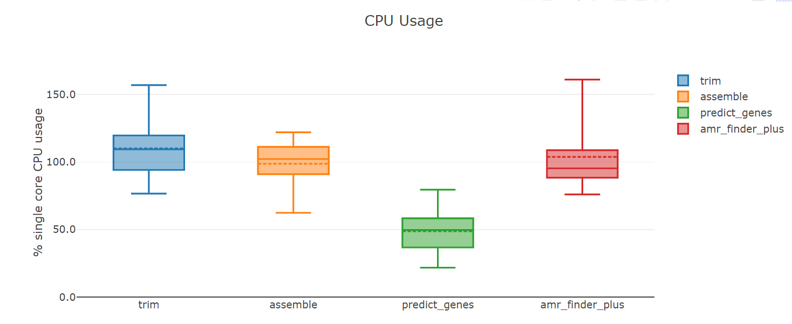

Slide 22
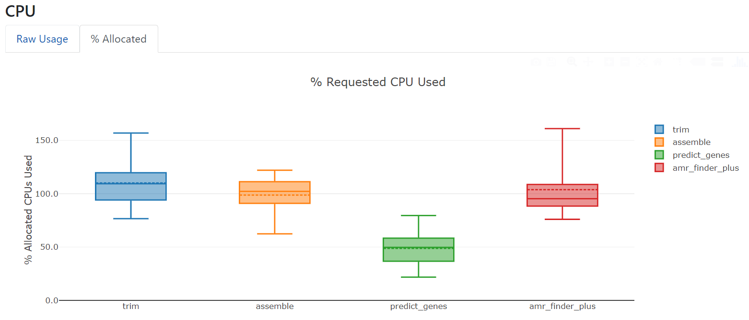

Slide 23
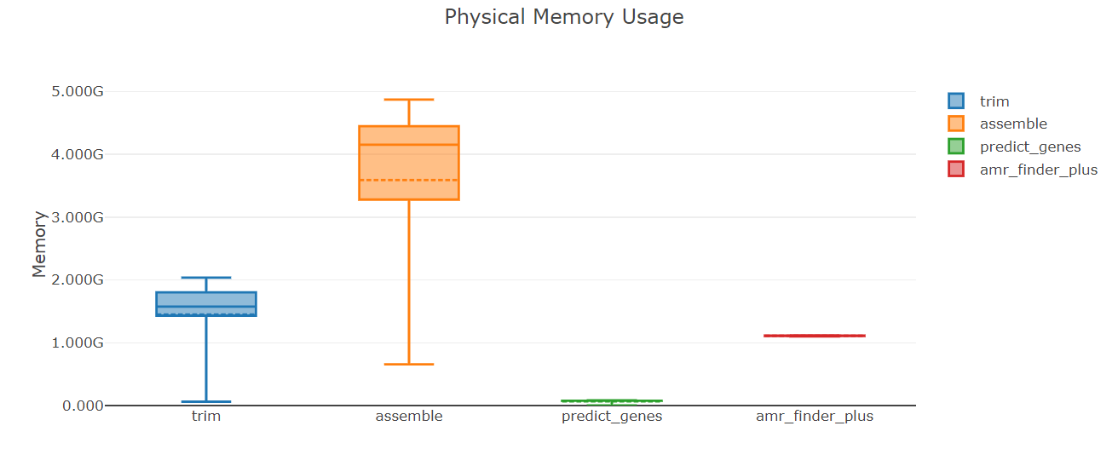

Slide 24
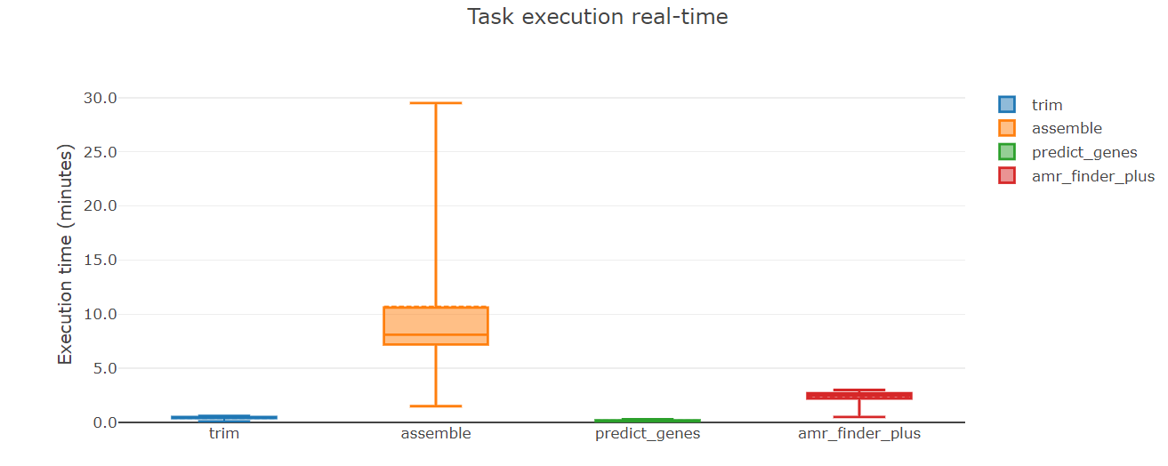

Slide 25
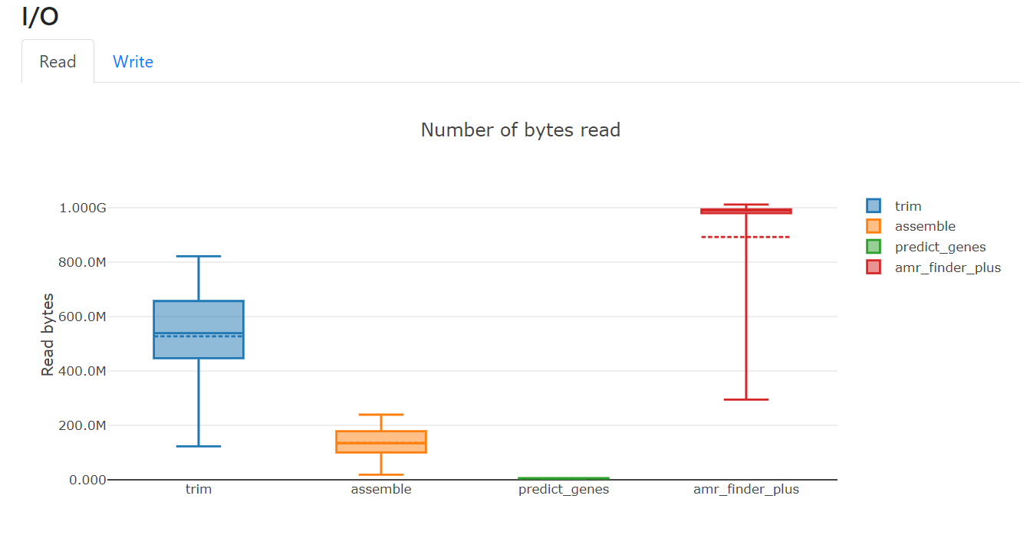

Slide 26
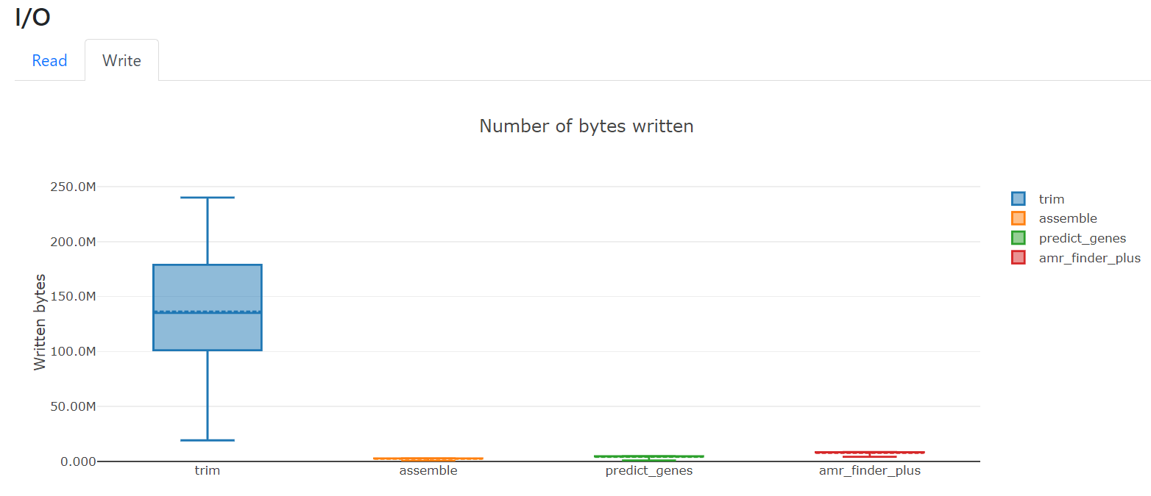

Slide 27
AMR Finder Results
ribosomal protection protein
fosfomycin resistance
quaternary ammonium compound efflux SMR transporter

Slide 28
SERVER DEMO

Slide 29
Thank you! Any questions?

Slide 30
Our Server

Slide 31
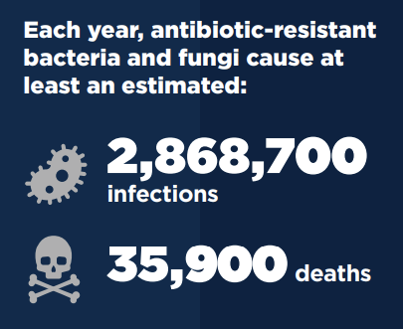
Server Purpose
Our server seeks to assemble user input FASTQ files and predict genes towards the ultimate goal of extracting the AMR sequences present in the user's bacterial isolates.
AMR development is a constant threat in public health
Provides information on the pathogen's environment and evolution
Stretch goals of heat-shock/cold-shock
It combines the efforts of Groups 1-3, and will hopefully streamline the processes we've learned over the whole semester into one accessible pipeline.
Abstract steps as much as possible to avoid overwhelming users.
CDC Antibiotic Threats Report, 2019
Notes:
AMR is a continuing threat to national public health.

Slide 32
Pipeline Implementation and Goal
Front End: Python Flask
Flask-Mail
Back End: NextFlow
NextFlow launcher package
FINAL DELIVERABLES
Fully functional predictive web server
Documentation for all processes
Explanatory flowchart for end user
Notes:
Flask has a lot of support, especially for webdev concepts. NextFlow allows for parallelization and is used at the CDC.

Slide 33
Work Delegation
Andy
HTML/CSS and Flask implementation
Sandhya
Translation of ASSEMBLY to Nextflow
Justin
Nextflow troubleshooting and translation of GENE PREDICTION to Nextflow
Joel
Translation of ANNOTATION to Nextflow
Everyone
Slides and documentation
Notes:
We'll all pitch in where we can as we navigate the Web Dev and front end implementation space.

Slide 34
References
What Is a Web Server? https://www.nginx.com/resources/glossary/web-server/
What is HTTP? https://www.cloudflare.com/learning/ddos/glossary/hypertext-transfer-protocol-http/
POST. https://developer.mozilla.org/en-US/docs/Web/HTTP/Methods/POST
Nextflow. https://www.nextflow.io/index.html
Mapiya. https://mapiya.lcbio.pl/project/m1mIs4bxQWVV/
Nginx. https://bs-uploads.toptal.io/blackfish-uploads/uploaded_file/file/194520/image-1582751182464-4b9d62e62912bd777a7c647a8309df8b.png

Slide 35
Syllabus Logistics
Each group will give a series presentations and laboratories/demos. Group
presentations and labs/demos will be judged by the depth of analysis presented, the
clarity of presentation, the utility of the exercises, the appropriateness and justification of
the choices made, the validity and robustness of the results and the thoroughness of the
documentation. In addition to presentations, results and documentation should be
presented on the class Wiki site. All student code and analysis contributions must be
shared and documented on Github – https://github.gatech.edu /comgenomics2023 .
Specific requirements for the presentations will be provided during class sessions.
Contributions of each individual student to the overall group effort must be meticulously
detailed and documented

Slide 36
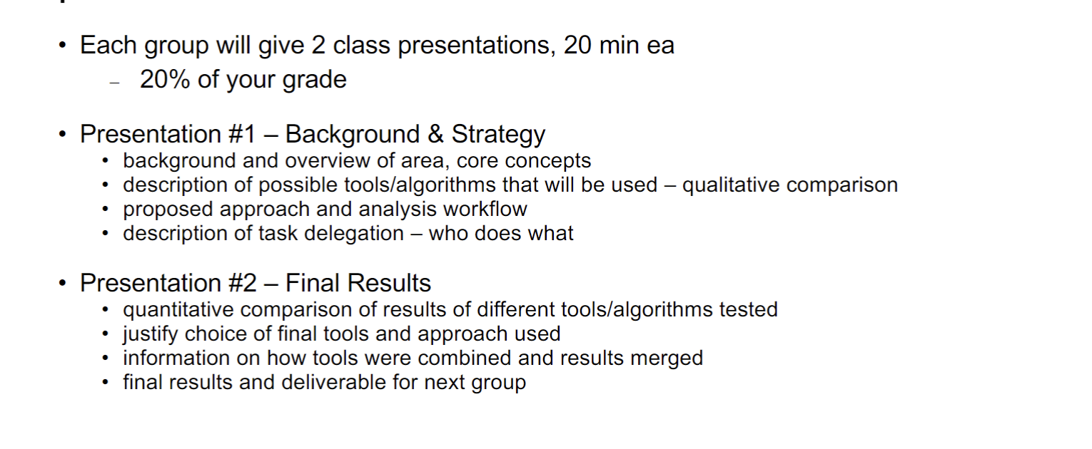

Slide 37
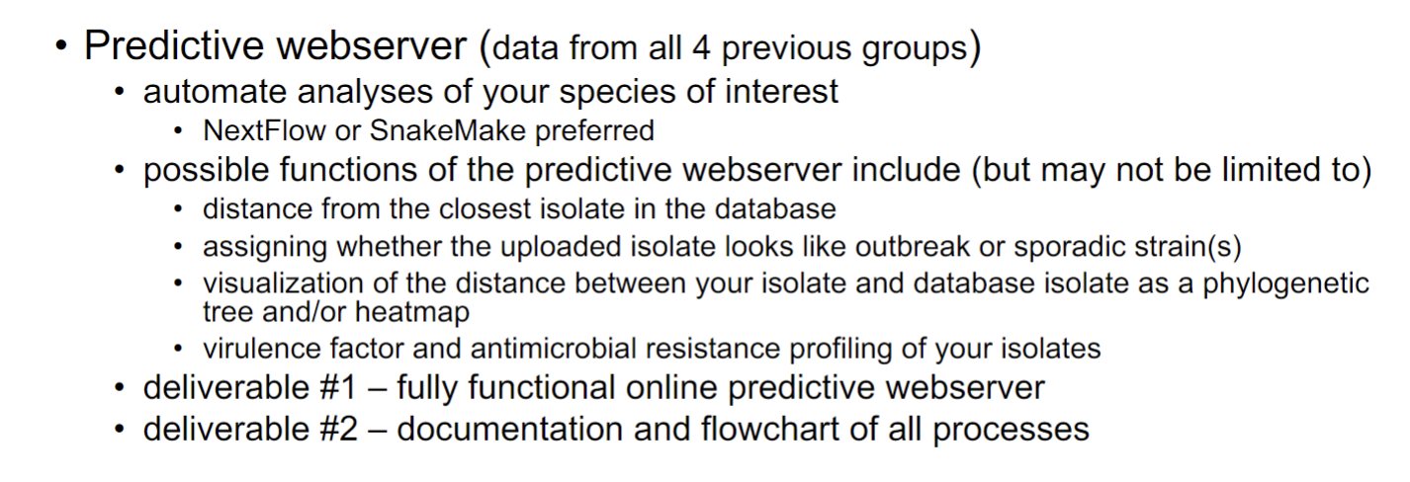
From first lecture:

