Slide 1
2022 JDP –
AI Detection and Causality Inferences for Fab Operations
Advisor: Wen-Chih Peng
Student: Zheng-Ming (Paul) Lin, Ching (Jason) Chang
Date: 2022/10/24

Slide 2
Outline
MicroHECL implementation progress report
Thoughs on log parsing
Root casue analysis about TCDF

Slide 3
Review - 張敬
Done in the past two weeks
get_trigger_point.py
get_topology.py
set_KPI.py
To do
The rest of MicroHECL
DeepTraLog with TrainTicket dataset (waiting for TSMC’s data)

Slide 4
Review - 正明
Done in the past two weeks
Log parsing post-processing
Merge the different cluster but similar template
Root cause analysis
To do
Apply the method from paper to TSMC data

Slide 5
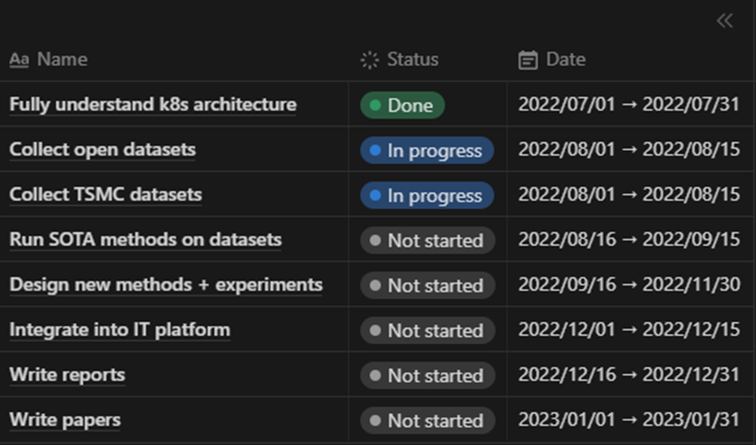
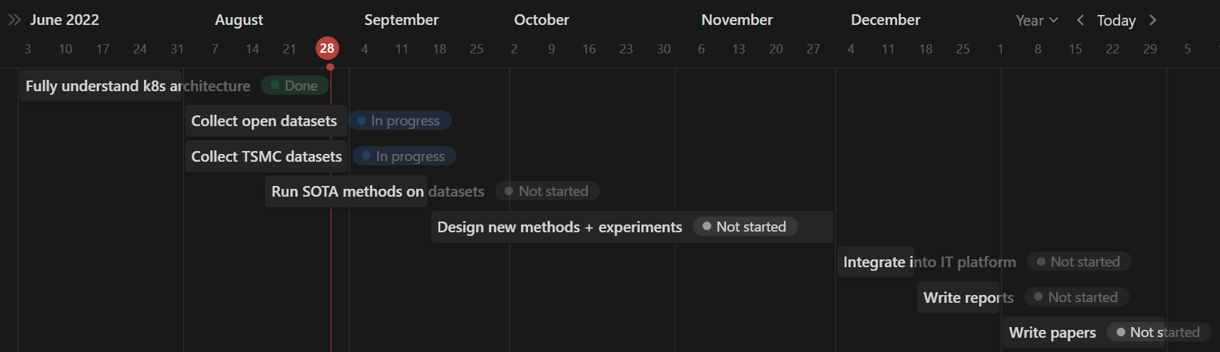
Internship plan (from NYCU)

Slide 6
Problem Settings
Supervised or Unsupervised | Unsupervised
Offline or Online | Online
Data type | Metric + Log + Trace + Changelog
Data source | System log (kubernetes-related) Application log
Others | Multiple sources time mismatch log sparsity issue (error message) Log parsing Causality/Interpretability/Explainability
Keywords: micro services, causal graph, root cause analysis, causal inference

Slide 7
Two main things
Implementation
MicroHECL with TSMC dataset
DeepTraLog with TrainTicket
3 Selling points for my own paper
Combine 3 data sources
Log, Trace, Metric (change “Changelog” to “Metric”)
GNN with RCA
Self-supervised learning (with GNN)
Contrastive learning

Slide 8
1. Service Call Graph Construction
RT
EC
QPS
10:00 10:05 … 11:00
7/1 11:00
S₁
S₃
S₅
S₇
S₉
S₂
S₄
S₆
S₈
S₁₀
topology: past 30 min (7/1 10:30~11:00)
KPIs: past 60 min (7/1 10:00~11:00)

Slide 9
2. Anomaly Propagation Chain Analysis
EC’s candidate root cause
QPS’s candidate root cause
S₁
S₃
S₅
S₇
S₉
S₂
S₄
S₆
S₈
S₁₀
RT’s candidate root cause

Slide 10
3. Candidate Root Cause Ranking
Pearson correlation
EC’s candidate root cause
QPS’s candidate root cause
S₁
S₃
S₅
S₇
S₉
S₂
S₄
S₆
S₈
S₁₀
RT’s candidate root cause

Slide 11
MicroHECL with TSMC dataset
Service Call Graph Construction
trigger_point
topology
KPI
Anomaly Detection
Propagation Chain Analysis
Candidate Root Cause

Slide 12
1. Service Call Graph Construction - trigger point
7/1 11:00
def get_trigger_point(
trigger_point_path: str,
category: str = ‘iSOP’,
service: str = ‘wfauto-cim-order-api’,
threshold: float = 0.3,
) -> pd.DataFrame:
S₅
NAME | RESULT | DETECT_TIME | category | service | …
iSOP-wfauto-cim-order-api(開單成功率 - 分類) | 0.25 | 2022-09-05 00:25:00 | iSOP | wfauto-cim-order-api
… | … | … | … | …
iSOP-wfauto-cim-order-api(開單成功率 - 分類) | 0 | 2022-09-15 14:50:00 | iSOP | wfauto-cim-order-api

Slide 13
1. Service Call Graph Construction - topolopy
def get_topology(
topology_path: str,
trigger_time: datetime,
topology_lookback_window: int,
service: str,
) -> nx.classes.digraph.Digraph:
7/1 11:00
S₁
S₃
S₅
S₇
S₉
S₂
S₄
S₆
S₈
S₁₀
topology: past 30 min (7/1 10:30~11:00)

Slide 14
1. Service Call Graph Construction - topolopy
def get_topology(
topology_path: str,
trigger_time: datetime,
topology_lookback_window: int,
service: str,
) -> nx.classes.digraph.Digraph:
S₁
S₃
S₅
S₇
S₉
7/1 10:05
S₂
S₄
S₆
S₈
S₁₀
S₁
S₃
S₅
S₇
S₉
Find the topologies that’s follow the time legitimacy
Graph-preprocessing
Drop useless nodes
Set trigger point
Drop isolated nodes (check weakly-connected)
Merge all topologies into one single topology
compose, not union
7/1 10:10
S₂
S₄
S₆
S₈
S₁₀
…

Slide 15
1. Service Call Graph Construction - KPI
RT
EC
QPS
10:00 10:05 … 11:00
7/1 11:00
S₁
S₃
S₅
S₇
S₉
S₂
S₄
S₆
S₈
S₁₀
topology: past 30 min (7/1 10:30~11:00)
KPIs: past 60 min (7/1 10:00~11:00)

Slide 16
1. Service Call Graph Construction - KPI
def accumulate_KPI(
KPI_path_dict: Dict[str, str],
) -> Dict[str, Dict]:
time value attr
S₁
S₃
2022-07-01
08:00:37
{'source_app': xxx,
…}
12.6
S₁
S₃
2022-07-01
13:42:56
{'source_app': xxx,
…}
14.9
…
[{‘time’: 2022-07-01
08:00:37,
‘value’: 12.6},
{‘time’: 2022-07-01
13:42:56,
‘value’: 14.9},
…
]
S₁
S₃
{'source_app': xxx,
…}

Slide 17
1. Service Call Graph Construction - KPI
What about the case that we don’t have any sample data in given time range?
def set_KPI(
G: nx.classes.digraph.Digraph,
KPI_dict: Dict[str, Dict],
trigger_time: datetime,
KPI_lookback_window: int,
sample_rate: int,
) -> nx.classes.digraph.DiGraph:
[{‘time’: 2022-07-01
08:00:37,
‘value’: 12.6},
{‘time’: 2022-07-01
13:42:56,
‘value’: 14.9},
…
]
S₁
S₃
{'source_app': xxx,
…}
if we have this (KPI_name, edge)
S₁
S₃
{'source_app': xxx,
…}
time | value
2022-07-01 10:00:00 | 0.25
… | …
2022-07-01 11:00:00 | 0
create df
df.resample
select corresponding time_range

Slide 18
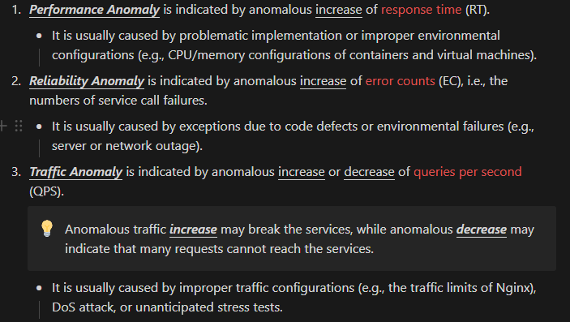
1. Service Call Graph Construction - KPI
What about the case that we don’t have any sample data in given time range?

Slide 19
MicroHECL with TSMC dataset
Service Call Graph Construction
trigger_point
topology
KPI
Anomaly Detection
Propagation Chain Analysis
Candidate Root Cause

Slide 21
~~~~~~~~~~~~~~~~~~~~~~~~~~~~~~~

Slide 22
Visualization
Three kinds of the node
Red: Choose from the top k of the out_degree of the node
Yellow: Normal node
Blue: Root (in_degree = 0)

Slide 23
TRV Lottery Case

Slide 24
MyTSMC WAF Case
Data preprocessing
Result

Slide 25
Data Preprocessing
In this case, there are two types of data
One is metric data; the other is log data
There are two files
File_1 is collected per minute
File_2 is collected per hour

Slide 26
File_1 Preprocessing
In this file, the data is collected per minute
Because the data in the file_2 is collected per hour, I have to align the time dimension
Gather the metric and the log data in an hour

Slide 27
File_2 Preprocessing
In this file, the data is collected per hour
Because the data is collected in 7 days per hour, so there should be 168 time stamp for each metric or log data
Two metric data only has 55 time stamp, so I don’t consider it
One metric data has 167 time stamp and its value only 1 time stamp is 1, so I fill in 0 the empty time stamp
After preprocessing two files, merge them together as the input of TCDF

Slide 28
Result

Slide 29
Shift the value of the log count

Slide 30
Result

Slide 31
Analysis
In my view, this case has two problem
First, the data from two files are collected in different time stamp
We should consider the data per minute instead of per hour
Second, the log count isn’t suitable for TCDF
I think that it should be considered when the anomaly occurs

