Slide 1
Individual meeting
Advisor: Wen-Chih Peng
Student: Zheng-Ming Lin
Date: 2022/11/30

Slide 2
Workflow
Metric, infra data
Anomaly
(user’s spec)
Combine the data
log data
Log clustering
Feature Selection
Causal Discovery
PageRank

Slide 3
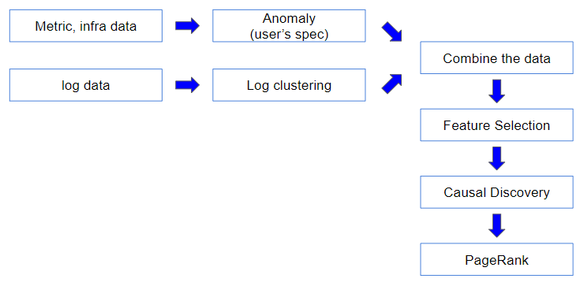
Data Preprocessing
Metric and infra data
Collected in per second
To align with log data, average their value in a minute
Transfer their value to 0 or 1 according to anomaly detection
0 denotes normal
1 denotes anomalous
Log data
Collected in per minute
Transfer their value to 0 or 1 according to anomaly detection
0 denotes normal
1 denotes anomalous

Slide 4
Combine the Data
Metric and infra data
Collected in per second
0 denotes normal
1 denotes anomalous
Log data
Collected in per minute
0 denotes normal
1 denotes anomalous
Combine three types of data
Combine them into multivariate time series data
Each time series represents a feature

Slide 5
Feature Selection
Calculate the pearson correlation of the trigger point with other features
Each feature is
Choose top 100 as the important feature
However, many features are zero vector, so the coefficient of pearson correlation will be nan

Slide 6
Feature Selection
However, many features are zero vector, so the coefficient of pearson correlation will be nan

Slide 7
Causal Discovery
Causal discovery
Read the code and the paper of TCDF

Slide 8
Page Rank
Page rank
Use the page rank to rank the root cause in the graph
Experiment on the 12 cases

