Slide 1

May 31, 2024
ADA 442 FINAL PROJECT PRESENTATION
Gülay YILMAZ
İrem Su DOĞAN

Slide 2
Understanding the dataset
We closely examined the distribution of various variables to understand their characteristics.
To visualize the data effectively, we employed a range of graphical techniques, including bar charts, histograms, count plots, and box plots.
We conducted a correlation analysis by creating a correlation heatmap.
Notes:
1-(This analysis revealed significant imbalances in the target variable, highlighting the need for careful consideration in subsequent modeling steps. )
2-(These visualizations provided clear insights into the data's structure and patterns. )
3-(which allowed us to identify and visualize the relationships between different variables, further enhancing our understanding of the dataset.)

Slide 3
Data Cleaning, Preprocessing and Feature Selection
We found that there were no missing values.
To prepare the data for machine learning models, we converted categorical variables into a suitable format using label encoding.
To address imbalances in the dataset, we applied the oversampling technique.
Numerical features were standardized through feature scaling to ensure uniformity across the dataset.
We performed feature engineering to create new features, which provided deeper insights and enhanced the analytical capabilities of our models.
Notes:
1-(This analysis revealed significant imbalances in the target variable, highlighting the need for careful consideration in subsequent modeling steps. )
2-(These visualizations provided clear insights into the data's structure and patterns. )
3-(which allowed us to identify and visualize the relationships between different variables, further enhancing our understanding of the dataset.)

Slide 4
Model Selection, Creating Pipeline and Deployment
We evaluated several models, including Logistic Regression, Random Forest, and Neural Networks, to determine the best fit for our data.
Based on key metrics such as accuracy, F1-score, and ROC AUC, we selected the Random Forest model.
To further enhance its performance, we optimized the model through hyperparameter tuning.
To ensure readability and maintain consistency, we developed a pipeline.
Finally, we deployed the model using a Streamlit web application, providing a simple user interface for users to interact with the model.
Notes:
1-(This analysis revealed significant imbalances in the target variable, highlighting the need for careful consideration in subsequent modeling steps. )
2-(These visualizations provided clear insights into the data's structure and patterns. )
3-(which allowed us to identify and visualize the relationships between different variables, further enhancing our understanding of the dataset.)

Slide 5

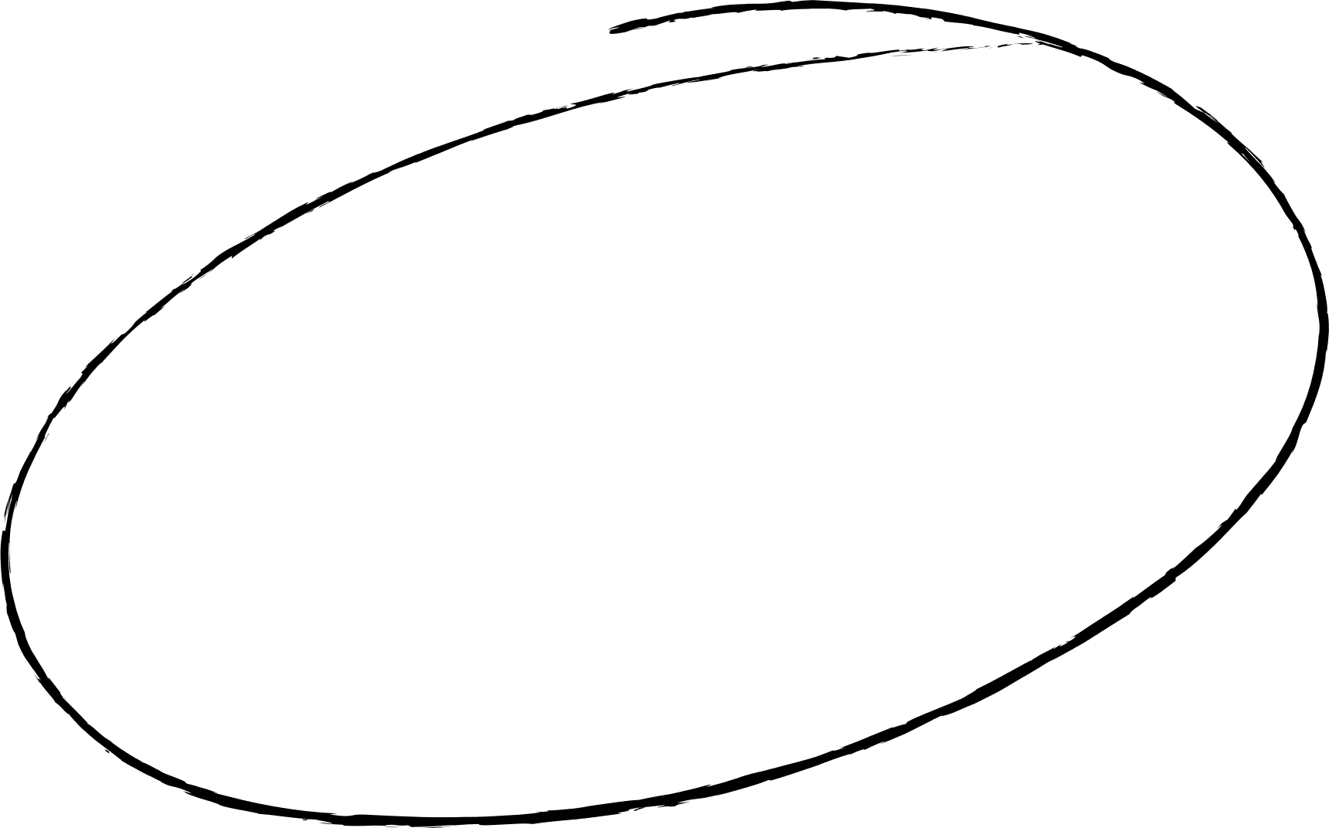
KEEP
GOING
Thank you!
Have
a good weekend!

