Slide 1

SRIRAM ENGINEERING COLLEGE
COMPUTER SCIENCE AND ENGINEERING DEPARTMENT
TITLE:
SMARTCREDIT : Credit Recommendations for Financial Institutions with Blockchain-based System
PRESENTED BY
MD SAQIB P (112619104008)
NIRANJAN C (112619104010)
SUPERVISED BY : ASSISTANT PROFESSOR Ms. V. PADMA PRIYA M.E.,

Slide 2
ABSRTACT
SmartCredit, a deep-learning based credit-recommender scheme for public blockchain to facilitate smart lending operations between prospective borrowers (PB) and prospective lenders (PL) to eliminate the need of third party credit-rating agencies (CRAs) for credit-score (CS) generation. Thus loan grants to PB from PL is secured, authorized, and automated so as to expedite the disbursement process. SmartCredit stores PB historical transactions, current assets, and liabilities as time-series sequenced data in a public blockchain. The sequenced data is fetched from blockchain by a long-short term memory (LSTM) model that generates CS for loan recommendations based on proposed lending algorithms for PB and PL. To ensure real-time updation of CS, edge-weights are updated based on boolean indicators from PB and PL, which indicates the successful repayments and loan-defaults.

Slide 3
OBJECTIVE
Sentiment-based rating.
Reliable sentiment-based scoring.
Direct lender recommendations.
Efficient secure lending.

Slide 4
EXISTING SYSTEM
Slow loan disbursement process.
Complex credit correlations.
Flawed profit-based lending.

Slide 5
PROBLEM DEFINITION
Calculation flawed credit score:
Single miss impacts.
Slow loan cycle.
High-risk classification.
New borrowers overlooked:
Good reputation ignored.
High assets excluded.
Unfair evaluation.
Need for reliable credit score:
Efficient mechanism needed.
Consider all factors.
Expedite loan process.
New scoring should:
Be more reliable.
Speed up loan process.
Evaluate fairly.

Slide 6
PROPOSED SYSTEM
High loan efficiency:
Faster disbursement process.
Direct communication channel.
Sentiment analysis utilized.
Sentiment analysis benefits:
Accurate reviews evaluation.
Positive and negative percentage.
Improved lending decisions.
Maximum user accessibility:
Increased loan approvals.
Reduced difficulties.
Equal opportunities provided
Blockchain Storage Advantage:
Secure leading data
Transparent payment history
Improved reliability

Slide 7
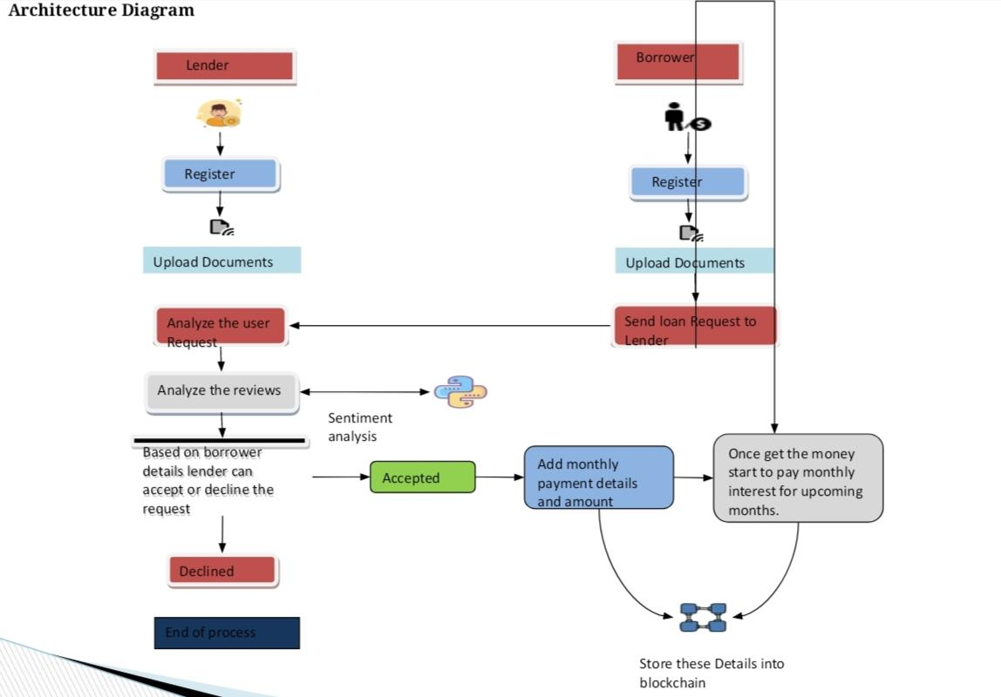

Slide 8
ADVANTAGE
Perspective borrowers have opportunity:
Equal loan chances.
No discrimination policy.
Access to financing.
Perspective Lenders and borrowers should:
Verify identities securely.
Build trust relationship.
Ensure Transparency

Slide 9
ALGORITHM
Sentiment analysis:
Collect and preprocess review data
Split dataset into training and testing sets
Train model using prior probabilities and likelihoods
Make predictions using learned probabilities
Evaluate model using metrics like accuracy, precision, recall, and F1 score
Fine-tune model if necessary
Naive Bayes is effective for sentiment analysis on large feature datasets.

Slide 10
SENTIMENT ANALYSIS
Borrower details listed.
Personal info check.
Basic verification completed.
Sentiment analysis performed.
Reviews analyzed automatically.

Slide 11
MODULE TITLES
Prospective borrowers and prospective lenders Registration
Loan Request by prospective borrowers
Sentiment Analysis
Payment Tracking

Slide 12
HARDWARE REQUIREMENTS
Hard Disk : 80GB and Above
RAM : 4GB and Above
Processor : P IV and Above

Slide 13
SOFTWARE REQUIREMENTS
Windows 7 and above(64 bit)JDK
Python(v3.8)
Tomcat(v3.6.3)
MySQL (v9.0.26)

Slide 14
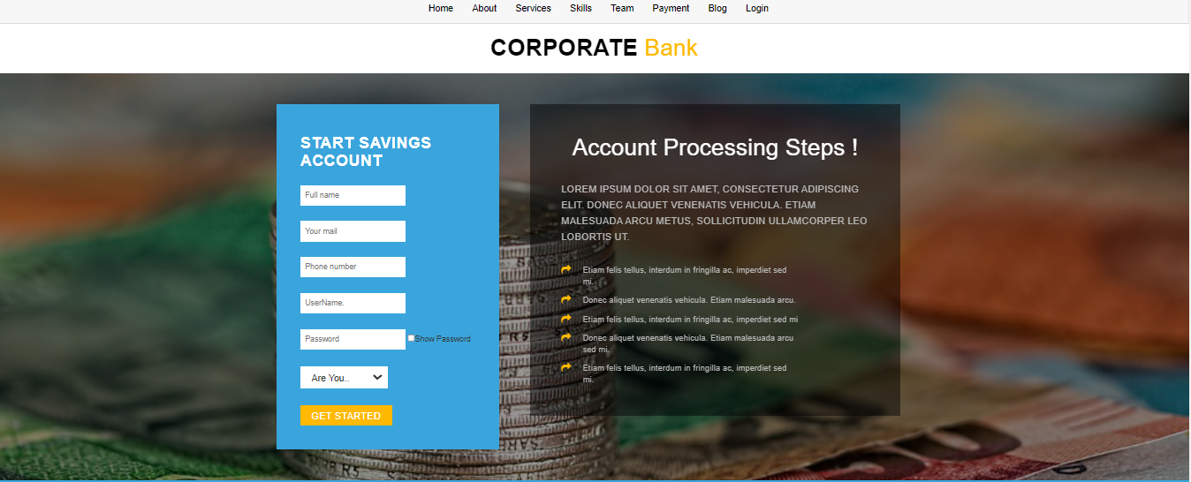
OUTPUT

Slide 15
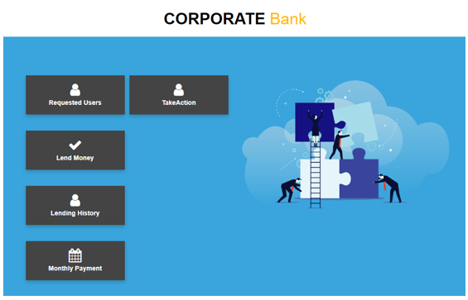
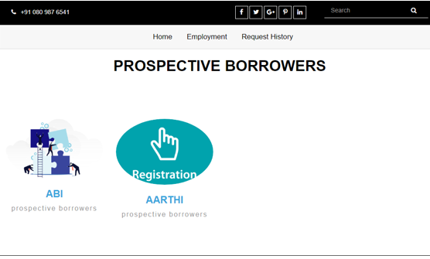
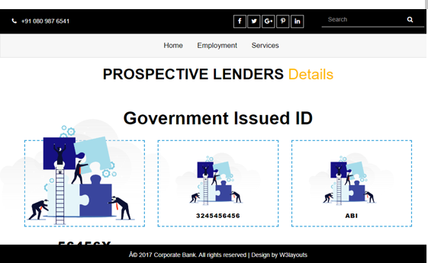
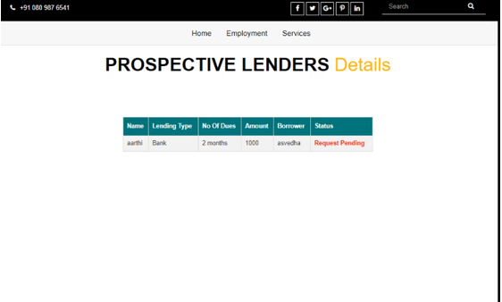

Slide 16
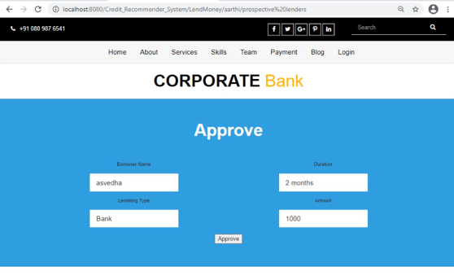
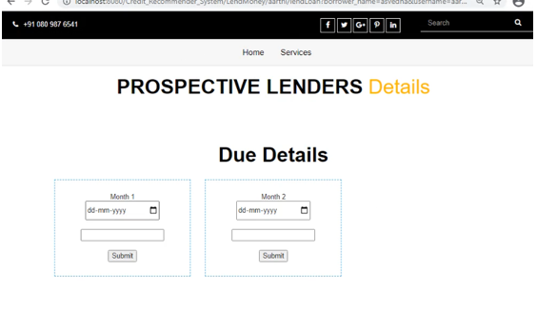
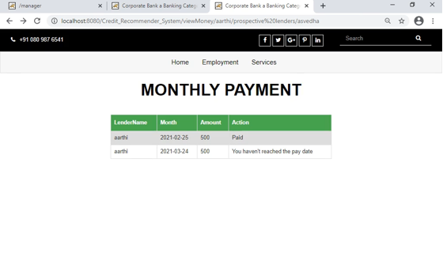

Slide 17
CONCLUSION
Smart lending operations
Integration of blockchain
Feedback system evolution
Outperforms existing schemes
Latency overheads
Improved decision analytics

Slide 18
FUTURE WORK
In the future, the authors will improve the regularization parameters with early stopping in training samples that improves the learning rate and optimized the loss functions. This will improves the overall response time of Credit score generation and induce responsive feedbacks through faster repayments at the same desired security and accuracy level.

Slide 19
REFERENCES
N. Kabra, P. Bhattacharya, S. Tanwar, and S. Tyagi, “MudrachainBlockchain- based framework for automated cheque clearance in financialinstitutions,” Future Generation Computer Systems, vol. 102, pp. 574–587, 2020.
“Equifax data breach settlement.” https://www.ftc.gov/enforcement/cases- proceedings/refunds/equifax-data-breach-settlement. Accessed:2019-12-27.
“Experian lapse allowed id theft service access to 200 million consumer records.” https://krebsonsecurity.com/2014/03/experian-lapseallowed-id-theft- service-to-access-200-million-consumer-records/. Accessed:2019-12-27.
P. Bhattacharya, S. Tanwar, U. Bodke, S. Tyagi, and N. Kumar, “Bindaas: Blockchain-based deep-learning as-a-service in healthcare 4.0 applications, ”IEEE Transactions on Network Science and Engineering, pp. 1– 1,2019.
H. Wang, C. Guo, and S. Cheng, “Loc — a new financial loan management system based on smart contracts,” Future Generation Computer Systems, vol. 100, pp. 648 – 655, 2019.

