Slide 1

Laptop Price Prediction
SmartTech.co.

Slide 2
Contents
Project overview
Business Problem
Business objective
CRISP -ML (Q) Methodology
Technical Stacks
Project architecture
Data collection And understanding
Data Information
Exploratory Data Analysis :
Data Visualizations
Model Result Comparison
Model Deployment And interface
G

Slide 3
Project overview
To develop a robust machine learning model that predicts laptop prices accurately for our client SmartTech Co. As the market for laptops continues to expand with a myriad of brands and specifications, having a precise pricing model becomes crucial for both consumers and manufacturers.

Slide 4
Business Problem
SmartTech Co. operates in a highly competitive laptop market where accurate pricing strategies are crucial for maintaining market share and profitability. The company faces challenges in determining optimal prices for laptops with diverse specifications and from various brands. Incorrect pricing can lead to lost sales, reduced margins, and an inability to respond effectively to market trends and consumer preferences.

Slide 5
Business objective
The business objective is to develop a precise machine learning model that accurately predicts laptop prices based on various features, enabling SmartTech Co. to optimize pricing strategies, enhance market competitiveness, and make data-driven decisions for better profitability and customer satisfaction.

Slide 6
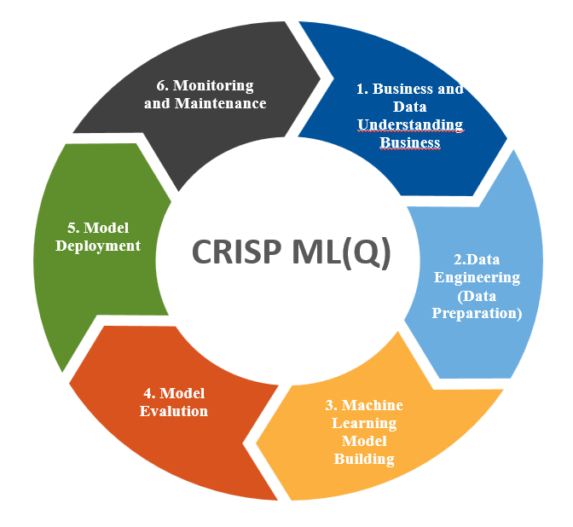
Crisp -ML(Q) Methodology

Slide 7


TECHNICAL STACKS

Slide 8
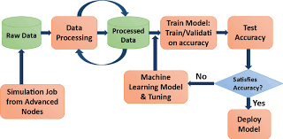

Project Architecture

Slide 9
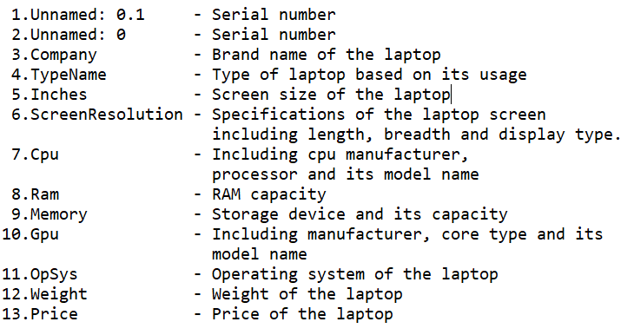
Data Collection and understanding
Source of Data:
The dataset downloaded from kaggle
Data Type: Structured Data Includes specifications such as brand, processor type, RAM, storage, screen size, etc.
Data Understanding:
Shape :1303 rows,13 columns

Slide 10
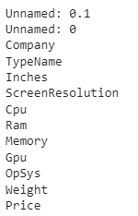
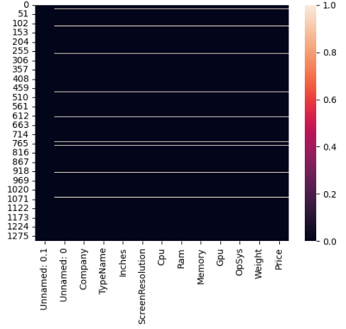
Data information
In the dataset we are having 30 blank rows with empty cells and with 2 unwanted columns.

Slide 11
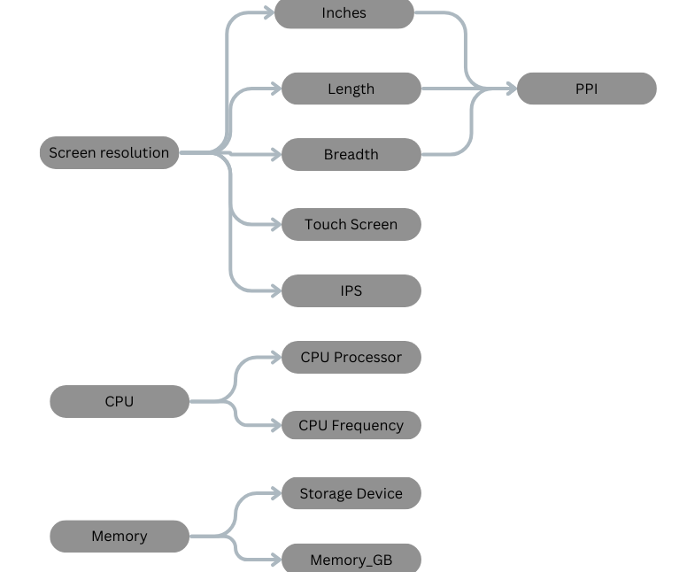
Exploratory Data Analysis :

Slide 12
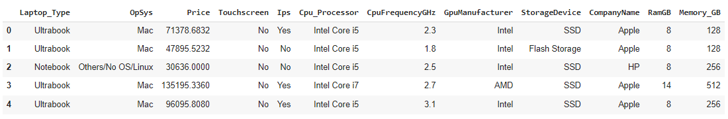
Data used for training the Algorithm
Shape - 1272 rows and 11 columns with 8 categorical columns and 4 numerical columns

Slide 13
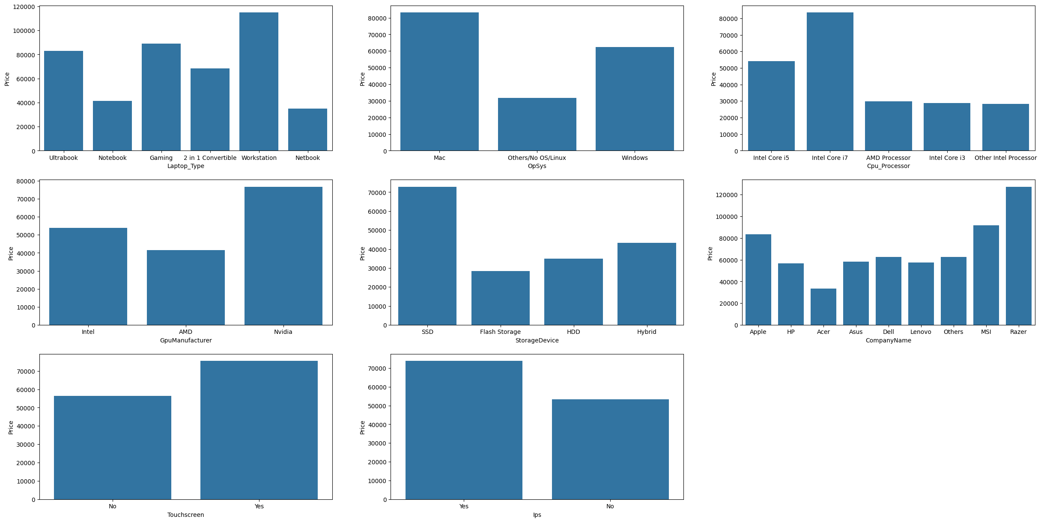
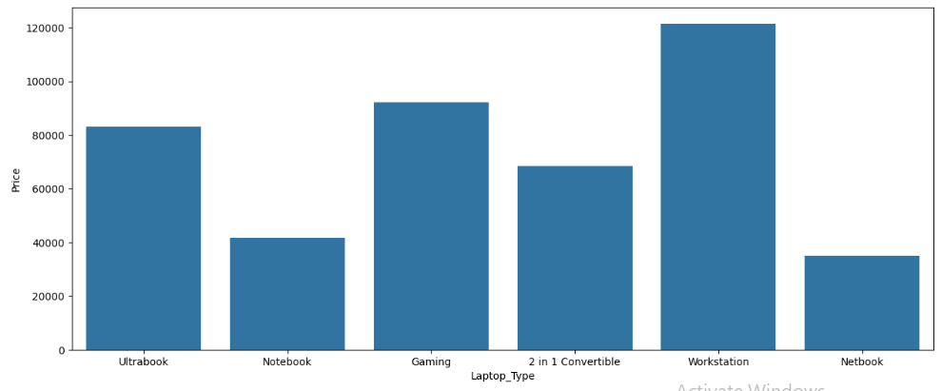
Data Visualizations of Categorical Columns

Slide 14
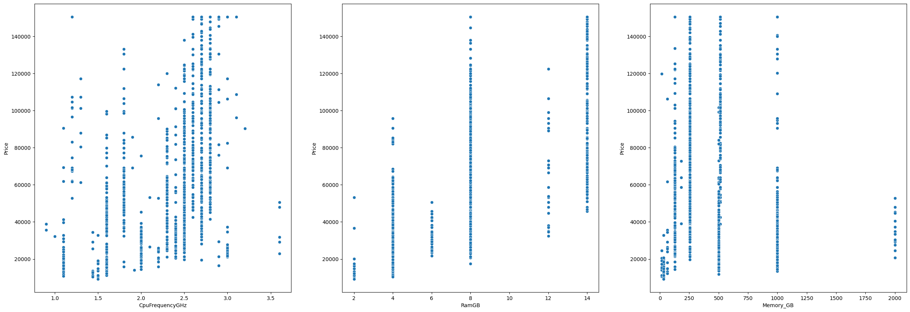
Data Visualizations of Numerical columns

Slide 15
Model result comparison
Regression Models | Root Mean square Error
Random Forest | 14862
XGBoost | 15410
Linear Regression | 17711
KNeighbors Regressor | 17844
Decision Tree Regressor | 19393
SVR | 34397

Slide 16
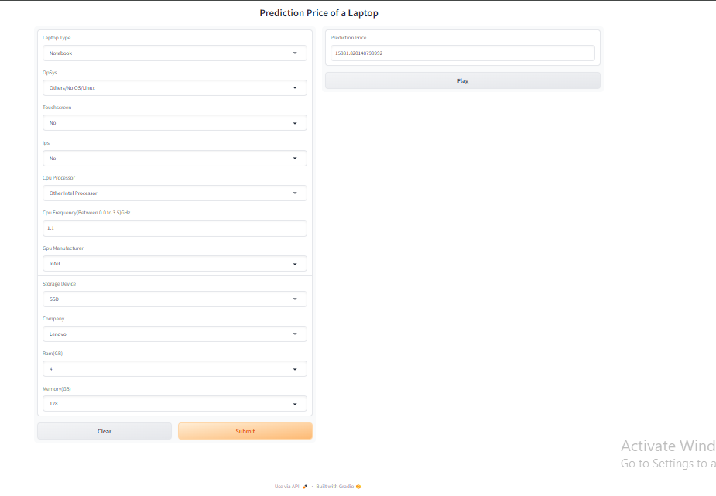
MODEL Deployment and interface
Deployed the model using Gradio user friendly application.

Slide 17
Thank you

