Slide 1


Analyzing Netflix Userbase

Slide 2
Index
Project overview
Business problem
Tools used
Data Exploring and Data Wrangling
Data Cleaning and Data Transformation
Feature Engineering
Exploratory Data Analysis
Conclusion

Slide 3
Project overview
Analyze a synthetic Netflix user dataset to uncover trends in subscription types, revenue, user behavior, and preferences across different countries and device types.

Slide 4
Business problem
Identify trends and factors affecting user engagement and revenue to optimize subscription plans and enhance user experience.

Slide 5





Tools used

Slide 6

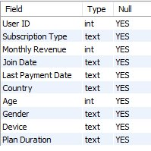

Data Exploring and Data wrangling
Dataset - from Kaggle
Shape - 2500 rows and 10 columns
Categorical -7, Numerical –3
No null values
2 columns 'Join Date', 'Last Payment Date' that are actually having dates are having their data type as text.

Slide 7
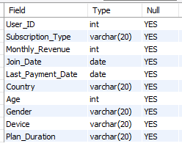
Data Cleaning and Data Transformation
Renamed the column names, as some had spaces.
Converted the format of date values stored as text into actual DATE values.
Changed the data type from text to either VARCHAR or DATE as needed.

Slide 8
Feature Engineering
Added 3 new columns to the dataset they are 'Join year', 'join month' and 'Join day' by extracting from Join date columns.
Added a new column 'Last payment day' to the dataset by extracting from 'Last payment date' column.
Added a new column 'Date Diff' to the dataset by subtracting 'Last payment date' and 'Join date' columns.

Slide 9
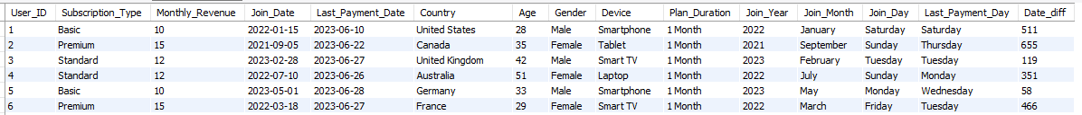
After data preprocessing and feature engineering the shape of the dataset is 2500 rows and 15 columns

Slide 10



Exploratory Data Analysis
Customer Analysis:

Slide 11
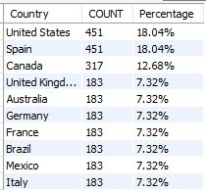



Slide 12

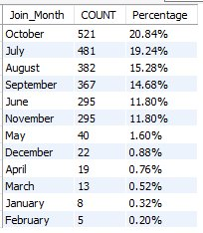
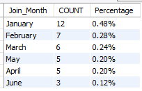
Percentage of people joined Netflix
2021 | 2022 | 2023

Slide 13


Product Analysis:
Here only one kind of Plan duration exist more plans has to be developed.
The Churn Rate represents the percentage of users whose difference between the last payment date and the join date is less than 30 days. This percentage is currently very low.

Slide 14


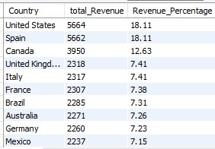
Sales Analysis:
The Total revenue Generated = $31,271

Slide 15
Conclusion:
The minimum age of our users is 26 and the maximum is 51.
Most of our customers are aged between 30 and 50 years.
In 2022, 97.92% of people joined Netflix. However, in the following year, the joining percentage dropped significantly to 1.52% for two quarters.
It would be beneficial to introduce additional plan durations, such as 3 months, 6 months, and 12 months, as we currently only offer a 1-month plan.
The revenue Generated from basic subscription is more compare to standard and premium type of customers.
Our churn rate is notably low at 0.016%, indicating that users who join Netflix maintain a good relationship with us.

