Slide 1
Amazon Sales Data Analysis

Slide 2
Index
§Project overview
§Business problem
§Technologies used
§Data Exploring
§Feature Engineering
§Exploratory Data Analysis

Slide 3
Project overview
The project aims to analyze Amazon's sales data across branches, exploring factors such as customer demographics, product lines, payment methods, and locations that impact sales. By utilizing SQL queries and conducting exploratory data analysis, the project seeks to draw insights from the data to enhance sales strategies and overall business performance

Slide 4
Business problem
Amazon wants to be the best company for customers among e-commerce platforms. so that it is sells more stuff and satisfies customers. But to do that, they need to figure out what products people are buying more and what products they are buying in less number considering factors like location, Gender etc.,. By looking at sales data, Amazon hopes to find answers to these questions and use them to sell more effectively.

Slide 5

Technologies used

Slide 6
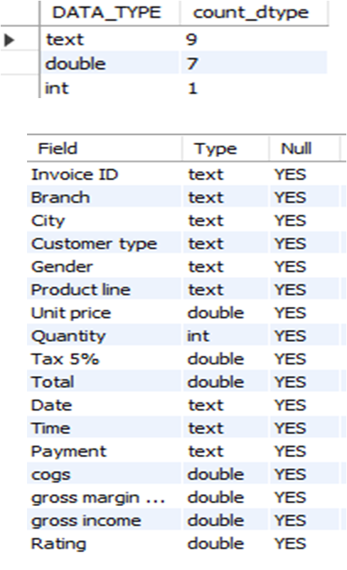

Data Exploring
Dataset - from Odin School
The dataset pertains to Amazon sales from three different branches in various cities of Myanmar during the first quarter of 2019.
Shape - 1000 rows and 17 columns
Categorical -9, Numerical -1, float –7
No null values

Slide 7
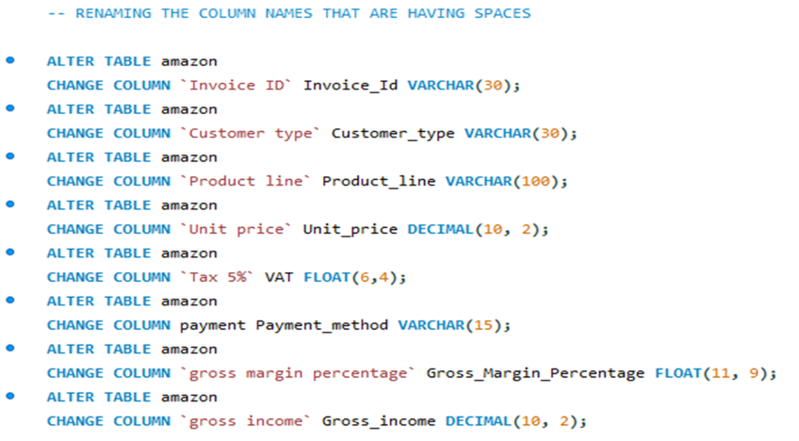
Feature Engineering
Renamed the column names as some are having spaces.

Slide 8
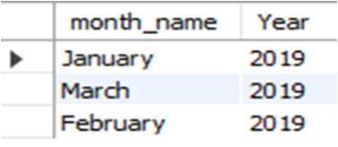
Added 3 new columns to the dataset they are time of day, day name, month name by extracting from data and time columns.
3 months data present i.e., JAN, FEB,MARCH of 2019

Slide 9
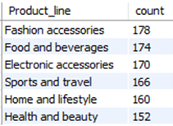

Exploratory Data Analysis
1.Product Analysis:
No of Product lines : 6
Highly purchased- Fashion accessories
Least purchased- Health and beauty
Average number of products each person is buying are 6.

Slide 10
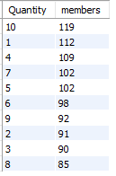
Max no of quantity each person is buying = 10 and minimum = 1

Slide 11
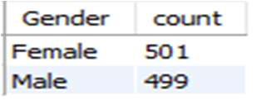
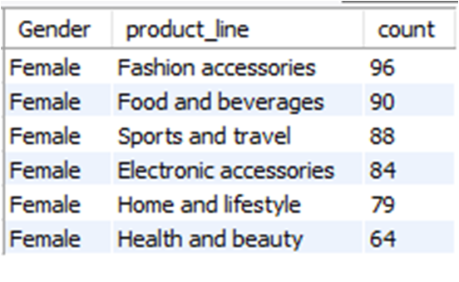
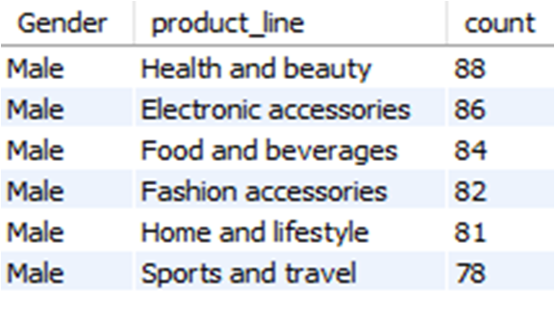
Female customer buy more products than male
Female buy Fashion accessories more, Health and beauty least number
Male buy Health and beauty more, Sports and travel least number

Slide 12
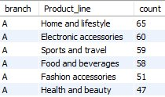
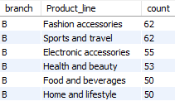
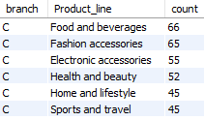
branch A - Home and lifestyle sold high, Health and beauty less sold
branch B - Fashion accessories and Sports and travel sold high, Home and lifestyle less sold branch C - Food and beverages sold high, Sports and travel less sold

Slide 13
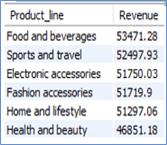


2.Sales Analysis
•Highest revenue - Food and beverages​
•Least revenue - Health and beauty ​
Sum of total sales - K322966.75 ​
Gross margin percentage - 4.761905
Sum of Gross income- K15380.05

Slide 14
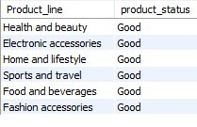


2.Sales Analysis
Average sales= K322 (Myanmar Kyat)
Sum of sales of each product line comparing with the Average sale

Slide 15


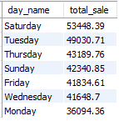



More than 50% of Sales are done during afternoon time

Slide 16


3.Customer Analysis:
Customer type – 2 (Member, Normal)
Payments – 3 (Ewallet, Cash, Credit card)

Slide 17




Female customers
Member type customer high
high customers in branch C i.e, Naypyitaw, least- branch A i.e, Yangon
Male customers
High in branch B i.e, Mandalay, least- branch A i.e, Yangon
High in Every city
Normal type customer high

Slide 18

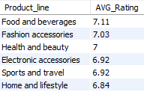
Min rating-4
Food and beverages got highest Average rating
Home and lifestyle got least average rating

Slide 19
Conclusion:
The no of customers of branch C- Naypyitaw is less compare to other branches but sales are more.
If we consider Branch A- Mandalay though the customer count is more it ranks second in sales here sales should get increase. Better product with best deals should be provided to make them buy .
As most of the sales are happening in the afternoon time more care is to be taken like app should work properly, adds related to the product line that they buy more has to run but in evening and morning time one by one product line all the adds should be played.
Least sold product line is to be given some discounts.
Things whose prices are decreased a lot those should also be included in recommendations.
If price of the thing placed in cart is decreased then customer should be given this information when he/she opens the app.
Product delivery should also be on time so that customer becomes happy.

Slide 20
Thank you

