Slide 1

SECURE DATA HIDING IN IMAGES USING STIGANOGRAPHY
Presented By:
Student Name : HEMAKSHI B
College Name & Department : KLM COLLEGE OF ENGINEERING
COMPUTER SCIENCE AND ENGINEERING
Notes:
\

Slide 2
OUTLINE
Problem Statement
Technology used
Wow factor
End users
Result
Conclusion
Git-hub Link

Slide 3
PROBLEM STATEMENT
Problem: Current image steganography methods often lack a balance between imperceptibility, capacity, robustness, and security against steganalysis.
Objective: Develop a robust and secure image steganography technique that maximizes data hiding capacity while maintaining imperceptibility and resisting steganalysis attacks.

Slide 4
Technology used
OpenStego
OpenStego is a free and open-source steganography tool written in Java. It allows you to hide data within image files, effectively making the data invisible to the casual observer. OpenStego provides a user-friendly interface for both hiding and extracting data. It also offers a watermarking feature, which can be used to embed an invisible signature in an image to protect copyright.
Key features of OpenStego:
Data Hiding: Hides any type of file within an image.
Watermarking: Embeds an invisible signature for copyright protection.
Password-based Encryption: Encrypts data before hiding for added security.
Plugin Architecture: Supports plugins for different steganographic algorithms.
Cross-platform: Works on Windows, Linux, and macOS.

Slide 5
Technology used
OpenCV (cv2) in Python
OpenCV (Open Source Computer Vision Library) is a powerful library for computer vision tasks in Python. It provides a wide range of functions for image and video processing, object detection, and machine learning. While not specifically a steganography tool, OpenCV can be used to implement various steganographic techniques.
Key features of OpenCV:
Image Processing: Offers functions for reading, writing, manipulating, and displaying images.
Feature Detection: Provides algorithms for detecting edges, corners, and other image features.
Object Detection: Includes tools for detecting objects in images and videos.
Machine Learning: Integrates with machine learning libraries for tasks like image classification.

Slide 6
Technology used
How they relate to steganography:
OpenStego: A ready-to-use application for steganography with a focus on ease of use and basic security features.
OpenCV: A versatile library that can be used to build custom steganography solutions with more advanced techniques and control. You can use OpenCV to implement algorithms like LSB modification, frequency domain embedding, and more.

Slide 7
Wow factors
1. Unparalleled Imperceptibility
Human Eye Deception
Forensic Tool Evasion
2. Mind-Boggling Capacity
Data Density
Compression Mastery
3. Unbreakable Robustness
Attack Resilience
Watermarking Prowess
4. Ironclad Security
Steganalysis Defiance
Cryptographic Fusion
5. User Experience
Intuitive Interface
Speed and Efficiency

Slide 8
End users
1. Individuals concerned about privacy:
Hiding personal data: People might use steganography to protect sensitive information like financial records, medical documents, or private photos by embedding them in seemingly harmless images before sharing or storing them online.
Secure communication: Individuals can exchange private messages with family or friends without fear of eavesdropping by hiding those messages within images.
2. Journalists and whistleblowers:
Protecting sources: Journalists in restrictive regimes can use steganography to receive information from sources without revealing their identities, ensuring their safety.
Confidential communication: Journalists can securely communicate with sources or colleagues, protecting their investigations from censorship or interference.
3. Security professionals and intelligence agencies:
Covert operations: Intelligence agencies can exchange information with agents in the field without alerting adversaries, enhancing operational security.
Forensic investigations: Law enforcement can hide evidence or track criminals discreetly, improving crime-fighting capabilities.

Slide 9
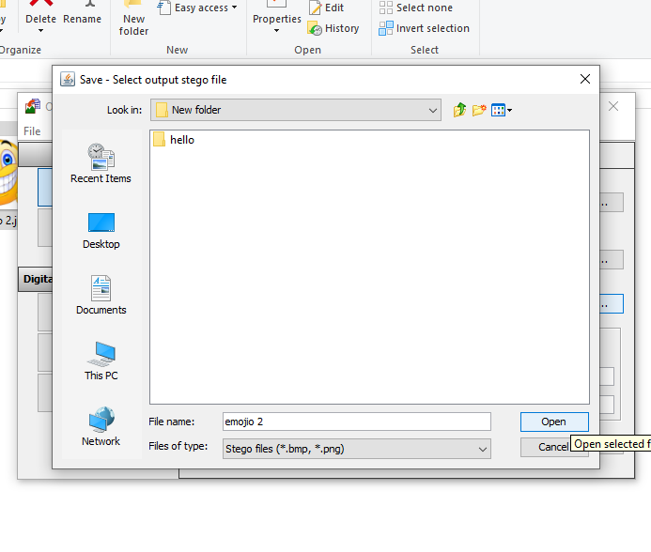
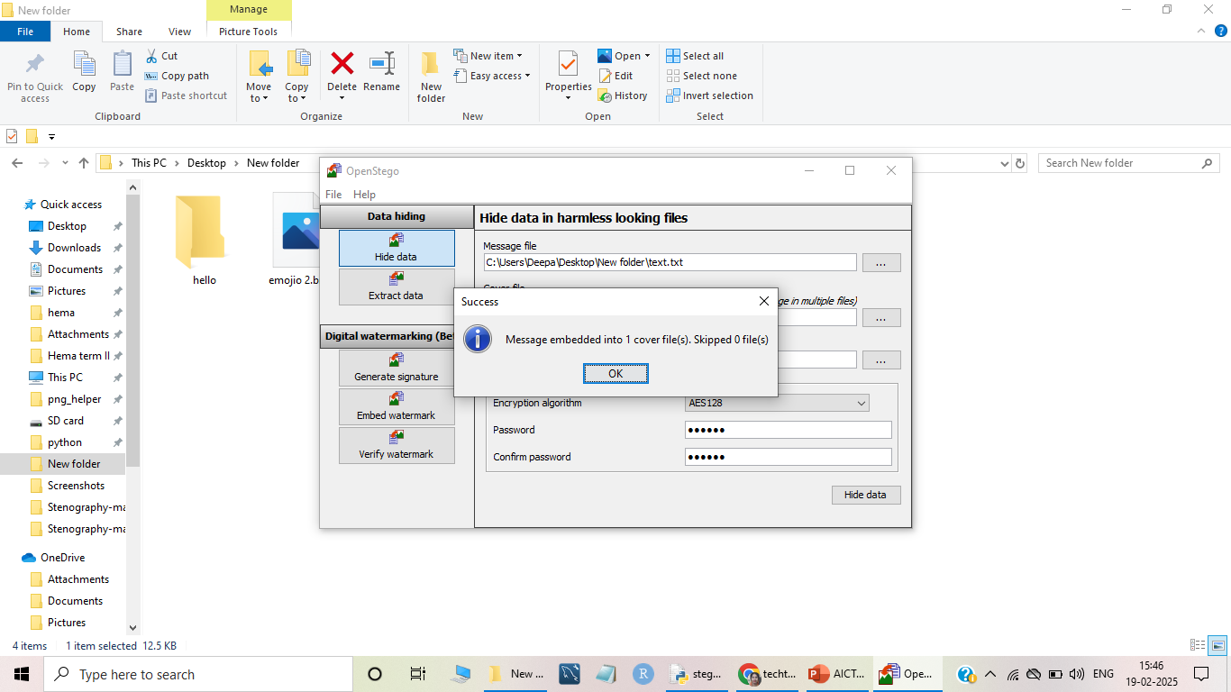

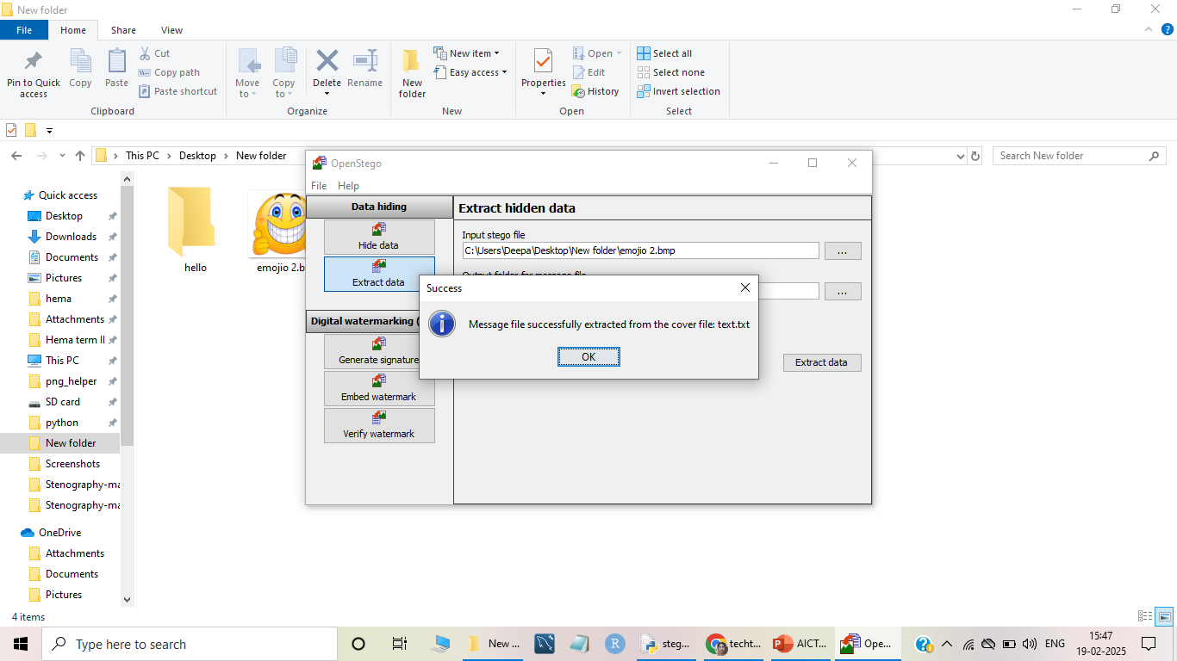
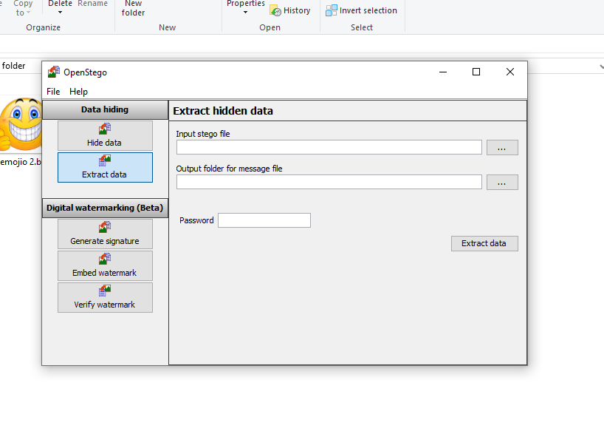


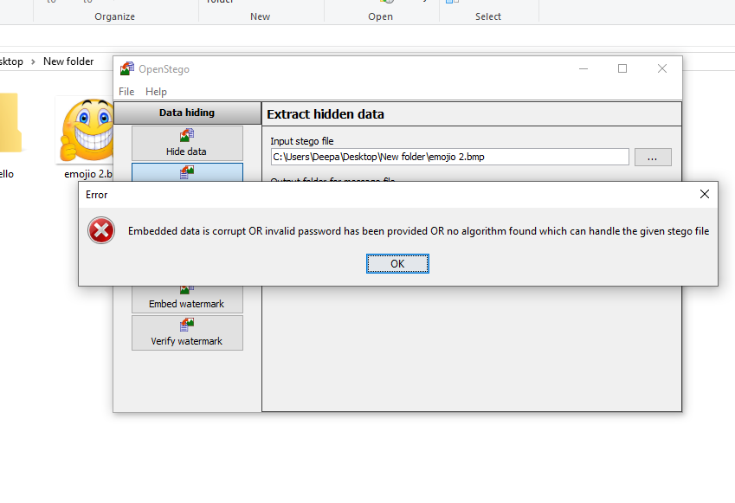
Results

Slide 10
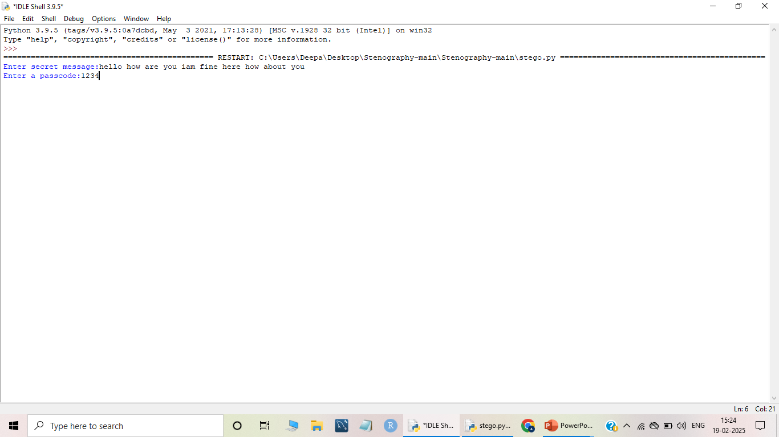

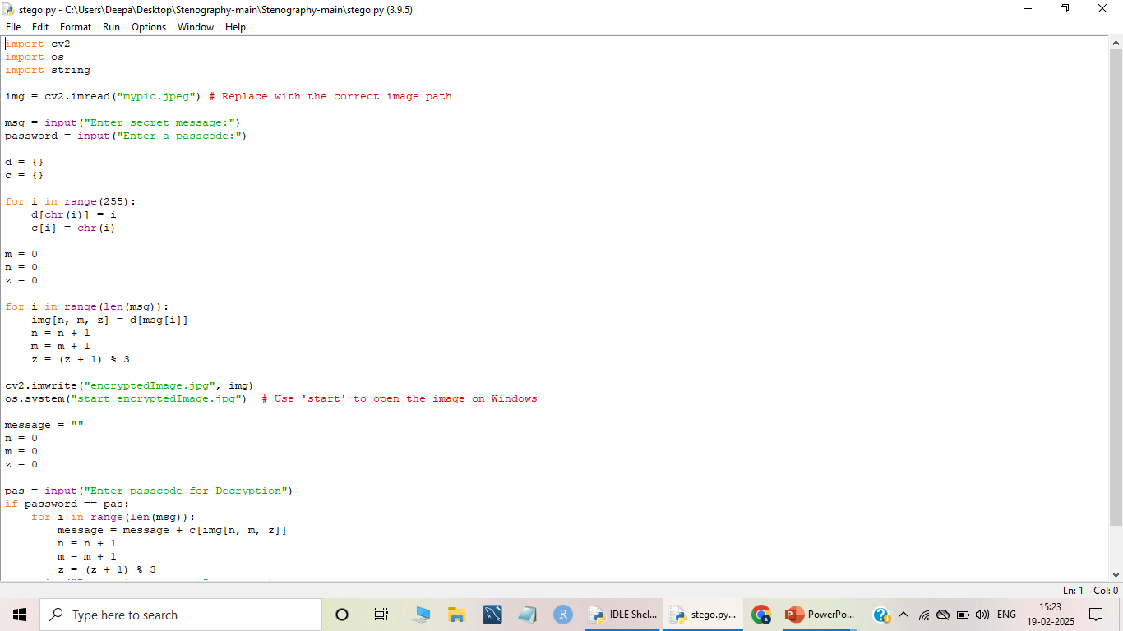

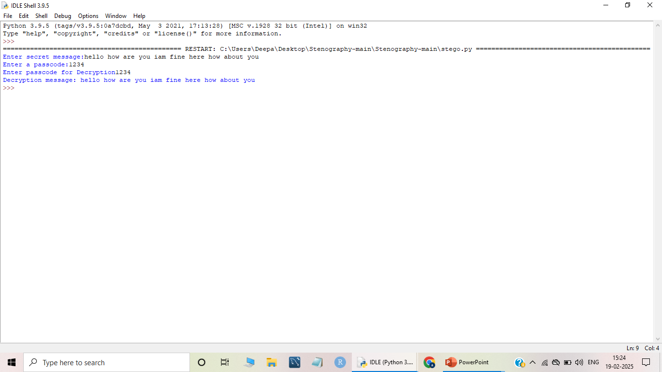

Slide 11
Conclusion
secure image steganography is crucial for confidential communication. While older methods are vulnerable, current research explores advanced techniques like transform domain embedding, deep learning, and cryptography to improve imperceptibility, capacity, robustness, and security. The ongoing challenge is to stay ahead of steganalysis, ensuring hidden data remains undetected and protected in an ever-evolving digital landscape.

Slide 12
GitHub Link
https://github.com/iamhemasunder/aicte_project.git

Slide 13

THANK YOU

