Slide 1



Covid-19 Data Analysis
Germany
Team members : Himanshu
Kaveri
Pranauti
Sunik

Slide 2
Table of contents
Project Overview
Exploratory Data Analysis
Modeling
Live Demo
Results
Next Steps

Slide 3

Project Overview

Slide 4
Project Overview
It is difficult to control the covid-19, but we can reduce the transmissions by taking strict actions like wearing masks & creating confinement zones .
The goal of our project is to predict the number of new cases for the forthcoming days based on the Covid-19 dataset.
Thus the predictions will help the organisations predict safe dates for adjusting confinement protocol and take other measures for a particular region.

Slide 5
Objectives
To gain better understanding of the dataset .
To Clean the data as per the requirements .
To Perform EDA (Exploratory Data Analysis) for model development.
To Modeling the data with help of feature selection technique.
Workflow
Week 1
Week 2
Week 3
In the first week we studied our problem statement and started with the data wrangling and analysis.
Based on our EDA , we did feature selection and started building our model.
We evaluated and iterated the process many times to get the desired results which was to deliver a model with at least 80% accuracy.

Slide 6
Exploratory Data Analysis

Slide 7
Exploratory Data Analysis
The source of our dataset was : www.ourworldindata.org
The dataset contains information related to Covid-19 for different countries .
We were assigned to work on a specific country which in our case is Germany . Therefore we filtered our dataset accordingly.
After filtering ,the dataset initially has 53 features and 413 samples.
We removed some columns which were irrelevant for our goal.
We replaced all the missing values according to the skewness of the data in the different columns.

Slide 8
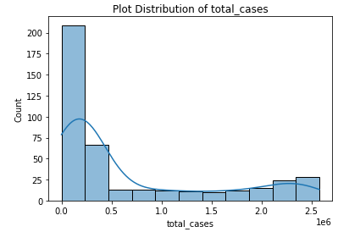
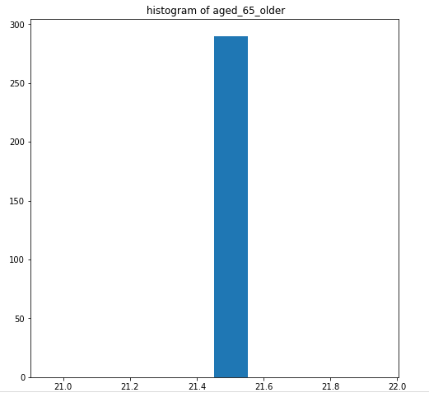
Univariate Analysis
After doing univariate analysis , we found out that our data was skewed and needed scaling .
Also a lot of columns had just one unique value thus we decide to drop these columns
Fig-1
The data in total_cases is right skewed.
Fig-2
The column named aged_65_older has a single unique value

Slide 9
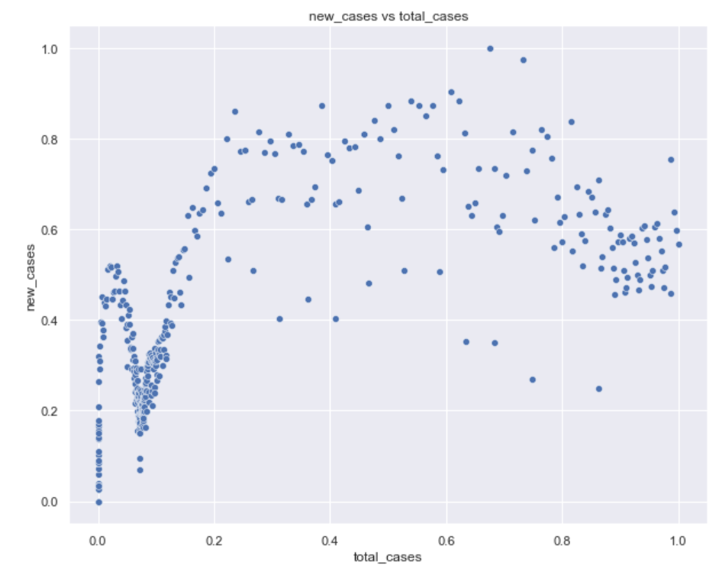
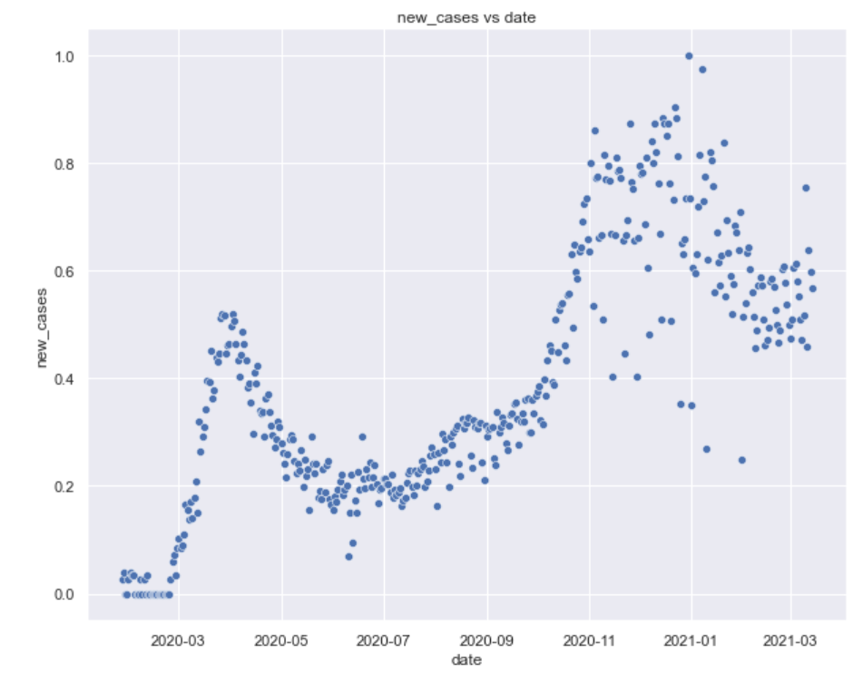
Bivariate Analysis
In bivariate analysis we looked for relationships between different variables and checked their collinearity with each other .
Fig-1
new_cases vs total_cases
Fig-2
new_cases vs date

Slide 10
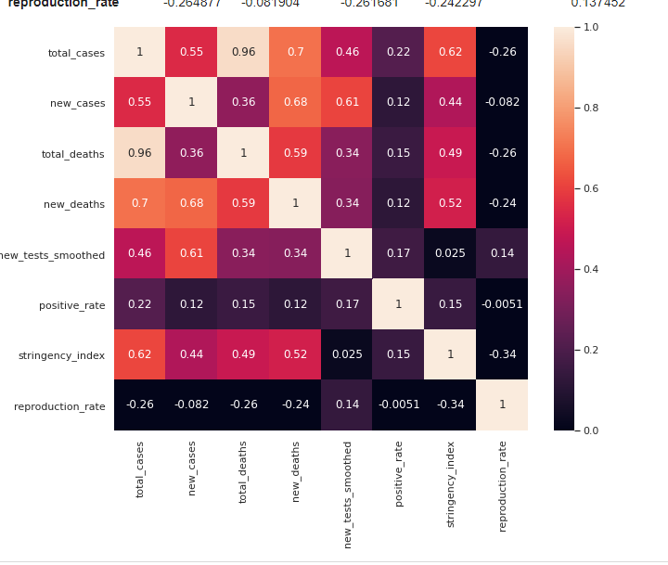
Correlation
With the help of correlation matrix we only selected features which were correlated with our target variable.
After doing bivariate analysis, we had found out that some columns were collinear with each other.Therefore while feature selection, we avoided collinear features.
Fig-1
Selected features show a strong correlation with each other.

Slide 11
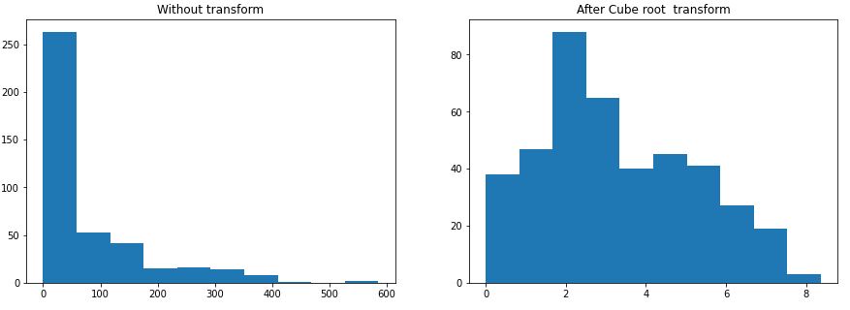
Preprocessing
During our EDA we had seen that our data was not uniformly distributed and had many outliers .So we have performed cube root transformation to normalize the skewed distribution and used a min -max scaler for scaling our data.

Slide 12
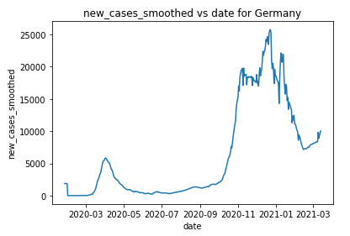
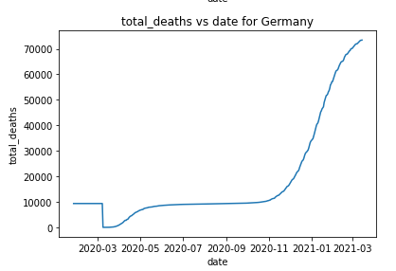
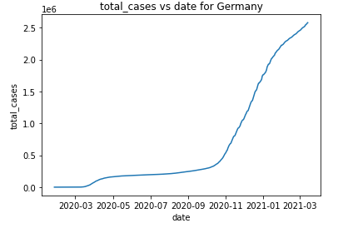
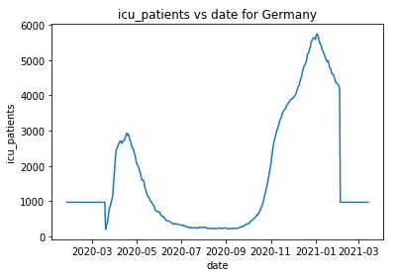
Trend Analysis
We found out the number of recovered cases from which we derived our target variable .

Slide 13
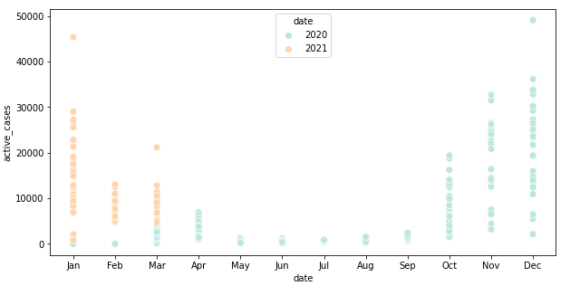
Relationship of the target variable with time .

Slide 14
Modeling

Slide 15
Models
Multiple Regression
SIR

Slide 16
Multiple Regression
As we had a lot of strongly correlated features ,we used multiple regression in our project .
Feature selection was done based on our EDA for the first iteration .
To improve our score we plotted regression plots for each feature separately and studied their relationship with our target variable and made changes accordingly for next iterations.
We splitted our data into training and testing sets according to the months .
Then we validated our results using K-fold cross validation .

Slide 17
Our Results

Slide 18
Results
As per the success criteria, we have achieved more that 80% accuracy .
Our final score for the regression model is :
Test Data Score 0.9411
Mean absolute error: 0.05
Residual sum of squares (MSE): 0.00
R2-score: 0.90
We also evaluated our model using k fold cross validation technique :
Accuracy: 0.958

Slide 19
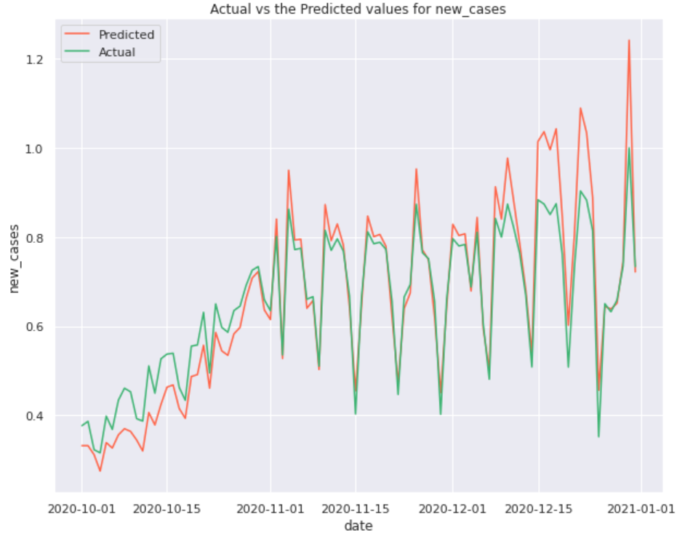
Fig-1
The graph depicts the relationship between the actual values and the predicted values for the new cases in Germany ..

Slide 20
Covid-19 Data Analysis - “Germany”
Demo

Slide 21
Next Steps

Slide 22
Next Steps - SIR Model
SIR model is a basic model of an infectious disease outbreak in a large population which divides the (fixed) population of N individuals into three "compartments" which may vary as a function of time, t:
S (t), are those who are not infected but could become infected.
I`(t): These are people that have already been infected with the virus and can pass it on to those who are susceptible
R(t): These are people who have recovered from the virus and are thought to be immune(t), or who have died, D(t).
SIR model - Parameters
β is the transmission rate constant.
γ the removal rate constant..
R0 : The total number of people an infected person infects (R0 = β/γ)

Slide 23
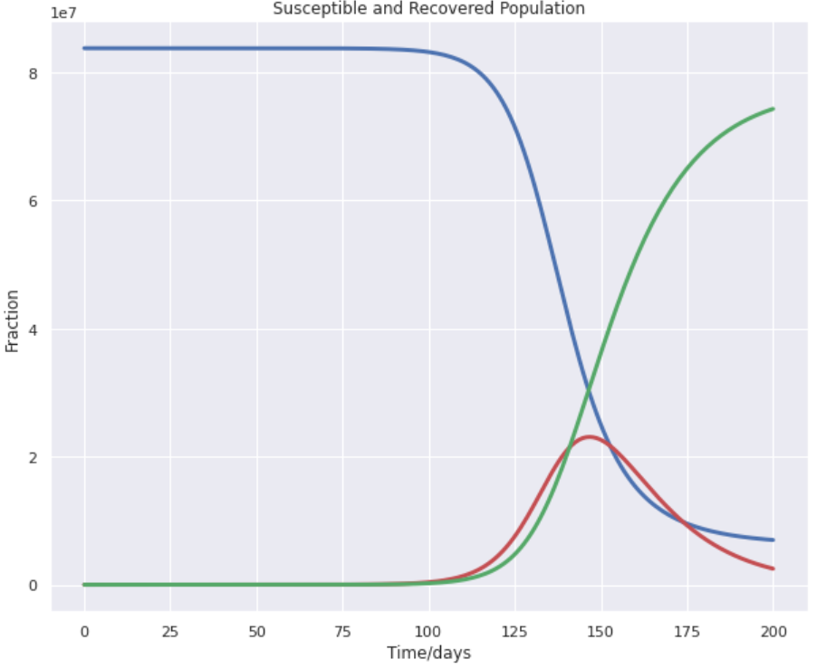
SIR Model Prediction
SIR model prediction
Number of infections and death that may occur in the future.
Estimate the time scale for the duration of virus within a community.
Lessen the impact of the virus
Can provide theoretical framework and prediction that can be used by the government Authorities to control the spread of covid-19

Slide 24
Thank you!
Any questions?

