Slide 1
S ft S
.in

Slide 2

Download Softwares of
Windows, MacOS
& Linux @
Just a click!
softos.in

Slide 3
S ft S
.in

Slide 4
S ft S
.in

Slide 9
Blogs

Slide 10
Create your blog article
Publish with the world
Share your knowledge
Get connected with world
Get reward

Slide 11

Be a pro
Creator

Slide 12
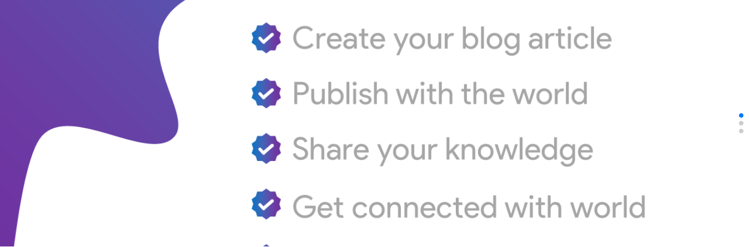

Slide 13
Try Now!
Share your
knowledge with other

Slide 19
S ft S
.in

Slide 20
Blogs

Slide 21
No screenshot
available!

