Slide 1
S ft S
.in

Slide 3

Download Softwares of
Windows, MacOS
& Linux @
Just a click!
softos.in

Slide 4
S ft S
.in

Slide 5
S ft S
.in

Slide 6
S ft S
.in

Slide 7
Hello I am Himanshu Sharma

Slide 8

Believe in yourself,
Everything will be alright.

Slide 13
Blogs

Slide 14
Create your blog article
Publish with the world
Share your knowledge
Get connected with world
Get reward

Slide 15

Be a pro
Creator

Slide 16
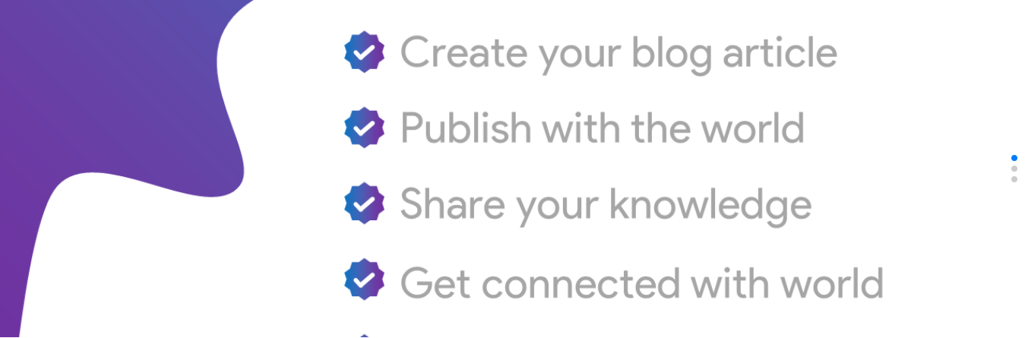

Slide 17
Try Now!
Share your
knowledge with other

Slide 25
S ft S
.in

Slide 27
Blogs

Slide 28
No screenshot
available!

